Slide 1
Transcripts
As we prepare for pre-registration and class selections for our 2021-2022 School Year, it is important that all students look at their transcripts, and get input from their teachers and parent(s)/guardian(s).
Counselors will also comb through transcripts to advise and assist students during registration.
The following slides will provide our students with step-by-step instructions to download their unofficial transcripts from their StudentVue accounts, as well as how to read a transcript and use it as a tool to for future planning.

Slide 2

Step 1
Login to your
StudentVue Account

Slide 3
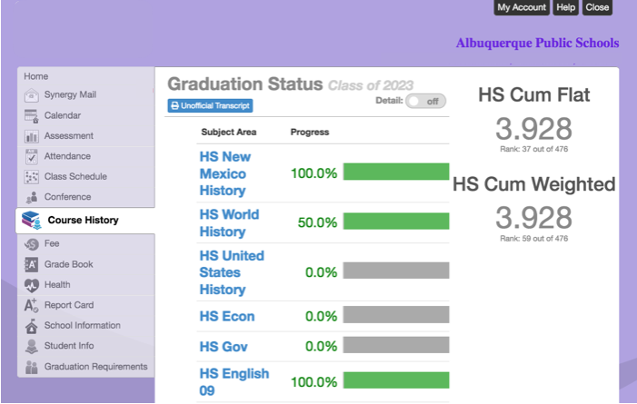
Step 2
Select Course History

Slide 4
Step 3
Click on Unofficial Transcript
& Open/Save the Document

Slide 5
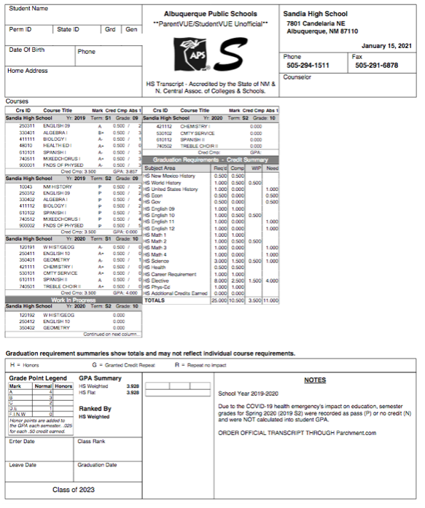
Your Transcript shows your progress, each school year and by Semester.
The box on this example transcript represents the entire school year.
The school year has two semesters.
Term S1= Semester 1
Term S2= Semester 2

Slide 6
Your transcript records the number of absences you have in each class.
The column highlighted in green shows the number of absences you had each semester.
Abs= Absences

Slide 7
Subject Area
The highlighted column lists the titles of each class needed in order to earn your
SHS High School Diploma.

Slide 8
25 Credits needed to graduate.
The column highlighted in green shows provides a list of the classes needed to meet graduation requirements.
Req’D= Required Courses

Slide 9
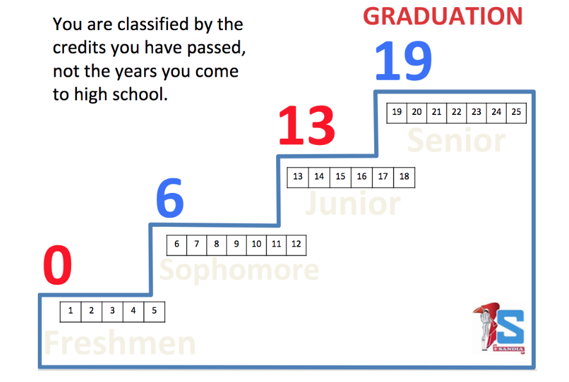
Earned Credits Demonstrate Classification
The column highlighted shows the credits you have earned each semester. At the bottom of the column you will find your total credits earned.
Comp = Completed

Slide 10
Your transcript tracks what you are working on.
The highlighted column shows the classes that you are currently enrolled in.
WIP = Work In Progress

Slide 11
Graduation Planning
The highlighted column shows the classes you still need in order to earn your SHS High School Diploma.
Need = Classes you will need to register for in the future.
If you earned an F or N you did not earn credit for the course. Your credit recovery will be listed in the Need column. However, you will need to pay close attention to which semester you will need to recover for each class (eg. S1, S2, or both).
Credit Recovery is offered by APS in the summer.
Registration usually opens mid-end April. Information will post on our school website when the registration window opens.
We have limited space in our eCad Labs during the school year. These recovery classes are free. They are typically reserved for Juniors and Seniors.
Students also have the option to take eCad/Edgenuity classes independently for $25 per semester. However, students must be able to balance the online class as well as their current course work.

Slide 12
Grade Point Average
Your grade point average (GPA) is calculated by dividing the total amount of grade points earned by the total amount of credit hours attempted. Your grade point average may range from 0.0 to a 4.0. (AP, Honors, and IB add .025 to the cumulative GPA for each semester earned).
Weighted = GPA with additional .025 points added for each AP, Honors, or IB class taken.
Flat = The GPA calculated on the 4 Point Scale.
A= 4
B= 3
C= 2
D= 1
F= 0 (No Credit)
N= (No Credit)
P= Pass

