Slide 1


Kentucky Division for Air Quality
Bring the science of air quality to life in your classroom. Face-to-face or Zoom sessions available for K-12.
Roberta Burnes
Environmental Education Specialist
Roberta.Burnes@ky.gov
Notes:
Hi! Roberta Burnes here, from the Kentucky Division for Air Quality. Clean air is important to everyone, but sometimes we take it for granted. Our outreach program brings the science of air quality to life in your classroom. Our in-person and virtual outreach sessions help students explore air quality, in their back yards and around the world.

Slide 2
Topics include …
Air pollution sources and solutions
Air monitoring and Kentucky's air quality
Air quality near and far: Using interactive maps to explore air quality around the world
How our bodies respond to air pollution
What plants can tell us about air quality
How to start a student-led idle reduction program at your school
Notes:
Free virtual and in-person sessions are available on a variety of topics, including:

Slide 3
Educational Resources
Story map: How clean is our air?
Design & build an air pollution collector
Air Quality Flag Program
Notes:
In addition, we have several resources on our website for teachers and students, including a story map that explores the science of air monitoring, and how we know WHAT we know is in the air you breathe. You’ll find a downloadable lesson plan that guides students in designing and building an air pollution collector. There’s also information about how your school can participate in the Air Quality Flag Program.

Slide 4
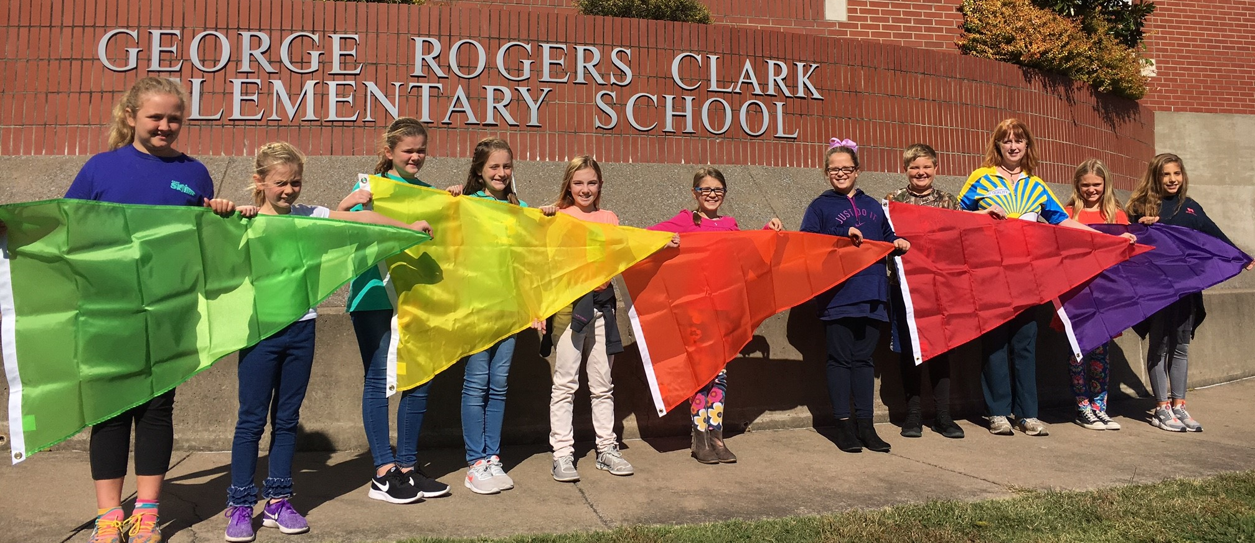
Air Quality Flag Program
Notes:
Here's how the Air Quality Flag Program works: each day your school raises a flag that corresponds to how clean or polluted the air is. The color of the flag matches EPA's Air Quality Index (AQI): green, yellow, orange, red, and purple. I love combining the flag program with online geography and air data to help students investigate and map air quality, pollution sources, and wildfire smoke across the U.S.

Slide 5
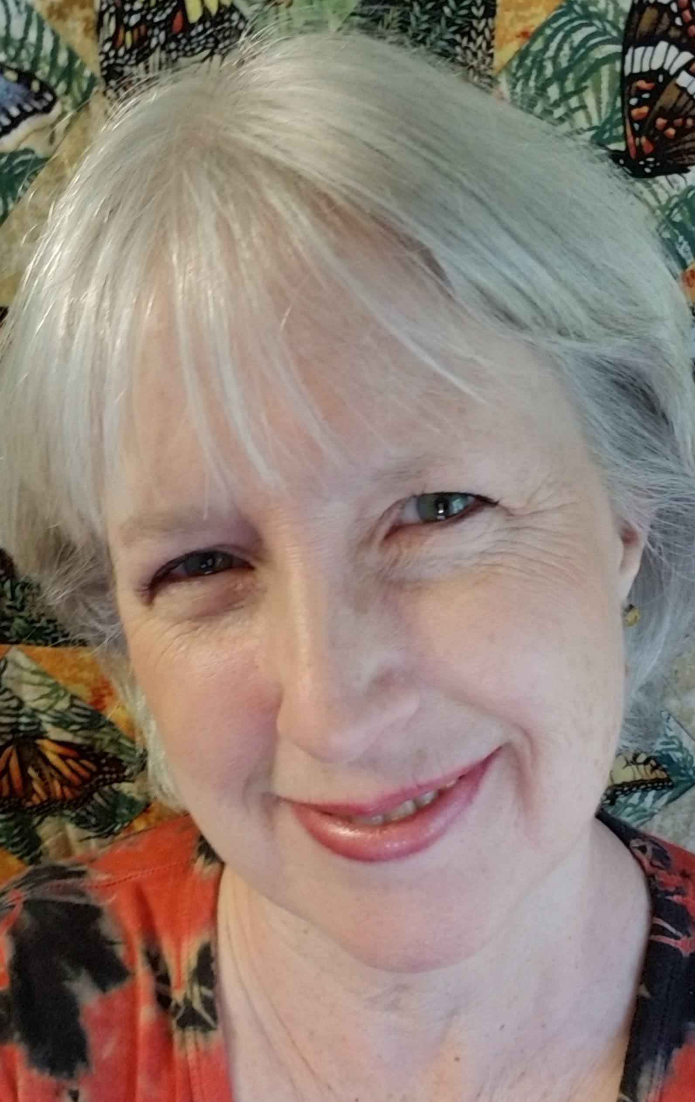
Contact Us!
Roberta Burnes
Environmental Education Specialist
Roberta.Burnes@ky.gov
https://bit.ly/KYAirOutreach
502-782-6571

