Slide 1


Sustainability Coordinator Training
Meeting Teachers Where You Are: Community Partnerships

Slide 2


Slide 3
Key Points
Non-profit
Expanding and maintaining tree canopy
Partner with community – including FCPS
  Tree plantings
  Tree care
  Education

Slide 4
FCPS Partnership - 2021
Tree Plantings
  Mary Todd Elementary
  Lexington Traditional Magnet
Tree Mulching
  Bryan Station High School
  Frederick Douglass High School
  North Side Elementary
Education
  Henry Clay High School
  Frederick Douglass High School

Slide 5
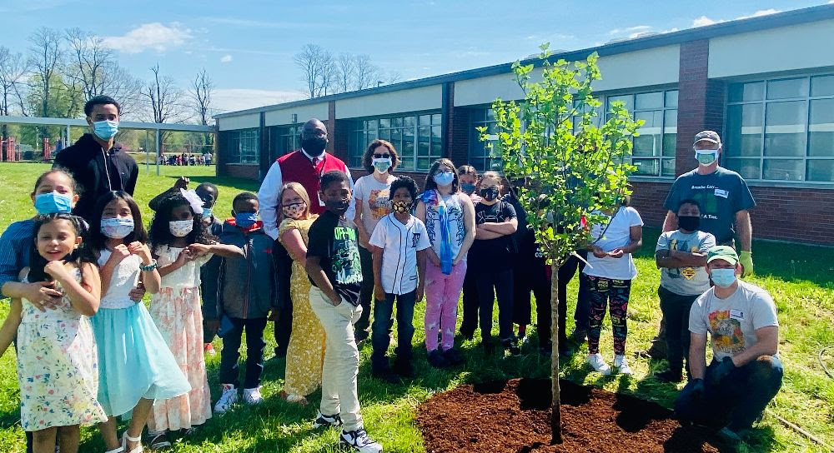
Mary Todd Elementary

Slide 6
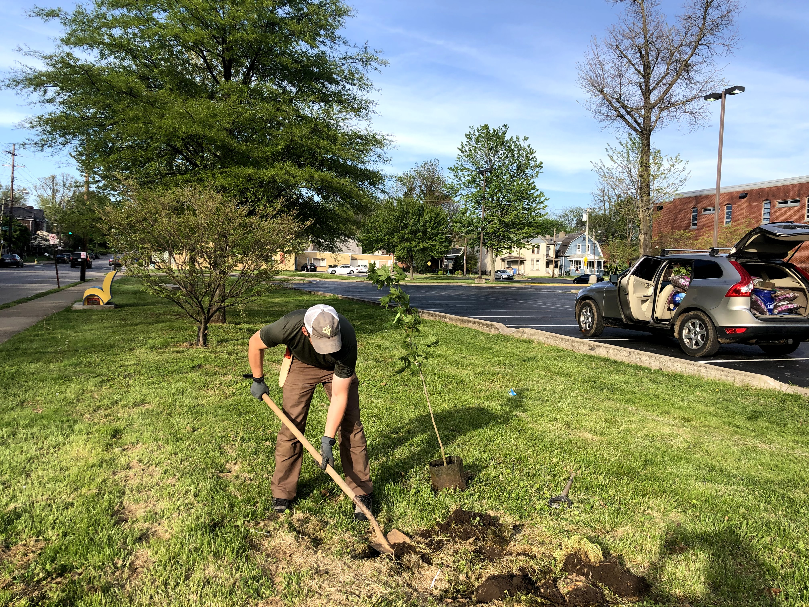
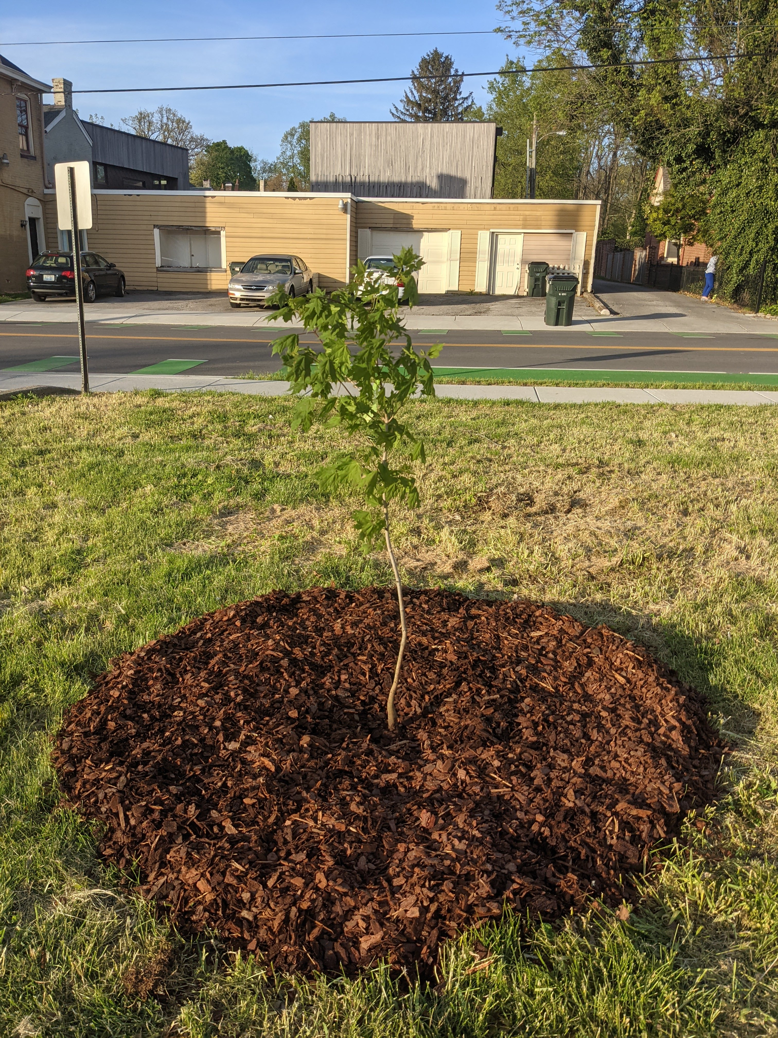
Lexington Traditional Magnet

Slide 7
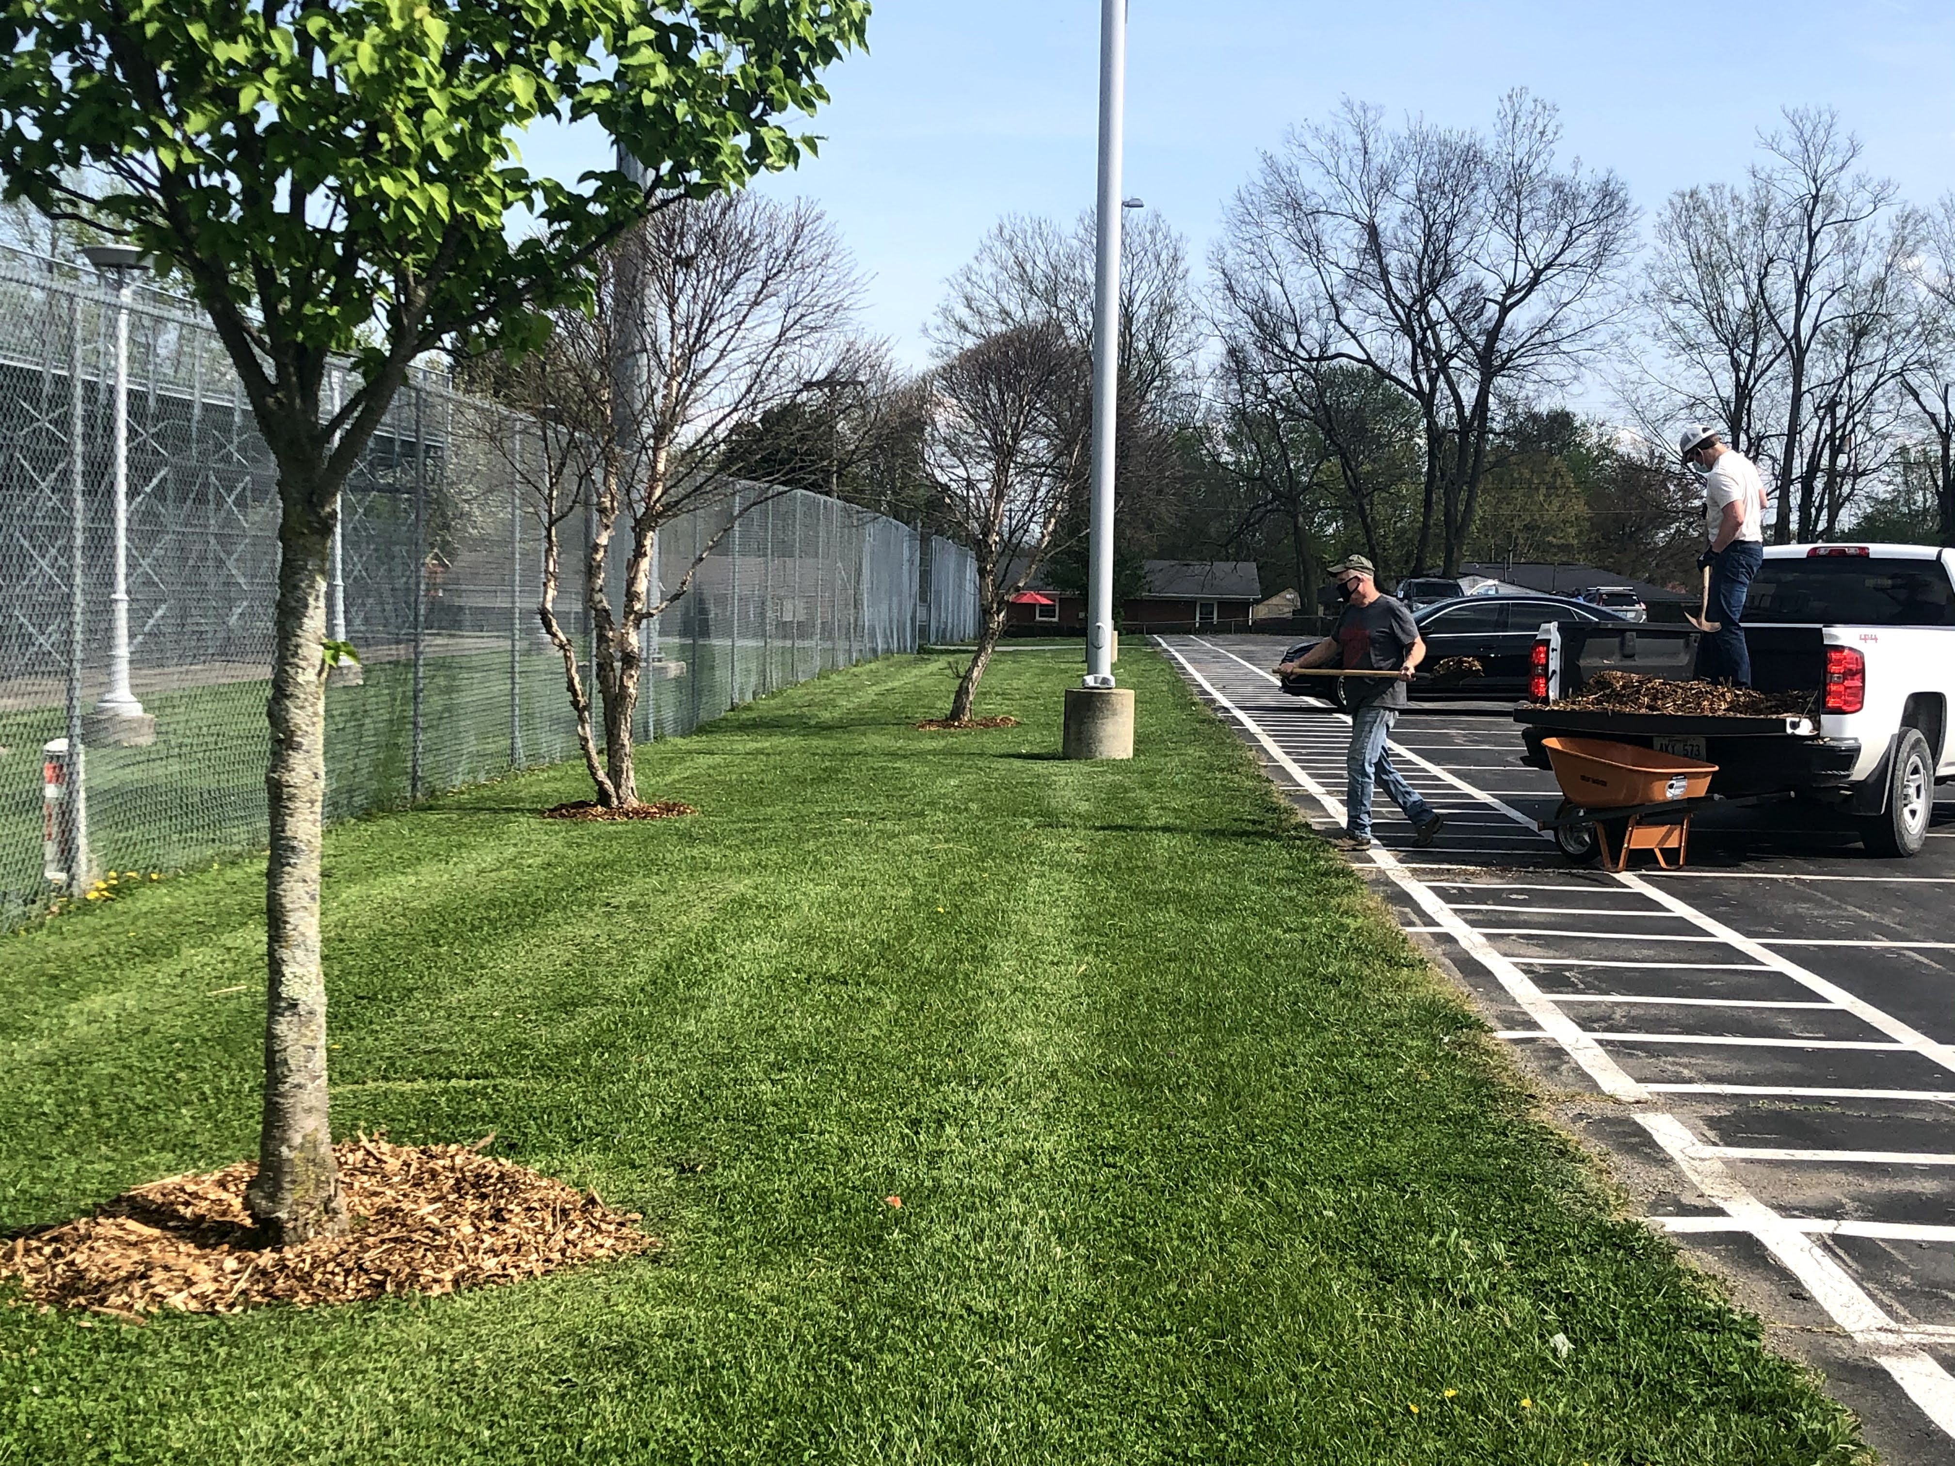
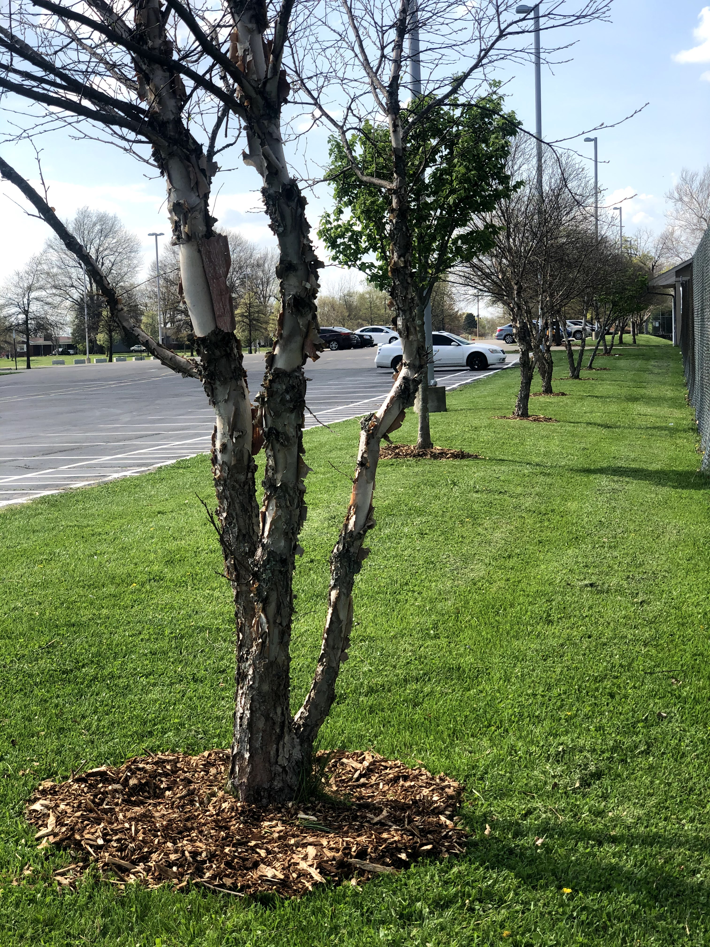
Bryan Station High School

Slide 8
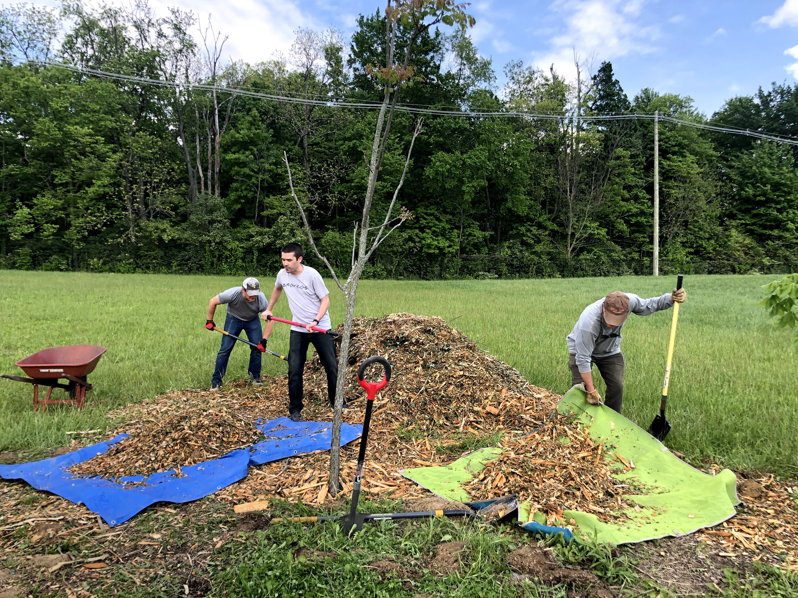
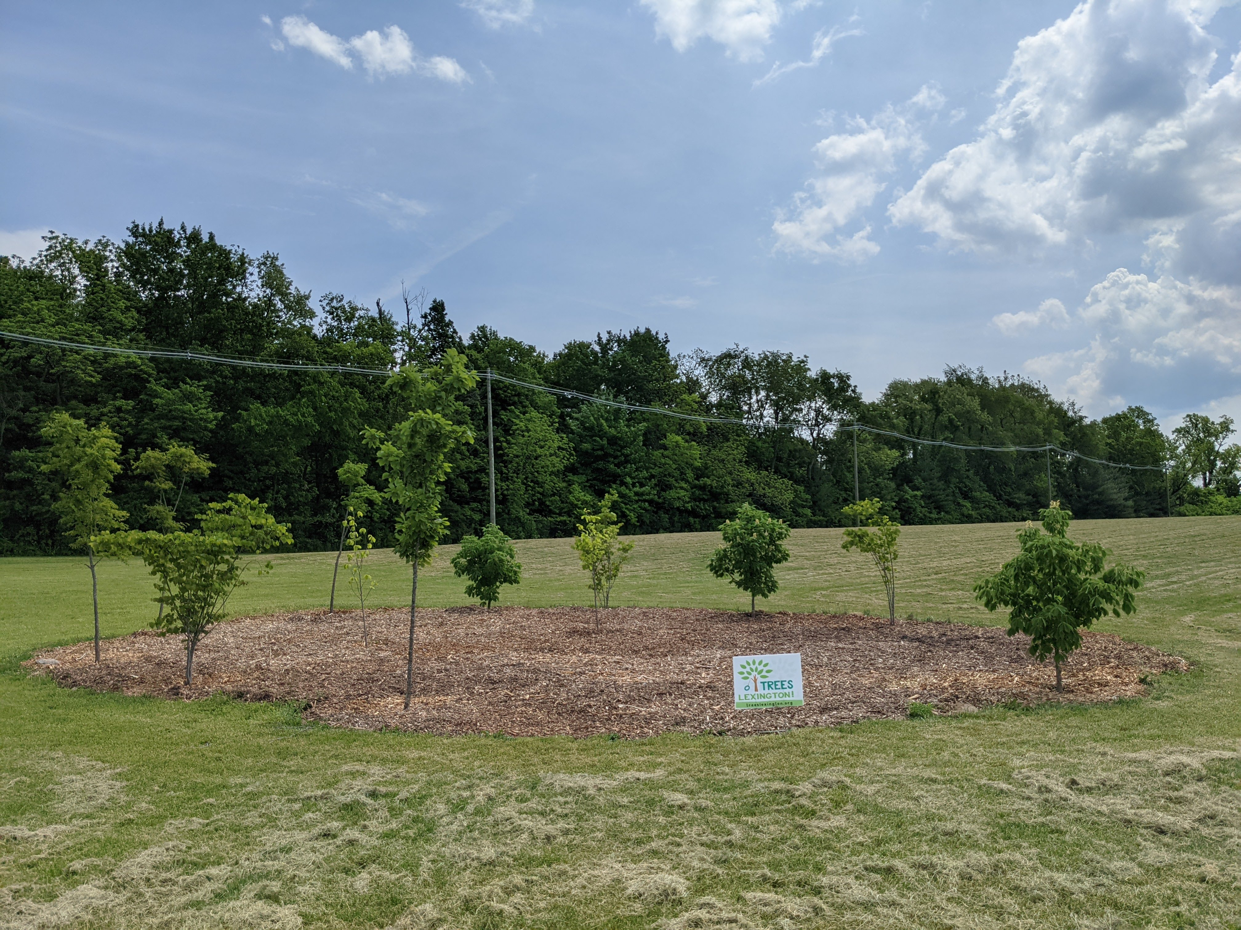
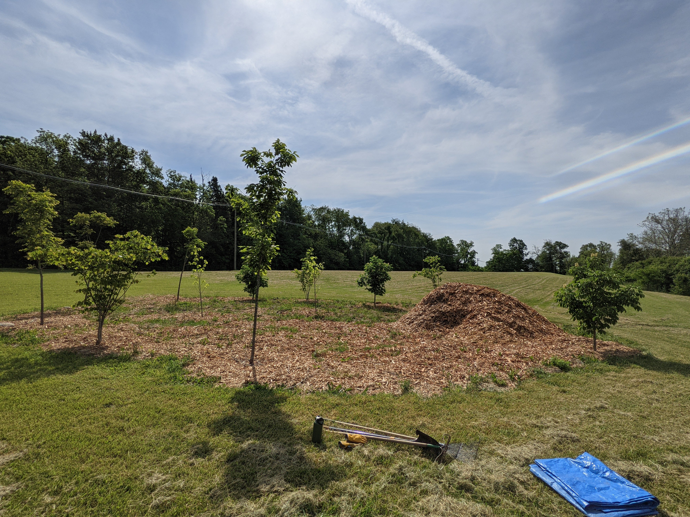
Frederick Douglass High School

Slide 9
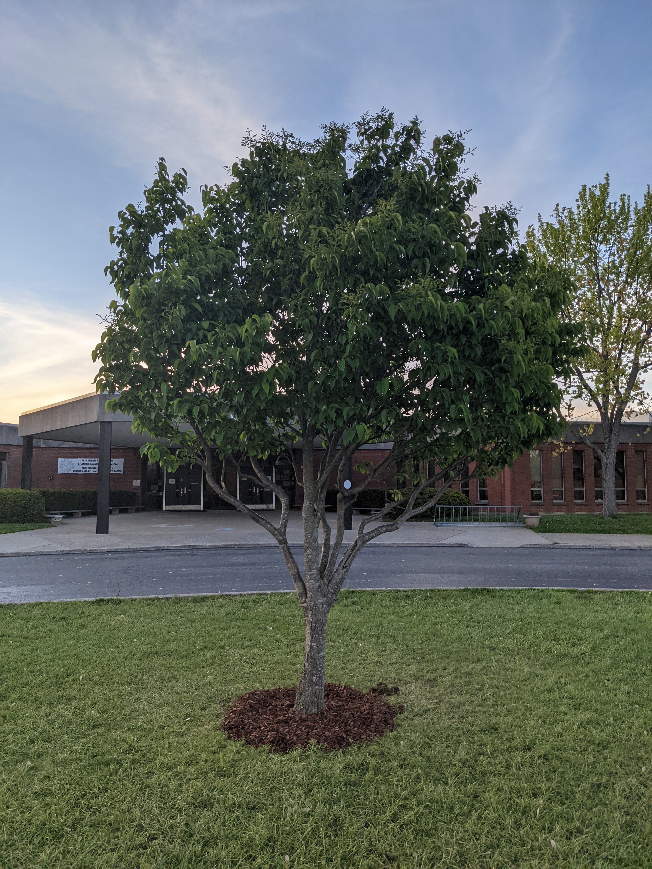
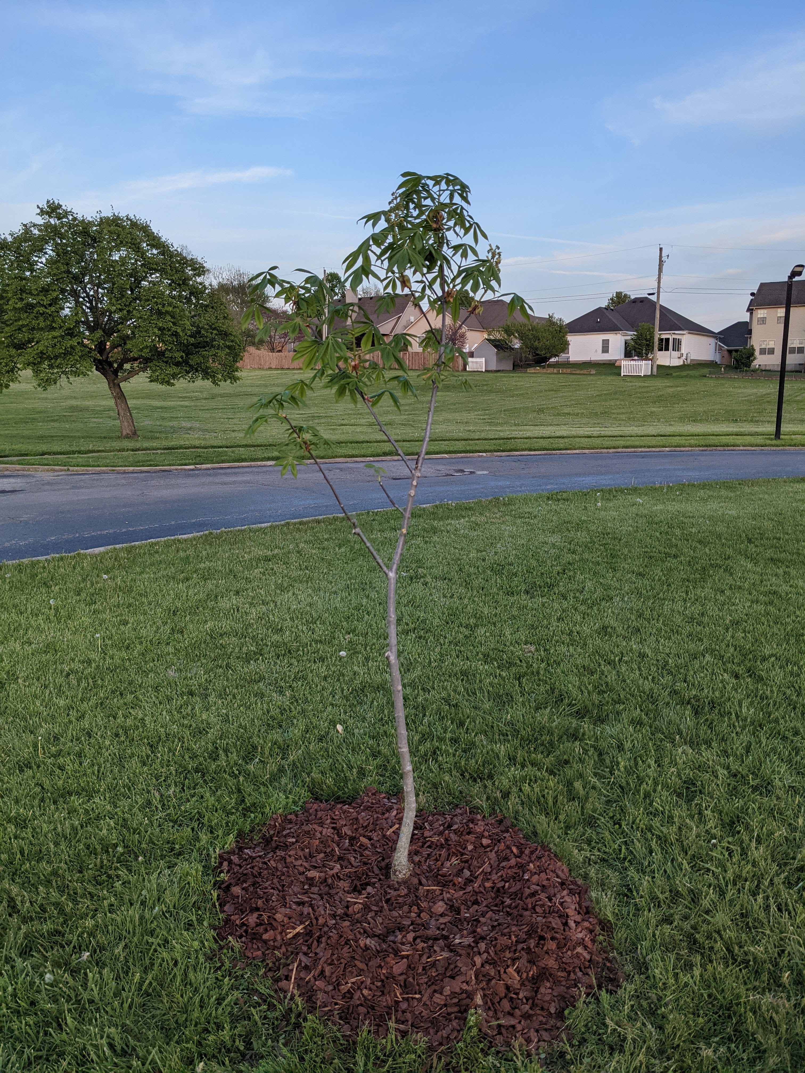
North Side Elementary

Slide 10
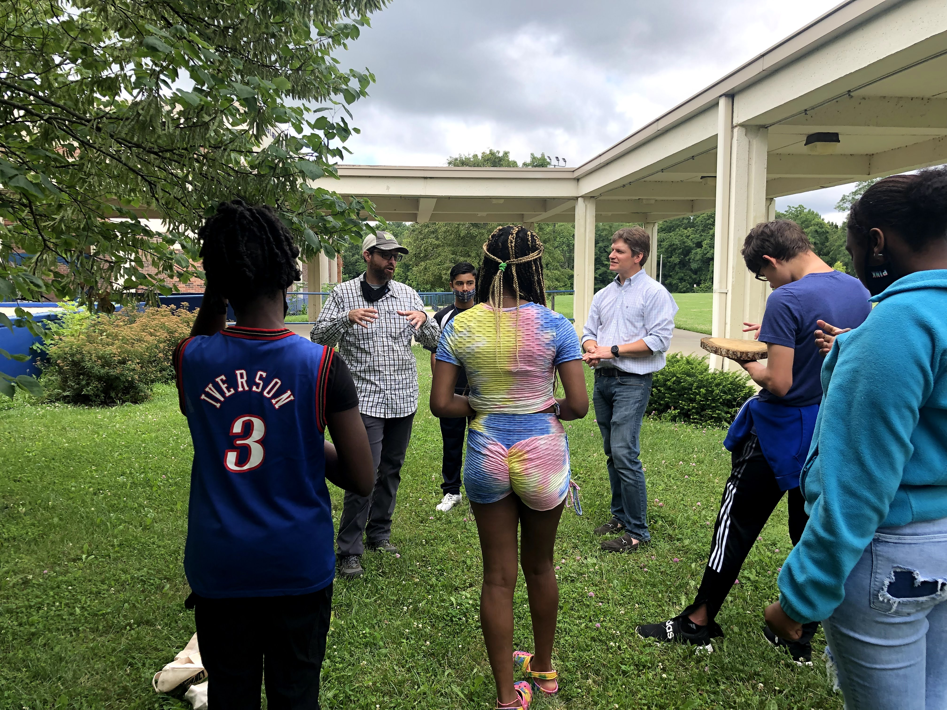
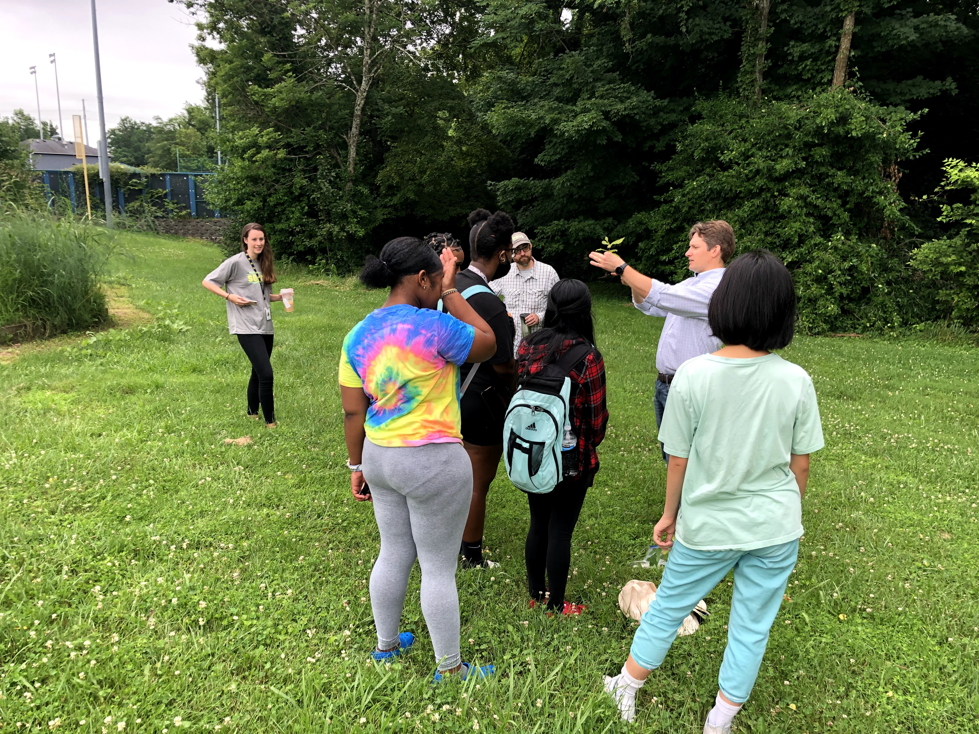
Henry Clay high School

Slide 11
Engagement Opportunities
Tree Plantings – open space
Tree Mulching – engage students and volunteers
Education – all things trees

Slide 12
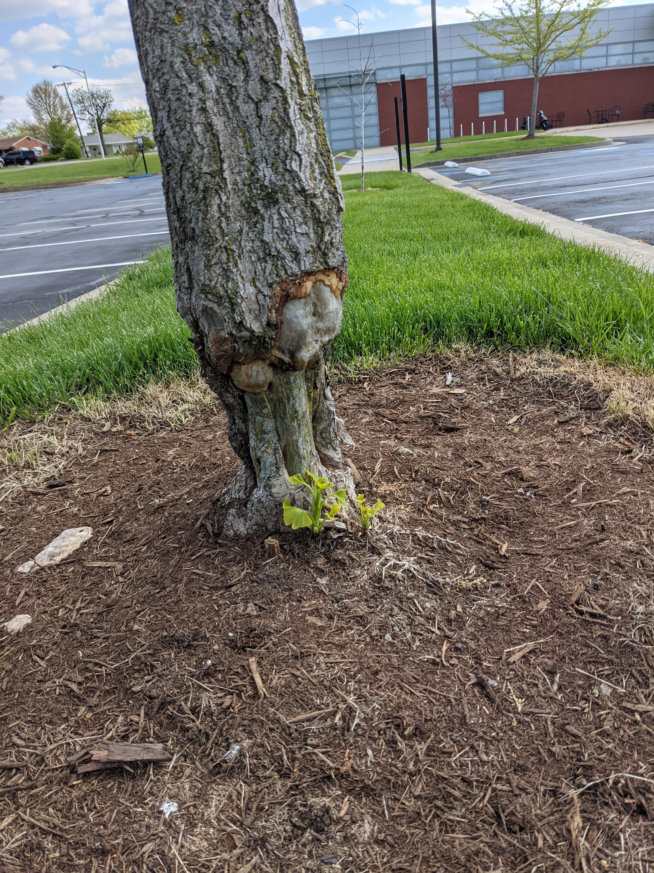
Why?
Lots of grass – few trees
New tree damage
The more students know, the more they care…

Slide 13
Contact Us
www.treeslexington.org
info@treeslexington.org

