Slide 1

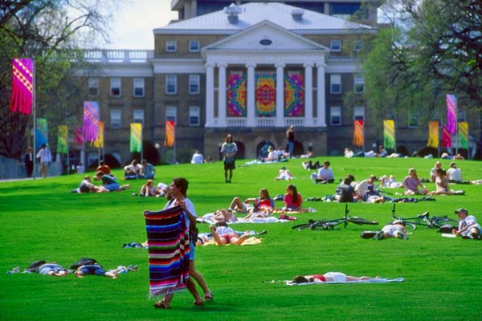
Henry Clay High School
College 101
2021-2022

Slide 2
Henry Clay Counseling Office
Counselors
Sharron Wesley – Students A – Ca
  sharron.wesley@fayette.kyschools.us - 381-3423 Ext. 53007
April Cain – Students Ce - Goll
  april.cain@fayette.kyschools.us - 381-3423 Ext. 53010
Rachael Howard – Students Gom – Kh
  rachael.howard@fayette.kyschools.us - 381-3423 Ext. 53069
Jordan Tarrence – Students Ki- N
  jordan.tarrence@fayette.kyschools.us - 381-3423 Ext. 53009
Josh Edwards – Students O - Sl
  joshua.edwards@fayette.kyschools.us - 381-3423 Ext. 53006
Ashley Harris – Students Sm – Z
  Ashley.harris@fayette.kyschools.us - 381-3423 Ext.
Vince Bingham- College & Career Coach
Vincent.Bingham@Fayette.kyschools.us – 381-3423 Ext. 58008

Slide 3
Henry Clay Mental Health & Family Support
Tori Mason- School Social Worker
Victoria.mason@Fayette.kyschools.us- 381-3423 Ext. 53012
Shevan Threats- District Mental Health Specialist
Shevan.threats@Fayette.kyschools.us 381-3423
Tamara Jones – District Mental Health Specialist
Tamara.jones@fayette.kyschools.us 381-3423
Mental Health Support Website:
https://sites.google.com/fayette.kyschools.us/hchs-nti-mental-health/home?authuser=0
Family Support:
Ciera Bowman - Youth Service Center Coordinator
ciera.bowman@fayette.kyschools.us 381-3423 Ext. 53094

Slide 4
Graduation Requirements
English/Language Arts – 4 credits
Math – 4 credits
Science – 3 credits (Physics, Biology, Chemistry)
Social Studies – 3 credits (US Government, World History, US History)
Health ½ credit and PE ½ credit
Arts and Humanities – 1 credit
Electives – 6 credits
Total = 22 credits
Students who have attended another high school may have additional requirements.
Check with your counselor for with your individual questions.

Slide 5
Transcripts and Credits
Check transcript for accuracy.
Are junior students scheduled into the classes they need to be a senior next year?
Make a note of any discrepancies on the transcript and discuss with counselor.
Unofficial Transcripts are in Student Portal under Documents.

Slide 6
Infinite Campus Portal
Students log into Infinite Campus with Google authentication.
Preferred Method - Google Drive: In a web browser, navigate to drive.google.com; login with your FCPS email address and FCPS account password. Use the waffle icon in the upper right hand corner to select Infinite Campus.
Single Sign-On (SSO) button: In a web browser, navigate to the Infinite Campus login page, click: Single Sign-On (SSO) and log in with your FCPS email address and FCPS account password. Students should also use the "Single Sign-On (SSO)" button to log in to the Campus Student smartphone app.
Remember to access IC through Google Drive using the waffle icon: https://drive.google.com/.
More details including FAQ, Handouts for students and staff, along with a Troubleshooting Guide can be found on the Google (SAML) IC Account Migration website.
Parents can check students' grades and attendance using Infinite Campus. If you would like a login to Infinite Campus, please go to https://fayetteky.infinitecampus.org/campus/portal/parents/fayette.jsp and use the IC Parent Support Tool to gain access.

Slide 7
Junior Year Plan of Action
Fall semester through end of school year - start exploring colleges.
March 2022- Free ACT given at Henry Clay
Consider taking the ACT again Spring/Summer 2022
  Some colleges may extend test optional admissions for class of 2023. Check college websites for more info.
May 2022- AP exams for students in AP classes
All year - work hard and get good grades - for many colleges these
are the last grades they will see.

Slide 8
Test Registration
Check the ACT and/or SAT dates and get registered.
Apply online for ACT at www.actstudent.org or SAT at www.collegeboard.org
Students on free/reduced lunch see counselor for fee waiver.
ACT College Readiness Benchmarks:
  English – 18, Math – 19, Reading – 20,

Slide 9
Test Prep
Free, online & directly from testing companies
ACT- https://academy.act.org/
ACT- www.act.org download free full length practice test
SAT- https://www.khanacademy.org/sat
Talk to counselor for more options.

Slide 10
AP Exam Registration Oct 1-31
AP Exam Registration opens October 1.
Registration is a TWO STEP process
  1. Go to www.totalregistration.net/AP/181425 to register and pay.
  2. Go to myap.collegeboard.org to make sure you’re enrolled in MyAP Classroom for each AP course you are taking.
Students must be enrolled in MyAP Classroom for an exam to be ordered through the College Board.
Cost: $40 per exam
  Students on free & reduced lunch are free and need to contact AP Coordinators Catherine.Stephens@Fayette.kyschools.us or Ashley.harris2@fayette.kyschools.us

Slide 11
The College Process
Explore colleges through:
  Online searches using websites such as www.kheaa.com & www.bigfuture.collegeboard.org
  College visits
    Online through HC & College websites
    College Fairs
    On campus visits
  Elevate
Apply to colleges at the beginning of Senior Year
FAFSA – Apply October 1, 2022

Slide 12
College Visits
Most colleges are offering in person visits. Check college websites for specifics for each college.
In person school Policy: Juniors & Seniors may schedule college campus visits. These visits should not exceed a total of 3 school days for Juniors and 5 for Seniors.
The procedure: Student submits the Request for College Visit form in advance to their counselor. All Junior and Senior students received this form in their packet during Junior/Senior meetings. Also, it can be found on the Henry Clay Counseling website.

Slide 13
College Visits to Henry Clay
*Representatives from colleges, universities, and technical schools come to Henry Clay to talk to students in small groups. Registration is on the HC Counseling webpage.
*It is a good way to make contact with the representative for our area for schools in which you might be interested.
*During this time, college visits are happening via Zoom. Check schedule & register at link below or on the Counseling webpage:
https://bit.ly/CollegeVisitsForm

Slide 14
Virtual College Fairs
Virtual College Fairs sponsored by Kentucky Association for College and Admissions Counselor
Dates & times for 2021:
  October 27 7:00 PM
Register here:
  https://kyacac.swoogo.com/registration
Virtual College Fairs – Oct 24, Nov 14
  https://virtualcollegefairs.org/

Slide 15
Scholarship Information
1. Senior year, always apply for scholarships directly from colleges.
2. A scholarship listing is updated frequently on Henry Clay’s Counseling webpage- www.henryclay.fcps.net
  There is a list for 12th grade and one for 9th-11th grades.
  See your counselor for more info.
3. Online scholarship search engines such as:
  www.fastweb.com
  www.scholarships.com
  www.cappex.com
  www.goingmerry.com
  www.bigfuture.collegeboard.org
  There are many more and typically you create a profile & they connect you with possible scholarships.

Slide 16
KEES (Kentucky Educational Excellence Scholarship)
Students who make at least a 2.5 GPA can earn a base scholarship amount every year.
The better the grades, the more money earned to pay for college.
Students can also earn a bonus award for at least a 15 on ACT.
Must be a US citizen and KY resident.
Check on your KEES status at www.kheaa.com

Slide 17
Governor’s Scholars Program
Five-week residential summer program for outstanding Kentucky junior students.
Provides academic enrichment, personal growth, challenging liberal arts program.
Full co-curricular, residential life experience.
Info & Application online at gsp.ky.gov
Register here if interested in GSP: http://bit.ly/HCGSPP
Sign up for Remind notices by texting @hcgsp2022 to 81010
Application deadline- December 1, 2021 to HC Counseling Office

Slide 18
Governor’s School for the Arts
3 week residential program offered for the states most creative high school students.
10th and 11th graders can apply.
9 artistic disciplines: Architecture & Design, Creative Writing, Dance, Drama, Film + Photography, Instrumental Music, Musical Theatre, Visual Art, Vocal Music.
Audition and/or review required.
Information Sessions: Chose 1 meeting to attend:
  Tuesday October 26 at 8:00am in the Library
  OR
  Tuesday October 26 during Advisory (10:25-10:50) in the Library
2022 Applicant Guides will be released on October 13, 2021 on GSA’s website.
Application due January 9, 2022
Additional info at www.kentuckygsa.org

Slide 19
Governor’s School for Entrepreneurs
Free 3-week residential summer program during which motivated teams of students develop a business model, design a prototype, and pitch their startup during Demo Day.
Open to 9th, 10th and 11th graders
Information Sessions: Chose 1 meeting to attend:
  Thursday October 28 at 8:00am in the Library
  OR
  Thursday October 28 during Advisory (10:25-10:50) in the Library
2022 Application Opens – Nov. 15, 2021
Deadline to apply – January 24, 2022
Learn more at www.KentuckyGSE.com

Slide 20
Youth Salute- 11th graders
Applications are available online at https://www.centralky.youthsalute.com/apply/
To be eligible, students must:
  Be a high school junior.
  Have at least a cumulative GPA of 3.0 through the fall of junior year.
  Have held TWO leadership roles for which they were chosen by their peers or an adult leader within the past two years in school.

Slide 21
Earn College Credit in High School!
AP - 22 different courses offered
Opportunity Middle College - program at BCTC
Dual Credit at Henry Clay
- ENG 101/102
- MA 111/150
- MA 150/170
Henry Clay U - students take some classes at Henry Clay and some at BCTC

Slide 22
NCAA/NAIA Guidelines
If you are a college-bound athlete, you must meet NCAA or NAIA academic eligibility requirements.
Register Online summer after junior year - (Fee waivers are available to students who have used a fee waiver on the ACT and/or SAT.)
www.eligibilitycenter.org
https://play.mynaia.org
Official Test Scores MUST be Sent from
ACT and/or SAT Use Code 9999

Slide 23
Junior Meeting Final Notes
If students have not already started the process, the Junior year is when students need to seriously begin examining their college and career options.
Juniors should take college tests, make college visits, and start searching for scholarships.
In the college admissions process, nothing is more important than a student’s high school academic record.
Juniors should work even harder at achieving their best grades.
Colleges use test scores to help them determine a student’s readiness for college level work. It is sometimes a good plan to enroll in a study class before you take the test.

Slide 24
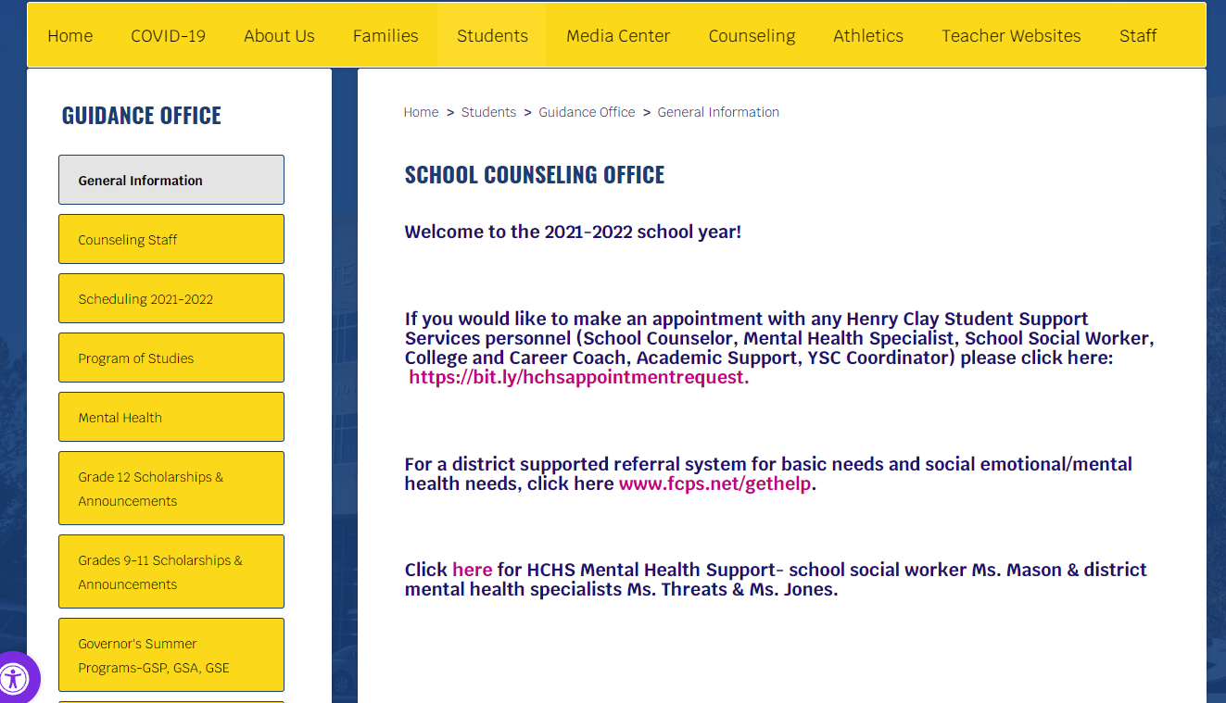
https://www.fcps.net/Page/9211

