Slide 1
Parents Guide to DragonFly
Desktop Version

Slide 2
Parent To Do List:
Create an account
Connect to Valley High School
Connect to your child
Submit Forms
It is highly recommended that you create your account on a Desktop and then use the DragonFly app to upload forms as photos.

Slide 3

Creating an Account
STEP 1: Visit dragonflymax.com

Slide 4
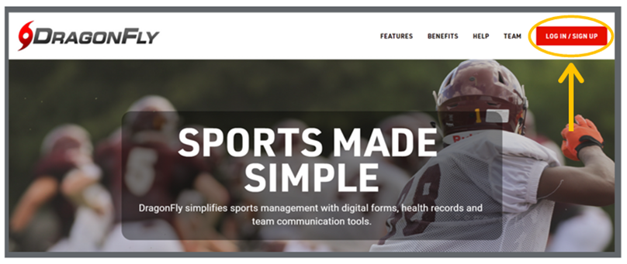
Creating an Account
STEP 2: Click on log in/ sign up in the top right corner then select SIGN UP FOR FREE

Slide 5
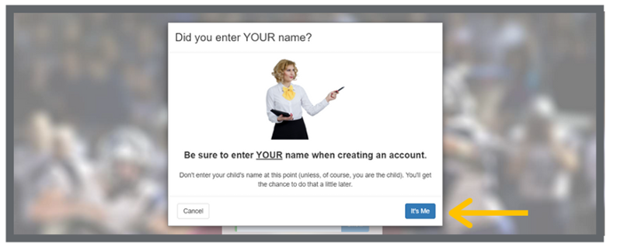
Be sure you use your own name - not the name of a student or child. If you are a parent/guardian, don't worry, you'll get to add your child later

Slide 6
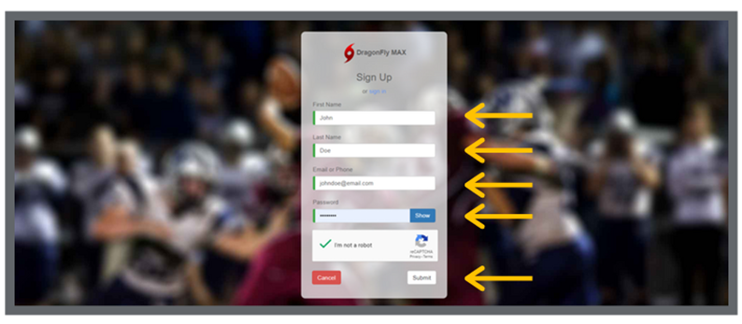
Creating an Account
STEP 3: Enter your first name, last name, email address, and password

Slide 7
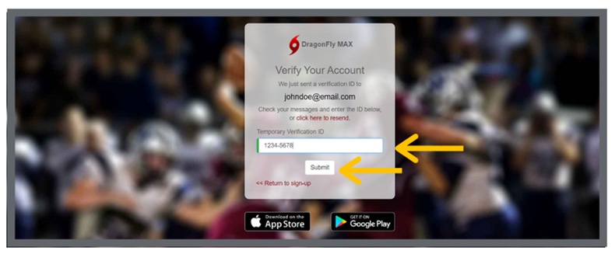
Creating an Account
STEP 4: Check your email for a verification ID, then copy and paste that code into the field and click ‘submit’

Slide 8
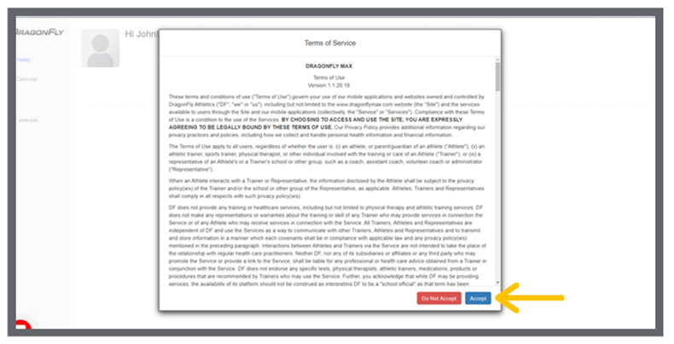
Creating an Account
STEP 5: Review the Terms of Service and click ‘Accept’.

Slide 9
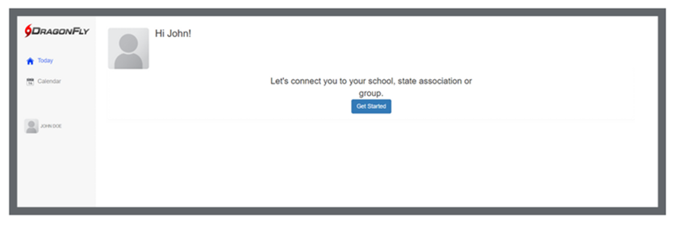
Creating an Account
Congratulations! You have made an account. Now, let's get connected to VALLEY HIGH SCHOOL.

Slide 10
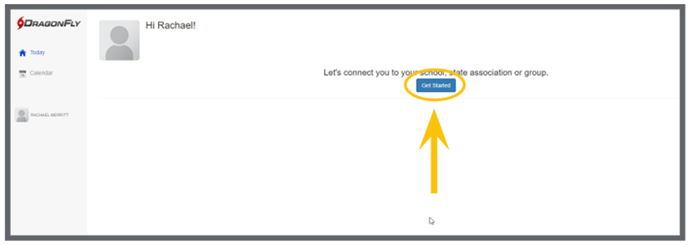
Connect to VALLEY High School
STEP 1: Click ‘Get Started’ on the ‘Today’ screen.

Slide 11
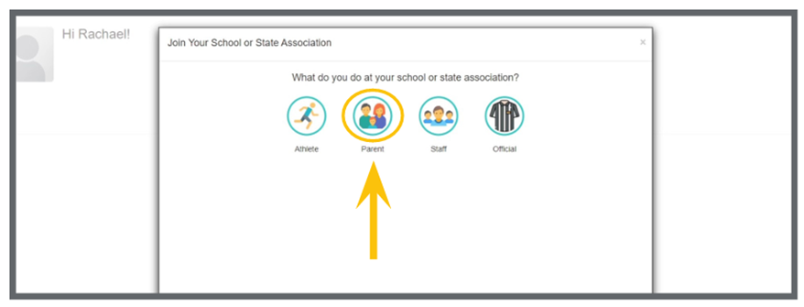
Connect to VALLEY High School
STEP 2: Follow the on-screen prompts and select ‘Parent’ as your role.

Slide 12
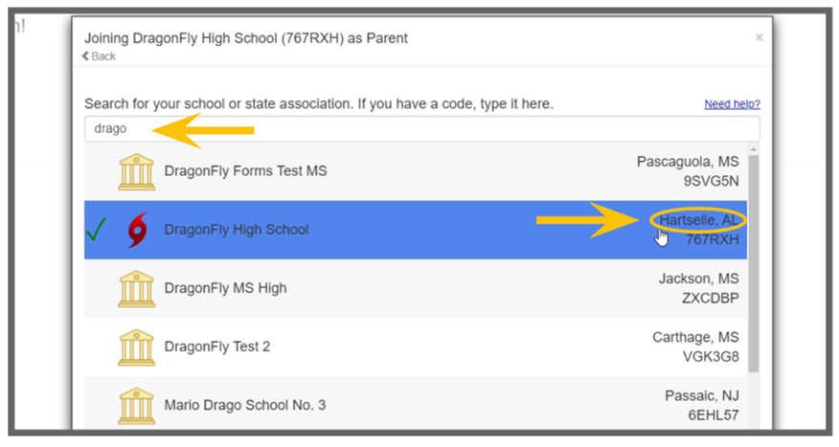
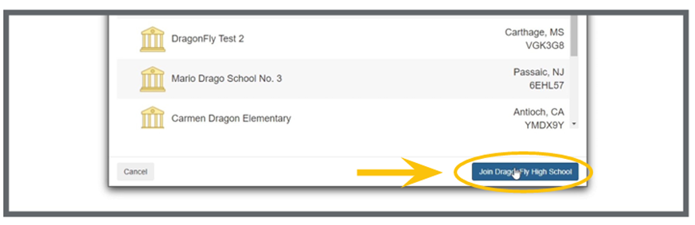
Connect to Valley High School
STEP 3: Next, type VALLEY HIGH into the search bar. Select HIGHLAND HIGH from the list. Double check the school’s location is Albuquerque, NM.

Slide 13
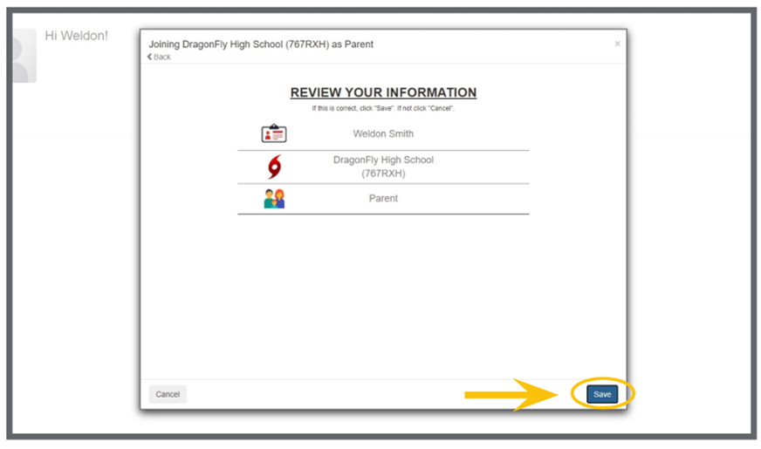
Connect to Highland High School
STEP 4: Select Valley High School, review your information, and tap the ‘Join’ button at the bottom of the screen.

Slide 14
Connecting your child

Slide 15
Connect to Your Child
There are two options to connect to your child
If your child already has an account, follow slides 16-22
If your child does not have an account, follow slides 23-29

Slide 16
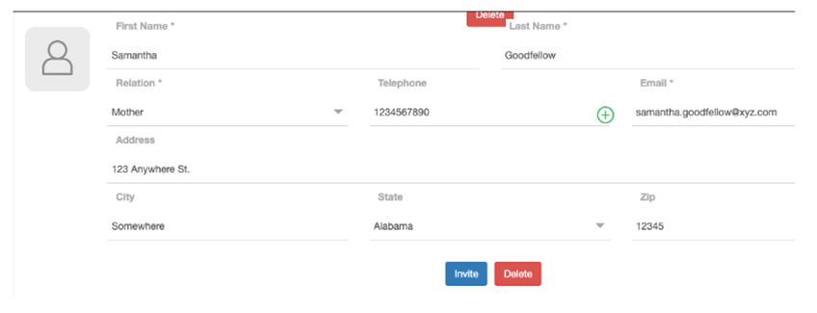
Connect to Your Child
STEP 1: Your child must create an account. Have your child log into their account from a web browser. From the ‘Contact Info’ screen, scroll to the bottom of the page where you see ‘Parents and Emergency Contacts.’

Slide 17
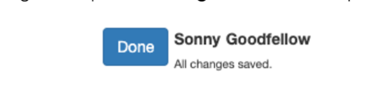
Connect to Your Child
STEP 2: Enter the information for the parent/ guardian you want to invite. Save the information by scrolling back up to the top and clicking ‘Done.’

Slide 18
Connect to Your Child
STEP 3: Scroll back to the bottom and click the ‘Invite’ button.

Slide 19
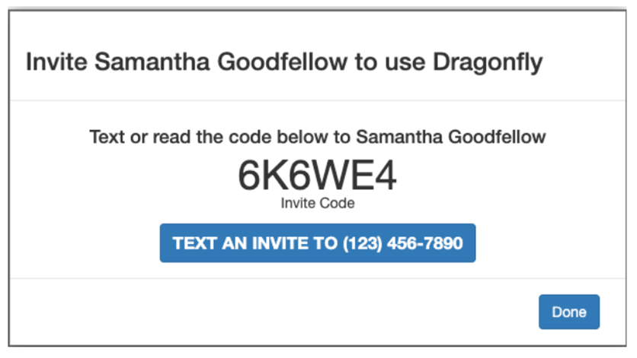
Connect to Your Child
STEP 4: You will be given an invite code that you can share with your parent/guardian.

Slide 20
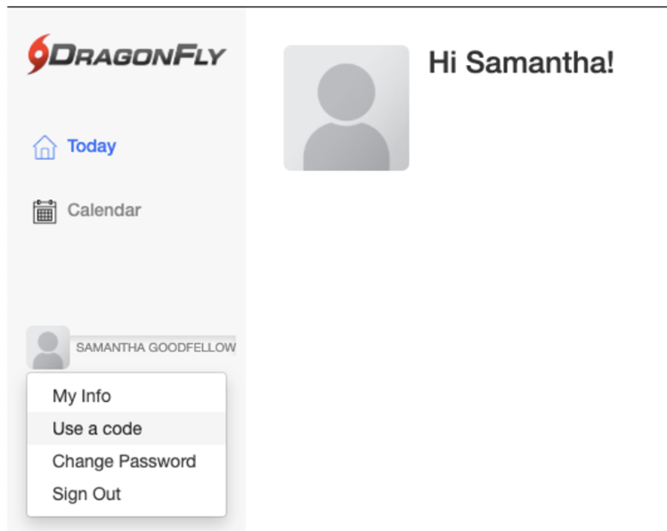
Connect to Your Child
STEP 5: Log in to your Parent account. On the left side of the screen click on Your Name and select “Use a code” from the dropdown.

Slide 21
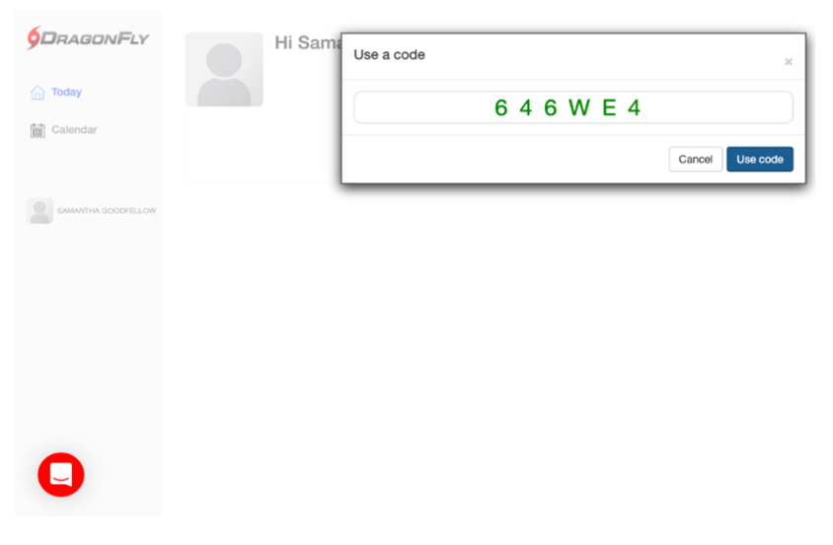
Connect to Your Child
STEP 6: Enter the invite code you got from your child and click the ‘Use code’ button.

Slide 22
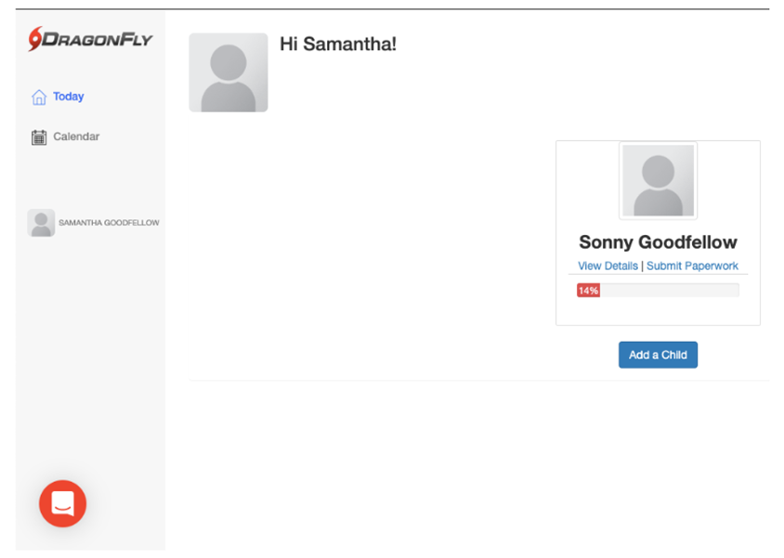
Connect to Your Child
You have successfully linked to your child. Now, let’s start submitting forms!

Slide 23
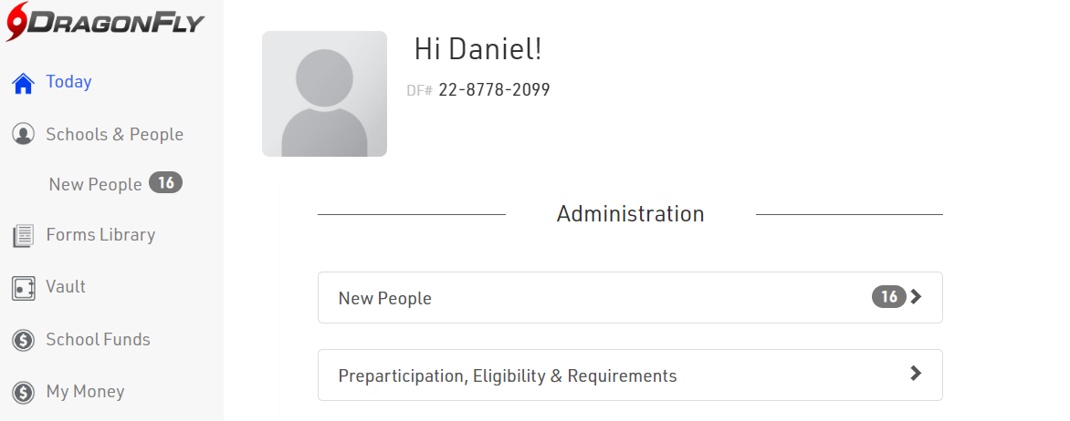
Connect to Your Child
STEP 1: Open your profile and select “TODAY” from the menu on the left

Slide 24
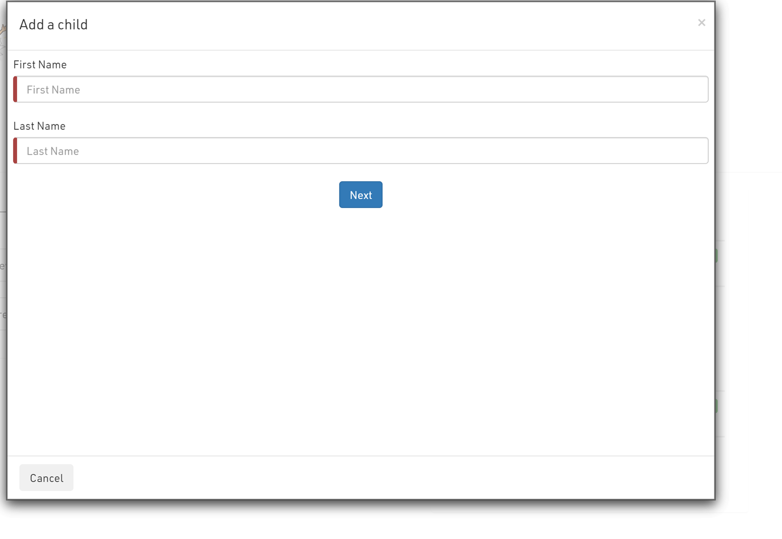
Connect to Your Child
STEP 2: Enter your child’s legal first and last name then select ‘next’.

Slide 25
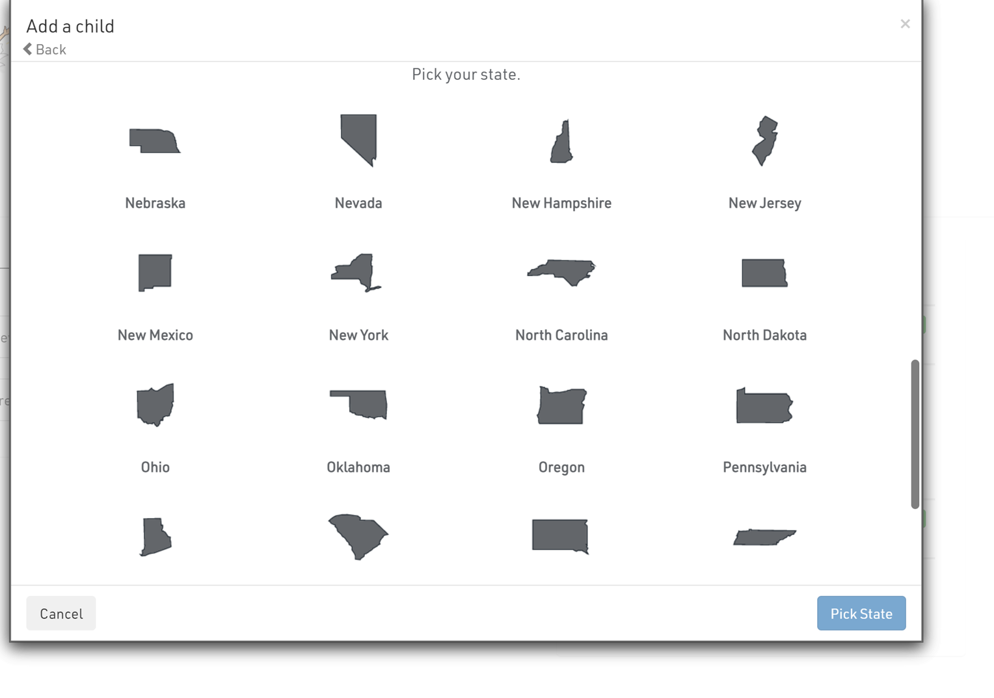
Connect to Your Child
STEP 3: Select New Mexico

Slide 26
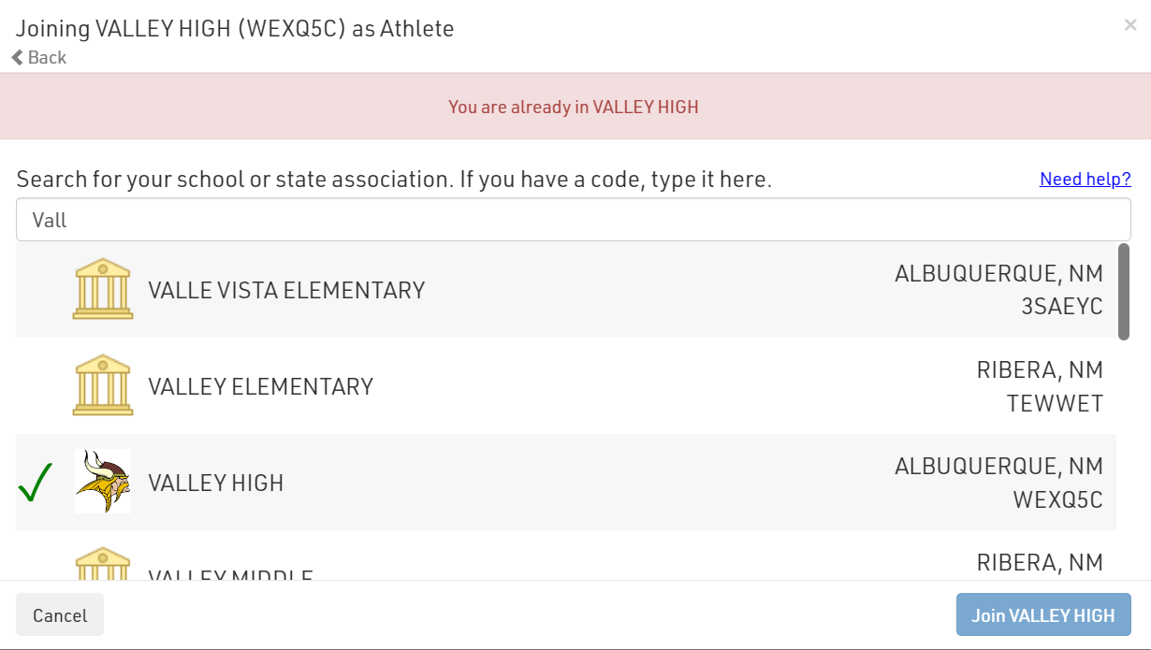
Connect to Your Child
STEP 4: Search for VALLEY HIGH and select ‘join’.

Slide 27
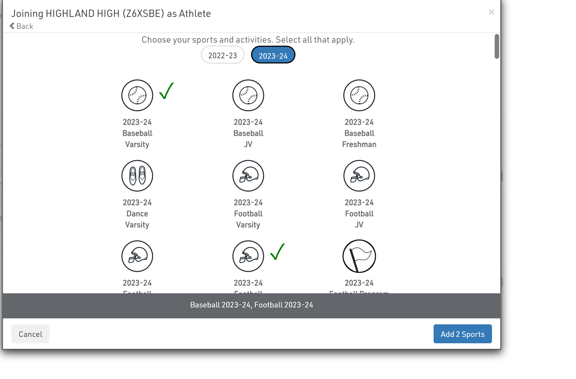
Connect to Your Child
STEP 5: Select the 2023-2024 school year and then select the sports your child is interested in.

Slide 28
Connect to Your Child
STEP 6: You are now ready to review all your child’s information and click ‘save.’
STEP 7: You will now see your child on the today tab. You can now add another child or begin submitting paperwork.

Slide 29
Submitting Forms
STEP 1: Click ‘ Submit Paperwork’ under your child’s name on the ‘Today’ screen

Slide 30
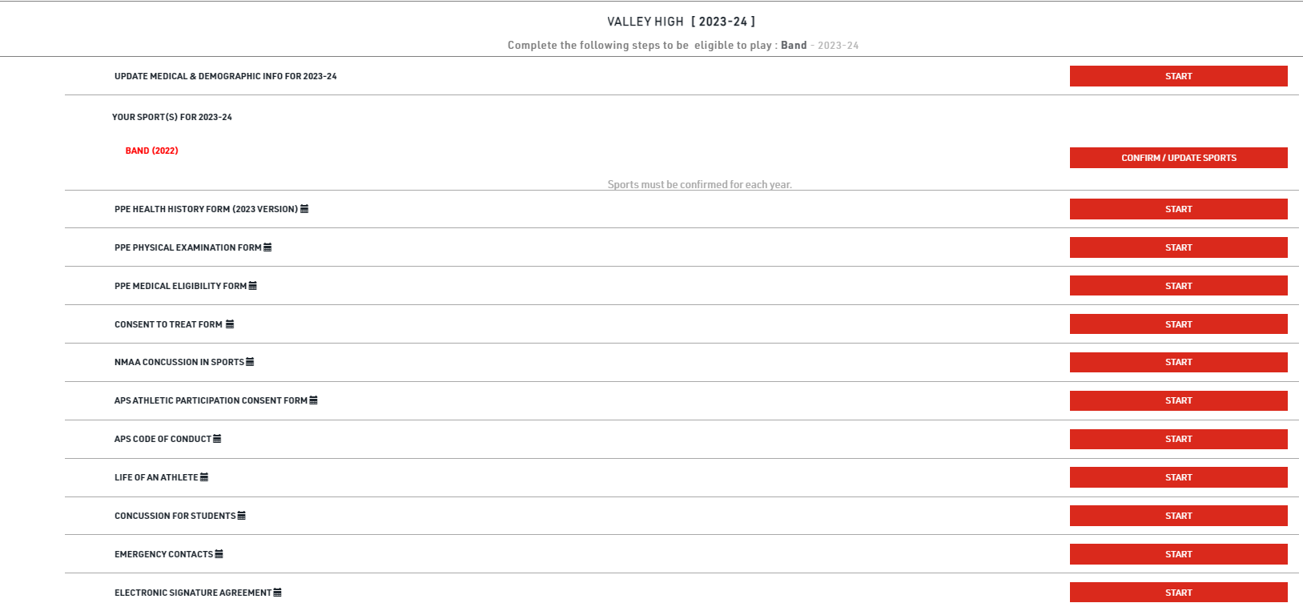
Filling out/Submit Forms
STEP 1: View the 2023-2024 requirements and click ‘start’ to begin.

Slide 31
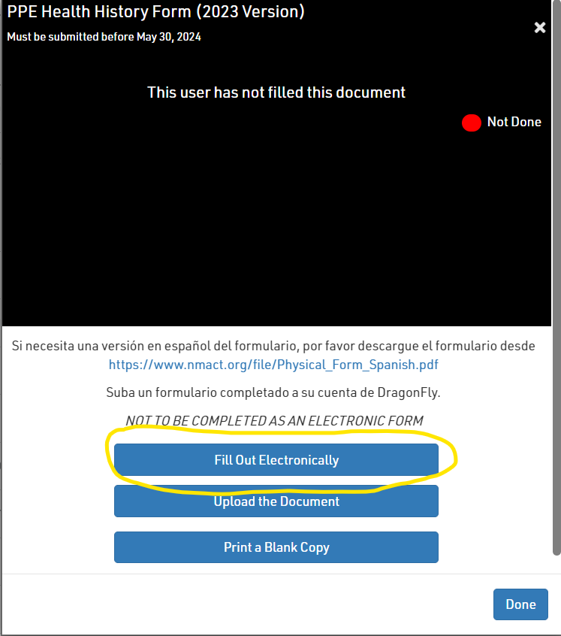
Filling out Forms
Filling out/Submit Forms
STEP 2:When you click Start on all links except for PPE Examination Form & PPE Medical eligibility form, you will see this screen pop up. Click on Fill out electronically to fill out all required forms electronically

Slide 32
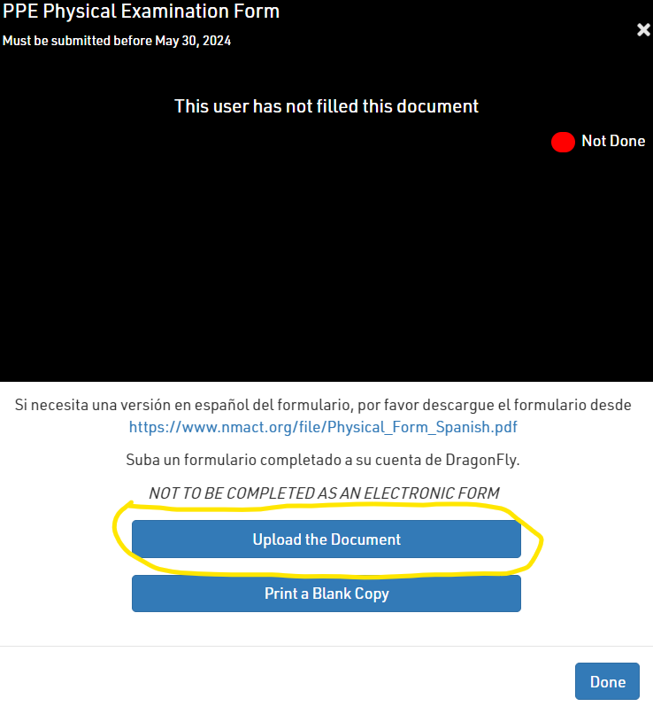
Submit Forms
To Submit PPE Examination Form and Medical Eligibility Form, Click ‘start’ and click on ‘upload document’ link. When submitting Please make sure to include a CLEAR PICTURE of the ENTIRE PAGE of any items that need to be uploaded.

Slide 33
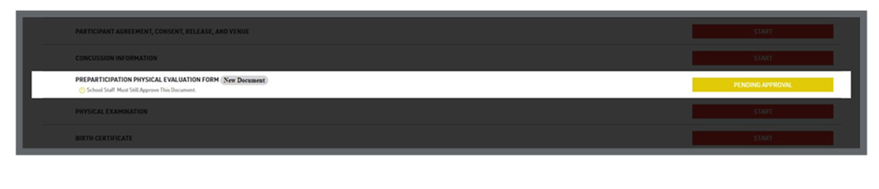
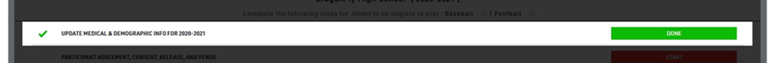
Submit Forms
As you complete each item, it will turn GREEN to show it has been completed an accepted or YELLOW to show it has been completed and is pending approval.
Athletes must be ALL GREEN in order to participate.

Slide 34
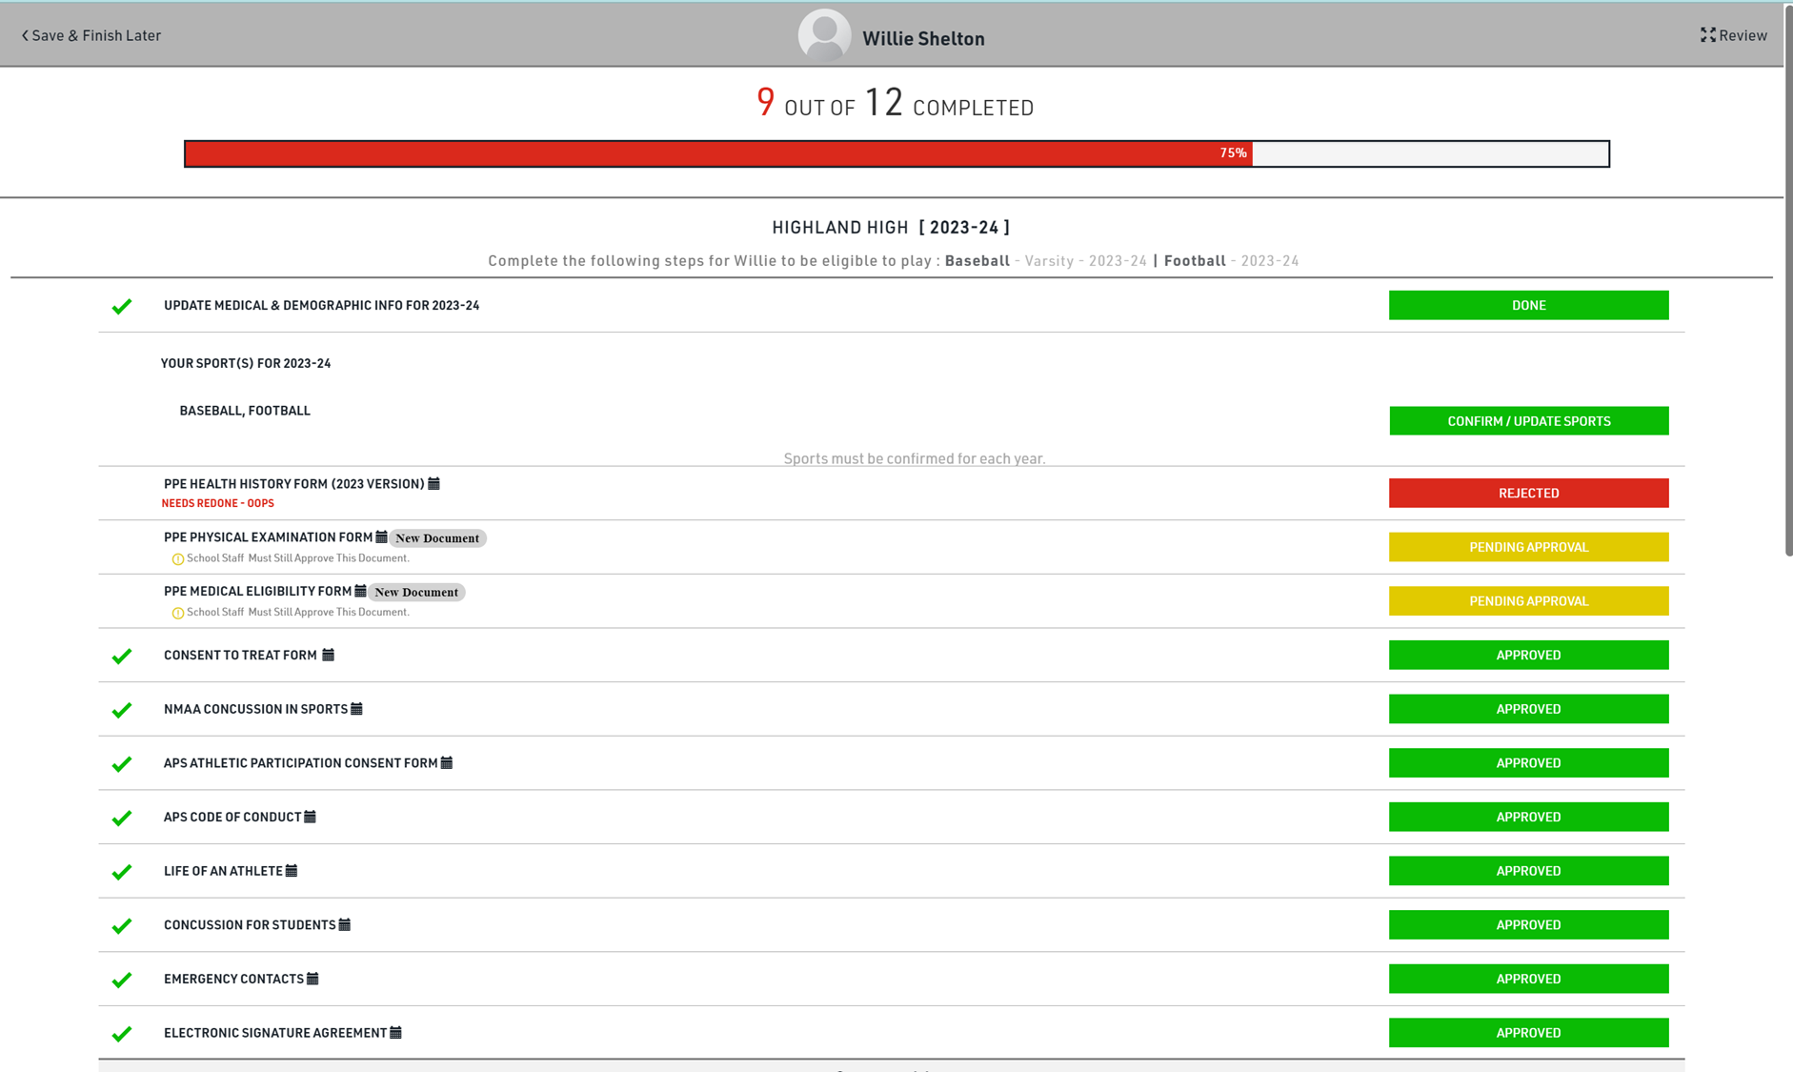
Submit Forms
This is what your child’s profile will look like after completing requirements.
Items pending approval will be marked in yellow. Please allow at least 24 hours for review and approval.
If an item is rejected, an explanation of what needs to be one will show up in red.
All items shown in green, must be green to be eligible for the free physical event.

Slide 35

Submitting and Uploading Forms
Complete the following items before uploading your physical:
NMAA Requirements: CONSENT TO TREAT FORM, PPE Health History Form (2023 Version) NMAA Concussion in Sports (the other three forms will be completed at the physical.)
APS Requirements: APS Athletic Participation Consent Form, APS Code of Conduct, Life of an Athlete, Concussion for Students. Emergency Contacts, Electronic Signature Agreement.
Print the NMAA Physical Examination Form_Medical Eligibility Form
Upload completed physical form to DragonFly.
UPLOADED DOCUMENTS MUST SHOW THE FULL PAGE, NO CUT OFFS, AND BE A CLEAR IMAGE. BLURRY IMAGES WILL BE REJECTED.
Adobe Scan is a free app for IOS and Android that you can use to upload your physical as a pdf.

Slide 36
You only need to upload pages 5-6 of the physical packet.
All other pages can be found electronically in Dragonfly
THESE FORMS MUST BE APPROVED BY ATHLETIC TRAINER BEFORE YOU ARE CLEARED. PLEASE ALLOW AT LEAST 24-48 HOURS FOR RESPONSE.

Slide 37
Checking Eligibility
Student athletes are not able to participate in any APS athletic events, including tryouts, until all requirements have been met on DragonFly.
Once all requirements have been met, the athlete’s name will turn from red to black.
Student Name RED = NOT CLEARED
Student Name BLACK = CLEARED

