Slide 1
Athlete Guide to DragonFly
Desktop Version

Slide 2
Athlete To Do List:
Create an account
Connect to Valley High School
Connect to your parent/ guardian
Fill out/Submit Forms
It is highly recommended that you create your account on a Desktop and then use the DragonFly app to upload forms as photos.

Slide 3

Creating an Account
STEP 1: Visit dragonflymax.com

Slide 4
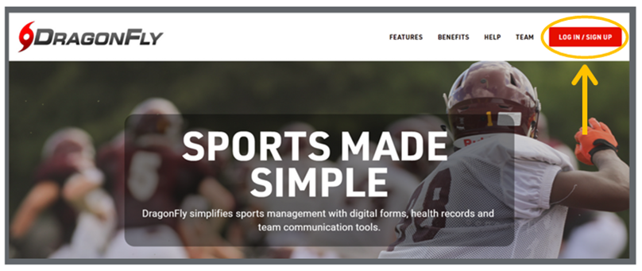
Creating an Account
STEP 2: Click on log in/ sign up in the top right corner then select SIGN UP FOR FREE

Slide 5
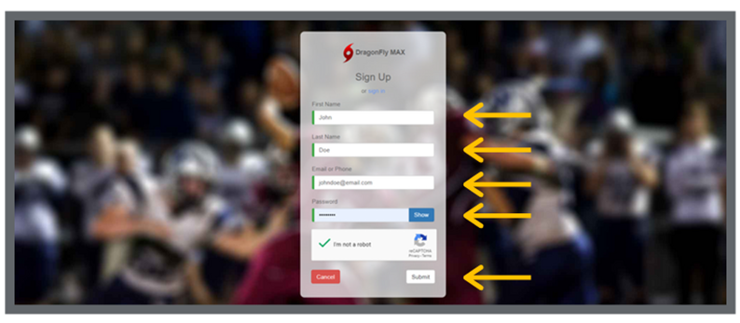
Creating an Account
STEP 3: Enter your first name, last name, email address, and password
*USE AN EMAIL YOU HAVE EASY ACCESS TO*

Slide 6
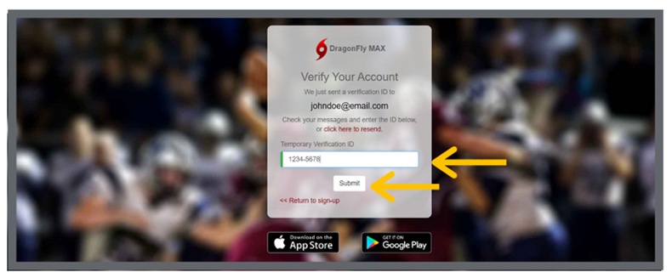
Creating an Account
STEP 4: Check your email for a verification ID, then copy and paste that code into the field and click ‘submit’

Slide 7
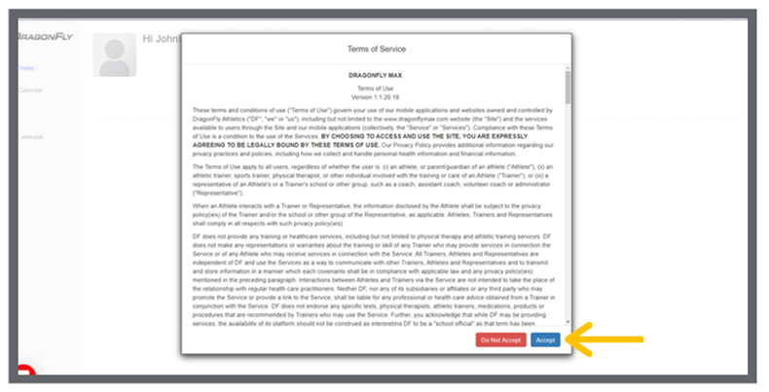
Creating an Account
STEP 5: Review the Terms of Service and click ‘Accept’.

Slide 8
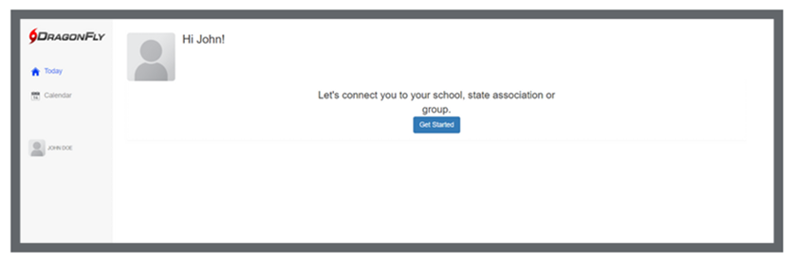
Creating an Account
You successfully have made an account. Now, let's get connected to VALLEY HIGH SCHOOL.

Slide 9
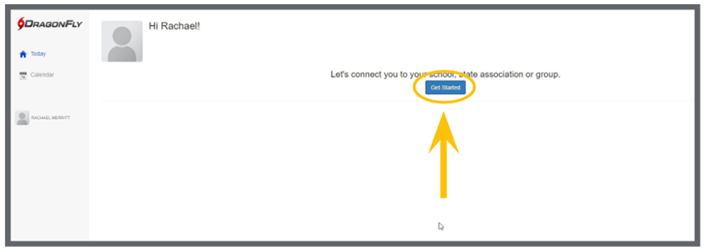
Connect to Highland High School
STEP 1: Click ‘Get Started’ on the ‘Today’ screen.

Slide 10
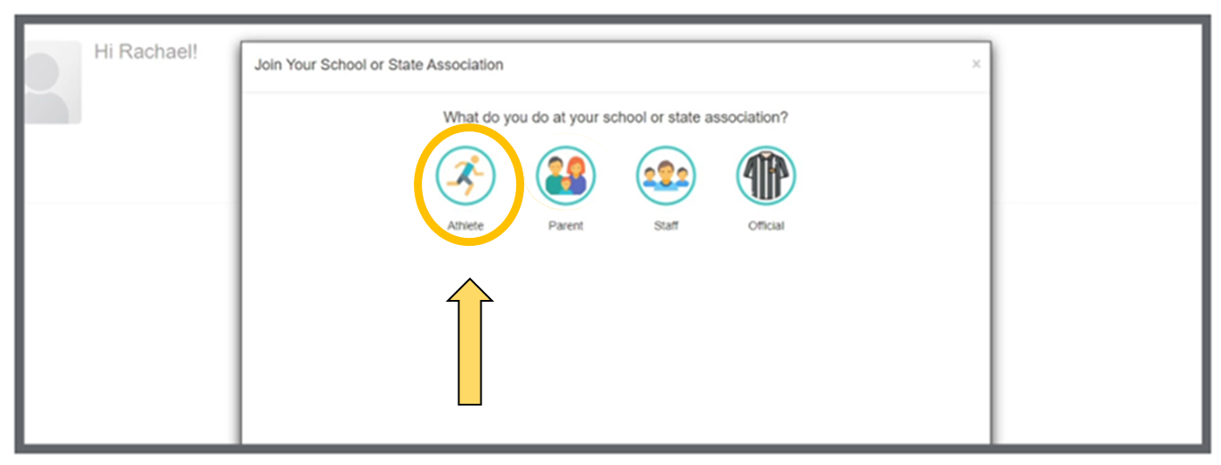
Connect to Highland High School
STEP 2: Follow the on-screen prompts and select ‘Athlete’ as your role.

Slide 11
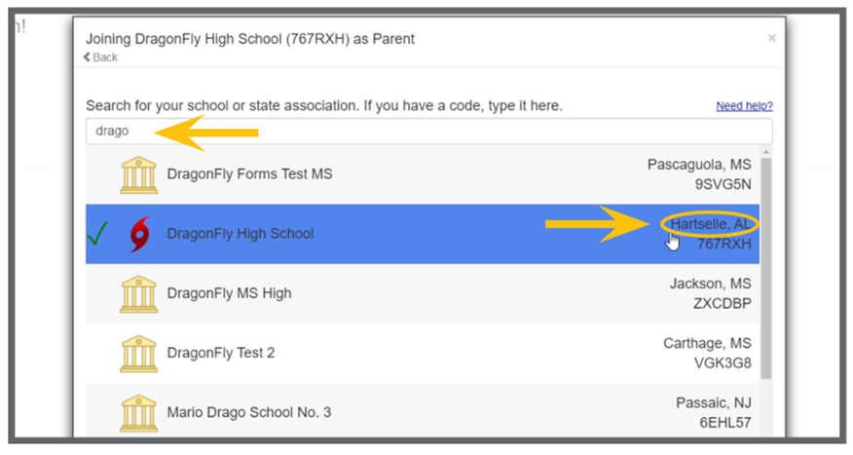
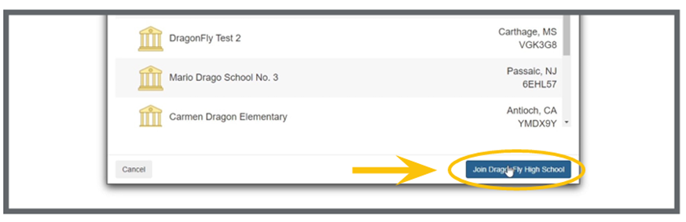
Connect to Highland High School
STEP 3: Next, type VALLEY HIGH into the search bar. Select VALLEY HIGH from the list. Double check the school’s location is Albuquerque, NM.

Slide 12
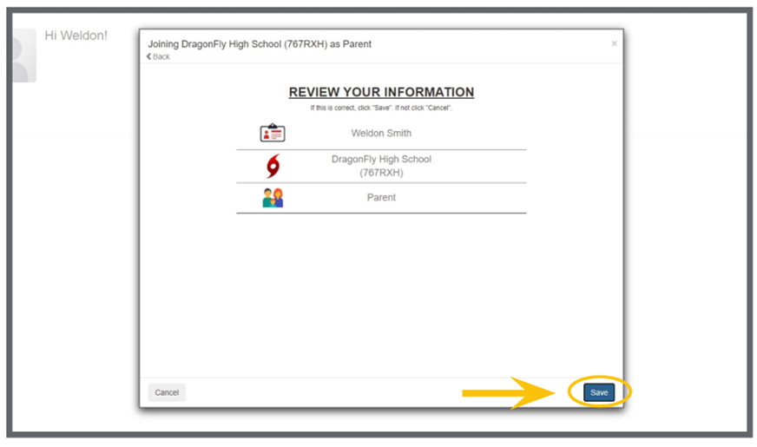
Connect to Highland High School
STEP 4: Select Valley High School, review your information, and tap the ‘Join’ button at the bottom of the screen.

Slide 13
Connect to Highland High School
You have successfully connected to Valley High School. Now, let's connect to your parent/guardian.

Slide 14
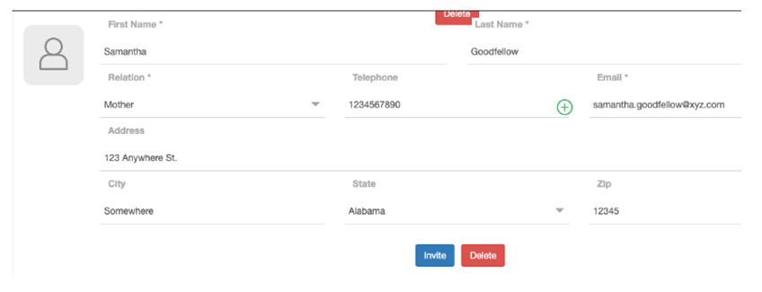
Connect to Parent/ Guardian
STEP 1: Log in to your account from a web browser. From the ‘Contact Info’ screen, scroll to the bottom of the page where you see ‘Parents and Emergency Contacts.’

Slide 15
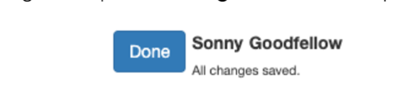
Connect to Parent/ Guardian
STEP 2: Enter the information for the parent/ guardian you want to invite. Save the information by scrolling back up to the top and clicking ‘Done.’

Slide 16
Connect to Parent/ Guardian
STEP 3: Scroll back to the bottom and click the ‘Invite’ button.

Slide 17
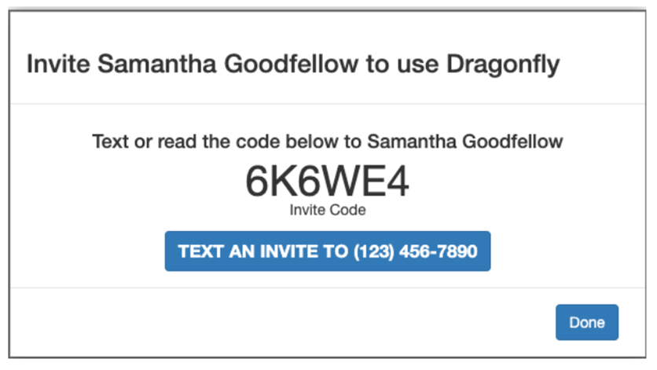
Connect to Parent/ Guardian
STEP 4: You will be given an invite code that you can share with your parent/guardian.

Slide 18
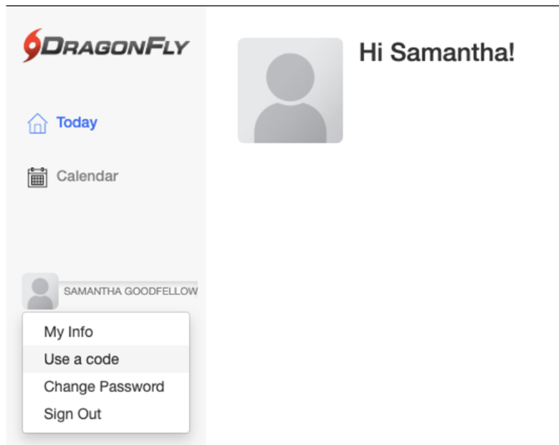
Connect to Parent/ Guardian
STEP 5: Have your parent/ guardian login to their account. On the left side of the screen click on Your Name and select “Use a code” from the dropdown.

Slide 19
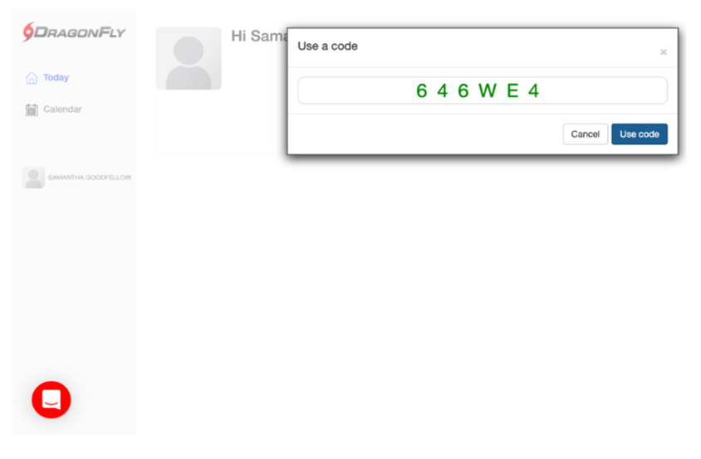
Connect to Parent/ Guardian
STEP 6: Enter the invite code you got from your child and click the ‘Use code’ button.

Slide 20
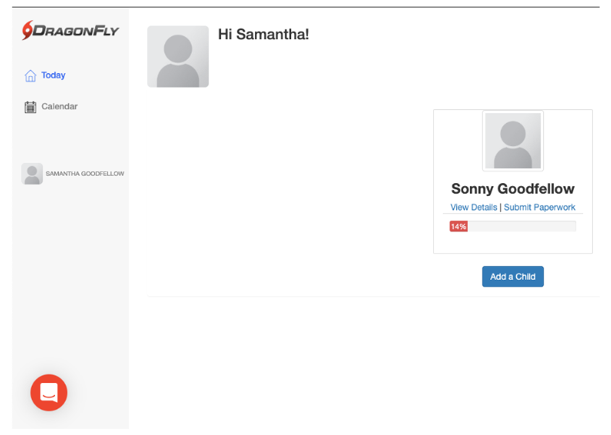
Connect to Parent/ Guardian
You are now linked to your child. Now, let’s start submitting forms!

Slide 21
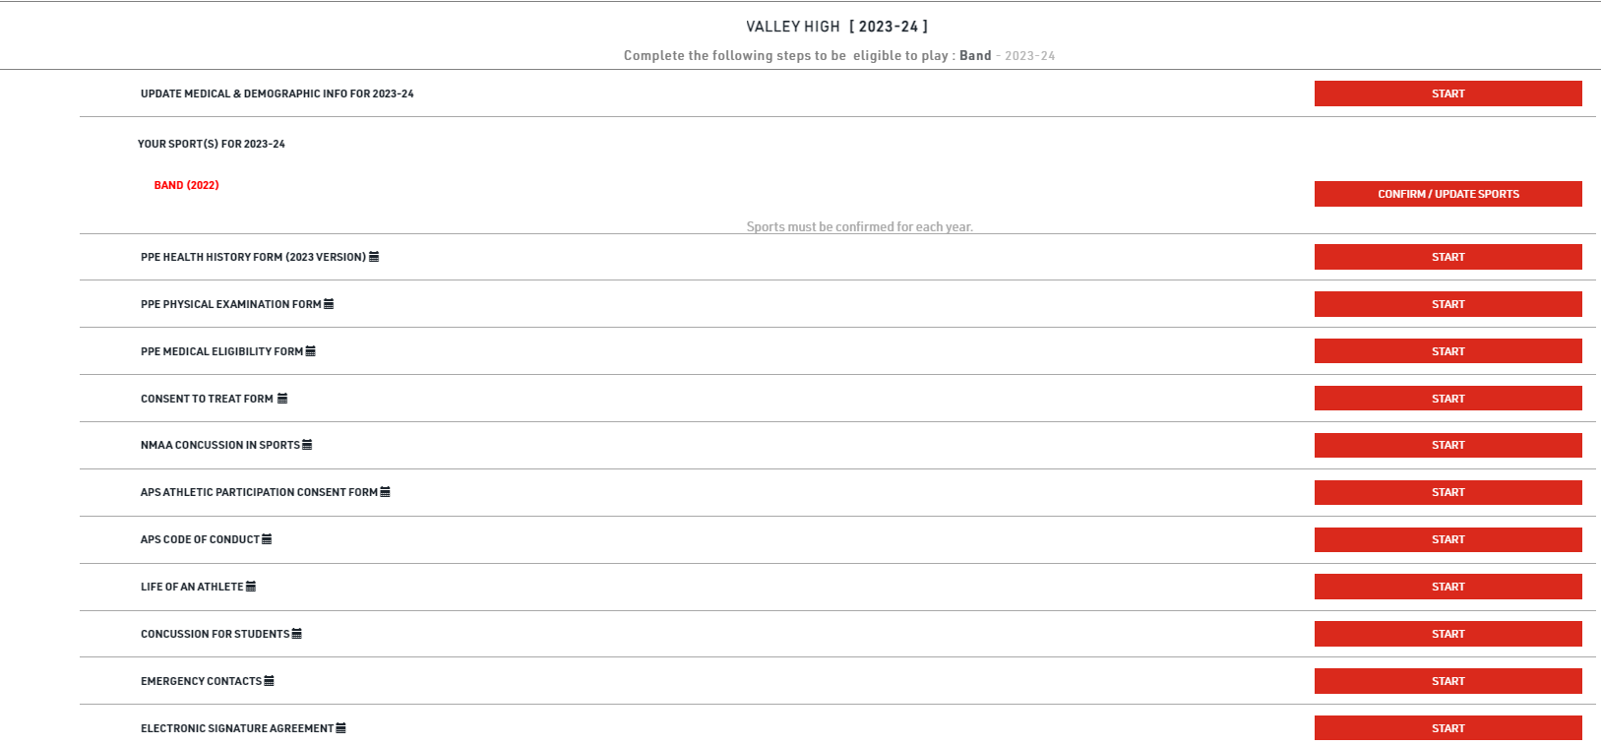
Filling out/Submit Forms
STEP 1: View the 2023-2024 requirements and click ‘start’ to begin.

Slide 22
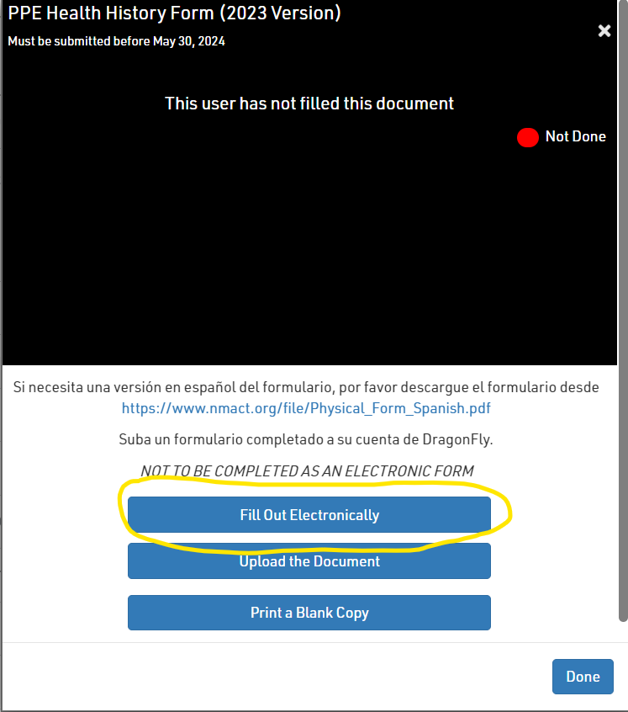
Filling out Forms
Filling out/Submit Forms
STEP 2:When you click Start on all links except for PPE Examination Form & PPE Medical eligibility form, you will see this screen pop up. Click on Fill out electronically to fill out all required forms electronically

Slide 23
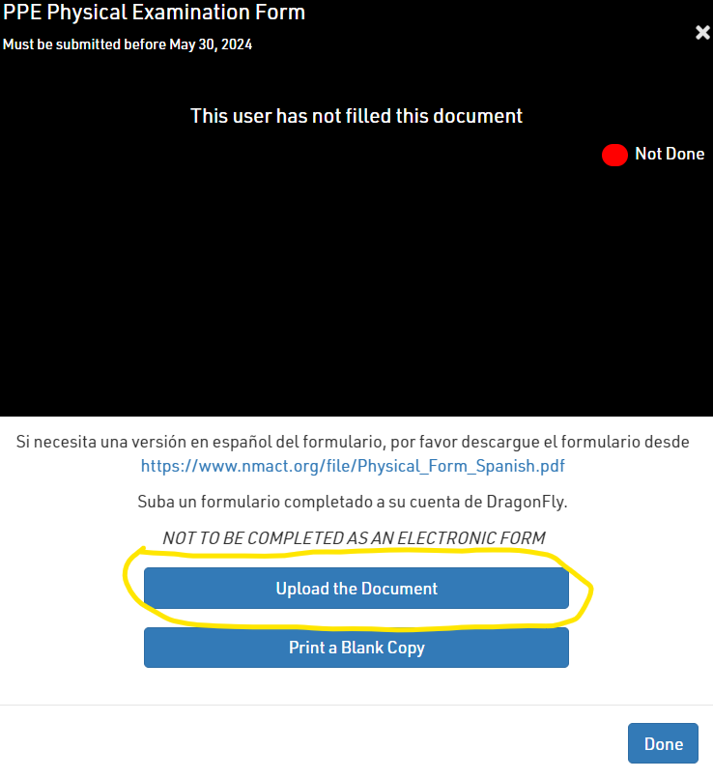
Submit Forms
To Submit PPE Examination Form and Medical Eligibility Form, Click ‘start’ and click on ‘upload document’ link. When submitting Please make sure to include a CLEAR PICTURE of the ENTIRE PAGE of any items that need to be uploaded.

Slide 24
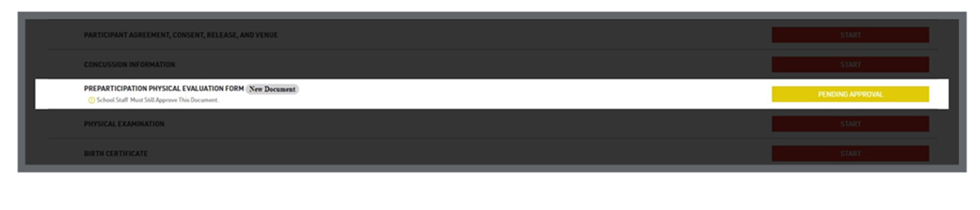
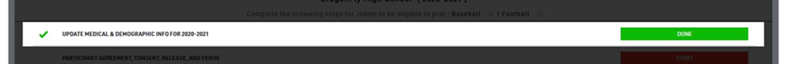
Submit Forms
As you complete each item, it will turn GREEN to show it has been completed an accepted or YELLOW to show it has been completed and is pending approval.
Athletes must be ALL GREEN in order to participate.

Slide 25
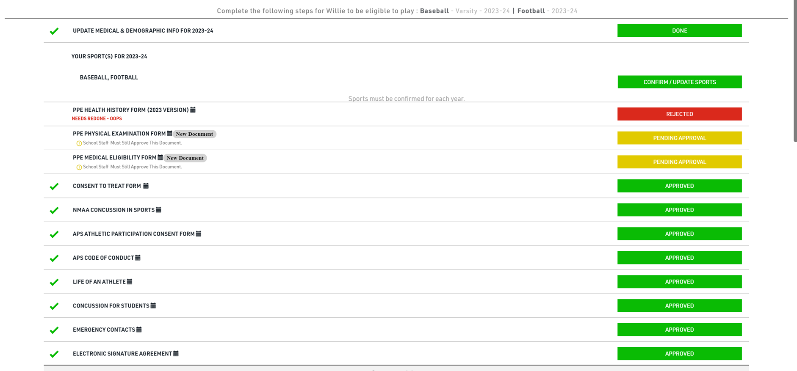
Submit Forms
This is what your profile will look like after completing requirements.
Items pending approval will be marked in yellow. Please allow at least 24 hours for review and approval.
If an item is rejected, an explanation of what needs to be one will show up in red.
All items shown in green, must be green to be eligible for the free physical event.

Slide 26

Submitting and Uploading Forms
Complete the following items before uploading your physical:
NMAA Requirements: CONSENT TO TREAT FORM, PPE Health History Form (2023 Version), NMAA Concussion in Sports (the other three forms will be completed at the physical.)
APS Requirements: APS Athletic Participation Consent Form, APS Code of Conduct, Life of an Athlete, Concussion for Students. Emergency Contacts, Electronic Signature Agreement.
Print the NMAA Physical Examination Form_Medical Eligibility Form
Upload completed physical form to DragonFly.
UPLOADED DOCUMENTS MUST SHOW THE FULL PAGE, NO CUT OFFS, AND BE A CLEAR IMAGE. BLURRY IMAGES WILL BE REJECTED.
Adobe Scan is a free app for IOS and Android that you can use to upload your physical as a pdf.

Slide 27
You only need to upload pages 5-6 of the physical packet.
Page 5: PPE Physical Examination Form
Page 6: PPE Medical Eligibility Form
THESE FORMS MUST BE APPROVED BY ATHLETIC TRAINER BEFORE YOU ARE CLEARED. PLEASE ALLOW AT LEAST 24-48 HOURS FOR RESPONSE.

Slide 28
Checking Eligibility
Student athletes are not able to participate in any APS athletic events, including tryouts, until all requirements have been met on DragonFly.
Once all requirements have been met, the athlete’s name will turn from red to black.
Student Name RED = NOT CLEARED
Student Name BLACK = CLEARED

