Slide 1
CVSD School Counseling Advisory Council
May 2020

Slide 2
Response to COVID-19
OPERATING UNDER TWO PREMISES
Importance of Social Emotional Learning: It’s important to provide social and emotional support to students during the most challenging times because it directly impacts their learning and how they view themselves in and navigate the world.
Power of Connection: Importance of maintaining engagement through communication and caring. Being part of school community fosters resilience in challenging, uncertain times.
HOW NEEDS ARE BEING MET?
Phone calls, emails, ZOOM meetings, resource distribution, letters to parents with tips

Slide 3
This year’s initiative: Meeting the Social/Emotional Needs of Our Students
Comprehensive Plan--339
Academic, Social/Emotional (Behavioral),
Career

Slide 4
School Counseling Programming
Tier 1: Universal Core Instructional Interventions
Preventative and Proactive
Tier 2: Supplemental/Strategic Interventions
Tier 3: Intensive/Individual Interventions

Slide 5
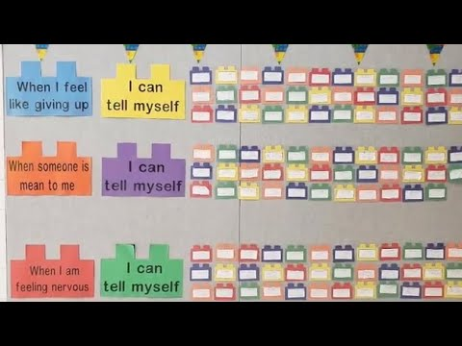
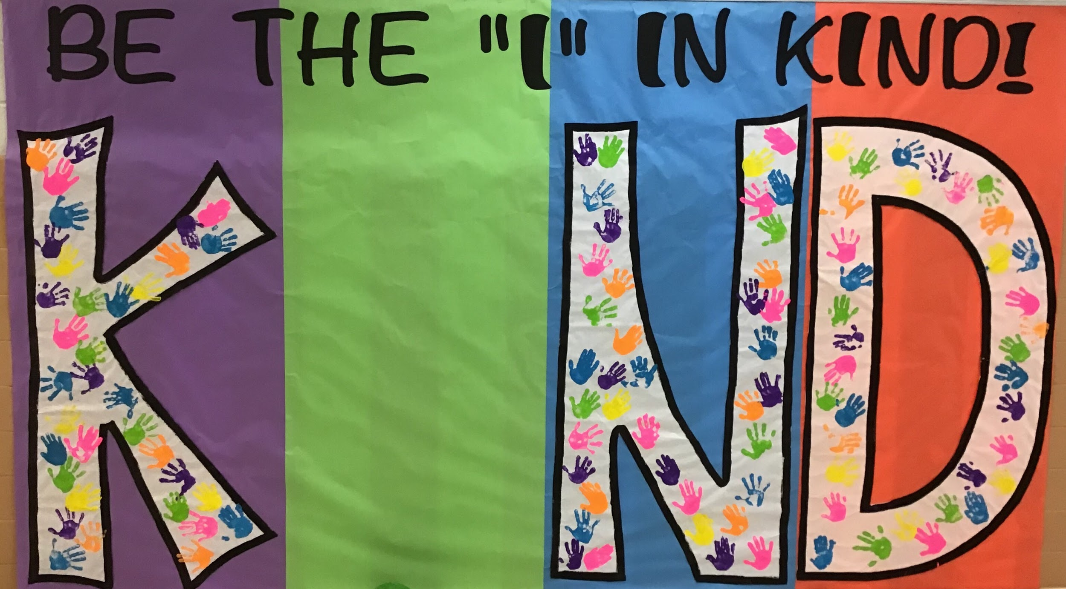
NOE/CTE
Tier I (approximately 1150 students)
Lessons regarding school wide expectations/Big 3 lessons -- all students
Core Essential lessons -- all students
Junior Achievement lessons -- all students Classroom Guidance Lessons focusing on Social Emotional Learning.
Tier II (approximately 150 students)
Small group sessions (4-8 sessions with 6-12 students) on topics defined by SRSS data
Check In/Check Out behavioral monitoring
Tier III (approximately 50 students)
Individual sessions (students who had more than 3 individual sessions)
School Based Counseling Services
Individual Positive Behavior Support Plans
A quick glimpse into a few of the emotional regulation skills discussed during our 2019-2020 school year.

Slide 6
CVIS
Tier I
Lessons regarding school wide expectations/P5 lessons -- all students (approximately 900 students)
Character Counts lessons -- all 4th grade students (300 students)
JA Biztown lessons -- all 6th grader students (300 Students)
Tier II
Small group sessions (4-8 sessions with 6-12 students) on topics ranging from friendship, divorce to emotional management (approximately 200 students)
Check In/Check Out behavioral monitoring (approximately 50 students)
Tier III
Individual sessions (students who had more than 3 individual sessions) (approximately 75 students)
School Based Counseling Services (approximately 25 referrals)
Daily Social Skills Lessons for Students in Colonial Academy (approximately 10 students)

Slide 7
NOMS
Tier I
Rachel’s Challenge-school wide kindness activities
Ox Strong Positive Behavior Rewards program
4-P lessons-school wide lessons on politeness, perseverance, preparation, participation in learning
Homework Club
Tier II
Saturday School Grade Recovery
Support Groups
Behavioral Plans-approximately 12 students
Student Support Team(SST)
Tier III
SAP (Student Assistance Program) -- approximately 35 referrals
School Based Counseling Services --approximately 15 referrals
Colonial Academy-- approximately 6 students
FBA / PBSP-approximately 20 students

Slide 8
NOHS
Tier I
Advisory lessons and activities -- all students (approximately 1,250 students)
Guidance Interview
Tier II
Freshman mentoring program (all freshman students & 70 upperclassmen)
Learning Center
Tutoring
SST (Student Support Team)
Behavioral Plans
Tier III
SAP (Student Assistance Program) -- approximately 65 referrals
School Based Counseling Services -- approximately 25 referrals
Colonial Academy-- approximately 10 students

Slide 9
THANK YOU!
Next Year’s Meeting Dates:
September 11, 2020
May 7, 2021

