Slide 1
CVSD School Counseling Advisory Council
September 2019

Slide 2
Welcome and Introductions
Parents
Teachers
Students
Administrators
Community Partners
Post High School Educators

Slide 3
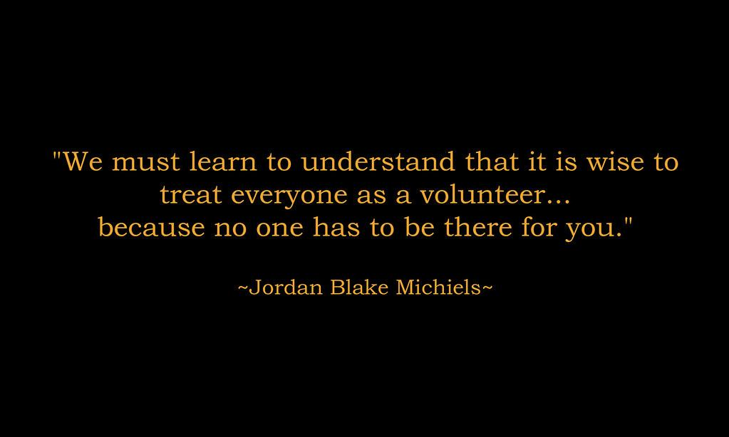


Slide 4
Building Updates
CTE
NOE
CVIS
NOMS
NOHS

Slide 5
Counselors’ Corner Topics for this Year
September--Organizational Strategies
October--Dangers of Vaping
November--Technology Update
December--Mindfulness
January-- CCTC
February--Self Management/Goal Setting
March--Developmental Stages
April--Resiliency

Slide 6
This year’s initiative: Meeting the Social/Emotional Needs of Our Students
Comprehensive Plan--339
Academic, Social/Emotional (Behavioral),
Career

Slide 7
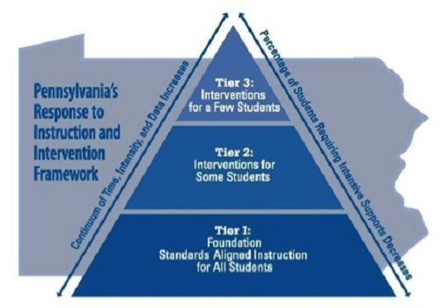
Traditional RTII Model

Slide 8
School Counseling Programming
Tier 1: Universal Core Instructional Interventions
Preventative and Proactive
Tier 2: Supplemental/Strategic Interventions
Tier 3: Intensive/Individual Interventions

Slide 9
Tier 1 Examples
NOE/CTE: School Wide Positive Behavior Support Program
(Core Essentials, Positive behavior recognition), Assemblies/presentations (Speak Up Be Safe, Mr. Yuk, Big 3, Core Values)
CVIS: Classroom lessons (Character Counts/BizTown), P5 lessons, Lessons regarding bullying
NOMS: Ox Strong Positive Behavior Support Program, Ox Strong Lessons, Safe2Say, Weekly SST meetings, Teens Need Teens student ambassadors
NOHS: Guidance Lessons, Classroom presentations, needs assessments, individual student interviews, Ox Strong Lessons, Weekly SST Meetings, Mentoring

Slide 10
Tier 2 Examples
NOE/CTE: Small group counseling, Check In/Check Out, Bus cards
CVIS: Small group counseling, Check In/Check Out, Buddies program, Homework Club
NOMS: Behavior Intervention Plans, Support Groups, HOPE Classroom
NOHS: Learning Center, Tutoring, Mentoring, SST, Behavioral Plans

Slide 11
Tier 3 Examples
NOE/CTE: Referrals to School Based Counseling, Positive Behavior Support Plans (PBSP), Communication logs, Skill replacement
CVIS: Colonial Academy lessons, Referrals to School Based Counseling, Referrals to SAP, Positive Behavior Support Plans (PBSP)
NOMS: Referrals to Student Assistance Program, Referrals to School-Based, Positive Behavior Support Plans, Colonial Academy Lessons, Psychological Evaluations
NOHS: Lifeskills Lessons, Colonial Academy, School Based Counseling, SAP, Crisis Intervention

Slide 12
SMART GOALS
Specific
Measurable
Attainable
Results-Oriented
Timebound

Slide 13
Discussion Per Building
Overarching Goal: To Meet the Social/Emotional Needs of Students in order to enable students to become competent, confident, and creative builders of the future.
Which tier does the intervention address?
What programs will ensure the completion of this goal?
What data would be important to consider?
What goal could be set regarding data?

Slide 14
THANK YOU!
Next Meeting Date:
May 8, 2020

