Slide 1
CVSD School Counseling Advisory Council
September 2018

Slide 2
Welcome and Introductions
Parents
Teachers
Students
Administrators
Community Partners
Post High School Educators

Slide 3


Slide 4
Counselors’ Corner Topics for this Year
September--Manufacturing
October--Career to Work Standards
November--Dealing with Loss
December--Safe Touch
January-- Mental Health/SAP
February--Keeping Students Safe
March--Financial Planning
April and May--To Be Announced

Slide 5
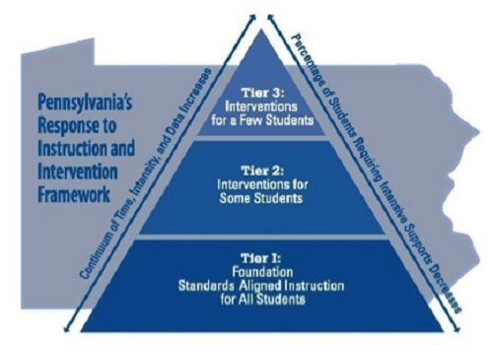
Traditional RTII Model

Slide 6
School Counseling Services
Tier 1: Universal Core Instructional Interventions
Preventative and Proactive
Tier 2: Supplemental/Strategic Interventions
Tier 3: Intensive/Individual Interventions

Slide 7
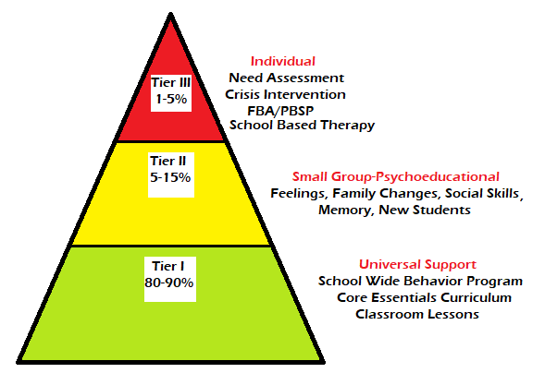
Elementary Programs:
CTE and NOE

Slide 8
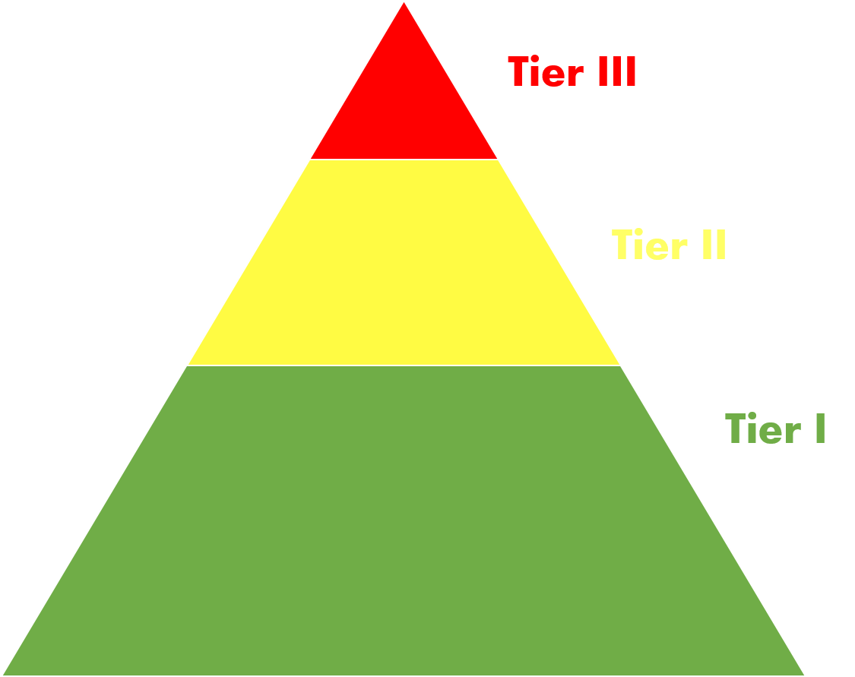
Individual (Tier 3)
Colonial Academy
FBA/BPP
School Based Counseling
Supplemental Interventions (Tier 2)
Small Groups (Divorce, Attendance, Self-Esteem, Friendship)
Check in/Check Out Program
Student Support Team
Universal (Tier 1)
Classroom Lessons/P5 Program
Conewago Valley Intermediate
Grades 4, 5 & 6

Slide 9
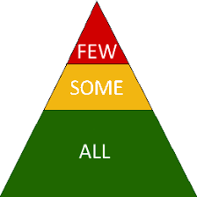
New Oxford Middle
Grades 7 & 8
FEW:HOPE classroom, Colonial Academy, FBA/PBSP
School Based Counseling, SAP
SOME: Support groups, BIPS, SST
ALL:Ox Strong, Guidance Lessons
(career exploration)

Slide 10
New Oxford High School
LSS, Colonial Academy,
School Based
Counseling,
SAP, Crisis Intervention
Learning Center, Tutoring,
Mentoring, SST
Guidance Lessons, Classroom Presentations,
Career Plan Needs Assessment, Individual Grade Level Interviews
Notes:
Parents-
Info that you would like to know? What is going on?? Events.
How can we get you that info? Twitter; encourage parents to be more involved with social media so they are seeing our updates. Start at younger ages because those parents are usually more involved. Train the parents at the beginning of students entering the district about checking website, social media. Photos on the wall to communicate about events (have guidance also be posting things). Send papers home and not emails.

Slide 11
This year’s initiative: Meeting Career to Work Standards
Sharing of Standards
Comprehensive Plan--339

Slide 12
Discussion Topics
Regarding the Career Education and Work Standards:
What information would be helpful to share with each stakeholder group?
Teachers
Parents
Students
Administrators
Community Partners
Post High School Educators
How can we best share this information?

Slide 13
May 10th
THANK YOU!
Next Meeting Date:

