Slide 1
Accommodations for ELLs
Krum ISD
2015-2016

Slide 2
Kinds of Accommodations for ELLs
Affective
Linguistic
Cognitive
504
IEP

Slide 3
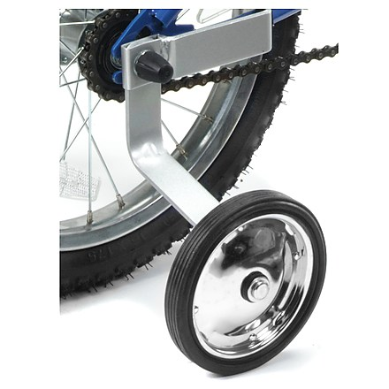

What are linguistic accommodations?
Linguistic accommodations are language supports that decrease the language barrier ELLs experience when learning and demonstrating knowledge and skills in English.

Slide 4
Linguistic Accommodations
Examples:
  Provide sentence stems for oral participation
  Allow use of drawing when writing
  Allow use of native language
    Bilingual dictionary
    Peer translation
  Extra time to complete assignments
  Pre-teach vocabulary with pictures
  Clarify the meaning of an unknown word using pictures, simple language, or gestures.
  etc.

Slide 5
Why Linguistic Accommodations?
The Texas English Language Proficiency Standards (ELPS) require all teachers to linguistically accommodate the instruction of ELLs in their classes commensurate with the students’ English language proficiency levels.

Slide 6

What does this mean?
Unlike with 504 or IEP accommodations, the teacher is expected to change linguistic accommodations over time, as he/she sees how the ELL student improves his/her English language skills. No LPAC meeting is required to change these accommodations. However, the teacher can ask for the support of LPAC committee or members of the LPAC.
Cho Chang
L. Accommodations for
writing in classroom.
Beginner Beginner Intermediate
writer writer writer
BOY
Allow drawing in her writing.
MOY
Use of simple sentence stems and allow use of native language.
EOY
Use of high-frequency word list and bilingual dictionary.

Slide 7
How do I Assign Linguistic Accommodations?
ELPS Training
TELPAS Training
Use your PLD’s throughout the year!

Slide 8
Proficiency Level Descriptors (PLDs)
The PLDs are the rubrics teachers use to determine students’ English language proficiency for ongoing formative assessment and the spring TELPAS administration.
Originally developed for TELPAS, the PLDs were incorporated into the Texas English language proficiency standards (ELPS) in the 2007–2008 school year to reinforce their use in instruction.
Notes:
The TELPAS holistically rated assessments were developed by TEA in collaboration with test development contractors, bilingual/ESL consultants, and a focus group of teachers, bilingual/ESL coordinators, test coordinators, and university professors.
The design of the assessments derives from the following language acquisition research and research-based standards, models, and assessments:
second language acquisition research of Jim Cummins concerning the
development of BICS and CALP
TESOL (Teachers of English to Speakers of Other Languages) ESL
standards
ACTFL (American Council for the Teaching of Foreign Languages)
proficiency guidelines and the ACTFL Performance Guidelines for K–12
Learners used in Texas LOTE (languages other than English) programs
similar assessment strategies used in other states

Slide 9
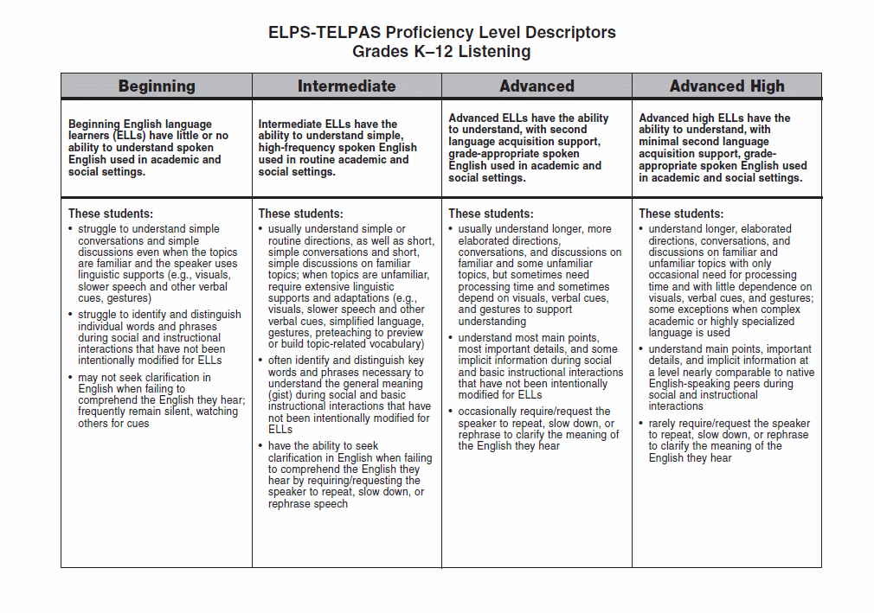
ELPS-TELPAS Proficiency Level Descriptors Grades K–12 Listening
Notes:
The PLDs for each language domain present a set of major attributes associated with each level. The descriptors do not constitute an exhaustive list but are sufficient for identifying students’ stages of English language proficiency. Together, the summary statement and bulleted descriptors for each proficiency level form a student profile.
Review the full-size listening PLDs, and note the overall English communication abilities described in the summary statement for each level.
B little or no English
I simple, high-frequency, routine
A grade-appropriate with second language acquisition support
AH grade-appropriate with minimal second language acquisition support
Examine the main features of each level. Note how the descriptors further define the summary statements and show the continuum of English language development across the proficiency levels.
1st descriptor: type of spoken English understood and extent to which
understanding is dependent on supports and linguistic adaptations
2nd descriptor: degree of comprehension demonstrated when interactions are not
modified to include supports and linguistic adaptations
3rd descriptor: degree of need to seek clarification to understand or confirm meaning
of spoken English
In the context of second language acquisition, the term “high-frequency words” refers to commonly encountered words that a student who knows very little English can be made to understand through context, gestures, and pictures. Initially, the kinds of high-frequency words and phrases typically acquired may include, for example, greetings, numbers, objects in the classroom and around school, names of classmates, etc.
When rating a student, read each proficiency level as a whole (i.e., the whole vertical column as opposed to isolated descriptors) and determine the level that best describes the student’s current, overall level of English language acquisition.

Slide 10
Sets of PLDs
Listening Grades K–12
Speaking Grades K–12
Reading Grades K–1
Grades 2–12
Writing Grades K–1
        Grades 2–12
Notes:
In alignment with the ELPS, TELPAS evaluates English language acquisition as it relates to grade-level expectations for understanding and using English to meaningfully engage in content area instruction.
The sets of PLDs are often referred to as rubrics for purposes of TELPAS. There is one K–12 rubric for listening and one K–12 rubric for speaking. Raters consider a student’s listening and speaking proficiency levels in relation to the typical listening and speaking abilities of native English speakers at the student’s grade level.
For reading and writing, there are separate rubrics for K–1. The K–1 rubrics are distinct because factors associated with emergent literacy distinguish K–1 learners from students in higher grades.
For grades 2–12, teachers use the reading PLDs in instruction but not for TELPAS, because TELPAS has a multiple-choice test for these grades.
ELLs receiving special education services should be evaluated relative to their ability to understand and use English to access the general curriculum at their enrolled grade in accordance with their IEP. This assessment guideline aligns with federal requirements for ensuring that students with disabilities have access to the general curriculum.

Slide 11
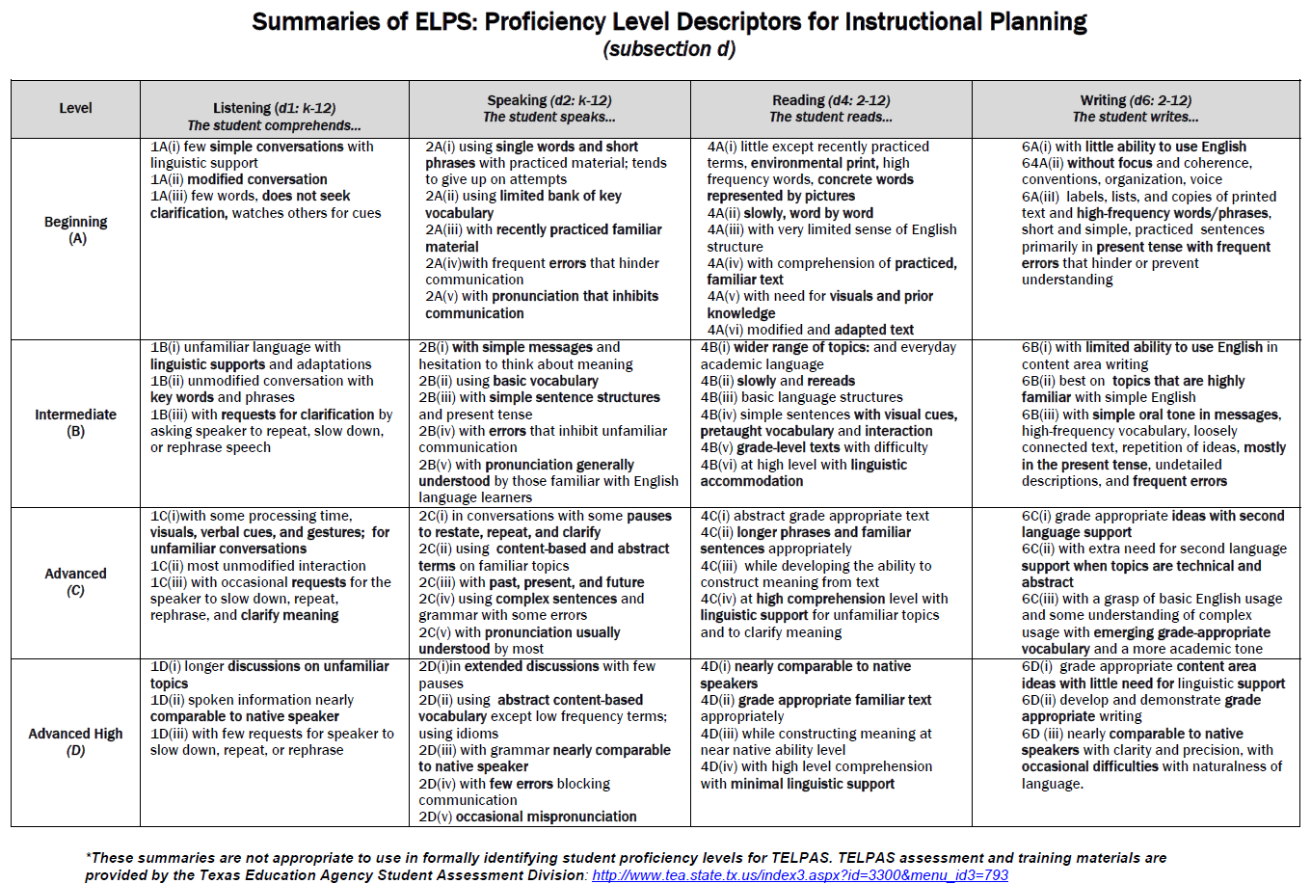

Slide 12
Key Features of Each Proficiency Level
Beginning
  Little or no English ability
Intermediate
  Limited ability, simple language structures,
  high-frequency vocabulary, routine contexts
Advanced
  Grade appropriate, with second language acquisition support
Advanced High
  Grade appropriate, with minimal second language acquisition support
Notes:
This slide summarizes key features of the PLDs in terms of how well ELLs can understand and/or use English in social and academic settings at each of the four levels. These key features are emphasized in the PLD summary statements for each language domain. As an example, refer to the summary statements at the top of the PLDs for listening.
Note the term second language acquisition support. This term refers to the language assistance ELLs need as they learn English. It is different from the type of assistance that any student (whether an ELL or not) might need when learning academic content. Second language acquisition support is specific to the unique language assistance that ELLs need.
The overall language abilities of each proficiency level are as follows:
Beginning students have little or no ability to understand/use English. They may know a little English but not enough to function meaningfully in social and academic interactions.
Intermediate students do have some ability to understand and use English. They can function in social and academic settings as long as tasks require them to understand and use simple language structures and high-frequency vocabulary within routine contexts.
Advanced students are able to engage in grade-appropriate academic instruction in English, although ongoing second language acquisition support is needed to help them understand and use grade-appropriate language. These students function beyond the level of simple, routinely used English.
Advanced high students have attained the command of English that enables them, with minimal second language acquisition support, to engage in regular, all-English academic instruction at their grade level.
Note that high academic achievement is not a prerequisite of the advanced high level of English language proficiency. Advanced high ELLs exhibit a range of academic achievement just as their native English-speaking peers do.

Slide 13
So, what should I do?
Look at BOY accommodations
Look at last year’s TELPAS results
Use PLD’s to see if student has made progress.
Adjust linguistic accommodations if needed.
Record new linguistic accommodations.

Slide 14
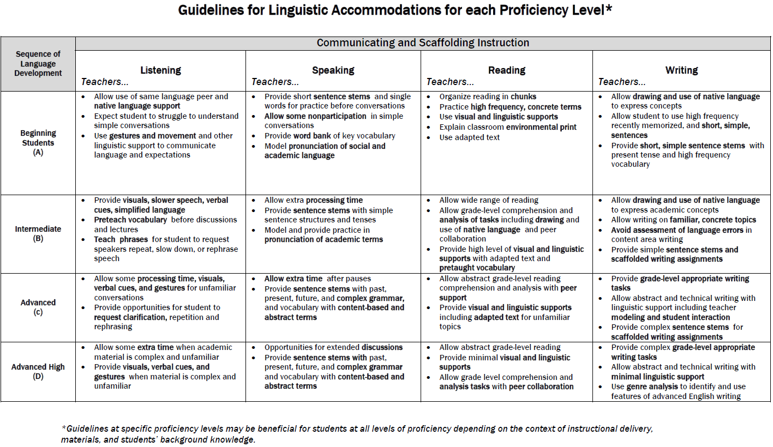

Slide 15
