Slide 1
Welcome to Curriculum Night

Slide 2
School-wide Expectations
Exhibit Picadome PRIDE in all areas
  Classroom, Cafeteria, Playground, Hallway, and Specials Classrooms
PRIDE
  Purpose
  Respect
  Integrity
  Determination
  Excellence

Slide 3
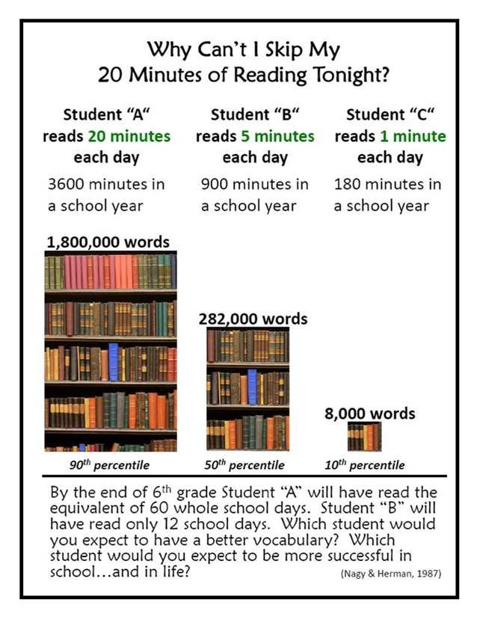

Slide 4
Team-wide Expectations
Being at school on-time each day
Reaching iReady Math and iReady Reading goals each week
Being prepared with necessary materials every day
Reading 20 minutes each evening

Slide 5
Assessments
Classroom Assessments
  Formative
  Summative
  Fayette County Common Assessments
MAP Test
  Fall and Spring (only twice this year)
  Students should reach their “goal” by the spring test

Slide 6
Assessments
KPREP
  Given in May
  Results available the following Fall
  5th grade is tested in:
    Math
    Reading
    Social Studies
    On-Demand Writing

Slide 7
Grading/Conferences
4 nine weeks
One conference in the fall, one in the spring
Report Cards
  October 28
  January 15
  March 23
  May 26 (or last day of school)

Slide 8
Movement
Recess
Go Noodle
Kagan Structures
Class Discussions

Slide 9
Field Trips
Toyota
  Fall
National Underground Railroad Freedom Center
    March
Bowling (Or Another “Fun” Field Trip)
    Second to last day of school

Slide 10
Curriculum

Slide 11
Math
Operations and Algebraic Thinking
Number and Operations in Base Ten
Number and Operations- Fractions
Measurement and Data
Geometry

Slide 12
English/ Language Arts
Reading
Writing
Language
Speaking and Listening
Technology

Slide 13
Social Studies
Geography
Native Americans
Exploration
Colonialism
Revolutionary War
Government and The Young Republic
Westward Expansion
The American Civil War
Industrialization
The 20th Century
Economics

Slide 14
Any Questions?

