Slide 1

Welcome to
Curriculum Night!
Ms. Cheesman, Ms. Housman, Mrs. McQueary, and Ms. Schumacher
Notes:
‹#›

Slide 2

Classroom
Management
In 2nd Grade, a child’s daily behavior is monitored by our “Behavior Clip/Slide Chart”. Each child is expected to follow our school’s Picadome P.R.I.D.E and specific classroom rules. Throughout the day the children “clip up/clip down” depending on the choices he/she makes.
Wow
Outstanding
Excellent Choices
Ready to Learn*
Think About It
Make Better Choices
Stop
Parent Contact

Slide 3

Literacy Homework
Your child receives a weekly Picadome Reading Log. All logs will be sent home on Monday and need to be returned the following Monday. Please see the due date in the top right hand corner.
Our Picadome expectation is that children read for at least 20 minutes per night (5 days a week).
At least 100 minutes per week.

Slide 4


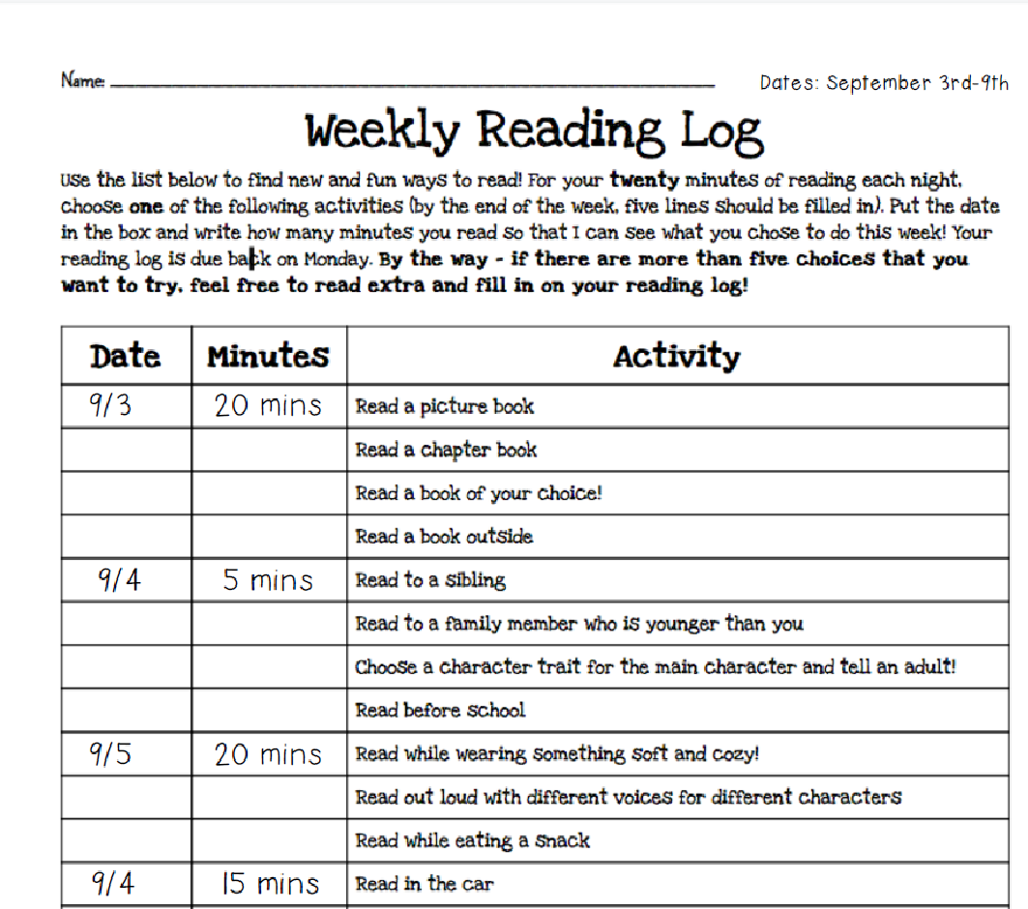
Weekly
Reading Log

Slide 5

Reading
Helpful Hints for Reading Sessions
Periodically listen to your child read a story/chapter.
Ask questions about the text (Who were the main characters?, What was the main character’s problem?, How did the main character solve the problem?, What happened in the beginning, middle, and end of the story?, or Retell the story events with a lot of detail.).
Encourage your child to self-correct and reread for meaning.
Work on decoding skills and building reading fluency.
Reading sessions should be for 20 minutes (5 days a week). Increase to longer sessions as the year progresses.
Reading sessions will increase to 25 minutes (5 days a week) in January.

Slide 6

Literacy
Unit 1 ~ Friends and Family
Unit 2 ~ Animal Discoveries
Unit 3 ~ Building Bridges with Unlikely Friends
Unit 4 ~ A Long Journey to Freedom
Unit 5 ~ Our Life, Our World
Unit 6 ~ Let’s Make a Difference

Slide 7

Writing
The children have an opportunity to write daily.
Building a foundation for writing through the 6 + 1 writing traits.
~ Ideas
~ Organization
~ Voice
~ Word Choice
~ Sentence Fluency
~ Conventions
~ Presentation

Slide 8

Mathematics
At Picadome Elementary we teach math concepts directly correlated to the Kentucky Academic Standard Mathematics (KASM). We use a variety of resources to supplement our math program. One program utilized is Investigations.
We will include the content for each unit in our monthly newsletters. It will also include important concepts that need to be mastered for unit proficiency.
In addition, your child participates in Every Day Counts Calendar Math, which addresses a number of math concepts each day and is aligned with the KASM.
Finally, students use the following math program, that can be utilized for at-home use.
iReady Math

Slide 9
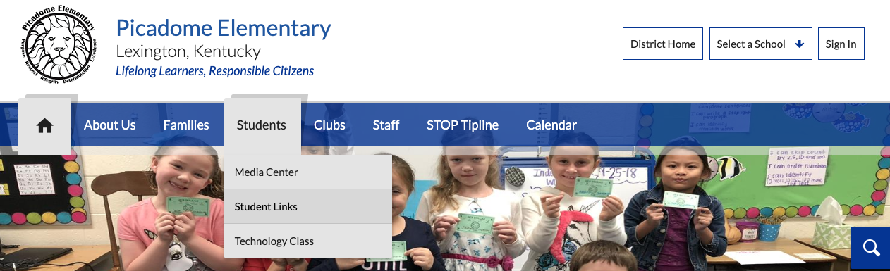
iReady
If your child has earned extra screen time, iReady Math and iReady Reading are available on the Picadome Website. These resources are complimentary for students to have additional practice for at-home use.
Steps to access iReady:
Step 1: Go to the Picadome Website.
(Picadome.fcps.net)
Step 2: Go to the Student Links

Slide 10
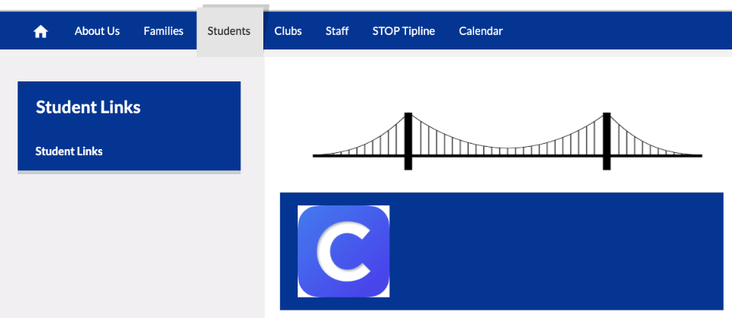
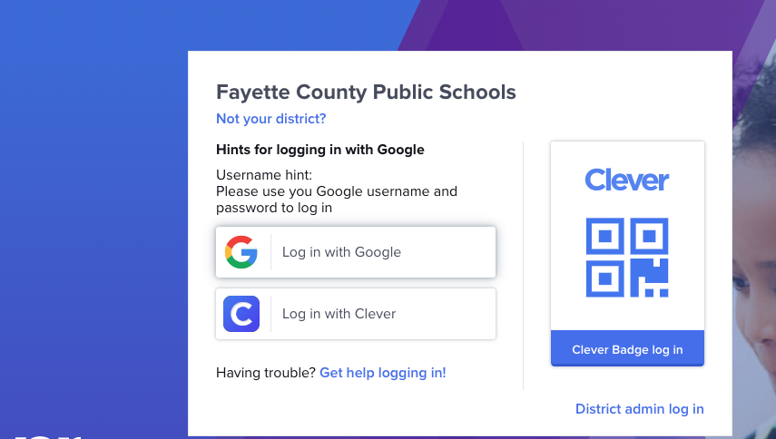
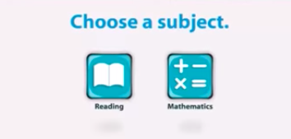
Step 3: Click on the “C” to access Clever.
Step 4: Click Log- In with Google
Step 5: Choose a subject

Slide 11

Make-Up Work
Work missed due to an absence, will be given to students on his/her first day back to school and should be returned within 2-5 days.
All parent &/or doctor notes need to be received within three days of the student’s return to school.

Slide 12


Primary Progress
Reports
Primary students will be assessed via Primary Progress Reports on nine week periods. The dates on which you should expect to see progress reports coming home with your child are as follows:
October 28, 2019
January 15, 2020
March 23, 2020
Last Day of School

Slide 13


Student Conferences
Conferences are held twice a year, once every fall and spring period.
We will begin scheduling our fall conferences in October.
We do our best to meet at times that are convenient for you, but schedule our times on a first come, first serve basis. The first conference forms that are returned will receive their top priority from the available time slots.
As a reminder, at Picadome Elementary, our Spring meeting will be a Student-Led Conference.

Slide 14


Movement
Throughout the school day, students have various opportunities for movement and brain breaks.
Some of our favorites include: GoNoodle, Recess, Kagan Activities, Literacy and Math Rotations, and a stretch break.
Let’s Practice! Find personal space ☺
I Get Loose

Slide 15


Field Trips
Living Arts and Science Center
Lexington Children’s Theatre ~
The Princess and the Pea
Safety City

Slide 16

Thank you for attending Curriculum Night!
You will receive the sign-up sheet for fall conferences towards the end of September. We look forward to meeting with you to discuss the specific behavioral and academic progress of your child.
Our delightful PTA Board is in the library tonight to meet you and tell you all the wonderful activities they have planned for the year. Please consider joining the PTA for $6.00.
Finally, our Specials Teachers are located
in the library and look forward to meeting
you!

