Slide 1

The ABC’s of Kindergarten
Picadome Curriculum Night 2019-2020

Slide 2
A is for arrival
Classroom Check in
Breakfast by 7:30
7:45 School Day Begins

Slide 3
B is for Behavior Management
Color system is K-2

Slide 4
C is For clothing
Extra clothing in backpack if needed
Appropriate clothes for change of seasons
Wear shorts under dresses

Slide 5
D is for Dismissal
Any change of transportation needs to be written and sign by a parent
If dismissal involves another student, both students need a note

Slide 6
E is for Expectations
Be here and ready to learn
Quality work
Follow Picadome Pride

Slide 7
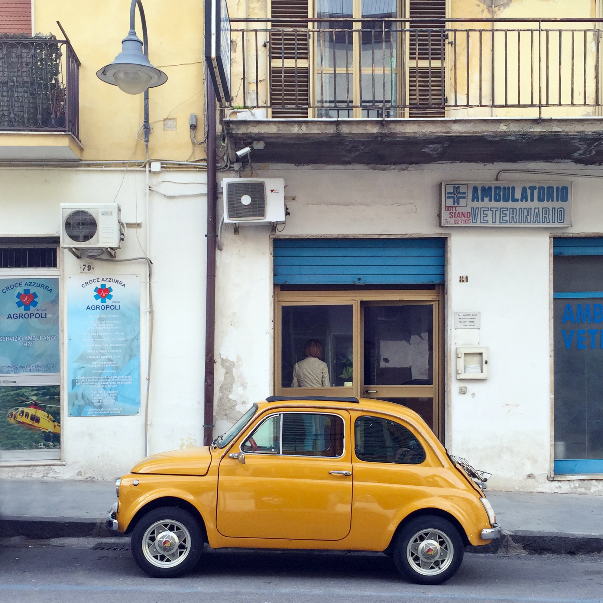
F is for field trips
MUST have Signed permission slip
Chaperones when needed
3 Field Trips planned:
  Two Plays to the Lexington Children’s Theatre
  Louisville Zoo

Slide 8
G is for guided reading
Flexible ability grouping
Includes…
  Working with letters/sounds (if necessary)
  Sight word review
  Reading with prompting and discussions
  Word study
  Guided Writing

Slide 9
H is for Homework
Reading log
20 minute daily reading
  Picture walk
  Siblings/grownups
reading to them
  Read to self
Return green folder on the last day of the week
Color one picture per reading session

Slide 10
I is for independence
Our goal is to have your child be as independent as they can by the time they reach first grade
  Please practice this at home

Slide 11
J is for Join the PTA
PTA is our parent Teacher Association that supports student achievement

Slide 12
K is for Kindergarten
High expectations for all of our kindergarteners academically and behaviorally

Slide 13
L is for letter of the day
Our curriculum is set up on cycles on how to introduce letters in variety of ways.
Different letter activities throughout the year

Slide 14
M is for money
Some classrooms use kindergarten cash to monitor behavior expectations
Whole school uses Den Dollars for positive reinforcement when students display Picadome Pride

Slide 15
N is for notes
Absences: Either need a doctors/ written grown up note within three days of the absence for it to be excused
Behavior: If your child receives a behavior note/email please respond to email or sign and return note
Transportation: Any change of transportation needs to be written and signed by a parent

Slide 16
O is for open Communication
Please check blue folder daily! This is used for communication
Make sure to sign up for remind!

Slide 17
P is for Pride
Purpose
Respect
Integrity
Determination
Excellence

Slide 18
Q is for questions
diane.littleton@fayette.kyschools.us
jeanne.elam@fayette.kyschools.us
victoria.groebner@fayette.kyschools.us
kathryn.briganti@fayette.kyschools.us

Slide 19
R is for Recess
School playground rules vs. park rules
Appropriate clothing for recess
Go Noodle (multiple Movement Breaks!)
  We go outside daily. even in the winter!

Slide 20
S is for specials
Not a daily rotation, but a 5 day rotation
Science, P.E, technology, art, music

Slide 21
T is for Technology
Use technology daily in the classroom and can use it at home
Need a working set of headphones

Slide 22
U is for usernames & passwords
The program we use will be iready
Usernames and passwords will be coming home

Slide 23
V is for voice levels
Schoolwide voicelevels

Slide 24
W is for word of the day
30 Kindergarten sight words

Slide 25
X is for eXcited
We are excited and looking forward to working with your child this year

Slide 26
Y is for You
You are your child’s teacher for life!!

Slide 27
Z is for z end!
Thank you for coming!

