Slide 1
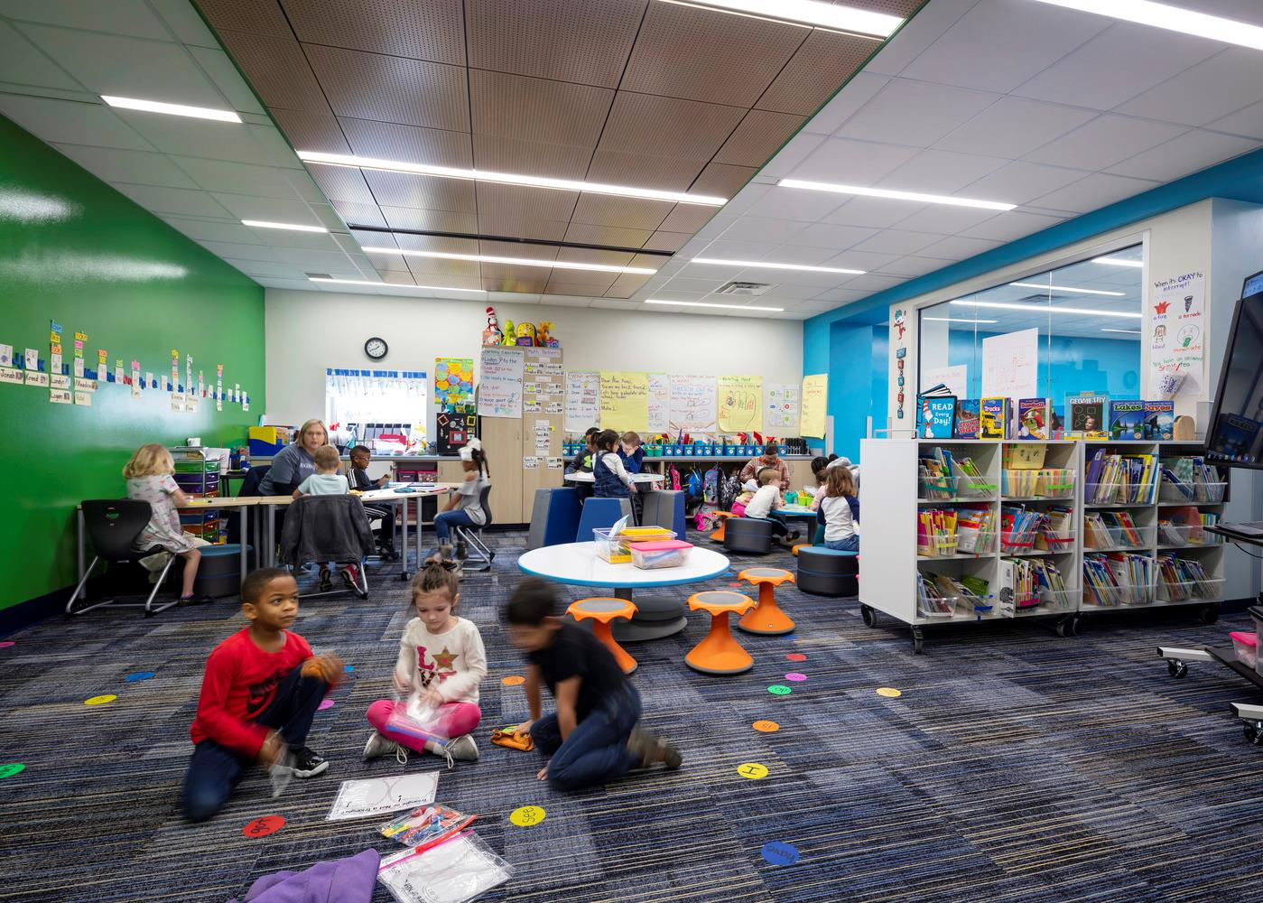


Long Range Planning –
Construction Cost Update
TEXARKANA ISD
May 19, 2022

Slide 2
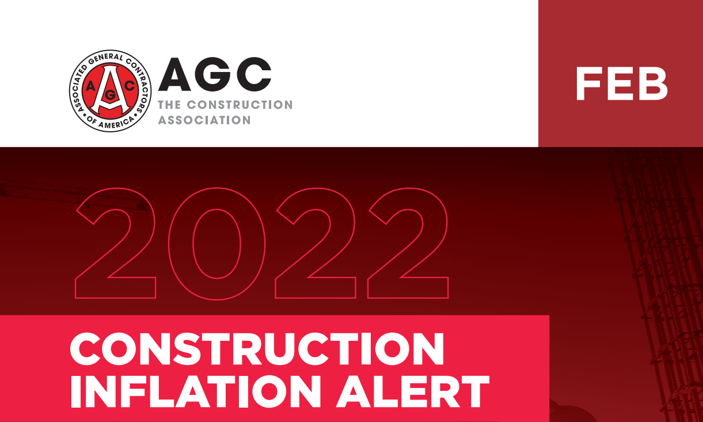
Construction Cost Update - 2022

Slide 3
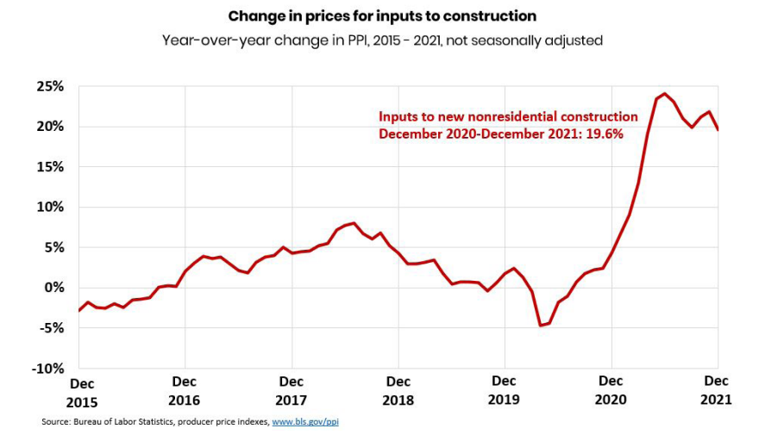
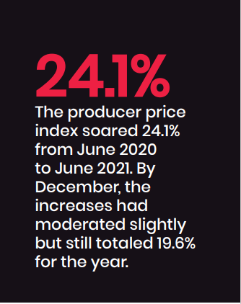
Construction Cost Update - 2022

Slide 4
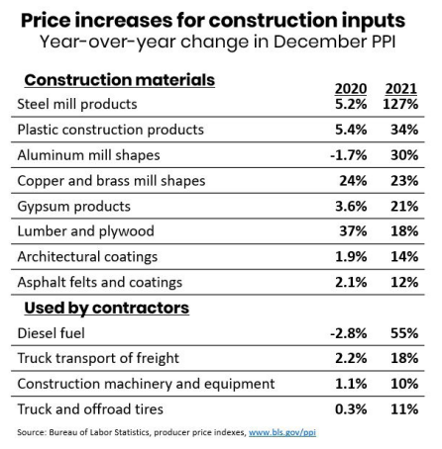
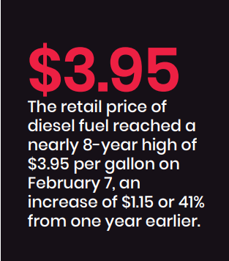
Construction Cost Update - 2022
$5.25

Slide 5
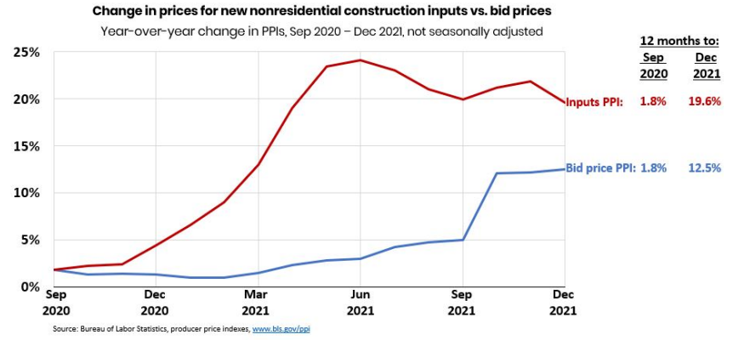
Construction Cost Update - 2022

Slide 6
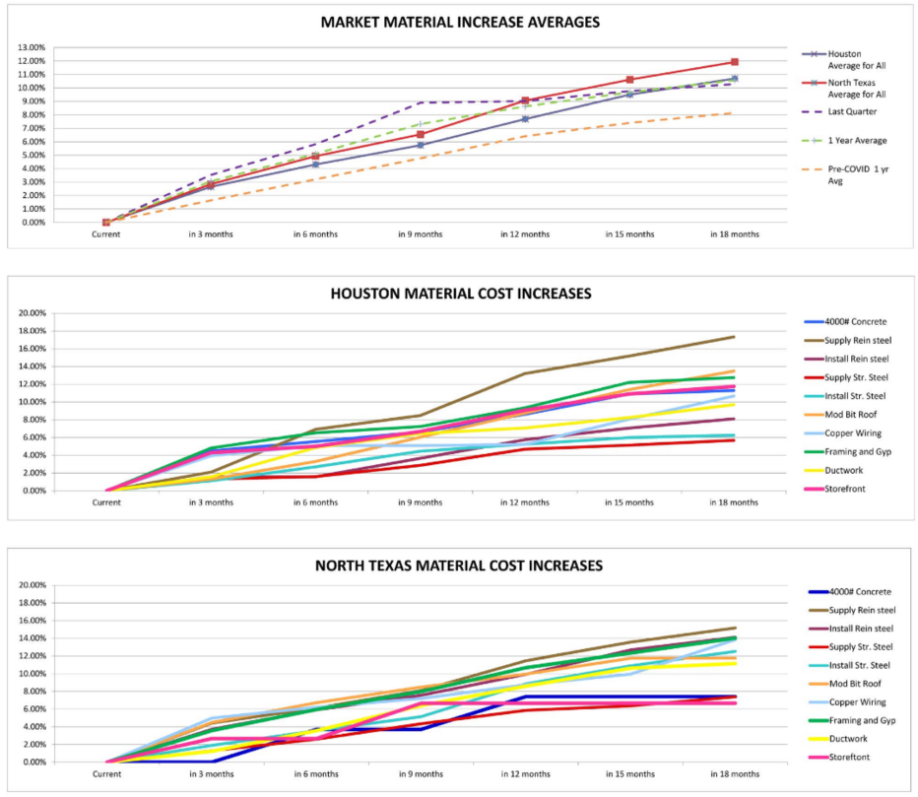
Construction Cost Update - 2022

Slide 7
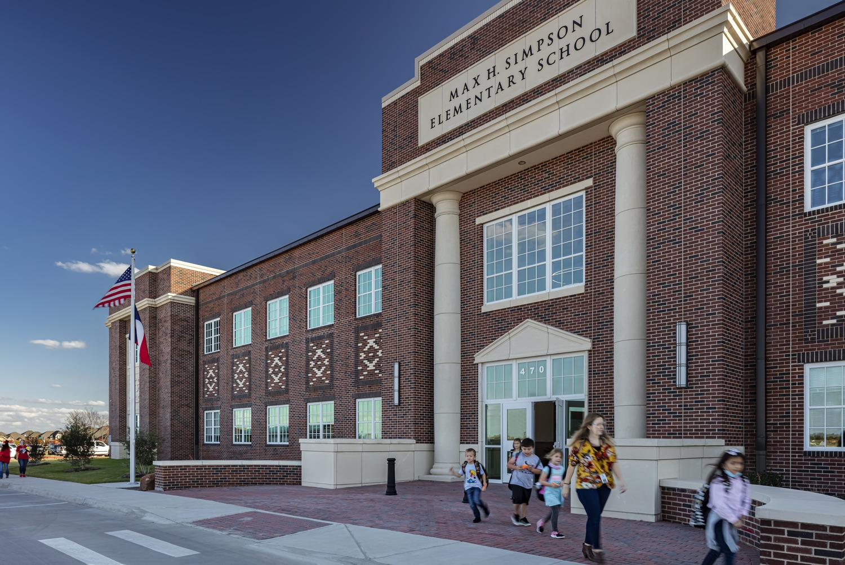
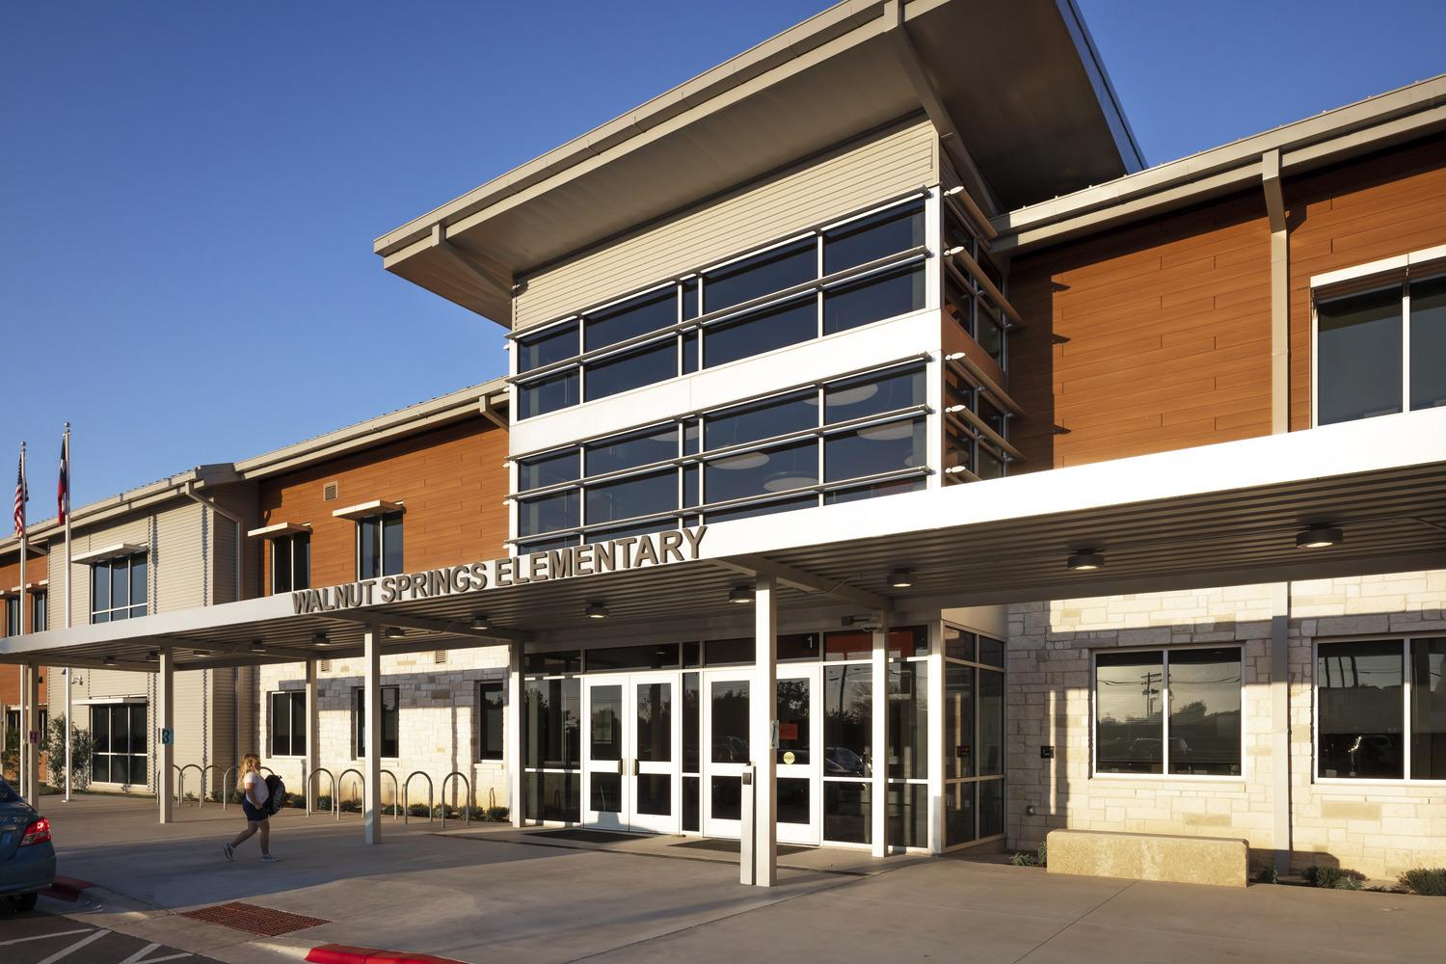
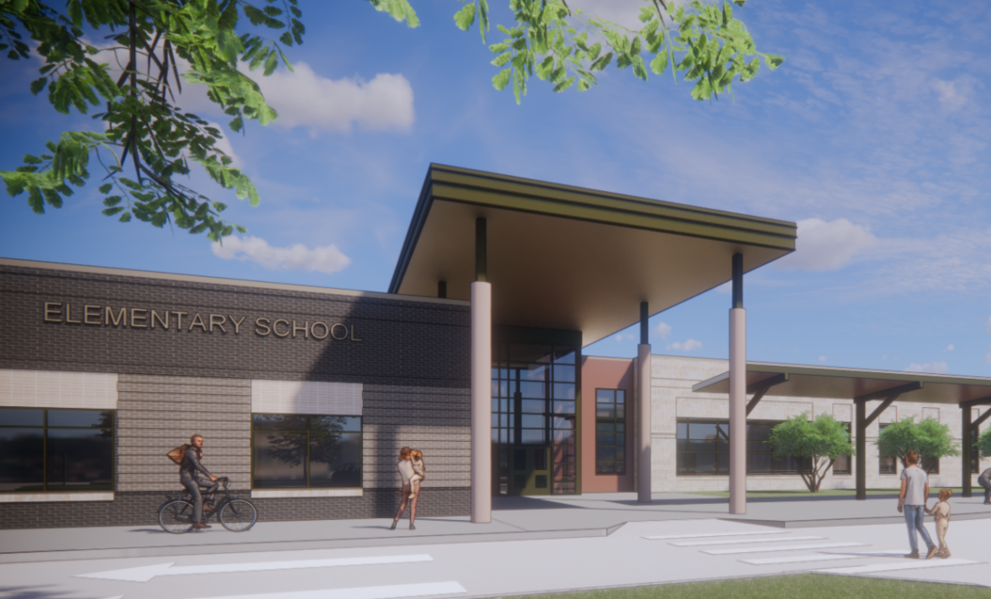
Construction Cost Update - 2022
Max Simpson Elementary – Waxahachie ISD
Bid April 2019
Open Sept 2020
$258.25 per SF
Walnut Springs Elementary – Dripping Springs ISD
Bid May 2020
Open Sept 2021
$305 per SF
McKinney Elementary
- McKinney ISD
Bid January 2022
Open Sept 2023
$281 per SF
18% increase
8.5% decrease

Slide 8
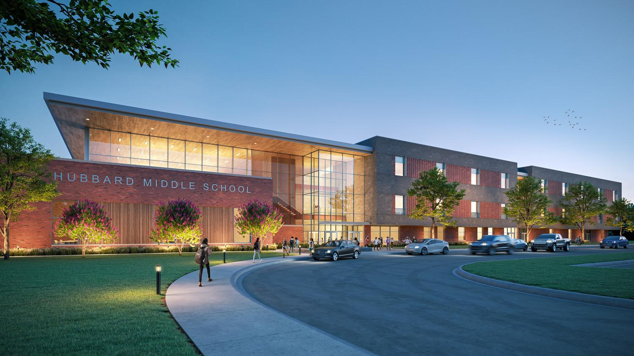
Construction Cost Update - 2022
Tyler ISD New Hubbard Middle School
Bid yesterday on May 18, 2022
$3xx per SF

Slide 9
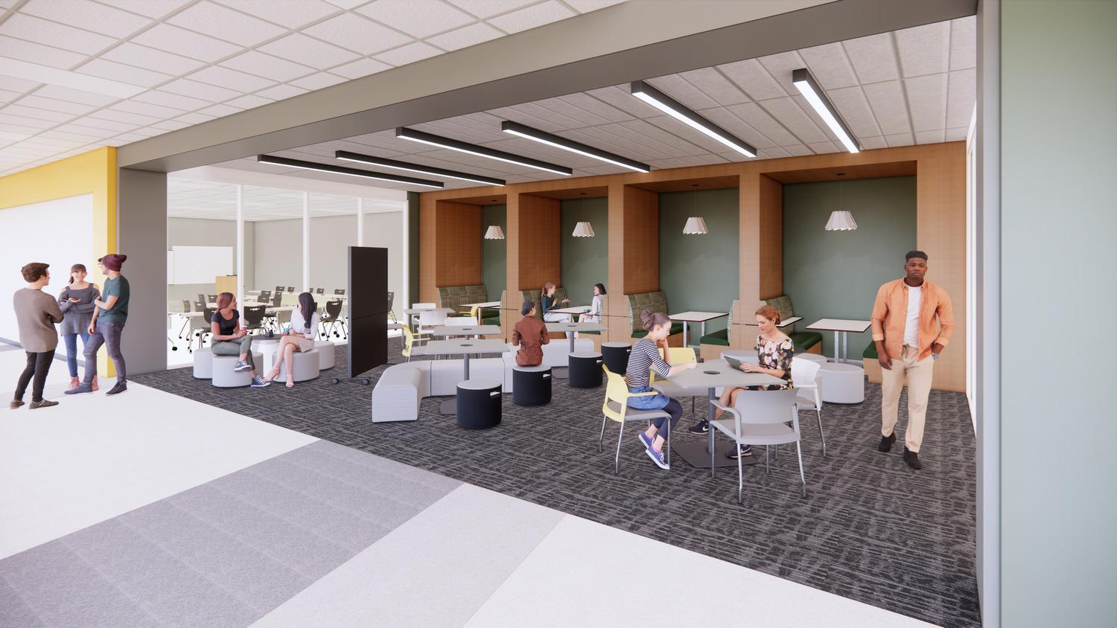
Construction Cost Update - 2022
Tyler ISD New Early College
Bid yesterday on May 18, 2022
$3xx per SF

Slide 10
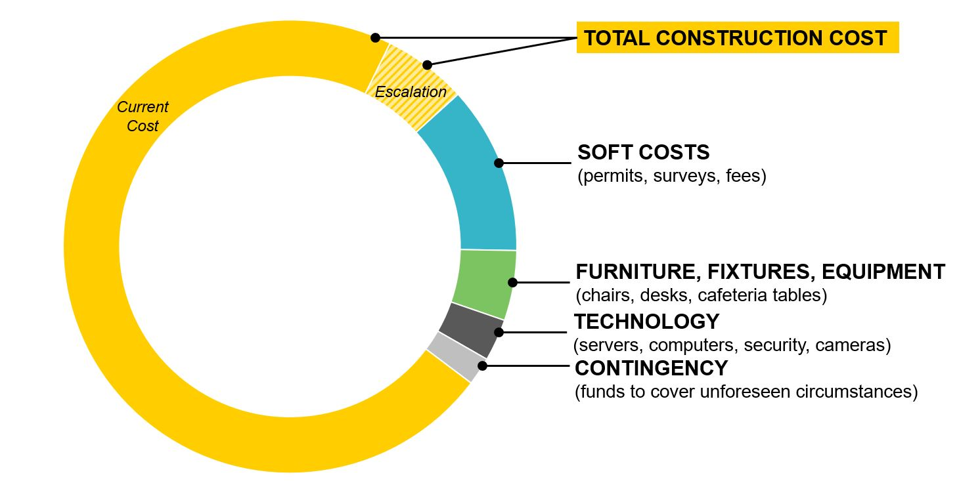
Building a Project Budget
Construction Cost Update - 2022

Slide 11
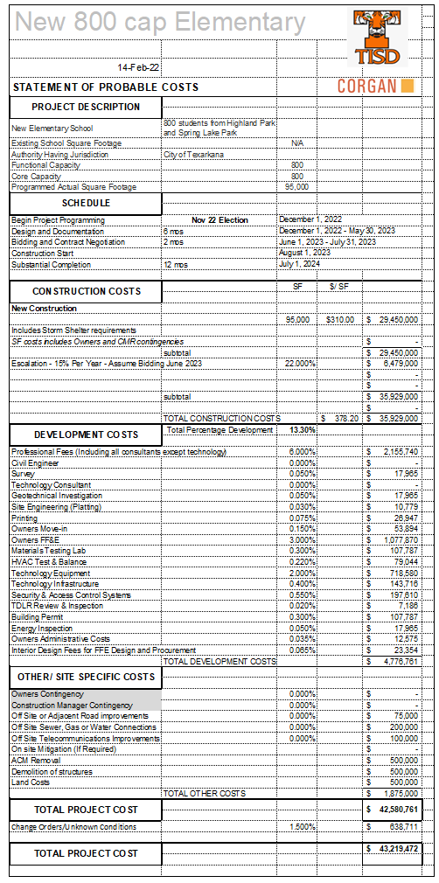
Construction Cost Update - 2022
Construction Cost versus Project Cost
Construction Cost
Development Cost
Other / Site Specific Cost
Total Bond Project Cost

Slide 12
Construction Cost Update - 2022
Construction Cost versus Project Cost
$29,450,000
At $310 per SF
Construction Cost
If it was bid today
Escalation (Inflation) for when it will actually be bid. This adds $6.479 million to the estimated cost of this project.
Our numbers are based on bidding in June 2023, with 15% inflation per year. This plans on the school opening in August of 2024.

Slide 13
Construction Cost Update - 2022
Construction Cost versus Project Cost
Development Cost
The District is responsible for these costs in addition to construction, and include items such as furniture, design and engineering fees, permits, testing, etc.
Although development costs can vary, for this new construction, they are projected to add another 13.3% to the project, or $4.776 million.

Slide 14
Construction Cost Update - 2022
Construction Cost versus Project Cost
Other / Site Specific Cost
These are costs specific to the Pine Street location, including new utility service, asbestos abatement and demolition of the existing structures, adding another $1.875 million.

Slide 15
Construction Cost Update - 2022
Construction Cost versus Project Cost
Finally, a 1.5% contingency is added for unknown conditions, and the total costs result in the amount shown in the bond.
$43,219,472
Total Bond Project Cost

Slide 16
Construction Cost Update - 2022
Construction Cost versus Project Cost
$29,450,000
Construction Cost
Development Cost
Other / Site Specific Cost
$43,219,472
Total Bond Project Cost

Slide 17
Construction Cost Update - 2022

