Slide 1
Albemarle County Public Schools
Instructional Practices Audit
Report to the Board of Education
Spring 2023

Slide 2








Introducing the Bellwether team!
MISSION
Bellwether is a national nonprofit that exists to transform education to ensure systemically marginalized young people achieve outcomes that lead to fulfilling lives and flourishing communities. We work hand in hand with education leaders and organizations to accelerate their impact, inform and influence policy and program design, and share what we learn along the way
VISION
We envision a future where all young people have access to an equitable and excellent education and live lives filled with opportunity. We look to a future where the education system is effective, equitable, and responsive
Anson Jackson
Project Lead
Akeshia Craven-Howell
Project Lead
Nick Allen
Project Manager
Adrienne Slaughter
Project Support
Montreece Hardy
Logistics Support
Daniela Torre Gibney
Project Advisor, Evaluation
Paul Beach
Project Support, Evaluation

Slide 3
In 2021 ACPS launched its current strategic plan—Learning for All—focusing on three primary goals
Source: ACPS Strategic Plan
1
Thriving Students
ACPS will facilitate learning experiences grounded in high expectations, networks of care, and student curiosity to ensure academic and social-emotional development for all students while eliminating opportunity, access and achievement gaps.
2
Affirming and Empowering Communities
ACPS commits to developing a culturally-responsive environment that will respect and champion the diversity of life experiences of all stakeholders and supports the physical and mental health of our students, staff and families so they are actively empowered to engage in our school community.
3
Equitable, Transformative Resources
ACPS will attract, develop and retain the highest-quality staff; develop sustainable and modern facilities, infrastructure and equipment; and distribute all resources in an equitable manner to transform learning experiences and opportunities.

Slide 4
With this context in mind, the Division hired Bellwether to help answer an essential question
Why are pass rates for ACPS students of color on the Virginia Standards of Learning (SOLs) for K-5 reading, K-5 math, and high school Algebra 1 lower than the averages for other students of color in the state and lower than their peers in other demographic groups in ACPS?

Slide 5

Bellwether’s engagement spanned three phases of work during the spring semester
Phase 1
Get to Know ACPS
Phase 2
Instructional Practices Audit
Phase 3
Root Cause Analysis
February |  |  | March |  |  |  | April |  |  |  | May |  |  |  | June
2/13 | 2/20 | 2/27 | 3/6 | 3/13 | 3/20 | 3/27 | 4/3 | 4/10 | 4/17 | 4/24 | 5/1 | 5/8 | 5/15 | 5/22 | 5/29 | 6/5
W 3/22
W 4/26
(In-person)
W 5/17
(Virtual)
Th 6/8
(In-person)
School Visits
Additional
Interviews
Division & school health assessment; quantitative analysis
Synthesize quantitative, qualitative data
Identity systemic barriers; develop recommendations
= Task Force
= Exec Leadership
= Phone Interviews
= Board Meeting
Stakeholder Engagement

Slide 6
A team from Bellwether visited 11 ACPS schools and spoke with over 350 stakeholders in the spring of 2023
Total individuals interviewed: 361
Schools |  | Community Partners
Albemarle HS Monticello HS Burley MS Journey MS Baker-Butler ES Brownsville ES | Greer ES Mountain View ES Scottsville ES Stony Point ES Woodbrook ES | Region 10 University of Virginia Equity Center Yancey Community Center Boys & Girls Club
Engagement Type |  | Number of Participants
Elementary Classroom Observations |  | 61 classes
Middle School Classroom Observations |  | 20 classes
High School Classroom Observations |  | 8 classes
Teacher Focus Groups |  | 93
Student Focus Groups |  | 99
Central Office Interviews |  | 29
Parent/Family Focus Group |  | 26
School Leader Interviews |  | 19
PLC Meetings |  | 13
Community Partners |  | 4
ACPS Board of Education Interviews |  | 4
Executive Leadership Team |  | 39
Instructional Audit Taskforce |  | 35

Slide 7




The resulting reports and recommendations are informed by four primary sources of insight
Qualitative Data
From interviews and focus groups with over 350 stakeholders from across ACPS
Observation Data
From visits to 61 elementary classes, 20 middle school classes, and 8 high school classes
Quantitative Data
From both publicly available datasets and internal datasets provided by ACPS
Best Practices
Drawing from research and Bellwether’s work with districts across the country

Slide 8


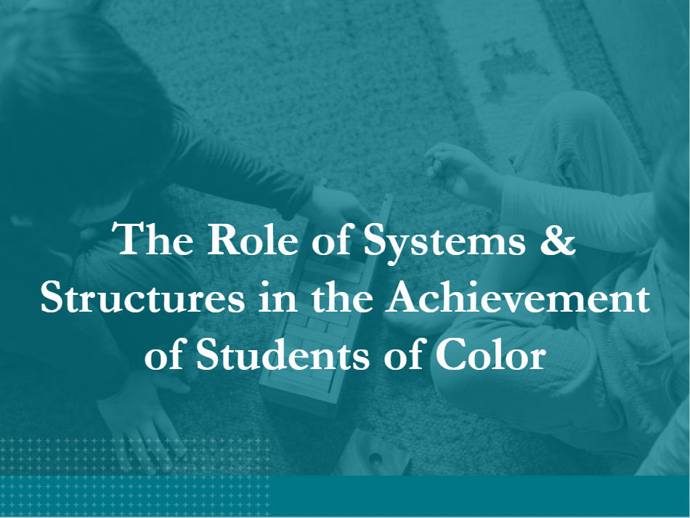
Findings from the instructional practices audit are synthesized into three reports
The first report focuses on Holistic Experiences of Students of Color and is informed by focus groups with 99 students and 26 caregivers across ACPS, along with written feedback from families
The second report focuses on Classroom-level Experiences of Students of Color, and is informed by staff focus groups and observations of 89 classrooms across 11 ACPS schools
The third report focuses on The Role of Systems & Structures in the Achievement of Students of Color, and is informed by conversations with 29 ACPS central office leaders, school leaders, and school-based staff

Slide 9
Themes: Holistic Experiences of Students of Color
Student Goals & Aspirations. Most students and their families expressed a desire for academic success and demonstrated an understanding of the value of school for their future aspirations. However, Black and Latinx students are overrepresented in ACPS’ career and technical education programs, and underrepresented in college-aligned pathways, specifically middle school Algebra 1, which raises questions about whether students of color are getting equal access to the coursework that will help them reach the goals they have for themselves.
School Climate. Most students, especially in elementary school, have positive relationships with adults and peers; however, evidence suggests these positive relationships are not translating into a culture of high expectations. Students of color, and Black students in particular, describe feeling overly scrutinized and disproportionately disciplined, a perception supported by data in some schools.
Accessing Tailored Supports. Many parents described challenges convincing schools to provide their students with RtI supports to help them when they experienced challenges with daily instruction; however, once students received tiered services, parents found the supports available to be beneficial.
Emerging Culture of Inclusion. ACPS schools have taken steps to build a culture of inclusion that shows an appreciation of different cultures and histories; however, Black and Latinx students still describe experiencing frequent microaggressions from their peers and teachers. Additionally, all students’ cultures are not consistently represented, how students’ cultures impact their experience in school is not always considered, students do not feel comfortable talking about issues of race in school, and, based on classroom observations, students’ engagement in culturally relevant materials is limited.
Family & School Interactions. Although schools have made an effort to go out into the community and coach teachers on family engagement, families would like more information on what their students are doing in school and how they can support students at home; additionally, some families distrust the school division, especially families of color who are not confident their students are getting access to the best resources.
1
2
3
4
5

Slide 10
Themes: Classroom Level Experiences of Students of Color
Theory vs. practice. The Division has invested in curricular resources and instructional approaches to strengthen instruction; however, these investments, which are supported by sound pedagogical theory, do not consistently translate into rigorous classroom practices.
Professional learning system. ACPS has developed ample structures for professional learning, with a clear focus on collecting and analyzing student data; school-based staff want a more intensive, systematic approach to professional development that supports data-driven instructional practices.
Analyzing vs. acting on data. Staff across the Division are increasingly collecting and analyzing student data disaggregated by subgroup; however, formative assessment data is not consistently used to inform timely decision-making at the classroom level.
Tier 1 instruction vs. RTI supports. The Division has purchased High-Quality Instructional Materials and developed standard approaches to some Tier 1 instructional practices; school-based staff expressed a desire for more Tier 2 and Tier 3 intervention supports to meet the needs of all students.
Compliance vs. engagement. Most schools and classrooms maintain safe environments in which students are generally compliant with school rules; however, authentic student engagement grounded in rigorous instructional practices and high expectations for all students was not observed in all classrooms.
1
2
3
4
5

Slide 11
Themes: The Role of Systems and Structures in the Experiences of Students of Color
Equality vs. equity. Stakeholders across ACPS described an ongoing shift within the Division toward a more equity-based approach to decision-making and resource allocation; some see a need to go even further to ensure schools and students who need the most support receive what they need to be successful.
Fidelity vs. autonomy. Recent moves to standardize elements of ACPS’ approach to learning and push for fidelity in implementation across schools can support more rigorous and consistent instruction; however, there are differing opinions from school leaders on what the Division should hold “tight” versus “loose”.
Inclusive decision-making. ACPS has developed some structures for collecting feedback from students, families, staff, and other stakeholders; however, there are gaps in how the Division gathers feedback and input from key constituencies to inform decisions before they are made, and then communicate the rationale for decisions once made.
Talent systems. ACPS benefits from talented, deeply committed teachers, support staff, and leaders; however, many staff do not feel supported in their professional learning, and ACPS struggles to attract and retain staff that more closely reflect the demographics of the Division’s student population.
Collaboration and alignment. School-based adults report strong, collaborative relationships within school walls; however, inter-school and inter-team collaboration is not as strong, and many stakeholders described tensions between school-based staff and central office staff.
1
2
3
4
5

Slide 12
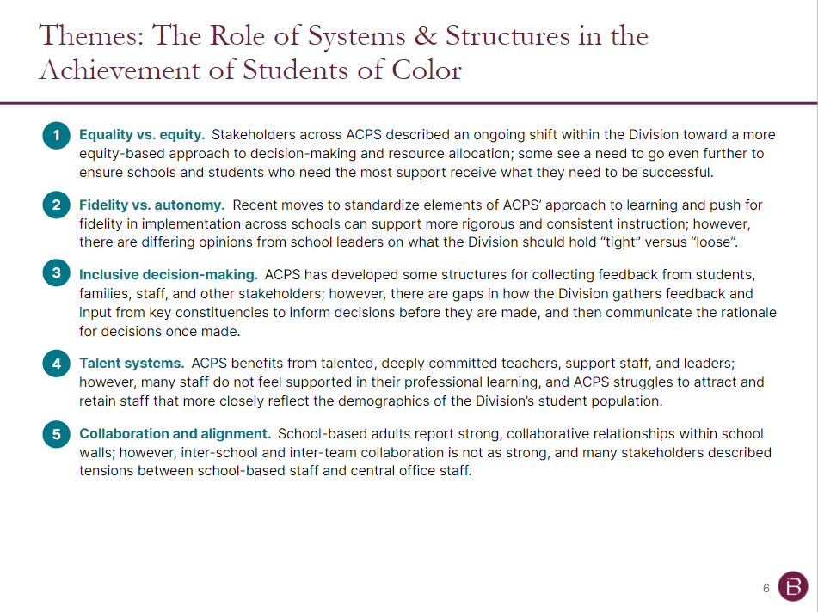
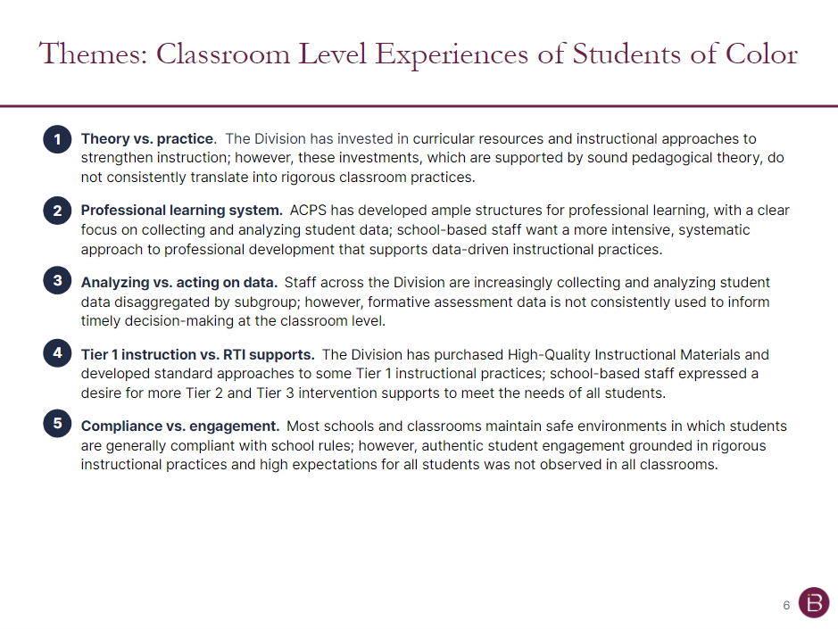
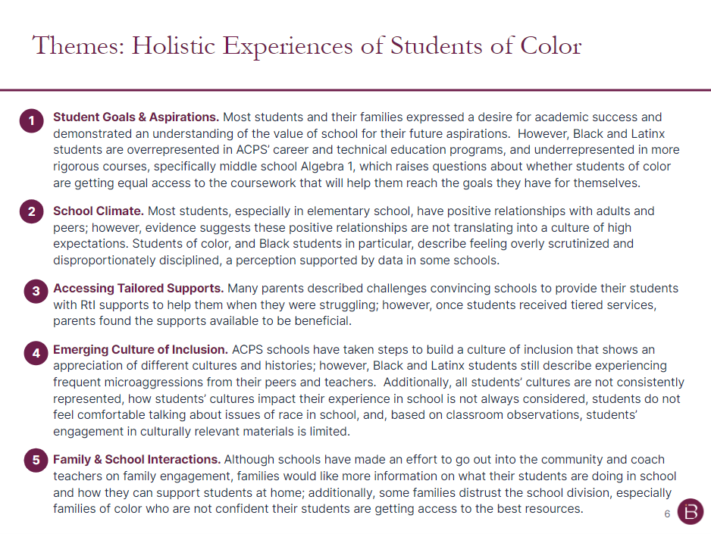
Based on the themes surfaced in these reports, Bellwether identified a set of root causes and recommendations
From the themes outlined in reports 1-3, Bellwether elevated five primary root causes for persistent achievement gaps, along with a set of recommendations to address each root cause moving forward

Slide 13
Summary Root Causes and Recommendations

Slide 14
We have framed our analysis of root causes in terms of Elmore’s Instructional Core…
Source: Instructional Rounds in Education: A Network Approach to Teaching and Learning, 2009.
The Instructional Core describes the essential interaction between teacher, student, and content around instructional tasks. It is the relationship between these, rather than the quality of any individual element, which determines the nature of instructional practice.
The Instructional Core outlines three interdependent elements of classroom-based instruction:
Teacher knowledge and skill
Student engagement in learning
Content that is standards-aligned and on grade level
The interplay between these elements determines the quality of teaching and student learning.
STUDENT
TASK
TEACHER
CONTENT
At the heart of these elements is the instructional task: what students are asked to do—and are actually doing—in real time. The instructional task is the greatest predictor of student performance.
The Seven Principles of the Instructional Core (see Appendix) provide guidance on how to intervene in the process of instruction to improve the quality and level of student learning.

Slide 15
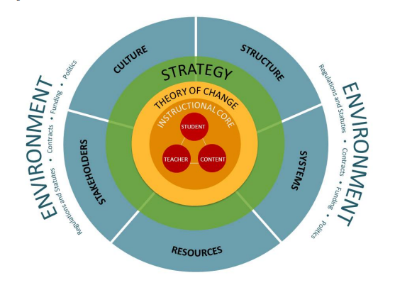
…and have used the PELP Coherence Framework to analyze how central office systems and structures impact instruction
Source: Note on the PELP Coherence Framework, Public Education Leadership Project at Harvard University, 2011.
The PELP Coherence Framework was designed to help school district leaders recognize how the interdependent elements of their school system reinforce one another to support implementing an improvement strategy that centers the instructional core.
The framework helps achieve coherence by:
Connecting the instructional core with a district-wide strategy for improvement
Highlighting district elements that can support or hinder improving the instructional core
Identifying interdependencies among district elements

Slide 16
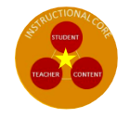
The instructional practices audit reveals five root causes as the primary drivers of gaps in student achievement (1 of 2)
Our report elevates three root causes tied to the instructional core
Root Causes
Challenge
Instructional
Tasks
Instructional tasks do not consistently reflect the same level of rigor required by the SOLs
Pass rates for ACPS students of color on the Virginia Standards of Learning (SOLs) for K-5 reading, K-5 math, and high school Algebra 1 are lower than the averages for other students of color in the state and lower than their peers in other demographic groups in ACPS.
1
Adult
Learning
Adults are not equipped with the knowledge and skills to meet the instructional needs of all students
2
Curricular Resources
Curricular gaps, especially in secondary math and K-5 interventions, create barriers for teachers and students
3

Slide 17
The instructional practices audit reveals five root causes as the primary drivers of gaps in student achievement (2 of 2)
Our report elevates two root causes tied to supporting the instructional core
Root Causes
Challenge
Strategic Alignment
Lack of clarity about ACPS’ theory of change, and how each role, program, approach, and element within the Division combines to improve student outcomes and close achievement gaps
Pass rates for ACPS students of color on the Virginia Standards of Learning (SOLs) for K-5 reading, K-5 math, and high school Algebra 1 are lower than the averages for other students of color in the state and lower than their peers in other demographic groups in ACPS.
4
Stakeholder Engagement
Internal and external stakeholders do not experience engagement in ways that meet their needs and center them as valued contributors to the solution
5

Slide 18
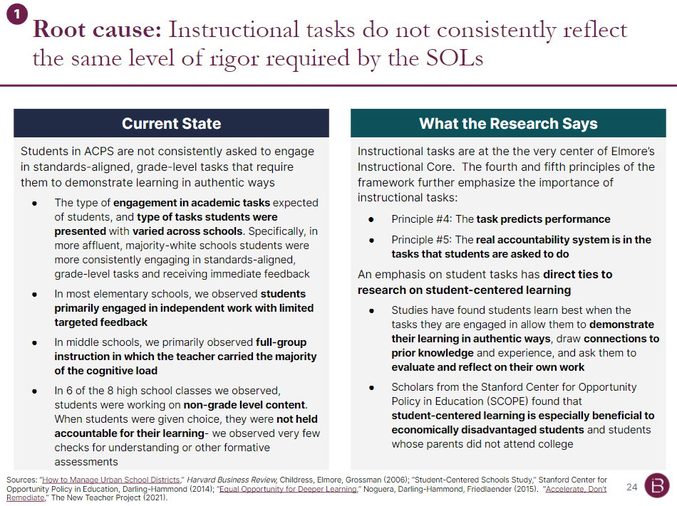
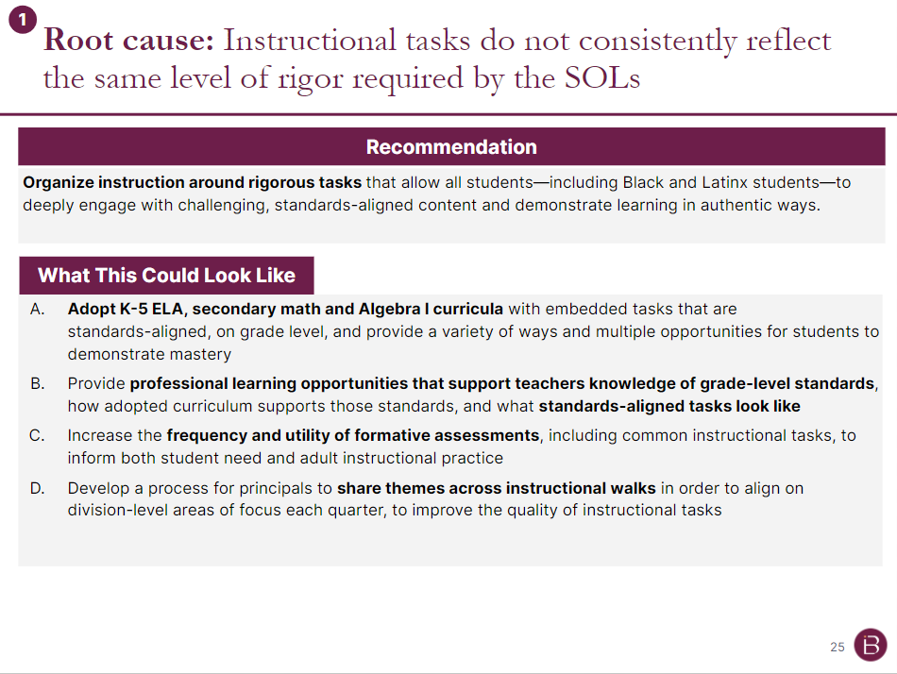
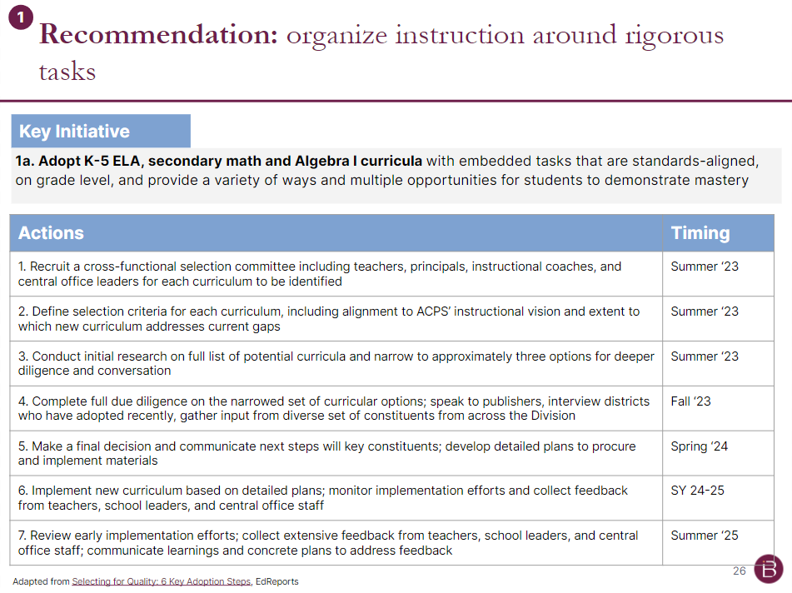
Report 4: Detailed Root Causes and Recommendations
Each root cause is accompanied by a synthesis of the current state based on evidence outlined in reports 1-3
We also include an overview of research and thought leadership tied to each root cause/ recommendation
Each recommendation includes ideas for “what this could look like” in action across the Division
For each rec, we also elevate 1-2 priority initiatives and outline a set of aligned action steps to consider

Slide 19
Root cause: Instructional tasks do not consistently reflect the same level of rigor required by the SOLs
1
Recommendation
Organize instruction around rigorous tasks that allow all students—including Black and Latinx students—to deeply engage with challenging, standards-aligned content and demonstrate learning in authentic ways.
What This Could Look Like
Increase the frequency and utility of formative assessments, including common instructional tasks, to inform both student need and adult instructional practice
Provide professional learning opportunities that support teachers knowledge of grade-level standards, how adopted curriculum supports those standards, and what standards-aligned tasks look like
Adopt K-5 ELA, secondary math and Algebra 1 curricula with embedded tasks that are standards-aligned, on grade level, and provide a variety of ways and multiple opportunities for students to demonstrate mastery
Develop a process for principals to share themes across instructional walks in order to align on division-level areas of focus each quarter, to improve the quality of instructional tasks

Slide 20
Root cause: Adults are not equipped with the knowledge and skills to meet the instructional needs of all students
2
Recommendation
Develop a systematic approach to adult learning that combines workshop-based PD, job-embedded coaching, and PLCs to support staff, at all levels, develop the skills to continuously improve instruction.
What This Could Look Like
Develop a unified vision for adult learning in which principal walkthroughs, instructional coaching, PDs and PLCs all reinforce the same set of teacher practices and behaviors
Build the capacity of individuals in central office and school-based roles—including interventionists, K-5 reading specialists, and other support roles—to support teacher professional learning
Revamp the classroom walkthrough tool to prioritize look-fors tied to practices that support closing achievement gaps, including teachers demonstrating high-expectations for all students, and students engaging in standards-aligned, grade-level tasks
Leverage instructional learning walks to identity the places teachers most need support; based on observations, apply coaching for individual needs, PLCs for school-based needs, and workshop PD for division-wide needs

Slide 21
Root cause: Gaps in content, esp. for secondary math and K-5 interventions, create barriers for teachers and students
3
Recommendation
Invest in High-Quality Instructional Materials to fill gaps in content, including a consistent math curriculum for Algebra 1 and middle grades, a comprehensive system of RTI supports, and a state-recommended literacy program
What This Could Look Like
A. Short-term: improve current middle school students’ Algebra 1 skills (with an early focus on 9th grade Algebra 1)
  Develop an 8th grade math diagnostic to identify students’ skill gaps heading into 9th grade
  Pilot a summer math transition camp for identified students to support mastery of pre-Algebra skills, and provide early exposure to Algebra 1 content
  Implement high-intensity tutoring or an interventionist to work with identified students during the school day on specific skills
  Leverage PLC and DPLC structure to identify themes in students’ mastery of Algebra 1 content and where gaps in learning exist
B. Long-term: strengthen the Division’s secondary math curriculum and system of RTI supports
  Adopt HQIM for Algebra 1 that builds upon the skills and strategies students develop through Math Investigations
  Build out the vision to embed Algebra 1 concepts in 6th, 7th, and 8th grade math
  Invest in developing the content knowledge and skills of school-based interventionists, and codify the system for RTI supports that utilizes both push-in and pull-out formats

Slide 22
Root cause: ACPS does not have a unifying Theory of Change linking interventions to student outcomes
4
Recommendation
Clarify how Division actions lead to student outcomes; articulate and communicate beliefs about both why and how each role within the Division is designed to contribute to strengthening the instructional core.
What This Could Look Like
Develop a Theory of Change document that articulates, in simple “if… then…” statements, the logic chain linking beliefs, decisions, and individual actions from the central office to school-based staff to students
Clarify what is held "tight" and "loose" across the division; where the division holds structures "tight" strengthen the division-provided resources for school campuses
Reimagine the instructional coaching model to target support in the schools and/or teachers that need it most, with a focus on transforming instructional practices and teacher actions
Identify role(s) that can be leveraged to support developing principals and APs as instructional leaders, so that principals can be better coaches for their teachers and instructional staff
Set annual targets for each of the Objective Success Measures in the ACPS Strategic Plan, and identify which roles at the division and campus-level are accountable for achieving each target; develop a corresponding system to monitor progress towards targets on a quarterly basis

Slide 23
Root cause: Internal and external stakeholders do not experience engagement in ways that meet their needs
5
Recommendation
Strengthen systems for input and feedback, and processes for communicating decisions at all levels to ensure full spectrum of stakeholders across ACPS are authentically engaged, including students, families, teachers, school leaders, central office staff, and community members.
What This Could Look Like
Increase transparency into Division-wide decisions by over-communicating with all stakeholders, using multiple methods of communication, and explaining the rationale behind decisions
Deepen engagement and supports for families across the Division; this could include:
  Create family-friendly companion guides aligned to the Division’s adopted curricula to provide families visibility into what students are learning, what "on-track" looks like, and what strategies families can use at home to support their students
  Increase family awareness of K-12 pathways and course progression and ensure parents are engaged in course selection, especially for 8th grade math and key transitions (e.g., rising 6th, rising 9th graders)
  Increase access to key school/ Division information by, at a minimum, providing interpretation services at all school and Division events, and translating info on curricula, course selection, and student safety
Deepen external partnerships at both the central office and school level with community-based orgs whose missions and goals align with those of ACPS and who are serving the same students and families

Slide 24
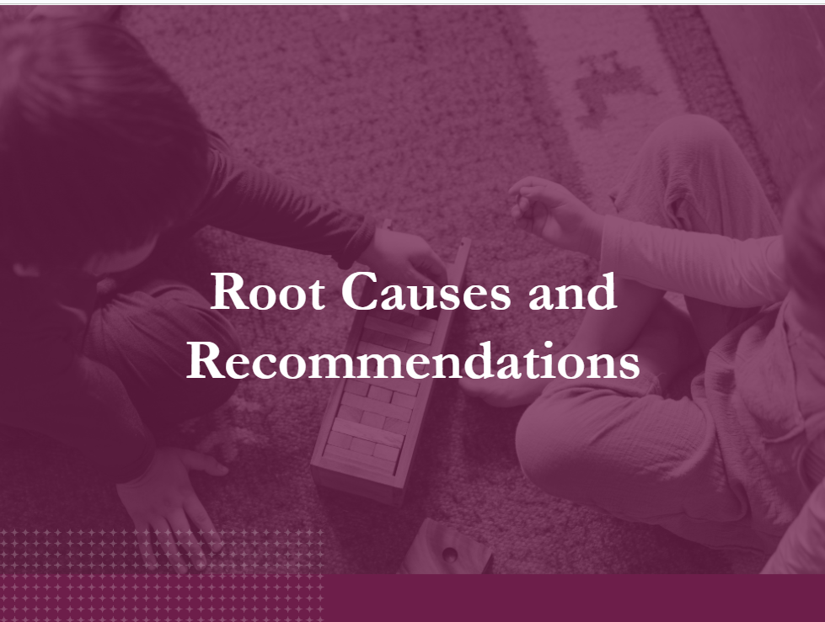
Together, the four reports highlight the current state as well as a path toward improving outcomes for students of color

Slide 26
Appendix

Slide 27
There are seven principles of the instructional core, all of which inform our recommendations for ACPS
Source: Instructional Rounds in Education: A Network Approach to Teaching and Learning, 2009.
Seven Principles of the Instructional Core
Increases in student learning occur only as a consequence of improvement in the level of content, teachers’ knowledge and skill, and student engagement.
If you change any single element of the instructional core, you have to change the other two to affect student learning.
If you can’t see it in the core, it’s not there.
The task predicts performance.
The real accountability system is in the tasks that students are asked to do.
We learn to do the work by doing the work, not by telling other people to do the work, not by having done the work at some point in the past, and not by hiring experts who can act as proxies for our knowledge about how to do the work.
Description before analysis, analysis before prediction, prediction before evaluation.

Slide 28
We have developed a set of recommendations to address each root cause (1 of 2)
Root Causes
Recommendations
Instructional
Tasks
Instructional tasks do not consistently reflect the same level of rigor required by the SOLs
Organize instruction around rigorous tasks that allow all students—including Black and Latinx students—to deeply engage with challenging, standards-aligned content and demonstrate learning in authentic ways.
1
Adult
Learning
Adults are not equipped with the knowledge and skills to meet the instructional needs of all students
Develop a systematic approach to adult learning that combines workshop-based PD, job-embedded coaching, and PLCs to support staff, at all levels, to develop the skills to continuously improve instruction.
2
Curricular Resources
Curricular gaps, especially in secondary math and K-5 interventions, create barriers for teachers and students
Invest in High-Quality Instructional Materials to fill gaps in content, including a consistent math curriculum for Algebra 1 and middle grades, a comprehensive system of interventions, and a state-recommended literacy program.
3

Slide 29
We have developed a set of recommendations to address each root cause (2 of 2)
Root Causes
Recommendations
Strategic Alignment
Lack of clarity about ACPS’ theory of change, and how each role, program, approach, and element within the Division combines to improve student outcomes and close achievement gaps
Clarify how Division actions lead to student outcomes; articulate and communicate beliefs about both why and how each role within the Division is designed to contribute to strengthening the instructional core.
4
Stakeholder Engagement
Internal and external stakeholders do not experience engagement in ways that meet their needs and center them as valued contributors to the solution.
Strengthen systems for input and feedback, and processes for communicating decisions at all levels to ensure full spectrum of stakeholders across ACPS are authentically engaged, including students, families, teachers, school leaders, central office staff, and community members.
5

Slide 30
Root cause: Instructional tasks do not consistently reflect the same level of rigor required by the SOLs
1
Current State
What the Research Says
Students in ACPS are not consistently asked to engage in standards-aligned, grade-level tasks that require them to demonstrate learning in authentic ways
The type of engagement in academic tasks expected of students, and type of tasks students were presented with varied across schools. Specifically, in more affluent, majority-white schools students were more consistently engaging in standards-aligned, grade-level tasks and receiving immediate feedback
In most elementary schools, we observed students primarily engaged in independent work with limited targeted feedback
In middle schools, we primarily observed full-group instruction in which the teacher carried the majority of the cognitive load
In 6 of the 8 high school classes we observed, students were working on non-grade level content. When students were given choice, they were not held accountable for their learning- we observed very few checks for understanding or other formative assessments
Instructional tasks are at the the very center of Elmore’s Instructional Core. The fourth and fifth principles of the framework further emphasize the importance of instructional tasks:
Principle #4: The task predicts performance
Principle #5: The real accountability system is in the tasks that students are asked to do
An emphasis on student tasks has direct ties to research on student-centered learning
Studies have found students learn best when the tasks they are engaged in allow them to demonstrate their learning in authentic ways, draw connections to prior knowledge and experience, and ask them to evaluate and reflect on their own work
Scholars from the Stanford Center for Opportunity Policy in Education (SCOPE) found that student-centered learning is especially beneficial to economically disadvantaged students and students whose parents did not attend college
Sources: “How to Manage Urban School Districts,” Harvard Business Review, Childress, Elmore, Grossman (2006); “Student-Centered Schools Study,” Stanford Center for Opportunity Policy in Education, Darling-Hammond (2014); “Equal Opportunity for Deeper Learning,” Noguera, Darling-Hammond, Friedlaender (2015). “Accelerate, Don’t Remediate,” The New Teacher Project (2021).

Slide 31
Recommendation: Organize instruction around rigorous tasks
1
Key Initiative
1a. Increase the frequency and utility of formative assessments, including common instructional tasks, to inform both student need and adult instructional practice
Actions | Timing
1. Develop standard definition of formative assessment that is inclusive of a broad range of practices, including common instructional tasks, and makes explicit connection between strong formatives and rigorous tasks for students; incorporate formative assessment training into Division-wide professional learning calendar | Summer ‘23
2. Communicate definition of formative assessment, rationale for focusing here, and training plans with staff across the Division; engage instructional coaches and staff to outline specific examples and techniques aligned to both the definition and a vision for rigorous instructional tasks; aggregate into a Division-wide resource | Fall ‘23
3. Increase the frequency of common formative assessments/instructional tasks, beginning with K-2 reading; develop quarterly common assessments for K-2 reading aligned to SOL standards and curriculum pacing; where possible, pull these from existing curriculum materials | SY23-24
4. Train and support staff to assess performance on formative assessments/common instructional tasks in PLCs to inform instruction- this could be a role for reading specialists at each elementary school | SY23-24
5. Collect data from learning walks and instructional coaches on the use of formative assessment in classroom instruction; gather feedback from school-based staff on how they use formatives to drive classroom instruction; celebrate wins and develop plans to further support staff to address any gaps or challenges | Spring ‘24

Slide 32
Root cause: Adults are not equipped with the knowledge and skills to meet the instructional needs of all students
2
Current State
What the Research Says
ACPS has developed several structures to support adult learning. However, the Division’s adult learning strategy lacks a clear focus on tangible, content-aligned instructional strategies to support teachers in implementing math and reading curricula, and incorporating differentiation and CRT principles with fidelity
Teachers consistently shared frustrations with the current instructional coaching model, and expressed a desire for instructional coaches to provide real-time feedback and tactical strategies
Staff across ACPS see a need for more training and support to implement curricular resources and drive rigorous instruction
Many staff view Division-led PLCs unfavorably and want more opportunities to collaborate within and across schools
The second principle of Elmore’s Instructional Core describes the interrelated nature of each element of the core:
  Principle #2: If you change any single element of the instructional core, you have to change the other two to affect student learning
  With this in mind, recommendations to change content and how students engage in learning must be accompanied by aligned changes in teachers’ knowledge and skills
A recent Carnegie study, which identified ten elements of effective curriculum-based professional learning highlighted the importance of teachers receiving repeated sessions of coaching and feedback during their workday, and found learning should be focused on instructional materials with specific teaching strategies. This aligned with the seventh principle of Elmore’s Instructional Core:
  Principle #7: We learn the work by doing the work
Relatedy, multiple studies have found that implementing a new curriculum is a multi-year process that takes at a minimum two years and it is a process all teachers must be engaged in
Sources: “The Elements: Transforming Teaching through Curriculum-Based Professional Learning,” Carnegie Corporation of New York, Short, Hirsch, (2020); “Professional Learning in the Learning Profession: A Status Report on Teacher Development in the United States and Abroad,” National Staff Development Council, Darling-Hammond, Wei, Andree, Richardson, Orphanos, (2009); “Beyond PD: Teacher Professional Learning in Higher-Performing Systems,” Center on International Education Benchmarking (2016).

Slide 33
Recommendation: Develop a systematic approach to adult learning
2
Key Initiative
2a. Develop a unified vision for adult learning in which principal walkthroughs, instructional coaching, PDs and PLCs all reinforce the same set of teacher practices and behaviors
Actions | Timing
1. Define instructional vision for ACPS that outlines a prioritized set of specific teacher practices and behaviors the Division wants to focus on over the coming 1-2 years (these might combine aspects of CRT and an instructional framework); calibrate among central office instructional staff, principal supervisors, and principals what the instructional vision looks like in practice; identify success measures, including changes in teacher practice as evidenced by instructional walks and staff feedback on the quality/utility of professional learning | Fall ‘23
2. Develop or refine SY23-24 professional learning calendar with differentiated supports for school-based leaders and teachers; specify function of each time of professional learning (e.g., workshop versus coaching versus PLC, etc.) and map to the learning needs of central office and school-based adults (e.g., understand the curriculum versus internalizing instructional shifts versus planning for instruction, etc.) | Summer ‘23
3. Repurpose instructional walks as a learning tool; increase frequency of instructional walks and participation by coaches, specialists, and central office instructional staff. Collect and synthesize observation data to identify how teachers are performing against expectations, where bright spots are evident, and what needs are prevalent. Based on data, map individual needs to coaching; map trends within a school to PLCs with external support; map trends across schools to workshop PD | SY23-24
4. Revisit instructional coaching model and shift from opt-in approach to one that positions instructional coaching as part of the comprehensive system of adult learning | SY23-24
5. Invest heavily in building the knowledge and skill of coaches, reading specialists and other adults meant to support professional learning for teachers | SY23-24

Slide 34
Root cause: Gaps in content, esp. for secondary math and K-5 interventions, create barriers for teachers and students
3
Current State
What the Research Says
ACPS has invested in high-quality instructional materials (HQIM) to support Tier 1 instruction in elementary math and literacy; however, this same investment has not been consistently made in middle school math, Algebra 1, and RTI.
ACPS lacks aligned middle school math HQIM that prepares students for Algebra 1, the gateway course for advanced math
ACPS’ Algebra 1 scope and sequence was developed in-house and is not accompanied by aligned resources; additionally, instructional coaches do not prioritize supporting secondary math
Teachers want more resources and research-based strategies to support Tier 2 and 3 instruction, and highlight challenges finding time in the school day for RTI supports
Relatedly, ACPS is required to replace Being a Reader with a state-recommended literacy program by the ‘24 -’25 school year
Education researchers have established that using better instructional materials improves student outcomes; when teachers use HQIM they can focus their efforts on more deeply understanding content, building relationships with students, and consistently maintaining high expectations for instructional tasks
In addition to the ample research on the impact of HQIM, there are many best practices around curricular adoption that should inform plans to adopt new curricula
As a shorter-term strategy, High-Impact Tutoring is a promising strategy for improving accelerating student outcomes with a growing research base effective than other interventions that have been tested and is effective across grade and content levels.
  We note that not all tutoring programs have been shown to improve student achievement; leaders should choose specific models backed by evidence of impact on important outcomes
Sources: Short, Hirsch (2020); “Selecting for Quality: 6 Key Adoption Steps,” EdReports. See ProvenTutoring.org for more on tutoring providers with a strong evidence base.

Slide 35
Recommendation: Invest in High-Quality Instructional Materials to fill gaps in content
3
Key Initiative
3a.1. Invest in short-term solutions to strengthen 9th Grade Algebra 1 skills; provide extended school time and targeted supports for Algebra 1 teachers and students
Actions | Timing
1. Recruit a design team made up of math teachers, interventionists, and other constituents to develop plans for targeted support Algebra I teachers and students, with early focus on 9th grade students | Summer ‘23
2. Based on plans from the design team, consider extending time during the school day (or offering additional time on “off” days with an every-other-day math schedule); make changes to master schedule as needed | Summer ‘23
3. Review 8th grade data to identify students to target for additional intervention support; reach out to families to invite participation in school-day math supports | Fall ‘23
4. Implement districtwide PLC among Algebra 1 teachers to support building practice around the existing scope and sequence, working together to solve problems of practice, and surfacing ideas for continuous improvement | SY23-24
5. Gather and synthesize feedback from Algebra 1 teachers on what is working and what could be improved; meet with all Algebra 1 teachers to communicate specific next steps based on feedback | Spring ‘24
Note: we recommend National Student Support Accelerator’s Toolkit for Tutoring Programs as a helpful starting point for HIT design and planning.

Slide 36
Recommendation: Invest in High-Quality Instructional Materials to fill gaps in content
3
Key Initiative
3a.2. Invest in short-term solutions to strengthen 9th Grade Algebra 1 skills; pilot a summer math transition camp and implement a high-intensity tutoring model to support middle school math students
Actions | Timing
1. Recruit a design team made up of math teachers, interventionists, and other constituents to begin developing plans for a high-intensity tutoring (HIT) program targeting current middle school math students | Summer ‘24
2. Outline the goals and design of the HIT program, and develop a budget to pilot the program at 1-2 middle schools during SY24-25 (should include deciding whether ACPS will run the program or partner with a provider) | Summer ‘24
3. Pilot HIT program at 1-2 middle schools; gather and synthesize feedback from students, families, tutors, teachers, and school leaders; develop plans to improve program based on feedback | Fall ‘24
4. Implement and communicate improvements to pilot program based on feedback; continue gathering feedback to inform decision about whether to stop, continue, or scale the program in SY25-26 | Spring ‘25
5. Recruit a design team to begin developing plans to pilot a math summer transition camp that targets middle school students in need of additional support to master pre-Algebra concepts | Spring ‘25
6. Communicate plans for summer math camp to families across the Division and begin recruiting students, prioritizing those most in need of additional supports | Spring ‘25
7. Pilot summer math camp; gather and synthesize feedback from students, families, teachers, and other constituents; develop plans to improve camps based on feedback | Summer ‘25
Note: we recommend National Student Support Accelerator’s Toolkit for Tutoring Programs as a helpful starting point for HIT design and planning.

Slide 37
Recommendation: Organize instruction around rigorous tasks
3
Key Initiative
3b. Adopt K-5 ELA, secondary math and Algebra 1 curricula with embedded tasks that are standards-aligned, on grade level, and provide a variety of ways and multiple opportunities for students to demonstrate mastery
Actions | Timing
1. Recruit a cross-functional selection committee including teachers, principals, instructional coaches, and central office leaders for each curriculum to be identified | Summer ‘23
2. Define selection criteria for each curriculum, including alignment to ACPS’ instructional vision and extent to which new curriculum addresses current gaps | Summer ‘23
3. Conduct initial research on full list of potential curricula and narrow to approximately three options for deeper diligence and conversation | Fall ‘23
4. Complete full due diligence on the narrowed set of curricular options; speak to publishers, interview districts who have adopted recently, engage teachers to interact with the narrowed set of curricula, gather broad input | Fall ‘23
5. Make final decision and communicate how the decision was made (e.g., input and feedback from constituents, criteria used, tradeoffs made, etc.); develop detailed plans to procure and implement materials | Spring ‘24
6. Implement new curriculum based on detailed plans with milestones; develop comprehensive adult learning plan and start with a small number of grade levels; monitor implementation and collect feedback | SY 24-25
7. Review early implementation efforts; collect extensive feedback from teachers, school leaders, central office staff, and students; communicate learnings and concrete plans to address feedback | Summer ‘25
Adapted from Selecting for Quality: 6 Key Adoption Steps, EdReports

Slide 38
Root cause: ACPS does not have a unifying Theory of Change linking interventions to student outcomes
4
Current State
What the Research Says
Division-level structures are not being effectively leveraged to transform instructional practices
Although some central office staff are in schools everyday and regularly conduct classroom walkthroughs with principals, they are not consistently providing principals with job-embedded coaching to strengthen their instructional leadership
Instructional coaches are currently an opt-in resource for teachers and do not report what they see in classrooms to principals; this limits their ability to be leveraged to drive implementation of specific instructional practices with fidelity
Although teachers engage in PLCs and DPLCs, more training is needed improve how teachers use data and division-wide assessment to target instruction
There is a lack of clarity around decision-rights within the Division, including which elements of instructional practice are centralized and held “tight” versus which are decentralized and held “loose”
A foundational principle of program evaluation is that, in order to evaluate the impact of an intervention, there must be a clear theory of change which describes the chain of events that leads from the intervention to intermediate outcomes to the desired final outcomes
Applied to a district, this means that for every role, both at schools and at central office, there should be a clear understanding of how their actions drive outcomes for students
A theory of change allows a district to hold roles accountable for intermediate outcomes and assess whether the role is effective at improving student outcomes
Articulating a theory of change across the Division should also describe which elements of instruction are held tight versus loose, and why
Source: “Building Evidence for Educator Effectiveness: Theory of Change,” U.S. Department of Education; Childress, Elmore, Grossman (2006)

Slide 39
Recommendation: Clarify how Division actions lead to student outcomes
4
Key Initiative
4a. Develop and document a Theory of Change that articulates, in simple “if… then…” statements, the logic chain linking beliefs, decisions, and individual actions from the central office to school-based staff to students
Actions | Timing
1. Review existing Division-wide planning documents that articulate linkages between ACPS’ vision, central office, schools, and student outcomes | Summer ‘23
2. Use existing documents as a starting place to draft an updated Theory of Change that succinctly describes how each element of the Division works together to achieve ACPS’ vision and drive student outcomes | Summer ‘23
3. As part of broader communication efforts (see key initiative 5a), share updated Theory of Change with stakeholders across the Division for further input and feedback on both the design of the Theory of Change, and the extent to which current systems and structures are aligned with the design | Fall ‘23
4. Follow up with all school teams to communicate synthesized feedback and resulting changes to Theory of Change based on feedback (i.e., what we we heard, what we changed based on feedback), including changes to the design and, importantly, changes to systems and structures to better reflect the design | Spring ‘24
5. Complete annual review of Theory of Change and make recommendations for further refinements of systems and structures to better reflect the Division’s theoretical framework | Summer ‘24

Slide 40
Root cause: Internal and external stakeholders do not experience engagement in ways that meet their needs
5
Current State
What the Research Says
Stakeholders across ACPS are dissatisfied with what they perceive as a lack of transparency around key decisions; stakeholders are eager for more communication, in more mediums, so they can be stronger partners to the division
School leaders and teachers want a greater say in the curriculum that is being taught; when the division does seek their input it is not clear how that feedback is used
ACPS has tried to provide opportunities for the community to engage with the division and schools, but community engagement remains inconsistent; this may be partially due to a distrust of the school division
Families and community leaders want more regular communication from schools on student’s academic progress, and currently face numerous barriers to engagement
A long-standing body of research has shown that when teachers are active in reaching out to students’ families, academic performance improves
One study of 71 high-poverty schools found that when teachers were active in outreach to families, students’ reading and math scores improved at a 50 percent faster rate in reading and a 40 percent faster rate for math
What worked? Meeting every family face-to-face, sending materials home for parents to use to help their kids, and staying in regular touch with families on students’ progress
Relatedly, there is ample research on approaches to changement management that is particularly important when planning significant shifts in practice
Change Management is one of the ten elements identified in the Carnegie Corporation Challenge Paper, which recommends the Concerns-Based Adoption Model to determine the appropriate support to provide to the stakeholders experiencing change
Sources: Short, Hirsch (2020); “Longitudinal Evaluation of School Change and Performance in Title 1 Schools,” U.S. Department of Education

Slide 41
Recommendation: Strengthen systems for input and feedback
5
Key Initiative
5a. Increase transparency into Division-wide decisions by over-communicating with all stakeholders, using multiple methods of communication, and explaining the rationale behind decisions
Actions | Timing
1. Share results of instructional practices audit with stakeholders across the Division using a variety of methods (digital/physical, written/video, in-person/virtual, etc.) | Spring ‘23
2. Leverage ACPS Task Force to to review audit findings and make final recommendations to the board; pending board approval, begin implementation planning for SY23-24 | Summer ‘23
3. Develop plans to implement highest priority recommendations that include extensive opportunities for further input and feedback from a diverse set of stakeholders across the Division | Summer ‘23
4. Conduct listening tour in which ACPS leadership shares findings and next steps with school-based staff (i.e., what we heard, what we plan to do) and asks for further input and feedback on plans; synthesize feedback | Fall ‘23
5. Follow up with all school teams to communicate synthesized feedback and resulting changes to implementation plans based on feedback (i.e., what we we heard, what we changed based on feedback) | Fall ‘23
6. Begin implementing high priority recommendations; set up structures to regularly gather, synthesize, and communicate feedback to stakeholders across the Division | Fall ‘23
7. Share summary of work to-date, highlighting early wins and learnings from first year; communicate using a variety of methods/formats (digital/physical, written/video, in-person/virtual, etc.) | Spring ‘24

Slide 42
Recommendation: Strengthen systems for input and feedback
5
Key Initiative
5b. Deepen engagement and supports for families across the Division by creating family-friendly informational materials, increasing awareness of K-12 pathways, and investing in interpretation/ translation services
Actions | Timing
1. Create family-friendly companion guides aligned to the Division’s adopted curricula to provide families visibility into what students are learning, what "on-track" looks like, and what strategies families can use at home to support their students | Fall ‘23
2. Increase family awareness of K-12 pathways and course progression and ensure parents are engaged in course selection, especially for 8th grade math and key transitions (e.g., rising 6th, rising 9th graders) | Fall ‘23
3. Plan sessions to share resources and gather input/feedback from families; schedule these to occur in multiple places (in schools, community centers, churches) and at multiple times (morning, afternoon, evening) | Fall ‘23
4. Increase access to key school/ Division information by, at a minimum, providing interpretation services at all school and Division events, and translating info on curricula, course selection, and student safety | Fall ‘23
5. Gather and synthesize feedback from families and staff; develop plans to improve family engagement based on feedback | Winter ‘23
6. Implement improvements to family engagement efforts based on feedback; continue gathering input and feedback from diverse constituents | Spring ‘24

