Slide 1
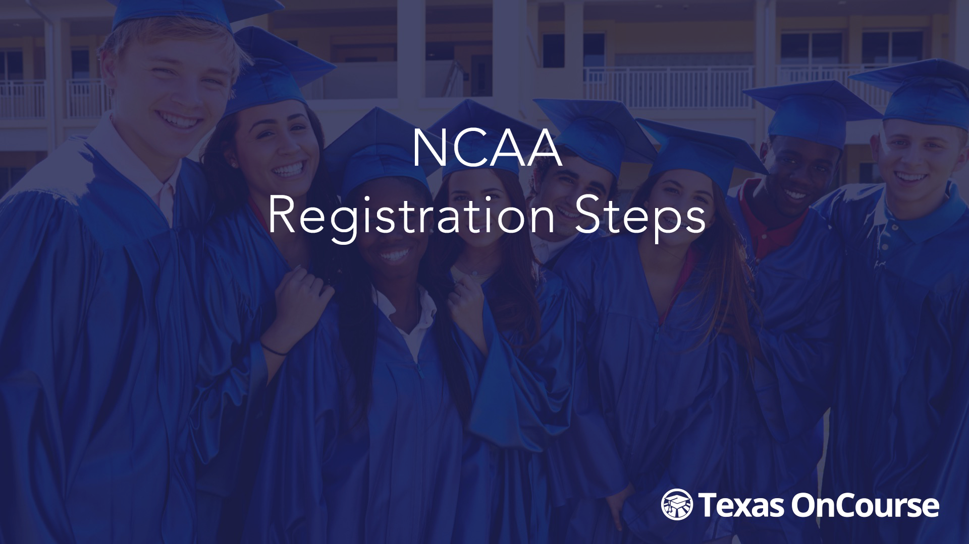

Slide 2
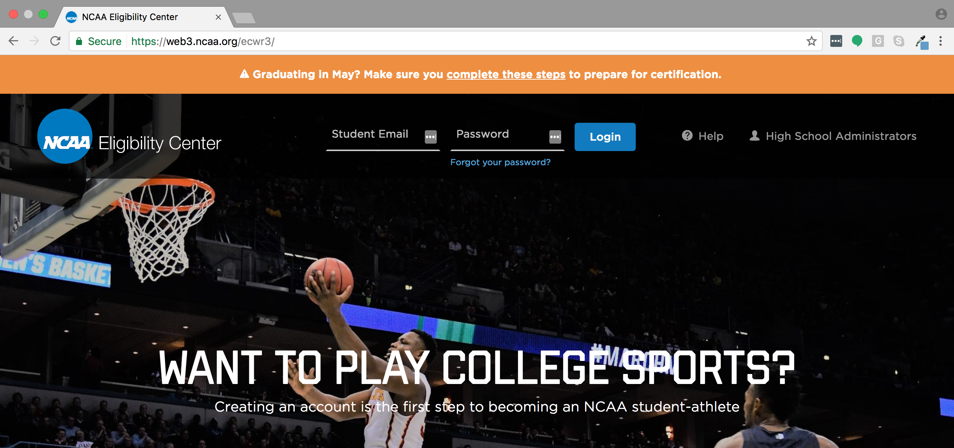
To begin the registration process, go to https://web3.ncaa.org/ecwr3/.

Slide 3
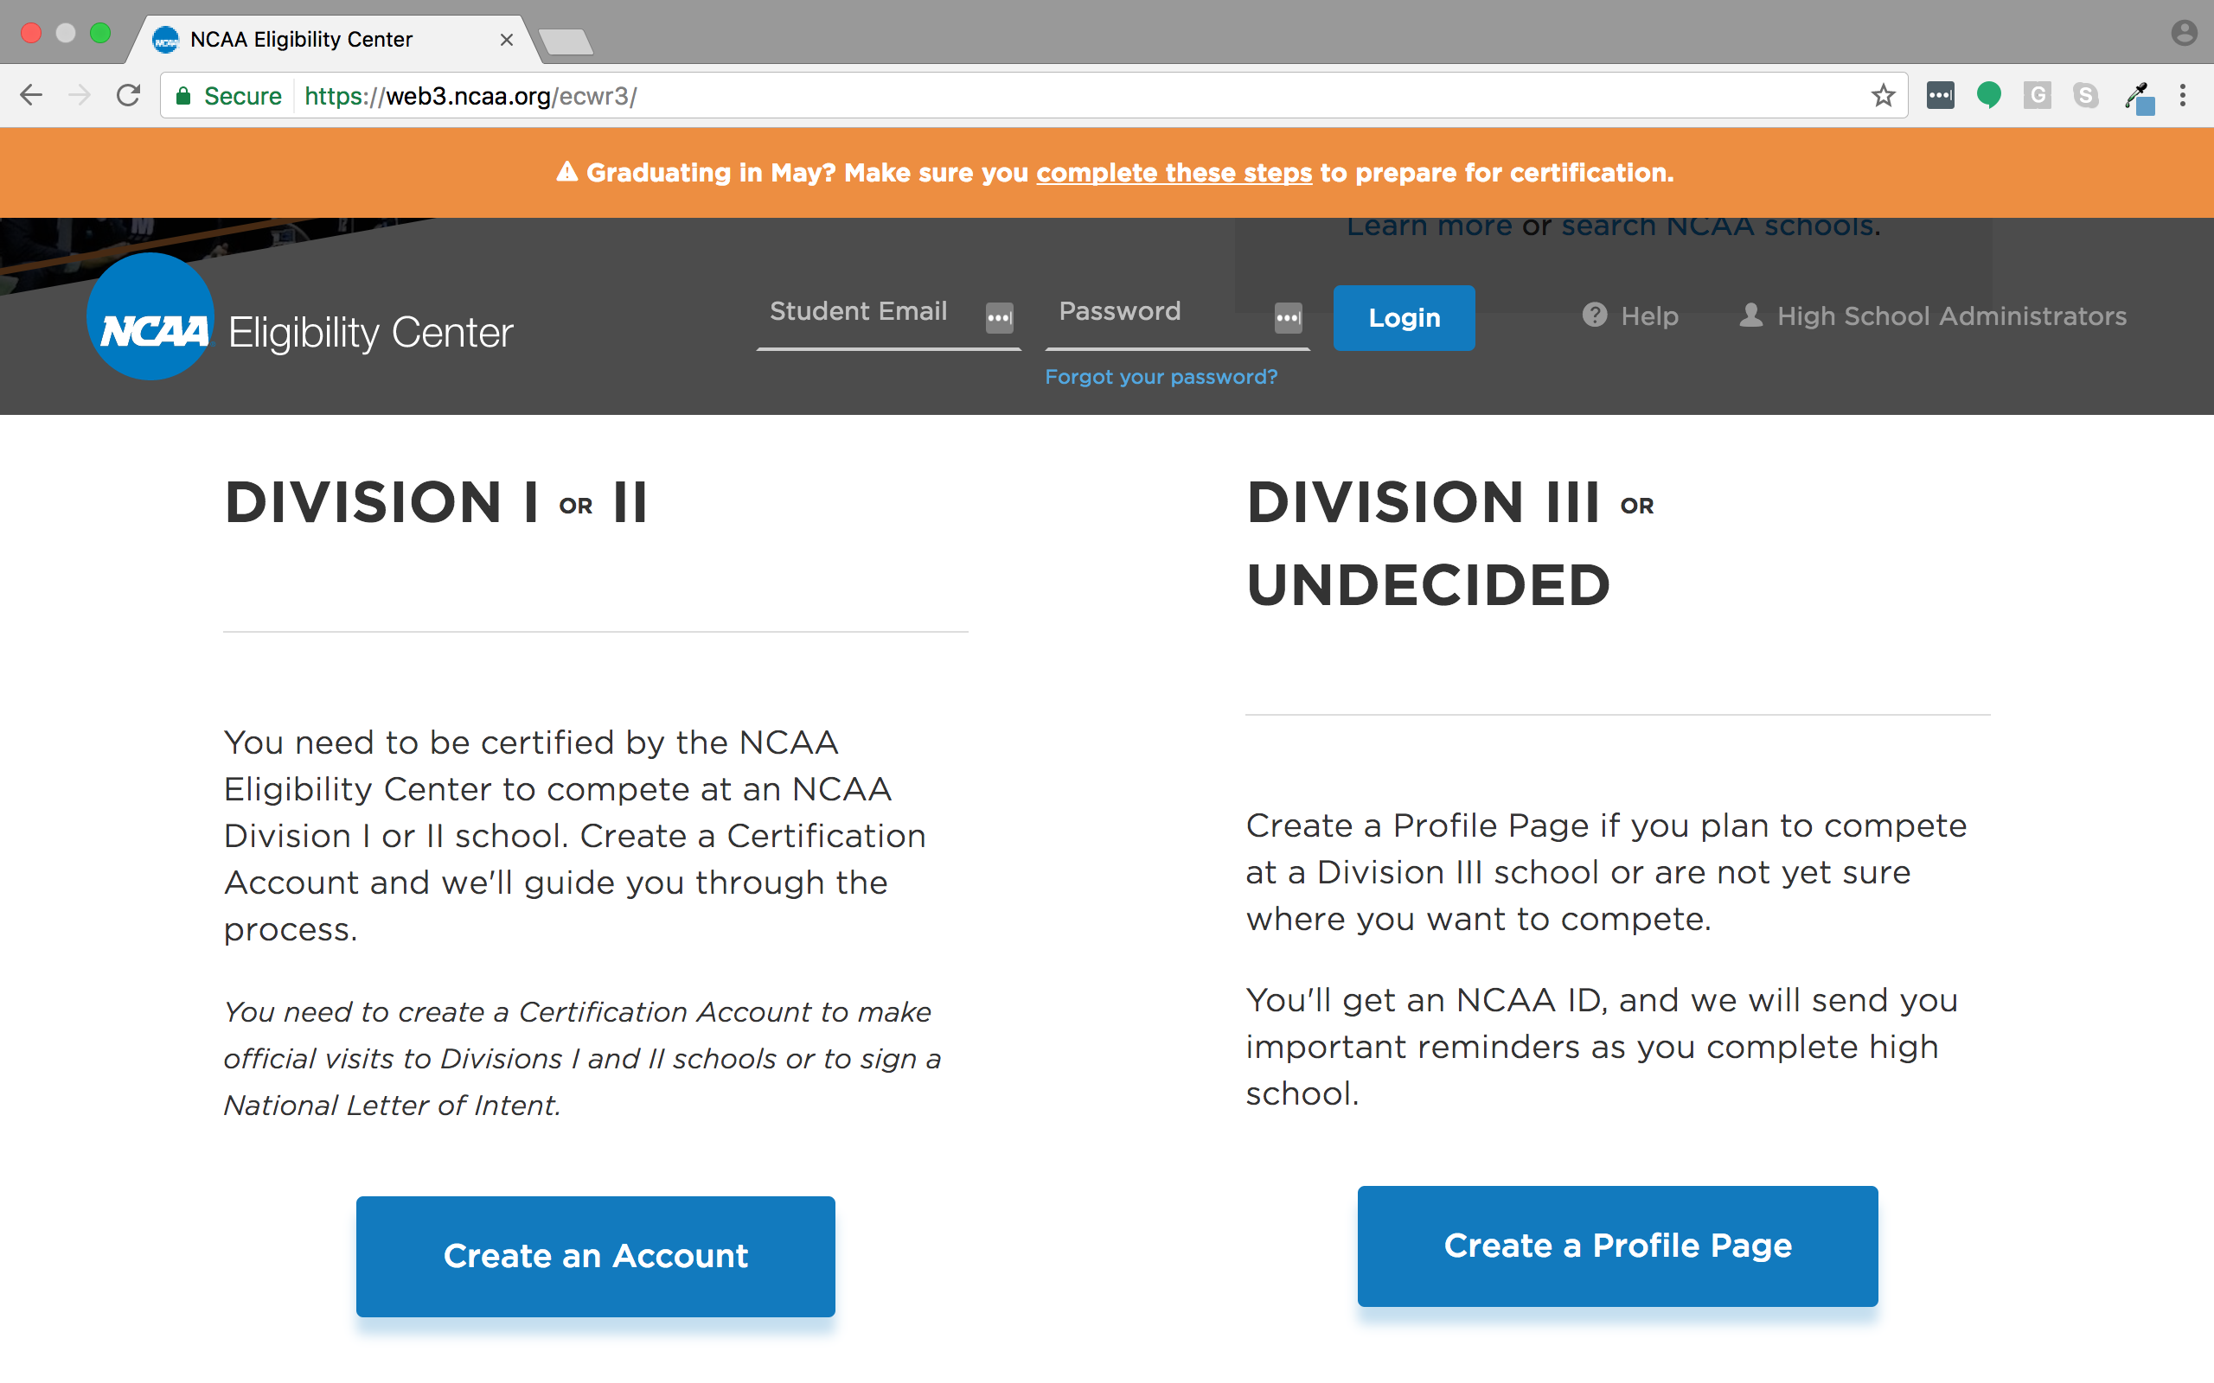
Scroll down the page and click on Create an Account under Division I or II.

Slide 4
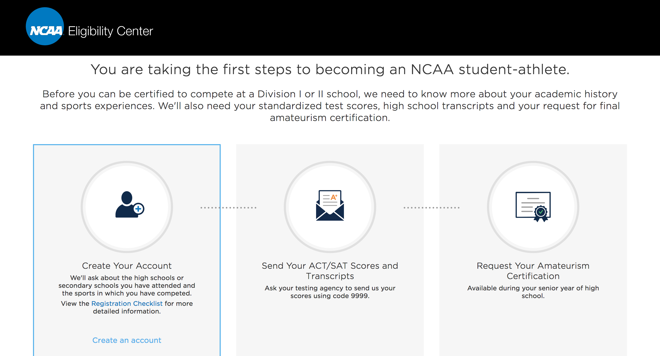
Next, click on Create Your Account. This is the first step toward athletic eligibility. Other steps include sending test scores and requesting an Amateurism Certification.

Slide 5
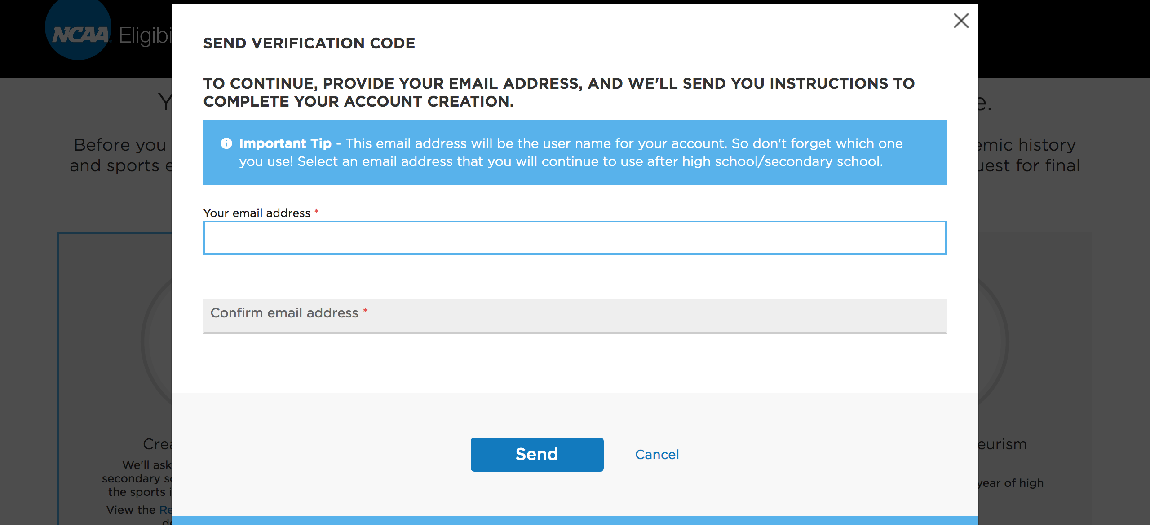
Provide a valid email address (preferably one you will use after high school) for NCAA to send a verification code.

Slide 6
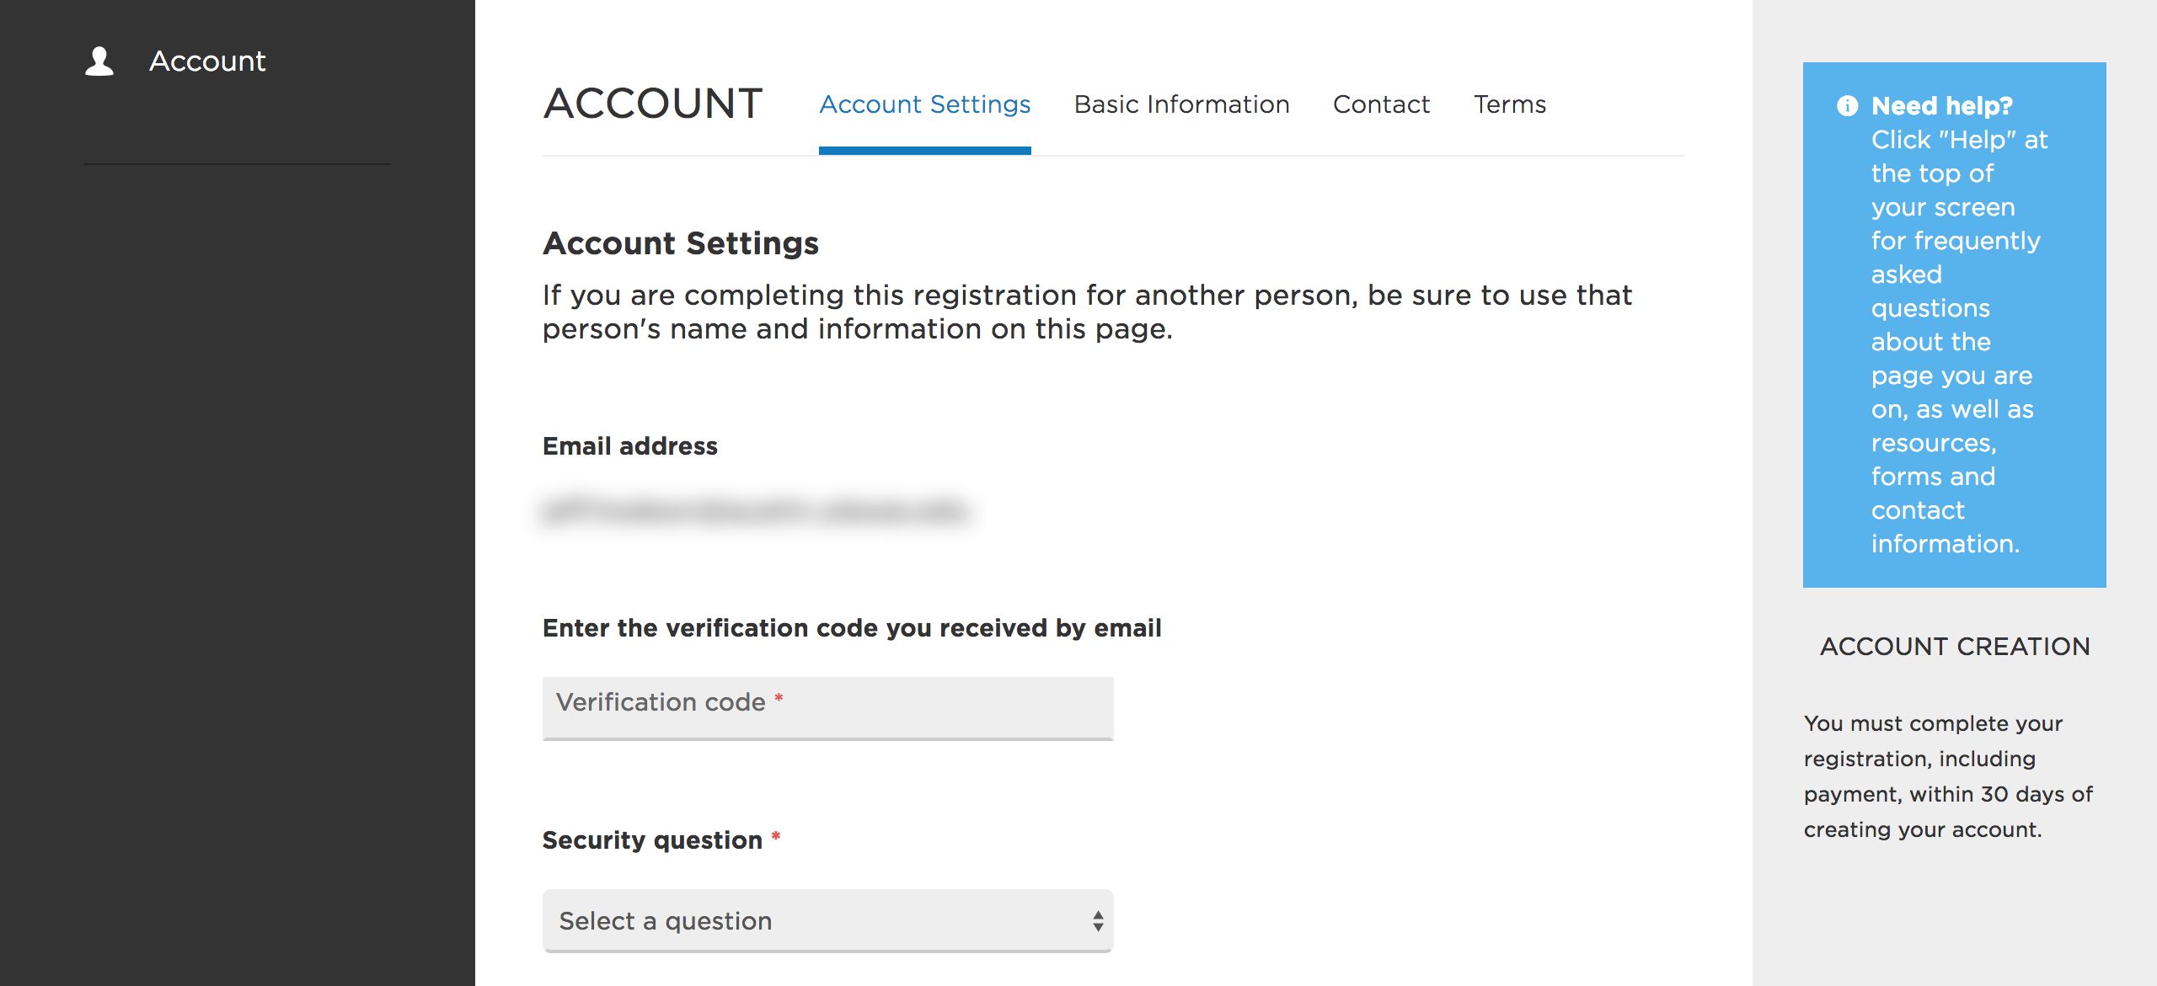
Retrieve the verification code from your email, then on the Account Settings page, enter the verification code, select a security question and answer, and create a password.

Slide 7
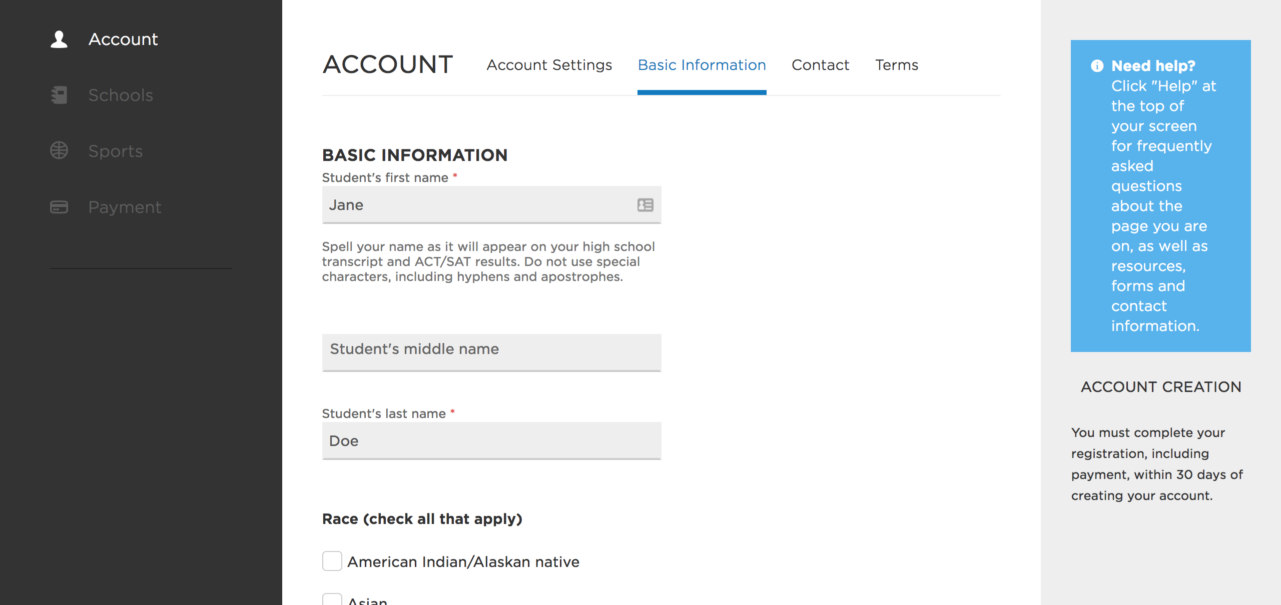
After creating the account, there are four sections to complete: Account, Schools, Sports, and Payment. The Account section asks you to provide basic personal and contact information and agree to the NCAA’s terms and ethics policy.

Slide 8
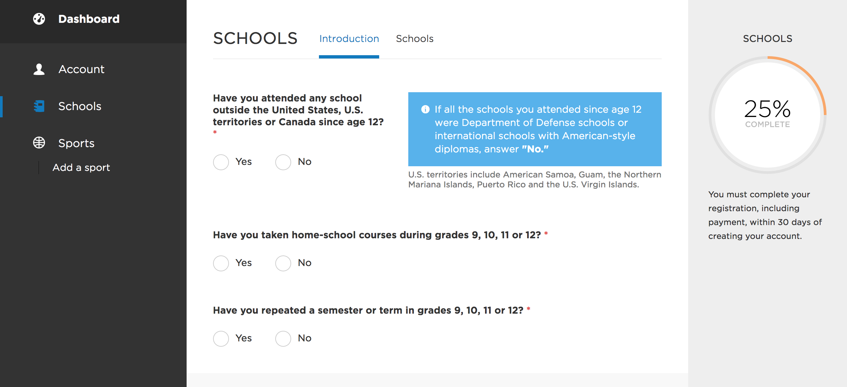
In the Schools section, you must answer some basic questions about your high school experience, including where you attended school, whether you were homeschooled, and whether you repeated a semester or term.

Slide 9
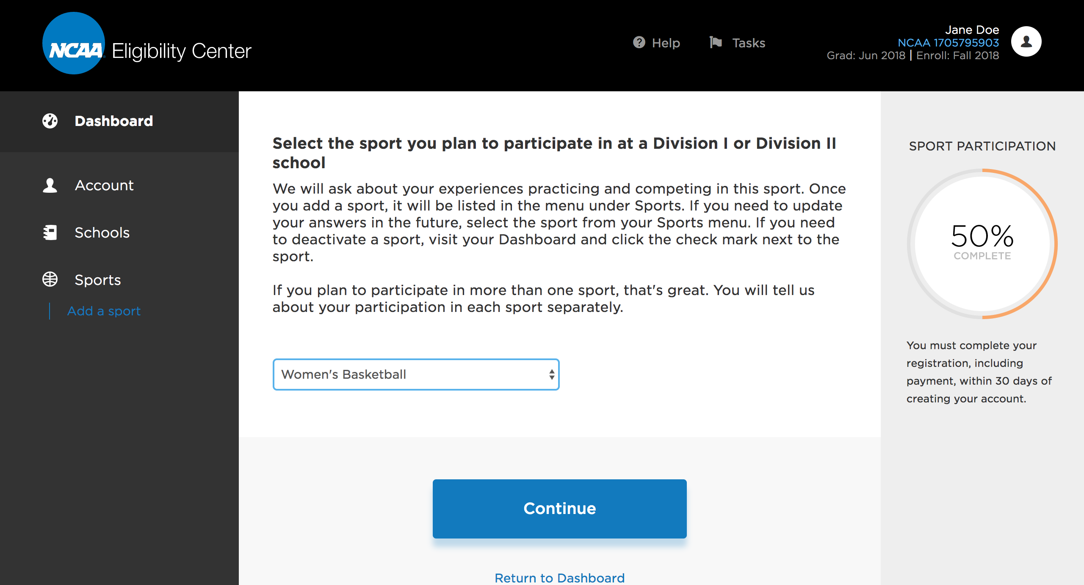
In the Sports section, you’ll select the sport(s) you plan to participate in and answer questions about your amateur status.

Slide 10
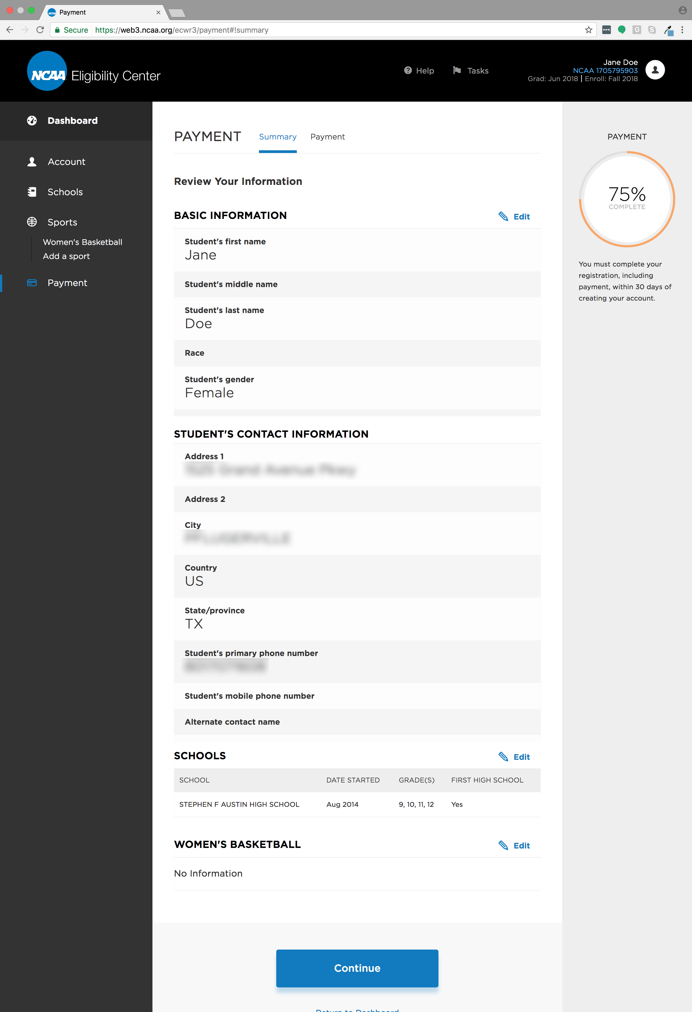
In the Payment section, you’ll review and verify the information you entered from the previous three sections and either pay the registration fee or complete the fee waiver request.

