Slide 1

Northtown
9th grade
Four Year plan of study
Welcome to your future!

Slide 2
Step 1: Name, Grad Year
Please put your FULL name at top
Graduation year next—2024
Diploma option: College/Career Readiness, Gold Medallion, AP Capstone (next slide)
Credits—everyone needs 26!
At the TOP of the PAGE: Write your counselor’s name:
Ms. Shelli Copas—last names A-G
Ms. Amanda Olvera - last names H-O
Ms. Maria Deister- last names P-Z
Ms. Michelle Washington – IB students

Slide 3
Step 2: Diploma options p8
College/Career Readiness | Gold Medallion (Honors) | AP Capstone
26 credits | 26 credits | 26 credits
No modern language | 2 units required | No modern language
No GPA required | 3.25 GPA required | No GPA required
NO AP or Honors required | 8 AP/Honors/Dual credit classes required + AP Seminar | 6 AP classes— AP Seminar junior year AP Research senior year 4 other AP classes
CPEG online

Slide 4

Step 3: 9th grade
Write in all of your 8 classes you are currently enrolled in HERE:

Slide 5
Step 4: English language arts p45
Now you will choose an ELA class for 10th, 11th and 12th
Here are your options:
10th grade courses: ELA II or Pre-IB ELA II
11th grade courses: American Literature, Multicultural Literature, AP Language, AP Literature, College English
12th grade courses: American Literature, Multicultural Literature, AP Language, AP Literature, College English
ELECTIVES: Debate, Journalism, Creative Writing(Launch), Film as Literature (Launch)

Slide 6
Choose one Ela for each year (line1)

Slide 7
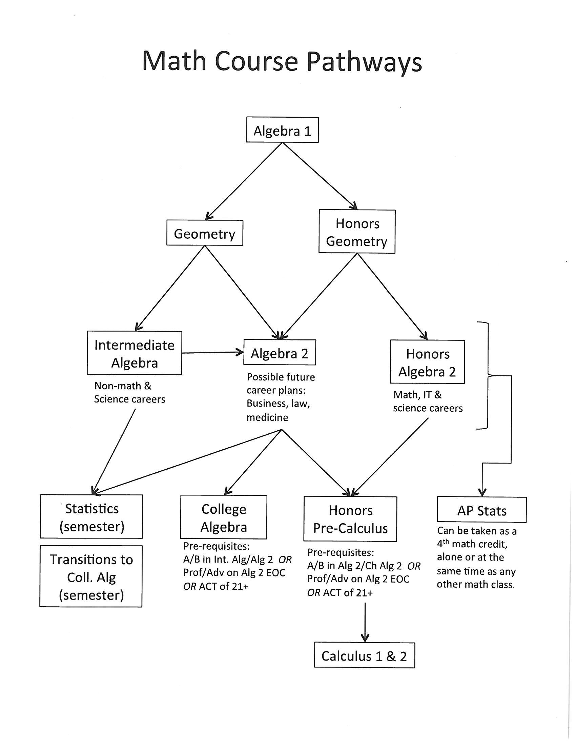
Step 5: Mathematics p51
Choose one math class for each year
See the flow chart for options! Math teachers will recommend courses for you!

Slide 8
Choose one math for each year (Line 2)

Slide 9

Step 6: Science p55
3 required Science courses
9th: Biology or Honors Biology
10th: Chemistry or Honors Chemistry
11th: IF you are interested in the medical field, we have several options:
---Principles of Biomedical Science (can also take this 9th/10th)
---Human Anatomy and Physiology
---Human Body Systems (after Princ Biomedical Sci)
🟡 We will add science courses next year! Stay tuned!

Slide 10
Choose one Science for three Years at least(line 3)
IF you are interested in a science related field, choose science every year!

Slide 11

Step 7: Social studies p60
3 units of Social Studies required
If you are interested in a human services/helping profession such as teaching, social work or law enforcement, you should consider more social studies!
9th: World History, Honors World History, AP Human Geo
10th: US History, Honors US History, AP US History
11th: American Citizen or AP US Government
12th: Any of the other options! Psychology, Sociology, Military history, IB Anthropology, and others!

Slide 12
Choose one social studies for at least three years (line 4)

Slide 13
Step 8: Modern Language p64
Remember, language is not required to graduate with our C/C Readiness diploma, but it IS REQUIRED for Gold Medallion + required for some colleges such as MU/UMKC
We have: French, Spanish, German (Honors and regular sections)

Slide 14
Choose one unit of language for two years IF college bound/Gold Medallion
IF you plan to attend a four year college or plan to earn the Gold Medallion diploma, please choose a modern language for two consecutive years.
Line 5 (or any line) for two years

Slide 15

PE p74
You will need at least one credit of PE to graduate
Please choose at least one PE—BUT, you can have more if you’d like!
PE can be repeated each year if you’d like!!

Slide 16
Health/Personal Finance
You will need both Health (.5 credit) and Personal Finance (.5)
We recommend taking these classes together to make one full credit
They are also good summer school options!

Slide 17
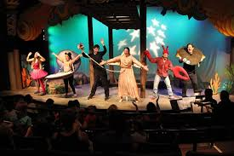


Fine Arts p67
Fine arts are: Music, Art, Theater
You must choose ONE, but can certainly choose to take fine arts every year!

Slide 18






Practical Arts p75
You must choose ONE practical art, but can choose many more!

Slide 19
Electives
You will need 8 classes for all four years; however, we have lots of off campus programs you will learn more about next semester and next year
So, for now, if there aren’t classes from all of our departments that interest you, you may leave some blanks!

Slide 20
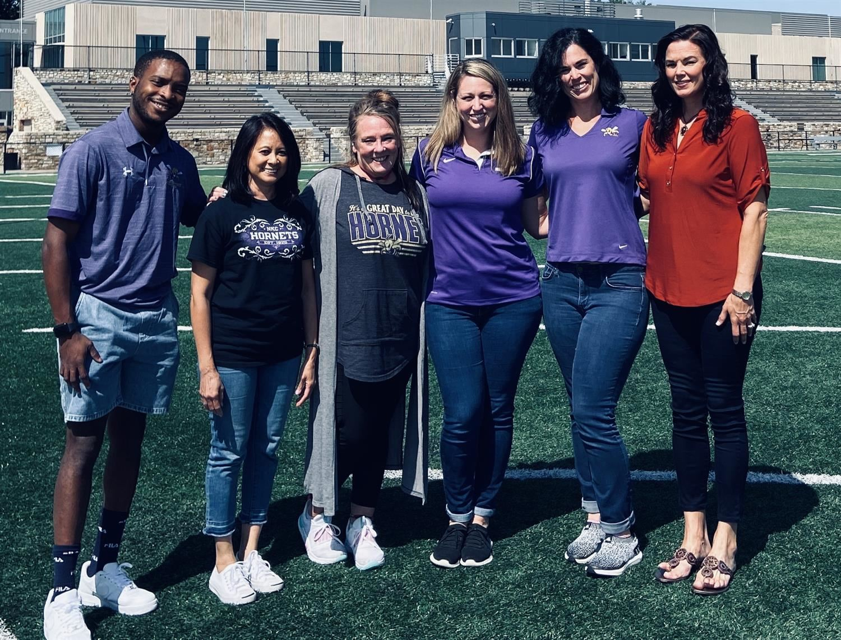
Thank you!
Please contact your counselor for questions and concerns moving forward!
We are here to help you!!! ☺

