Slide 1
GRAPEVINE ELEMENTARY
Talking to Parents
About the English Language Proficiency Assessments for California (ELPAC)

Slide 2
GRAPEVINE ELEMENTARY
Hablando con los padres
Acerca de las evaluaciones de dominio del idioma inglés para California (ELPAC)

Slide 3
The Intent of This Presentation
  This presentation is intended for use to provide information to parents and guardians about the ELPAC. It includes:
    A description of why the ELPAC is given
    Information on who takes the ELPAC
    An overview of test administration for the ELPAC
    Information on how test results are reported
    Available resources for parents related to the ELPAC

Slide 4
El Objetivo de esta Presentación
Esta presentación está diseñada para proporcionar información a los padres y tutores sobre ELPAC. Incluye:
    Una descripción de por qué se da ELPAC
    Información sobre quién toma el ELPAC
    Una descripción general de la administración de pruebas para ELPAC
    Información sobre cómo se informan los resultados de las pruebas.
    Recursos disponibles para padres relacionados con ELPAC

Slide 5
Recommended Handouts
Parent Guide to Understanding
  Available in seven languages
  https://www.cde.ca.gov/ta/tg/ep/elpacparentguide.asp
ELPAC Practice Test Flyer
  http://www.elpac.org/resources/practicetests/

Slide 6
Folletos recomendados
Guía para padres para comprender:
  Disponible en siete idiomas.
  https://www.cde.ca.gov/ta/tg/ep/elpacparentguide.asp
Folleto de prueba práctica de ELPAC
  http://www.elpac.org/resources/practicetests/

Slide 7
Understanding the English Language Proficiency Assessments for California (ELPAC)
Notes:
Good Evening Families!
My name is [insert name] and I’m very excited about all the learning that will take place this year here at [insert school name].
Tonight, I’d like to share with you a few of the ways that we evaluate the progress of our students whose primary language is not English and what we do with that information.
I’ll also talk to you about important ways that you can work in partnership with your child’s teacher to ensure their success.
Let’s get started!

Slide 8
Comprensión de las evaluaciones de dominio del idioma inglés para California (ELPAC)
Notes:
Good Evening Families!
My name is [insert name] and I’m very excited about all the learning that will take place this year here at [insert school name].
Tonight, I’d like to share with you a few of the ways that we evaluate the progress of our students whose primary language is not English and what we do with that information.
I’ll also talk to you about important ways that you can work in partnership with your child’s teacher to ensure their success.
Let’s get started!

Slide 9

About the ELPAC
Sobre el ELPAC
Notes:
California is a very diverse state and many of the students in California speak more than one language.
At this school [44%] of our students are English learners.
Now I’d like to tell you a little bit more about the ELPAC so you know what to expect when your child participates in this test.

Slide 10
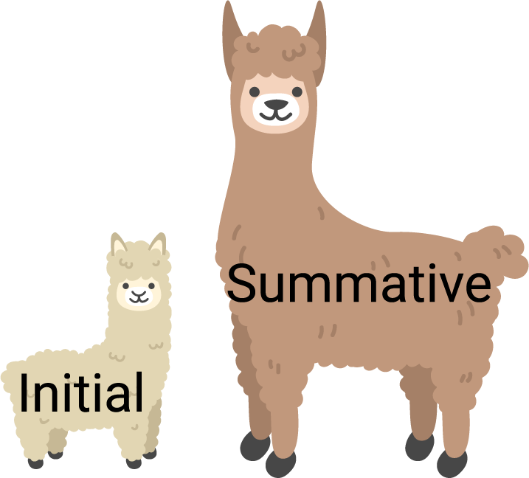
The ELPAC Has Two Assessments
El ELPAC tiene dos evaluaciones
SUMATIVO
INICIAL
Notes:
The first important thing to know is that the ELPAC is made up of two separate tests: the Initial ELPAC and the Summative ELPAC.
Each assessment has a different purpose.
The Initial ELPAC is used to identify a student as either an English learner who needs support to learn English, or as proficient in English.
The Summative ELPAC is used to measure the skills of English learners. The results will help tell the school or district if the student is ready to be reclassified as proficient in English.

Slide 11


Who:Students in grades K through 12
Quién:Estudiantes en grados K a 12
Initial ELPAC
ELPAC Inicial
Summative ELPAC
ELPAC Sumativo
Notes:
Let’s start by answering the question of who takes the ELPAC assessments.
For the Initial ELPAC, the test is given to students who are new to school in California AND whose Home Language Survey indicates a language other than English.
If your child is in their first year of school in California you completed a home language survey that asks what languages you speak at home when you enrolled your child in school.
When you said that your child speaks a language other than English at home, this tells us that we need to give your child the Initial ELPAC so we can learn about their English language proficiency.
The Initial ELPAC is given to students within 30 days of enrollment in a California school.
Students take the Initial ELPAC only once in their school career.
The Summative ELPAC is given to students who have been identified as English learners.
They will take this test each spring to measure their progress in learning English until they are reclassified as English proficient.

Slide 12

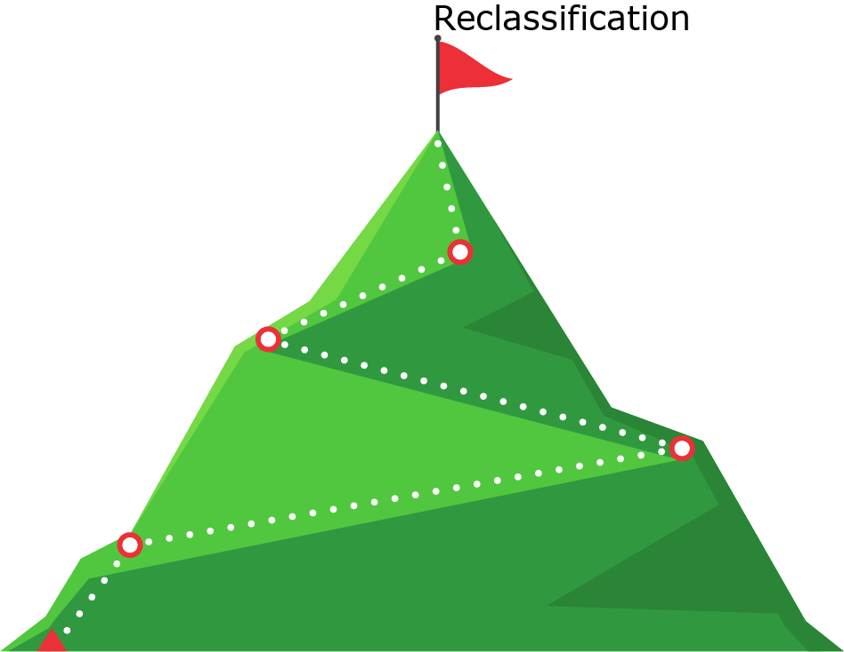
Why - Por que:
Initial ELPAC
ELPAC Inicial
Summative ELPAC
ELPAC Sumativo
Notes:
You may be wondering why students need to take the ELPAC, other than the fact that it is a legal requirement.
The results of the Initial ELPAC are used to determine if your child needs support in learning English.
The Summative ELPAC is the test which will help the teachers gain a better understanding of what type and how much support students need so they can learn in English and be successful in school.
Additionally, and more importantly, it is this annual measure that tells us how much progress students are making in learning English and whether or not they are eligible for reclassification.

Slide 13


What- Que:
Notes:
So far, we have talked about why the ELPAC is given and to which students, but what is it?
The ELPAC is the test that is used to measure how well California students understand English.
This test will give you and your child’s teacher information about your child's progress in learning in English, and how to best support your child at home and at school towards English language proficiency.
When your child takes the ELPAC, they will be tested in four different areas:
Reading
Writing
Listening, and
Speaking

Slide 14

How - Como:
Computer–Based
Basado en computadora
By a Test Examiner
Por un examinador de prueba
In groups or individually
En grupos o individualmente
Notes:
How is the ELPAC given to students?
The ELPAC is transitioning from a paper-pencil test to a computer based test.
They are given by a trained test examiner.
For our youngest students in Kindergarten through 2nd grade, the test is given individually.
Grade two Listening and Reading will be computer-based and administered one-on-one. However, the Writing domain in grade two will continue to be paper-based and delivered in small groups.
For students in grade three and above, the Listening, Reading, and Writing section is administered in a group. The Speaking section is always done individually.

Slide 15
When- Cuando:
Initial ELPAC- ELPAC Inicial
July 1 – June 30
Julio 1- Junio 30
Summative ELPAC
ELPAC Sumativo
Feb 1 – May 31
Feb 1- Mayo 31
Notes:
The Initial ELPAC can be given year round because it needs to be given to new students within 30 days of enrollment.
The Summative ELPAC is given each spring between February 1 and May 31.
The ELPAC will be given to students at [insert school name] starting on [insert first day of testing].

Slide 16
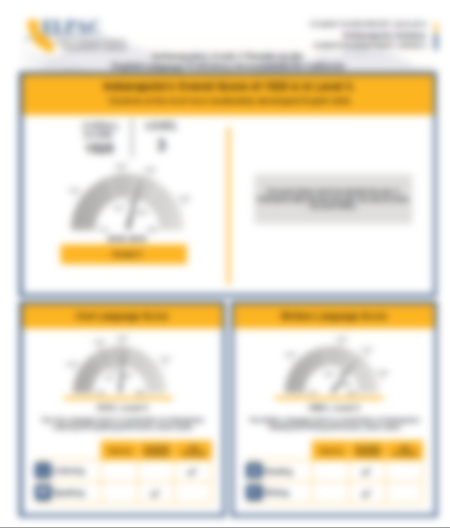
Scores:
Resultados:
Notes:
[BEFORE PRESENTING, SELECT THE SCORE REPORT IMAGE ON THIS SLIDE. GO TO THE “FORMAT” TAB ON THE TOP TOOLBAR. SELECT THE “RESET PICTURE” BUTTON TO REMOVE THE BLUR EFFECT AND REVEAL THE DETAILED REPORT.]
Your child will receive a Score Report that looks like this one for the Summative ELPAC.
Students who take the ELPAC will receive scores in the summer or fall.
[Insert more specific information about the timing of this report for your school]
It will have their overall score which is a four-digit number.
The overall level will be 1, 2, 3, or 4, where 4 is the highest level and means that the student has a good understanding of English.
Your child will also receive level scores for Oral Language that includes Listening and Speaking and Written Language that includes Reading and Writing. The level score will be one of the following:
Beginning
Somewhat/Moderately, or
Well Developed

Slide 17

Starting Smarter
Comenzando con el buen pie
https://elpac.startingsmarter.org
Notes:
The California Department of Education has created a new website for families who want additional information about the student score reports; ca.startingsmarter.org.
This website has sample student score reports, additional information on the claim areas for ELA and mathematics, as well as resources for families. Those resources include a link to the learning heroes site, a flyer on how to have an effective parent teacher conference, as well as links to the practice tests.
On this website, among other valuable resources, you will find a document created in collaboration with the Parent Teacher Association (PTA) that gives parents additional guidance on what questions to ask teachers in order to create the most supportive environment for your children.

Slide 18
Videos
English :
https://youtu.be/HS8cVQin_fc
Spanish: https://www.youtube.com/watch?v=sAZAsNNir5o
Notes:
[ BEFORE PRESENTING, YOU MAY CHOOSE TO EMBED THIS VIDEO ON THE SLIDE. IN THE “INSERT” TAB ON THE TOP MENU, SELECT THE “VIDEO” BUTTON, FOLLOWED BY “ONLINE VIDEO” FROM THE DROP-DOWN MENU. PASTE THE FOLLOWING URL INTO THE YOUTUBE SEARCH BOX: https://youtu.be/HS8cVQin_fc (THE SAME URL THAT APPEARS ON THE SLIDE) WHICH WILL LEAD TO THE CALIFORNIA STARTING SMARTER OVERVIEW VIDEO ]
There is a video available that helps explain the starting smarter website to families.

Slide 19

Ask your child’s teacher:
  In what areas is my child doing well?
  In what areas might my child need some extra support?
  How can I help support my child at home?
  How are you supporting my child at school?
Notes:
At the start of this presentation I talked about the partnership between you and your child’s teacher.
Your child’s teacher is the best person to talk to about what your child is learning.
The best time to contact your child’s teacher is either before or after school. Ask your child’s teacher about how they like to be contacted – either by phone or via e-mail.
When you talk to your child’s teacher, ask him/her specific questions about your child, ask:
Where is my child doing well?
Where might my child need some extra support?
Who will provide that extra support?
How can I and other family members help at home?
Those are just a few examples of how to start a conversation with your child’s teacher.

Slide 20
Pregunten a su maestra/o:
  ¿En qué áreas está bien mi hijo/a?
  ¿En qué áreas podría mi hijo/a necesitar apoyo adicional?
  ¿Cómo puedo ayudar a mantener a mi hijo/a en casa?
  ¿Cómo estás apoyando a mi hijo/a en la escuela?
Notes:
At the start of this presentation I talked about the partnership between you and your child’s teacher.
Your child’s teacher is the best person to talk to about what your child is learning.
The best time to contact your child’s teacher is either before or after school. Ask your child’s teacher about how they like to be contacted – either by phone or via e-mail.
When you talk to your child’s teacher, ask him/her specific questions about your child, ask:
Where is my child doing well?
Where might my child need some extra support?
Who will provide that extra support?
How can I and other family members help at home?
Those are just a few examples of how to start a conversation with your child’s teacher.

Slide 21

Help Your Child Succeed
Read with your child
Ask your child to tell you what he or she sees in the picture or what is happening in the picture.
Provide your child with opportunities to use language
Notes:
Additionally, here are a few other ways that you can help your child be successful:
[For elementary schools]
Encourage your child to read daily.
[For middle and high schools]
Your child will likely have homework every day. You can help support their success by making sure your child has a quiet place at home to do that work that is free from distractions.
[For all students]
When it’s time for testing, talk to your child about the test. Make sure your child knows that the tests are important, but they are just one measure of learning. The teacher uses that information along with other information to make sure your child is getting the support they need.
If you’re interested, the California Department of Education has also developed ELPAC Practice Tests that you can access from home on the computer. You can look at sample test questions and get familiar with the way questions are presented on the computer. More information about the ELPAC Practice Tests are on the Parent Resources flyer that you received today/tonight.

Slide 22
Ayude a su hijo/a a tener éxito
Lee con tu hijo/a
Pídale a su hijo/a que le diga qué ve en la imagen o qué está sucediendo en la imagen.
Brinde a su hijo/a oportunidades para usar el lenguaje
Notes:
Additionally, here are a few other ways that you can help your child be successful:
[For elementary schools]
Encourage your child to read daily.
[For middle and high schools]
Your child will likely have homework every day. You can help support their success by making sure your child has a quiet place at home to do that work that is free from distractions.
[For all students]
When it’s time for testing, talk to your child about the test. Make sure your child knows that the tests are important, but they are just one measure of learning. The teacher uses that information along with other information to make sure your child is getting the support they need.
If you’re interested, the California Department of Education has also developed ELPAC Practice Tests that you can access from home on the computer. You can look at sample test questions and get familiar with the way questions are presented on the computer. More information about the ELPAC Practice Tests are on the Parent Resources flyer that you received today/tonight.

Slide 23
Learn More:
Review the Parent Guide to Understanding
  Available in seven languages
  https://www.cde.ca.gov/ta/tg/ep/elpacparentguide.asp
Take an ELPAC Practice Test with your child at home
  http://www.elpac.org/resources/practicetests/
Notes:
The California Department of Education has developed a series called the Parent Guide to Understanding. These are designed to be simple overview that answer the critical questions of what, why, who, how, and when about each assessment.
[NOTE: Suggest providing parents a printed copy of the Parent Guide to Understanding the ELPAC]
You can find those on the Web site listed on this slide.
There are also practice tests available that will help you and your child understand the type of test questions that they might receive. You can take the practice tests from home with your child.

Slide 24
Learn More:
Revise la Guía para padres para comprender
Disponible en siete idiomas.
https://www.cde.ca.gov/ta/tg/ep/elpacparentguide.asp
Tome una prueba de práctica ELPAC con su hijo en casa
http://www.elpac.org/resources/practicetests/
Notes:
The California Department of Education has developed a series called the Parent Guide to Understanding. These are designed to be simple overview that answer the critical questions of what, why, who, how, and when about each assessment.
[NOTE: Suggest providing parents a printed copy of the Parent Guide to Understanding the ELPAC]
You can find those on the Web site listed on this slide.
There are also practice tests available that will help you and your child understand the type of test questions that they might receive. You can take the practice tests from home with your child.

Slide 25
ELPAC Dates
2nd Grade-5th Grade (Individual-Speaking/2nd Grade All Tests)
March 4th-9th
3rd-5th Grade (Group-Listening, Writing, Reading)
March 9th-20th
Tk-1st Grade (Individual-Listening, Speaking, Reading, Writing)
April 8th-9th

Slide 26

Questions- Preguntas
Notes:
That brings us to the end of today/tonight’s presentation.
We’ll take a moment to answer some of your questions now.
Thank you for coming today/tonight!

