Slide 1

Writing the extended essay!
The Purdue OWL is your friend!

Slide 2
MLA 8th Edition Formatting and Style Guide
Purdue OWL Staff
Brought to you in cooperation with the Purdue Online Writing Lab
Notes:
Welcome to “MLA Formatting and Style Guide“. This Power Point Presentation is designed to introduce your students to the basics of MLA Formatting and Style. You might want to supplement the presentation with more detailed information available on the OWL’s “MLA Formatting and Style Guide“ at http://owl.english.purdue.edu/owl/resource/747/01/
Designer: Ethan Sproat
Based on slide designs from the OWL “APA Formatting and Style Guide “powerpoint by Jennifer Liethen Kunka and Elena Lawrick.
Contributors: Tony Russell, Alllen Brizee, Jennifer Liethen Kunka, Joe Barbato, Dave Neyhart, Erin E. Karper, Karl Stolley, Kristen Seas, Tony Russell, and Elizabeth Angeli.
Revising Author: Arielle McKee, 2014

Slide 3
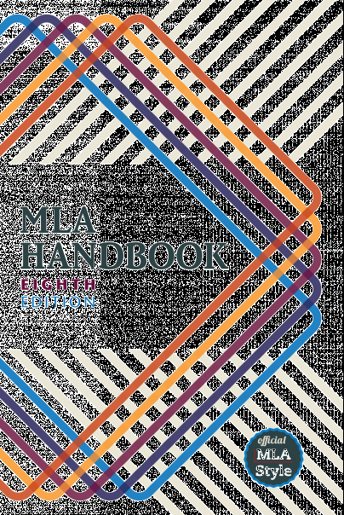
MLA regulates:
document format
in-text citations
works-cited list
Notes:
This slide presents three basic areas regulated by MLA students need to be aware of—document format, in-text citations, and works cited. The following slides provide detailed explanations regarding each area.

Slide 4
Overview
This presentation will cover:
  How to format a paper in MLA style (7th or 8th ed.)
    General guidelines
    In-text citations
      Formatting quotations
      More than one way to cite a source
    Introductions & Conclusions
    Note-taking
    Section headings
    Works Cited

Slide 5
General Guidelines
An MLA Style paper should:
  Be typed on white 8.5“ x 11“ paper
  Double-space everything
  Use 12 pt. Calibri (or similar) font
  Leave only one space after punctuation
  Set all margins to 1 inch on all sides
  Indent the first line of paragraphs one half-inch
Notes:
The entire document should be double-spaced, including the heading, block quotations, and list of works cited. There should be no extra space between paragraphs.
Leave only one space after periods or other punctuation marks (unless otherwise instructed by your instructor).
Set the margins of your document to 1 inch on all sides
Indent the first line of paragraphs one half-inch from the left margin. MLA recommends that you use the Tab key as opposed to pushing the Space Bar five times.

Slide 6
General Guidelines
(Continued)
An MLA Style paper should:
Have a header with page numbers located in the upper right-hand corner
Use italics for resource titles
Use quotation marks for article titles
Place works cited on a separate page at the end
Notes:
Create a header that numbers all pages consecutively in the upper right-hand corner, one-half inch from the top and flush with the right margin. (Note: Your instructor may ask that you omit the number on your first page. Always follow your instructor's guidelines.)
･Use italics throughout your essay for the titles of longer works
･If you have any endnotes, include them on a separate page before your works-cited list. Title the section Notes (centered, unformatted).

Slide 7
In-Text Citations
(The Basics)
An in-text citation is a brief reference in your text that indicates the source you consulted.
  It should direct readers to the entry in your works-cited list for that source.
  It should be unobtrusive: provide the citation information without interrupting your own text.
  In general, the in-text citation will be the author’s last name (or abbreviated title), enclosed in parentheses.
Notes:
Basic In-Text Citation Rules
The source information in a parenthetical citation should direct readers to the source’s entry in the works-cited list.
The in-text citation should be placed, if possible, where there is a natural pause in your text. If the citation refers to a direct quotation, it should be placed directly following the closing quotation mark.
Any source information that you provide in-text must correspond to the source information on the works-cited page. More specifically, whatever signal word or phrase you provide to your readers in the text, must be the first thing that appears on the left-hand margin of the corresponding entry in the works-cited list (so the author’s last name or the title, usually, with no punctuation in between)

Slide 8
In-Text Example
In-Text Example:
Wordsworth stated that Romantic poetry was marked by a “spontaneous overflow of powerful feelings”.
Romantic poetry is characterized by the “spontaneous overflow of powerful feelings” (Wordsworth).
Wordsworth, William. Lyrical Ballads. Oxford UP, 1967.
If the essay provides a signal word or phrase—usually the author’s last name—the citation does not need to also include that information.
Notes:
In-Text Citations: Author-Page Style
MLA format follows the author-page method of in-text citation. This means that the author's last name and the page number(s) from which the quotation or paraphrase is taken must appear in the text, and a complete reference should appear in your works-cited page. The author's name may appear either in the sentence itself or in parentheses following the quotation or paraphrase, but the page number(s) should always appear in the parentheses, not in the text of your sentence.
Since the majority (if not all) of the resources are from online databases, the examples are shown for those, not books with page numbers.
Both citations in the in-text examples on this slide, tell readers that the information in the is a work by the author, William Wordsworth. If readers want more information about this source, they can turn to the works-cited list, where, under Wordsworth, they would find the information in the corresponding entry also shown on this slide.

Slide 9
How to cite a work with no known author:
We see so many global warming hotspots in North America likely because this region has “more readily accessible climatic data and more comprehensive programs to monitor and study environmental change…” (“Impact of Global Warming”).
Corresponding Entry in the List of Works Cited:
“The Impact of Global Warming in North America.” Global Warming: Early Signs. 2015. Accessed 23 Mar. 2017.
Notes:
In-text Citations for Print Sources with No Known Author
When a source has no known author, use a shortened title of the work instead of an author name. Place the title in quotation marks if it's a short work (e.g. articles) or italicize it if it's a longer work (e.g. plays, books, television shows, entire websites) and provide a page number.
In this example, since the reader does not know the author of the article, an abbreviated title of the article appears in the parenthetical citation which corresponds to the full name of the article which appears first at the left-hand margin of its respective entry in the works-cited list. Thus, the writer includes the title in quotation marks as the signal phrase in the parenthetical citation in order to lead the reader directly to the source on the works-cited page.

Slide 10
Work by Multiple Authors
In-text Examples:
Smith et al. argues that tougher gun control is not needed in the United States.
The authors state: “Tighter gun control in the United States erodes Second Amendment rights” (Smith et al.).
A 2016 study suggests that stricter gun control in the United States will significantly prevent accidental shootings (Strong and Ellis).
Notes:
Citing a Work by Multiple Authors
If the entry in the works-cited list begins with the names of two authors, include both last names in the in-text citation, connected by and.
If the source has three or more authors, the entry in the works-cited list should begin with the first author’s name followed by et al. The in-text citation should follow suit.

Slide 11
Writing an Introduction
Hook
Transition / Background Information
Thesis Statement
Sometimes the introduction is written after the body of the paper is completed

Slide 12
Writing an Introduction
Hook (A sentence used to draw in the reader)
Three types of hooks:
Anecdote (a short story or a quote about a person or event)
  Reading Shakespeare’s tragic love story Romeo & Juliet for high school English class was never meant to be a trigger for a teenage suicide.
Statistic (a shocking statistic can be used to introduce the topic and make the reader want to read more)
  For teenagers in the United States, suicide ranks second only to accidents as the leading cause of death.
Thoughtful Question (used to make the reader think deeply about your topic.)
  What would you do if your best friend told you they felt like a burden to their family and wanted to give you all of their prized possessions?

Slide 13
Writing an Introduction
2. Transition or Background Information
A sentence or two that explains the hook and transitions to the thesis.
Introduces the main points
Explains why the topic is important

Slide 14
Writing an Introduction
3. Thesis Statement
A thesis statement focuses your ideas into one or two sentences. It should present the topic of your paper and also make a comment about your position in relation to the topic. Your thesis statement should tell your reader what the paper is about and also help guide your writing and keep your argument focused.
Purdue OWL – General Writing – The Writing Process – Creating a Thesis Statement.
Sometimes the introduction is written after the body of the paper is completed

Slide 15
Writing a Conclusion
Conclusions wrap up what you have been discussing in your paper. After moving from general to specific information in the introduction and body paragraphs, your conclusion should begin pulling back into more general information that restates the main points of your argument. Conclusions may also call for action or overview future possible research.

Slide 16
Writing a Conclusion
The following outline may help you conclude your paper:
In a general way,
Restate your topic and why it is important,
Restate your thesis/claim,
Address opposing viewpoints and explain why readers should align with your position,
Call for action or overview future research possibilities.

Slide 17
Writing a Conclusion
Remember that once you accomplish these tasks, you are finished. Done. Complete. Don't try to bring in new points or end with a whiz bang conclusion or try to solve world hunger in the final sentence of your conclusion. Simplicity is best for a clear, convincing message.
The preacher's maxim is one of the most effective formulas to follow for argument papers:
Tell what you're going to tell them (introduction).
Tell them (body).
Tell them what you told them (conclusion).

Slide 18
Note Taking
Note cards or electronic file
Print your articles (make sure citation is at the top)
Number your articles and put corresponding number at top of note card (for in-text citations)
Use your outline as a guide
Note card suggested comments
Short description of what card’s about Source #
Quote/paraphrase/summary
Sample note card
Description of well blowout near Taft Source 3
“The fire raged uncontrolled, blasting from the gaping mouth of the well, leaping in a wide column an estimated 600 feet into the air. The steel derrick was torn to pieces.”

Slide 19
Note Taking
Using your printed articles, annotated bibliography & outline you will start writing notes that will form the basis of your paper
  Old-fashioned index cards
  Word or Google Docs
  Google Keep
Paraphrasing
Summarizing
Quoting

Slide 20
MLA Formatting
In the Fall we will complete:
Title Page
Table of contents
Page numbering
Notes:
･In the upper left-hand corner of the first page, list your name, your instructor's name, the course, and the date. Again, be sure to use double-spaced text.
･Double space again and center the title.
Do not underline, italicize, or place your title in quotation marks; write the title in Title Case (standard capitalization), not in all capital letters.
･Use quotation marks and/or italics when referring to other works in your title, just as you would in your text: Fear and Loathing in Las Vegas as Morality Play; Human Weariness in “After Apple Picking“
･Double space between the title and the first line of the text.

Slide 21

Section Headings
  Headings should be consistent in grammar and formatting but, otherwise, are up to you
Notes:
Section Headings
Writers sometimes use Section Headings to improve a document’s readability. These sections may include individual chapters or other named parts of a book or essay.
Essays
They can be numbered if they are also numbered in the Table of Contents.

Slide 22
Works Cited List
Authors
Author.
Begin the entry with the author’s last name, followed by a comma and the rest of the name, as presented in the work. End this element with a period.
Examples:
Baron, Naomi S. “Redefining Reading: The Impact of Digital
Communication Media.” PMLA, vol. 128, no. 1, Jan. 2013, pp.
193-200.
Jacobs, Alan. The Pleasures of Reading in an Age of Distraction.
Oxford UP, 2011.
Notes:
While these examples are in different mediums (the first one is a periodical, the second is a printed book), they are both formatted according to the list of key elements. Note: there are other types of author situations, such as multiple authors, translators, editors, corporate authors, performers, and pseudonyms (such as online user names). Refer to the 8th edition handbook or the MLA online Style Center https://style.mla.org/ for more information.

Slide 23
Work Cited
Titles
Title of source.
Books and websites should be in italics:
Hollmichel, Stefanie. So Many Books. 2003-13, somanybooksblog.com.
Linett, Maren Tova. Modernism, Feminism, and Jewishness. Cambridge
UP, 2007.
Periodicals (journal, magazine, newspaper article), television episodes, and songs should be in quotation marks:
Beyoncé. “Pretty Hurts.” Beyoncé, Parkwood Entertainment, 2013,
www.beyonce .com/album/beyonce/?media_view=songs.
Goldman, Anne. “Questions of Transport: Reading Primo Levi Reading
Dante.” The Georgia Review, vol. 64, no. 1, 2010, pp. 69-88.
Notes:
The title of the source should follow the author’s name. Depending upon the type of source, it should be listed in italics or quotation marks.

Slide 24
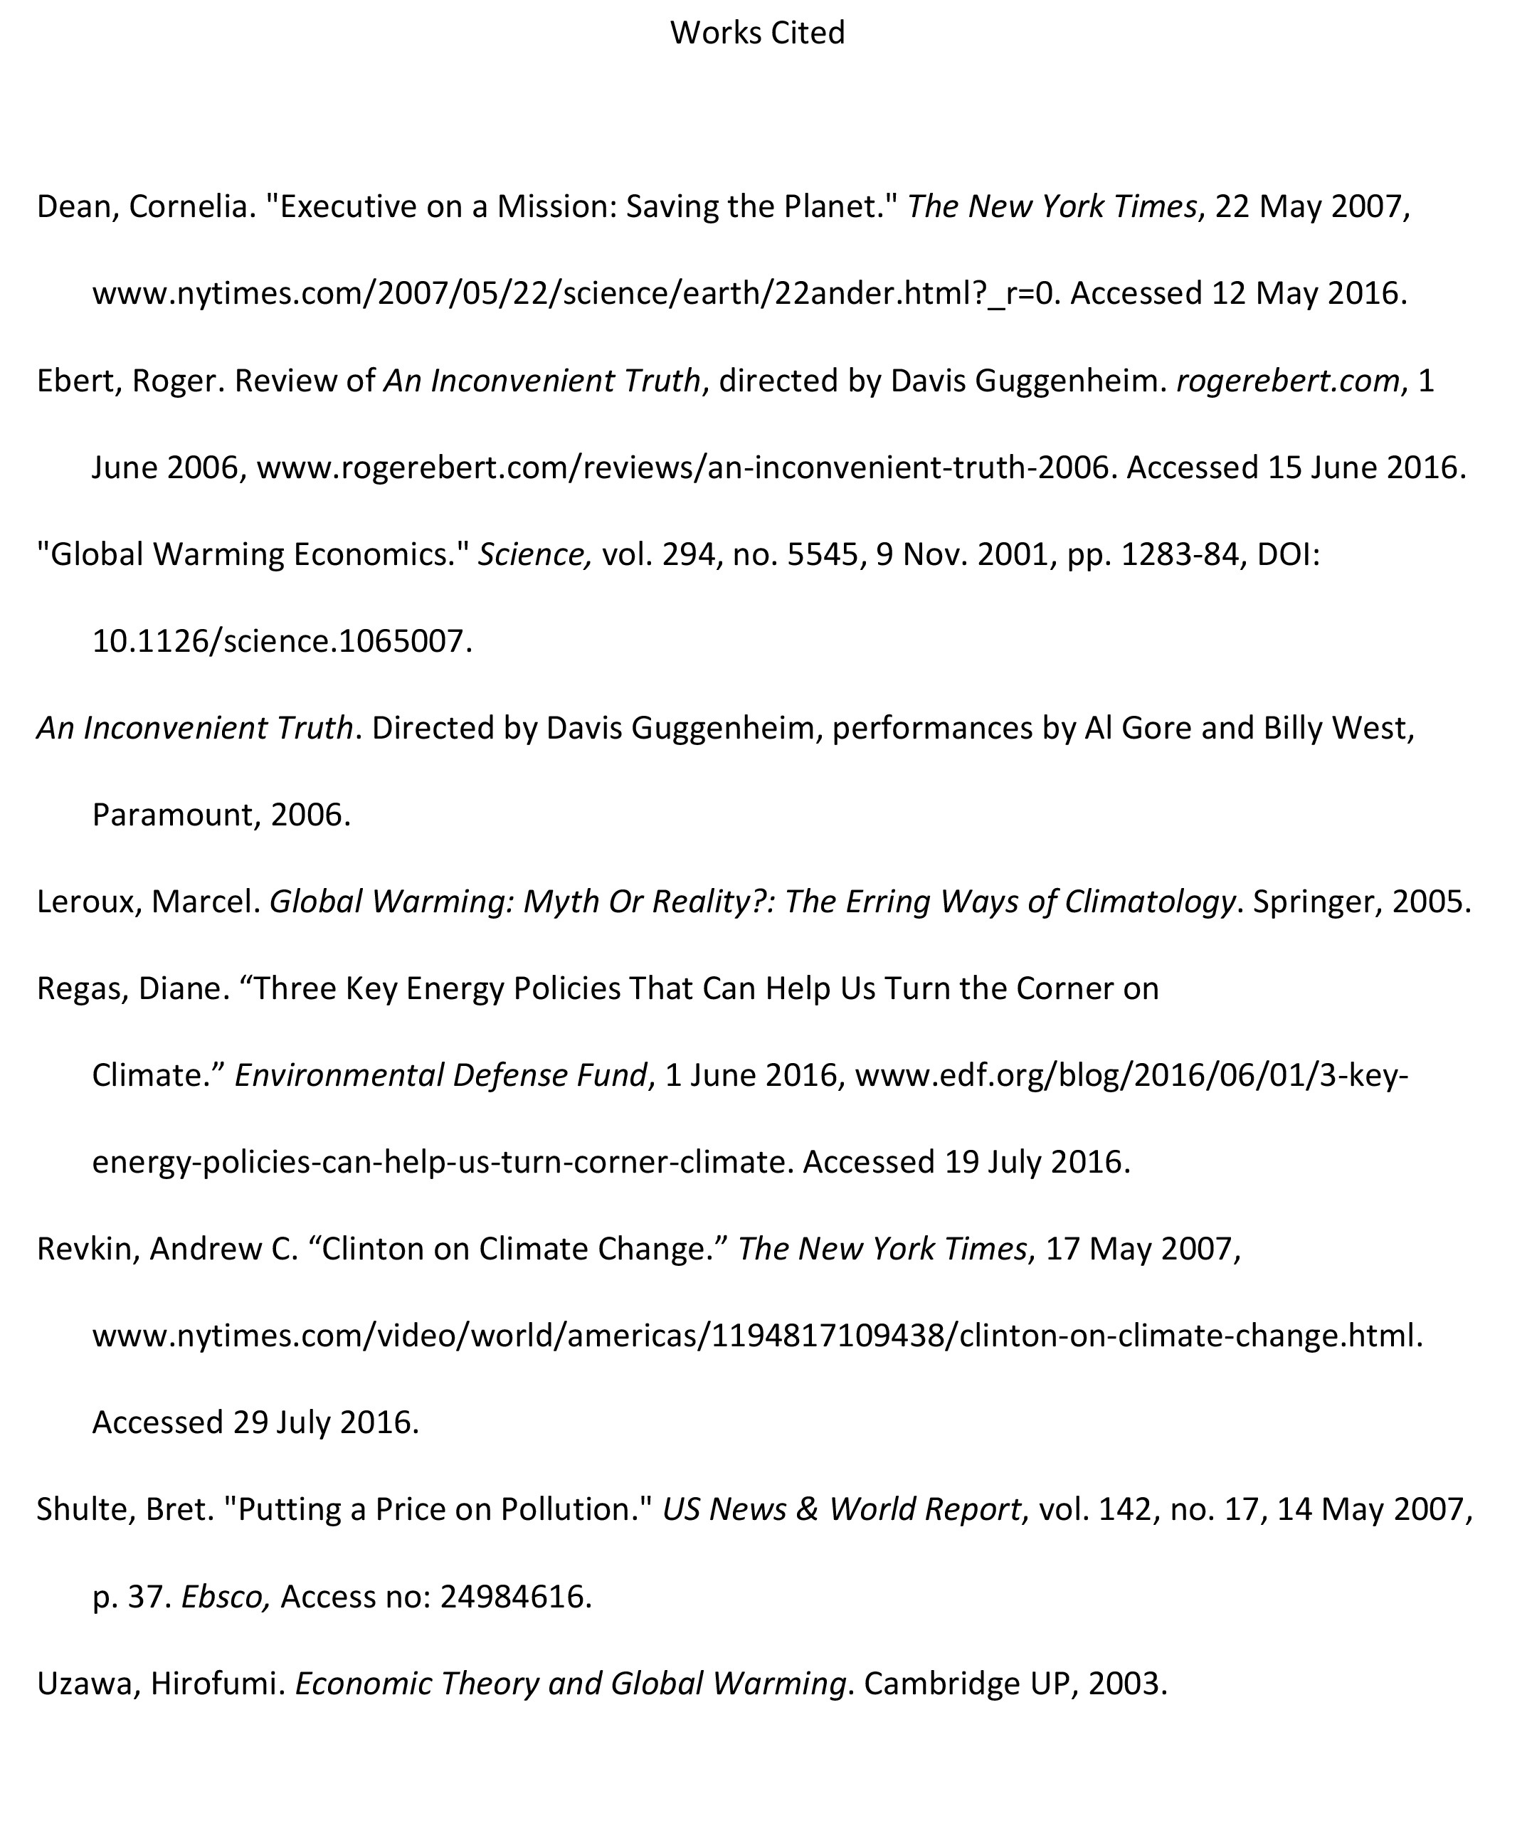

Slide 25
The End
MLA 8th Edition Formatting Style Guide
Brought to you in cooperation with the Purdue Online Writing Lab

