Slide 1



Slide 2
WHAT IS AVID?
AVID:
  Stands for Advancement via Individual Determination
  It is a college readiness program
  Targets least served students in the academic middle who have the capacity to succeed

Slide 3
AVID's Mission:
To close the achievement gap by preparing all students for college readiness and success in a global society.

Slide 4
Why AVID works?
Places AVID students in rigorous curriculum and gives them the support to achieve.
Provides the explicit “hidden curriculum” of schools.
Provides a team of students for positive peer identification.
Redefines teacher’s role as that of student advocate.

Slide 5
AVID Student profile
Students with Academic Potenial
  Average to High Test Scores
  2.0-3.5 GPA
  College potential with Support
  Show individual desire, motivation, and DETERMINATION to be successful

Slide 6
AVID Student profile cont.
Meets one or more of the following criteria
  First to attend college
  Historically underserved in a 4 year college/university
  Low Income
  Special Circumstances

Slide 7
The AVID Program Essentials
AVID Student Selection
Voluntary Participation
AVID elective class offered during the school day.
Rigorous course and study
Writing and Reading Curriculum
Inquiry to promote critical reading
Collaboration
Trained tutors
Data Collection and Analysis
District and School Commitment
Site team

Slide 8
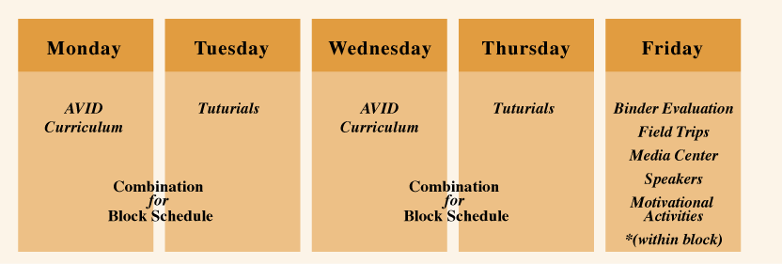
A Sample week in the AVID Elective

Slide 9
AVID Curriculum and Tutorials
Curriculum Includes
Tutorials Include
Rigorous standards
WICOR: Writing, Inquiry, Collaboration, Organization and Reading
Cornell Notes
Socratic Seminars
College and Careers strategies for success
Collaborative Study Groups
Writing Groups

Slide 10
Testimonials from Atrisco Heritage AVID Students

Slide 11
GIS Application process:
January 21, 2016-AVID Information Night
February 4, 2016-Students turn in AVID application
Week of February 8: AVID site team reviews applications and sets up interviews
Week of February 15: Students interviews
Family Conferences –February 25 and 26: Acceptance/Waiting list letters will be given to families during conferences.

Slide 12
CONTACT INFORMATION
GIS AVID SITE COORDINATOR
MRS. LUCIA ANGLADA
505-253-0300 X39611
anglada_l@aps.edu

