Slide 1

STATE SEAL OF BILITERACY
NEWPORT-MESA UNIFIED SCHOOL DISTRICT
BY GRACIELA GARCIA AYALA

Slide 2
HISTORY
In the advent of new educational reform the district will prepare its students for success in a multilingual world.
600 different languages are spoken
20 different countries are Spanish-speaking
36 different countries are French-speaking
10 main languages in the business world

Slide 3
IMPORTANCE OF THE STATE SEAL OF BILITERACY
It recognizes students who have achieved a high level of proficiency in speaking, reading and writing in 1 or more languages in addition to English.
It encourages the study of world languages.
It allows for greater cognitive development of bilingual and multilingual students.

Slide 4
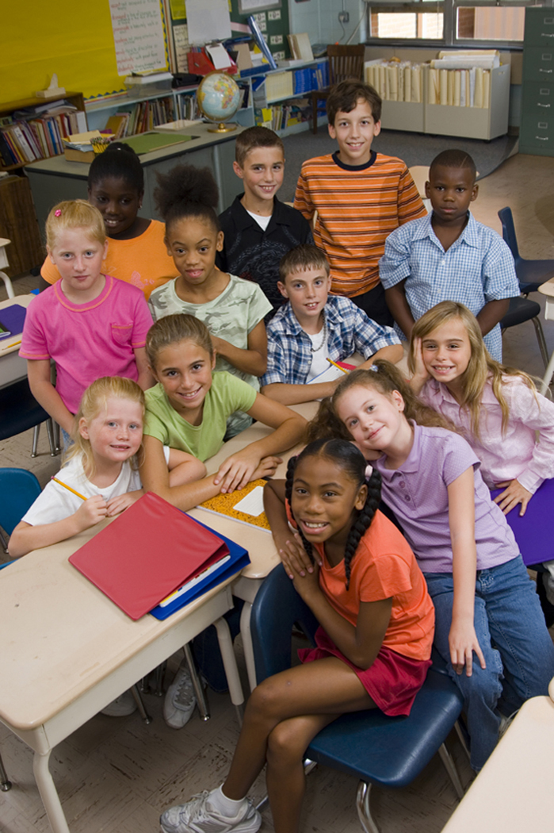
It encourages the value of diversity and promotes the respect of other cultures and languages.
It prepares students for success in the 21st century.

Slide 5
CRITERIA FOR RECEIVING THE SEAL
The State Seal certifies that the student graduating meets the following :
2.0 gpa or above in all English Language Arts courses
Pass CST in English with a mark of proficient or better in grade 11
High proficiency in Foreign Language through one of the following:
Passing AP Language Test
Completion of 4 year foreign language high school courses with a 3.0 gpa better.
Earn 700 or higher on SAT II Foreign Language Exam.

Slide 6
WORLD LANGUAGE PATHWAY
7th/8th grade 1st year of world language
9th grade 2nd year of world language
10th grade 3rd year of world language
11th grade 4th year of world language
12th grade 5th year Advanced Placement

Slide 7
SPANISH SPEAKERS PATHWAY
8th grade Spanish for Spanish Speakers I
9th grade Spanish for Spanish Speakers II
10th grade Spanish for Spanish Speakers III
11th grade AP Spanish Language
12th grade AP Spanish Literature

Slide 8
COST TO SCHOOL/DISTRICT
No cost to students.
Support from the Costa Mesa Chamber of Commerce
Partnership with Orange County Business Organizations
Partnerships with local universities

Slide 9
ROLE OF COUNSELORS
Maintain records of those students who have earned the State Seal of Biliteracy
Place the appropriate seal on the diploma and/or transcript of the student who earns the state seal.
Invite the consulate members from different countries to present students the diplomas with the affixed seal.

Slide 10
ROLE OF TEACHERS/ADMINISTRATORS
Teachers will encourage students to take 4 years of a foreign language.
Teachers will promote the importance of biliteracy in the 21st century.
Administrators may create partnerships in the community .
Administrators will show businesses and universities through the seal program that CMHS students are prepared to compete with their high language levels in either the university or workforce.

Slide 11
NEWPORT-MESA UNIFIED SCHOOL DISTRICT SEAL OF BILITERACY COMMITTEE
District contacts : Dr Steve Mc Laughlin
Graciela Garcia Ayala
Site contacts:
Corona Del Mar High School (Tory Hewes)
Costa Mesa High School (Graciela Garcia Ayala)
Estancia High School (Daniel Valenzuela)
Newport Harbor High School (Belen Pitones)

Slide 12
WHERE CAN STUDENT SEE THE AWARD OF BILITERACY?
High school Diploma
High School Transcript
Pin or plaque presented at awards ceremony.
Medallion and/or special cord worn at graduation

Slide 13
BILITERACY IS THE FUTURE
A DIFFERENT LANGUAGE IS A DIFFERENT VISION OF LIFE. – Federico Fellini
THE LIMITS OF MY LANGUAGE MEAN THE LIMITS OF MY WORLD. – Ludwig Wittgenstein

