Slide 1
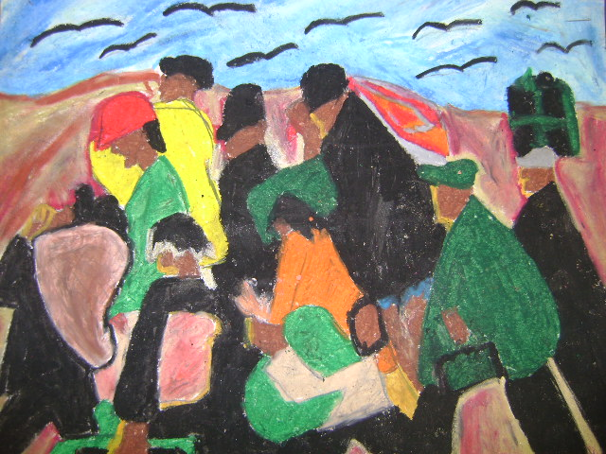
2015-16 First Interim Financial Report
December 9, 2015
Board Meeting
Matthew Villaroman
6th Grade, Mrs. Smisko
Prairie Vista Fine Arts Academy

Slide 2

2015-16 First Interim – Mandated Report
Education Code (EC) Sections 35035(g), 42130 and 42131 require the Governing Board of each school district to certify at least twice a year to the district’s ability to meet its financial obligations for the remainder of that fiscal year and for the subsequent two fiscal years.
Tonight Board approval is requested for the
  2015-16 First Interim Financial Report, Positive Certification
  Associated Budget Revisions

Slide 3
2015-16 First Interim – Assumptions
Revenue
  Statutory COLA / Net Funded COLA – 1.02%
  Gap Funding – 51.52%
  Base Grant per ADA - $7,820 (K-3), $7,189 (4-6), $7,403 (7-8) and $8,801 (9-12)
  K-3 CSR Augmentation Grant - $737 per ADA
  Supplemental and Concentration Grant - $12,814,936
  Supplemental and Concentration Grant, Economic Impact Aid - $1,977,650
  Routine Restricted Maintenance (RRMA) Contribution - $2,700,970
  Lottery - $140 per ADA (Unrestricted) and $41 per ADA (Restricted)
  Parcel Tax - $1,511,698

Slide 4
2015-16 First Interim – Assumptions
Expense
  Required progress made toward K-3 Grade Span Adjustment, with district moving to 24:1 in 2016-17
  Step and Column movement at 1.1%
  Statutory Fringe Benefits – as required by LACOE

Slide 5
2015-16 First Interim – Revenue Unrestricted General Fund
LCFF/Revenue Limit Sources | $72,003,468
Federal Revenues | 10,575
Other State Revenues | 5,498,980
Other Local Revenues | 2,069,385
Contributions | (8,380,881)
TOTAL REVENUE SOURCES | $71,201,527

Slide 6
2015-16 First Interim – Expense Unrestricted General Fund
Certificated Salaries | $36,687,848
Classified Salaries | 9,062,061
Employee Benefits | 16,662,071
Books and Supplies | 4,710,860
Services and Other Operating | 6,037,737
Capital Outlay | 123,403
Other Outgo | (380,069)
Transfers Out | 4,012,734
TOTAL EXPENDITURES | $76,916,645

Slide 7
2015-16 First Interim – Summary Unrestricted General Fund
Total Revenue Sources | $71,201,527
less
Total Expenditures | $76,916,645
NET INCREASE(DECREASE) IN FUND BALANCE | ($5,715,118)

Slide 8
2015-16 First Interim – Summary Unrestricted General Fund
Beginning Fund Balance | $8,515,265
Net Increase (Decrease) in Fund Balance | ($5,715,118)
Ending Fund Balance | $2,800,147

Slide 9
2015-16 First Interim – Summary Unrestricted General Fund
Components of Ending Fund Balance
Nonspendable | $90,936
Assigned | $0
Reserve of Economic Uncertainties (Required 3%)* | $2,709,210
* Includes $290,099 from Fund 17.0

Slide 10
2015-16 First Interim – General Fund, Multi-Year Projections
 | 2015-16 | 2016-17 | 2017-18
Total Revenue Sources | $93,480,622 | $89,855,309 | $93,188,618
Total Expenditures | $99,976,949 | $90,194,805 | $92,032,883
NET INCREASE (DECREASE) IN FUND BALANCE | ($6,496,327) | ($339,496) | $1,155,735

Slide 11
2015-16 First Interim – General Fund, Multi-Year Projections
 | 2015-16 | 2016-17 | 2017-18
Beginning Fund Balance | $9,944,092 | $3,447,765 | $3,108,269
Net Increase (Decrease) in Fund Balance | ($6,496,327) | ($339,496) | $1,155,735
Ending Fund Balance | $3,447,765 | $3,108,269 | $4,264,004

Slide 12
2015-16 First Interim – General Fund, Multi-Year Projections
Components of Ending Fund Balance | 2015-16 | 2016-17 | 2017-18
Nonspendable | $90,936 | $114,138 | $114,138
Restricted | $647,619 | $0 | $0
Other Commitments | $0 | $0 | $0
Assigned | $0 | $287,531 | $1,388,123
Reserve of Economic Uncertainties (Required 3%) | $2,709,210 | $2,706,600 | $2,761,743

Slide 13
2015-16 First Interim - Education Code 42127
Pursuant to Education Code 42127(a)(2)(C), Hawthorne School District Board of Trustees must:
  Identify the minimum reserve for economic uncertainties in each year identified in the fiscal report
  Identify the amount of assigned and unassigned ending fund balance that exceeds the minimum
  Provide reasons for the HSD reserve level if it is greater than the minimum

Slide 14
2015-16 First Interim - LACOE Bulletin #4237 (Need for Reserves)
Los Angeles County Office of Education (LACOE) issued Informational Bulletin # 4237 on November 10, 2015.
This bulletin indicates:
“We continue to recommend that districts that project and increase in LCFF revenues in 2016-17 and beyond, assign, reserve or otherwise set-aside the increase. If districts choose to budget this increased revenue they must have a contingency or alternative plan in place should these funds fail to materialize.”
“County offices continue to reinforce the need for reserves over the minimum reserve requirements. The experience of the most recent recession has clearly demonstrated these minimum levels are not sufficient to protect educational programs from severe disruption in an economic downturn. The typical 3.0 percent reserve minimum represents less than two weeks of payroll for many districts. Many LEAs have established reserve policies calling for higher than minimum reserves, recognizing their duty to maintain fiscal solvency. The adequacy of a reserve level should be assessed based on the LEA’s own specific circumstances.”
HSD Board Approved Budget | 2015-16 | 2016-17 | 2017-18
Funded Local Control Funding Formula | $72,003,468 | $76,164,053 | $79,497,362
Increase in LCFF Over Prior Year |  | $4,160,585 | $3,333,309
Increase in LCFF from 2015-16 |  | $4,160,585 | $7,493,894

Slide 15
2015-16 First Interim - Need for Reserves
Examples provided in LACOE Bulletin #4125:
  Financial flexibility to absorb unanticipated expenditures without significant disruption to educational programs
  Protection against exposure to significant one-time outlays, such as disasters, lawsuits or material audit findings
  Protection against the volatility of state revenues
  Cash management / avoiding the cost of borrowing for cash flow purposes

Slide 16
2015-16 First Interim – Reserve
Components of Ending Fund Balance | 2015-16 | 2016-17 | 2017-18
Nonspendable | $90,936 | $114,138 | $114,138
Restricted | $647,619 | $0 | $0
Assigned* | $0 | $287,531 | $1,388,123
Reserve of Economic Uncertainties (Required 3%) | $2,709,210 | $2,706,600 | $2,761,743
Reserve % Including Assignments | 3.45% | 3.45% | 4.63%
Reserve % Including Fund 17 | 3.45% | 3.13% | 3.12%
Reserve % Excluding LACOE LCFF Assignment | 7.17% | 7.57% | 8.67%
*Per LACOE Bulletin #4237: Increases in LCFF revenue in 2016-17 and beyond should be assigned.

Slide 17
Questions / Comments
December 17, 2015
Board Meeting
Matthew Villaroman
6th Grade, Mrs. Smisko
Prairie Vista Fine Arts Academy

