Slide 1



The Common Core State Standards
A commitment to Student Success

Slide 2


Presentation Targets
Common Core Background
Areas of Focus & Shifts of Common Core Shifts
    Mathematics
    English/Language Arts
Smarter Balanced Assessment
Parent Resources

Slide 3


Slide 4
Simply lay out what foundational skills our students should have mastered at each grade in order to be on track to graduate ready for college and career.
Provides you, the parent, a clearer picture of how prepared your child is for his or her next steps.
Provides you and your child’s teacher an opportunity to make adjustments as needed to ensure there are no surprises down the road.
Common Core State Standards
CCSS are:
  Not a curriculum and do not tell teachers how to teach
  Changes in learning for English/Language Arts and Mathematics
  Benchmarked against academic standards from the world’s top performing countries
  Aligned to College and Workplace expectations
  Focus on 21st Century skills

Slide 5
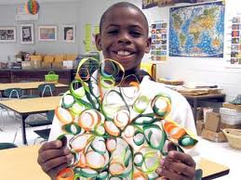

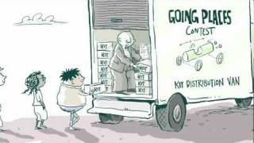
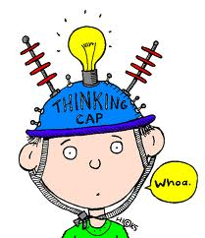
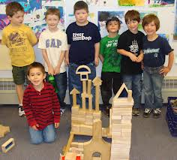
21st Century Skills and the 4c’s are infused in the Common Core Standards which are the end goals of the
Career and College Ready Standards
Today’s students are moving beyond
the basics are embracing the 4 C’s –
‘super skills’ for the 21st Century
Creativity
Communication
Critical Thinking
Collaboration

Slide 6
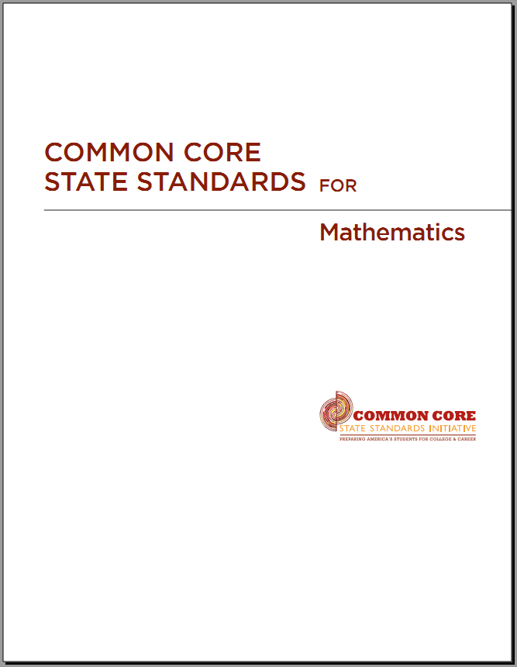
CCSS – Mathematics
The Three Shifts
Focus strongly where the standards focus
Coherence: Think across grades and link to major topics within grades
Rigor: Require conceptual understanding, fluency, and application

Slide 7
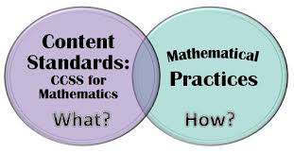

CCSS -Mathematics
There are two sets of standards in math

Slide 8
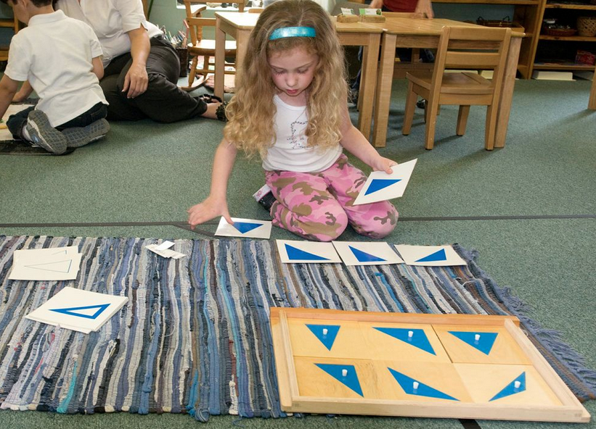
The ‘What’ of the CCSS
Counting and Cardinality (K only)
Operations in Algebraic Thinking
Number and Operations in Base Ten
Measurement and Data
Geometry
Number and Operations-Fractions (grades 3-5)

Slide 9
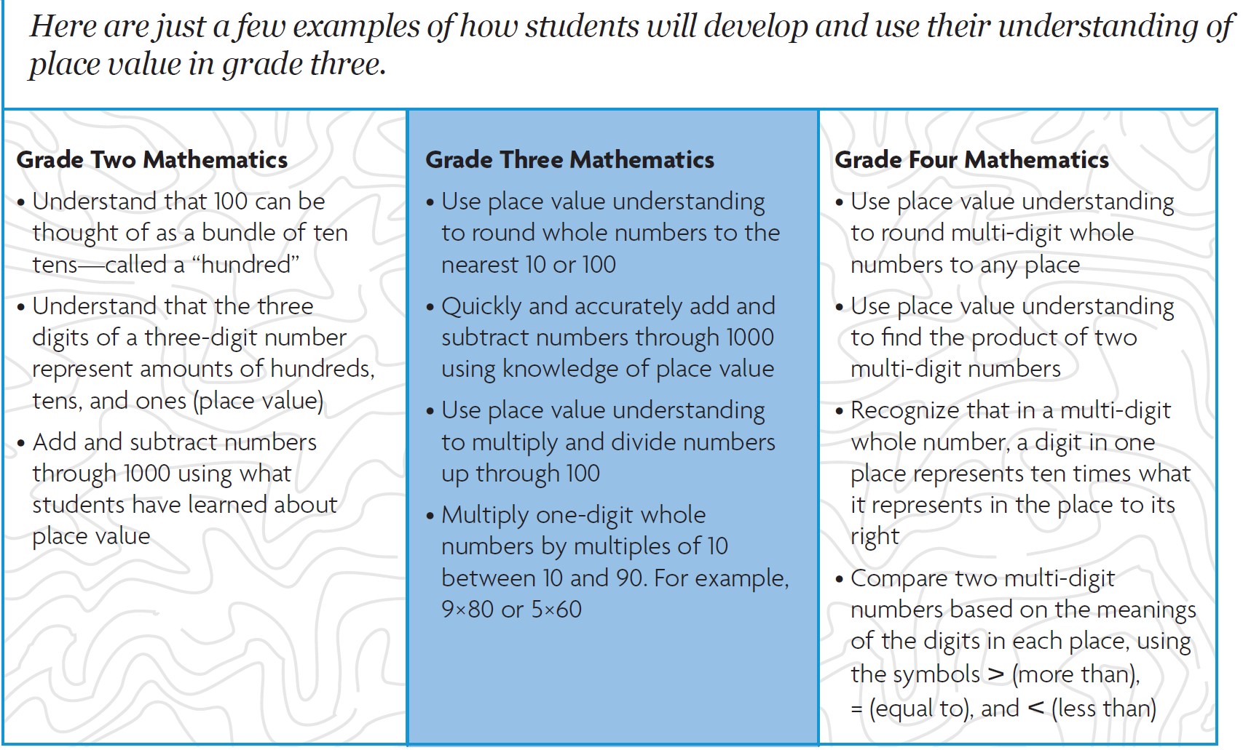

Slide 10

The ‘How’ of the CCSS-M
  Eight Standards for Mathematical Practice
  Make sense of problems and persevere in solving them
  Reason abstractly and quantitatively
  Construct viable arguments and critique the understanding of others
  Model with mathematics
  Use appropriate tools strategically
  Attend to precision
  Look for and make use of structure
  Look for and express regularity in repeated reasoning

Slide 11
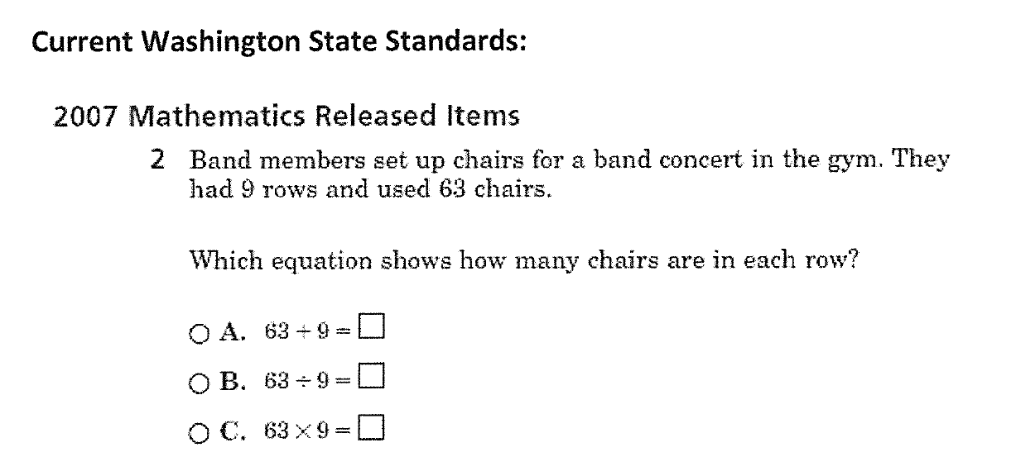
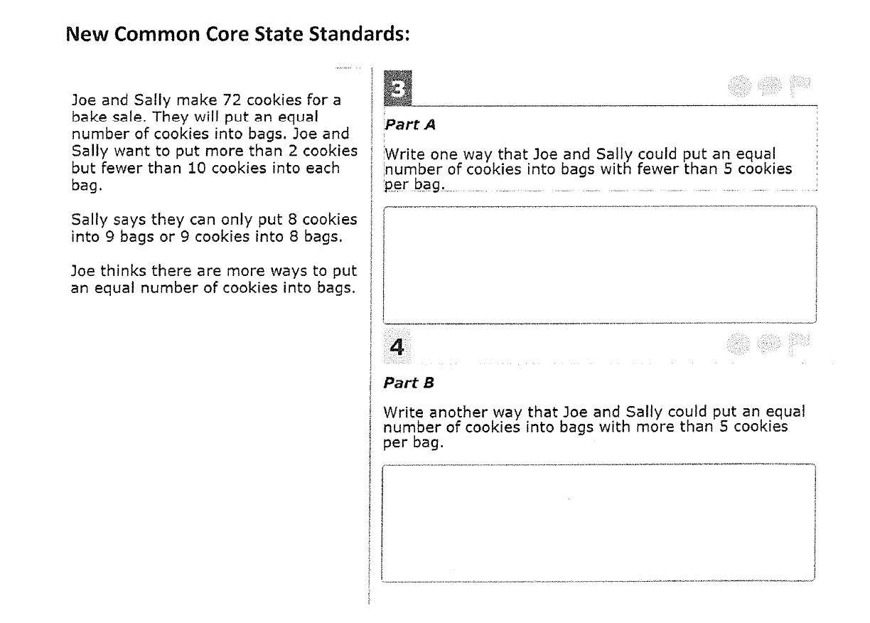

Slide 12

How can Parents help?
Help children practice their addition, subtraction, multiplication and division facts.
Encourage children not to give up while solving problems, to build stamina and develop their critical thinking skills.
Don’t give them the answers - ask them to think of different ways they can solve problems.
Have children illustrate the math they were thinking in their head and discuss it out loud.
Have children apply their math knowledge to a real-world scenario at home, such as doubling a recipe or calculating the area of a room.

Slide 13


  http://www.cgcs.org//site/Default.aspx?PageID=244

Slide 14
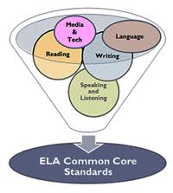
CCSS - English/Language Arts
Framework
K-5 ELA
History/SS
Science & Tech Subjects
Reading
6-12 ELA
Reading
Literature
Informational Text
Literature
Informational Text
6-12 History/SS
Writing
Speaking & Listening
Language
Writing
Speaking & Listening
Language
Reading
Informational Text
Writing
6-12 Science &
Technical Subjects
Reading
Informational Text
Writing
Foundational Skills

Slide 15
CCSS - ELA / Literacy: Major Shifts
Balance of Literary and Informational Texts
Informational Text
SS, Science, etc.
Literature
Poetry,
Drama
Myths, Legends,
Short
stories,
Informational Text
Directions,
Forms, etc.
Literature
Poetry,
Drama
Myths, Legends,
Short
Stories,
Social Studies,
History, Arts,
Science,
Biographies,
Notes:
These major shifts in instruction and content show the moves educators will make. If something is not on this list, it doesn’t mean it’s not important… it means it isn’t a shift, since we already do it!

Slide 16
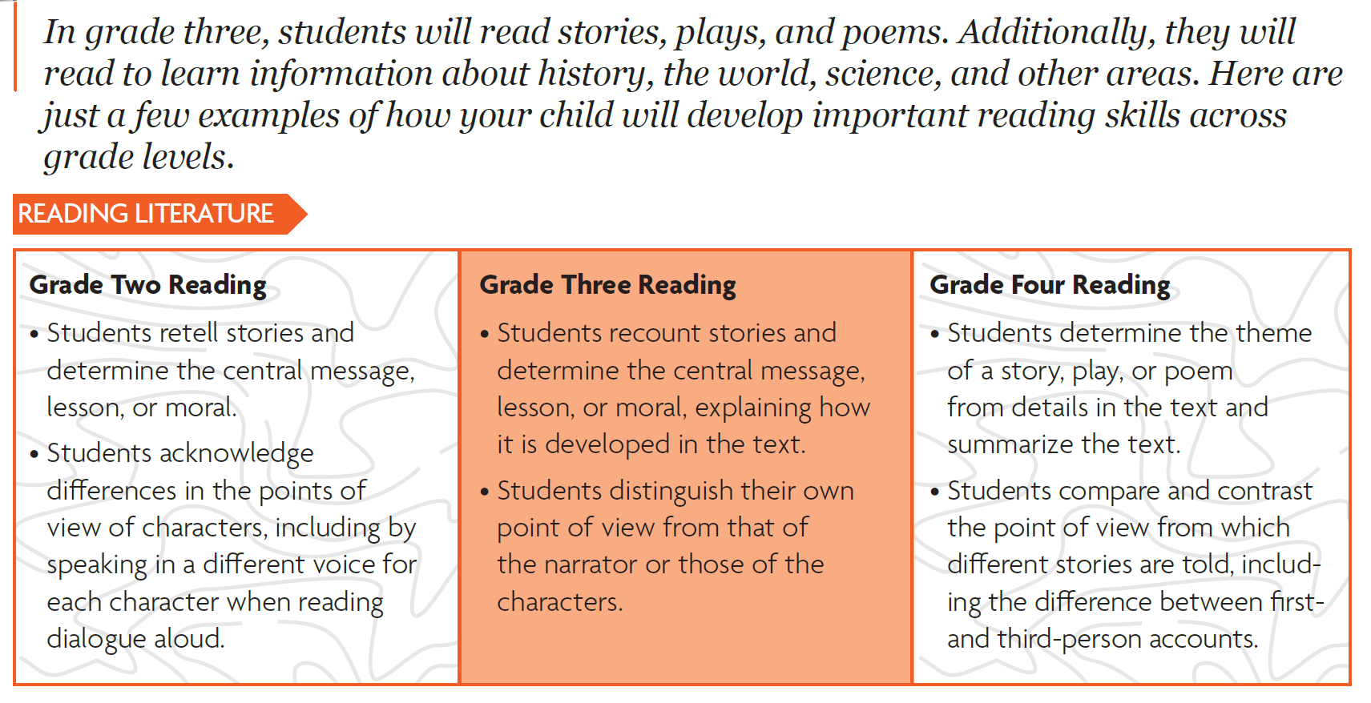

Slide 17

How can Parents help?
Read more nonfiction texts aloud or with your child – books newspapers, articles, magazines.
Talk about the text you read, making connections to your home, culture, or community
Ask for evidence in every day discussions, moving beyond just opinions
Provide texts your child wants to read and can read comfortable and provide challenging text too.
Talk, read, listen, sing, and play games with your child
Start a family vocabulary box or jar – have everyone write down new words they discover, add them to the box , and use the words in conversation

Slide 18


http://www.cgcs.org/Page/328

Slide 19




Assessment Update

Slide 20
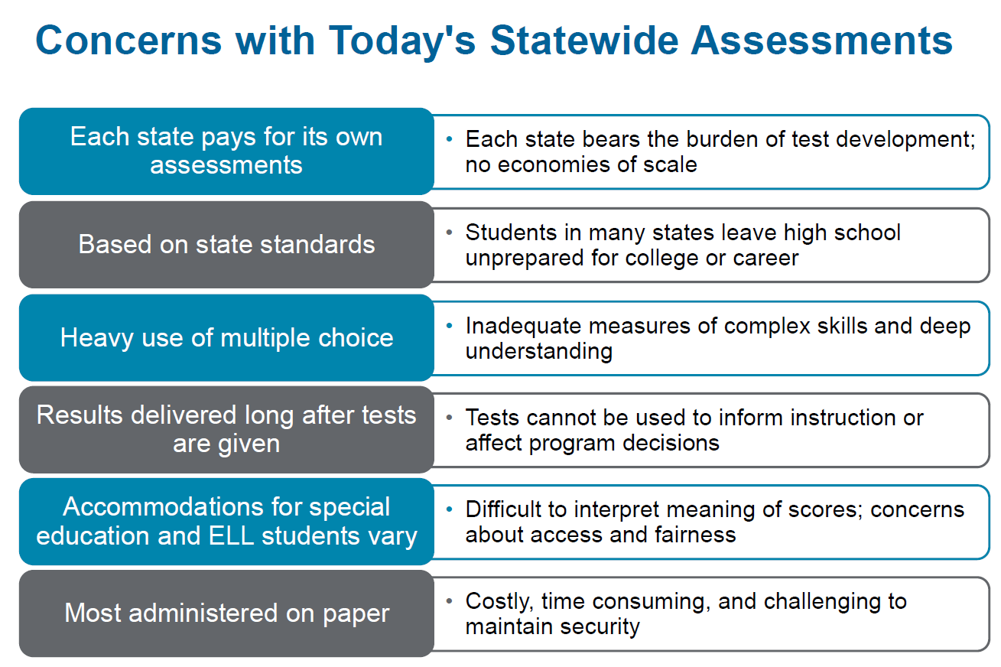

Slide 21
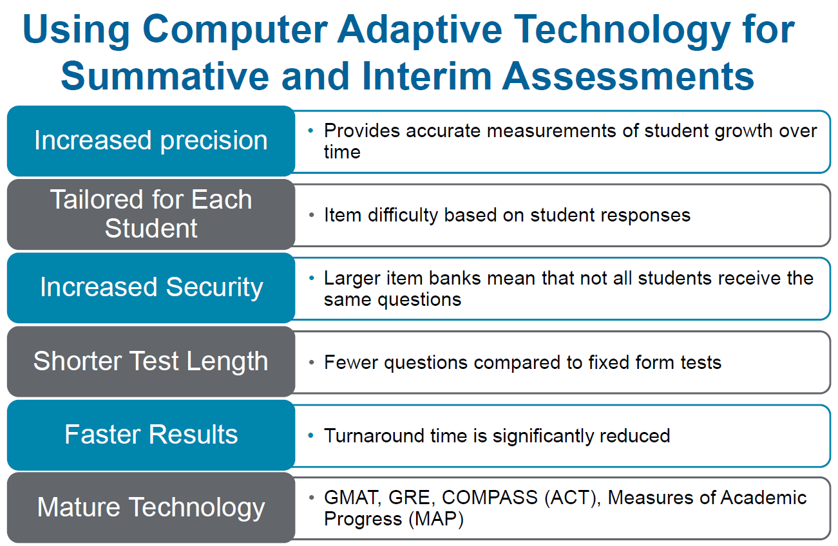

Slide 22

How will it be assessed?
Assessments will begin the 2014-2015 school year
Two groups of assessments:
  SMARTER Balanced Assessment and PARCC (Partnership for Assessment of Readiness of College and Career)
Will incorporate technology with computer based testing
All grade levels will be assessed
Notes:
State of Illinois will be using PARCC-Partnership for the Assessment of Readiness for College and Careers-test spread out throughout the year to track growth and an end of the year assessment-MORE Informative

Slide 23
SBA Assessment System Components
Summative Assessment Assesses full range of Common Core – grades 3-8 and 11 Measures current student achievement and growth across time Variety of question types: selected response, short responses, extended responses, performance tasks Administered during the last 12 weeks of the school year
Interim Assessment (Computer Adaptive) Identify specific needs of each student Administered throughout the year Provides clear examples Variety of question types
Formative Assessment Practices Bank of Assessments Aligned to Common Core Enables differentiation of instruction
Online Reporting Provides parents, students, practitioners access to assessment information
Support for Special Populations Accurate measures of progress for students with disabilities, and ELL

Slide 24
Smarter Balanced Assessment
Field Test
WA State has selected the Blended Model Option
  Some schools administer the current state assessment or administer the Smarter Balanced Field Test only this spring.
Participating in the SBA Field Test is all or nothing:
  If a school decides to field test, it must do it at all grades in both ELA (Reading & Writing) and Math
  ***Science will still be assessed using the MSP at grades 5 & 8
The 2012-13 MSP results roll forward and will count in 2014
  Federal accountability purposes only
All SBA tests will be completed online

Slide 25
Smarter Balanced Field Test
Pros | Cons
Gain experience with the new assessment before it counts New assessment format Testing protocols with performance assessments Response of students Online complexities Technology Infrastructure Use of mobile devices Not trying to serve ‘two masters’ with current state curriculum and assessments Provides additional time to communicate with parents as we transition to the CCSS. CCSS Traveling Roadshow 2014 is last year students will be assessed with the current state assessments for reading, mathematics and writing | Impact of getting system 100% ready by spring of 2014 There are still a few unknowns and might not know the particulars until close to the testing time. (+/-) Creates more urgency for current curriculum and assessments to push over to CCSS (+ and -) Limited reporting at building/individual students on subset of questions field tested. No MSP results from the spring 2014 assessment at grades 3-8 (R-W-M)

Slide 26

Smarter Balanced Assessment
Smarter Balanced Assessment
  http://www.smarterbalanced.org/
Take the student practice test:
http://sbac.portal.airast.org/practice-test/

Slide 27
Additional Resources
English/Language Arts & Mathematics – Parent Roadmap to CCSS
  http://www.cgcs.org//site/Default.aspx?PageID=244
National Parent Teachers Association (PTA)
  http://pta.org/parents/content.cfm?ItemNumber=2583
Common Core State Standards Text Exemplars
  http://www.corestandards.org/assets/Appendix_B.pdf
Sample reading texts, printable poems, practice grammar sheets
  http://www.superteacherworksheets.com/full-ela.html
Smarter Balanced Assessment
  http://www.smarterbalanced.org/
Take the student practice test:
  http://sbac.portal.airast.org/practice-test/

Slide 28


