Slide 1
Welcome to the CIMI
Information Meeting
FOX LANDING
Newton Middle School
Wednesday, April 13, 2016

Slide 2
When is CIMI?
May 9-11th, 2016
Arrive at Newton at 6:00 am on Monday, May 9th
Pick up students at Newton at 4:00 pm on Wednesday, May 11th
We will be meeting in the Newton cafeteria
There will be group lists posted around the room.
Please sit with your assigned group.

Slide 3
How will students get to CIMI?
Newton students will ride school chartered buses to Long Beach.
In Long Beach, we will board a large boat to Catalina Island.

Slide 4
Who will be in my group?
Your groups will be assigned.
6th grade teachers will be putting the groups together.
This will only be your group during CLASSROOM type activities.
Please give all medicine and inhalers to your group leader.

Slide 5
What will I be doing at CIMI?
Hiking
Snorkeling
Dissections
And more marine & outdoor activities!

Slide 6
Where will I be sleeping?
The student dorms are furnished with two to ten bunk beds per room.
Restrooms and shower facilities are located right outside of the rooms.
Chaperones from Newton Middle School will be in the rooms a short distance from students.
The boys and girls areas are separate.

Slide 7
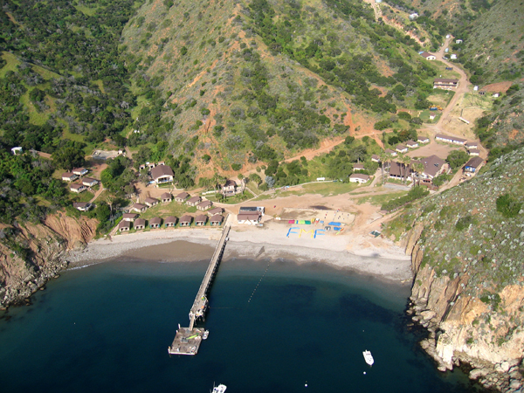

Slide 8
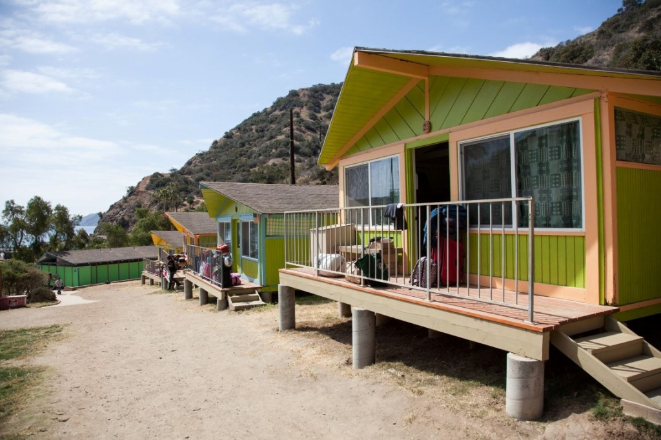

Slide 9
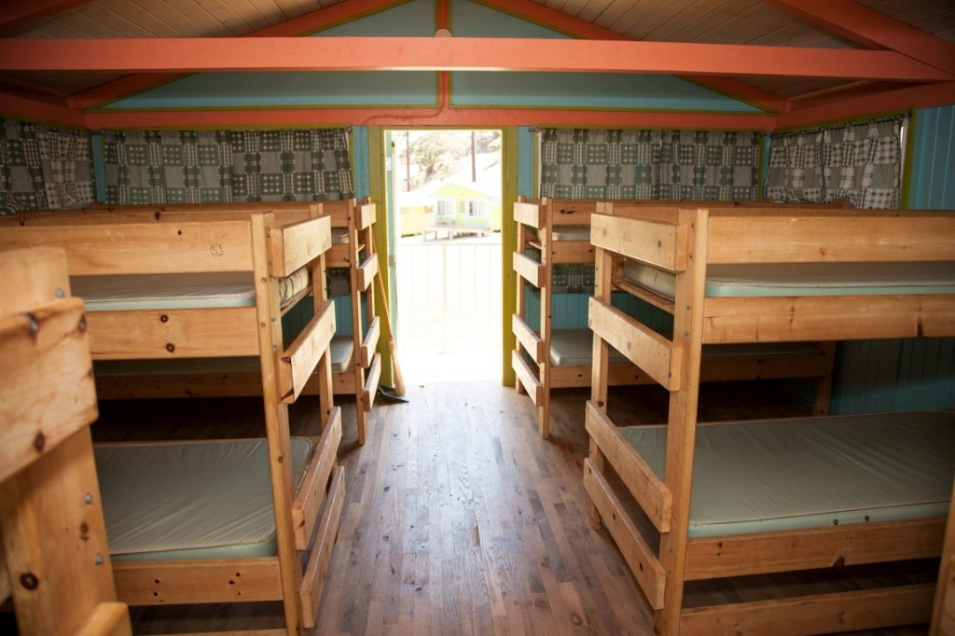

Slide 10
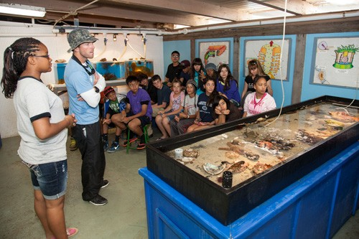

Slide 11
What do I bring to CIMI?
Only two bags will be allowed, a backpack counts as a bag.
Bring a sack lunch.

Slide 12
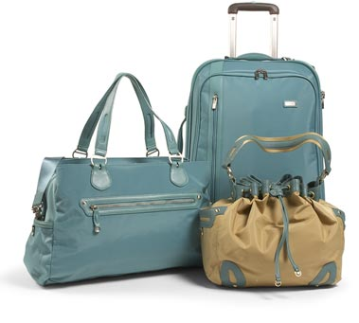
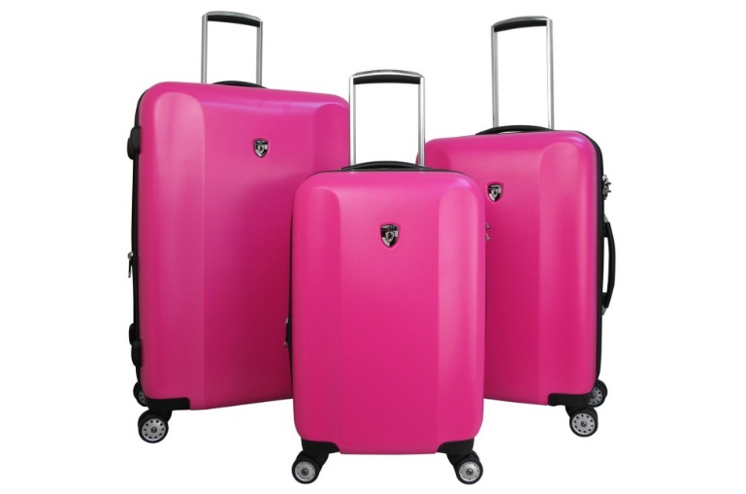
What types of bags can I bring?

Slide 13
What do I need to wear on
Monday, May 9, 2016?
T-shirt
Jeans
Sweatshirt or Jacket
Athletic shoes

Slide 14
What do I need to pack?
Bag 1
  1 pair of shorts
  1 pair of pants
  2 t-shirts
  1 set of pajamas
  1 pair of flip flops
  Socks
  Underwear
  1 pair of gloves
  1 swimsuit
  Camera
Bag 2
  1 sleeping bag
  1 pillow
  1 bed sheet
  1 bath towel
  1 beach towel
  Shampoo
  Conditioner
  Soap
  Toothpaste
  Toothbrush
  Garbage bag for dirty clothing

Slide 15
Optional Items to Bring:
Flashlight
Sunscreen
Pillow
Sunhat
Additional Toiletries
Long Sleeve Shirt(s)

Slide 16
Dress Code
Attending CIMI will need to bring clothing that meet district dress code standards for all activities. Please refer to page 11 of the Newton Middle School Student Handbook for specific school attire.
Students will be allowed to wear hats while on outside excursions due to hot weather.
Students will need to wear swimsuits and flip flops for kayaking and snorkeling excursions.
Students must wear clothing over their swim attire while walking down to the beach.
  Girls: One piece swimsuits
  Boys: Board shorts or swim trunks
  Optional: Rash guards

Slide 17
What am I not allowed to bring?
Spear guns
Pole spears
Knives
Food (gum, candy, etc.)
Blow Dryers, Curling Irons, Hair Straighteners
Weapons
Fireworks (Firecrackers)
Alcohol or drugs
Water guns/balloons

Slide 18
Electronics
There is no cellphone service at CIMI
There is no WiFi at CIMI
If you bring your electronics to camp, you will be responsible for those items.
Remember, there are no locks on the tents and we are not the only school at camp.

Slide 19
Remember…
Kids are still split by gender (on different sides)
Chaperones will sleep in their own cabins
Kids tents and chaperone cabins are all in same area
Bathrooms are not far from the tent area, boys, girls and chaperone bathrooms are all separated

Slide 20
Any questions?
Contact our Office: 626.933.2401
Thank you for coming!

