Slide 1
Common Core State Standards
Information and Hands-On Fun
Wednesday, November 20, 2013
6:00 p.m. – 7:00 p.m.

Slide 2

Where Are We Now?
17th in English Language Arts
  Score of 500, Average is 493
31st in Math
  Score of 487, Average is 496
23rd in Science
  Score of 502, Average is 501
Programme for International Student Assessment (PISA) of
Organisation for Economic Co-operation and Development (OECD), 2009

Slide 3
Historical Trends in the US
In 1973, 1/4 of all jobs required postsecondary education.
By 2018, 3/4 of all jobs will require postsecondary education.
By 2018, 70% of all middle class jobs will require
postsecondary education.
There will be 26% growth in jobs requiring a
postsecondary degree.
In 1985, the US had the most college graduates in the world,
today it ranks 16th.

Slide 4
How Are WE Doing?
56% of students enrolled in a four year university receive a degree.
29% of students enrolled in a two year college program receive a degree.
We must do better.

Slide 5

What are Common Core
State Standards?
Common Core Standards are a coherent progression of learning expectations in English Language Arts and Mathematics.
Designed to prepare K–12 students for college and career success, by providing 10 Anchor Standards that apply to each grade level.

Slide 6


Consistency Throughout…
http://www.youtube.com/watch/?v=5s0rRk9sER0&desktop_uri=%2Fwatch%2F%3Fv%3D5s0rRk9sER0&nomobile=1

Slide 7

Common Core State Standards
Are aligned with college and work expectations;
Are clear, understandable, and consistent;
Are rigorous in both content and application of knowledge through high-order skills;
Are built on strengths and lessons of current state standards; and
Are informed by other top-performing countries, so that all students are prepared to succeed in a global economy and society.

Slide 8

How were the
Standards Developed?
Partnership of the Council of Chief State School Officers and the National Governors Association, along with
Input from parents, teachers, school administrators, and experts from across the country.
Developed in the following areas:
  English Language Arts and Literacy in History / Social Studies, Science, and Technical subjects.
  Standards for Mathematical Practice and Mathematical Content.
Were adopted by the California State Department of Education on August 2nd, 2010 for full implementation in the 2014-2015 school year.

Slide 9
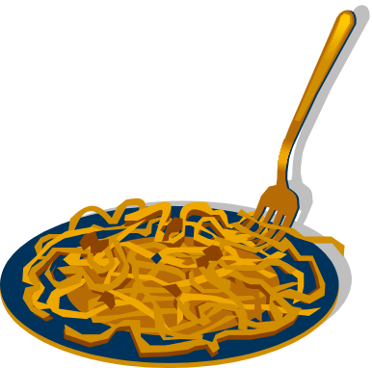

Let’s Have Some Hands-On Fun!
It’s Pasta Time
  Hope everyone has had dinner, because it is not time to eat!
  Using the Pasta and Masking Tape provided, create a Pasta Tower at least three feet tall (or pretty close to it ☺).

Slide 10

Did You Step Outside the Box?
http://www.youtube.com/watch?v=7KMM387HNQk

Slide 11

Thank you, thank you, thank you!
Thanks for joining us this evening for our first meeting in the Common Core State Standards Parent Series. We will provide a schedule for the next three meetings beginning in January. Please look for the note home with your child.
Grazide is amazing because of YOU!

