Slide 1

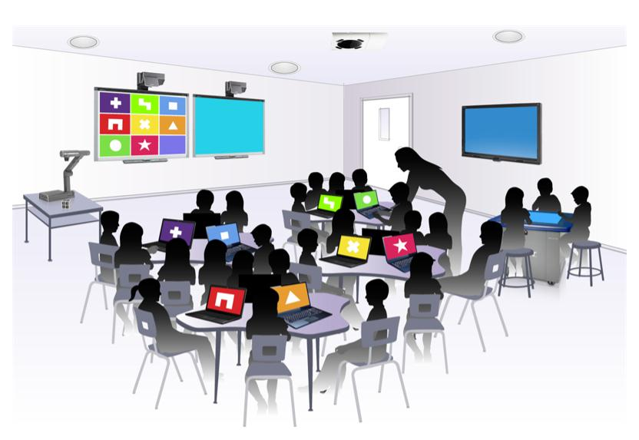
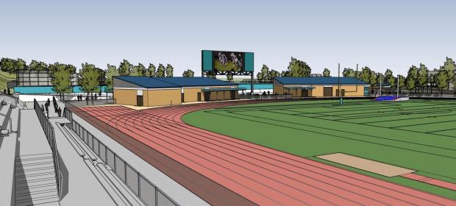
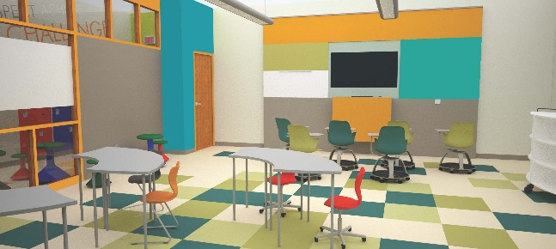
Hacienda La Puente
Unified School District
Measure BB - Bond Projects
Monthly Report
Regular Board Meeting
March 28, 2019
Business Services Division

Slide 2
Latest News
At both March 2019 meetings of the 21st Century Classroom Committee, the following items were discussed:
Existing classrooms’ built-in cabinets: Schemes 1 and 2 of the Design Guidelines
Classroom floor finishes: LVT, carpet, robber, finished concrete
Classroom windows: New Lexan, blocking with panels
Classroom technology: Computers, printers, charging carts, projection systems
Wall finishes: tackable walls, paint, shiteboard

Slide 3
Planning
Architects are preparing design documents for Phase 1 and Phase 2 of the 21stCentury Classroom and Interim Housing projects (12 projects).
Office p.S. withdrew from both projects at Mesa Robles K-8 on March 21, 2019.
School | 21st Century Classrooms | Interim Housing
Cedarlane K-8 | X | X
Grandview K-8 | X
Mesa Robles K-8 | X | X
Sparks MS | X
Newton MS | X | X
Workman ES | X
Nelson ES | X
Los Altos ES | X | X

Slide 4
Planning – cont.
Architects are working with the local Fire Marshall in regards to fire hydrant requirements for Interim Housing projects at the following schools:
  Cedarlane Academy
  Los Altos ES
  Mesa Robles K-8
  Newton MS
A new fire hydrant is to be installed by Suburban Water systems for the Mesa Robles K-8 Interim Housing project.

Slide 5
Planning – cont.
Mobile Modular is preparing documents for submittal to DSA for the 20 Interim Housing buildings:
  Cedarlane Academy: Four (4) buildings
  Los Altos ES: Four (4) buildings
  Mesa Robles K-8: Eight (8) buildings
  Newton MS: Four (4) buildings

Slide 6
Planning – cont.
Measuring and documenting of restrooms located on the Path of Travel (POT) are in progress as follow:
Completed |  |  | To Be Completed
Elementary Schools K-6 | Middle Schools |  | Elementary Schools K-6
Amar | Newton |  | Sunset
Baldwin | Orange Grove |  | High School
Bixby | Sierra Vista |  | La Puente
California | Sparks Middle |  | Los Altos
Del Valle |  |  | Wilson
Grazide | K-8 Schools |  | Workman
Kwis | Cedarlane |  | Adult Ed
Los Altos | Fairgrove |  | Dibble
Los Molinos | Grandview |  | Willow
Los Robles | Mesa Robles |  | Learning Centers and Support Sites
Nelson | Valinda |  | Stimson
Palm | Lassalette |  | Palm Canyon
Wedgeworth
Wing Lane
Workman
Sparks
Temple

Slide 7
Planning – cont.
The Bond team is evaluating and documenting the current network architecture at phase 1 and 2 schools.
The following slides are samples of documents prepared for Mesa Robles K-8.

Slide 8
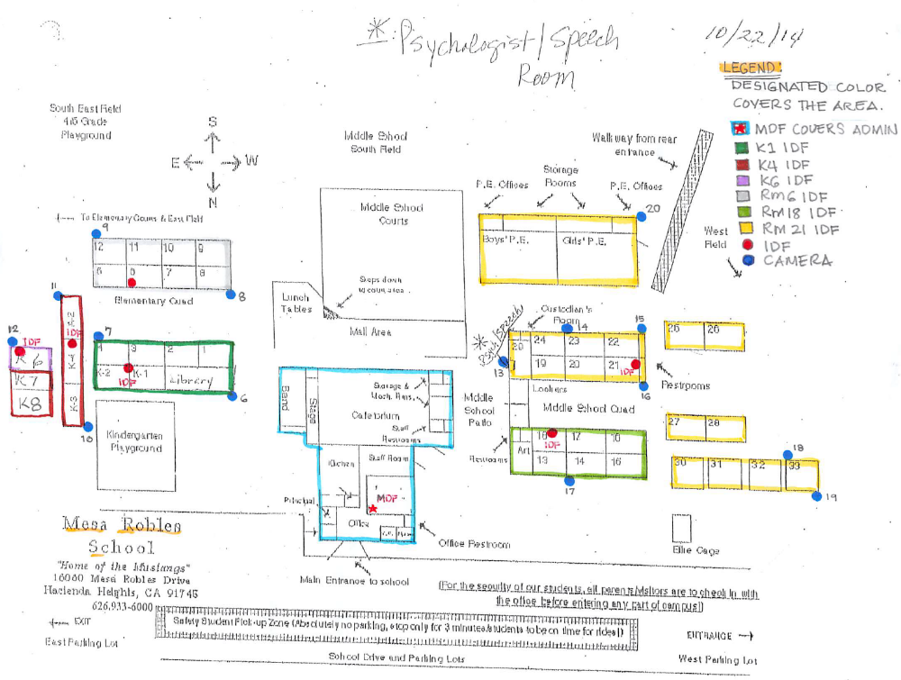
Planning – cont.
Mesa Robles K-8

Slide 9
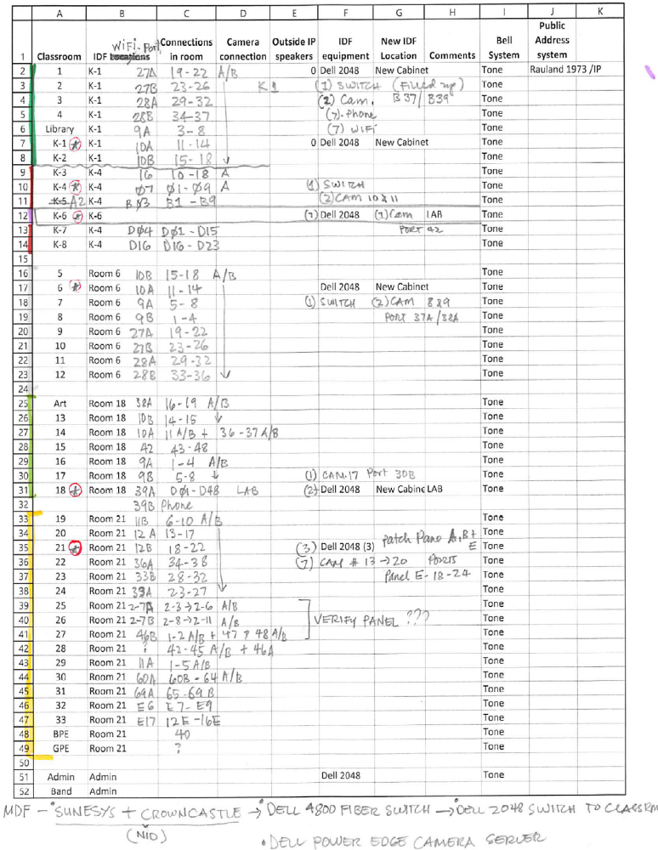
Planning – cont.
Mesa Robles K-8

Slide 10
Thank you!

