Slide 1

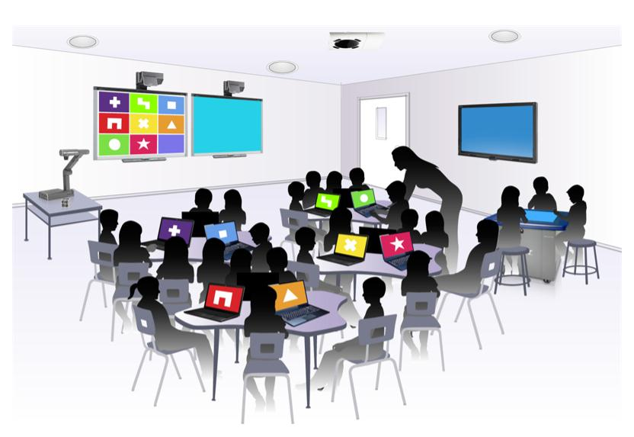
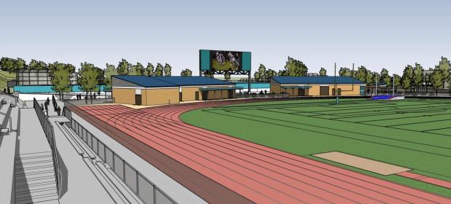
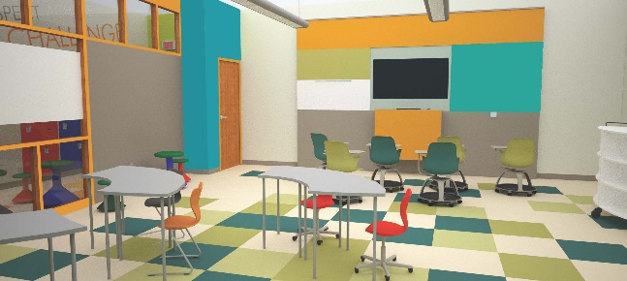
Hacienda La Puente
Unified School District
Measure BB - Bond Projects
Monthly Report
Regular Board Meeting
January 21, 2020
Business Services Division

Slide 2
Bond Expenditures as of January 17, 2020
Expenditures:
Cost of Issuance Fees |  | $ 465,750
Materials & Supplies |  | 8,606,776
Planning Services Fees |  | 1,700,156
Total Expenditures to Date |  | 10,772,682
Committed Amounts to Date |  | 11,208,432
Scheduled/Projected Expenditures:
Phase 1 and 2 |  | $ 32,000,000
Fire Alarm |  | 4,167,195
Water Bottle Filler |  | 967,400
Ceiling Tiles-Phase 4 Lighting Project |  | 726,586
Furniture, Fixtures and Equipment |  | 3,600,000
Future Phase Planning |  | 6,000,000
Total Expenditures, Committed and Projected to date |  | $ 69,442,295

Slide 3
Planning
Fire Alarm Projects
  11 school sites DSA approved
  Pre-construction site walks completed at all sites
  Sparks MS
    Kicked off meeting on December 5, 2019
    Work starts January 21, 2020 – The contractor has mobilized on site. Sparks MS is the first site on the plan to work out questions and standards for the remaining sites. This will assist in speeding up work for the remainder of the project.
  Contractor will move to Newton, Grandview, Mesa Robles and Cedarlane as work progresses
Cedarlane | Grandview | Nelson | Wilson HS
Workman HS | Mesa Robles | Newton | Los Altos HS
Sparks MS | Workman ES | Los Altos ES

Slide 4
Planning (Continued)
Phase 4 Lighting project – Ceiling Tiles
  Delivery of materials in process
  Schneider Electric mobilizing lighting equipment
    Containers delivered to Baldwin, Grazide, Los Altos ES, Los Molinos, Nelson, Sparks ES, Wing Lane and Facilities
    Lighting replacement
      Lighting complete at Stimson
      Lighting started November 20th at Workman ES
  Estimated schedule of completion January 2021

Slide 5
Planning (Continued)
Bottle Filling Stations
  Approved sites by DSA:
    Amar Children Center (2 Stations)
    Cedarlane (3 Stations)
    Fairgrove Academy (3 Stations)
    Kwis (3 Stations)
    La Puente HS (3 Stations)
    Lassalette (3 Stations)
    Sparks ES (2 Stations)
    Sunset (3 Stations)
    Wedgeworth (PO has been issued)
    Wilson HS (3 Stations)
    Workman ES (2 Stations)

Slide 6
Planning (Continued)
Furniture, Fixtures and Equipment
  21st Century Classroom Furniture
    38 Child Development classroom
      Delivery completed to all sites
      Amar completed on December 20th

Slide 7
Project Status
Los Altos ES - TDM
  Interim Housing
    Construction Complete and ready to be occupied
  21st Century Classrooms
    100% Construction Documents - DSA Backcheck appointment awaiting certification of four open DSA Applications
Newton MS - HED
  Interim Housing
    100% Construction Documents. Going to DSA 1/20/2020
  21st Century Classrooms
    50% Construction Documents - DSA Submittal in February anticipated. DSA approval contingent upon certification of 3 open DSA applications.

Slide 8
Project Status (Continued)
Cedarlane Academy - PBK
  Interim Housing
    55% Design development
  21st Century Classrooms
    75% Construction Documents
    New fire hydrants in design phase with Suburban Water
Workman ES - SVA
  21st Century Classrooms 100% Complete with CD’s
    DSA Backcheck appointment scheduled for February 5, 2020
    Upon approval by DSA, estimated schedule for bidding in
    February

Slide 9
Project Status (Continued)
Grandview Academy - HED
  21st Century Classrooms
    75% Construction Document – DSA submittal in February anticipated
    Awaiting certification of 3 open DSA applications
    Mesa Robles
  Interim Housing - tBP
    DSA approved on November 26, 2019
  21st Century Classrooms – OFFICE p.S. reassigned to PBK
    50% Schematic Design Documents

Slide 10
Project Status (Continued)
Nelson ES - TDM
  21st Century Classrooms
    DSA Backcheck ready. Appointment pending DSA certification of outstanding Application
    Room C1 model classroom in progress
Sparks MS - HED
  21st Century Classrooms
    50% Construction Documents
    DSA submittal in February anticipated

Slide 11
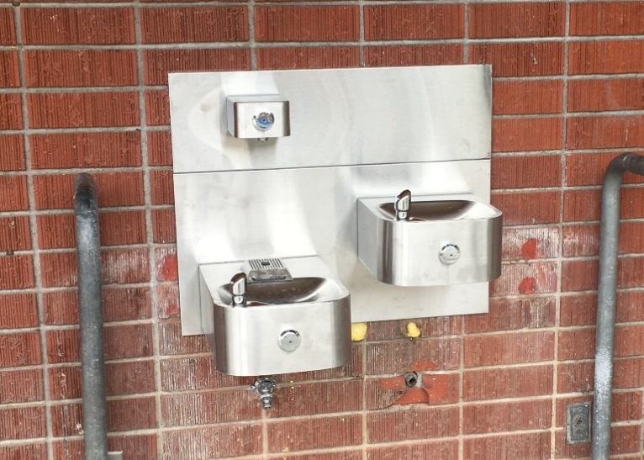
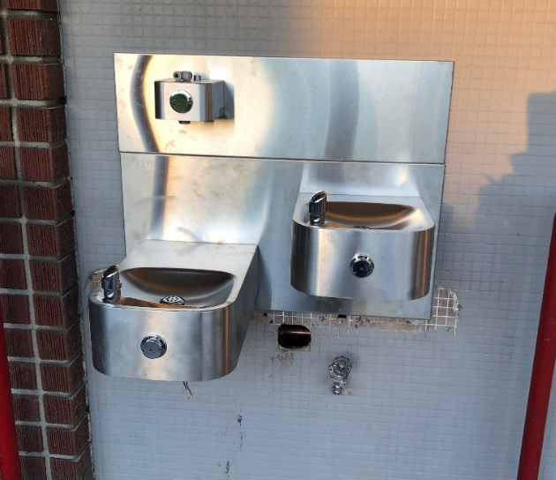
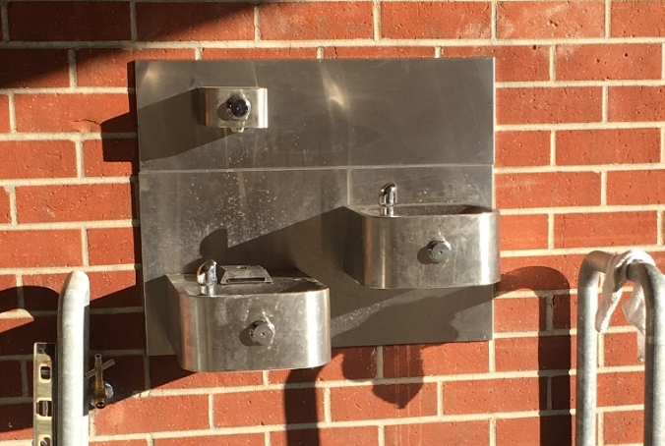
Completed
Amar Bottle Filing Station
Mesa Robles Bottle Filing Station
Wing Lane Bottle Filing Station

Slide 12
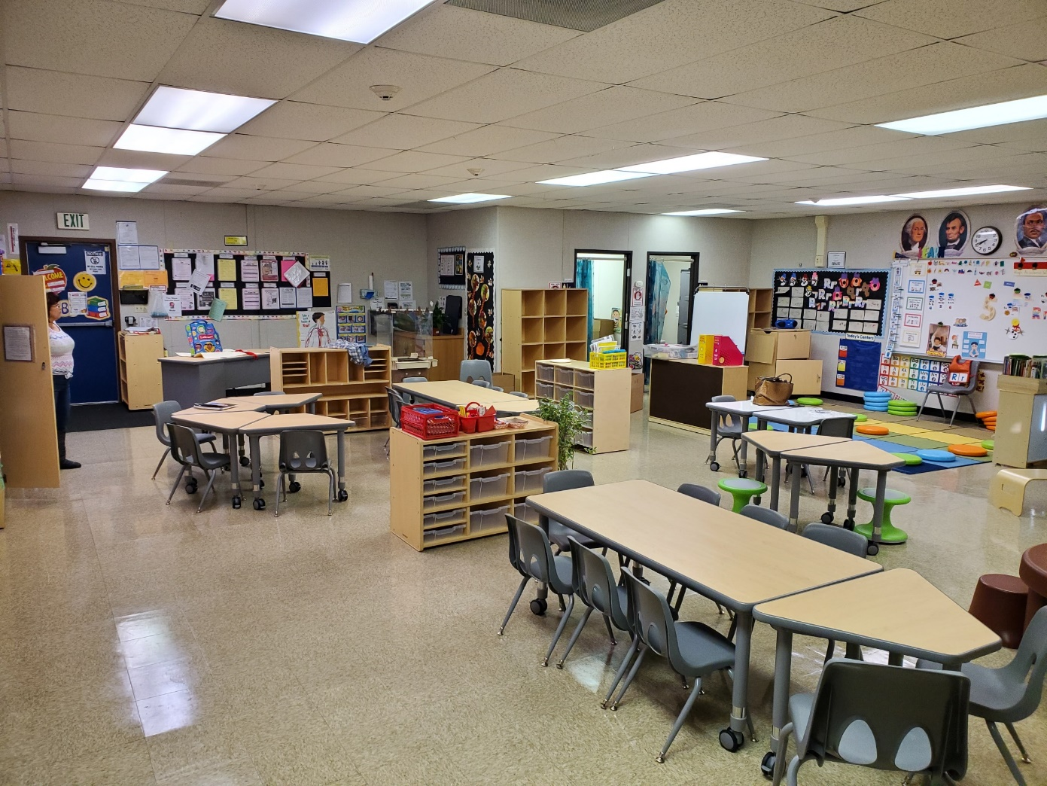
Completed
Bixby’s preschool bond project renovations

Slide 13
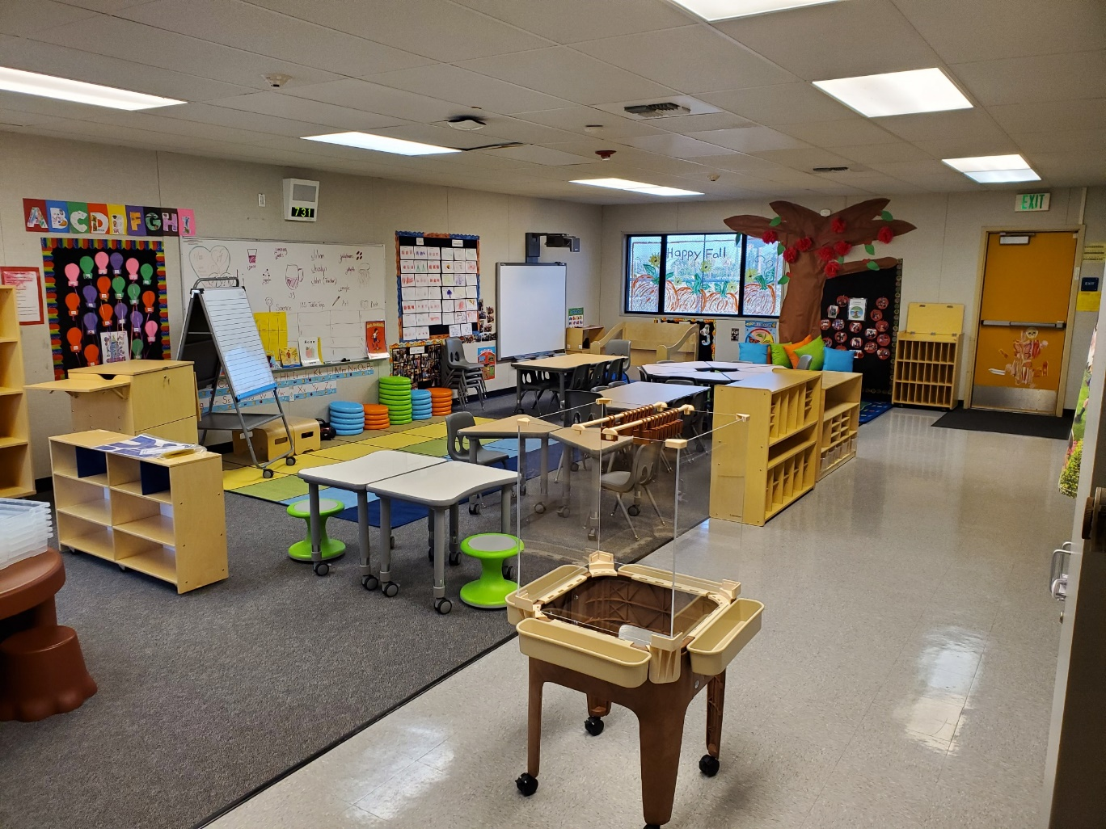
Completed
Cedarlane’s preschool bond project renovations

Slide 14
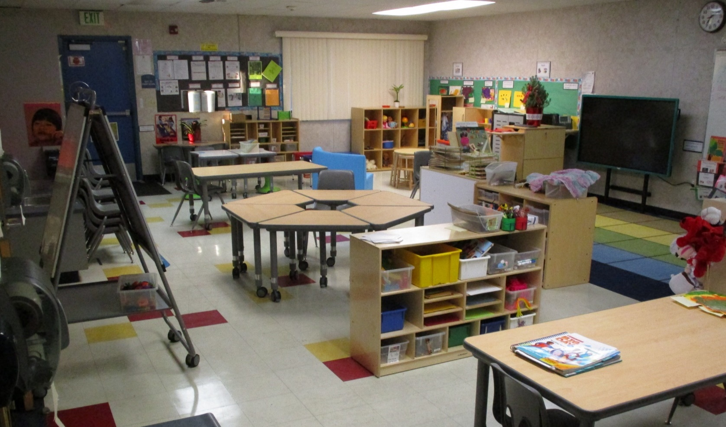
Completed
Nelson’s preschool bond project renovations

Slide 15
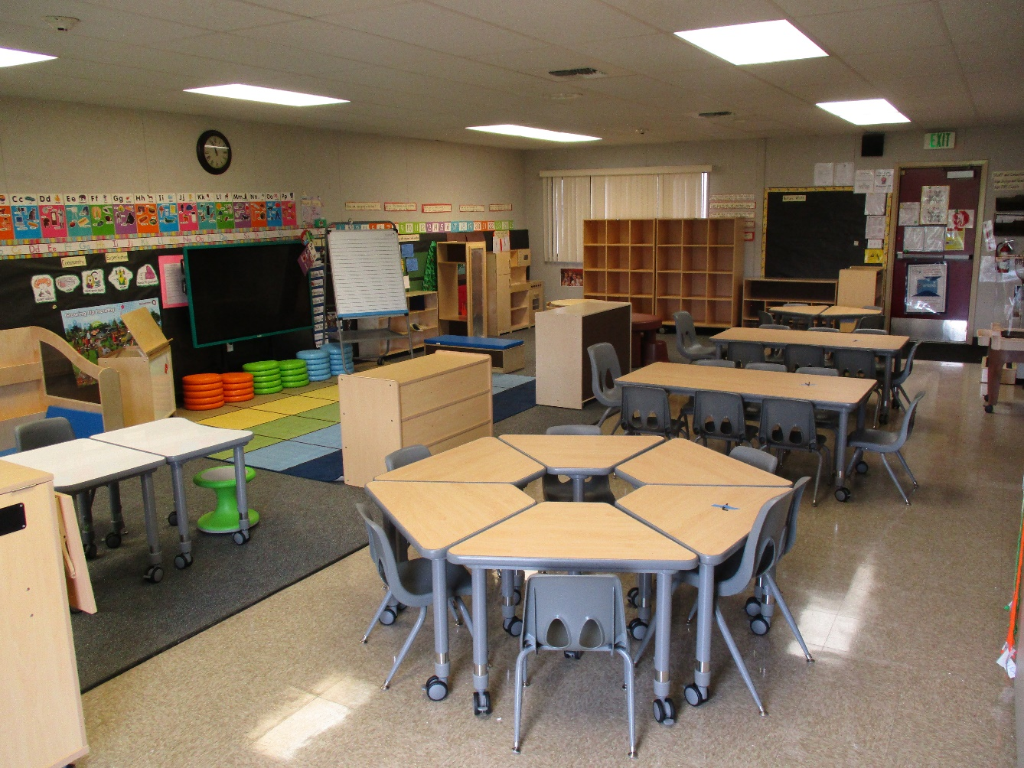
Completed
Wing Lane’s preschool bond project renovations

Slide 16
Thank you!

