Slide 1


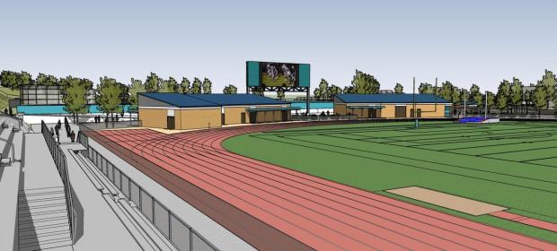
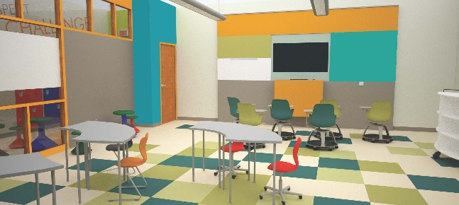
Hacienda La Puente
Unified School District
Measure BB - Bond Projects
Monthly Report
Regular Board Meeting
December 12, 2019
Business Services Division

Slide 2
Bond Expenditures as of December 5, 2019
Expenditures:
Cost of Issuance Fees |  | $ 465,750
Materials & Supplies |  | 8,582,283
Planning Services Fees |  | 757,949
Total Expenditures to Date |  | 9,805,982
Committed Amounts to Date |  | 11,547,428
Scheduled/Projected Expenditures:
Phase 1 and 2 |  | $ 32,000,000
Fire Alarm |  | 4,167,195
Water Bottle Filler |  | 967,400
Ceiling Tiles-Phase 4 Lighting Project |  | 726,586
Furniture, Fixtures and Equipment |  | 4,200,000
Future Phase Planning |  | 6,000,000
Total Expenditures, Committed and Projected to date |  | $ 69,414,591

Slide 3
Planning
Fire Alarm Projects
  11 school sites DSA approved
  Pre-construction site walks completed at all sites
  Sparks MS
    Kicked off meeting on December 5, 2019
    Work starts next Monday December 16, 2019
  Contractor will move to Newton, Grandview, Mesa Robles and Cedarlane as work progresses
Cedarlane | Grandview | Nelson | Wilson HS
Workman HS | Mesa Robles | Newton | Los Altos HS
Sparks MS | Workman ES | Los Altos ES

Slide 4
Planning (Continued)
Phase 4 Lighting project – Ceiling Tiles
  Delivery of materials in process
  Schneider Electric mobilizing lighting equipment
    Containers delivered to Baldwin, Grazide, Los Altos ES, Los Molinos, Nelson, Sparks ES, Wing Lane and Facilities
    Lighting replacement
      Lighting complete at Stimson
      Lighting started November 20th at Workman ES
  Estimated schedule of completion January 2021

Slide 5
Planning (Continued)
Furniture, Fixtures and Equipment
  21st Century Classroom Furniture
    38 Child Development classroom
      Delivery completed to all sites except Amar
      Amar to be complete by December 20th
      Work is ahead of target completion date of December 31, 2019

Slide 6
Planning
Program/Construction Management
  Balfour Beatty master agreement will be presented to the Board of Education for approval
  Bernards signed the master agreement

Slide 7
Project Status
Los Altos ES - TDM
  Interim Housing
    Construction Complete and ready to be occupied
  21st Century Classrooms
    100% Construction Documents - DSA Backcheck appointment awaiting certification of four open DSA Applications
Newton MS - HED
  Interim Housing
    100% Construction Documents
  21st Century Classrooms
    100% Construction Documents - DSA Backcheck appointment awaiting certification of one open DSA Applications

Slide 8
Project Status (Continued)
Cedarlane Academy - PBK
  Interim Housing
    25% Schematic Design
  21st Century Classrooms
    75% Construction Documents
Workman ES - SVA
  21st Century Classrooms
    DSA Backcheck appointment scheduled for December 11, 2019
    Upon approval by DSA, estimated schedule for bidding in
    January

Slide 9
Project Status (Continued)
Grandview Academy - HED
  21st Century Classrooms
    75% Construction Document
    Mesa Robles
  Interim Housing - tBP
    DSA approved on November 26, 2019
    Estimated schedule for bidding in January
  21st Century Classrooms – OFFICE p.S. reassigned to PBK
    5% Schematic Design Documents

Slide 10
Project Status (Continued)
Nelson ES - TDM
  21st Century Classrooms
    DSA Backcheck ready. Appointment pending DSA certification of outstanding Application
    1 model classroom in progress
Sparks MS - HED
  21st Century Classrooms
    50% Construction Documents
    Due in 2-3 weeks

Slide 11
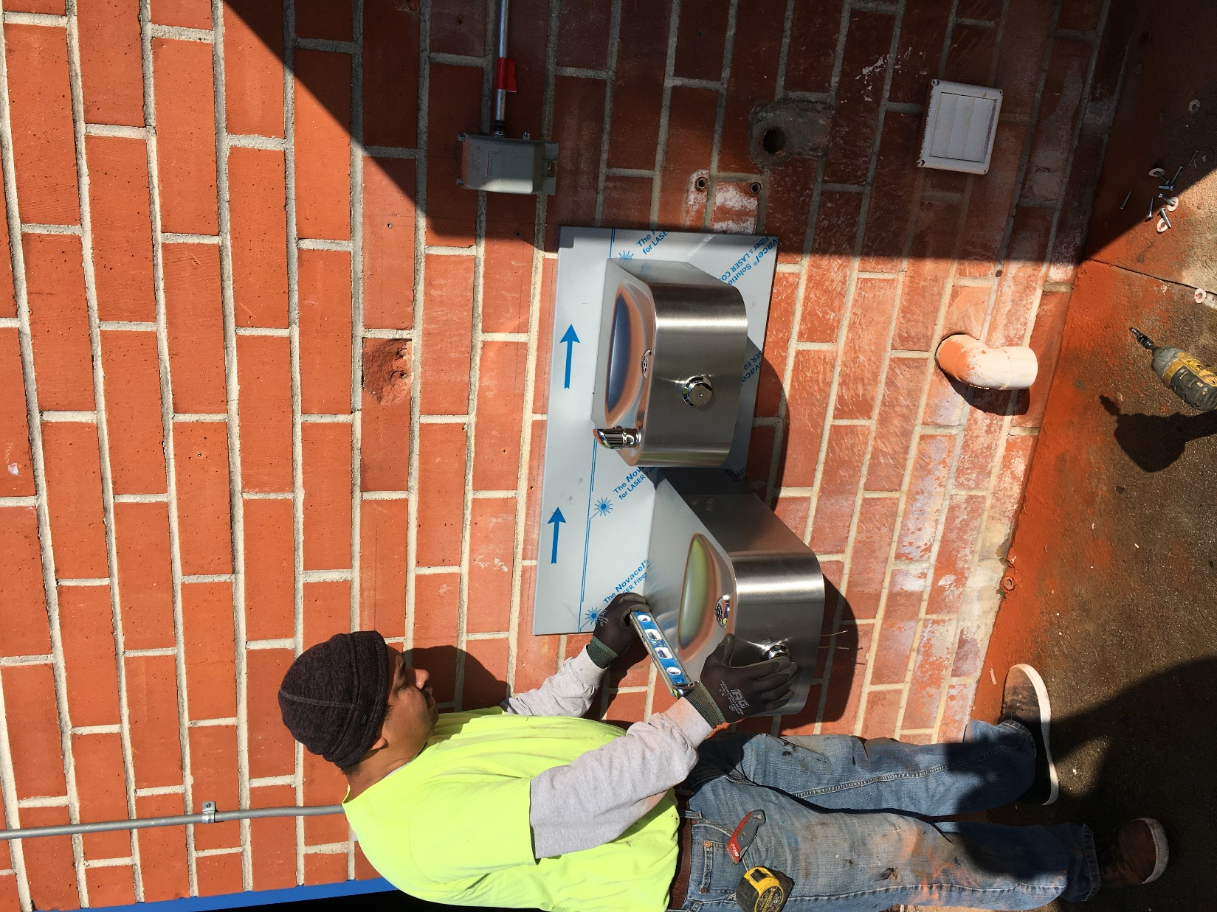
Work in Progress
Los Altos HS water bottle filler installation

Slide 12
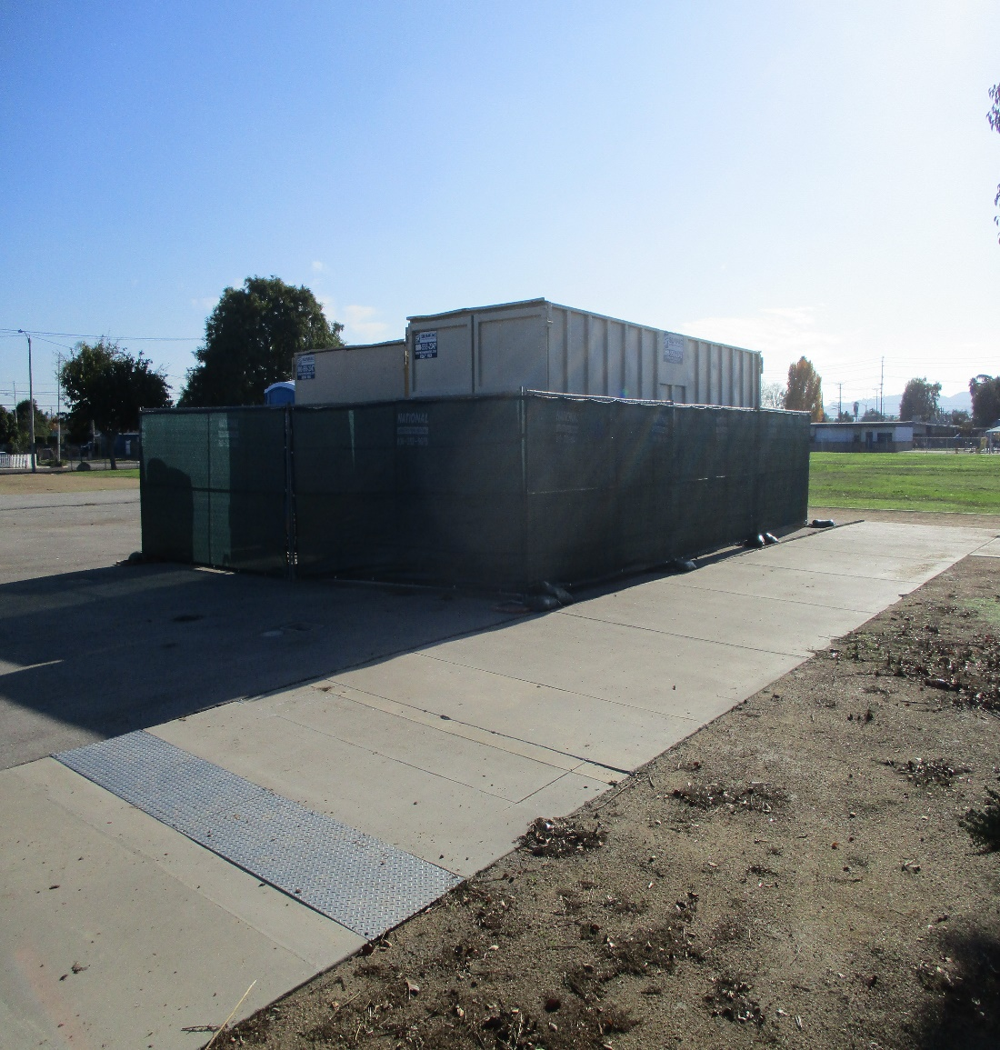
Work in Progress
Mobilization of equipment for fire alarm project at Sparks MS

Slide 13
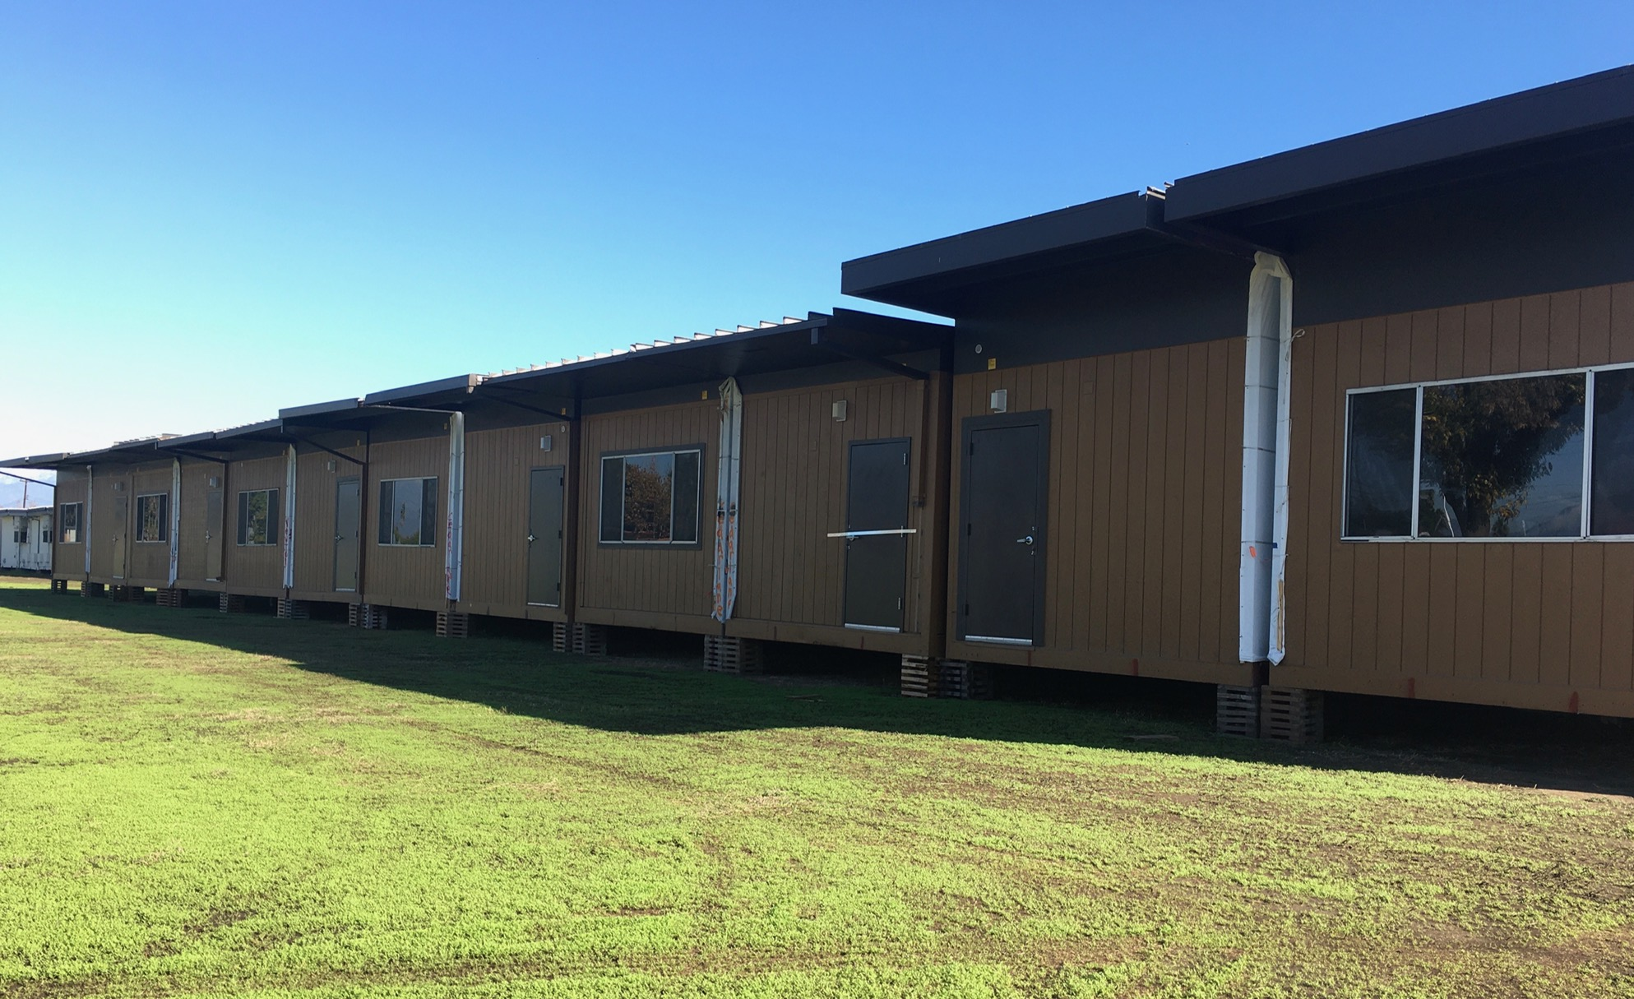
Work in Progress
Interim housing delivered to Amar center

Slide 14
Completed to Date
Cumming Program Implementation - completed
  Met with all architects
  Reviewed budgets, bond allocations and compared with architects’ budgets
  Constructability reviews done for 5 sites
  Performed independent bid take off for Los Altos for cost verification
  Met with Phase 2 architectural teams to assess progress, gather and analyze work to date and update project status.
  Toured the prototype classrooms at the target campuses
  Toured the Phase 2 Schools
  Reviewed Technology Delivery Equipment
  Workshopped The Technology Equipment and Infrastructure Layouts with Staff
  Continued Review and Comparison of the Architect’s Scopes of Work
  Reviewed and Analyzed the Updated Architects Estimates of Probably Cost

Slide 15
Progress Going Forward
Cumming is currently developing procedures, processes, and policies which include but are not limited to the following:
  Solidifying project scopes tailored to site specific conditions
  Validating all scopes with Bond budget for balance and equity
  Defining and coordinating efforts and timelines for project delivery (i.e. classroom move-out, demolition, construction, relocations, certification, etc.)
  Refining individual specifications into District Standard Specifications
  Implementing status reporting and communications on a project by project log
  Developing and coordinating the projects schedules for “unit bid contractor scopes” in concert with the design bid build scopes

Slide 16
Next Steps…
Cumming next steps on-going
  Reviewing, validating, and analyzing the scopes of work to conform with and align with program intent, equity and budget;
  Reviewing the preliminary estimates and validating the budgets; on Phase 2
  Reviewing, comparing, validating and assessing, preliminary specifications, drawings, and contracts
  Reviewing Phase 1 drawings for feasibility and constructability to minimize change orders
  Drafting the Master Schedule
  Reviewing and vetting the campus move, demo and construction logistics

Slide 17
Thank you!

