Slide 1

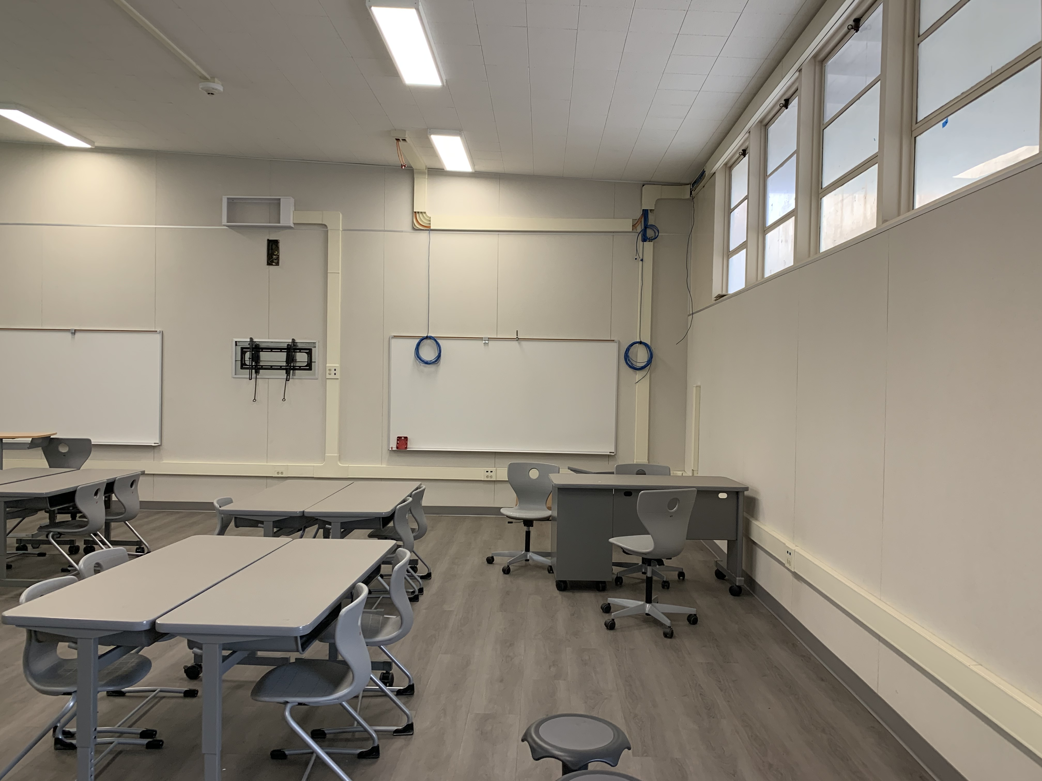


21st CENTURY CLASSROOM IMPROVEMENTS | PHASES 1 & 2
BOND UPDATES
February 25, 2021

Slide 2
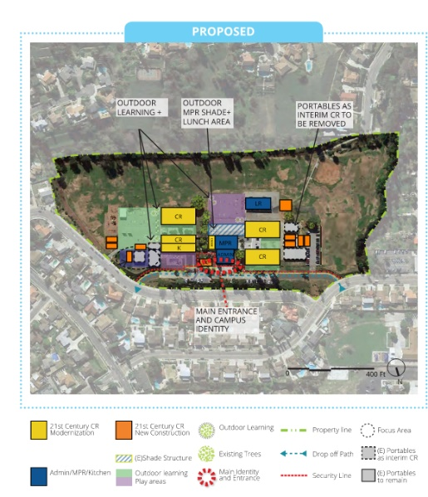
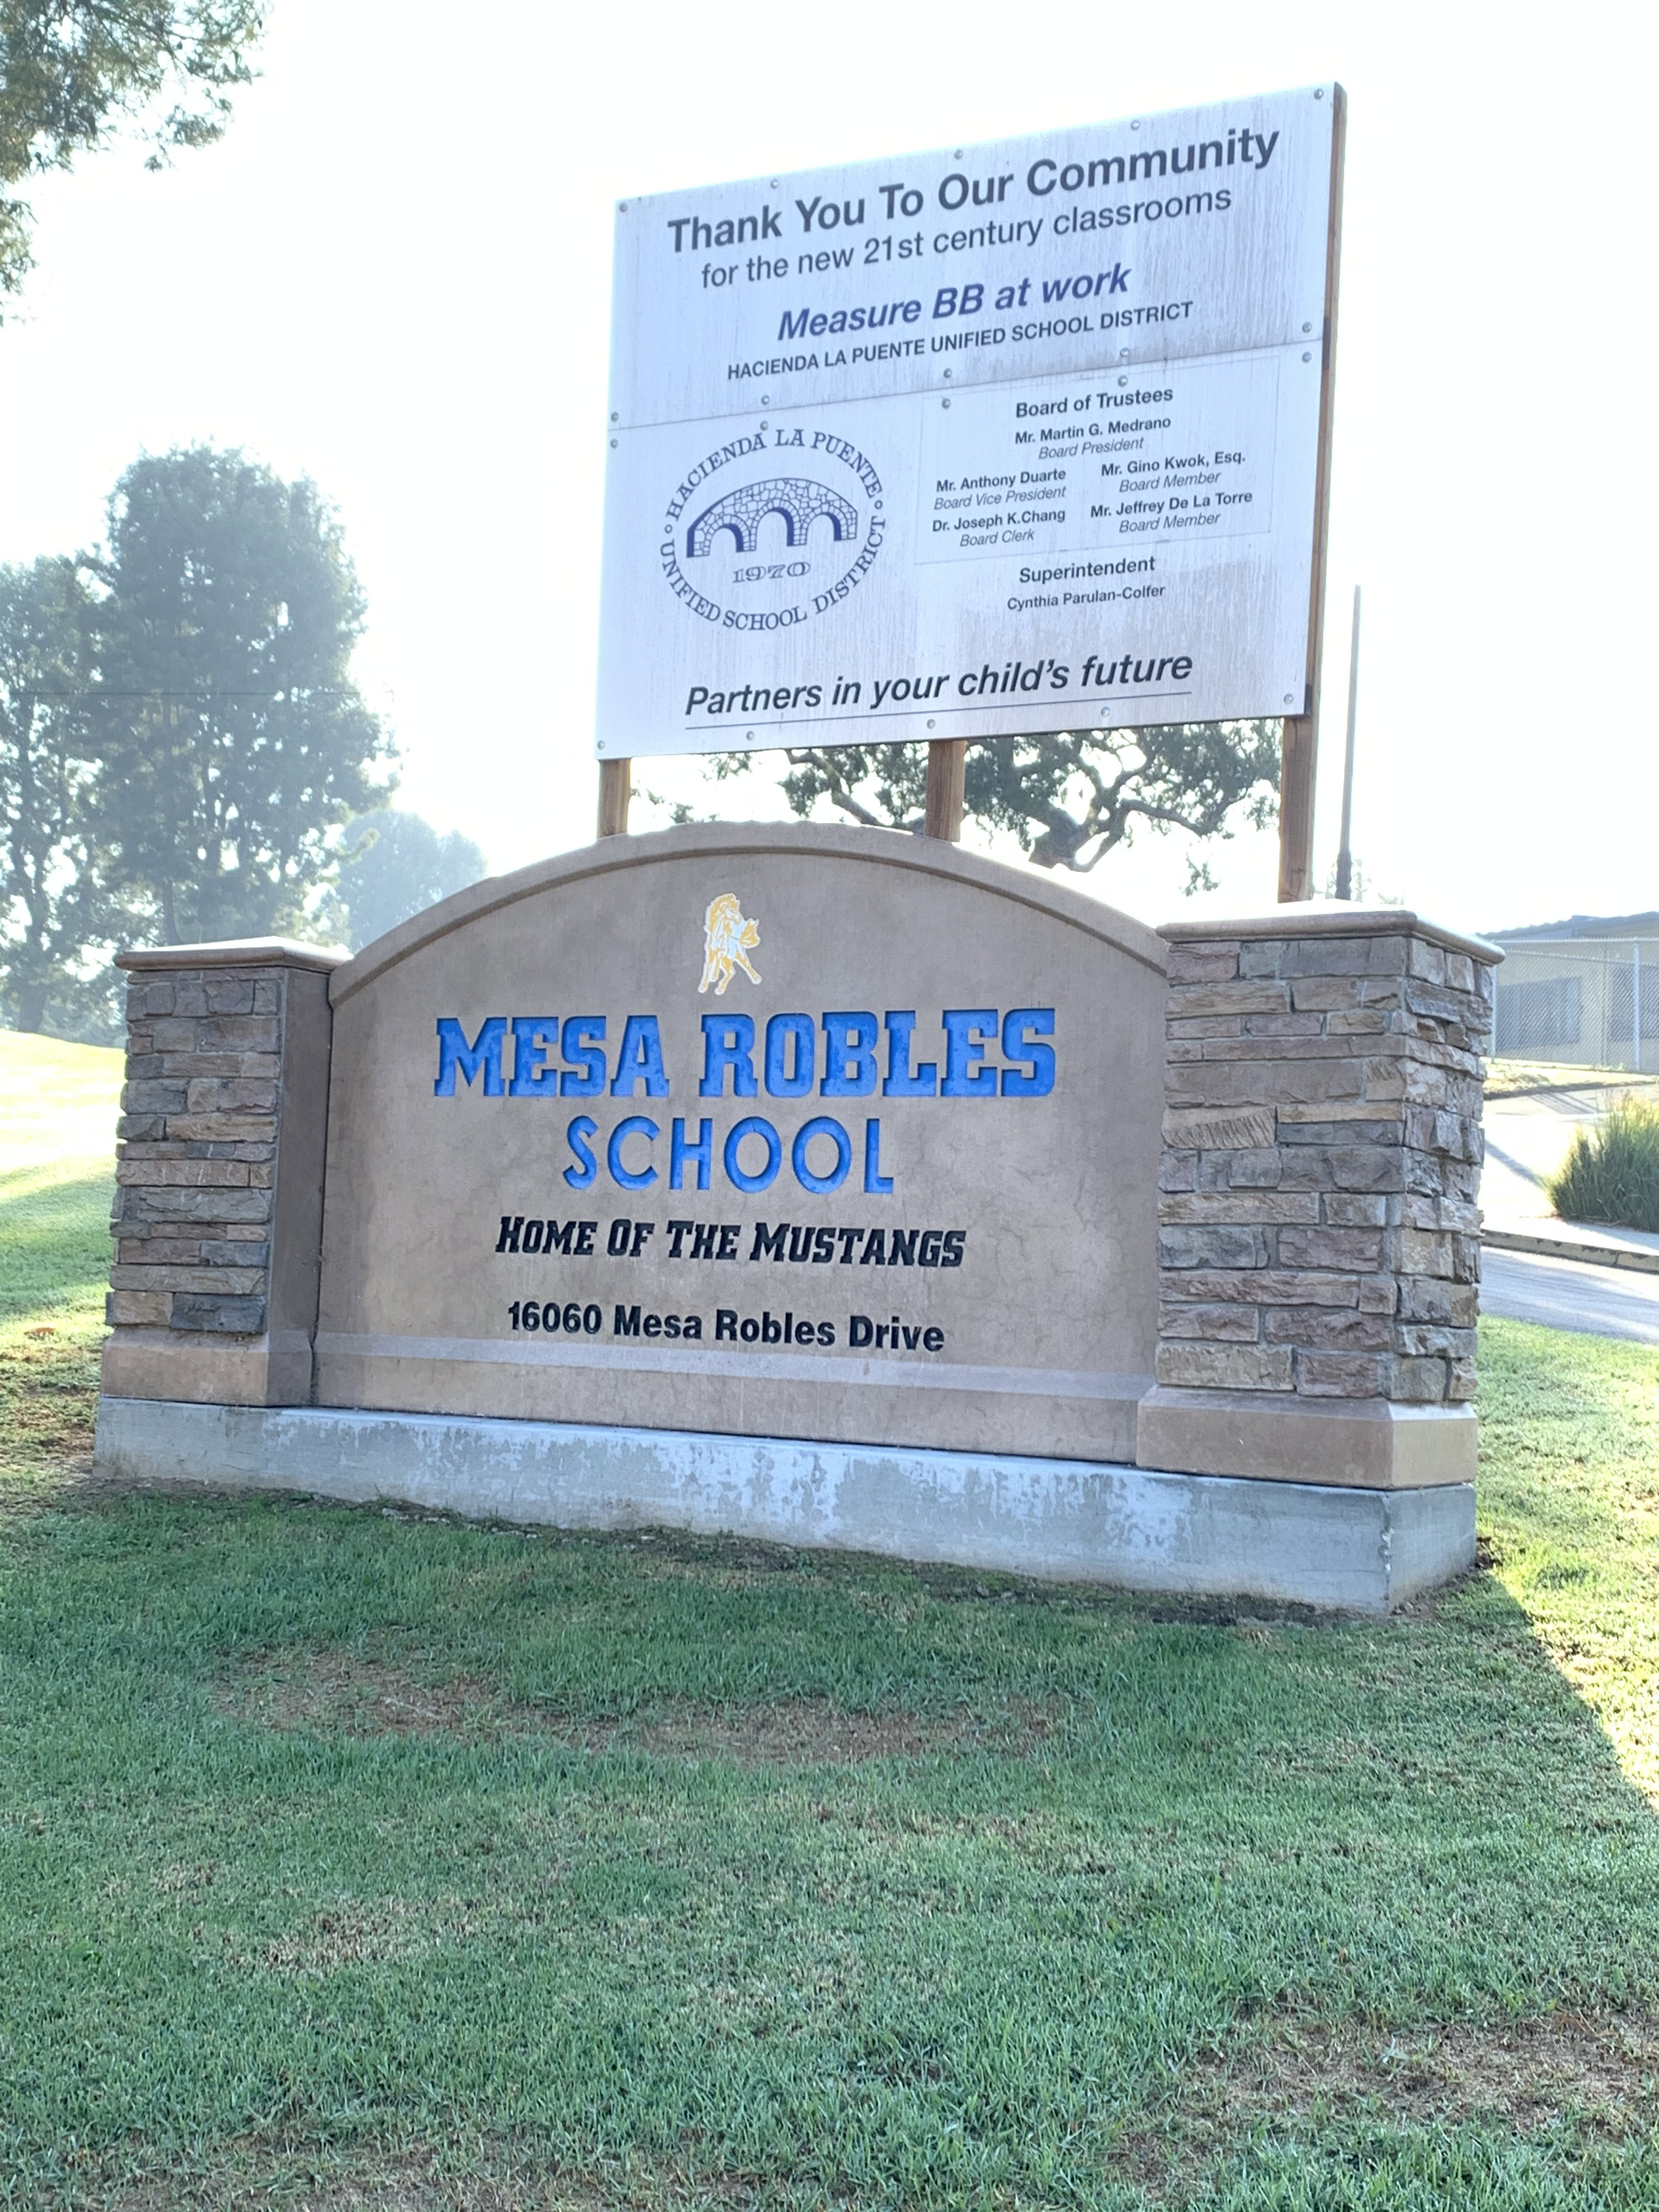
MESA ROBLES SCHOOL
PROJECT STATUS
PROJECT STATUS
INTERIM HOUSING |  |  |  |  |  |  | 21ST CENTURY CLASSROOM
SCHEMATIC DESIGN | DESIGN DEVELOPMENT | CONSTRUCTION DOCUMENTS | CONSTRUCTION | DSA APPROVAL | OCCUPANCY |  | SCHEMATIC DESIGN | DESIGN DEVELOPMENT | CONSTRUCTION DOCUMENTS | DSA APPROVAL | CONSTRUCTION | COMPLETION
UNDER CONSTRUCTION
NOTES:
Interim Classrooms
  COMPLETE
21st Century Classroom Improvements
NTP issued October 19
  Demolition Complete Phase 1 and Phase 1A
  Construction Phase 2 started January 13 is nearly complete
  Phase 3 to begin March 30
100%
25%

Slide 3
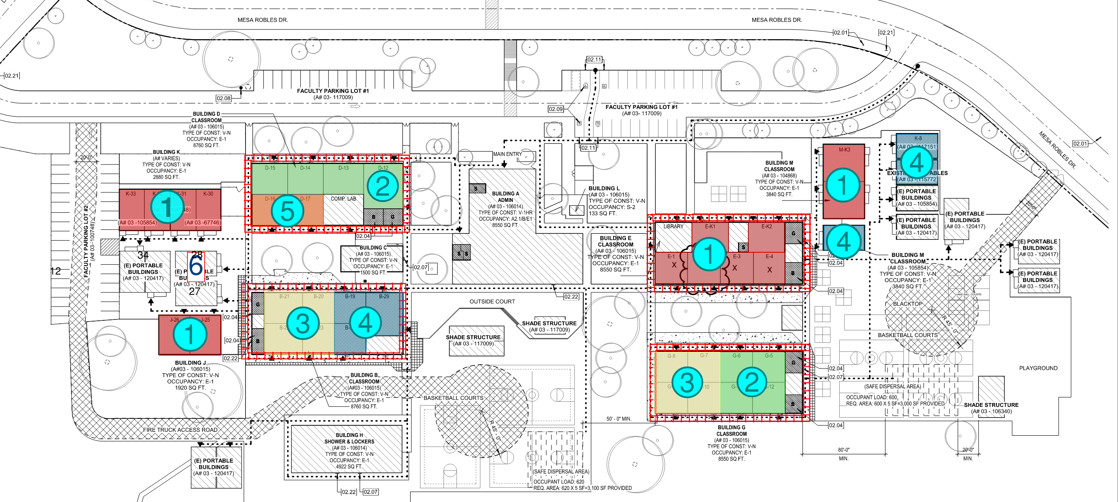
Interim Housing
MESA ROBLES SCHOOL
PHASING PLAN
Elementary School Side
Middle School Side
CONSTRUCTION PHASE 2
Phase 2, 4 CR Middle School Side B-20, B-21, B-23 and B-24 1-13-21 to 3-29-21
Phase 2, 4 CR: G-4, G-5 and G-11, G-12 1-13-21 to 3-29-21

Slide 4
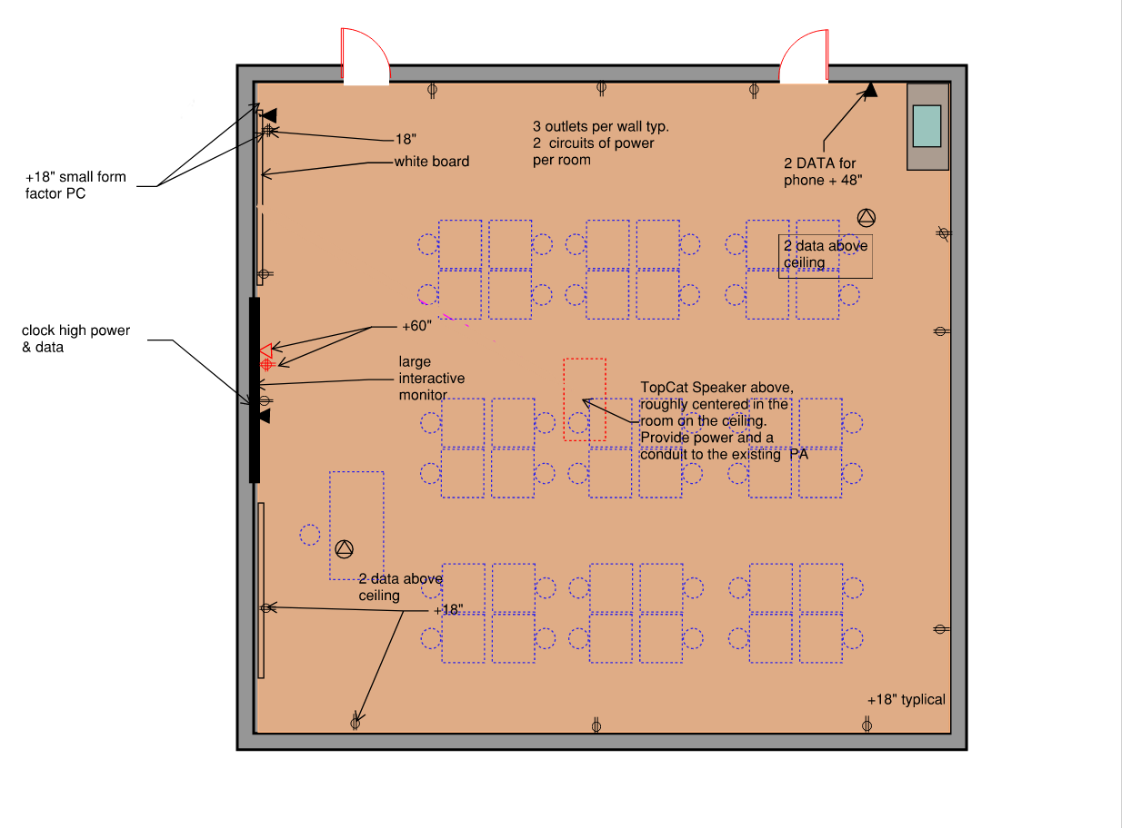
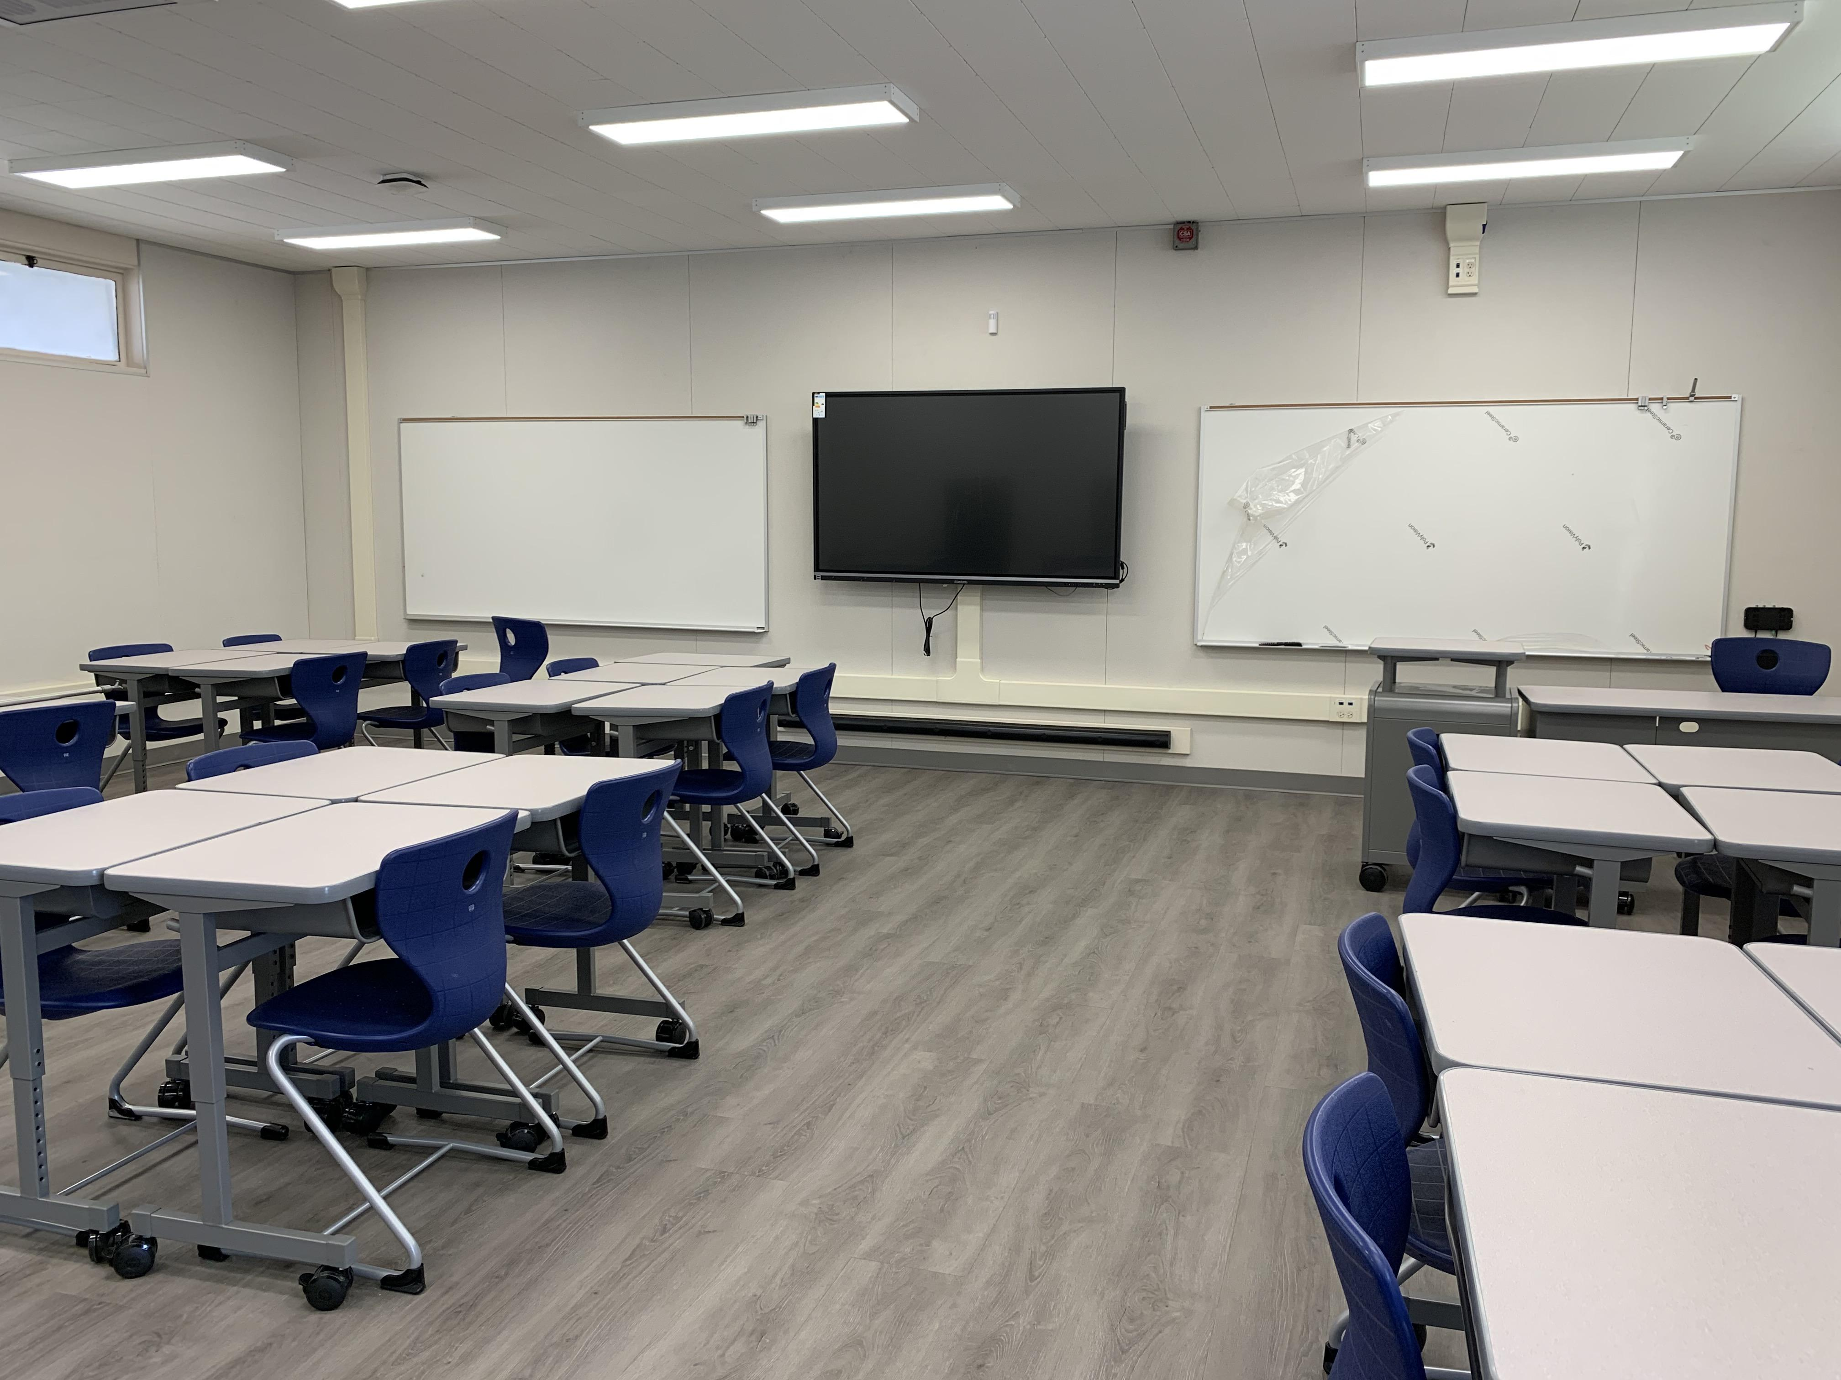
21st CENTURY CLASSROOM IMPROVEMENTS
MESA ROBLES SCHOOL
• NEW LVT FLOORING
• NEW WALL BASE
• NEW TACKABLE WALL BOARD
• NEW COUNTER AND SINK
• NEW PLUMBING VALVES PER FIXTURE
• NEW WHITE BOARDS
• NEW INTERACTIVE MONITOR
• NEW ENHANCED WHOLE CLASS AUDIO TECHNOLOGY
• NEW UPGRADED WIRE CABLING INFRASTRUCTURE

Slide 5
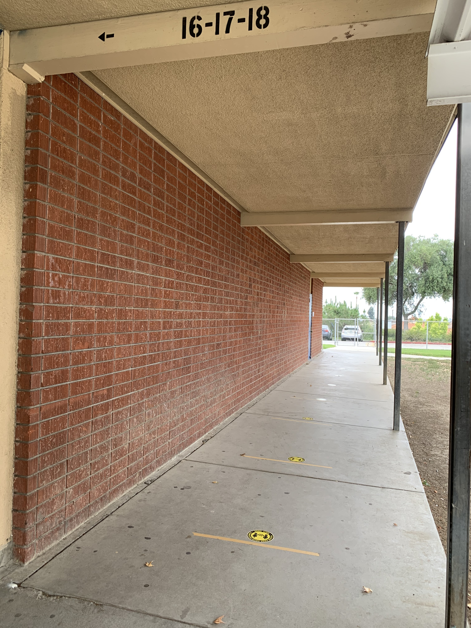
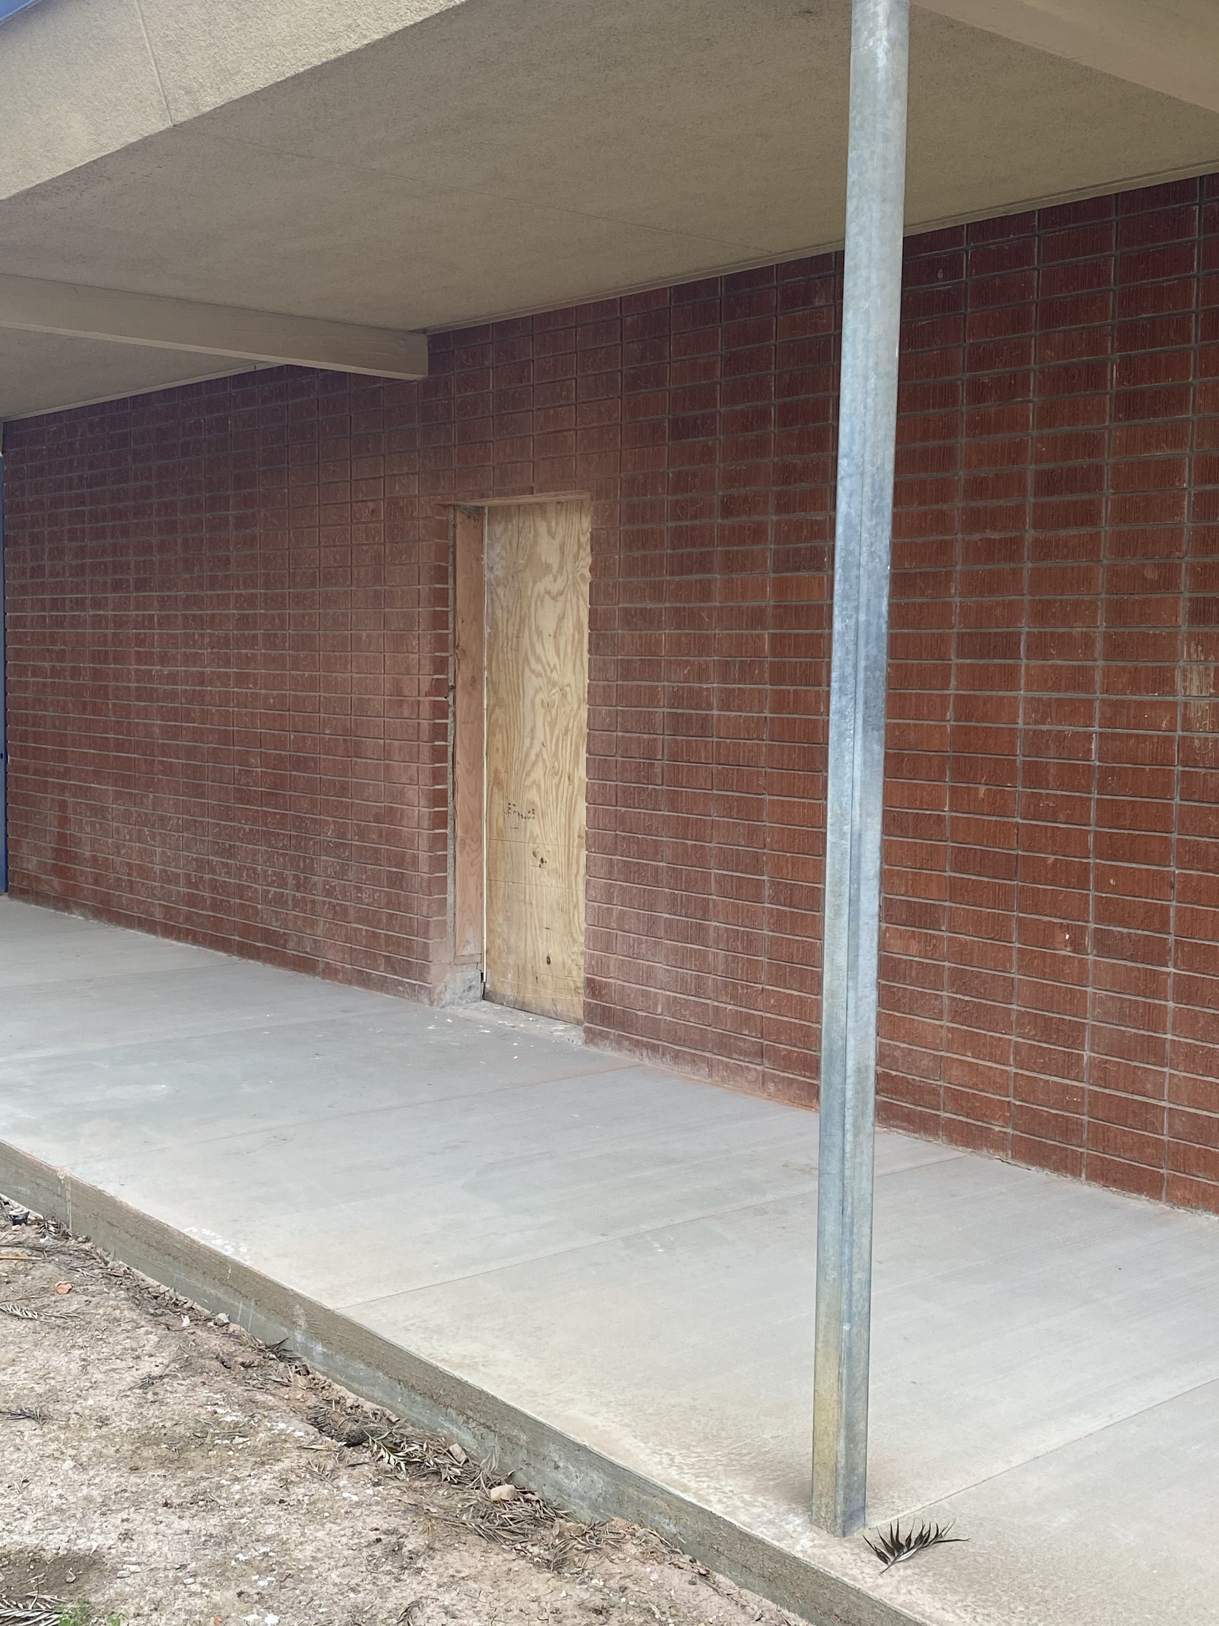
MESA ROBLES SCHOOL
21st CENTURY CLASSROOM IMPROVEMENTS
ADA ACCESS IMPROVEMENTS
BEFORE
IN PROGRESS
ACCESS DOOR D-12
NEW ACCESSIBLE DOOR & WALKWAY

Slide 6
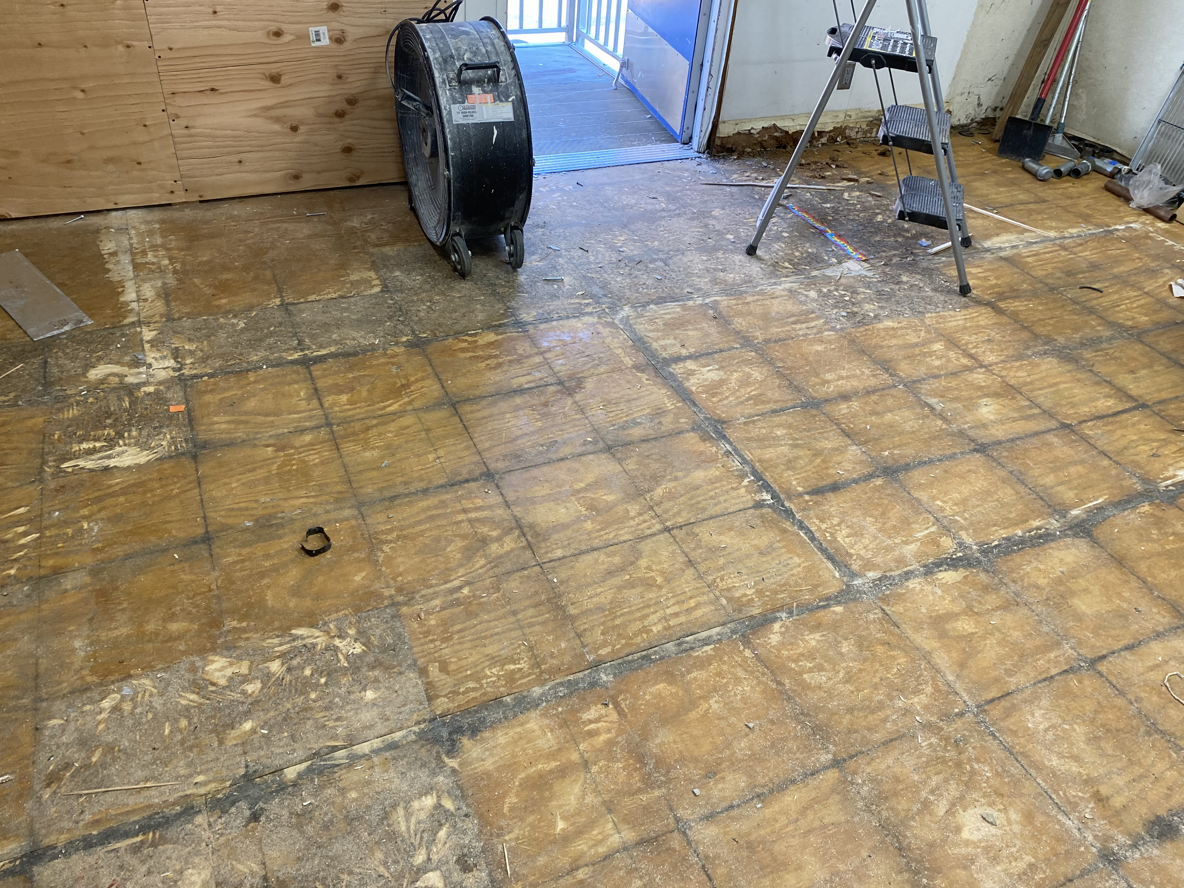
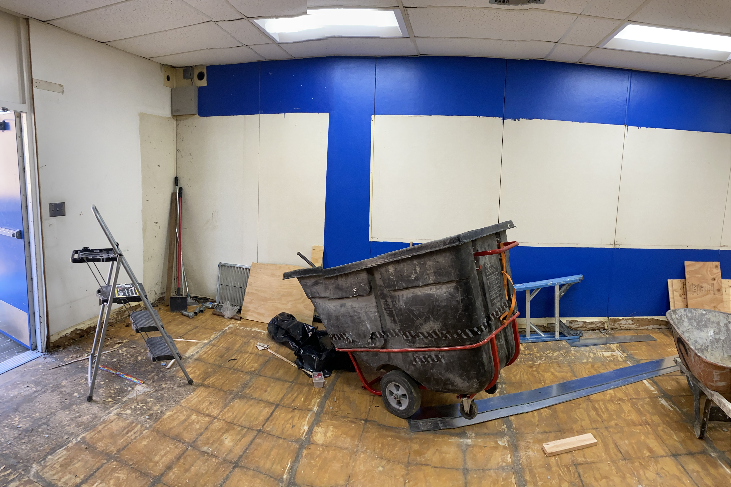
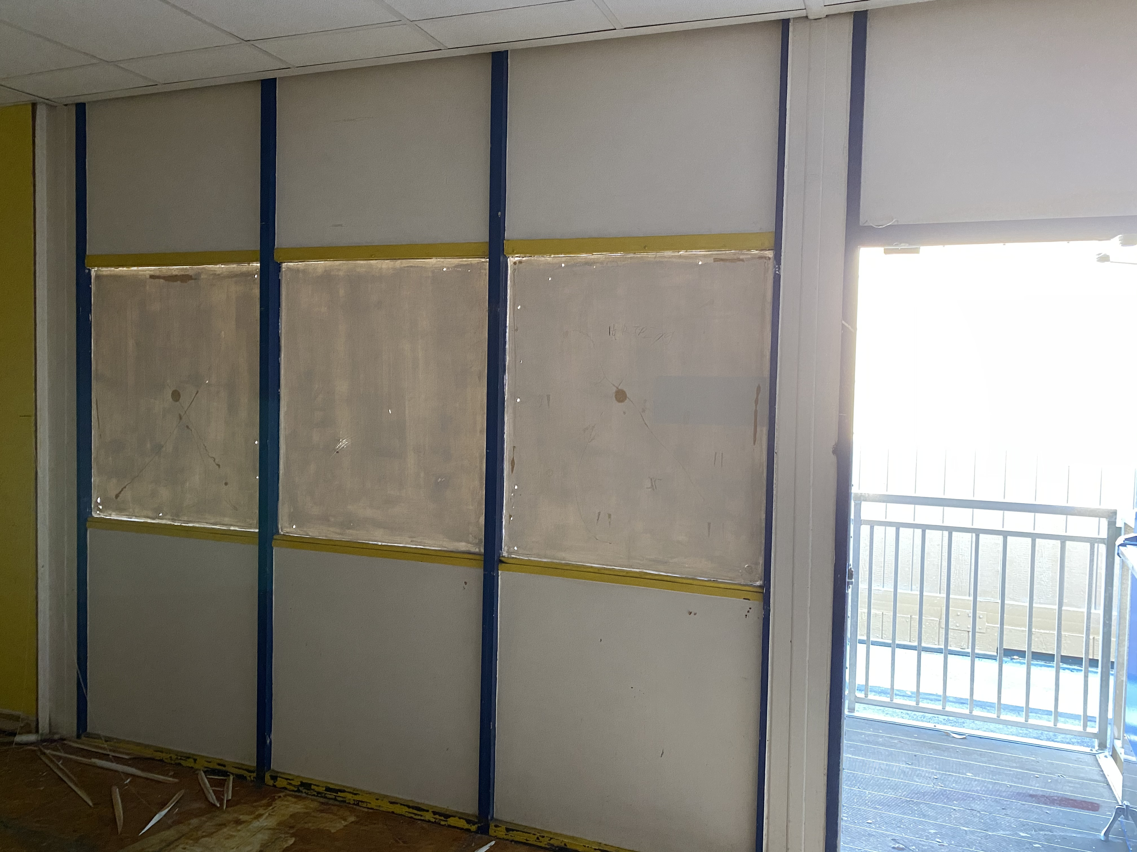
21st CENTURY CLASSROOM IMPROVEMENTS
MESA ROBLES SCHOOL
CLASSROOM DEMOLITION

Slide 7
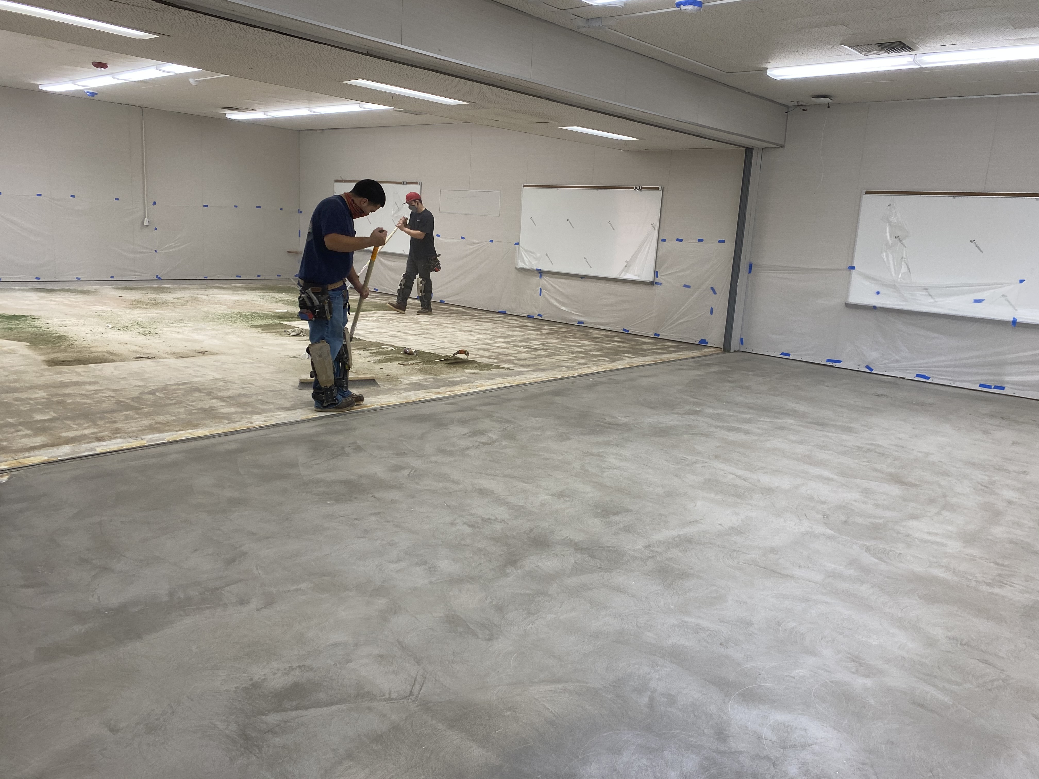
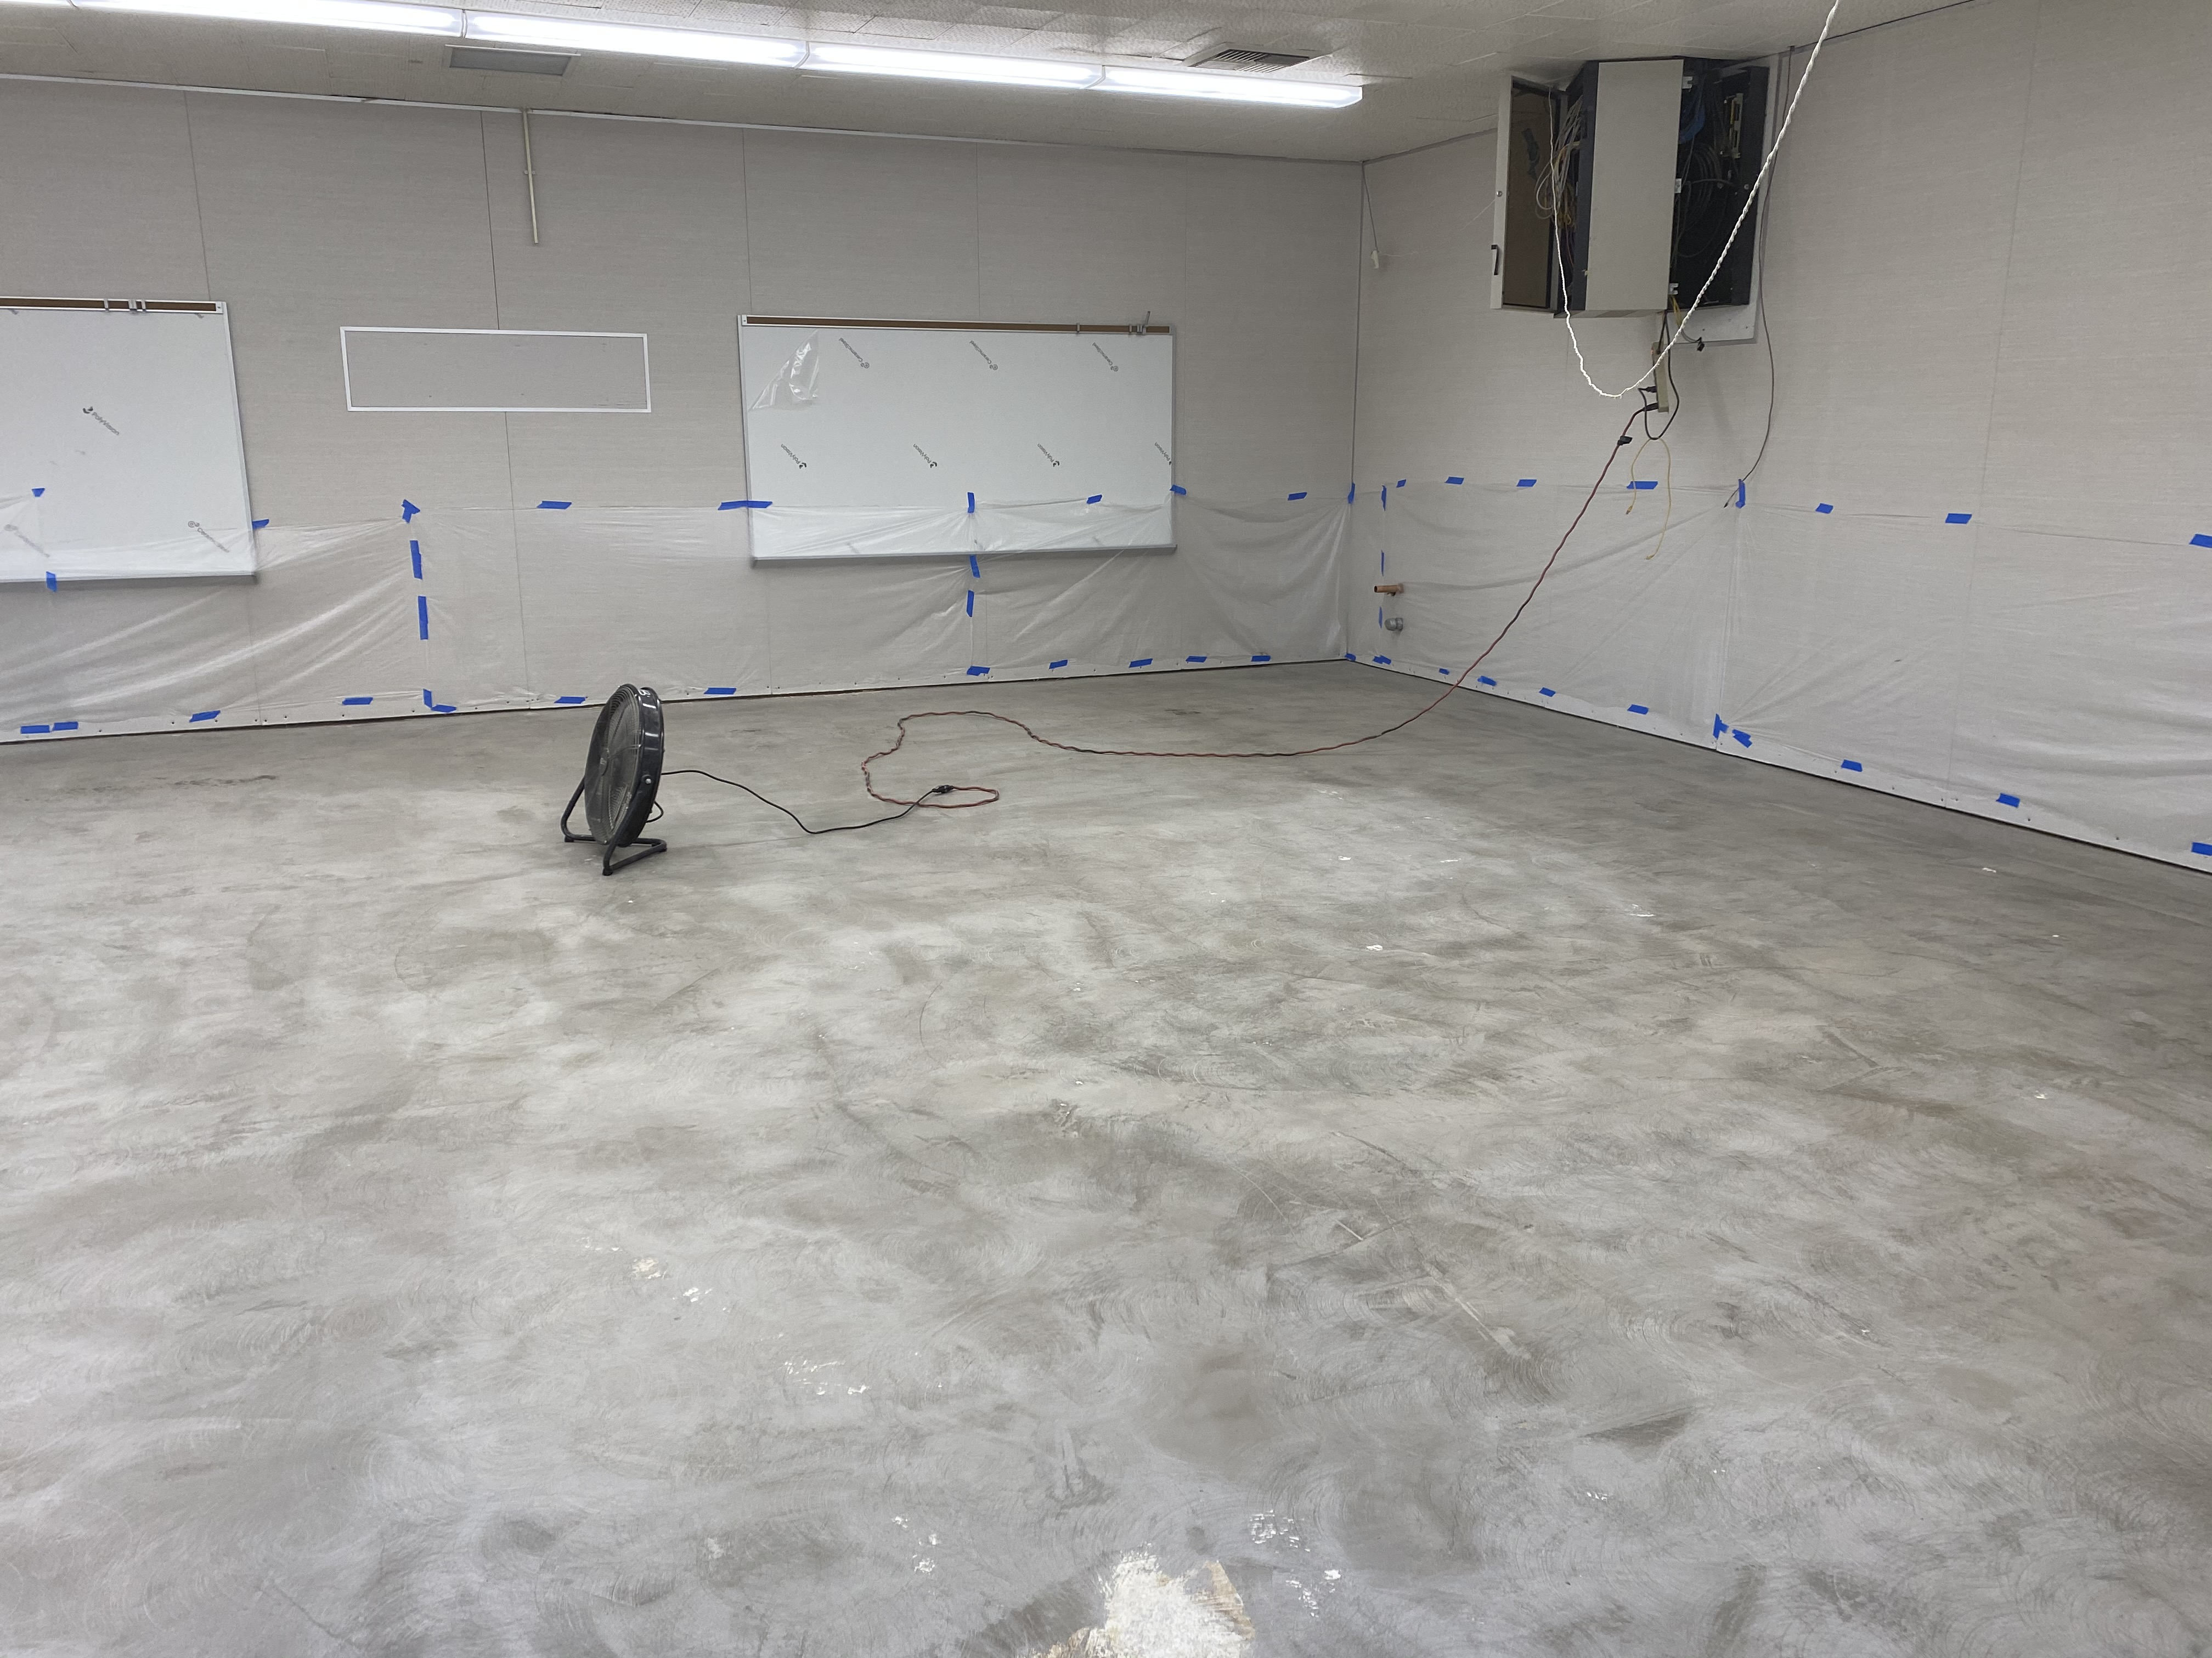
21st CENTURY CLASSROOM IMPROVEMENTS
MESA ROBLES SCHOOL
CLASSROOM IMPROVEMENT CONSTRUCTION

Slide 8
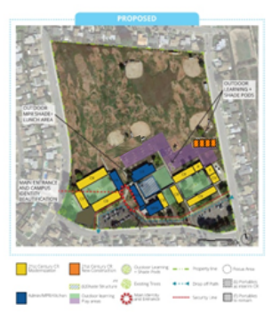
CEDARLANE ACADEMY
PROJECT STATUS
INTERIM HOUSING |  |  |  |  |  |  | 21ST CENTURY CLASSROOM
SCHEMATIC DESIGN | DESIGN DEVELOPMENT | CONSTRUCTION DOCUMENTS | CONSTRUCTION | DSA APPROVAL | OCCUPANCY |  | SCHEMATIC DESIGN | DESIGN DEVELOPMENT | CONSTRUCTION DOCUMENTS | DSA APPROVAL | CONSTRUCTION | COMPLETION
UNDER CONSTRUCTION
50%
23%
NOTES:
N.T.P. October 19
Demolition East Courtyard
  Interior site work phase 1 and 1A East Courtyard Complete
  Interior Demolition and Abatement Phase 2 Complete
  Interior Construction Nearing Completion

Slide 9
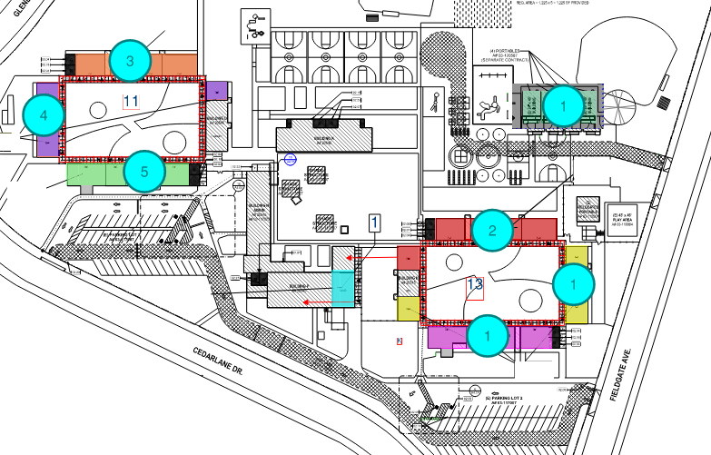
PROJECT STATUS
CEDARLANE ACADEMY
START PHASING PLAN & INTERIM HOUSING
CONSTRUCTION PHASE 2
Phase 2, 5 CR East Side E-1, E-2, E-3, E-4 and H-3

Slide 10
CEDARLANE ACADEMY
PROJECT STATUS
INTERIOR IMPROVEMENTS
BEFORE
AFTER
CLASSROOM INTERIOR IMPROVEMENTS

Slide 11
PROJECT STATUS
CEDARLANE ACADEMY
NEW FLOORING
NEW WALL FINISH
NEW PLUMBING
NEW WHITE BOARDS
NEW TECHNOLOGY
PHASE 1 CLASSROOM IMPROVEMENTS COMPLETE

Slide 12
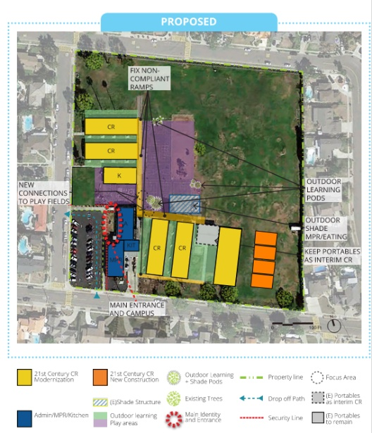
LOS ALTOS ELEMENTARY SCHOOL
PROJECT STATUS
INTERIM HOUSING |  |  |  |  |  |  | 21ST CENTURY CLASSROOM
SCHEMATIC DESIGN | DESIGN DEVELOPMENT | CONSTRUCTION DOCUMENTS | CONSTRUCTION | DSA APPROVAL | OCCUPANCY |  | SCHEMATIC DESIGN | DESIGN DEVELOPMENT | CONSTRUCTION DOCUMENTS | DSA APPROVAL | CONSTRUCTION | COMPLETION
UNDER CONSTRUCTION
95%
NOTES:
Interim Housing Project is 100% complete
21st Century Walkways Complete
  Access Ramp Railing Installation
  Phase 2 & 3 Substantial Punch list Items
Finish Plumbing and Electrical; Low Voltage In Progress
Finishes Completed

Slide 13
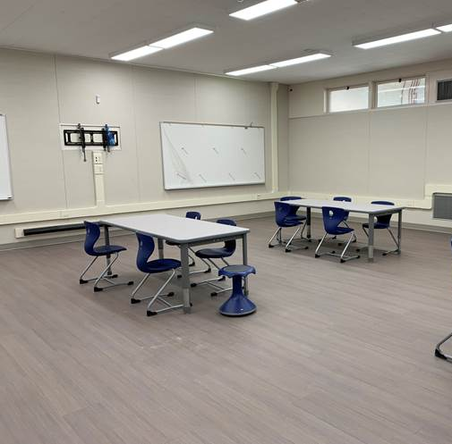
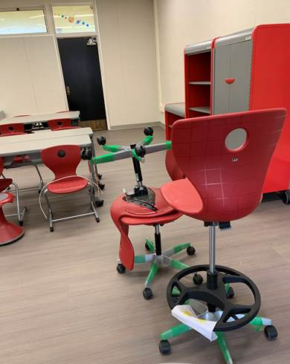
PROJECT STATUS
LOS ALTOS ELEMENTARY SCHOOL
CLASSROOM INTERIORS NEARLY COMPLETE

Slide 14
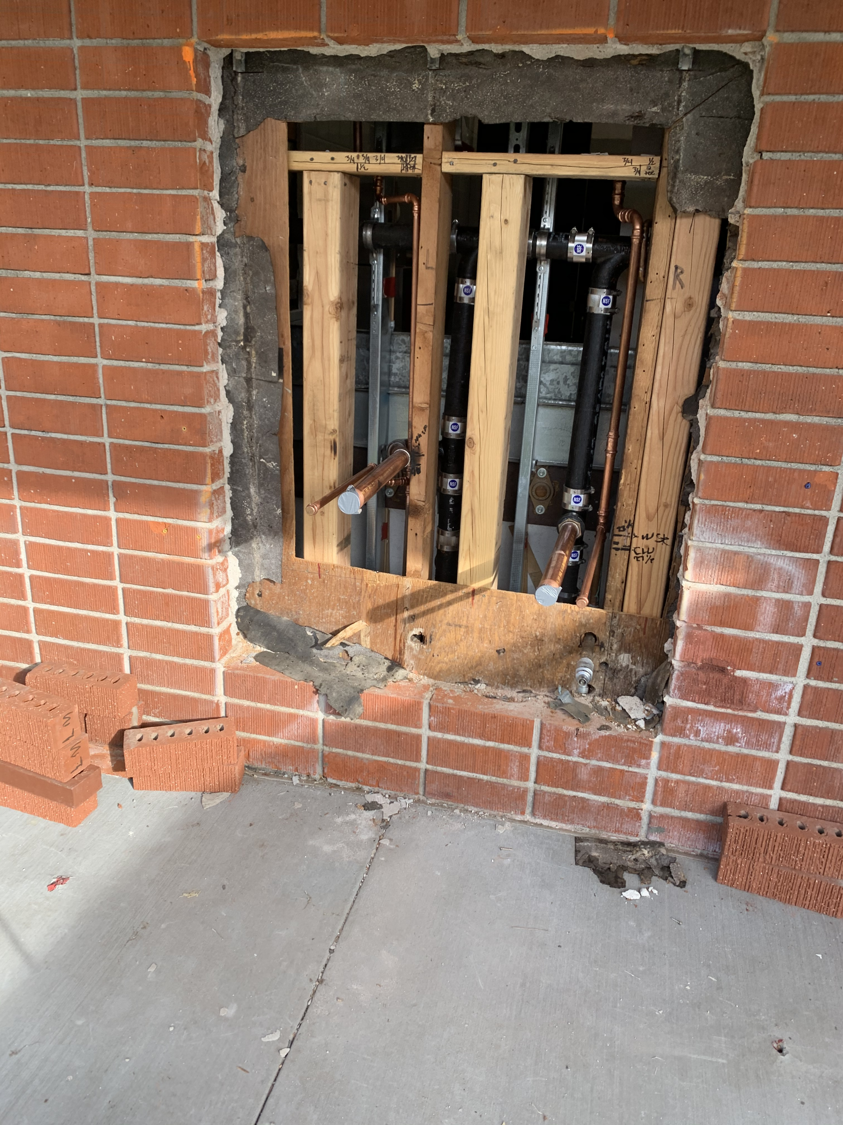
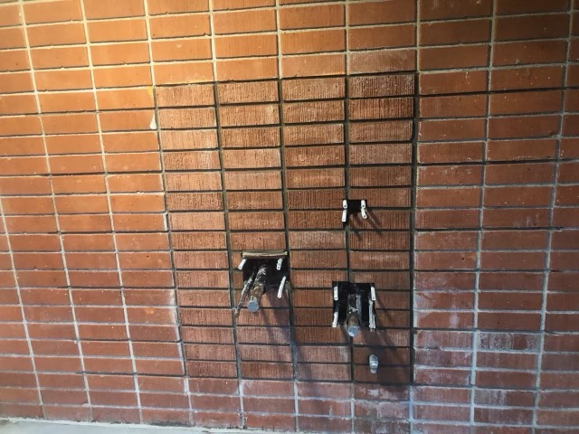
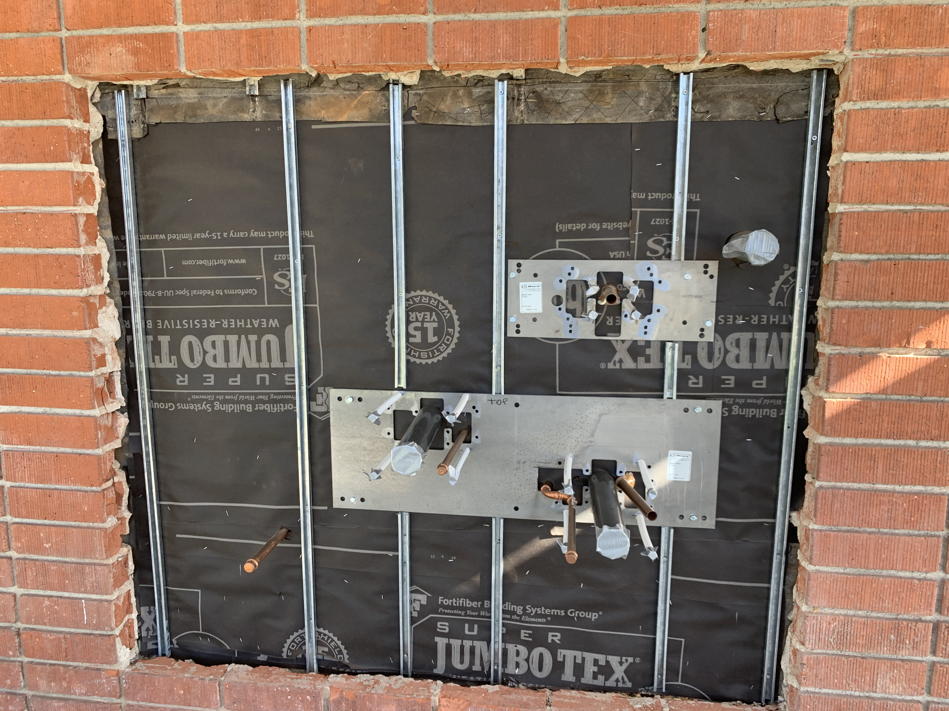
LOS ALTOS ELEMENTARY SCHOOL
PROJECT STATUS
SITE IMPROVEMENTS
BEFORE
READY FOR FIXTURE MOUNT
PROGRESS
DRINKING FOUNTAINS & BOTTLE FILLERS IN BRICK VENEER

Slide 15
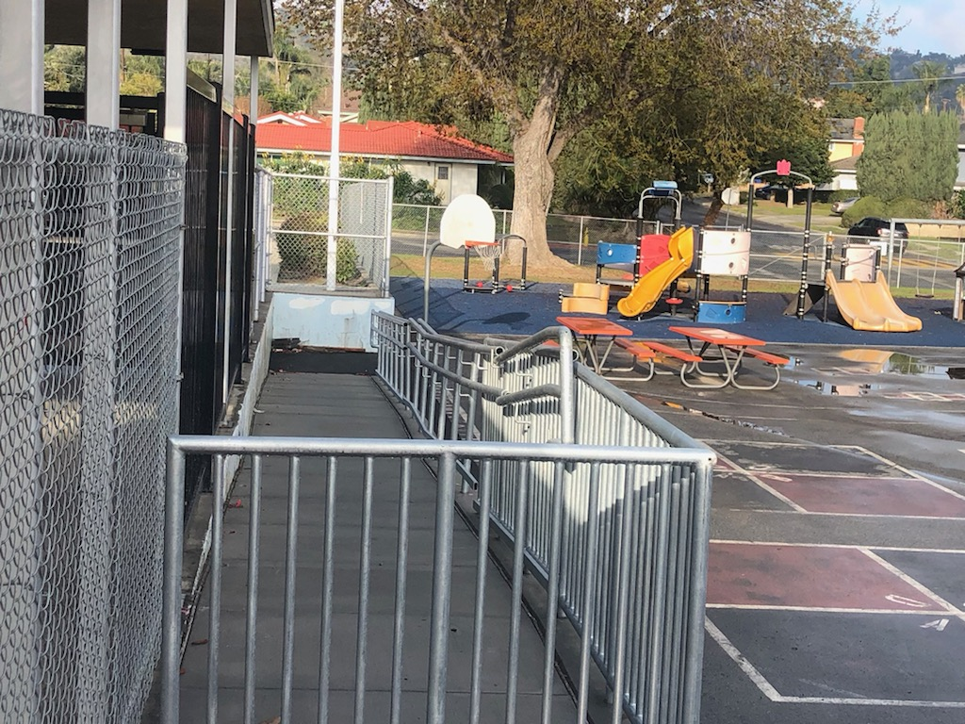
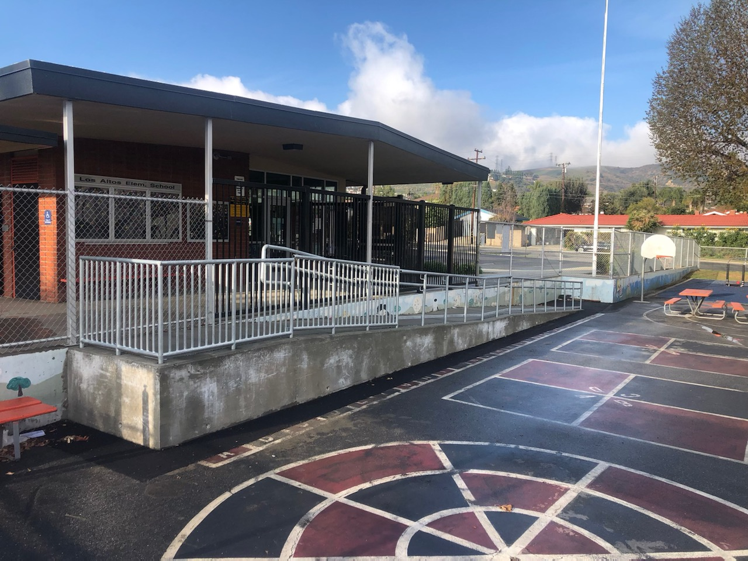
PROJECT STATUS
LOS ALTOS ELEMENTARY SCHOOL
ACCESS IMPROVEMENTS COMPLETE

Slide 16
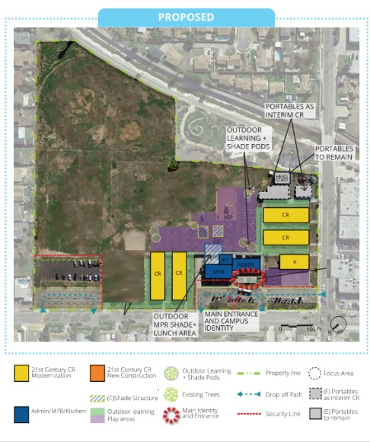
NELSON ELEMENTARY SCHOOL
PROJECT STATUS
21ST CENTURY CLASSROOM
SCHEMATIC DESIGN | DESIGN DEVELOPMENT | CONSTRUCTION DOCUMENTS | DSA APPROVAL | CONSTRUCTION | COMPLETION
UNDER CONSTRUCTION
95%
NOTES:
Notice to Proceed on 6-8-20
Construction Phases 2 and 3 Substantially Complete 12/18/20 Punch List Issued By Architect
Site Concrete corrections completed
Lighting and Fire Alarm Began by Unit Cost Service Providers
Technology installation near completion

Slide 17
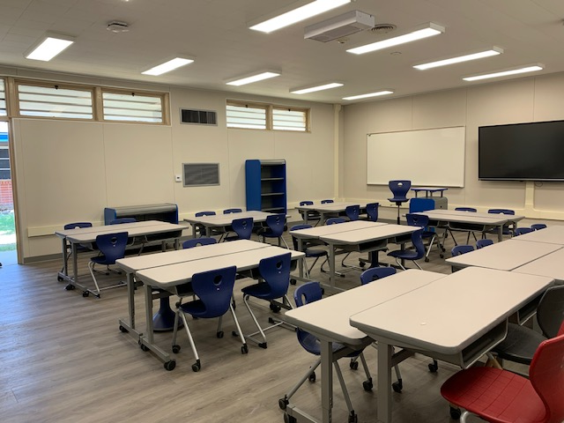
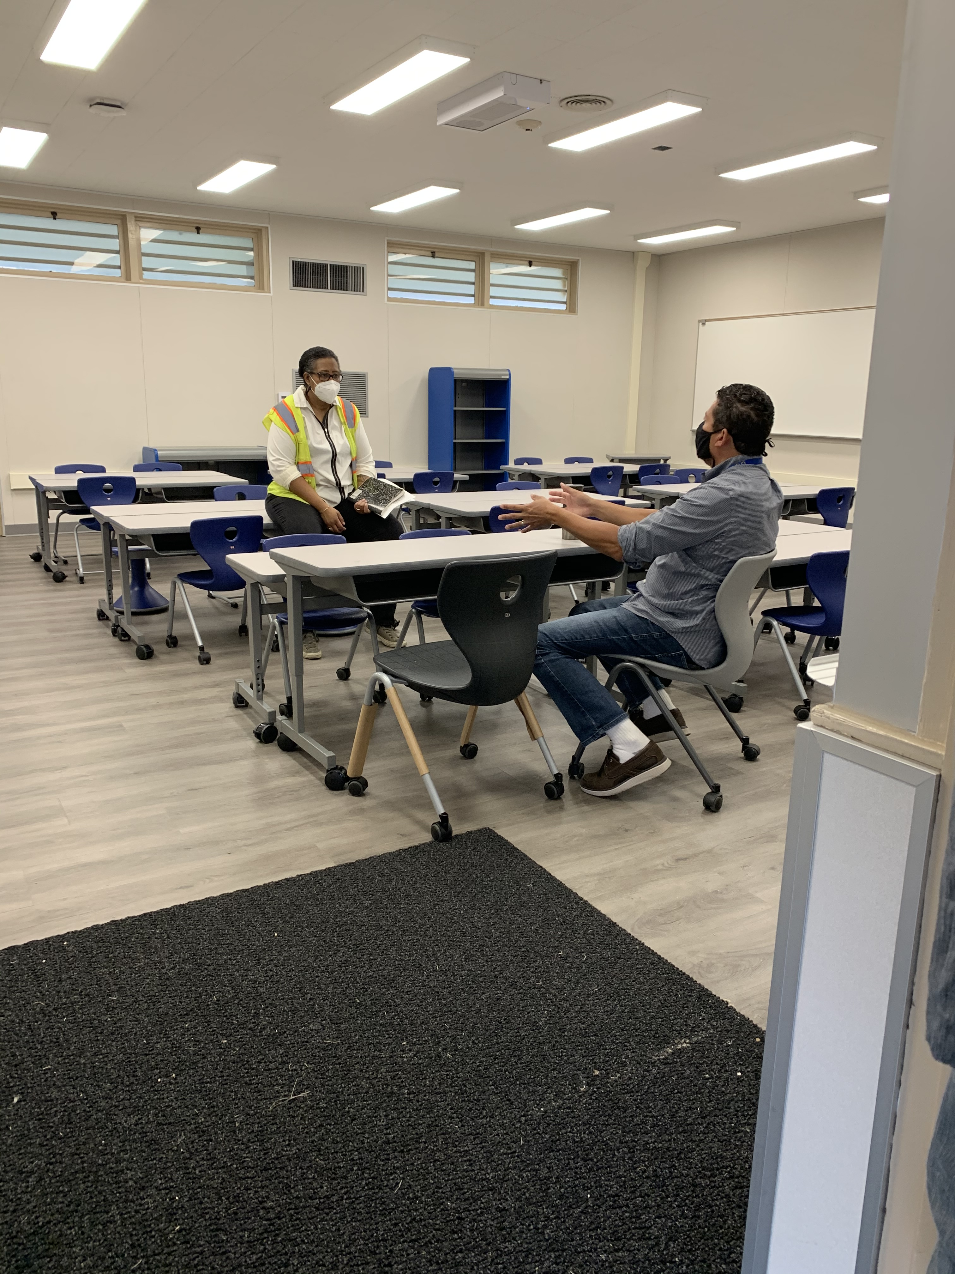
NELSON ELEMENTARY SCHOOL
PROJECT STATUS
FURNISHING ARRIVING
SUBSTANTIALLY COMPLETE

Slide 18
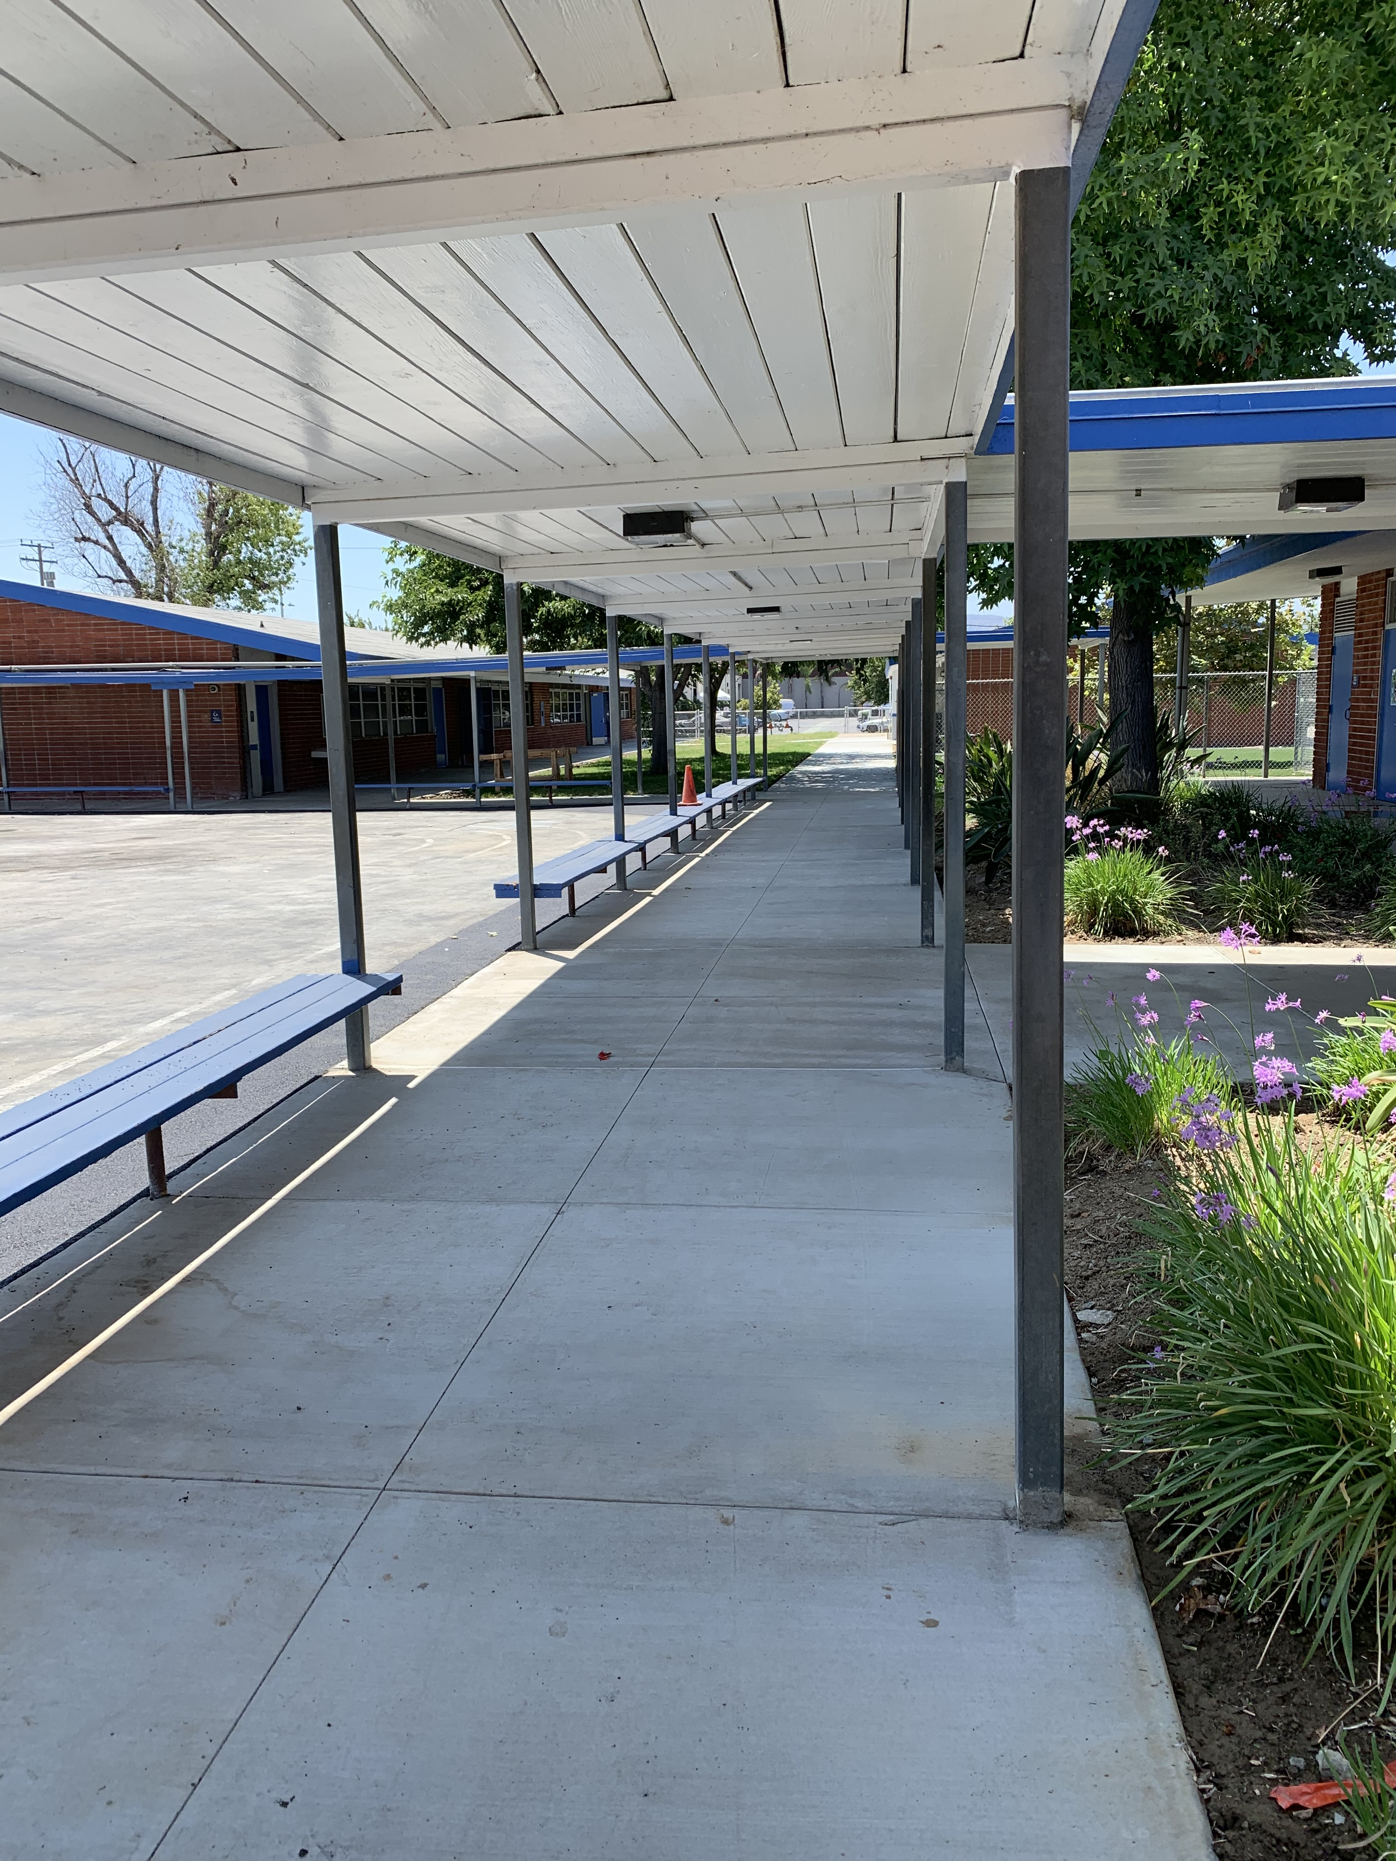
NELSON ELEMENTARY SCHOOL
PROJECT STATUS
SITE WORK COMPLETE
SITE WORK SUBSTANTIALLY COMPLETE

Slide 19
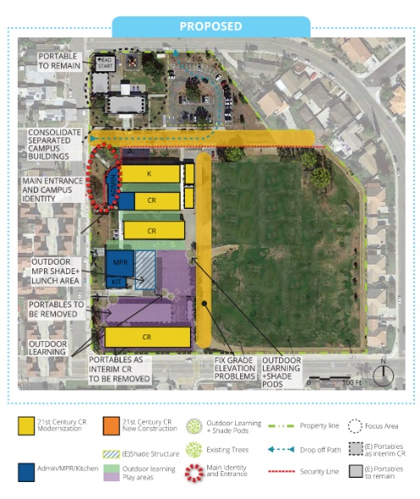
WORKMAN ELEMENTARY SCHOOL
PROJECT STATUS
21ST CENTURY CLASSROOM
SCHEMATIC DESIGN | DESIGN DEVELOPMENT | CONSTRUCTION DOCUMENTS | DSA APPROVAL | CONSTRUCTION | COMPLETION
UNDER CONSTRUCTION
99%
NOTES:
21st Century Classroom Improvements Started Construction 6-15-2020; Construction Phases 2 & 3 Punch List
  SUBSTANTIALLY COMPLETE

Slide 20
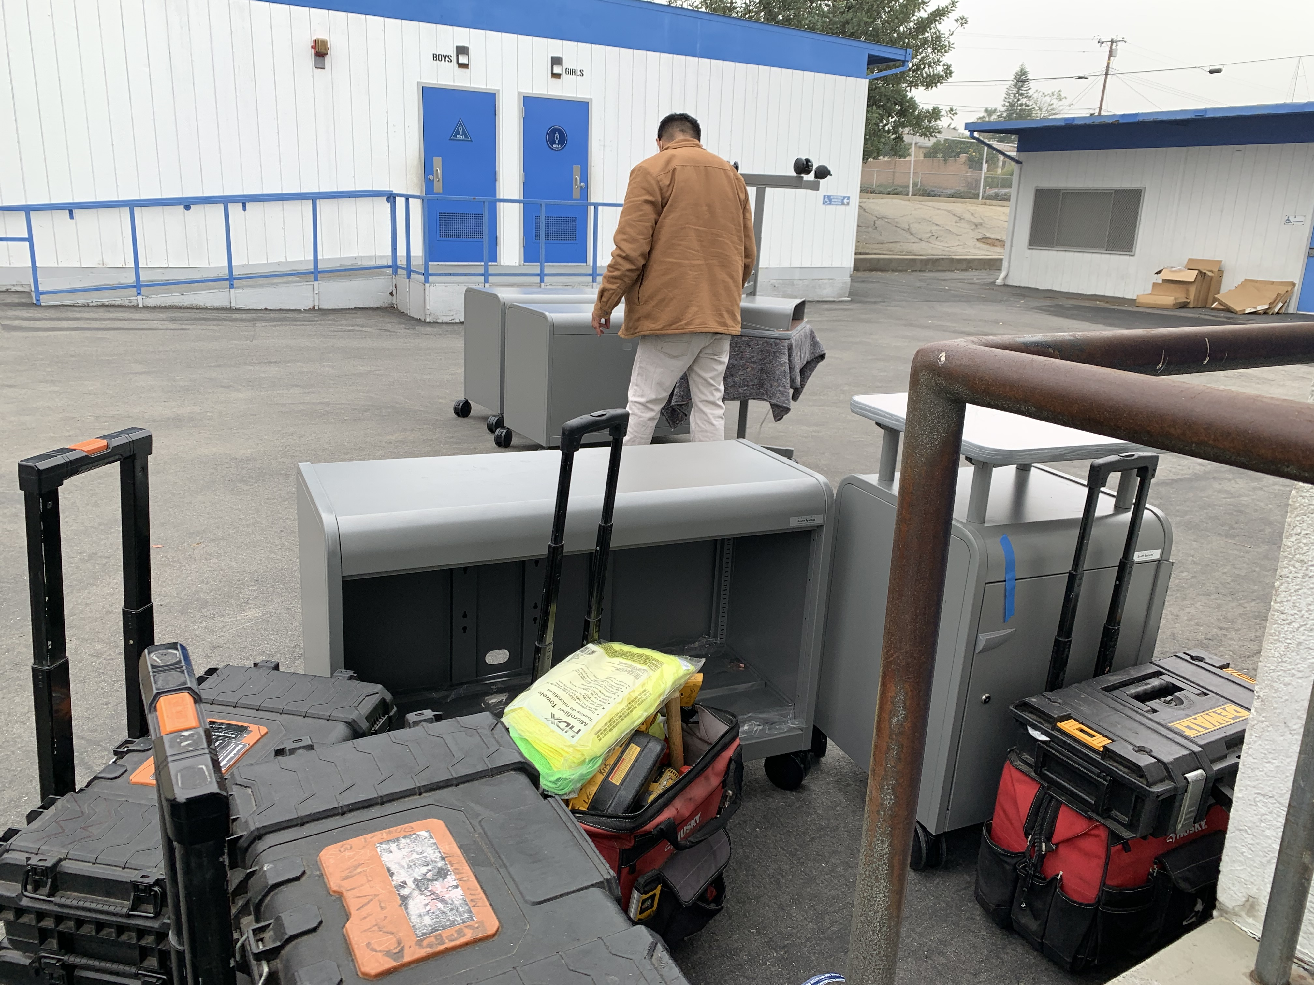
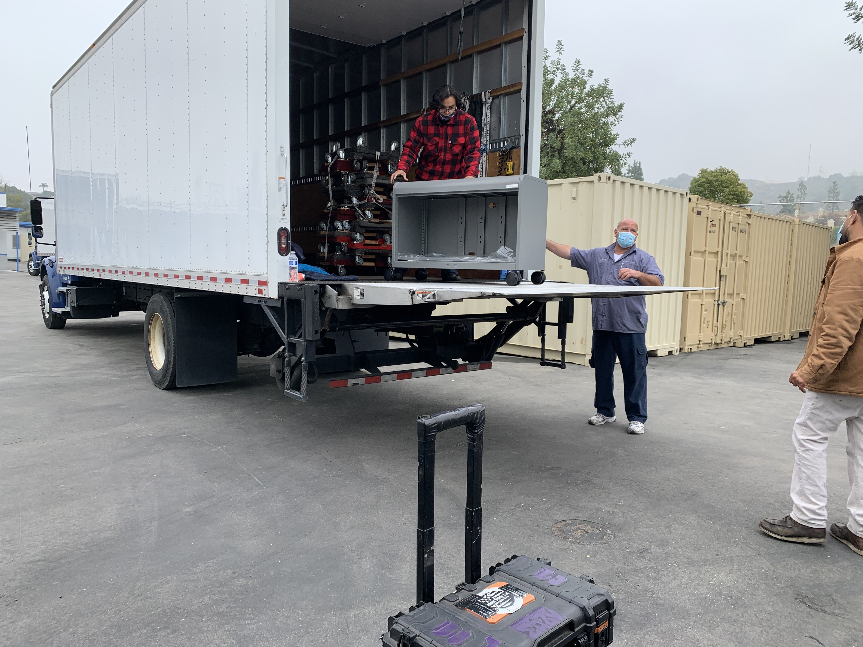
PROJECT STATUS
WORKMAN ELEMENTARY SCHOOL
UPPER GRADE FURNITURE
DELIVERY & SET UP

Slide 21
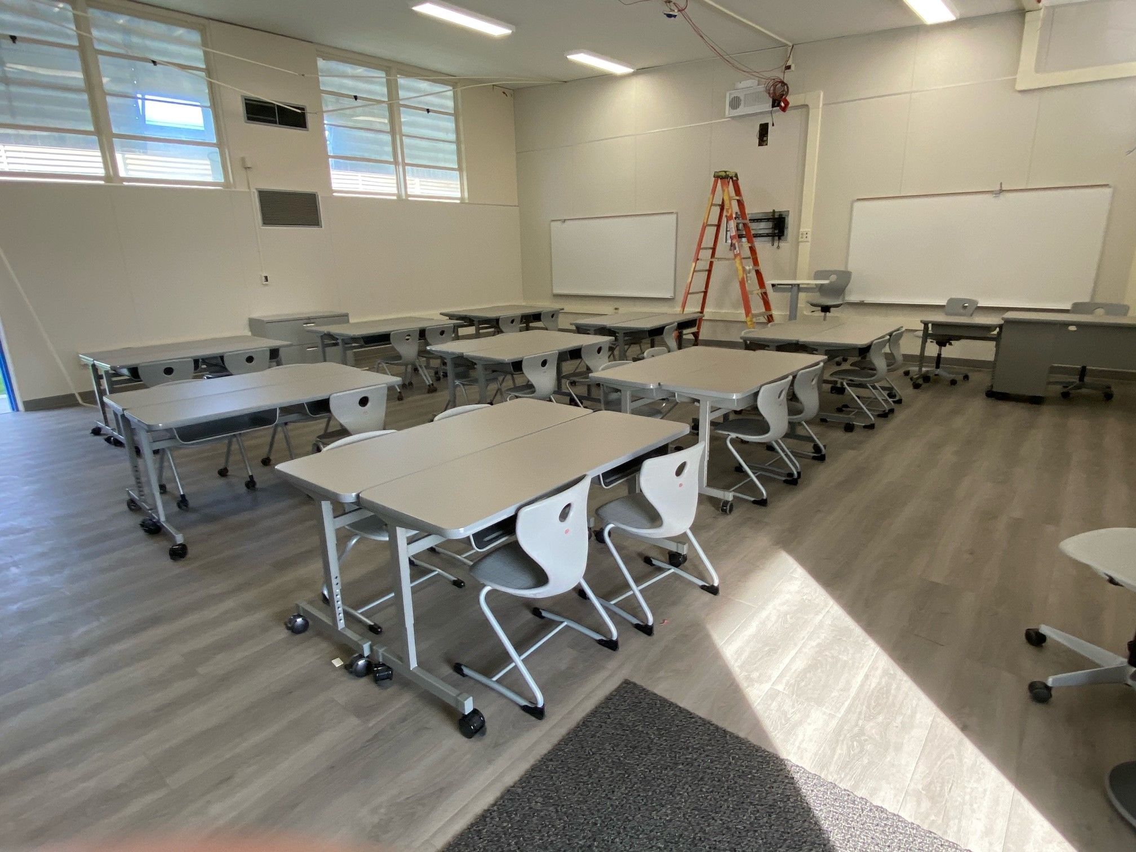
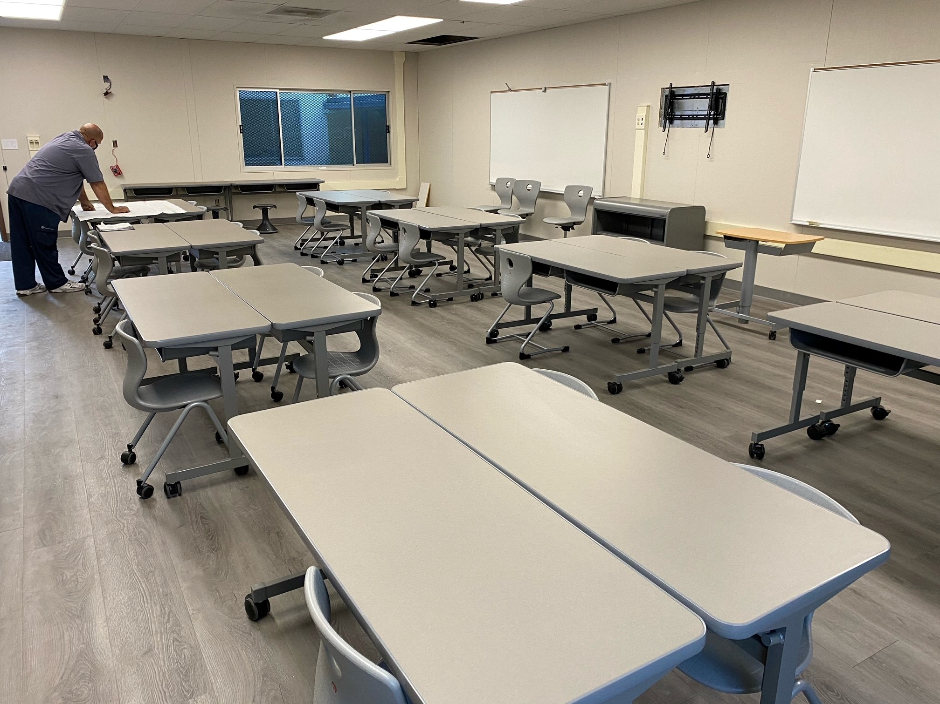
WORKMAN ELEMENTARY SCHOOL
PROJECT STATUS
NEW FURNITURE INSTALLED
CLASSROOM INTERIORS NEARLY COMPLETE

Slide 22
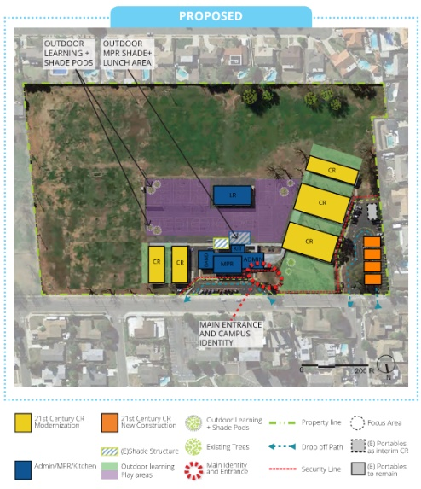
NEWTON MIDDLE SCHOOL
PROJECT STATUS
INTERIM HOUSING |  |  |  |  |  |  | 21ST CENTURY CLASSROOM
SCHEMATIC DESIGN | DESIGN DEVELOPMENT | CONSTRUCTION DOCUMENTS | CONSTRUCTION | DSA APPROVAL | OCCUPANCY |  | SCHEMATIC DESIGN | DESIGN DEVELOPMENT | CONSTRUCTION DOCUMENTS | DSA APPROVAL | CONSTRUCTION | COMPLETION
BID #3
90%
95%
NOTES:
Interim Housing Construction Documents are DSA approved
Temp power installation complete
DSA Project Inspector assigned
21st Century Classroom Improvements
  DSA Submittal Date February 25, 2021

Slide 23
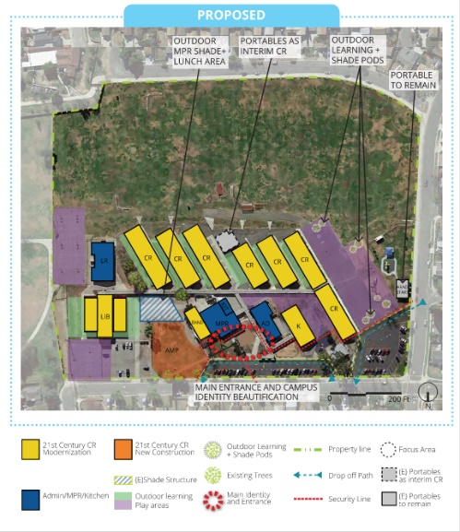
GRANDVIEW ACADEMY
PROJECT STATUS
21ST CENTURY CLASSROOM
SCHEMATIC DESIGN | DESIGN DEVELOPMENT | CONSTRUCTION DOCUMENTS | DSA APPROVAL | CONSTRUCTION | COMPLETION
BID #3
85%
NOTES:
21st Century Classroom Project Construction Documents are 85% complete
DSA Project Inspector assigned
21st Century Classroom Improvements
  DSA Submittal Date February 25, 2021

Slide 24
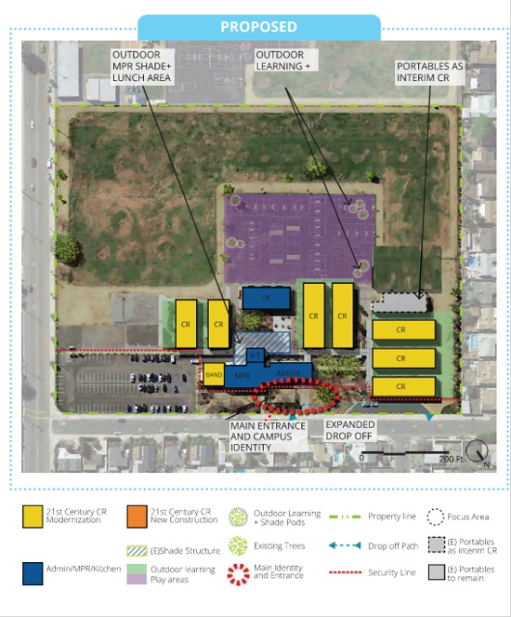
SPARKS MIDDLE SCHOOL
PROJECT STATUS
21ST CENTURY CLASSROOM
SCHEMATIC DESIGN | DESIGN DEVELOPMENT | CONSTRUCTION DOCUMENTS | DSA APPROVAL | CONSTRUCTION | COMPLETION
BID #3
85%
NOTES:
Construction Documents for the 21st Century Classroom Improvements are 85% complete
DSA Project Inspector assigned
21st Century Classroom Improvements
  DSA Submittal Date February 25, 2021

Slide 25

QUESTIONS & ANSWERS

