Slide 1

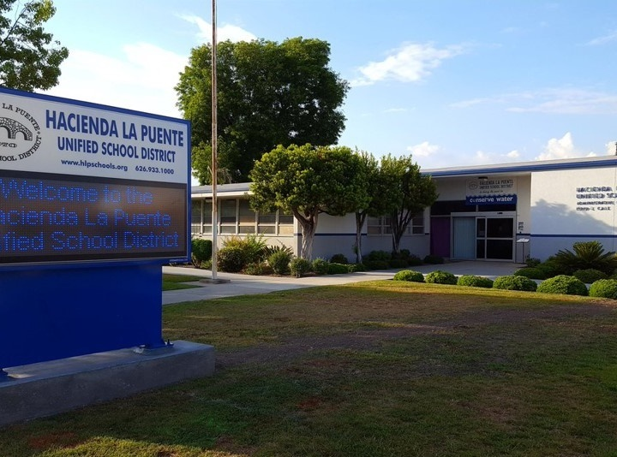

21st Century Classroom Improvements
January 25, 2022 Board Update

Slide 2
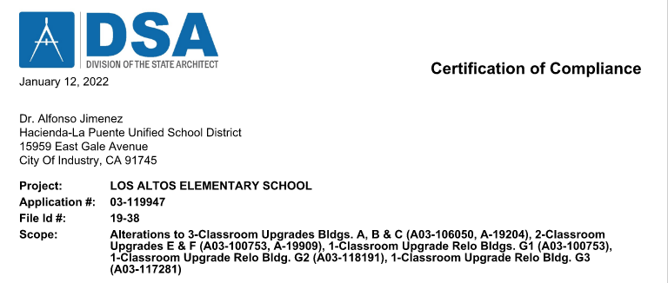
21st Century Classroom Improvements
PROJECT CERTIFIED

Slide 3
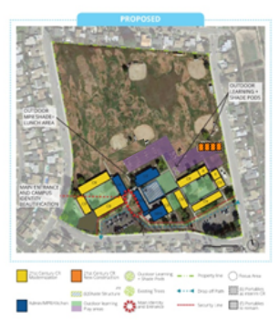

Cedarlane Academy
INTERIM HOUSING |  |  |  |  |  |  | 21st CENTURY CLASSROOM
SCHEMATIC DESIGN | DESIGN DEVELOPMENT | CONSTRUCTION DOCUMENTS | CONSTRUCTION | DSA APPROVAL | OCCUPANCY |  | SCHEMATIC DESIGN | DESIGN DEVELOPMENT | CONSTRUCTION DOCUMENTS | DSA APPROVAL | CONSTRUCTION | COMPLETION
100%
100%
NOTES
Interim Housing Complete Close Out Phase
21st Century Classroom Improvements Complete
CLOSEOUT & DSA CERTIFICATION
Project Status
SUBSTANTIALLY COMPLETE

Slide 4
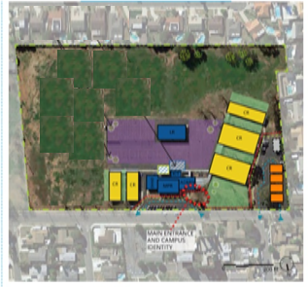
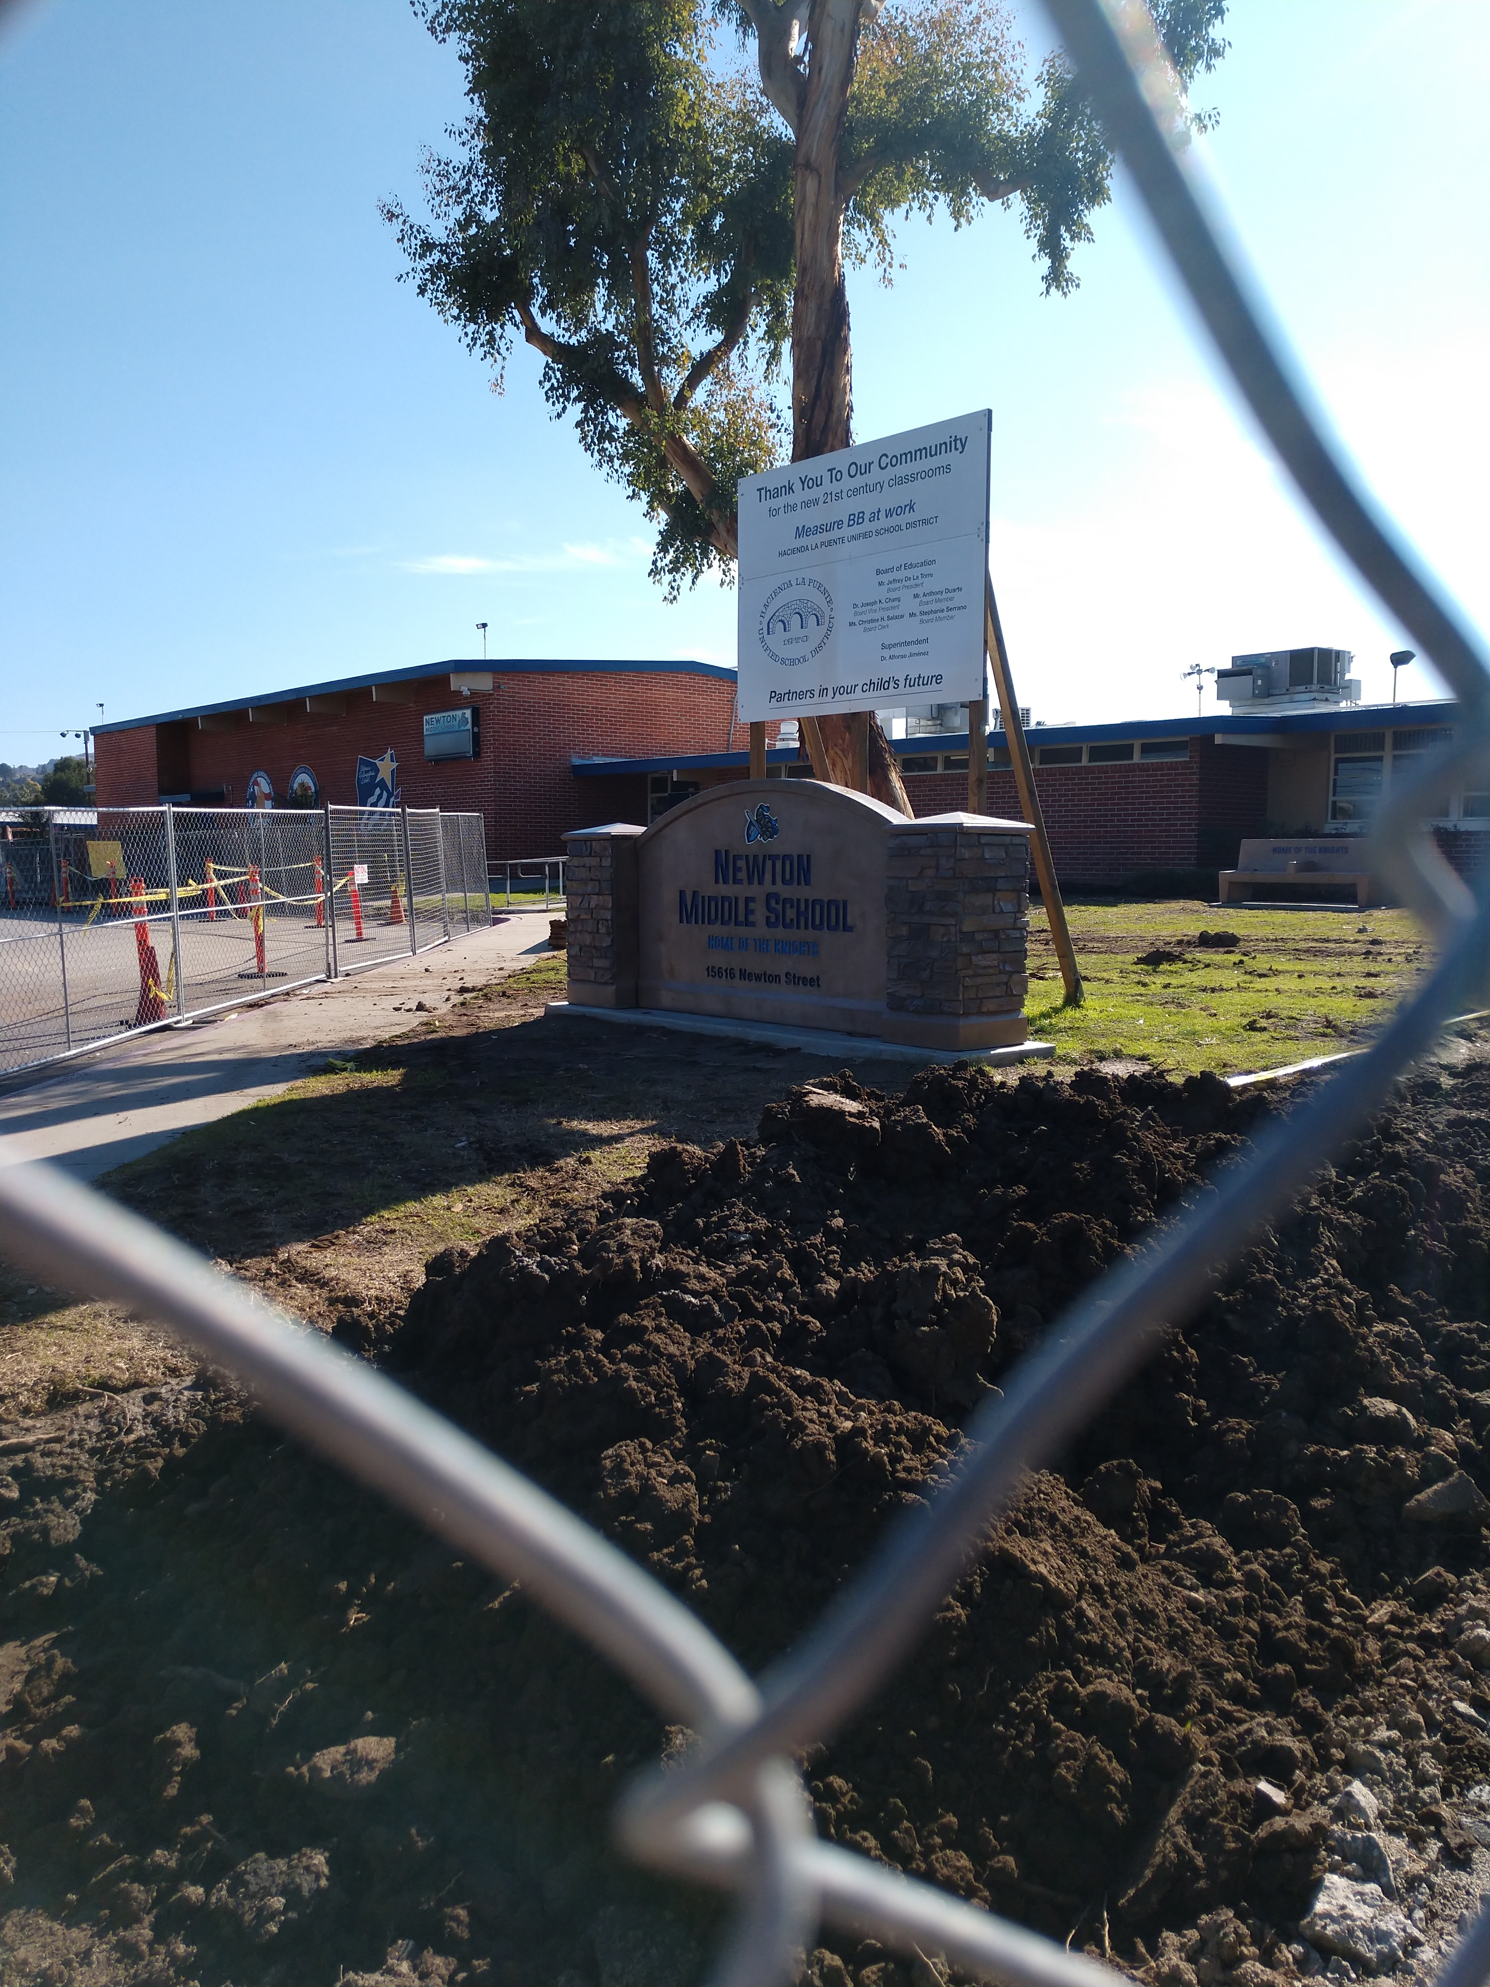
Newton Middle School
INTERIM HOUSING |  |  |  |  |  |  | 21st CENTURY CLASSROOM
SCHEMATIC DESIGN | DESIGN DEVELOPMENT | CONSTRUCTION DOCUMENTS | DSA APPROVAL | CONSTRUCTION | COMPLETION |  | SCHEMATIC DESIGN | DESIGN DEVELOPMENT | CONSTRUCTION DOCUMENTS | DSA APPROVAL | CONSTRUCTION | COMPLETION
UNDER CONSTRUCTION
100%
100%
100%
100%
100%
100%
100%
100%
25%
NOTES
Interim Housing
Construction In Progress
Current Tasks
  Grading
  Paving
  Accessible walks
  Placing Buildings
  Electrical & Communications
Project Status
SITE WORK & BUILDING PLACEMENT

Slide 5
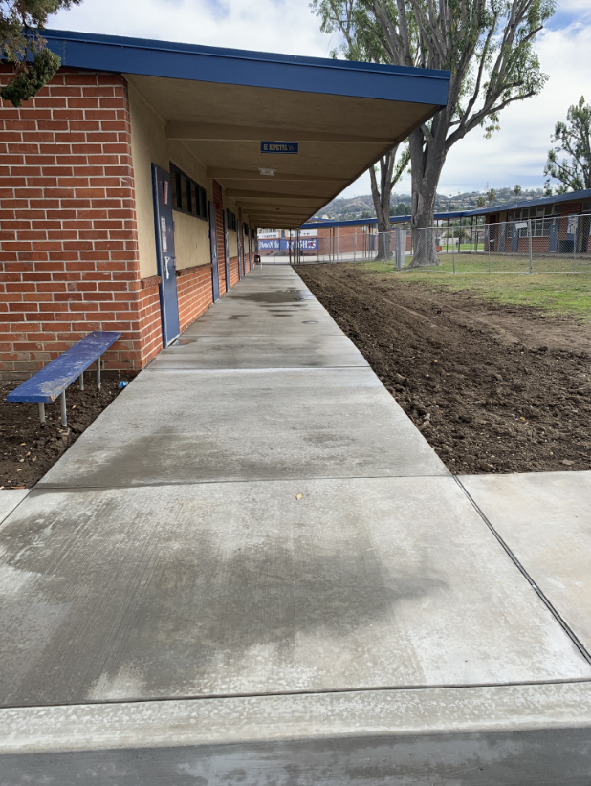
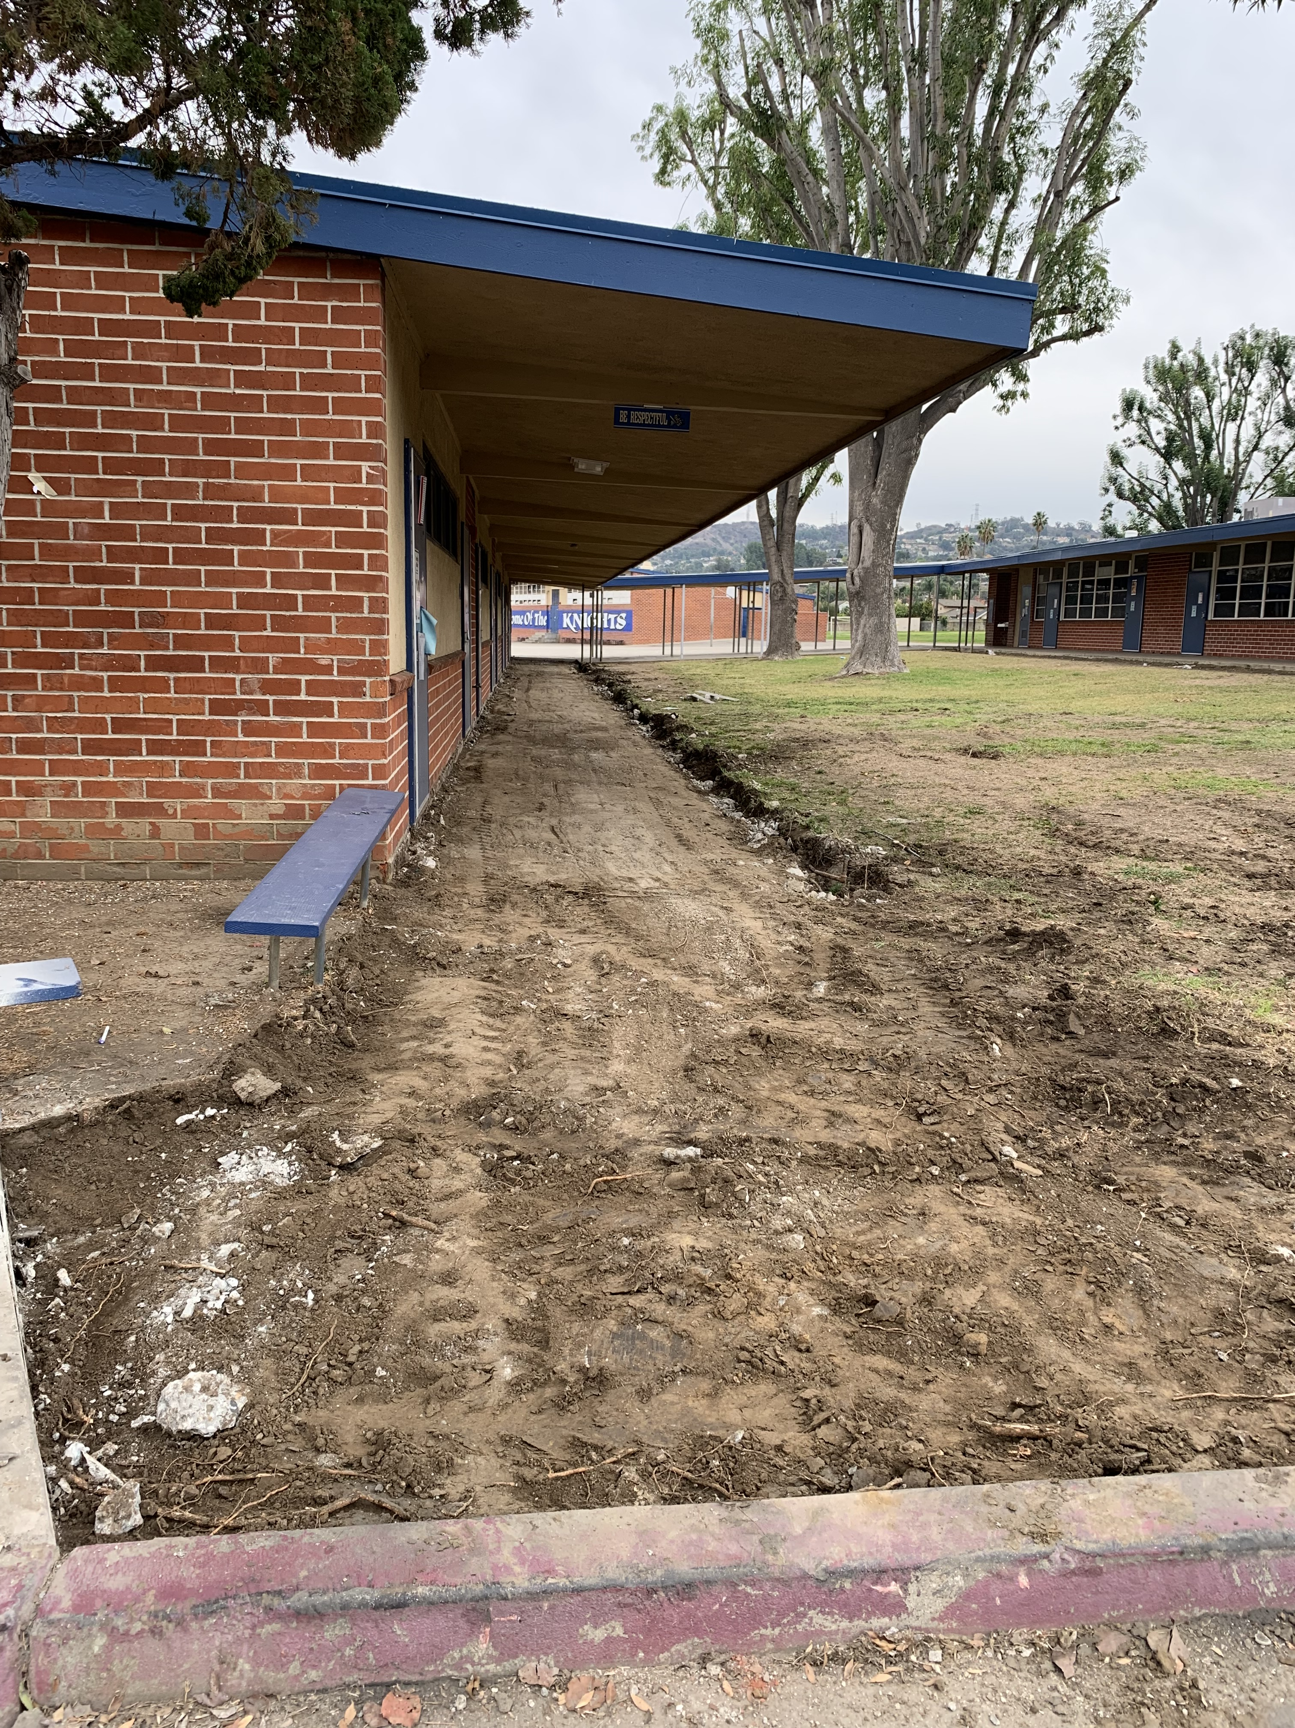
Newton Middle School
Under Construction
After
Accessible Walkway “B” Wing

Slide 6
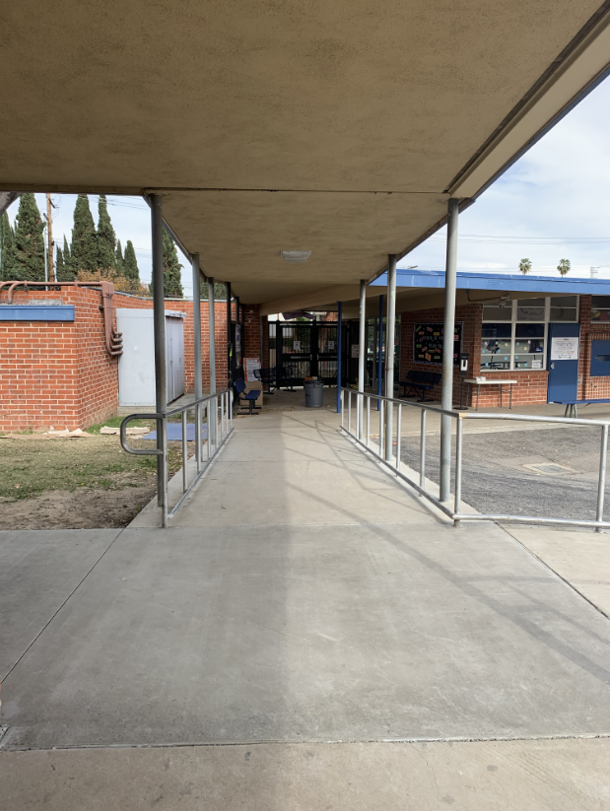
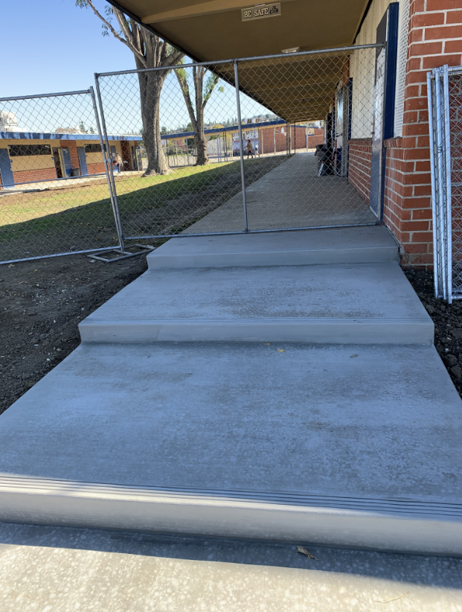
Newton Middle School
Accessible Walk “B” Wing
New Steps “C” Wing

Slide 7
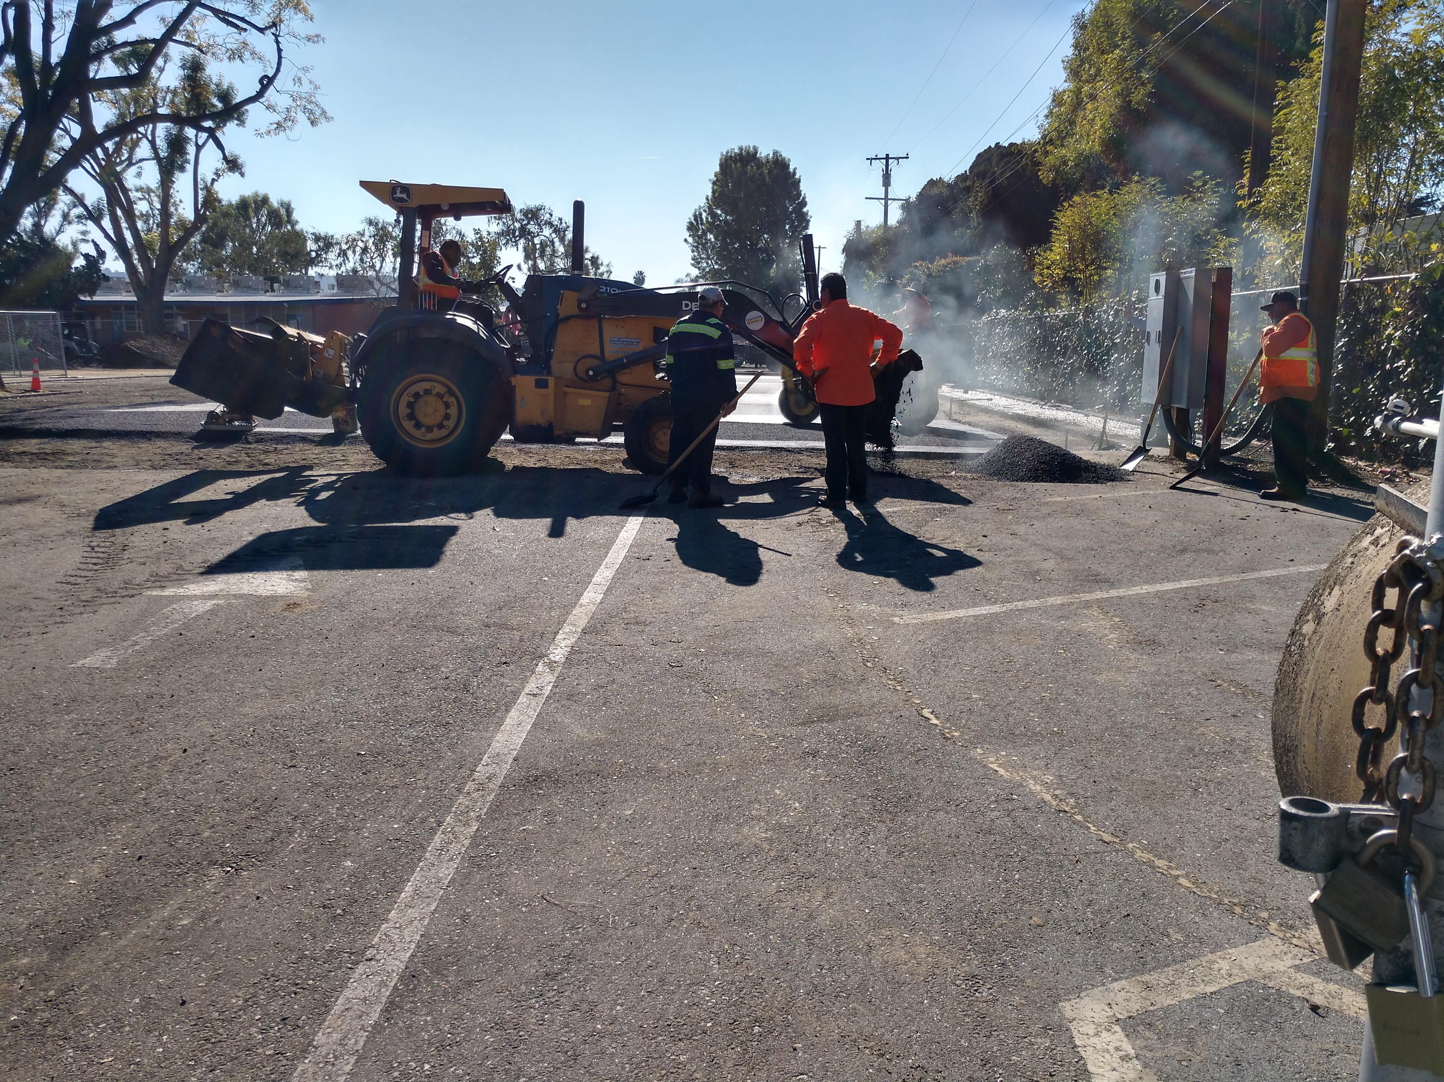
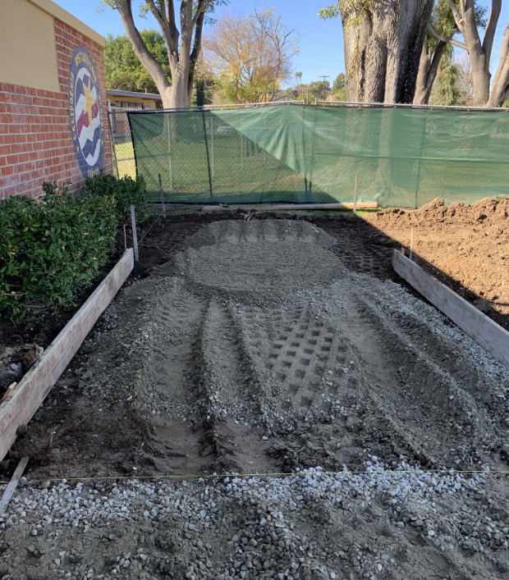
Newton Middle School
Building Pads
North Parking Lot
Accessible Walks- Main Entry

Slide 8
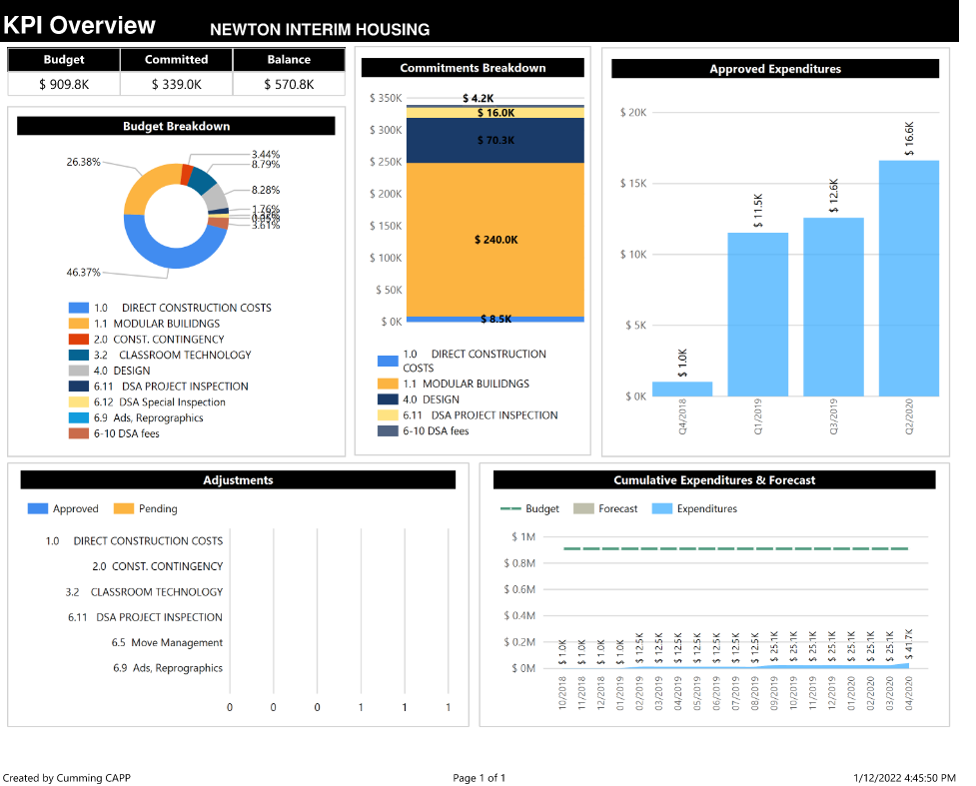
PROJECT DASHBOARD: SITE FINANCIALS

Slide 9
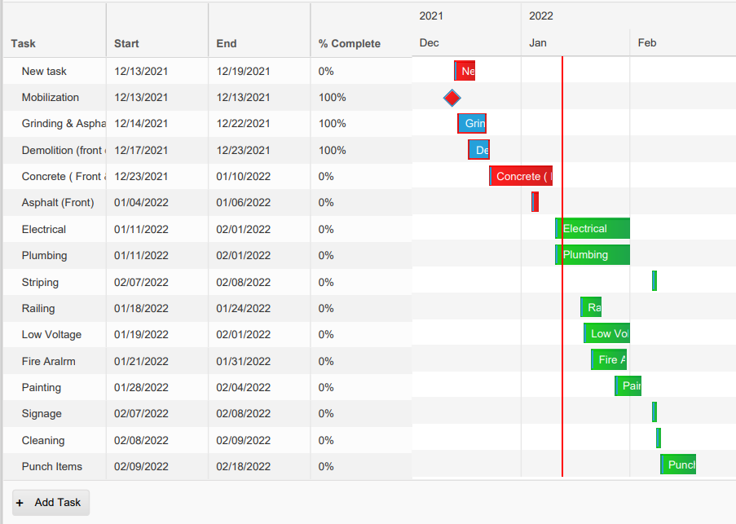
PROJECT DASHBOARD: SITE SCHEDULE

Slide 10
Grandview Academy, Newton, Sparks MS
  21st Century Classroom Projects APPROVED BY DSA
  Newton Middle School 6-30-21
  Grandview College Prep 6-30-21
  Sparks Middle School 6-30-21
  Scope review meetings with sites to gain stakeholder input per the Board's guidance at the Special Board Meeting
  Re-Programing with Associations, Teachers and Principals
    Storage
    Furniture
    Technology
Preparing New Annual Contractor Pre-Qualifications Package
Project Status
Programming & Qualifying

Slide 11
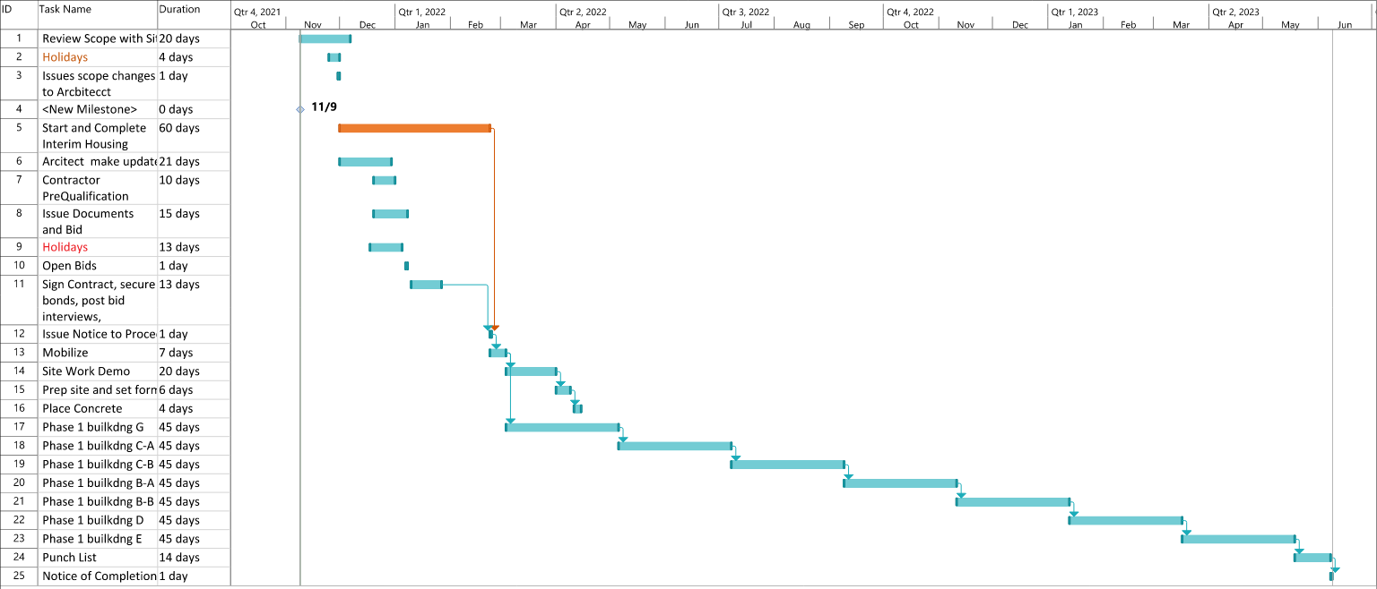
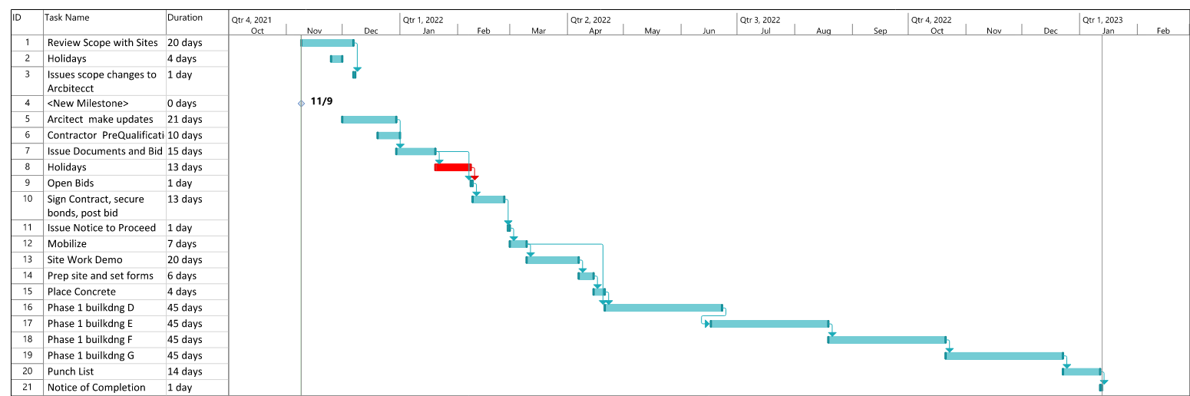
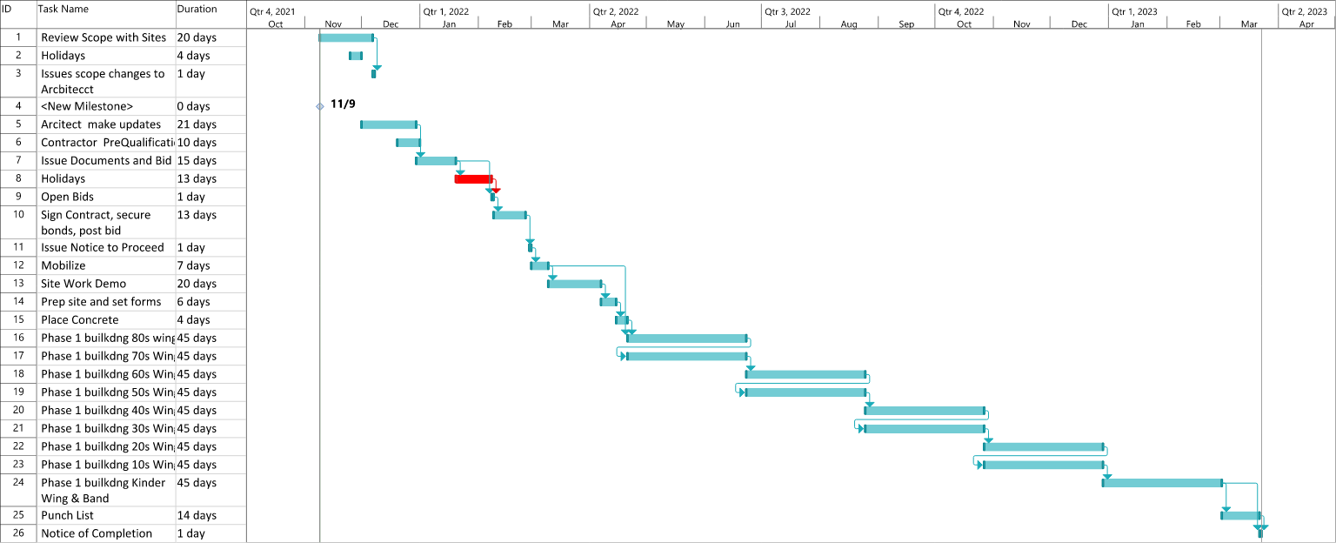
Newton 21st Century Projected Schedule
3-23-22 to 6-30-23
Sparks MS 21st Century Projected Schedule
3-23-22 to 2-23-23
Grandview 21st Century Projected Schedule
3-23-22 to 4-22-23

Slide 12

Questions + answers

