Slide 1
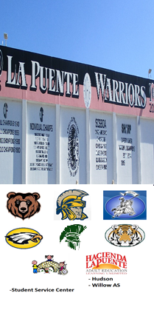
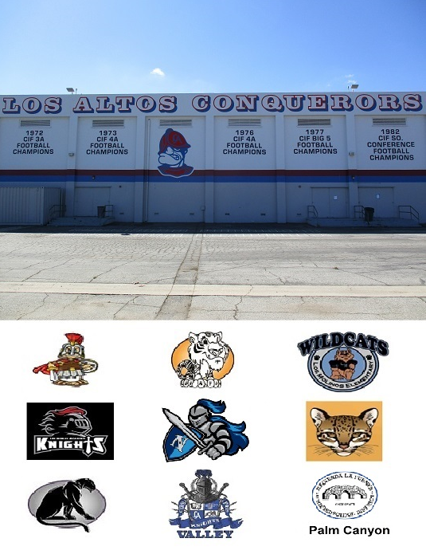



HACIENDA LA PUENTE UNIFIED SCHOOL DISTRICT
La Puente Quad
Los Altos Quad
Wilson Quad
Workman Quad
School Site Improvement Projects
Regular Board Meeting
February 24, 2022
Business Services

Slide 2

PROJECT COMPLETE LIST
Site | Item Description | Funding Source | Completed Date
Willow Center | Conference Center Fence | Adult Ed | 12/2021
Workman HS | Front Entry Concrete | Facilities | 12/2021
Wilson HS | Gym & Locker Room HVAC | Prop 39 | 10/2021
La Puente HS | Gym Lights Upgrade | Facilities | 11/2021
Workman HS | Gym Lights Upgrade | Facilities | 11/2021
Workman HS | Media Center Flooring & Paint | Donation | 11/2021
Willow | MPR Floor Repair | Adult ED | 11/2021
Grandview | Office Modular Furniture | Facilities | 11/2021
Grandview | Roofing | Facilities | 12/2021
Los Altos | Roofing | Facilities | 12/2021
Grazide | Tree Barrier | Facilities | 11/2021
Bixby | Wedgeworth Interim Housing | Project | 12/2021
Changes And Progress Since Last Report - Blue

Slide 3

Projects In Progress
2021-2022

Slide 4
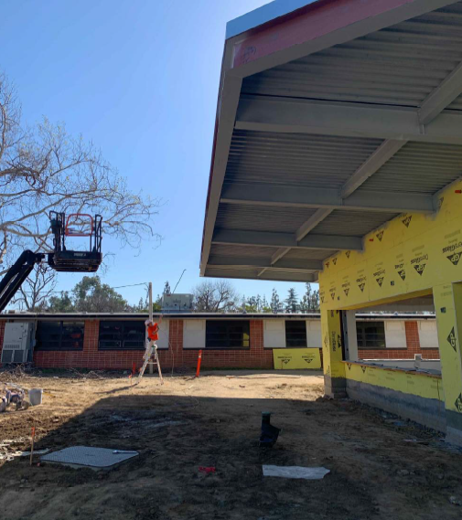
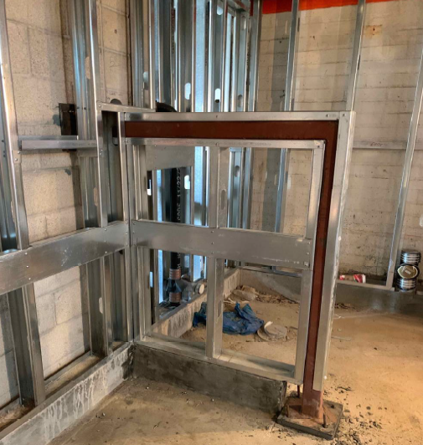
Projects In Progress as of February 24, 2022
Site | Item Description | Architect Plans | DSA Approval | Procurement | Construct | Funding Source | Target Completion Date
Willow AS | Conference (South) Room Flooring | Complete | N/A | Complete | In Progress | Adult Ed. | 2/28/2022
La Puente HS | New Kitchen (including exterior hardscape) | Complete | Complete | Complete | In Progress | Facilities & COP | 4/30/2022
La Puente HS | Pool & Locker Room Project | Complete | Complete | Complete | In Progress | Facilities & COP | 5/20/2022
Workman HS | Phase II Stadium and Baseball Field (Phase I Track & Field and Softball Field Complete) | Complete | Complete | Pending | Pending | Various - Estimate Cost $16.5M | 12/2023
Workman HS | Gym & Locker Room HVAC | Complete | Complete | Complete | Prop 39 | Prop 39 | 3/1/2022
La Puente HS Kitchen – Metal Deck is Being Spray Painted
La Puente HS Pool – Structural Pony Wall Completed

Slide 5

Projects with Division of State Architect (DSA)
Waiting on Approval
Site | Item Description | Architect Plans | DSA Approval | Procurement | Est. Construct Start | Target Completion Date
Wedgeworth | K-5 Permanent School & Interim Housing | Complete | In Progress (Revisions for K-5 & Single Story Pending Approval) | Interim Housing: Complete New School: Pending | 2/2022 | 07/2024
La Puente HS | Gym & Locker Room HVAC | Complete | Estimated 1/31/22 | Complete | TBD | Approx. 3 months
Los Altos HS | Gym & Locker Room HVAC | Complete | Estimated 2/28/22 | Complete | TBD | TBD
Projects in Design
Site | Item Description | Architect Plans | DSA Approval | Procurement | Est. Construct Start | Target Completion Date
Performing Arts Center | Partnership with LA County Aquatic Center | In Progress |  | Pending
Districtwide | HVAC System Replacements | Pending |  | In Progress
Kwis Elementary | Baseball Fields | In Progress |  | Pending | 11/2022 | 8/2023
Changes And Progress Since Last Report - Blue

Slide 6
Next Report – March 24, 2022

