Slide 1

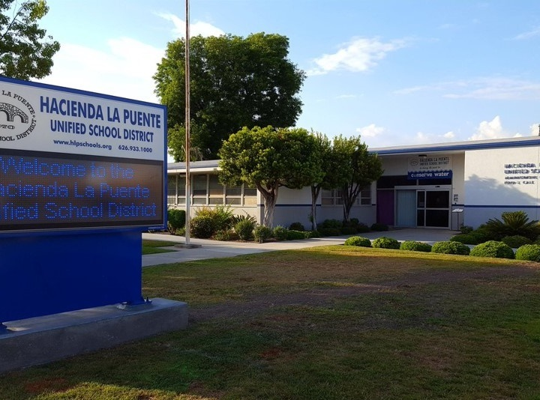

21st Century Classroom Improvements
March 24, 2022 Board Update

Slide 2
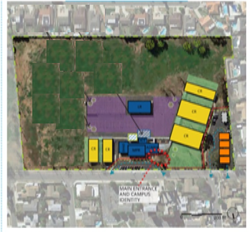
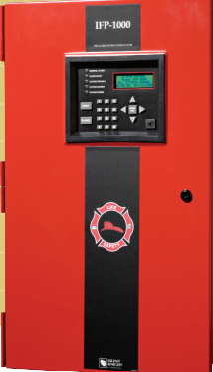
Newton Middle School
INTERIM HOUSING |  |  |  |  |  |  | 21ST CENTURY CLASSROOM
SCHEMATIC DESIGN | DESIGN DEVELOPMENT | CONSTRUCTION DOCUMENTS | DSA APPROVAL | CONSTRUCTION | COMPLETION |  | SCHEMATIC DESIGN | DESIGN DEVELOPMENT | CONSTRUCTION DOCUMENTS | DSA APPROVAL | CONSTRUCTION | COMPLETION
UNDER CONSTRUCTION
100%
100%
100%
100%
100%
100%
100%
100%
75%
NOTES
Interim Housing Construction Nearing Completion
Current Tasks
  Electrical Near Complete
  Low Voltage
  Fire Alarm
  Seal Coat
  Plumbing
Project Status
INTERIM HOUSING
SYSTEMS INSTALLATION

Slide 3
PROGRESS TRACKING
Total Budget
$951.9 K
$475.95 K
$475.95 K
Project Status
Budget and Schedule

Slide 4
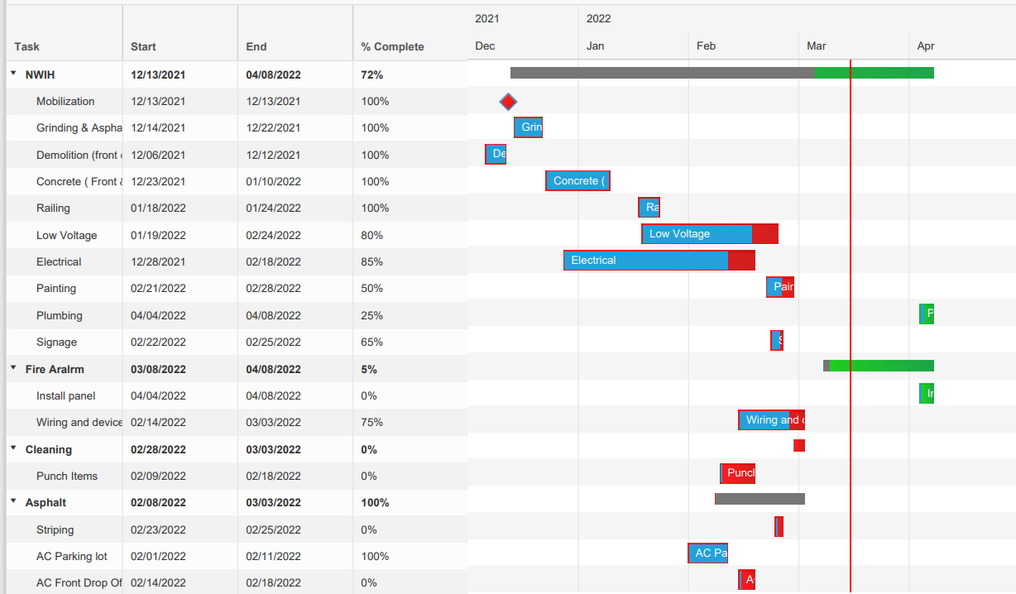
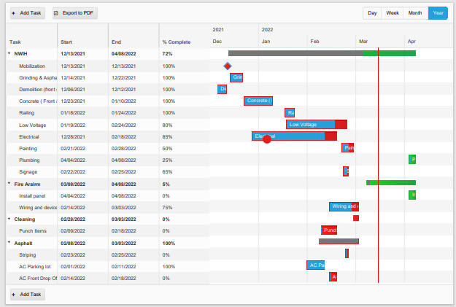
Newton Middle School Interim Housing Schedule
Fixture change out during Spring break
Supply change equipment delay fire alarm panel only

Slide 5
Grandview Academy, Newton, Sparks MS
  21st Century Classroom Projects APPROVED BY DSA
  Newton Middle School 6-30-21
  Grandview College Prep 6-30-21
  Sparks Middle School 6-30-21
  Scope review meetings to gain stakeholder input per the Board's guidance at the Special Board Meeting on October 21, 2021
Contractor Pre-Qualifications Underway
Public Qualification Period is Currently Open
  Re-Programing with Associations, Teachers and Principals
    Storage
    Furniture
    Technology
    Wall Surface/Windows
Project Status
Programming & Qualifying

Slide 6
PROGRESS TRACKING
$3.24 M
$0.82 M
Project Status
Budget and Schedule

Slide 7
PROGRESS TRACKING
Total Budget
$3.66 M
$0.74 M
$2.92 M
Project Status
Budget and Schedule

Slide 8
PROGRESS TRACKING
Total Budget
$6.00 M
$0.88 M
$5.12 M
Project Status
Budget and Schedule

Slide 9
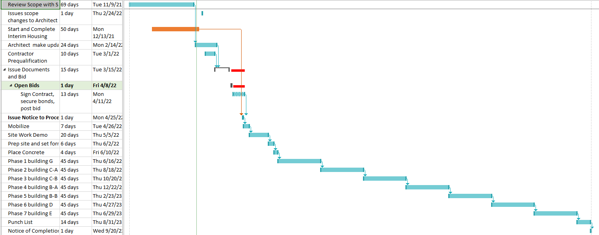
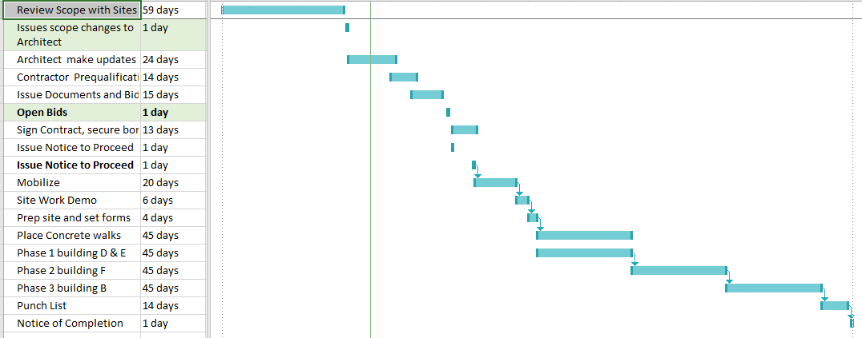
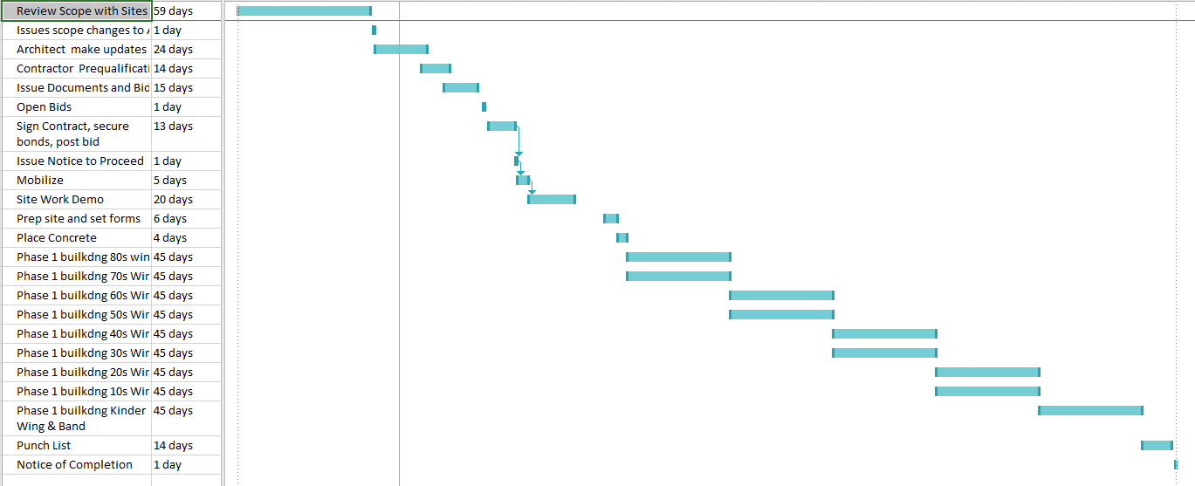
Newton MS 21st Century Projected Schedule 5/22/22 to 11/20/23
Sparks MS 21st Century Projected Schedule 5/22/22 to 3/2/23
Grandview 21st Century Projected Schedule 5/22/22 to 8/5/23

Slide 10

Questions + answers

