Slide 1
Hacienda La Puente School District SPECIALIZED AUDIT update
Presented by Brandon Waldren on 7/21/2022

Slide 2
aGENDA
Engagement Scope
Part 2 Status
Part 1 Procedures and Observations
Information Reviewed
Definitions

Slide 3
Engagement Scope
PART I
Examine bond expenditures for the purpose of identifying questionable transactions.
PART 2
Determine how the shortfall of bond funds occurred
Identify indicators of fraud, if present.
Provide recommendations on how to mitigate the risk of this issue from happening in the future.

Slide 4
Definitions of Fraud – Provided by Office of Inspector General
Fraud
Waste
Abuse
The wrongful or criminal deception intended as to result in financial or personal gain. This includes false representation of fact, making false statements, or by concealment of information. This is proved in court or with evidence.
Thoughtless or careless expenditure, mismanagement, or abuse of resources to the detriment of a Government. This also includes incurring unnecessary costs resulting from inefficient or ineffective practices, systems, or controls. This is subjective.
Excessive or improper use of a thing, or to use something in a manner contrary to the natural or legal rules for its use. This is subjective.

Slide 5
Definitions of Construction – Provided by DAE Group
Hard Cost
Soft Cost
Contingency Cost
Hard costs are often referred to as ’brick-and-mortar costs,’ and refer to any costs associated with the physical construction of the building or project, under any equipment used, and any labor associated with the construction of the project. Because hard costs are more tangible, they are easier to estimate.
Soft costs are any costs that are not considered direct construction costs or ’hard costs.’ These costs typically are associated with non-tangible items such as design, fees, taxes, and insurance. Soft costs can be a significant part of a project’s budget.
Construction contingency refers to a percentage of money reserved to cover unanticipated construction costs or delays not identified in the budget or scope of work for the project.

Slide 6
Summary of definitions for planning
Estimating
Budgeting
allocation
Goal: To calculate an amount used to help develop a budget or allocation for a project.
Goal: To set limits for the project in order to not overspend funding or resources.
Goal: To reserve resources for a project, with the expectation that more may or may not be needed.

Slide 7
Information reviewed
PART 2
Interviews with 12 District personnel
Interviews with all 5 Board Members
Board Meeting Agendas and Attachments (6,523 in total, 778 were directly related (12%))
CBOC Meeting Agendas and Attachments (302 in total, 25 were directly related (8%))
Human Resource Information
Attempted to contact 6 prior District personnel (only 2 responded)

Slide 8
History of the issue (Per our review of information)
A Facilities Master Plan was completed in June 2016. The results showed an estimate of $1.02 billion dollars was needed to complete all the projects wanted by the District.
The Measure BB Bond was approved in November of 2016 and issued on June 2017.
The Measure BB Bond was approved for $148 million. This approval was not done to fit a specific budget, but was what the District felt the voters would be comfortable approving.
The intention of the Measure BB Bond funds was use them to construct 21st Century classrooms for all schools. Interim Housing was added as a by-product due to the decision to complete the construction in phases.

Slide 9
History of the issue (Per our review of information)
The first estimate was created on 03/27/2018 and was done so by estimating how much per classroom was needed. The estimate included hard, soft, contingency costs and was portrayed to be around ~$107,000 per classroom.
Phase 1&2 was approved by the Board on 08/24/2017 and the first budget for these phases occurred on 12/05/2018. This was calculated by taking a price of $130,219 per classroom and multiplying it by the number of classrooms. To our knowledge this included, hard costs, soft costs, and contingency costs. This produced an estimate of ~$30,500,000 Million for Phases 1&2.
If this price per classroom would have been applied to all classrooms for all schools, the estimate would have been ~$111,500,000. This estimate would have not included Interim Housing, which was estimated ~$28,000,000. In total, this would have provided an estimate of ~$139,500,000.

Slide 10
History of the issue (Per our review of information)
It was noted through part one of our engagement that ~$5,000,000 million worth of laptops were purchased for phases not approved yet by the Board. These purchases occurred in June and July of 2019. These were not reflected in any budget or estimate.
Phase 3&4 was approved by the Board on 09/26/2019. No budget or updated estimates were provided at this time.
The construction management company Cumming was hired by the District on 12/12/2019. Through interviews, we were told they notified District personnel in December 2019 of a possible shortfall. Due to lack of information available, we are unable to confirm this.

Slide 11
History of the issue (Per our review of information)
The Chief Business Officer (CBO) of the District notified the Board on 6/21/2021 that there is a shortfall. Per interviews and information reviewed, the Board members did not know about the shortfall before this meeting.
New estimates were calculated by Cumming and provided to the Board on 08/24/2021. These estimates included the estimates of all schools and not just Phases 1 through 4. They showed that it was cost ~$225 million to finish all phases, creating a $77,000,000 shortfall.
Eide Bailly is hired to provide specialized audit services on 09/23/2021.

Slide 12
Causes of the shortfall
Escalation
Lack of Bond Director
Scope Changes
Unapproved Spending
Budgets Not Created
Phase Construction

Slide 13
Questions and answers
Questions asked by the Board
Answers to the questions
What are the facts related to the shortfall?
When was the shortfall identified?
See the previous slides.
We estimate that the potential of the shortfall could have been identified around December 2018. The shortfall was confirmed through an estimate provided by Cumming in December 2019. The official calculation was not released until July 2021.

Slide 14
Questions and answers
Questions asked by the Board
Answers to the questions
3. When was the shortfall brought to staffs’ attention?
4. When was the shortfall brought to the Boards attention?
5. Was there a breakdown of internal controls?
3. We estimate the timeframe to be in December 2019.
4. Per interviews, it appears the Board was first notified of the shortfall on June of 2021.
5. Yes.

Slide 15
Internal Control Recommendations
Issues
Recommendation
1. Estimates and possible allocations were provided. Budgets were not.
2. Scope of the projects were not specifically defined.
Budgets need be set by the Board and followed by the District, in order to set the expectation for the public of whether more funds will be needed or not.
Education Specifications should be completed and approved by the Board to establish hard scopes for the projects. These scopes can be shared with the public this way.

Slide 16
Internal Control Recommendations
Issues
Recommendation
3. Expenditures for non-Board approved projects were made.
4. High turnover caused individuals to perform duties and jobs for multiple positions.
5. Construction Commitments were not completed in the audited financial statements.
3. The District should only spend funds on Board approved projects, in order to not overspend funds intended for other projects.
4. Keep job duties assigned to their specific positions. Combining job duties will can inefficiencies in each one.
5. District should complete Construction Commitment disclosures in order to help the District, Board, and public monitor estimates.

Slide 17
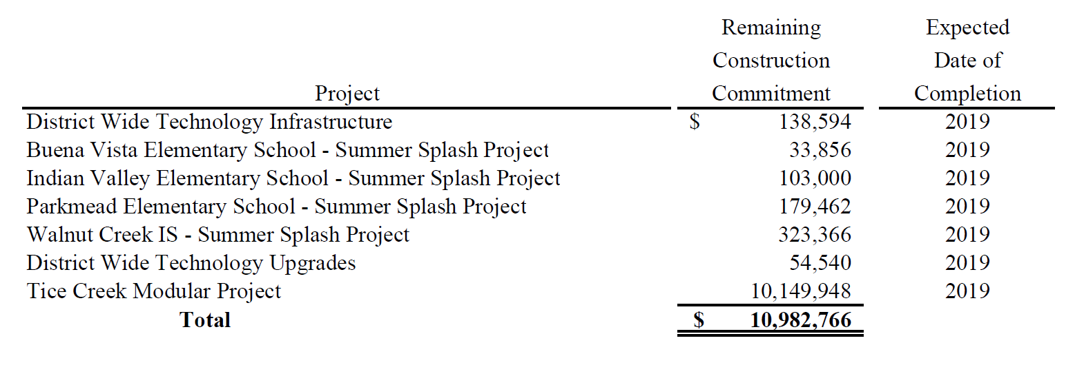
Example of Construction Commitments

Slide 18
QUESTIONS?

Slide 19
Thank You!
Brandon Waldren, CPA, CFE, CFI
Senior Manager of Fraud and Forensics
bwaldren@eidebailly.com
925.819.2668

