Slide 1
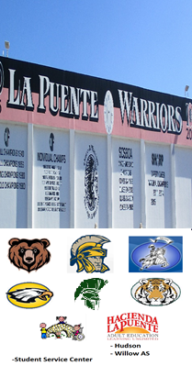
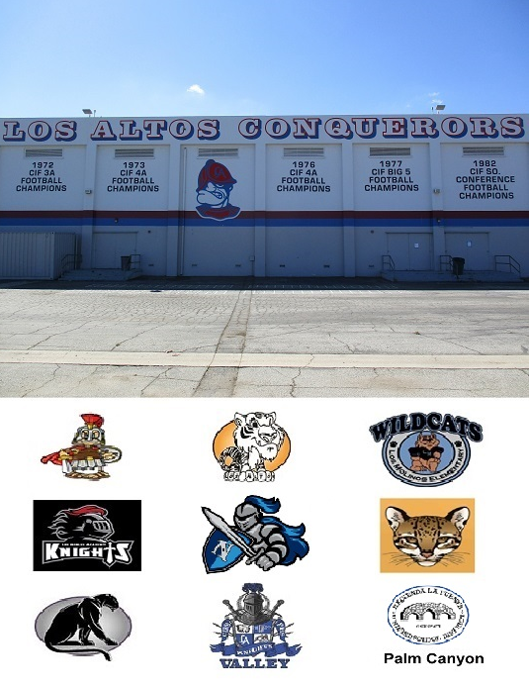



HACIENDA LA PUENTE UNIFIED SCHOOL DISTRICT
La Puente Quad
Los Altos Quad
Wilson Quad
Workman Quad
School Site Improvement Projects
Regular Board Meeting July 21, 2022
Business Services

Slide 2

PROJECT COMPLETE LIST
2021-2022
Site | Item Description | Funding Source | Completed Date
Willow Center | Conference Center Fence | Adult Ed | 12/2021
Orange Grove MS | Flooring – Administration Flooring | Facilities | 4/2022
Baldwin | Flooring – P12 | Facilities | 4/2022
Workman HS | Front Entry Concrete | Facilities | 12/2021
Wilson HS | Gym & Locker Room HVAC | Prop 39 | 10/2021
Workman HS | Gym & Locker Room HVAC | Prop 39 | 4/2022
La Puente HS | Gym Lights Upgrade | Facilities | 11/2021
Workman HS | Gym Lights Upgrade | Facilities | 11/2021
Workman HS | Media Center Flooring & Paint | Donation | 11/2021
Grandview | Office Modular Furniture | Facilities | 11/2021
Grandview | Roofing | Facilities | 12/2021
Los Altos | Roofing | Facilities | 12/2021
Los Altos HS | Solar Panel Arrays | Power Purchase Agreement | 11/2021
Wilson HS | Solar Panel Arrays | Power Purchase Agreement | 12/2021
District Office | Solar Panel Arrays | Power Purchase Agreement | 10/2021
La Puente HS | Solar Panel Arrays | Power Purchase Agreement | 1/2022
Willow AS | Solar Panel Arrays | Power Purchase Agreement | 1/2022
Workman HS | Solar Panel Arrays | Power Purchase Agreement | 11/2021
Changes And Progress Since Last Report - Blue

Slide 3
PROJECT COMPLETE LIST
2021-2022
Site | Item Description | Funding Source | Completed Date
Workman HS | Pool Coping Repairs | Facilities | 6/2022
Willow | South Conference Room Flooring | Adult ED | 3/2022
Valinda | Trash Bin Enclosure | Facilities | 3/2022
Grazide | Tree Barrier | Facilities | 11/2021
Bixby | Wedgeworth Interim Housing | Project | 12/2021
Cedarlane Academy | PA System Installation | Deferred Maintenance | 6/2022
Workman ES | PA System Installation | Deferred Maintenance | 6/2022
Wedgeworth | Phase I - Kinder Portable Relocation | Project COP | 6/2022
Changes And Progress Since Last Report - Blue

Slide 4

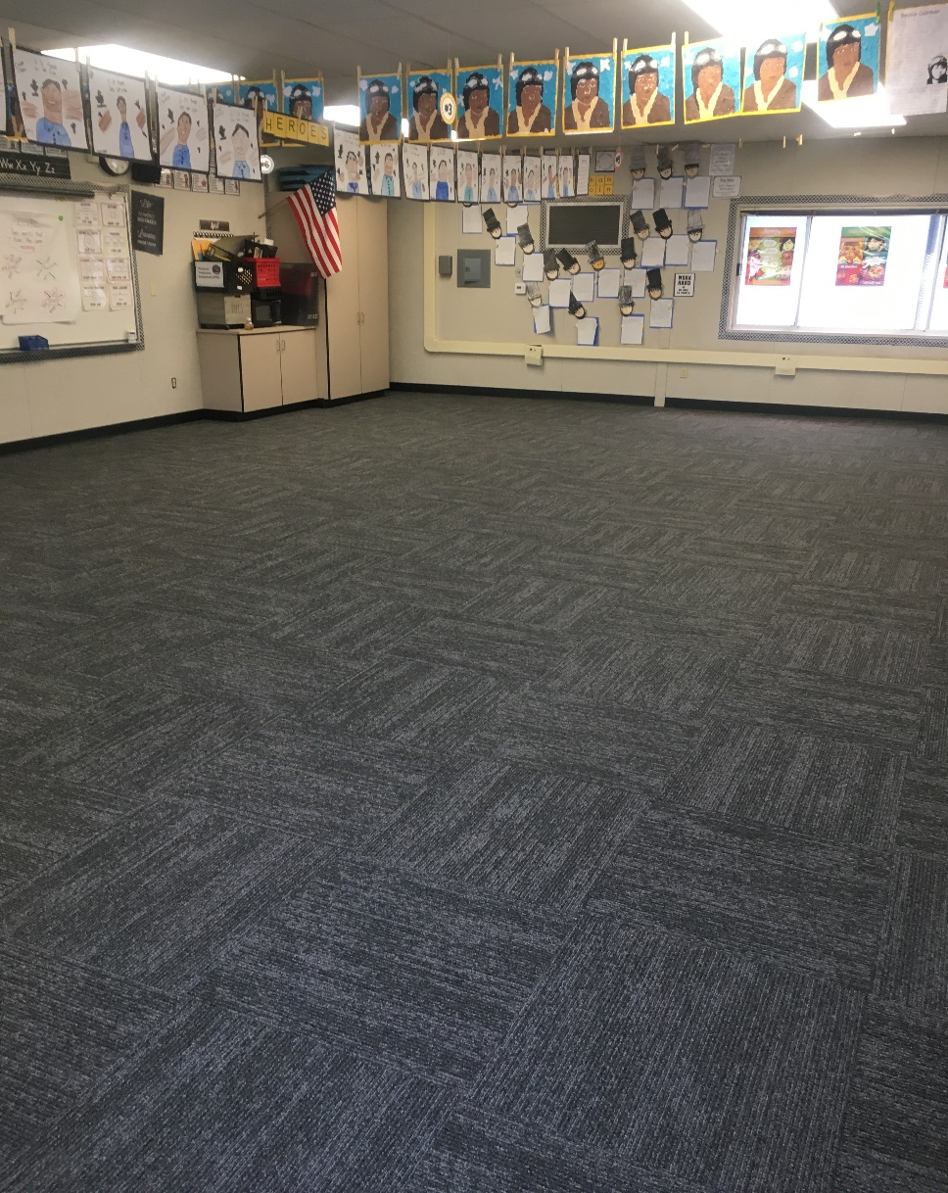
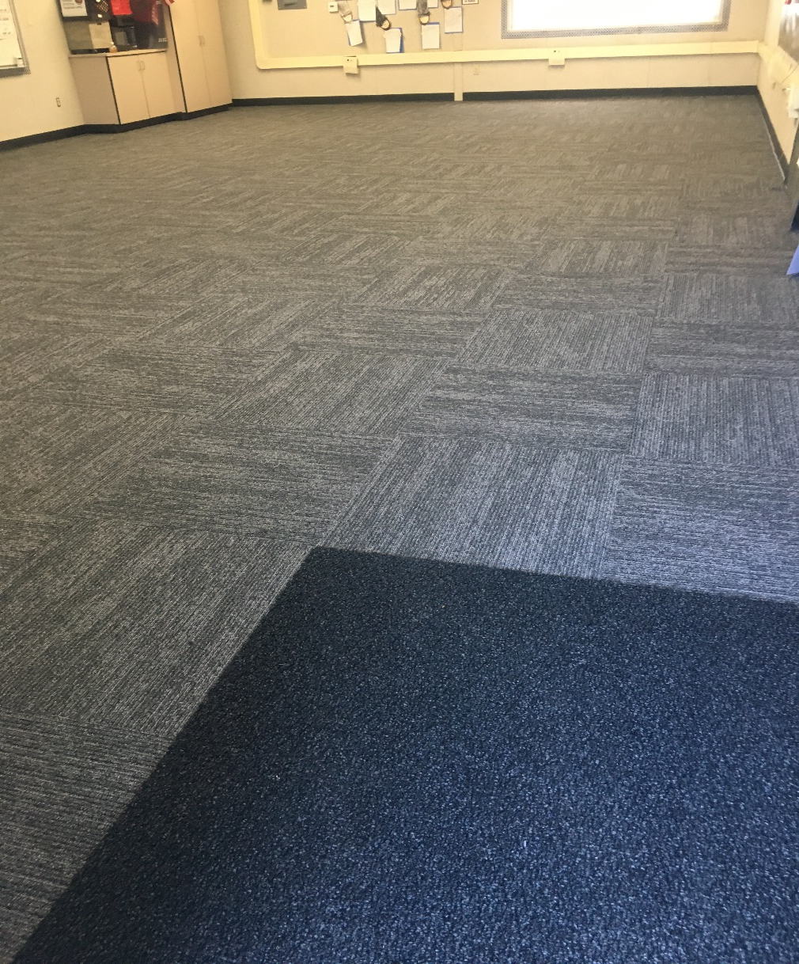
Projects Completed as of July 21, 2022
Baldwin – New Flooring P12 (4/6/2022)

Slide 5
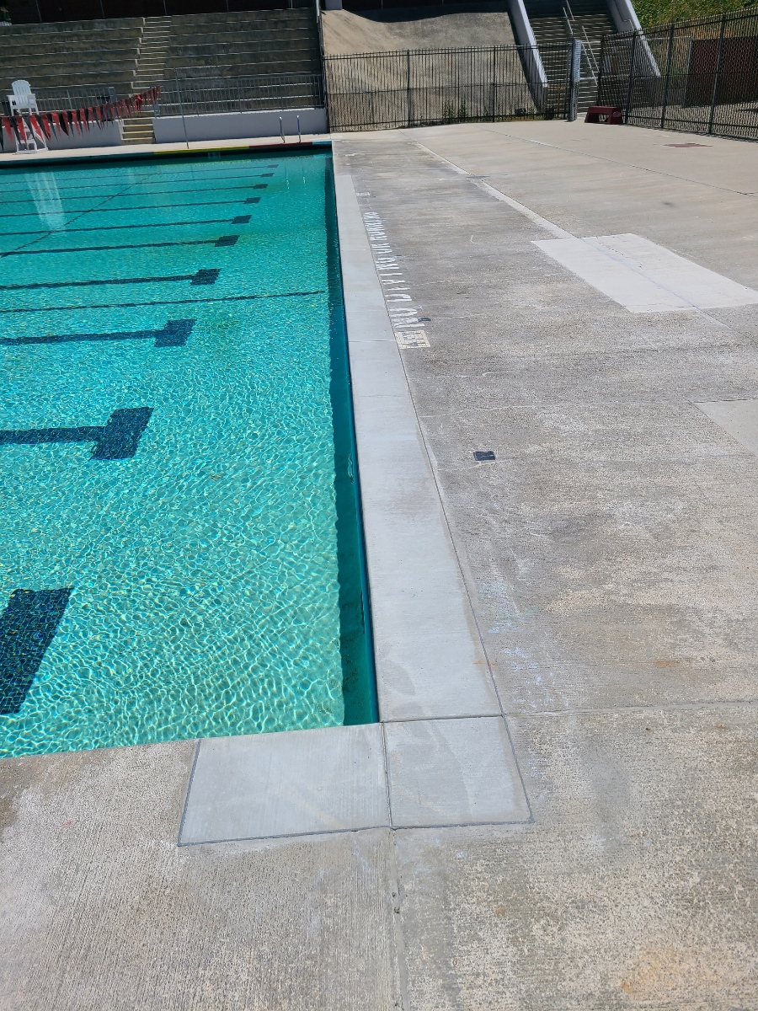
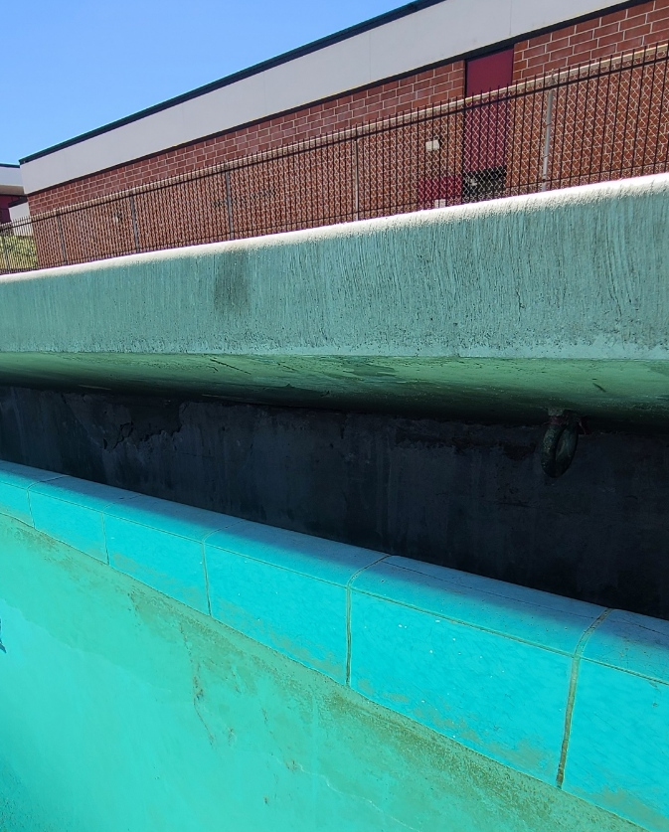
Projects Completed as of July 21, 2022
Workman HS – Pool Coping Repairs (6/24/2022)

Slide 6
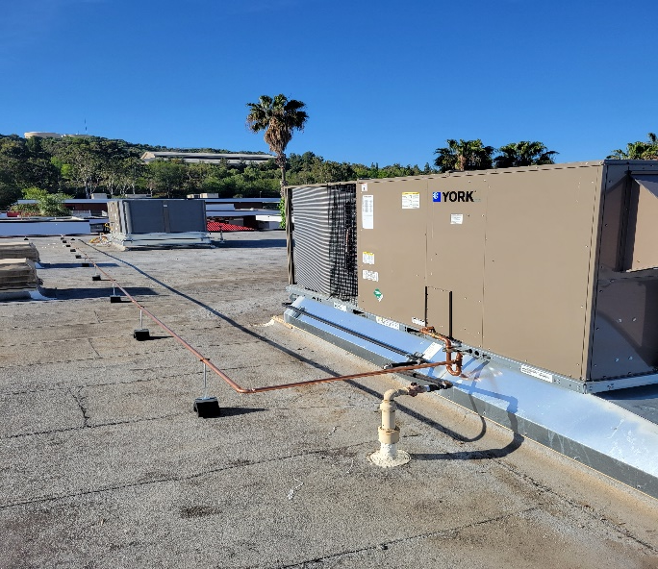
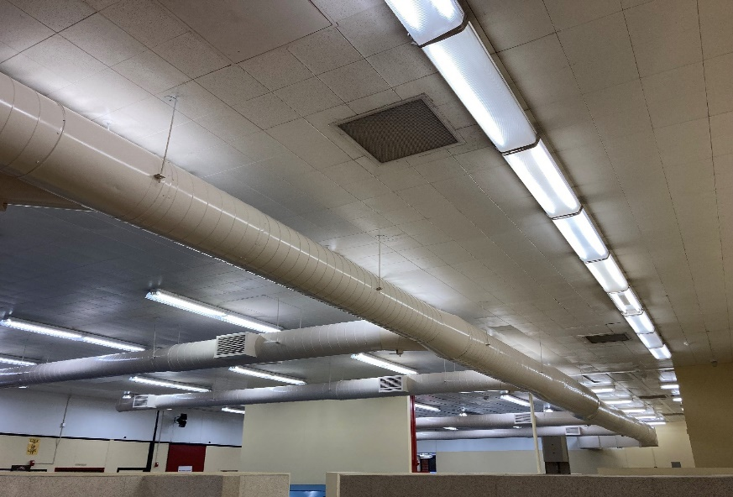
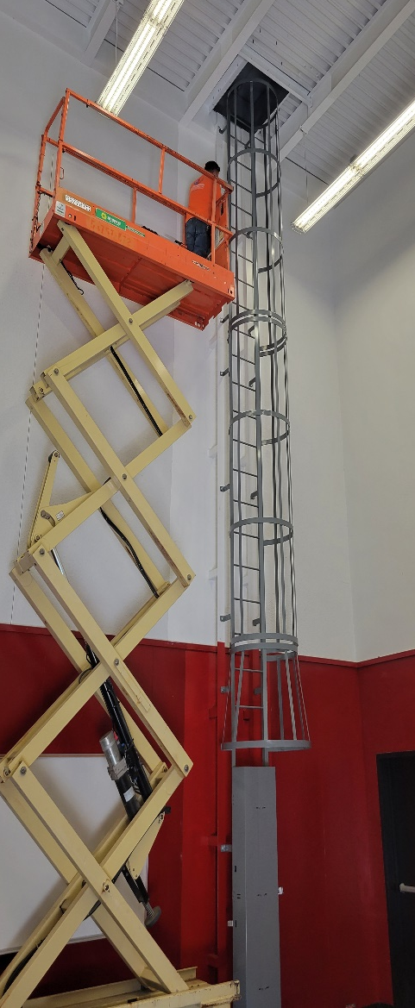
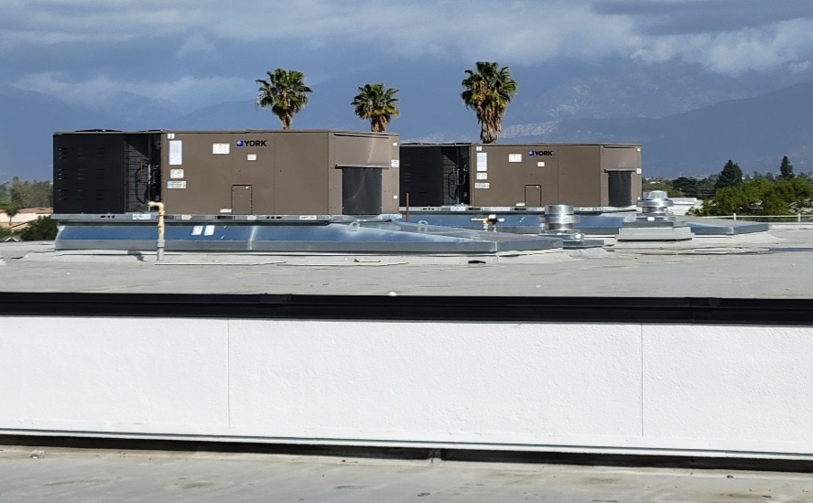
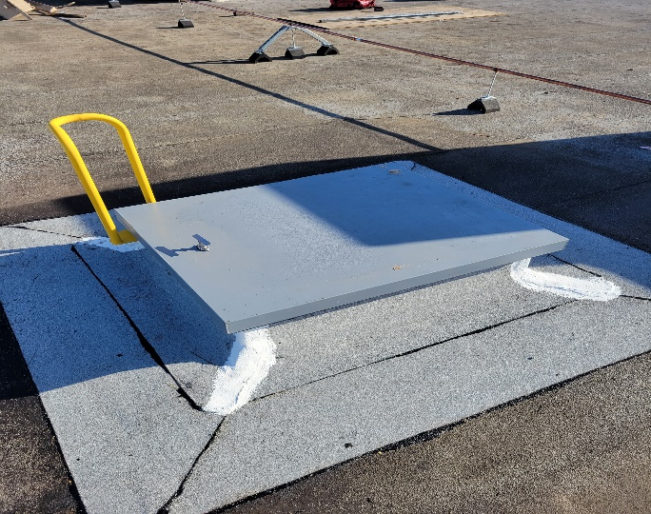
Projects Completed as of July 21, 2022
Workman HS Gym & Locker HVAC (4/22/2022)

Slide 7

Projects In Progress

Slide 8
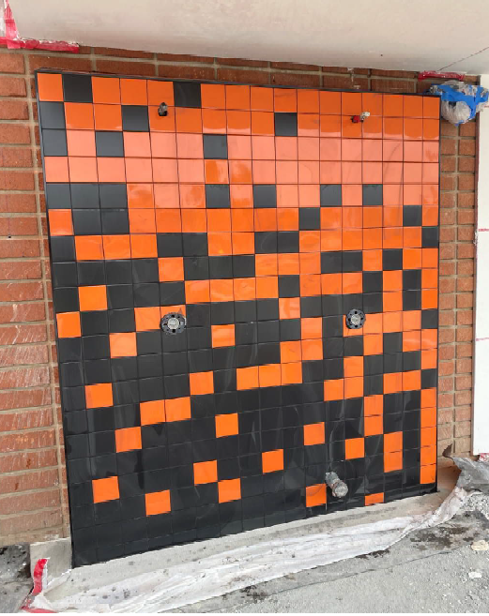
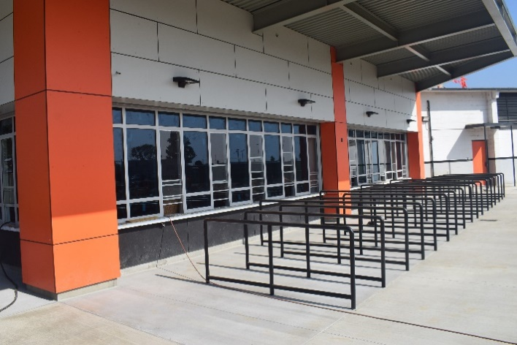
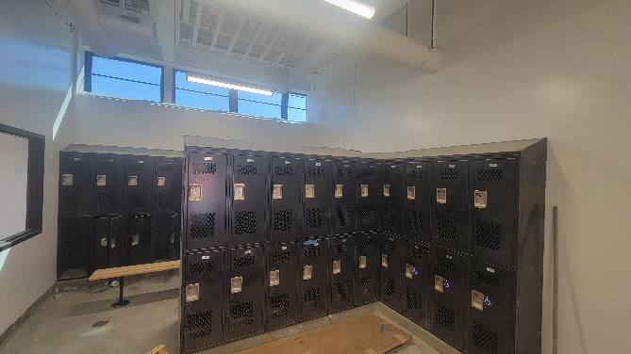
Projects In Progress as of July 21, 2022
Site | Item Description | Architect Plans | DSA Approval | Procurement | Construct | Funding Source | Target Completion Date
La Puente HS | New Kitchen (including exterior hardscape) | Complete | Complete | Complete | In Progress | Facilities & COP | 8/20/2022
La Puente HS | Pool & Locker Room Project | Complete | Complete | Complete | In Progress | Facilities & COP | 8/20/2022
Workman HS | Phase II Stadium and Baseball Field (Phase I Track & Field and Softball Field Complete) | Complete | Complete | Pending (Currently Working on CEQA) | Pending | Various - Estimate Cost $16.5M | 8/2024
La Puente HS - Updates
Kitchen – Started Installation of the Storefront Window Panels
Locker Room – Plastered the Exterior of the Locker Building
Pool – Finished Install of Exterior Tiles

Slide 9
Projects In Progress as of July 21, 2022
Site | Item Description | Architect Plans | DSA Approval | Procurement | Construct | Funding Source | Target Completion Date
Wedgeworth | K-5 Permanent School | Complete | Complete | Pending Award | 9/2022 | COPS | 8/2024
District Office (C wing) | HVAC Replacement, Lighting, Flooring and Fire Alarm | Complete | NA | Pending | Pending | Facilities | 3/2023
Sierra Vista (Child Dev) | Flooring Replacement | NA | NA | Complete | Pending | Program | 8/30/2022
Workman HS | Gym Restroom ADA Upgrades | Complete | Complete | Complete | In Progress | Facilities | 8/30/2022
Lassalette | Front Exterior Turf | NA | NA | Complete | Pending | Facilities | 7/22/2022
La Puente HS | Gym & Locker Room HVAC | Complete | Complete | Complete | In Progress | Prop 39 | 10/12/2022
Dibble AS | HVAC Replacement | Complete | NA | Complete | Pending | Adult Ed | 12/2023
Willow AS | HVAC Replacement | Complete | NA | Complete | Pending | Adult Ed | 12/2023
Willow AS | Fire Alarm Installation | Complete | NA | Pending | Pending | Adult Ed | 12/2023
Dibble AS | Fire Alarm Installation | Complete | NA | Pending | Pending | Adult Ed | 12/2023

Slide 10

Projects with Division of State Architect (DSA)
Waiting on Approval
Site | Item Description | Architect Plans | DSA Approval | Procurement | Est. Construct Start | Target Completion Date
Los Altos HS | Gym & Locker Room HVAC | Complete | Pending | Complete | TBD | TBD
Projects in Design
Site | Item Description | Architect Plans | DSA Approval | Procurement | Est. Construct Start | Target Completion Date
Center for the Performing Arts | New Performing Arts Center with approx. 500 seat capacity | In Progress | Pending | Pending |  | 2/2025
Districtwide | HVAC System Replacements | Pending | Pending | In Review
Kwis Elementary | Baseball Fields (Two Youth) | In Progress | Pending | Pending | 11/2022 | 3/2024
Changes And Progress Since Last Report - Blue

Slide 11
Next Report – August 25, 2022

