Slide 1

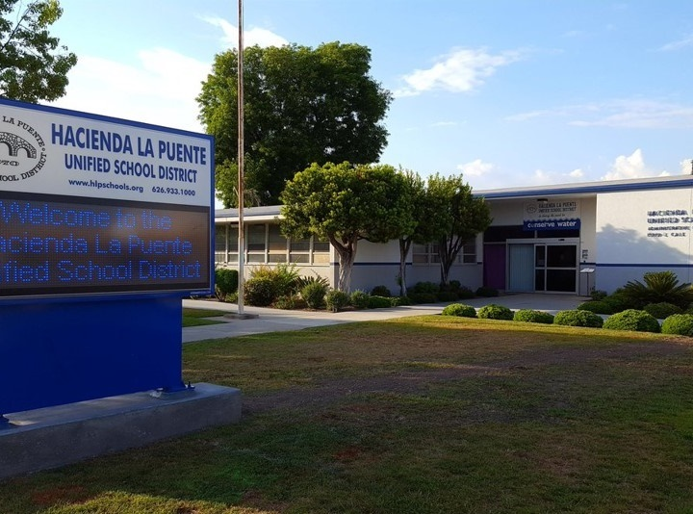

21st Century Classroom Improvements
August 25, 2022 Board Update

Slide 2
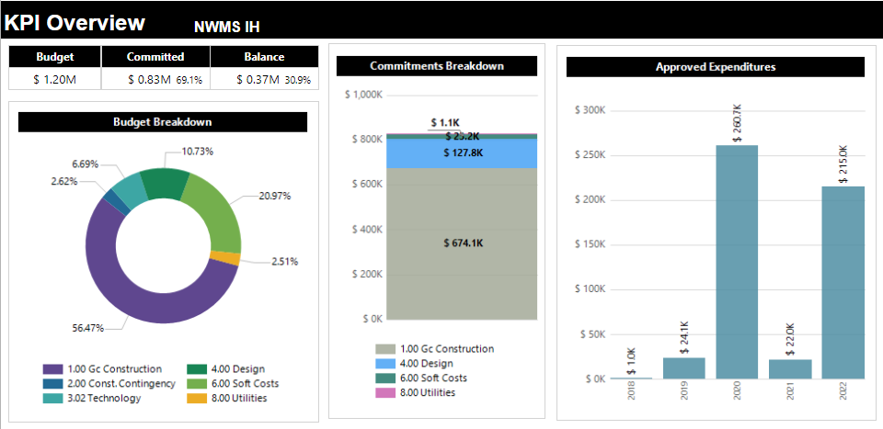
Newton Middle School Interim Housing
Design Payments 2018
Design Payments 2019
Design, DSA, Power, Portable Purchase
Design, Bidding and Administration
Bid & Build
Project Status
Close out

Slide 3
Bid Bundle #3 Phase 1 & 2
Bid Bundle #3:
Sparks MS, Newton MS
&
Grandview College Prep
21st Century Classroom Modernization
Bid No. 2022-23.01
Construction Durations
Grandview College Prep. 285 Days
Sparks Middle School 180 Days
Newton Middle School 410 Days

Slide 4
Grandview Academy, Newton, Sparks MS
  Budget Optimization
  Enrollment Analysis and Alignment with Site Capacity
  Cluster Classroom Renovations to Reduce Required DSA Access Improvements
  Value Engineer Sound System Components
  Right Sized Data Infrastructure
CURRENTLY BIDDING
Project Status
Bidding

Slide 5

Questions + answers

