Slide 1
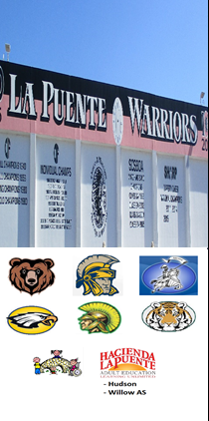
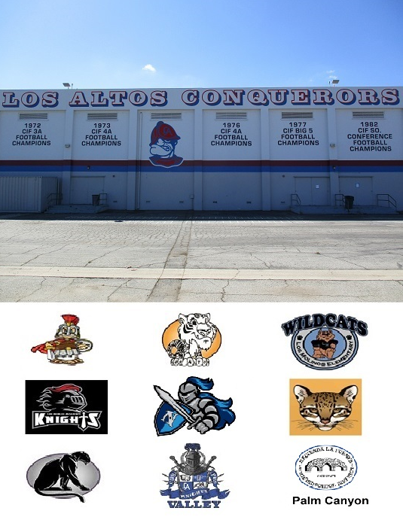



HACIENDA LA PUENTE UNIFIED SCHOOL DISTRICT
La Puente Quad
Los Altos Quad
Wilson Quad
Workman Quad
School Site Improvement Projects
Regular Board Meeting October 27, 2022
Business Services

Slide 2

PROJECT COMPLETE LIST
2022-2023
Site | Item Description | Funding Source | Completed Date
Willow | Bottle Filling Stations | Adult ED | 7/2022
Sparks ES | Carpet – Classroom 12 | Facilities | 7/2022
La Puente HS | Dream Center | Facilities | 8/2022
Workman HS | Exterior Lighting at Lobo Lane | Facilities | 8/2022
District Office | Flooring and Lights – Board Room | Facilities | 8/2022
Lassalette | Front Exterior Turf | Facilities | 7/2022
Sparks MS | Front Exterior Turf | Facilities | 10/2022
Workman HS | Gym Restrooms ADA Upgrades | Facilities | 7/2022
La Puente HS | Kitchen | COPS/Facilities | 9/2022
Wing Lane | Parking Lot Striping | Facilities | 8/2022
La Puente HS | Pool | COPS/Facilities | 9/2022
Workman HS | Railing | Facilities | 10/2022
Workman HS | Additional Exterior Lighting at Lobo Lane | Facilities | 10/2022
Changes And Progress Since Last Report - Blue

Slide 3

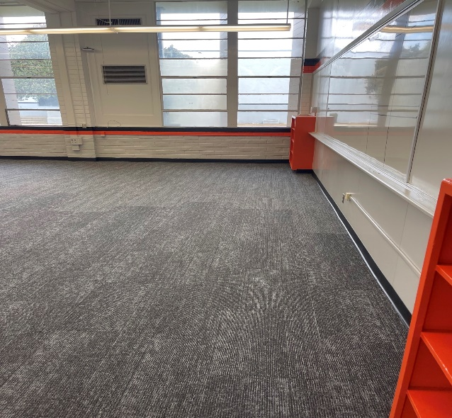
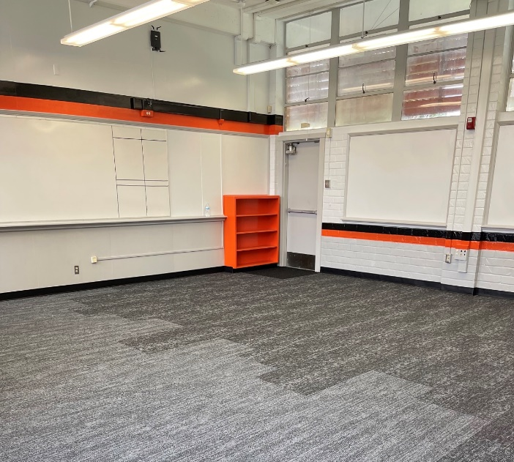
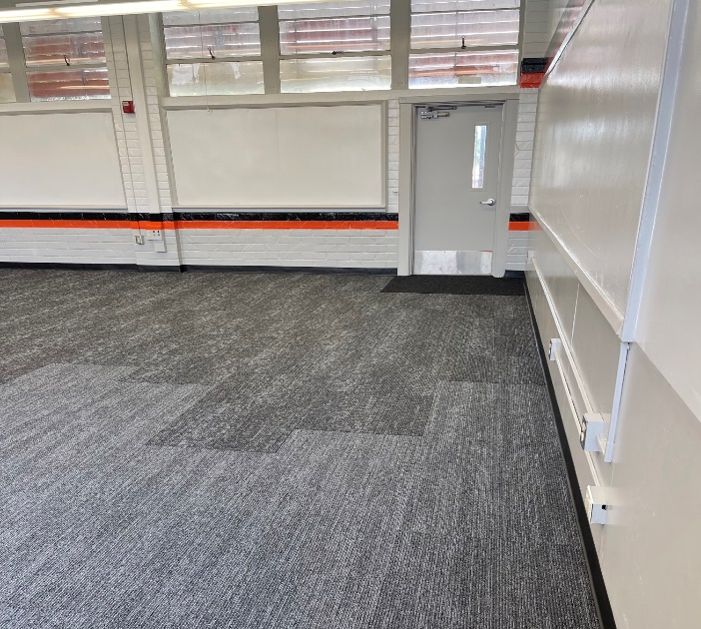
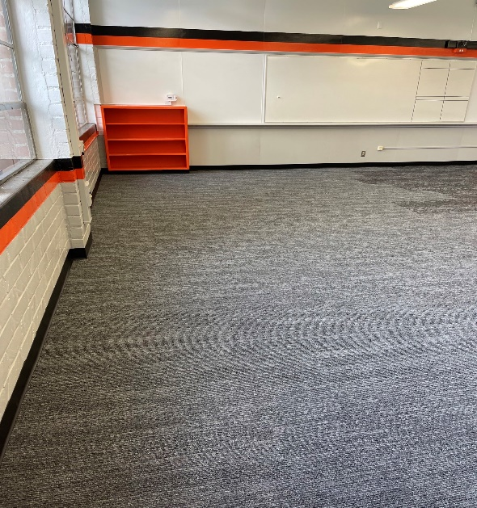
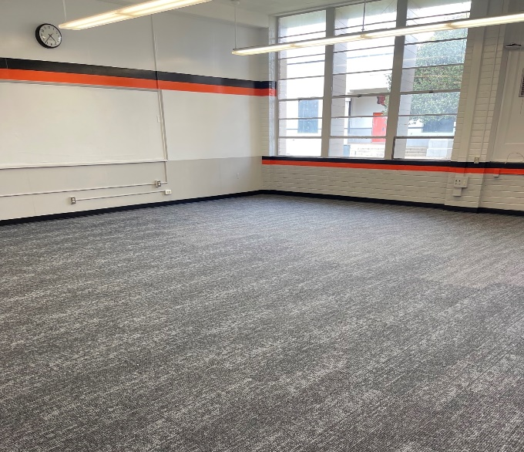
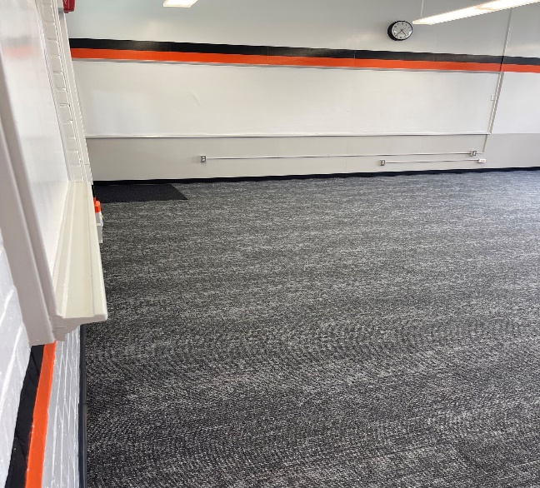
Projects Completed as of October 27, 2022
La Puente HS – Dream Center New Carpet and Paint (8/2022)

Slide 4
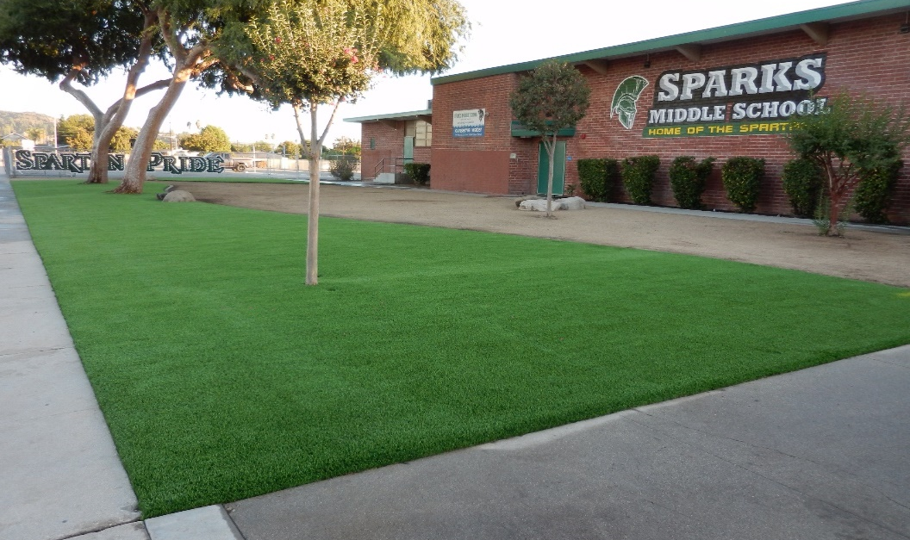
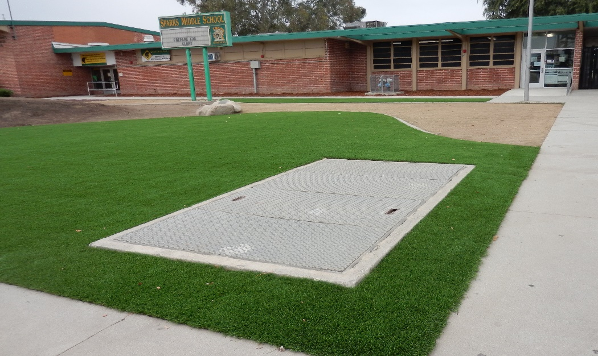
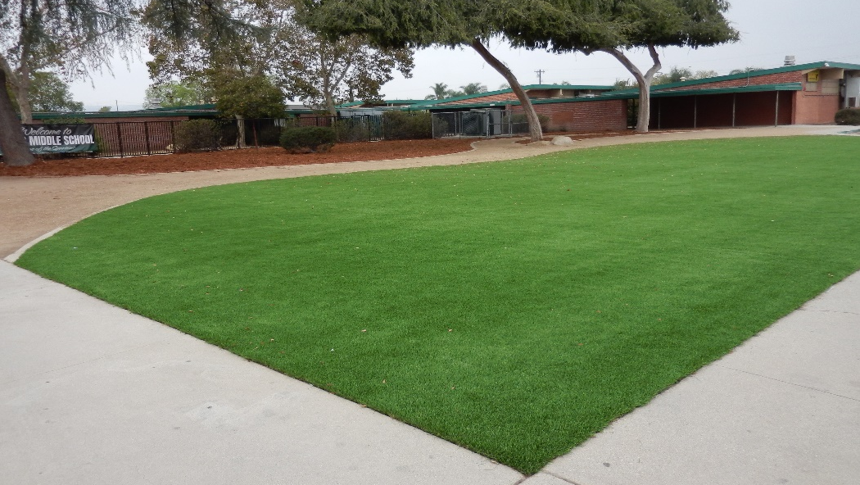
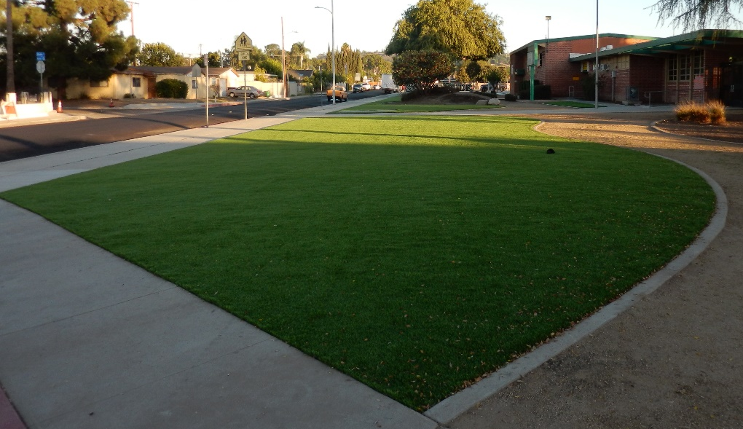
Projects Completed as of October 27, 2022
Sparks MS – Front Exterior Turf (10/2022)

Slide 5
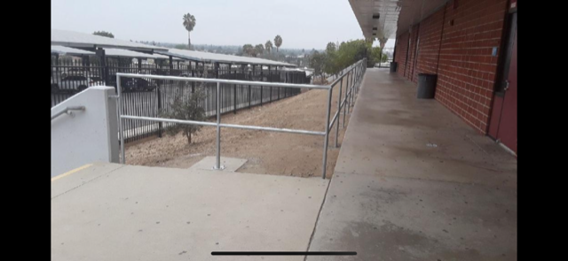
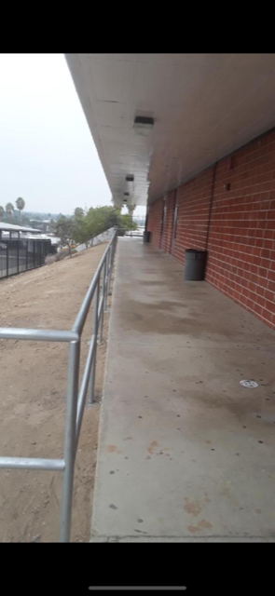
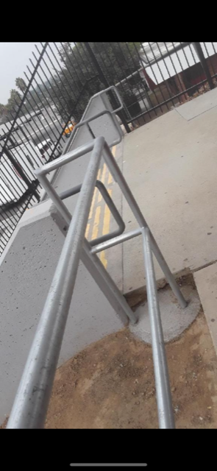
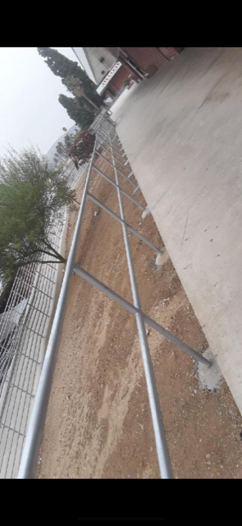
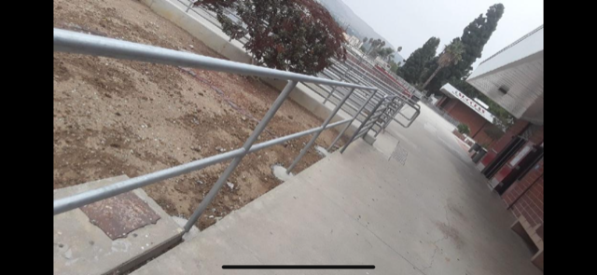
Projects Completed as of October 27, 2022
Workman HS – New Railing
(10/2022)

Slide 6
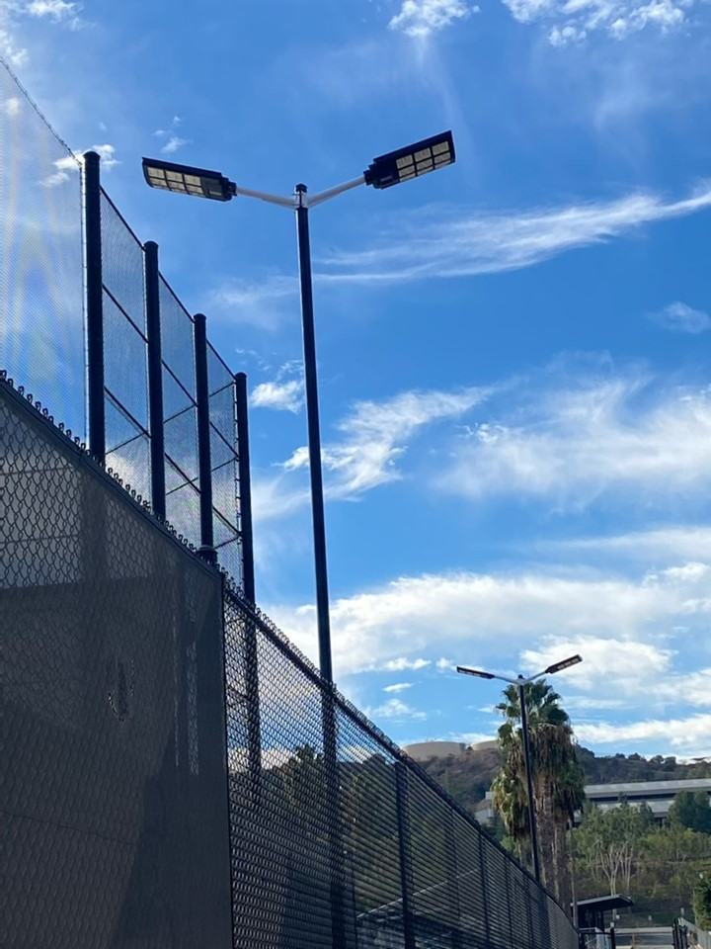
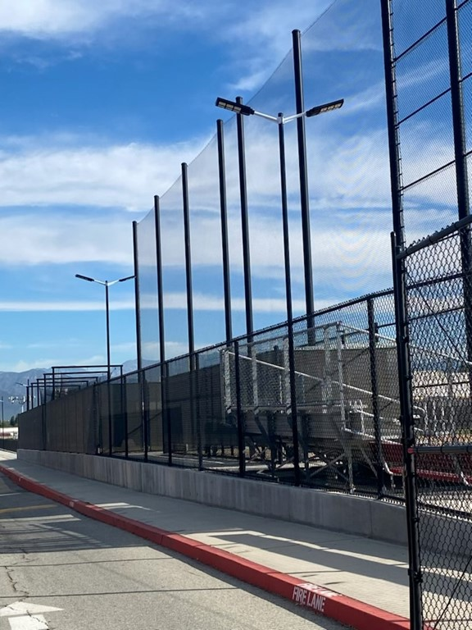
Projects Completed as of October 27, 2022
Workman HS – – Additional Lights for Lobo Lane
(10/2022)

Slide 7

Projects In Progress
2022-2023

Slide 8
Projects In Progress as of October 27, 2022
Site | Item Description | Architect Plans | DSA Approval | Procurement | Construct | Funding Source | Target Completion Date
Workman HS | Phase II Stadium and Baseball Field (Phase I Track & Field and Softball Field Complete) | Complete | Complete | Pending (Currently Working on CEQA) | Pending | Various - Estimate Cost $18 M | 8/2024
Sparks ES, Lassalette, Cedarlane, Baldwin ES, Fairgrove | Blacktop Asphalt & Striping | NA | NA | Pending | Pending | Facilities | 12/31/2022
Wedgeworth | K-5 Permanent School | Complete | Complete | Complete | 9/2022 | COPS | 8/2024
District Office (C wing) | HVAC Replacement, Lighting, Flooring and Fire Alarm | Complete | NA | Complete | In Progress | Facilities | 3/2023
Sierra Vista (Child Dev) | Flooring Replacement | NA | NA | Complete | In Progress | Head Start | 12/15/2022
La Puente HS | Gym & Locker Room HVAC | Complete | Complete | Complete | In Progress | Project Funds | 11/4 /2022
Dibble AS | HVAC Replacement | Complete | NA | Complete | In Progress | Adult Ed | 12/2023
Willow AS | HVAC Replacement | Complete | NA | Complete | In Progress | Adult Ed | 12/2023
Willow AS | Fire Alarm Installation | Complete | NA | Complete | In Progress | Adult Ed | 12/2023
Dibble AS | Fire Alarm Installation | Complete | NA | Complete | In Progress | Adult Ed | 12/2023
Los Altos HS | Path of Travel – ADA Issues | Complete | Complete | Pending Award | Pending | Facilities | 12/15/2022
Cedarlane | Front Exterior Improvements | NA | NA | Pending | Pending | Facilities | 12/31/2022

Slide 9
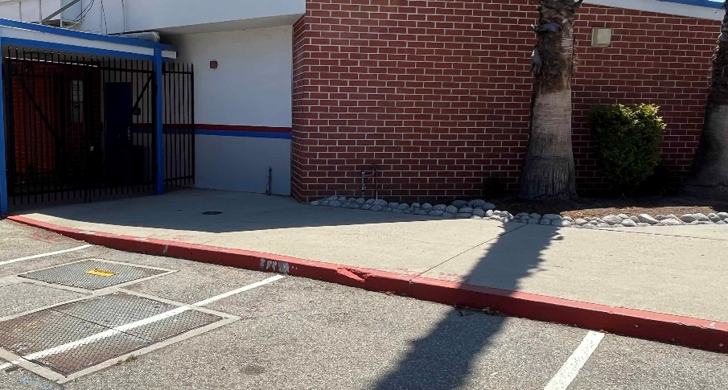
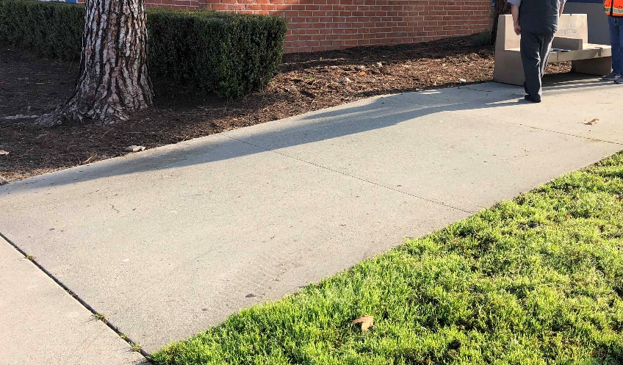
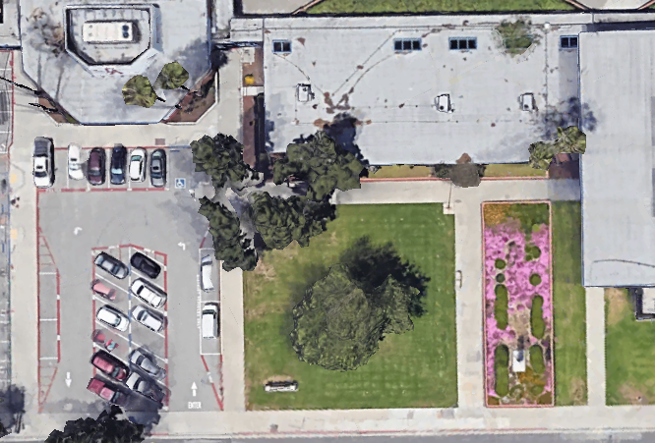
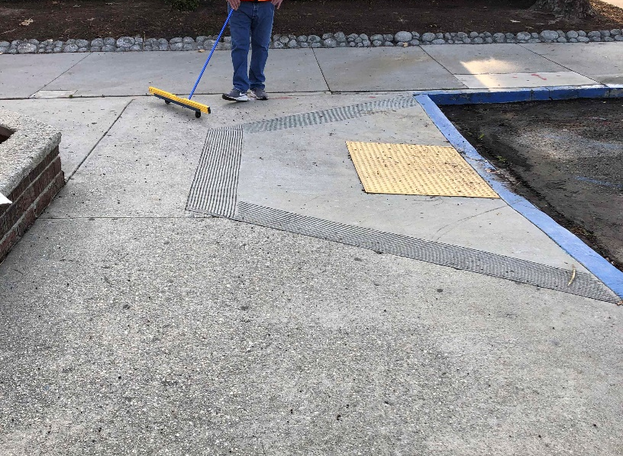
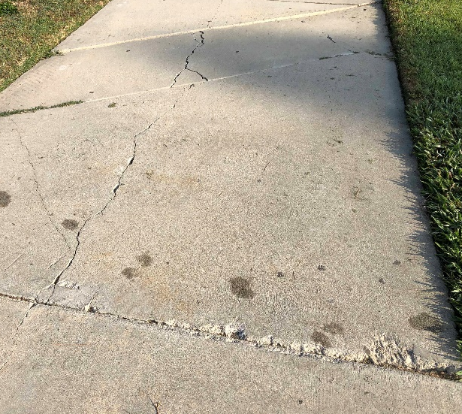
Los Altos High School ADA Improvements

Slide 10

Projects with Division of State Architect (DSA)
Waiting on Approval
Site | Item Description | Architect Plans | DSA Approval | Procurement | Est. Construct Start | Target Completion Date
Los Altos HS | Gym & Locker Room HVAC (65 tons of temporary HVAC units have been installed) | Complete | Pending | Complete | TBD | TBD
Kwis Elementary | Baseball Fields (Two Youth) | Complete | Pending | Pending | 1/2023 | 3/2024
Projects in Design
Site | Item Description | Architect Plans | DSA Approval | Procurement | Est. Construct Start | Target Completion Date
Center for the Performing Arts | New Performing Arts Center with approx. 500 seat capacity | In Progress | Pending | Pending |  | 2/2025
Districtwide | HVAC System Replacements | Pending | Pending | Pending
Changes And Progress Since Last Report - Blue

Slide 11
Next Report – November 17, 2022

