Slide 1
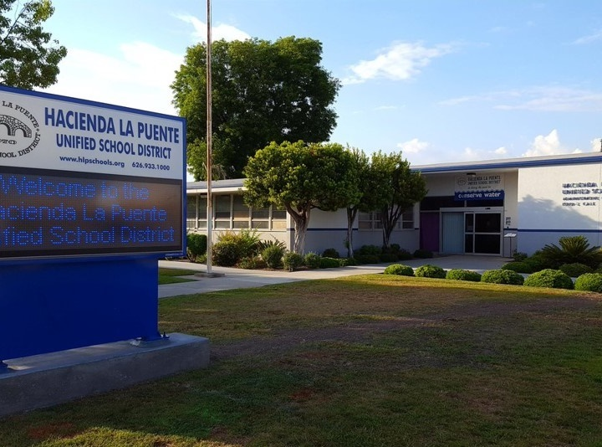


21st Century Classroom Improvements
October 27, 2022 Board Update
Notes:
1

Slide 2
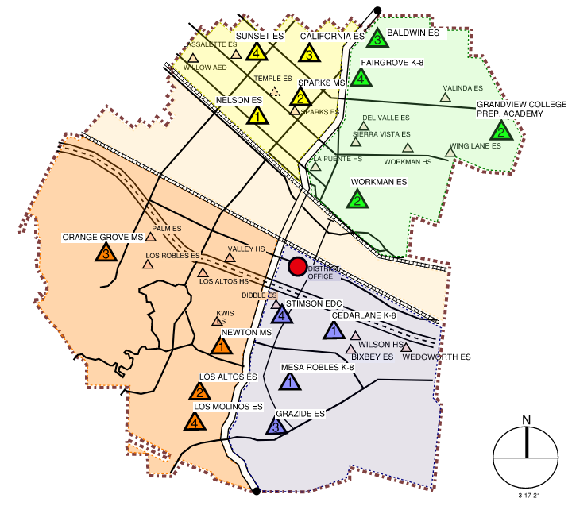
Quadrant Map Final Three Sites of Phases 1 & 2
Phase
1
IN PROGRESS
Newton MS
Phase
Grandview K-8
Sparks MS
2
Completed
Nelson ES
Los Altos ES
Workman ES
Mesa Robles K-8
Cedarlane K-8
Q + A
2

Slide 3
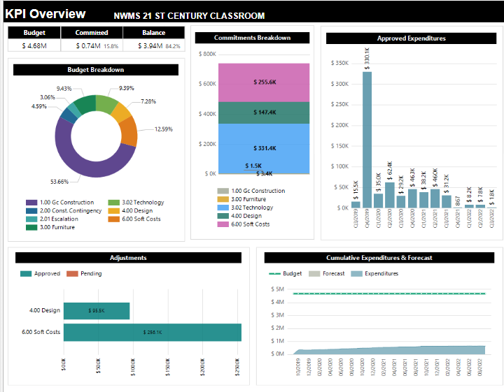
Newton Middle School
Project Status
Construction
3

Slide 4
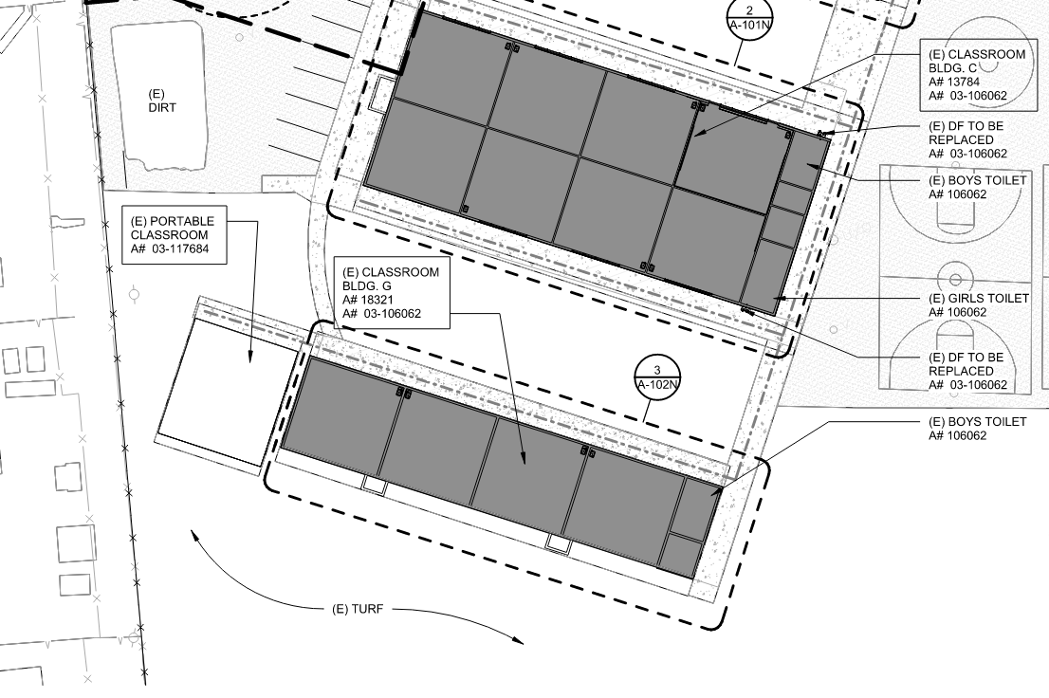
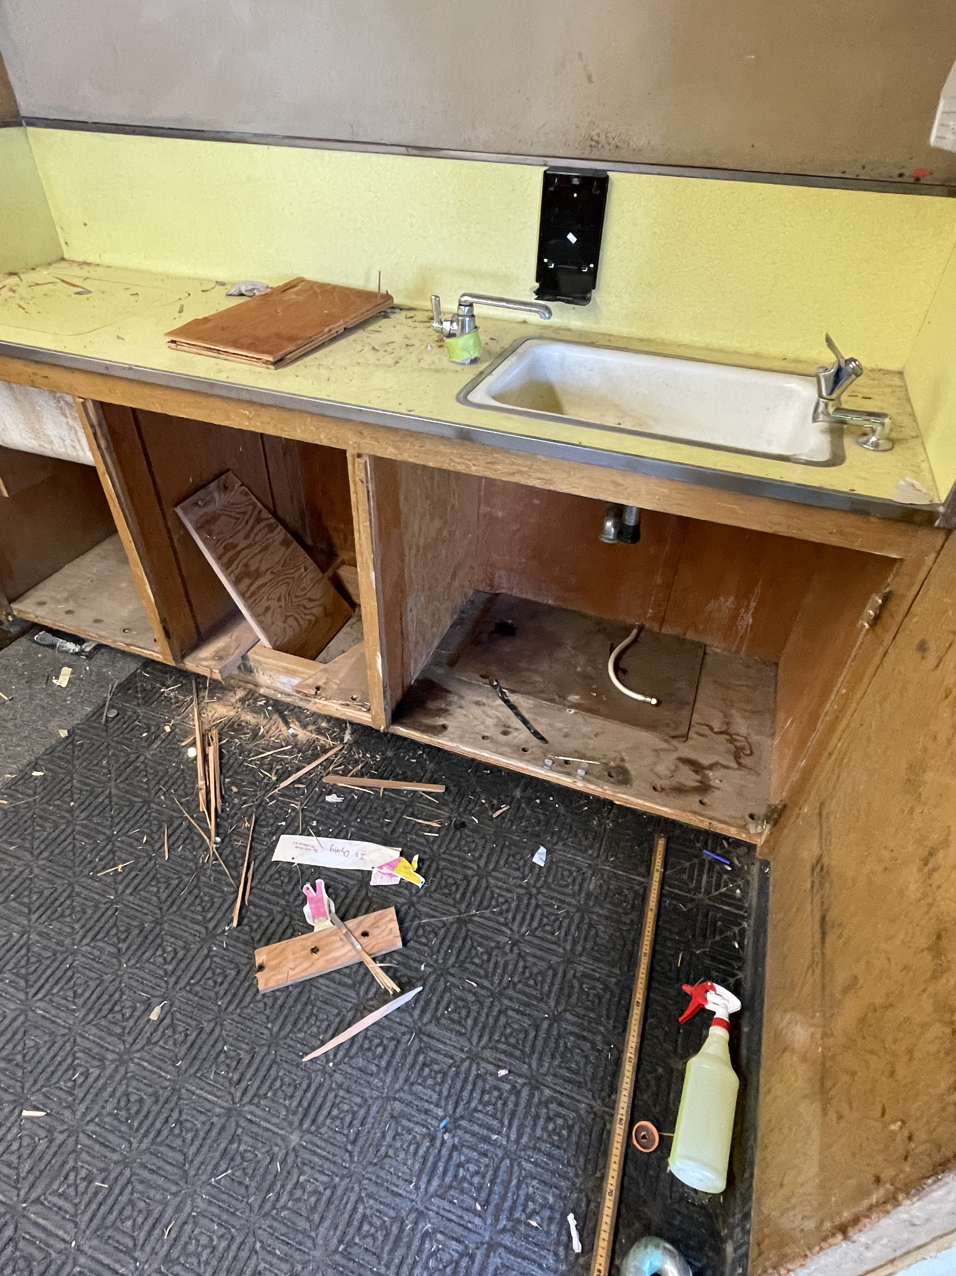
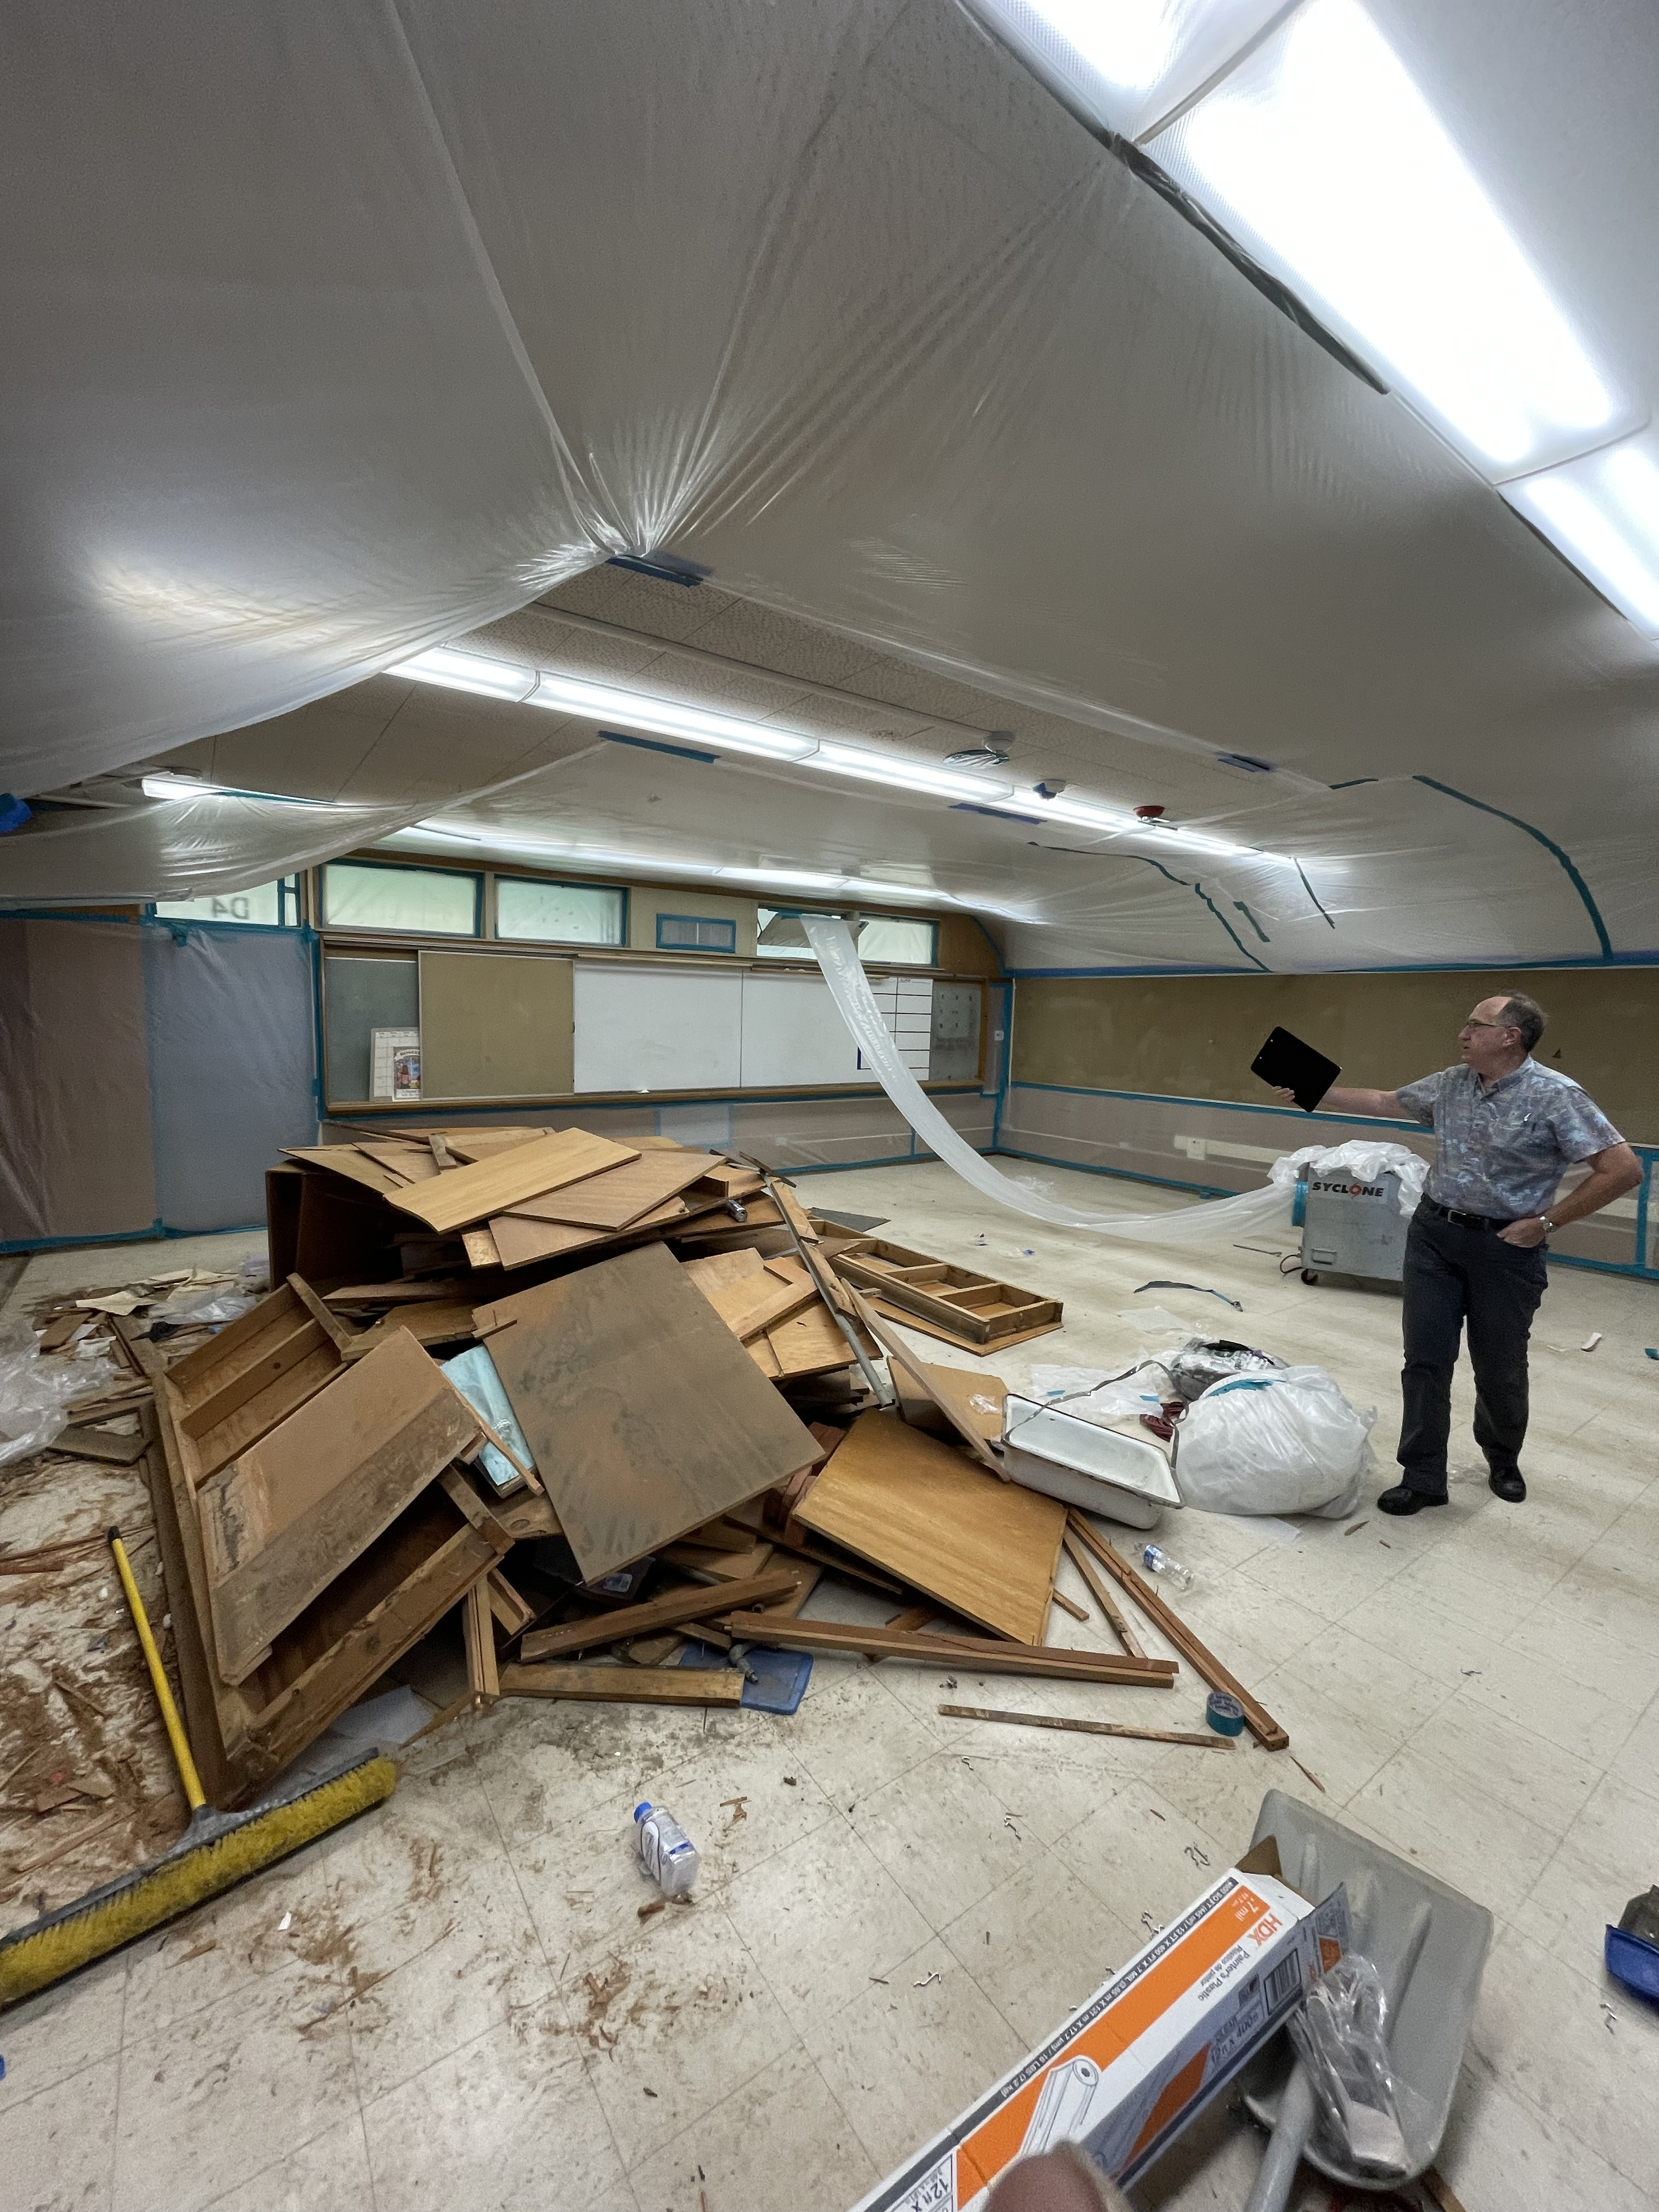
Newton Middle School
Construction Demolition Building D
Room D4
Project Status
Construction
4

Slide 5
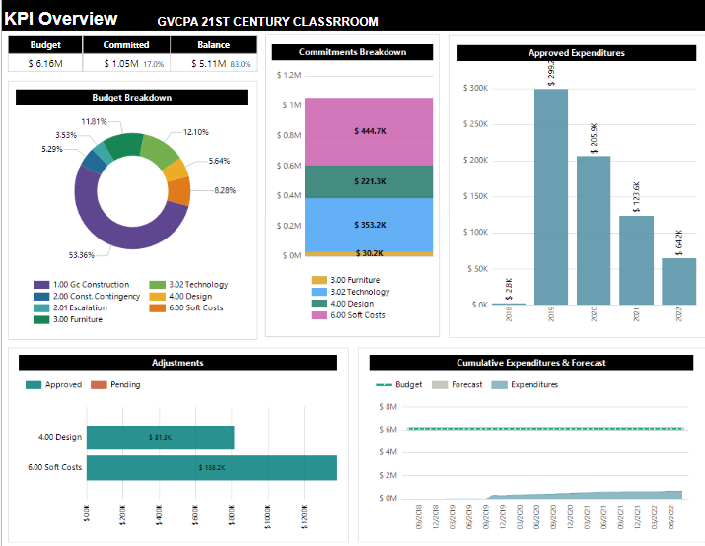
Grandview College Prep. Academy
Project Status
Construction
5

Slide 6
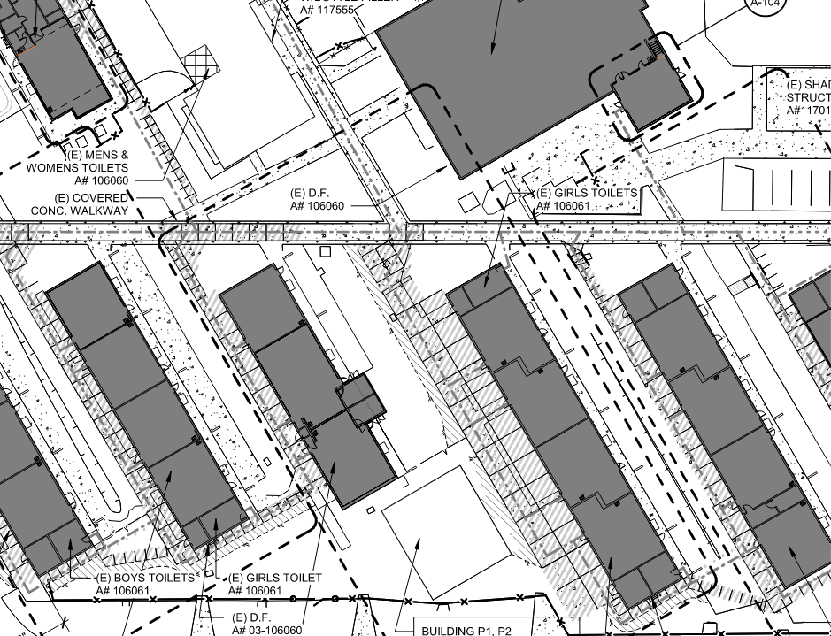
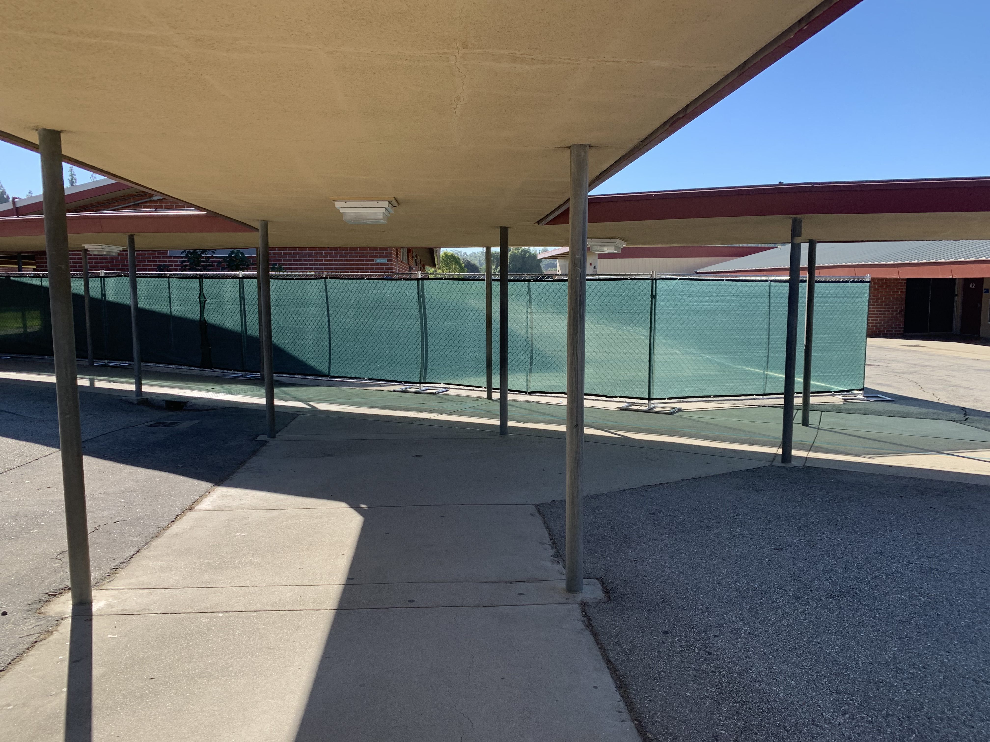
Grandview College Prep. Academy
Construction Safety Fencing at Wings 50 and 60
Wing 50
Project Status
Construction
6

Slide 7
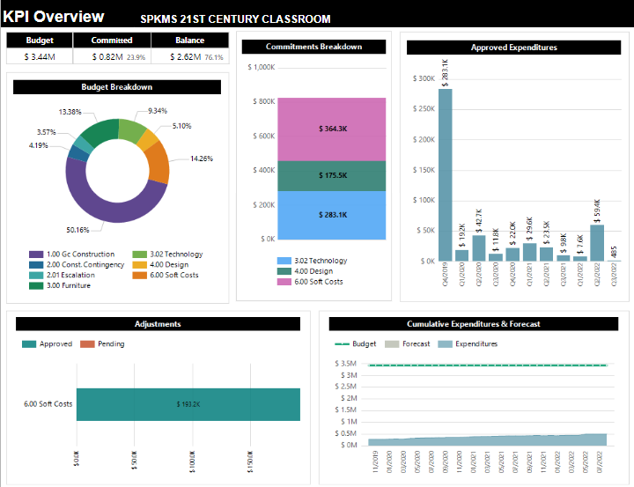
Sparks Middle School
Project Status
Construction
7

Slide 8
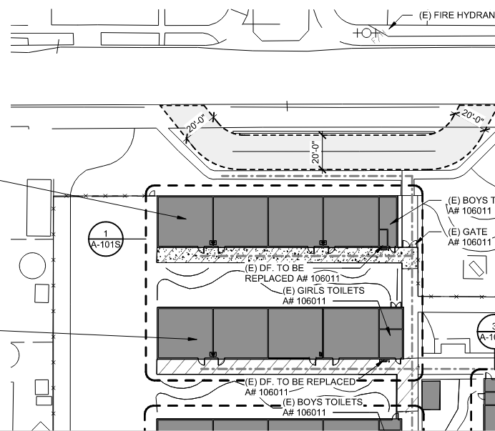
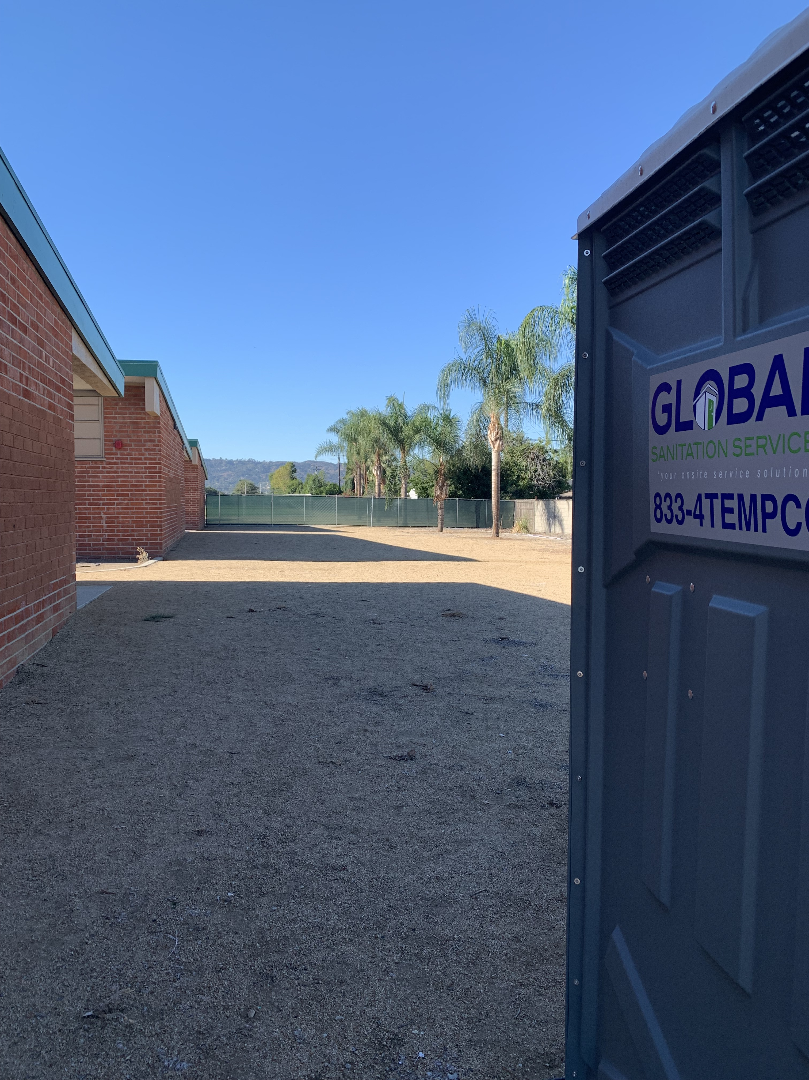
Sparks Middle School
Construction Safety Fencing West of Buildings C and D
Project Status
Construction
8

Slide 9

Questions + answers
9

