Slide 1
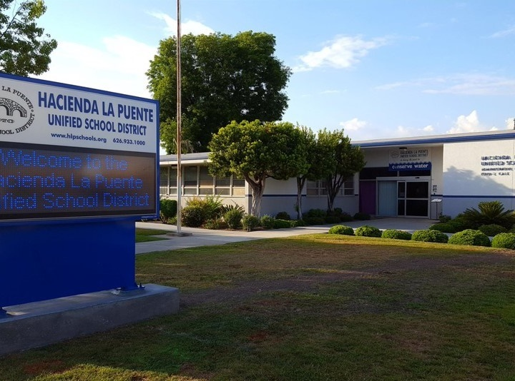


21st Century Classroom Improvements
March 23, 2023, Board Update
Notes:
1

Slide 2
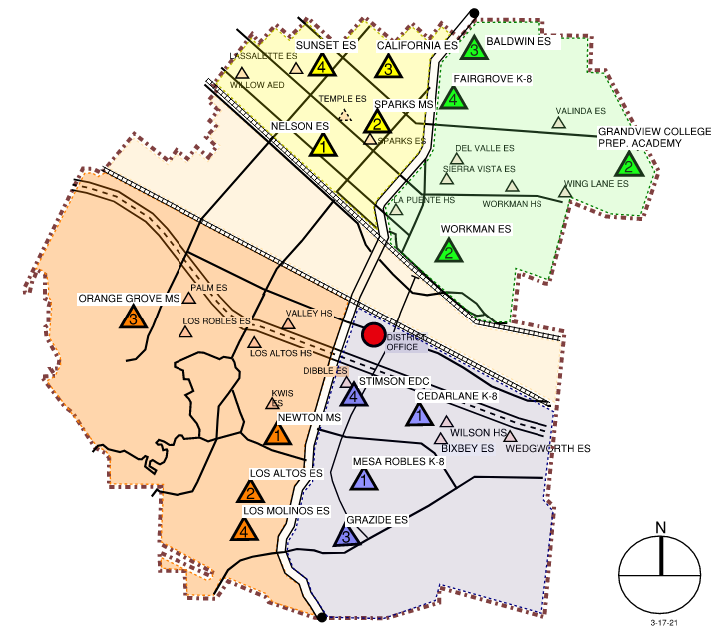
Sites In Progress & Completed
IN PROGRESS
Newton MS
Grandview K-8
Sparks MS
Completed
Nelson ES
Los Altos ES
Workman ES
Mesa Robles K-8
Cedarlane K-8

Slide 3
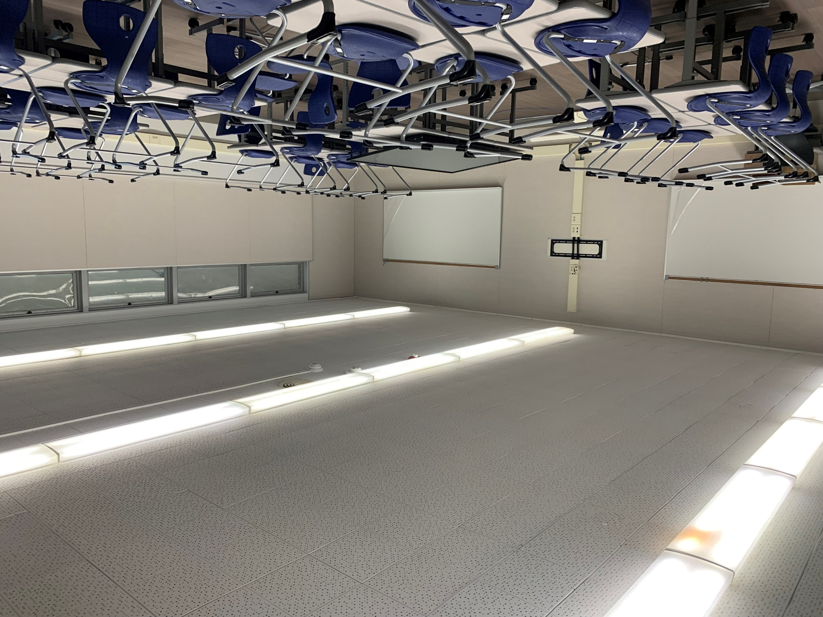
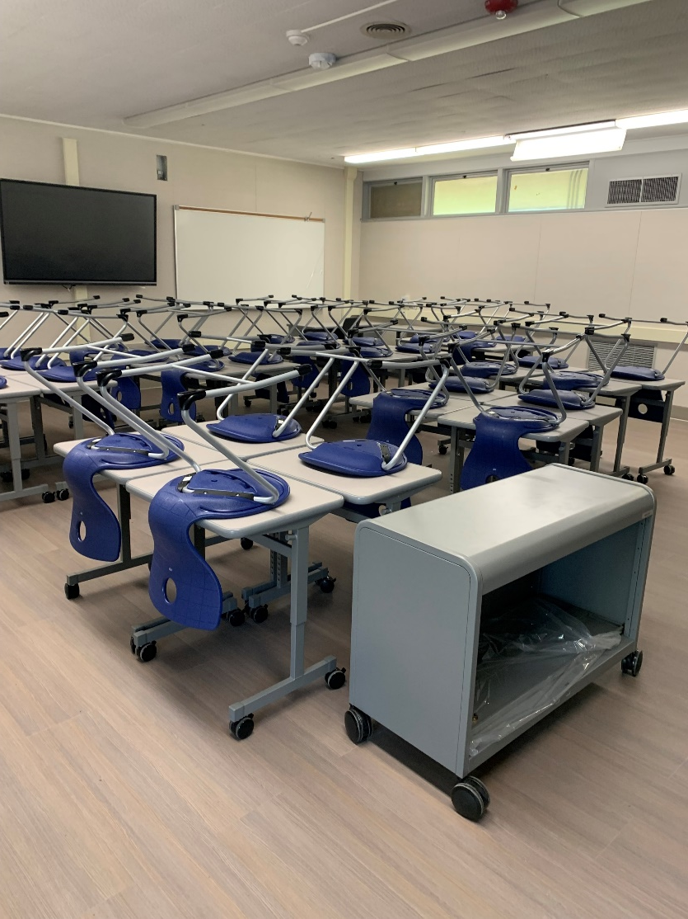
Newton Middle School
Prep for Phase 1 Turn Over– Building D, March 10, 2023
Project Status
Construction

Slide 4
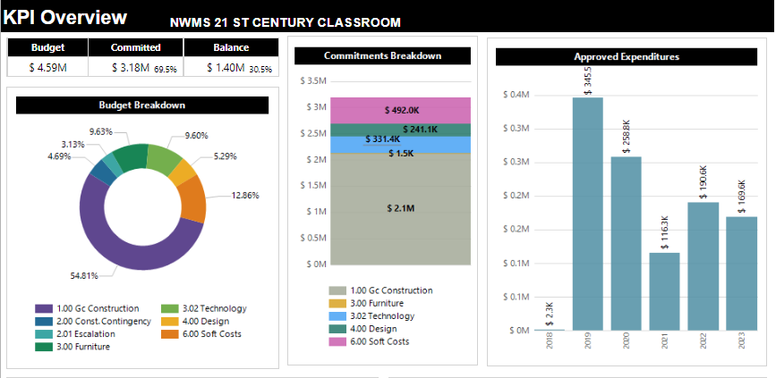
Newton Middle School
$ 1.41M
Modernization Plan
Classrooms: 19
Music Room: 1
Project Status
Construction

Slide 5
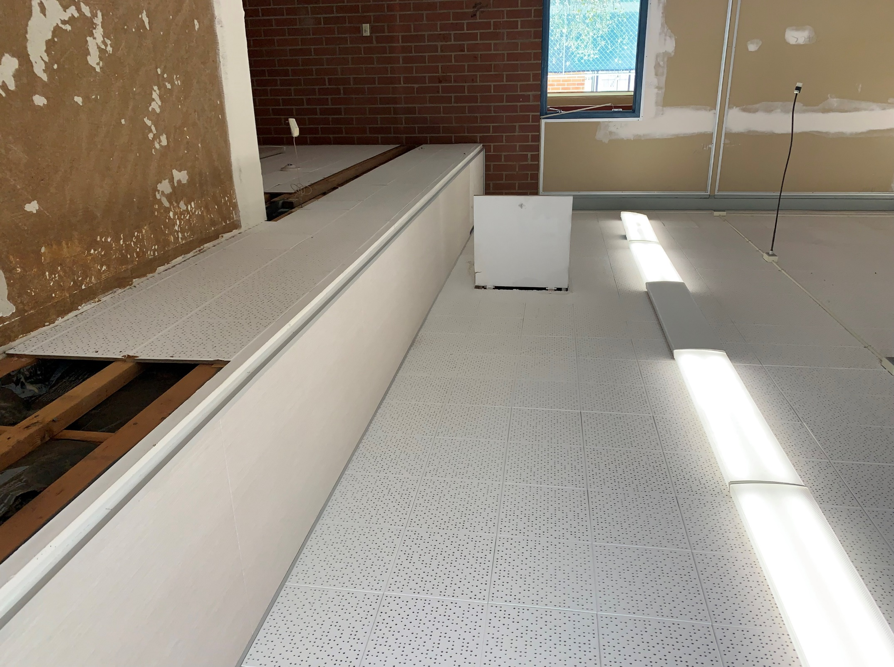
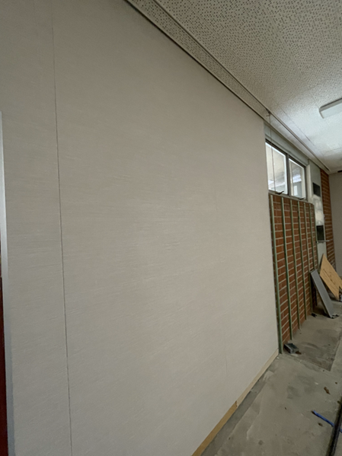
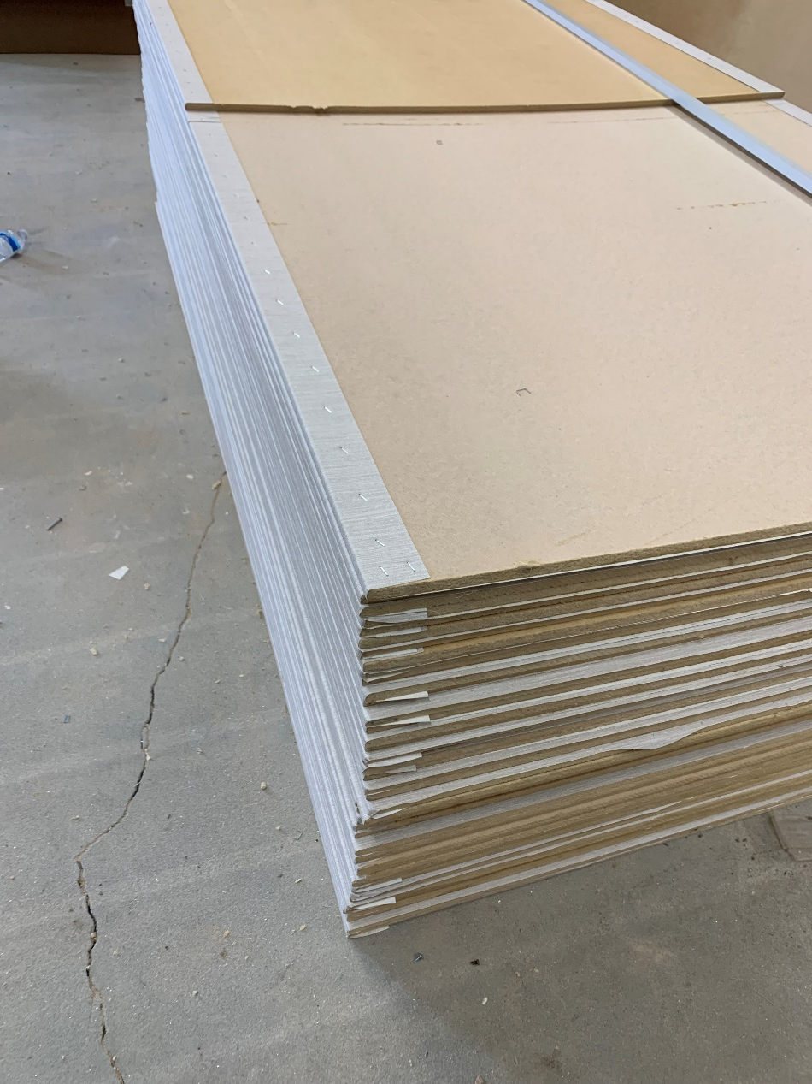
Grandview College Prep. Academy
Construction Site Work at Wings 50 and 60
Project Status
Tackable Wall Board
Construction
5

Slide 6
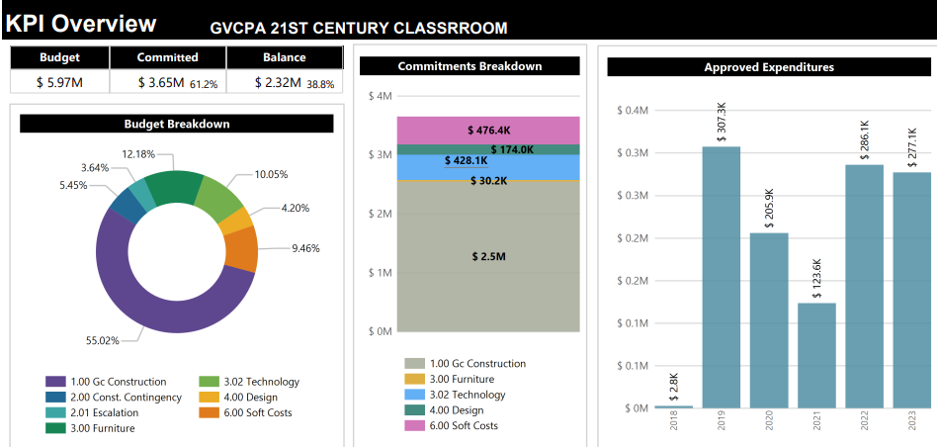
Grandview College Prep. Academy
Modernization Plan
Classrooms: 18
Music Room: 1
Kinder: 2
Project Status
Construction

Slide 7
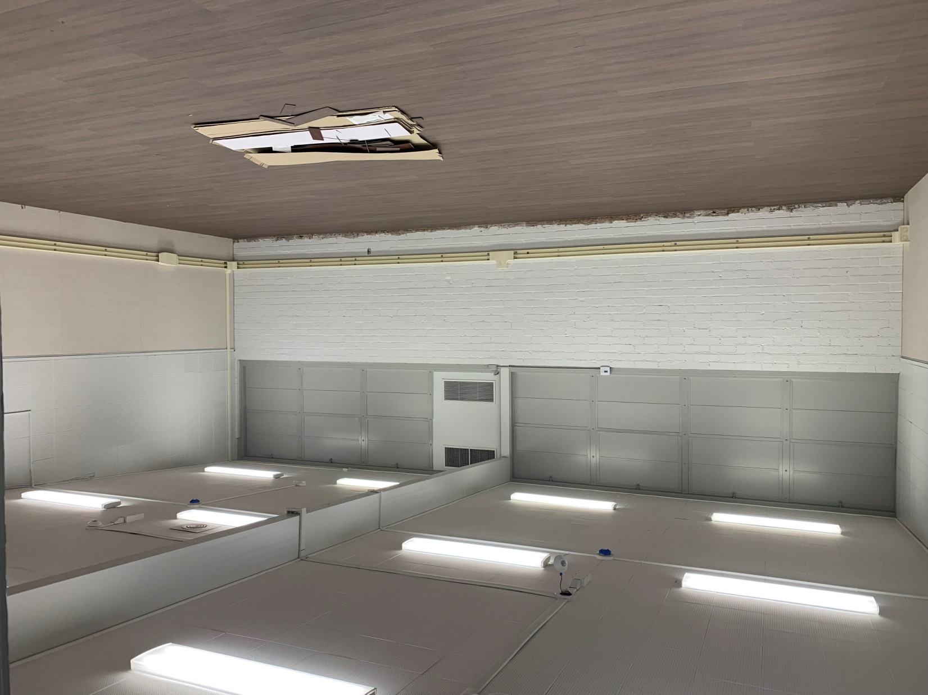
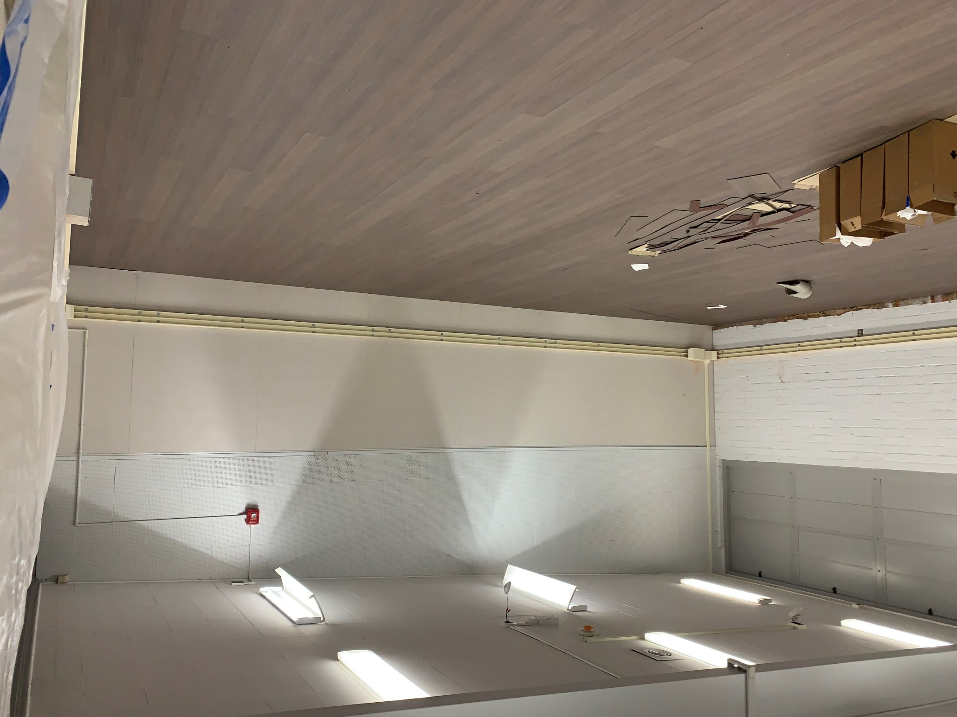
Sparks Middle School
Construction: Site Work Buildings E and D
Tackable Wall Board, Power, Data
Technology and Flooring
Project Status
Construction

Slide 8
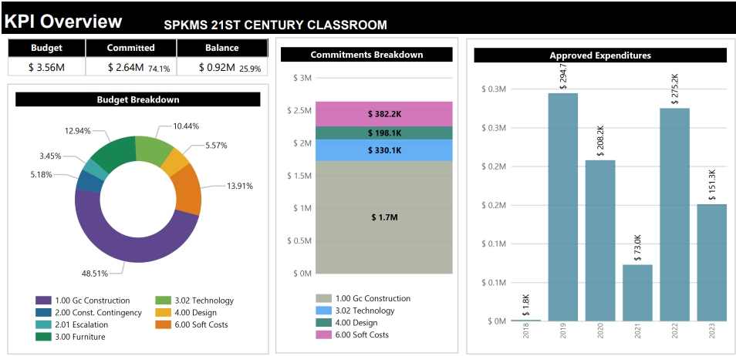
Sparks Middle School
Modernization Plan
Classrooms: 12
Music Room: 1
Project Status
Construction

Slide 9
Scheduled Completion
Grandview: August 2023
Sparks MS: May 2023
Newton MS: December 2023
Project Status
Construction

Slide 10

Questions + answers

