Slide 1
OUR CHILDREN AND
THEIR SCHOOLS
How will potential 2015-17 SSF Levels Impact the Futures of Oregon Students?
Shorter school years and higher class sizes? Or full-day kindergarten that is truly funded? Or an investment and improvement trajectory?

Slide 2
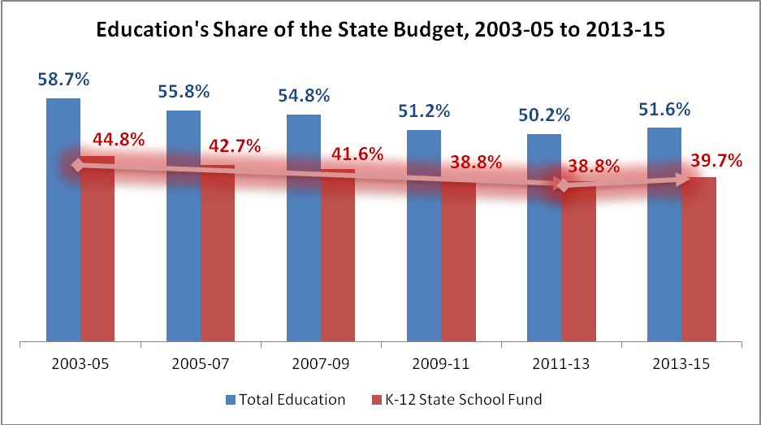
Education’s share of the state budget has declined by about 5 percent since 2003-05
Data Source: Oregon Legislative Revenue Office, 2014

Slide 3
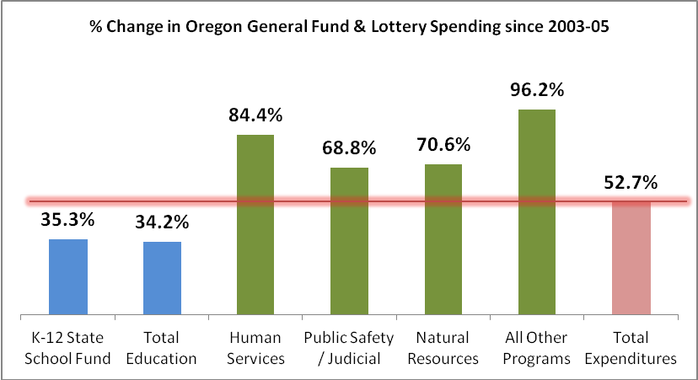
Oregon’s state budget has prioritized services other than education since 2003-05
Data Source: Oregon Legislative Revenue Office, 2014

Slide 4
A dozen+ years of disinvestment have created
Oregon’s ‘Education Fundamentals’ Gap
Instructional Time Gap
  One year less than the national average, grades 1-12
Large Class Sizes
  49th in student-teacher ratio
    (Nearly 6 more students per teacher that the U.S. average)
Lack of Funding to provide Basic Programs and Supports
  Oregon spends about 88% of the national average per pupil on K-12
  Oregon is 46th in state expenditures on K-12 as a percent of state taxable resources
Low ranking in graduation rates, closing achievement gaps
Data Sources: Education Commission of the States, 2013; National Education Association, 2013;
National Center on Education Statistics, 2012; Quality Counts, 2014

Slide 5
Oregon’s ‘Smarter Balanced Time Gap’
Total Required Minimum Instructional Hours by ‘Smarter Balanced’ State, Grades 1-11
Data Source: Education Commission of the States, “Number of Instructional Days/Hours in the School Year,” 2013

Slide 6
How did we determine what potential 2015-17 school funding levels will mean for our schools?
Our goal was to provide you with accurate information so we:
Met regionally with superintendents throughout the fall
Worked with OASBO to survey superintendents and business managers, and to provide worksheet so that all districts were calculating information consistently
Collectively determined the SSF levels at which:
  Most districts could maintain current programs and class sizes while adding full-day kindergarten.
  A meaningful investment could be made in improving outcomes for students, especially those most at risk.
Arrived at three levels: $7.235, $7.5 and $7.875 billion

Slide 7
What would a 2015-17 State School Fund of
$7.235 BILLION
mean for Oregon students and their schools?

Slide 8
A $7.235 billion State School Fund will mean:
Significantly reduced funding per student (-$77 per student)
Oregon is no longer in a recession, but schools would continue to be, with many districts and students experiencing:
  Teacher and staff layoffs
  Fewer school days
  Higher class sizes
  Reduced programs and services
Full-day kindergarten is not truly funded. Instead, districts would be forced to choose between full-day K or maintaining programs and class sizes for students in grades 1-12. This is $300 million short of what schools need to add full-day kindergarten and maintain current class sizes and programs.

Slide 9
Per student funding, 2014-15 vs. 2015-16 based on the Co-Chairs’ $7.235 billion SSF
Portland
-$132 per ADMw
Woodburn
-$117 per ADMw
Lincoln County
-$89 per ADMw
Lebanon
-$89 per ADMw
North Clackamas
-$87 per ADMw
North Wasco (The Dalles)
-$85 per ADMw
Gresham-Barlow
-$78 per ADMw
Salem-Keizer
-$70 per ADMw
Hood River
-$66 per ADMw
David Douglas
-$63 per ADMw
Parkrose
-$61 per ADMw
ST. HELENS
-$77 per ADMw
Data Source: ODE State School Funding Estimates, December 5, 2014 (2014-15) and February 24, 2015 (2015-16)

Slide 10
What would a 2015-17 State School Fund of
$7.5 BILLION
mean for Oregon students and their schools?

Slide 11
A $7.5 billion State School Fund will mean:
Most districts will be able to maintain current programs and class sizes, while adding full-day kindergarten.
An important first step in improvement – funding the implementation of full-day kindergarten.
*It is not the investment level required to make significant progress toward the national average in instructional time or class size.

Slide 12
What would a 2015-17 State School Fund of
$7.875 BILLION
mean for Oregon students and their schools?

Slide 13
A $7.875 billion State School Fund will mean:
Most districts will be able to reduce class size, increase instructional time and/or provide needed programs and services for students most at risk.
Over time, these investments will result in:
  Greater third-grade literacy
  Higher graduation rates
  Reduced achievement gaps
  Increased college-and-career readiness
Notes:
.

Slide 14
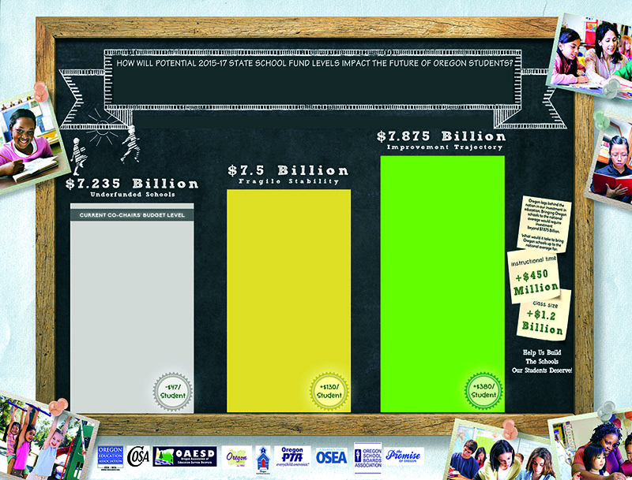
For more information: State and Local Posters
http://www.cosa.k12.or.us/content/ssf-levels

