Slide 1
How to Place a Book Hold
Use the Destiny Library Catalog
to Reserve Books!

Slide 2
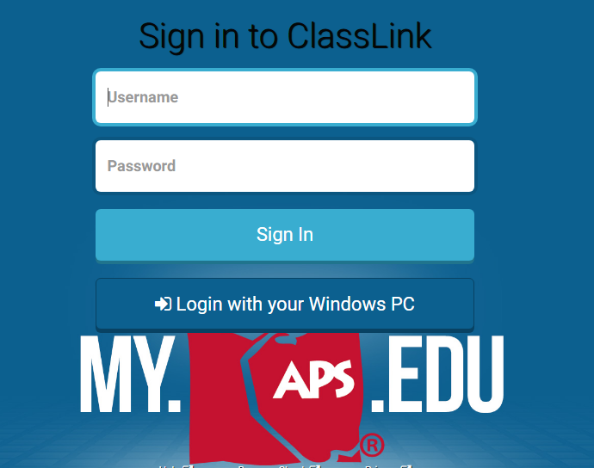
Log-in to ClassLink (my.aps.edu)
Go online to ClassLink (my.aps.edu) and login using your APS username and password.

Slide 3
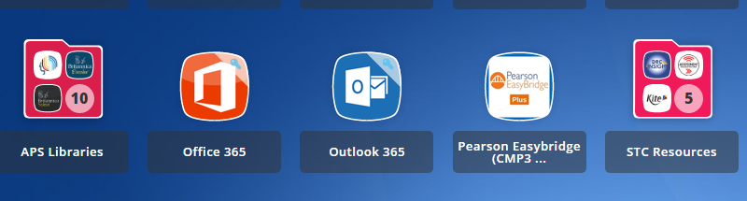
Choose APS Libraries
Click on APS Libraries

Slide 4
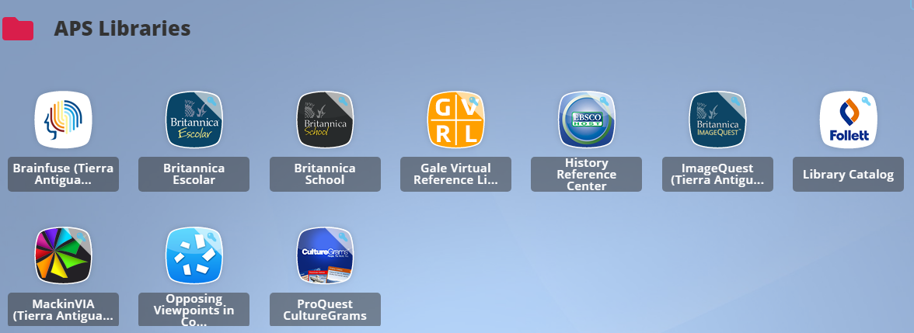
Click on Follett Library Catalog
There are several database choices in APS Libraries. For now, click on Library Catalog.

Slide 5
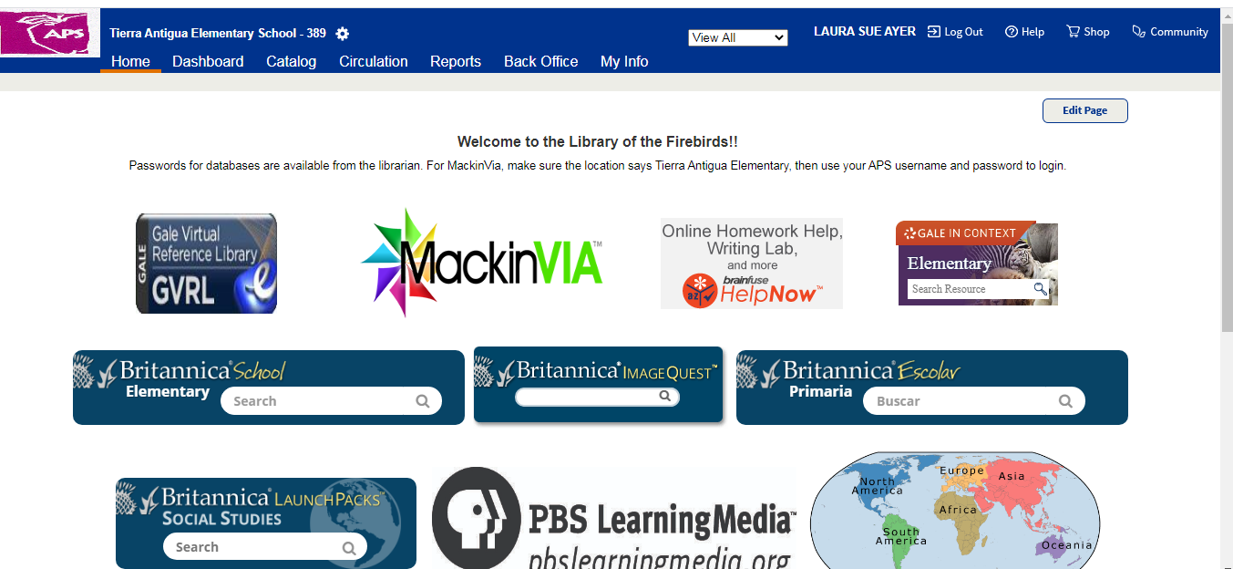
Destiny Catalog Home Page
This is the Destiny Catalog Home Page. Click on “Catalog” in the banner at the top of the page.

Slide 6
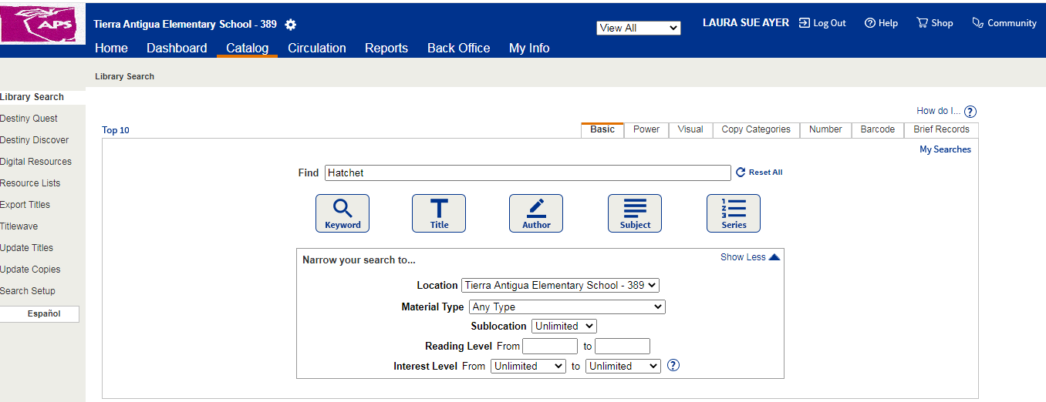
Search for keyword, title, author, subject or series on this page.
I typed in the book title Hatchet, then clicked on the “Title” box.

Slide 7
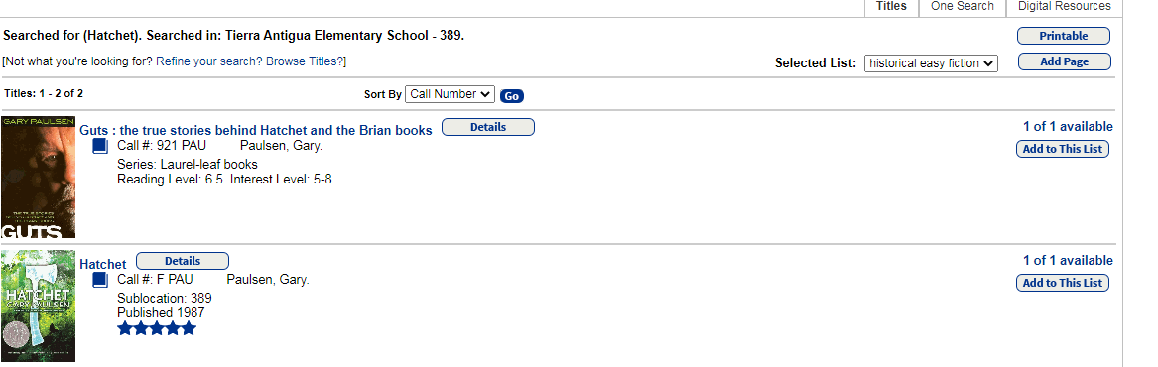
Now click on the title of the book.
Click on the title of the book, which will take you to a detail page about the book.

Slide 8
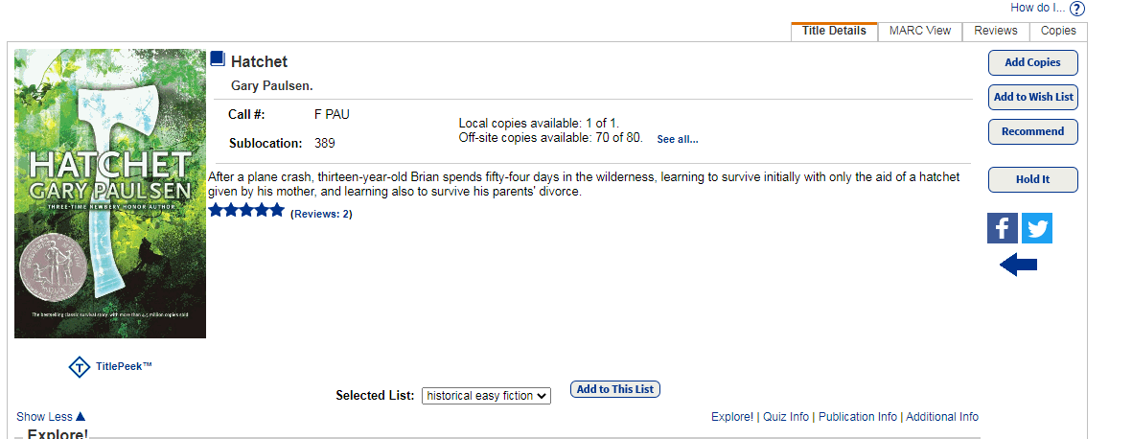
Click on “Hold It”.
On the right side of the page, click on “Hold It”.

Slide 9
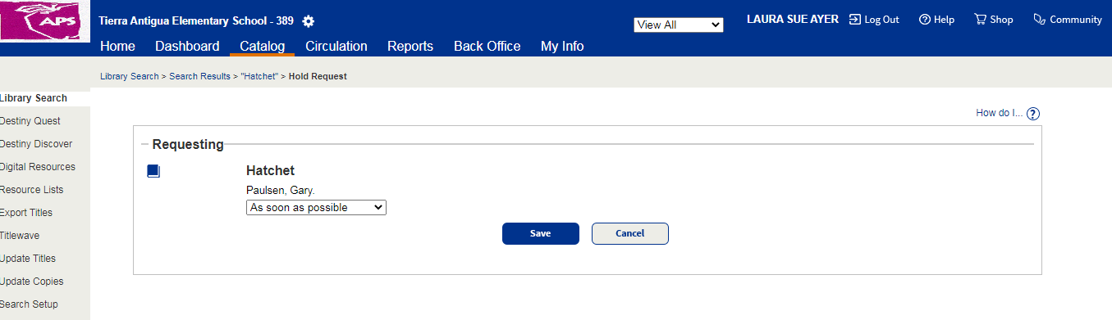
Now click “Save”.

Slide 10
Check Hold Status
To check if the books you placed on hold are ready for pickup, click on My Info in the blue banner at the top of the page. Click on “Holds” to see if your books are “Ready” or “Pending”. Book holds that are “Ready” can be picked up, book holds that are “Pending” are not available yet.

Slide 11
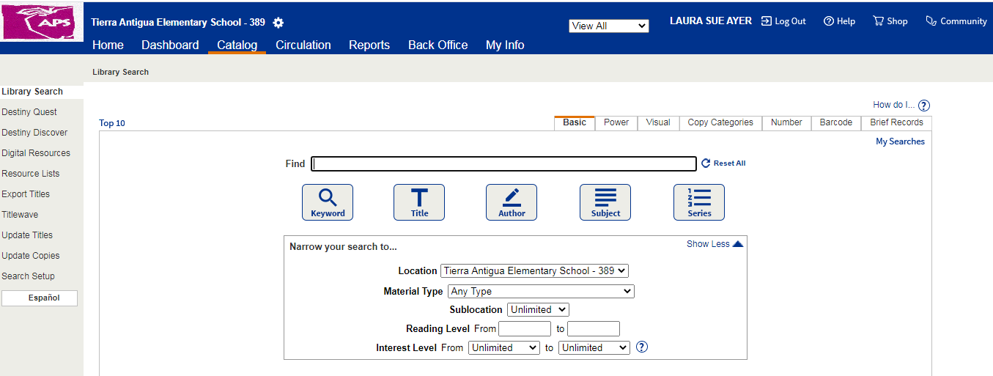
Visual Catalog Search
If you prefer, you can search for books using pictures, by clicking on the “Visual” tab on the Catalog search page.

Slide 12
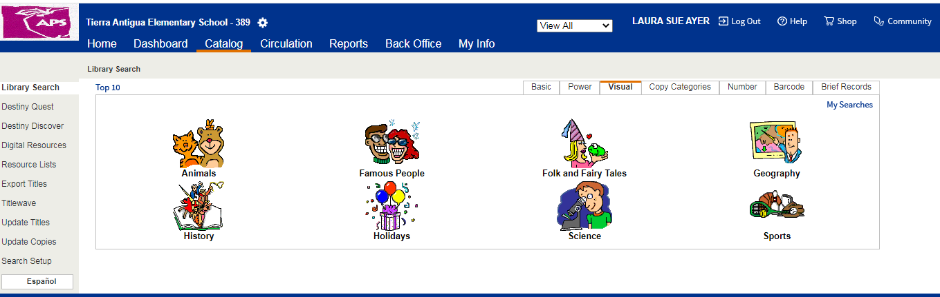
Click on the pictures until you find the book category you want. Follow the previous instructions to place a book hold.

Slide 13
Other Ways to the Library Catalog
Here are other ways to access the library catalog and Destiny Discover ebooks:
https://library.aps.edu/ Scroll down to Tierra Antigua ES and click on our school name. Click on “”Log-in” in the upper right corner of the catalog home page. Use your APS username and password to log-in.
https://tierraantigua.aps.edu/ Go to our school website. Scroll down just a bit and click on “Library”. Now click on the button that says “Library Catalog”. Click on “Log-in” in the upper right corner of the page and login using your APS username and password.

