Slide 1
How to Access Destiny Discover eBooks
Read Books on Your Device!

Slide 2
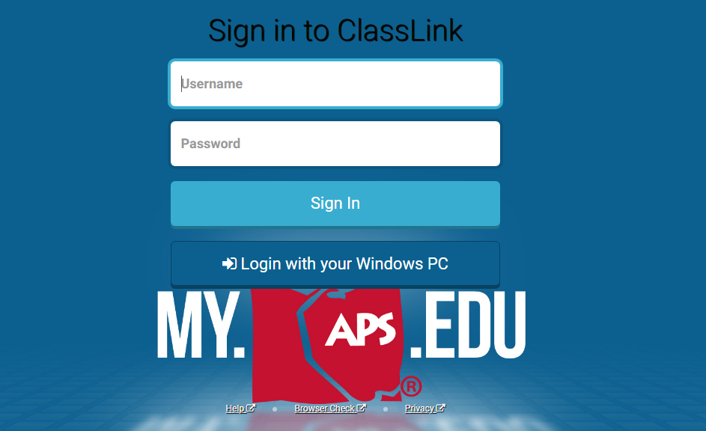
Log-in to ClassLink (my.aps.edu)
Go online to ClassLink (my.aps.edu)and log-in using your APS username and password. If you have an iPad, just click on the app icon.

Slide 3
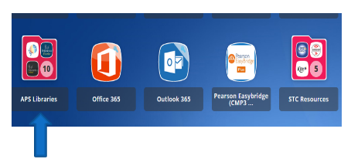
Choose APS Libraries
Click on “APS Libraries”

Slide 4
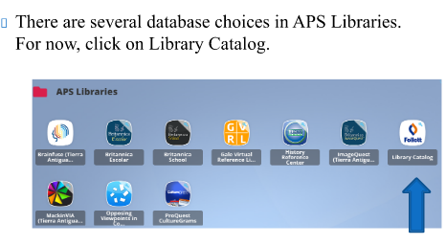
Click on Follett Library Catalog

Slide 5
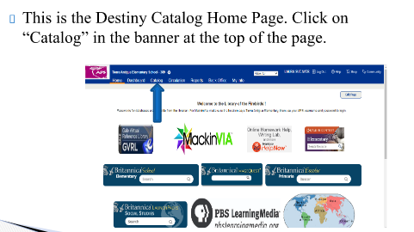
Destiny Catalog Home Page

Slide 6
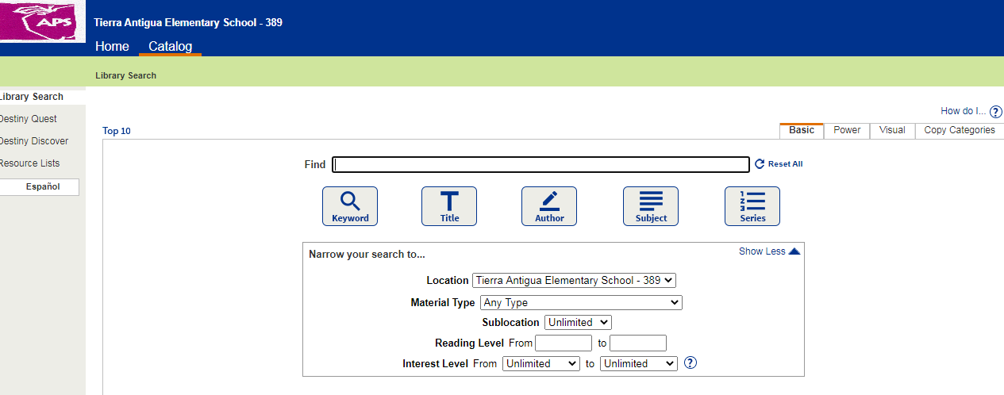
Click on “Destiny Discover”
On the left side of the screen, click on Destiny Discover.

Slide 7
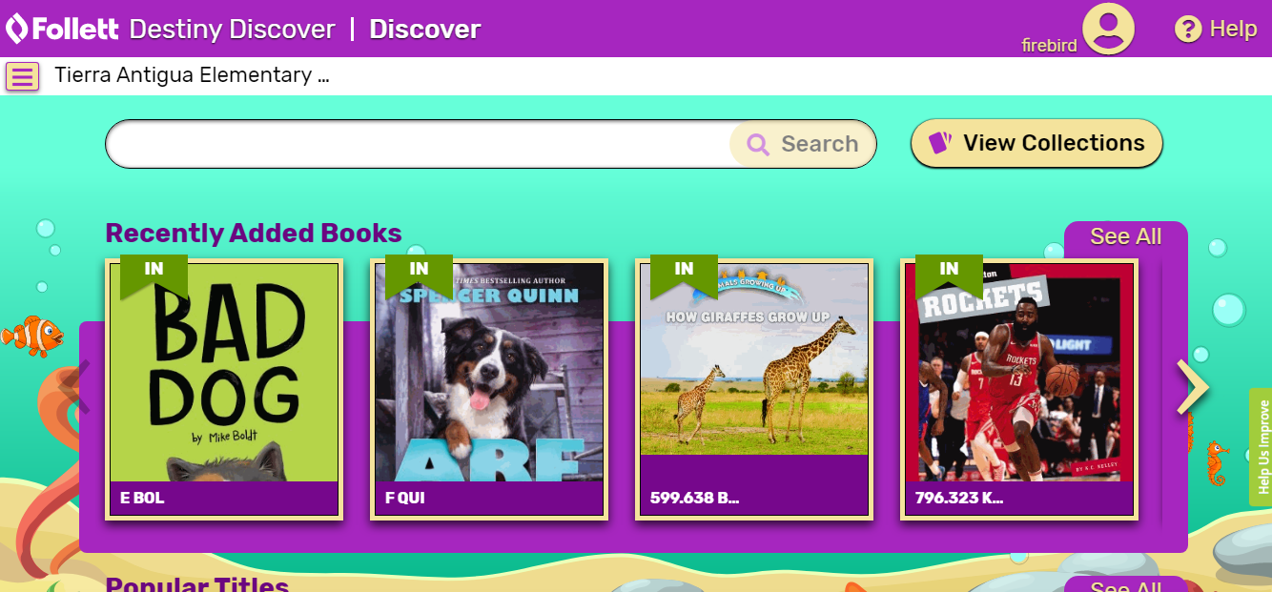
This is Destiny Discover.
This is where you can check out or open ebooks or audiobooks, see what’s new in the library, or even place holds!

Slide 8
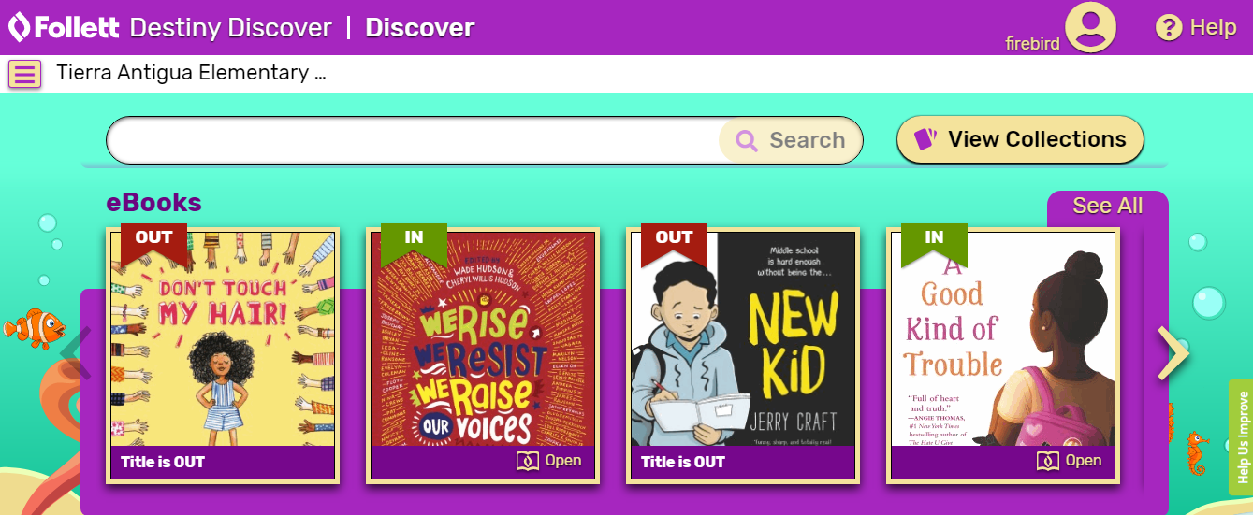
Scroll Down to eBooks
Scroll down to ebooks and click “See All”. This shows you the eBooks in our collection.

Slide 9
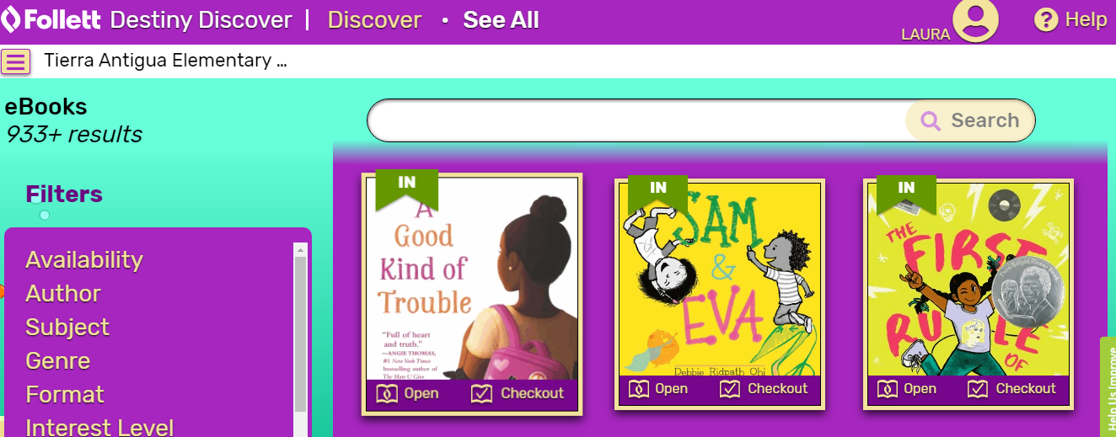
Scroll through the titles.
Scroll through the ebooks to find one you want to read. Click on “Open” or “Checkout”. For some ebooks you may be redirected to another login page. Use your APS username and password. For more information about your library account, click the “person” in the upper right corner of the screen. Click on “Checkouts” to see what books you have out, or to open and read previously checked-out ebooks.

Slide 10
Returning ebooks
If you checked out the ebook, it will automatically be returned on the due date – no action needed!

Slide 11
Other Ways to the Library Catalog
Here are other ways to access the library catalog and Destiny Discover ebooks:
https://library.aps.edu/ Scroll down to Tierra Antigua ES and click on our school name. Click on “”Log-in” in the upper right corner of the catalog home page. Use your APS username and password to log-in.
https://tierraantigua.aps.edu/ Go to our school website. Scroll down just a bit and click on “Library”. Now click on the button that says “Library Catalog”. Click on “Log-in” in the upper right corner of the page and login using your APS username and password.

