Slide 1

Booster Club Organization Best Practices Workshop

Slide 2
Objectives for tonight:
Communicate Board Policy pertaining to Booster Organizations
Provide resources and ‘best practices’ for documenting Booster Club activities
Offer District resources to support and protect you and your organization

Slide 3
The Board-Booster Relationship
Boosters Clubs are independent of the District, but the School Board has a responsibility to protect the interests and reputation of district and its students.

Slide 4
Board Policies
Board Policy 1230 and Administrative Regulation 1230 address School-Connected Organizations and Community Relations
Excerpts:
  The board supports such activities (supporting educational program and/or extracurricular activities) and welcomes parental interest and participation.
  The Board recognizes that these organizations are independent of the school or district. In order to protect the district and students, the Superintendent or designee may establish appropriate controls for the relationship between such organization and the district.

Slide 5
Board Policies - continued
Board Policy 1230 and Administrative Regulation 1230 addressed School-Connected Organizations and Community Relations
Excerpts:
  Any program, fund-raiser or other activity sponsored by parent/guardian clubs shall be organized and conducted according to Board policy, administrative regulations and school rules. Announcements of events and related parent/guardian permission slips shall clearly indicate that the activity or event is sponsored by the parent/guardian organization, not by the school or district.
  School-connected organizations shall present the Superintendent or designee and annual financial statement showing all expenditures and all income from fund-raisers. School-connected organizations grant the district the right to audit their financial records at any time, either by district personnel or by a CPA.

Slide 6
Internal Controls
They protect you, other volunteers, and your club!
Quote:
By following proper guidelines, not only are schools and their booster clubs protected, but volunteers also protect themselves from being accused of taking cash.
“Embezzlement of School Booster Club Funds No Joking Matter,”

Slide 7
Internal Controls
Good internal controls are not about trust.
There only has to be the accusation of impropriety to damage a person’s reputation or the effectiveness of your club.
Quote:
“Two years ago a PTO president contacted me after being accused of being accused of embezzling money,” said Sandra Englund of parentbooster.org. “She was originally accused of stealing $62,000. That amount has been reduced to $15,000…and although formal charges have never been filed, she’s had to go to hearings every 1-2 months to try to clear her name. All because her PTO did not have or use good financial reporting guidelines.”

Slide 8
Internal Controls
Document, document, document
Documenting activities is not just one person’s responsibility – it’s everyone’s responsibility
However, a great deal of this does fall on the Treasurer
Ideally the Treasurer should have 3 years of experience in the Organization (background check, Google the person)
Quote:
“Many booster organizations embrace anyone who volunteers their services and may often overlook the fact the treasurer has little or no professional background in finance. “Somebody is tagged, pushed into the role of treasurer and given the checkbook,” says Steve Beden, Executive Director of the North American Booster Club Association. “There’s no accounting, and there are no oversight committees. Clubs that operate like that end up getting in trouble.”

Slide 9
Fraud: It won’t happen to us!
Only terrible people commit fraud, right?
    No. Just read the papers and you will find out it can be:
      Those in a position of trust, authority, control
      Friends
      Long-time employees/volunteers
      First-time offenders
      People under some type of personal stress

Slide 10
When check stock is not safeguarded, even unsophisticated thieves know they can simple copy a blank check and create their own duplicate check stock.
Organized fraud groups seek out individuals with “access” to this type of information and make it profitable for them to collect it.
The original check stock physically remains and the fraud is perpetrated by simple transferring the information to check-printing software. It only takes a short time to after that to deplete any banking account.
Fraud – Check Images

Slide 11
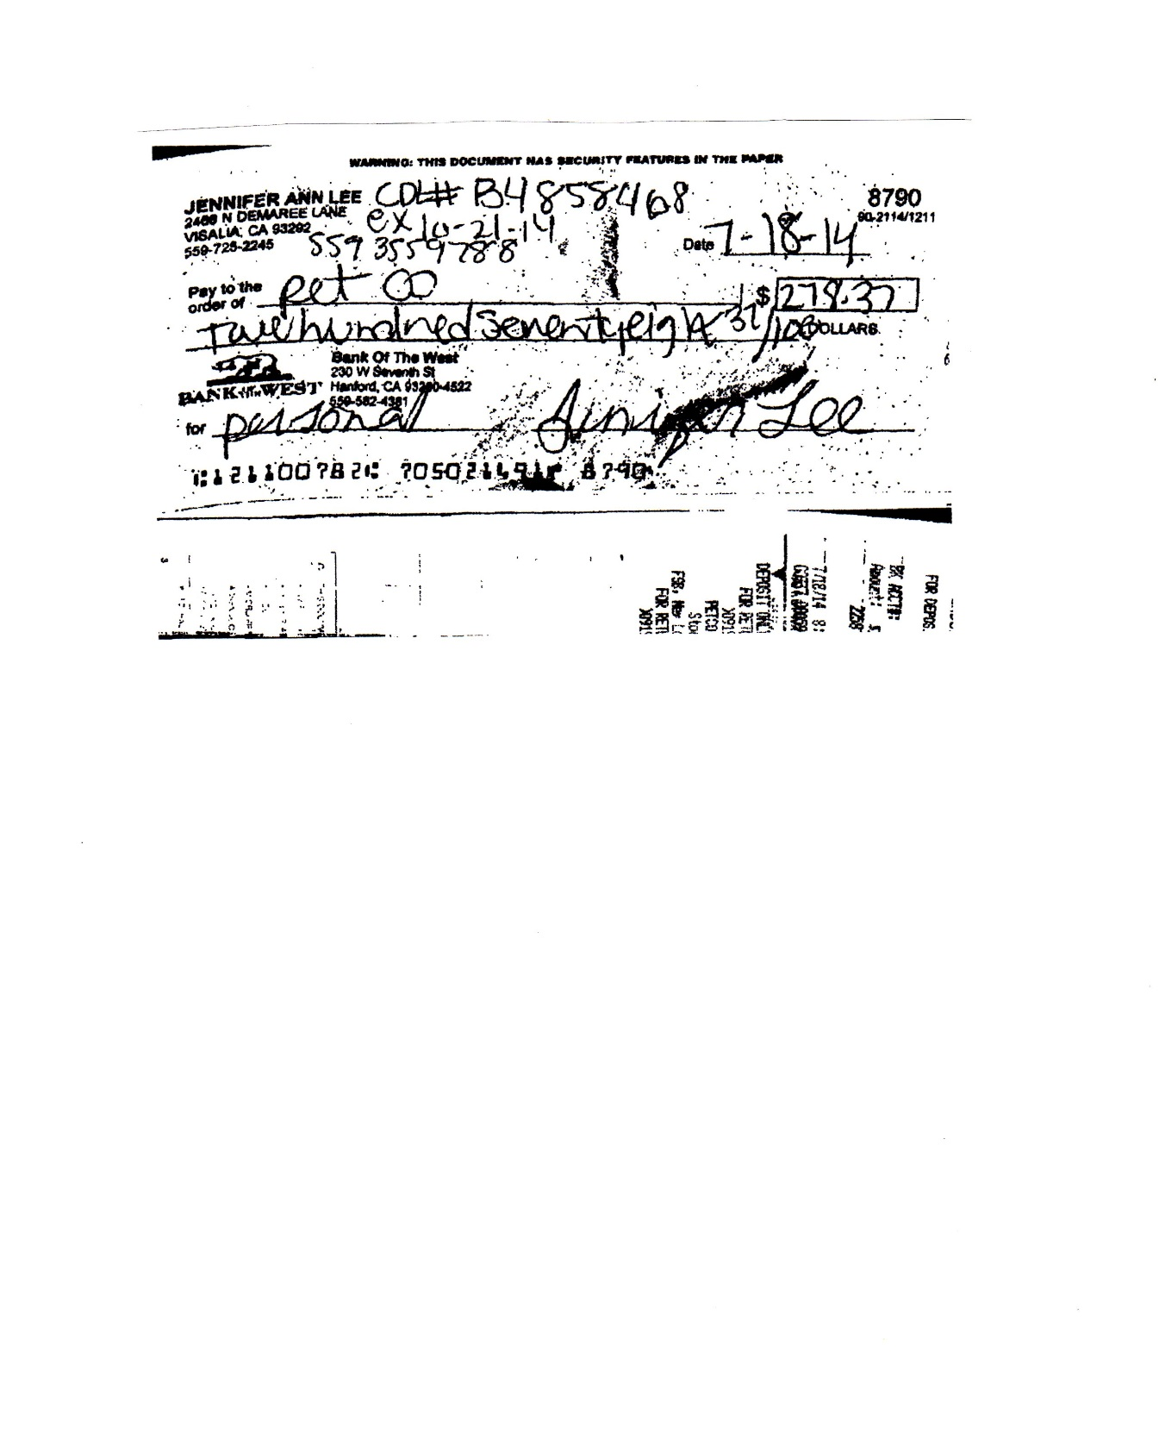
Fraud – Check Images

Slide 12
Internal Controls
Event Accounting
  Revenue Potential
  Final Reporting
  Cash Count Form
Financial Statements
  General Ledger
  Statement of Assets & Liabilities
  Statement of Revenue & Expenses (comparison to budget)
  Bank Statement & Reconciliation
Sound Policies and Procedures for approving and paying expenses, including meeting minutes and monthly financial reports

Slide 13
Internal Controls
It is best to have a division of responsibilities
  The person(s) who sign(s) the checks should not be the person who receives and reconciles the bank account statements
  Two people should sign all checks
Never pre-sign blank checks
Do not use a signature stamp in lieu of a original signature
Do not pay anyone in cash or write checks payable to “cash”
Check signers should review invoices and/or pre-approval of the expense (organization minutes authorizing expenditure) to ensure it is a valid club expense

Slide 14
Internal Controls
Ensure all deposits are made on a timely basis. Timely would be considered within 1-3 days of the fundraising activity.
Keep all deposits, checks, tickets, etc. in a lockable storage
Stamp checks immediately with bank endorsement
Use a federally insured bank or credit union

Slide 15
Internal Controls
Term Limits on key positions are recommended, e.g. two years
Multiple family members should not serve as club officers
All agreements ( i.e. vendors, donors, etc.) must be in writing and should be consistent
Never, ever, ever have a bank debit card.
  May 2014 - The Treasurer of the Hollister, Ca Band Boosters, is arrested and accused of utilizing an ATM card to deplete the booster bank account of all funds, leaving it $700 in the hole.
Utilizing a credit card is not recommended

Slide 16
Examples of Internal Controls
Carnivals - use tickets (do not allow cash at any booth)
Reconcile the number of tickets used to actual cash received (reasonableness check)
Check out ticket rolls, confirming first and last numbers.

Slide 17
Fundraising & Deposits
Five main control points:
  Always monitor and safeguard cash collections during events
  Always count money in the presence of a witness
  Always use a Cash Count Form and ensure it is signed by the individual responsible and the witness
  Whenever possible, have two people transport the deposit. If only one can do it, it should be one of the persons who counted the money. If the money is to be turned over to the Treasurer, the monies should be counted again at the time of the handover, with that person also signing the Cash Count Form
  When using “starting cash”, both the Treasurer and individual responsible should verify the cash, note the amount and sign the proper spot on the Cash Count Form

Slide 18
Fraud
Warning Signs
  Changing behavior, such as suddenly missing meetings or non providing information in a consistent, timely manner
  Perceived delays in getting answers
  Providing reports with no supporting documentation – for example, an financial report but no bank statement supporting the cash balance.
    Bank statement reconciliation fraud is as simple as recording a deposit, stealing the money, and showing the deposit as outstanding. There should be no delay in bank statement clearing – it should clear the same date as it is receipted by the bank.

Slide 19
Fraud - Real Life Scenario 1
Former treasurer of a band booster club arrested for suspicion of grand theft and embezzlement of $135k
2 year term as treasurer
Under severe financial pressure
New treasurer unable to obtain records
About 100 transactions that did not match monthly reports
$63k in checks and $73k in cash withdrawals

Slide 20
Real Life Scenario 2
Former treasurer of a high school booster club charged with multiple counts of theft of $60k
Longtime community volunteer who was named First Citizen in 2010
Served as treasurer from 1993-2010
Served on school district and fire district boards of directors
New officers could not schedule meeting to transfer access authority to club funds
Bank balance reported as $63k was actually $2,981.22

Slide 21
Transparency Helps All of Us
The District has a vested interest in protecting parent donations
Please submit the following paperwork to the Business Office by October 1st
  List of Officers with contact information
    Physical address, email address and phone number
  List of Official Check Signers
  Organizational By-Laws
  Proof of Insurance

Slide 22
Fundraising – Hot Topics
Fundraisers must be conducted according to the law
  Raffles have state registration and reporting requirements
  Even legal raffles have restrictions, mainly 90% of the proceeds must benefit the 501(c)
  Unless specifically exempted, a nonprofit organization must register with the Attorney General's Registry of Charitable Trusts prior to conducting a raffle and file an aggregate financial disclosure report for all raffles held during the reporting year. Forms for registering and reporting activities are provided on the Attorney General’s website: www.oag.ca.gov

Slide 23
Fundraising – Hot Topics
Laws for Non-Profits limit advertising profit to $999 per year
Anything above $999 is taxable income
Offset all income with production costs
Sell “Sponsorships” instead of “Ads”

Slide 24
Fundraising – Food Sales
Food Sales on School Grounds - Important that you understand the rules regarding food regulations
New Competitive Food regulations effectively prohibit the sale of foods until after the lunch period
  Applies to food and beverage sales by student organizations and booster clubs
  Competitive Foods are: foods sold in schools that are not part of the federal school meal programs. These include:
    Vending machines
    Snack bars
    Student stores
    A la carte lines
    Fundraising sales

Slide 25
Fundraising – Food Sales
Booster Club sales must meet all of the following:
Only one food or beverage item per sale
The food or beverage item must be pre-approved by the governing board of the school district
The sale must occur after the lunch period has ended.
The food or beverage item cannot be the same item sold in the food service program at that school during the same school day
Cannot be prepared on campus or in private homes
Must include Safe food handling practices in compliance with the Health & Safety Code
Meet nutrition requirements – state & new federal

Slide 26
Tax Returns & Reporting
As a Non-Profit, no taxes are due, but a return must be filed
Most DUSD groups would qualify to file the IRS Form 990-N (organization with less than $50K in revenues)
  IRS Federal Form 990 - due the 15th day of the 5th month following your fiscal year end (e.g. Nov. 15th if a June 30 year end)
California Franchise Tax Board Form 199 same due date as IRS Form 990
Form 1099 for all individuals paid in excess of $600 in a calendar years
  Distributed to individuals by January 31 and filed with IRS by February 28

Slide 27
Facility Use & Insurance
Contact Maintenance & Operations for a Facility Use Application
Certificate of Liability Insurance to be provided to the District Office annually

Slide 28
Questions?

Slide 29
Thank you for supporting our students!

