Slide 1

Redlands Unified Middle School
AVID
Decades of College Dreams
Notes:
1

Slide 2


Slide 3
Advancement
Via
Individual
Determination
Notes:
3

Slide 4
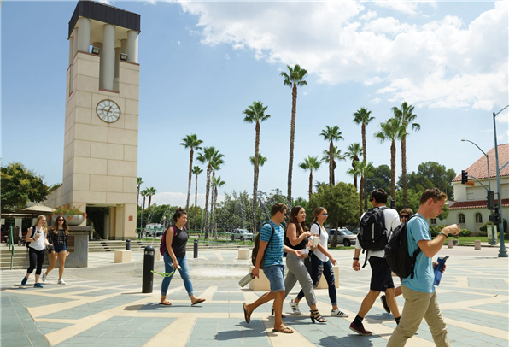
AVID is a program designed to prepare students for admission to four-year colleges and universities.
94% of AVID students report enrolling in college.
Notes:
4

Slide 5


Slide 6


Slide 7
Middle School AVID Requirements
We are looking for students who...
Want to go to college.
Want to be in a program that provides college preparatory skills and opportunities.
Are willing to commit themselves to completing daily homework and maintaining a 2.0 GPA or higher.
Have regular attendance and good work habits.
Have appropriate classroom behavior.
Notes:
7

Slide 8
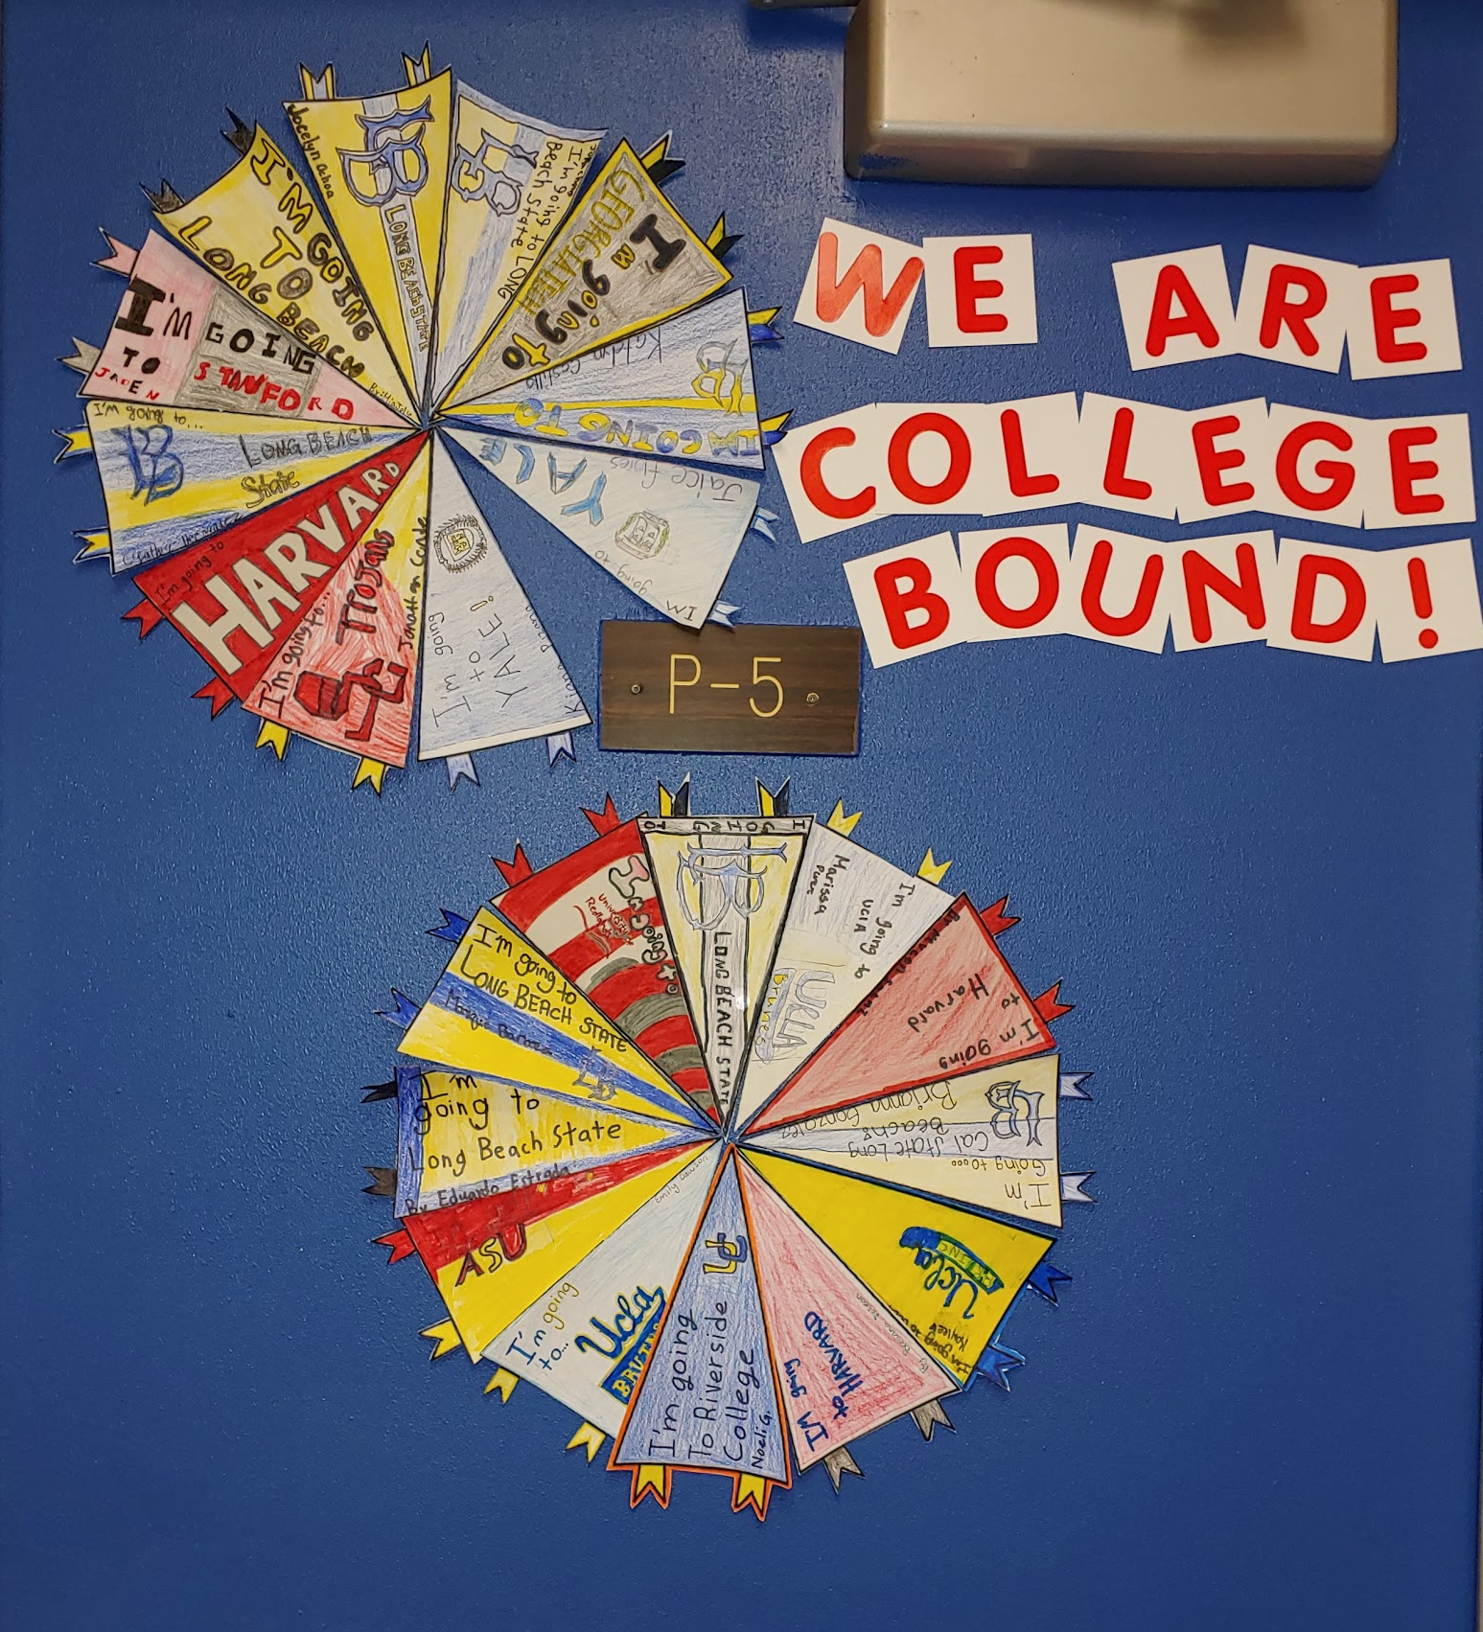
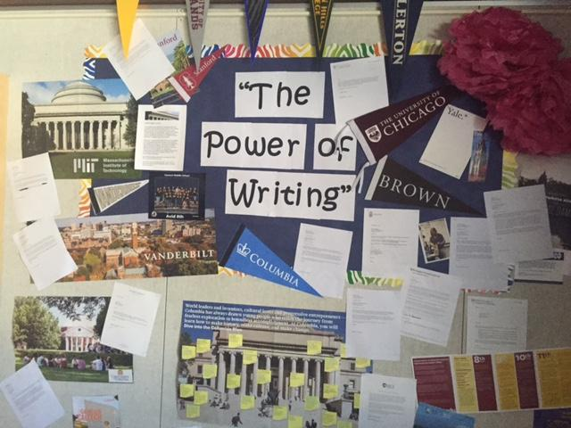
Some things we do in AVID are
Complete individual and/or group projects relating to colleges and careers.

Slide 9
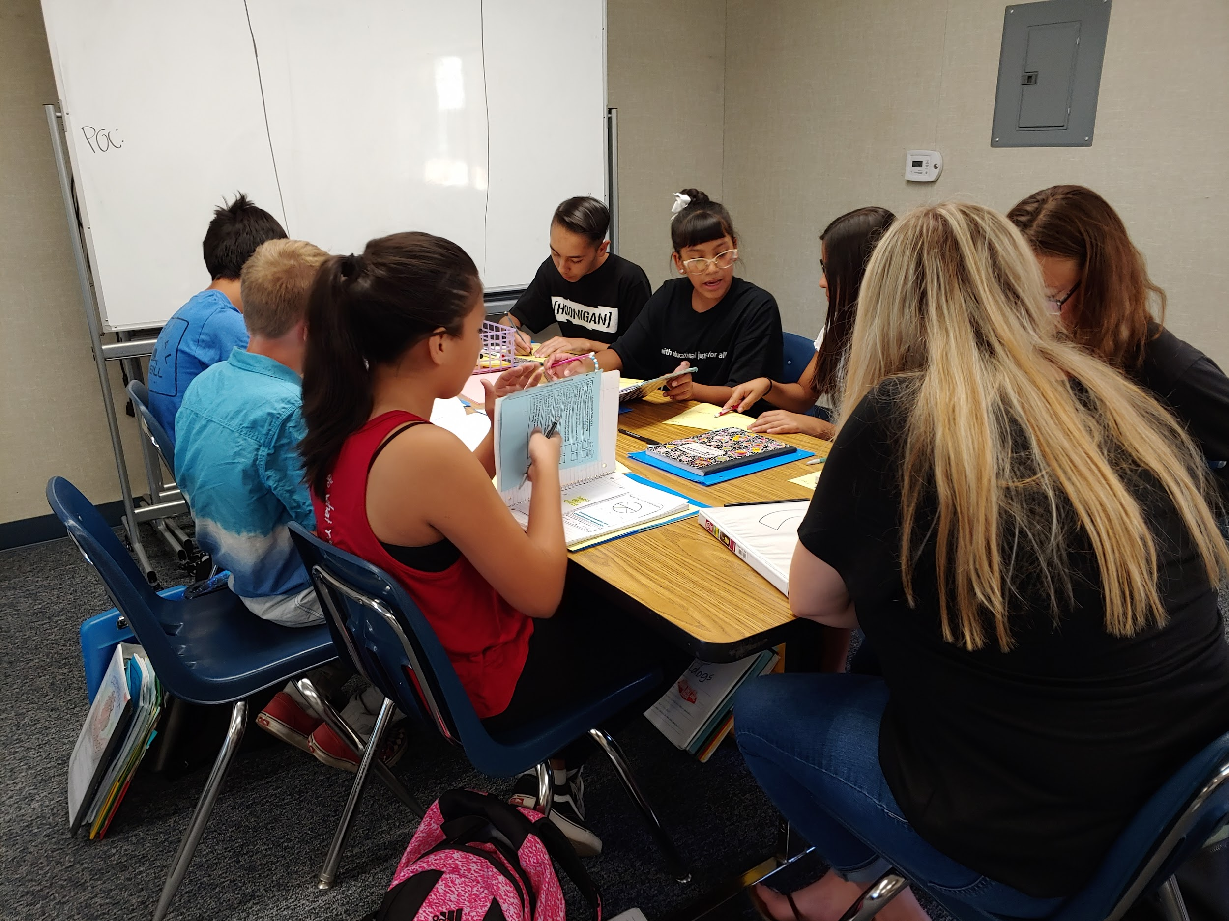
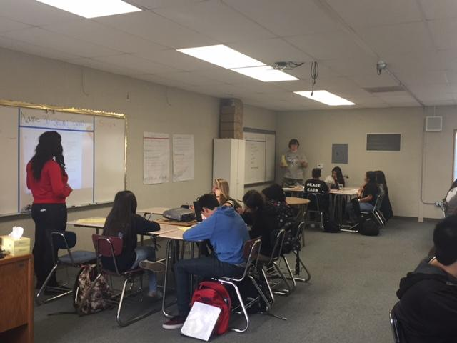
Some things we do in AVID are
Participate in group tutorials with college tutors twice each week.

Slide 10
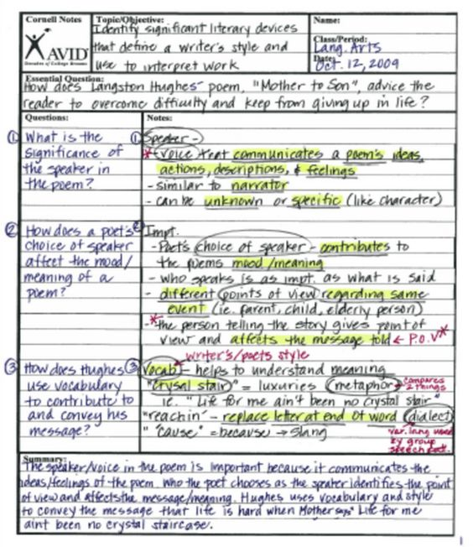
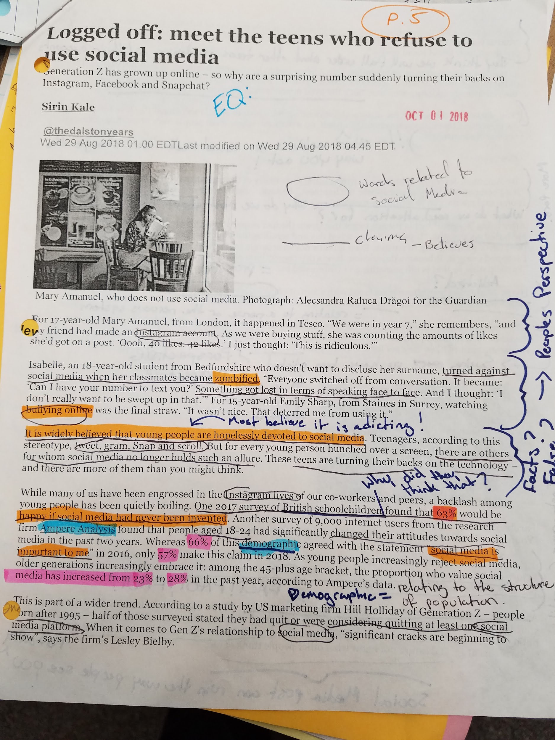
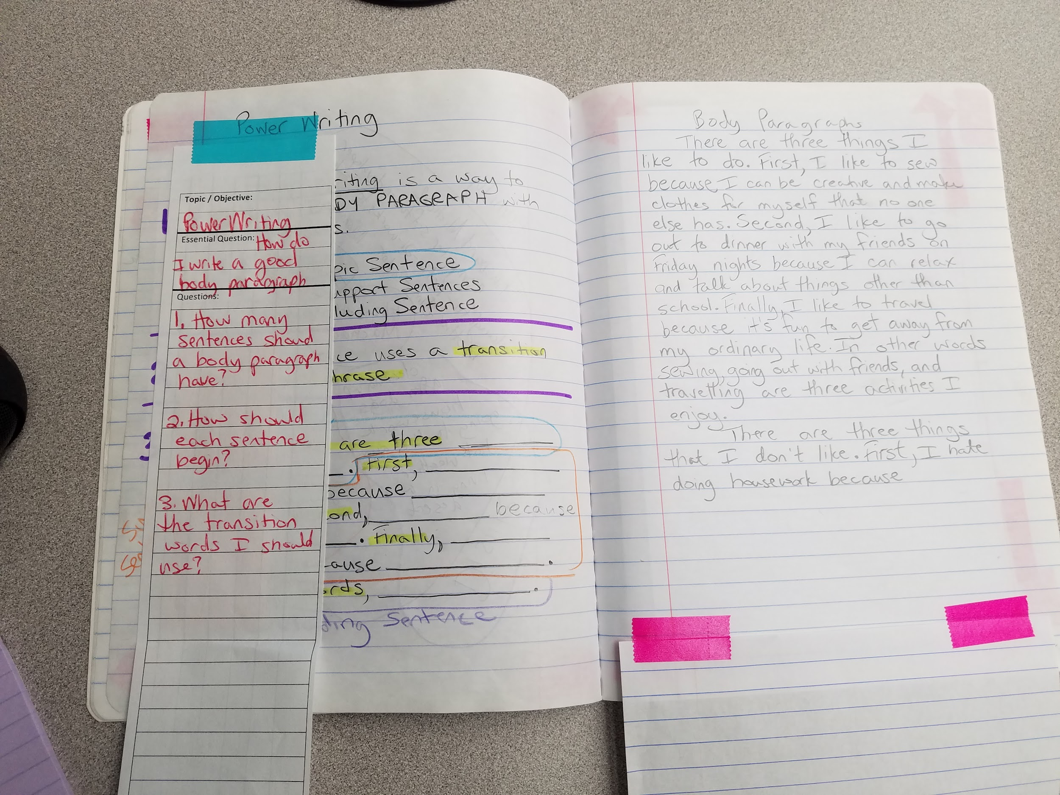
Some things we do in AVID are
Learn and practice note-taking skills.

Slide 11


Some things we do in AVID are
Keep calm
and
love my AVID binder!
Organize binders and backpacks regularly.
Notes:
11

Slide 12
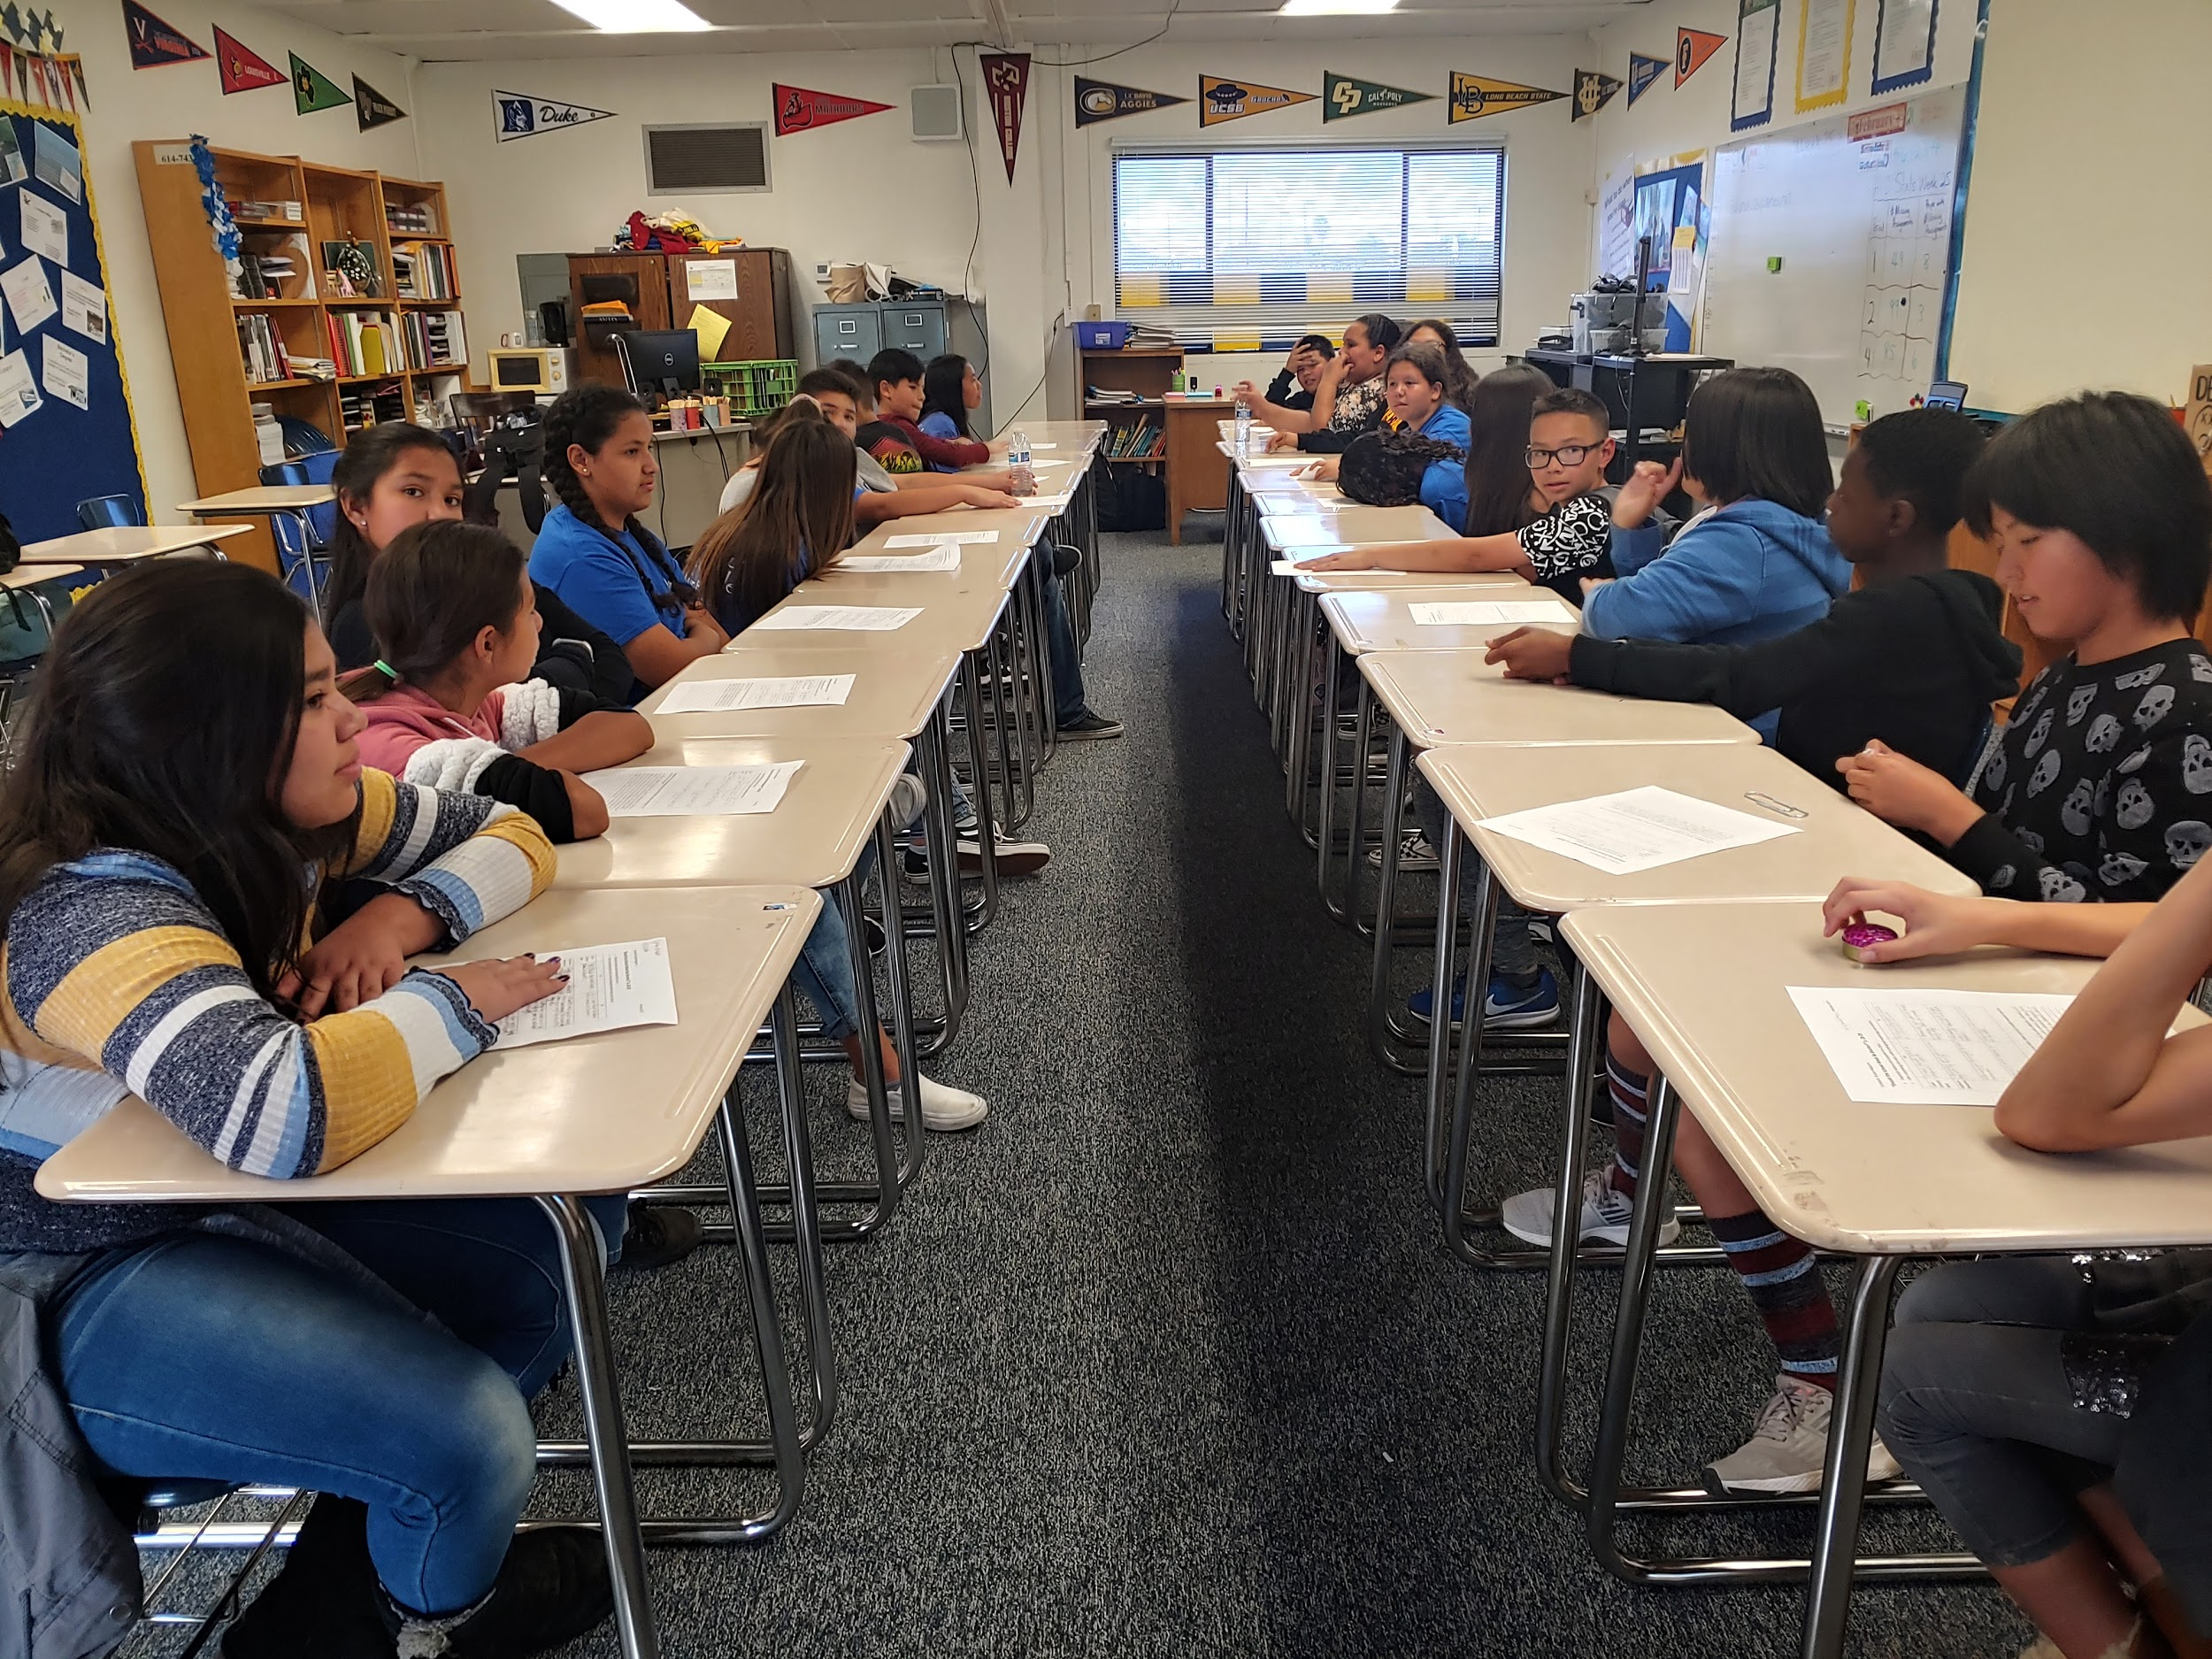
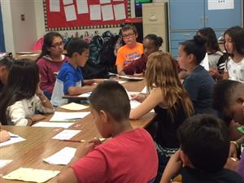
Some things we do in AVID are
Discuss and debate informational articles.

Slide 13
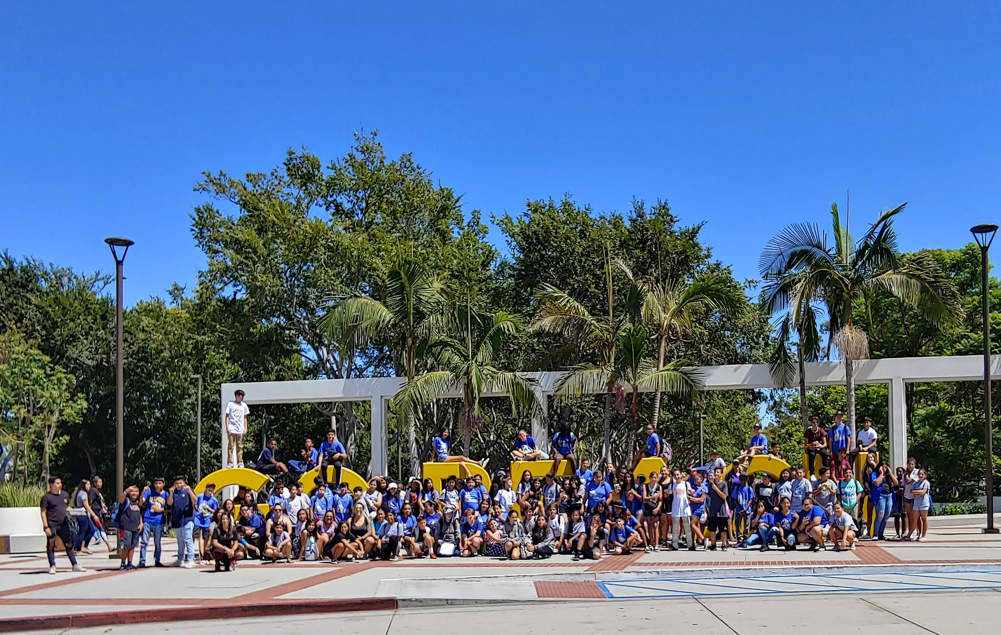
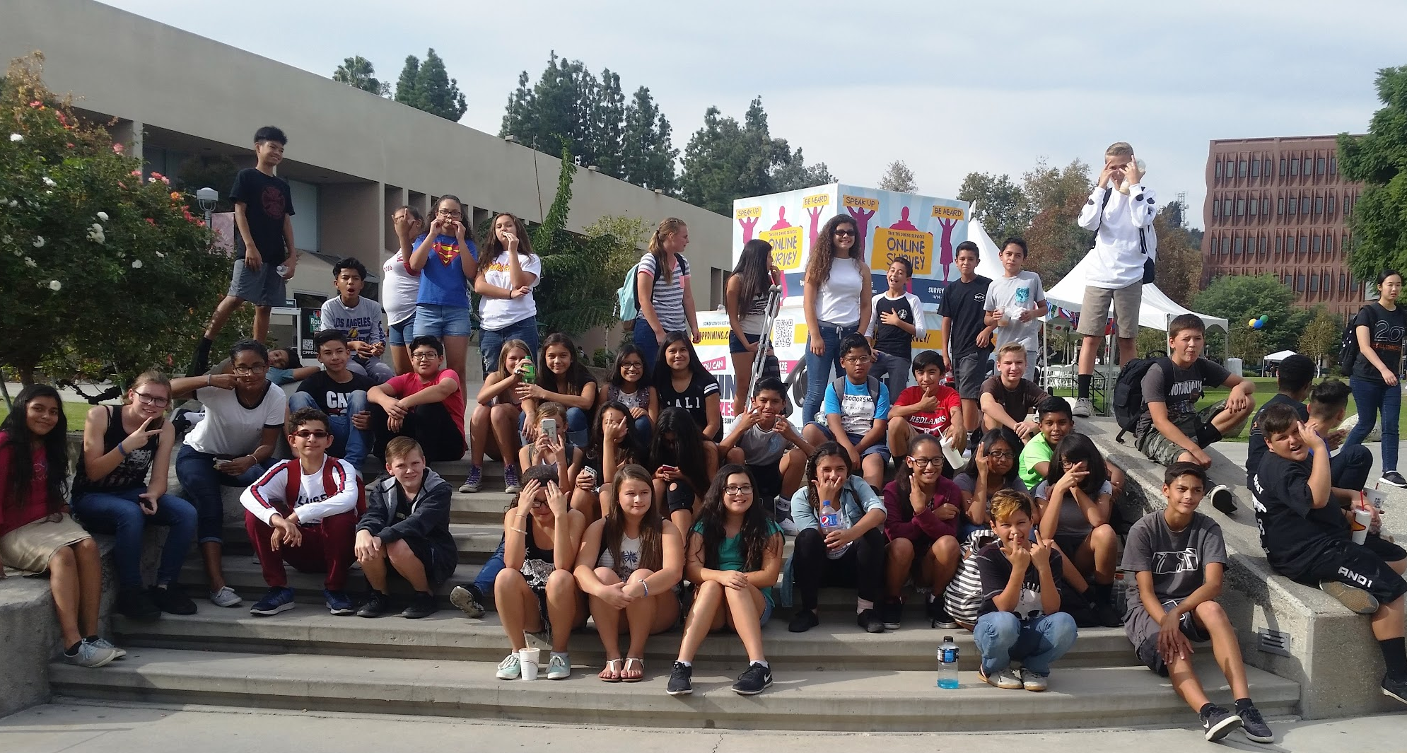
Some things we do in AVID are
Visit Colleges and Universities
Cal State Long Beach
Crafton Hills College
Cal Poly Pomona
Cal State San Bernardino

Slide 14
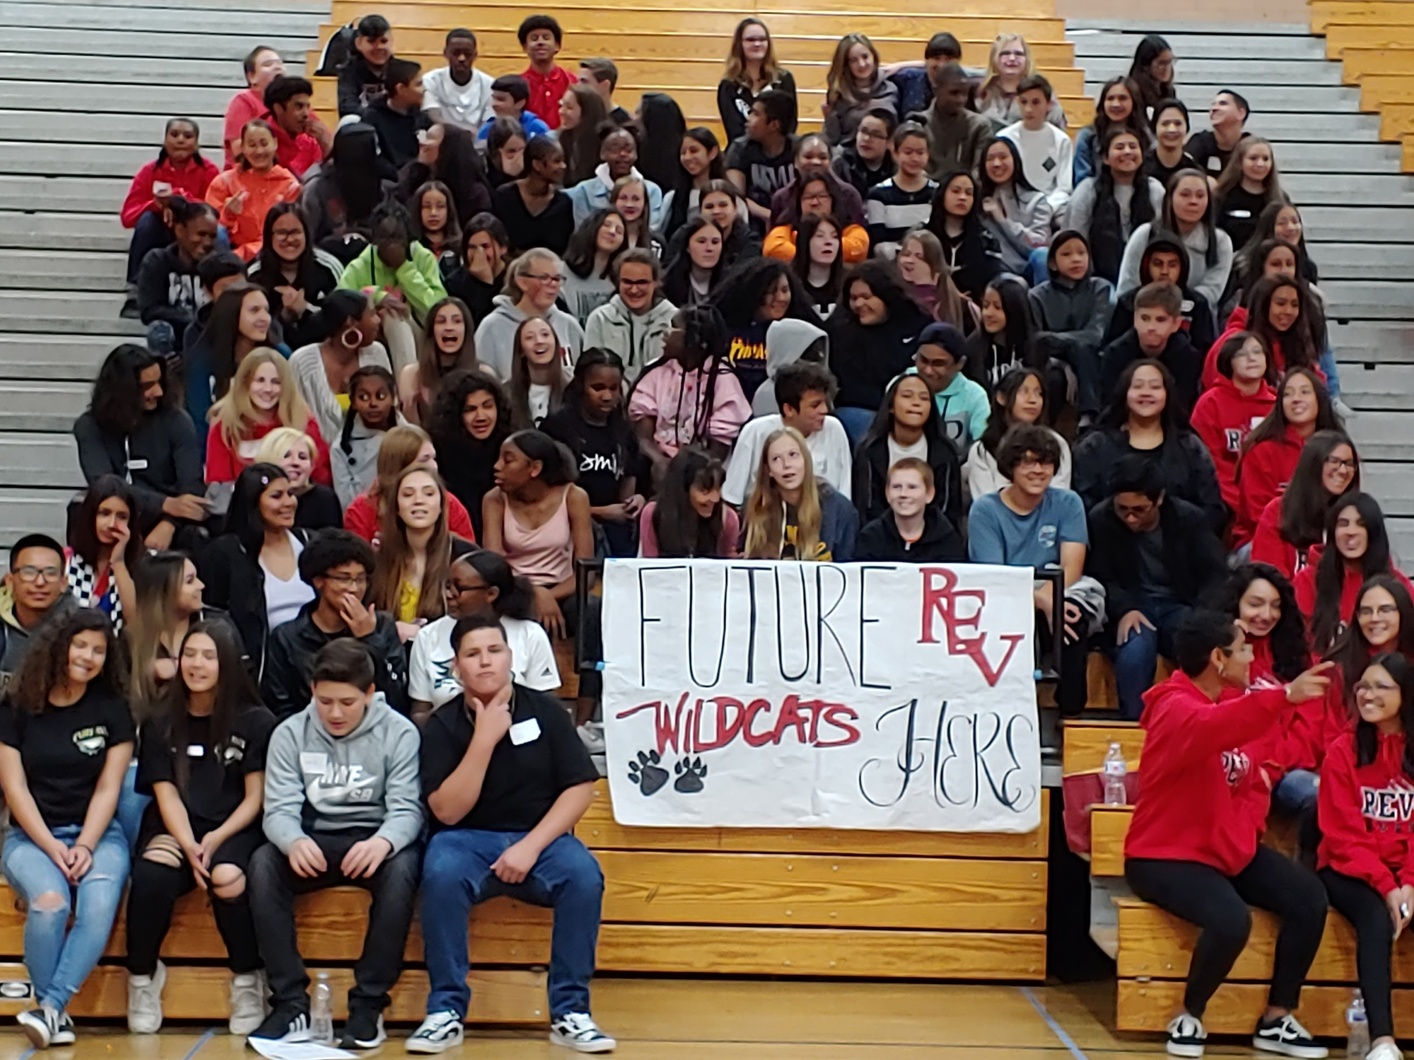
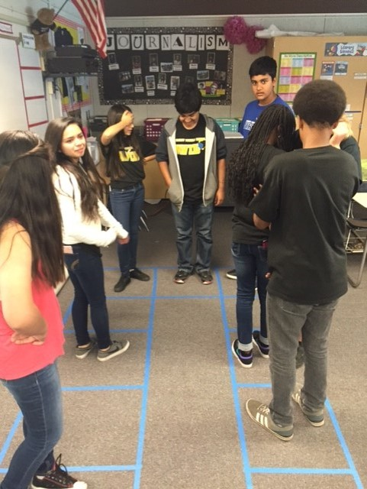
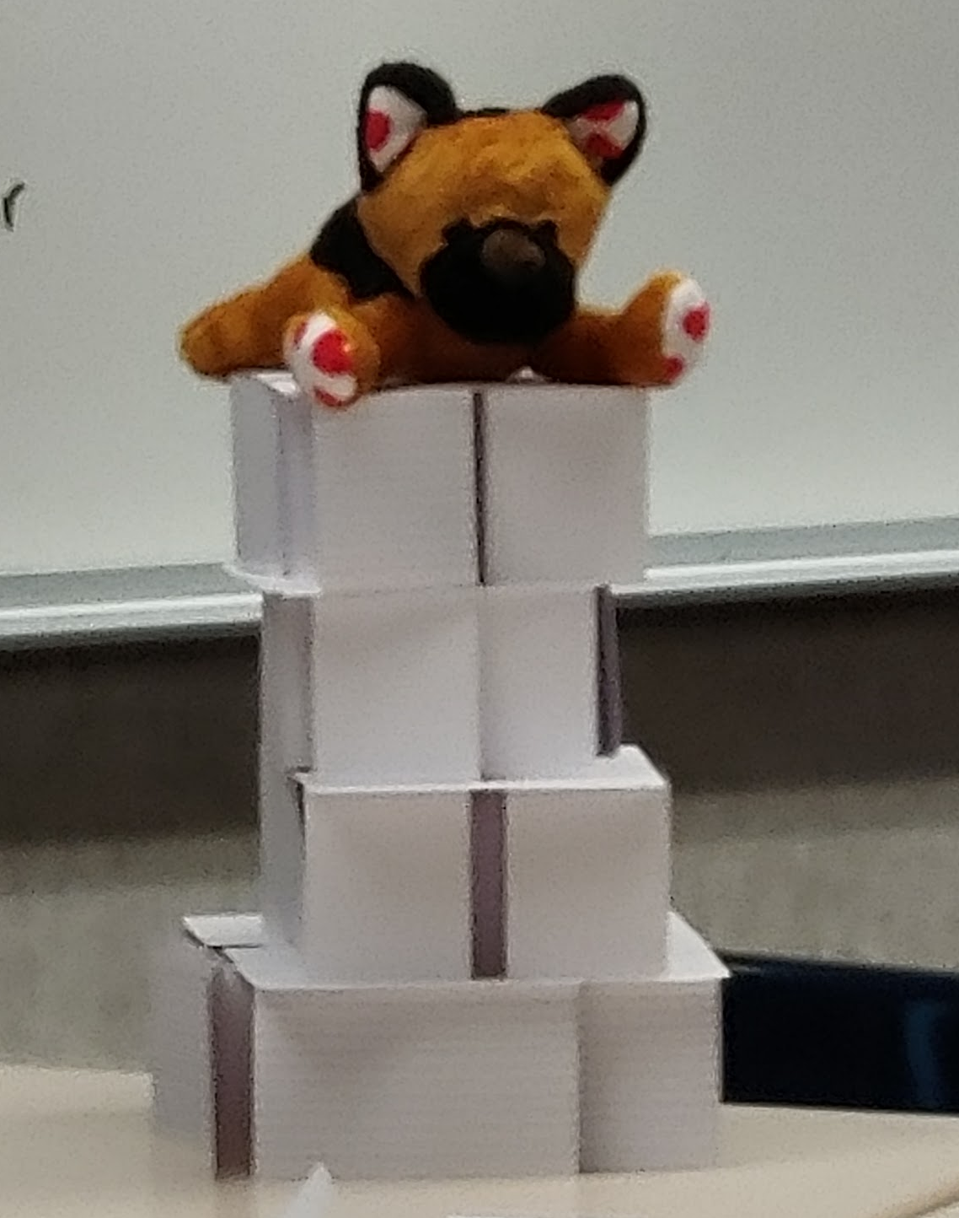
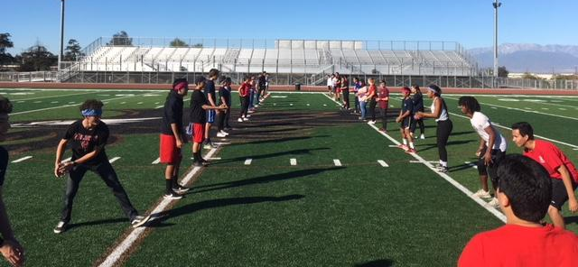
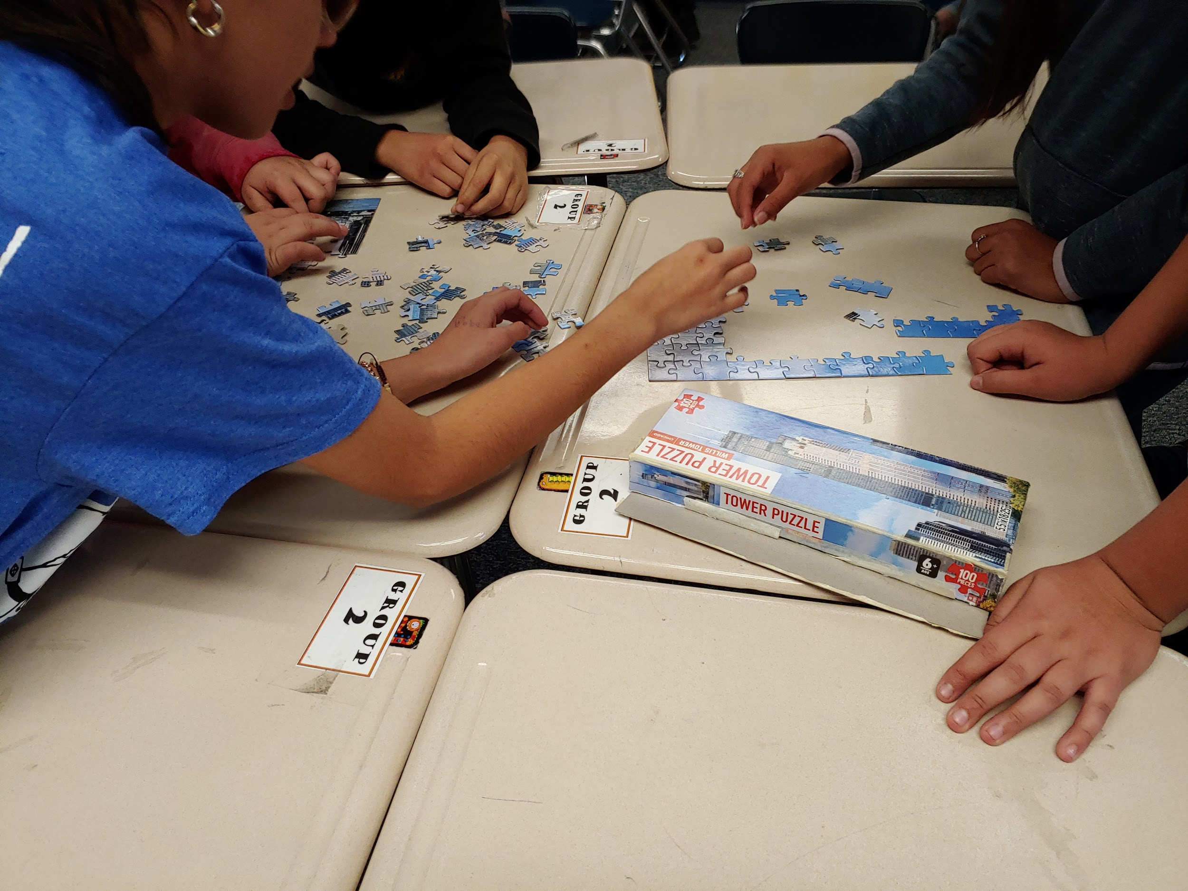
In AVID we also like to
Have a little fun along the way!

Slide 15
AVID Application Process
Email Elizabeth_Machado@Redlands.k12.ca.us for an application - due by May 26, 2022.
Come to an interview
  Incoming 6th graders
    Clement Middle School
    May 26, 4-6 pm – Room P-5
  Current 6th & 7th graders
    Scheduled during the school day week of May 30 – June 3
Notification will be sent during the week of June 6-9.

Slide 16
For Further Information…
Contact Elizabeth Machado,
AVID Coordinator
Elizabeth_Machado@Redlands.k12.ca.us

