Slide 1
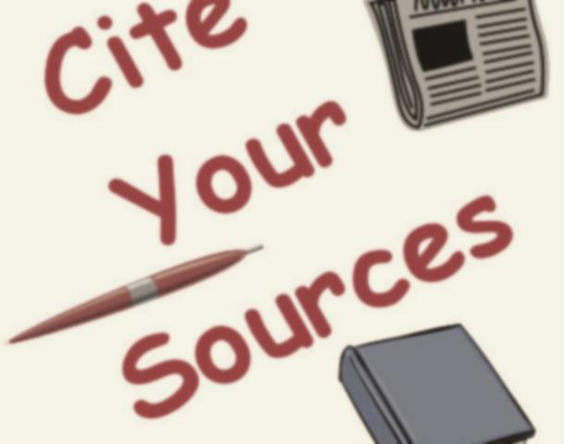
Citations
Redlands Middle Schools
Mrs. Zinner
http://www.brainpop.com/english/writing/citingsources/

Slide 2
Plagiarism
What is it?
  Plagiarism is the un-credited use (both intentional and unintentional) of somebody else's words or ideas.
  Plagiarism is when you use someone else's words or ideas and pass them off as your own.
  Plagiarism is a form of cheating.

Slide 3
When do I need to cite a source?
  When using another person's idea, opinion, or theory.
  When using any facts, statistics, graphs, drawings.
  When using quotations of another person's actual spoken or written words.
  When using paraphrases of another person's spoken or written words.
  When using any pieces of information that are not common knowledge.

Slide 4



What information do I need to cite a source, what does the format look like, and where do I find the information?
Book
  Author
  Title
  City of Publication
  Publisher
  Year
  Medium
Website (abbreviated form for middle school))
  Author
  Title of Web site
  Medium
  Date of Access
  URL (if required by teacher)
Encyclopedia
  Author
  Article Title
  Title of Encyclopedia
  Year
  Medium
  For online
    Publisher
    Date of access
Click on each of the pictures to see a sample citation for each of the sources!

Slide 5

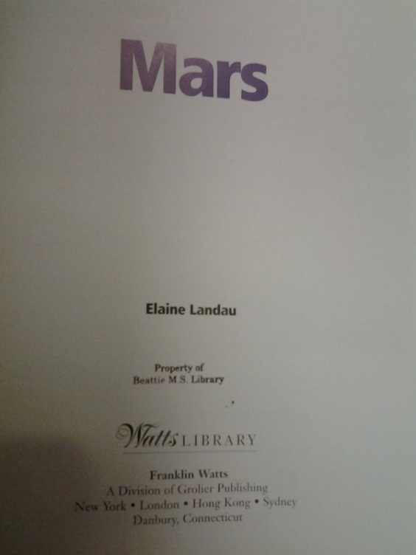
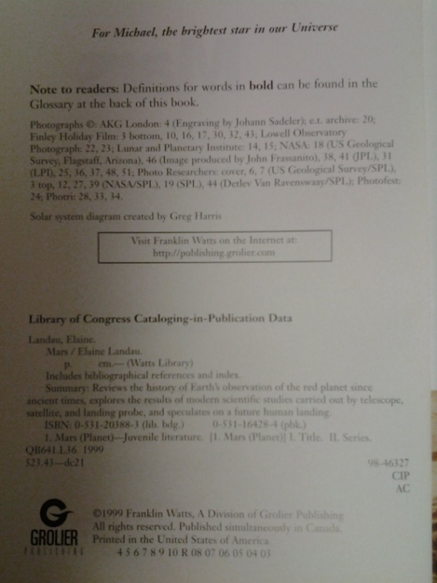
Book
Click on the picture to go back to your page!
AUTHOR /EDITOR Last _____ (comma), First ______ Middle _____ (period).
TITLE (italicized) ___________________________________________ (period).
CITY of Publication _________(colon): PUBLISHER _____________(comma),
YEAR ________________ (period). MEDIUM (Print) _______________(period).
Example:
Landau, Elaine. Mars. New York: Franklin Watts, 1999. Print.

Slide 6


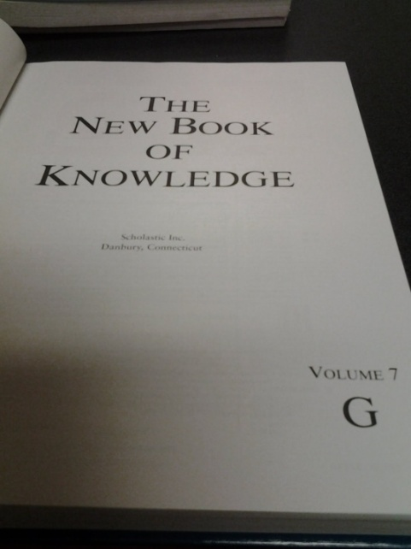
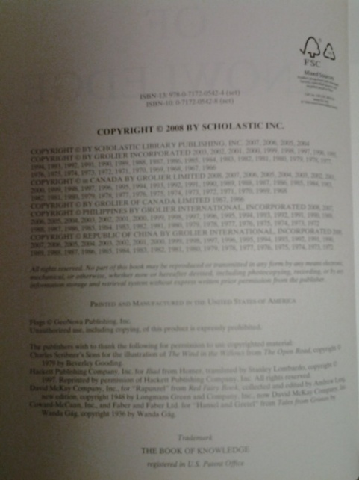
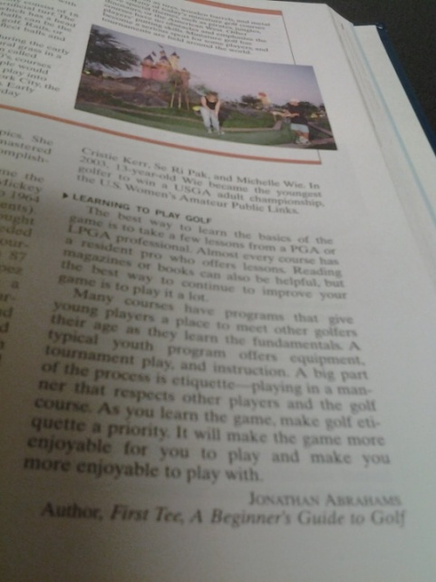
Encyclopedia
AUTHOR Last __________ (comma), First ______ Middle ________ (period).
ARTICLE TITLE ("quotation marks") _________________________ (period).
TITLE of encyclopedia (italicized) ____________________________(period).
PUBLISHER___________________(comma), YEAR _______________(period). MEDIUM (Print)_________________ (period).
Example:
Abrahams, Jonathan. “Golf.” The New Book of Knowledge. Scholastic
Inc., 2008. Print.

Slide 7

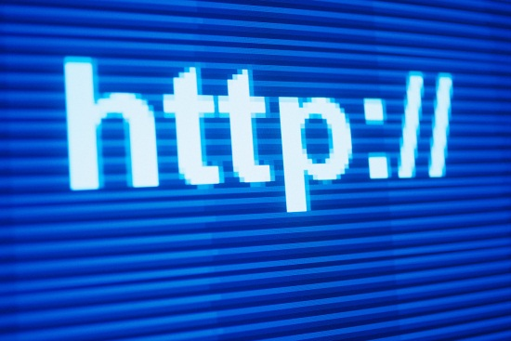
Online Encyclopedia
Click on the picture to go back to your page!
AUTHOR Last _________ (comma), First _______ Middle _______ (period).
ARTICLE TITLE ("quotation marks") ________________________ (period).
TITLE of encyclopedia (italicized)__________________________(period).
YEAR ______ (period).PUBLISHER ______________________(period). MEDIUM (Web). _____(period). DATE of access (dmy) __________( period).
Example:
Abrahams, Jonathan. “Golf.” The New Book of Knowledge. 2010. Scholastic Library Publishing. Web. 7 Jan. 2010.

Slide 8
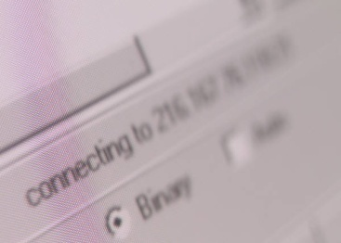


Internet
Click on the picture to go back to your page!
AUTHOR (if available) Last ____ (comma), First ___ Middle _____ (period).
TITLE of article (“quotation marks”) “_____________________ (period).”
TITLE of website (italics) _________________________(period).
MEDIUM (Web). __________
DATE of Access (dmy) __________________(period).
URL (Web site address if required by teacher) ___________ (period).
Example:
Pioch, Nicolas. “Bruegel, Pieter the Elder." Web Museum. Web. 14 Nov. 2012. <http://www.ibiblio.org/wm/paint/auth/bruegel/>.

Slide 9
What does a works cited page look like?
A list of citations at the end of a research paper.
Starts on a new page.
Alphabetized by author.
5 space indentation for all lines after the first line.
Double-space the entire list.
Sample Works Cited Page

Slide 10

Easy citation makers via internet
Easybib (http://www.easybib.com/)
Son of citation machine (http://citationmachine.net)
NOTE: You may want to write down the ISBN number of your references. Many times the automatic citation makers can pull information from the web and create a citation for you!

Slide 11
How do we know if a source is valid?
Anyone can put anything on a Web site. It might be the absolute truth, or it could be bogus. How can you tell for sure?
Look at the URL (web address). What is the domain? .gov (government), .edu (education), .com (business), and .org (non-profit organization) These are often valid sites!
Does the author provide his or her name? Is there an e-mail address to inquire for further information?
Does the author list his or her credentials on the subject matter? Are sources cited and do they look credible?
Look at the purpose and content of the website. Does the site provide academic information on your subject? Why did the author write/develop the website? Is it biased in a certain direction?
Critique the author’s writing ability and grammar. Are things spelled correctly and does he/she use complete sentences? Is the information clear and on the topic you are looking for?
Always check the date on the website. When was the site last updated and how current is the information?

Slide 12
THE END

Slide 13

Click on the picture to back to your page!

