Slide 1
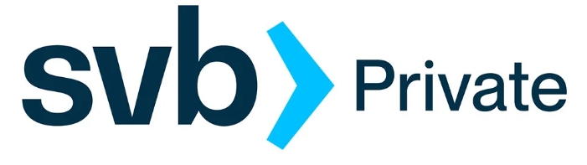
Takeover by FDIC
Summary of Events

Slide 2
Friday, March 10th ,2023
Received notification of the SVB bank failure
We had an emergency Zoom meeting
We tried to move $8,643,000 by writing a check from SVB to St. Mary’s
At noon there was an announcement that the FDIC had taken over SVB and that all of our money would be frozen for the entire weekend. It was also announced that they would reopen on Monday morning as a separate bank (SVBB) with $250,000 insured limits that would be available to us.
At 1:46 pm. Liana received a call from St. Mary’s bank saying they would have to reverse the deposit of the check due to the FDIC takeover.

Slide 3
Sunday, March 12th, 2023
At 6:30 pm, the FDIC announced that all our money would be fully insured and that it would be business as usual on Monday Morning at 9:00 am PST.

Slide 4
Monday, March 13th, 2023
Liana cut a check from SVB to St. Mary’s for $500,000 to cover the 3/17 payroll.
There were some emails forwarded to us from SVBB stating that it was business as usual and that our deposits were safe.
There was a call with Mass Development and there was some concern that not all of our loan money had been drawn down yet.
A Zoom Meeting with the 11 other Charter Schools CFOs affected by the SVB takeover along with the Mass Charter School Association took place. Some ideas were shared, and a Google Document was prepared and shared with the group. AMSA Charter School was right in line with how the other Charter Schools were proceeding with priority on meeting payroll on March 17th and moving the money to a secure bank.

Slide 5
Wednesday, March 15th, 2023
A check was cut from SVB to St. Mary’s Credit Union for $8,360,000 and deposited it in St. Mary’s Credit Union. There was a 5 day hold on the available funds due to the size of the check. The funds were available to AMSA as of March 22nd.
There was a Zoom call with the new CEO of the bridge bank, Tim Mayopoulos. During the call, he outlined the four possible options that will happen with the bridge bank:
The bank will continue as a standalone bank.
The bank will be sold to another financial institution.
Other investors will buy it and the bank will become a private bank.
The bank will become liquidated.

Slide 6
Thursday, March 16th, 2023
SVB assured us that the term of the loan, the current interest rate and the ability to draw down funds will remain intact regardless of which option happens to the bank but that we should confirm this with our attorney who was involved in the closing of the building purchase.
We later confirmed with our attorney that he believed this to be true as well.

Slide 7
Monday, March 20th, 2023
An additional meeting was held to discuss moving the project forward given the current bank situation. Three options were discussed, and it was decided that more information was needed to make the decision.
A Zoom meeting occurred with the other charter school CFOs that have loans at SVB. There is a potential opportunity to band together to buy our loans back at a discounted rate.

