Slide 1
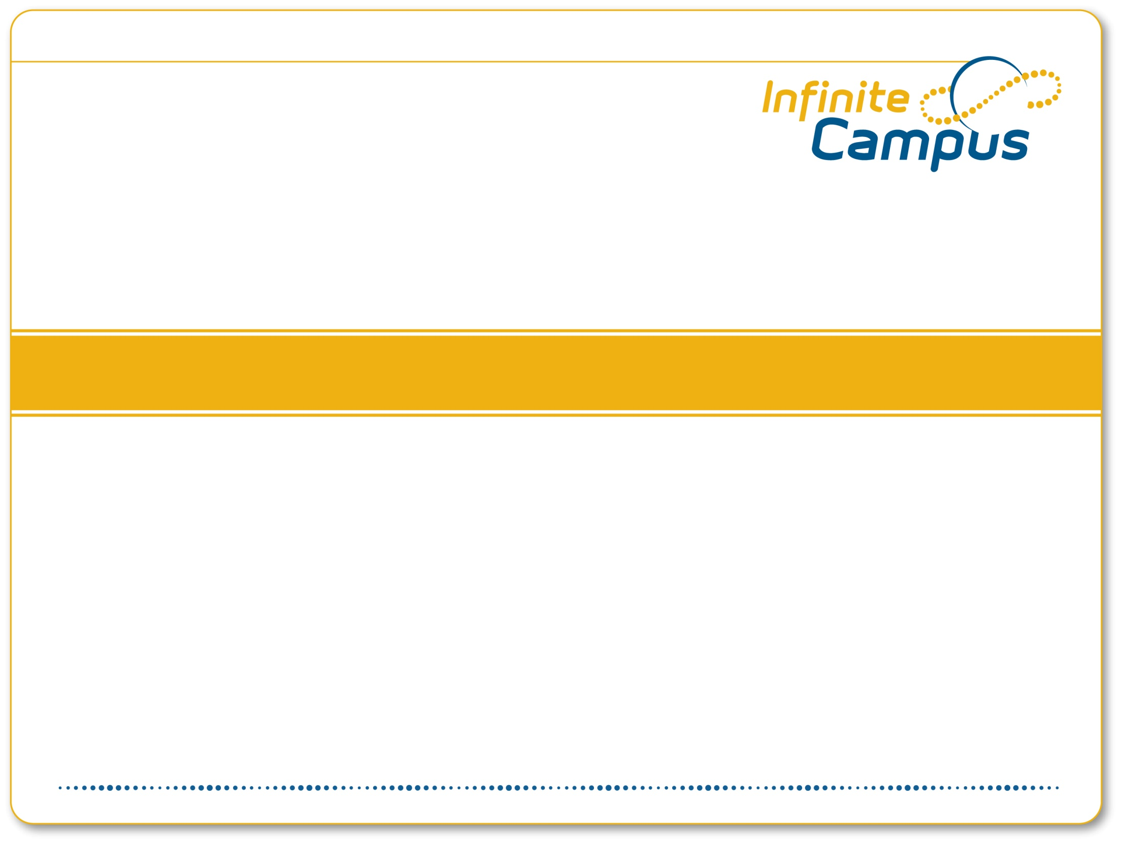
Grade Submission & Reporting Process
GR1600

Slide 2
Course Overview & Agenda
This course will cover the processes involved in teacher submission of grades and standard scores, reporting on these scores for internal purposes, creating and printing report cards, and corrections to posted grades as needed. This course will include discussion of best practices surrounding the grade submission and reporting process.
Discussion of Essential Setup Prior to Grading
Opening the Grading Window
Teacher Submission of Grades & Standard Scores
Reporting: Checking Up on Teachers
Closing Grading Window
Report Card Templates
Report Card Batch Printing
Correcting Mistakes
Transcript Posting
Correcting Transcript Mistakes

Slide 3
Essential Grading Setup
Course Setup
Score Groups
Grading Tasks
Credit Groups
Setup of Score Groups (grades used on report cards, GPA Weight, Credit Coefficient), Grading Tasks (types of grades expected from the teacher for a student), and Credit Groups (how transcripted credits are organized and group) as well as the setup of these items on the course are critical to a successful grade submission and reporting process.

Slide 4
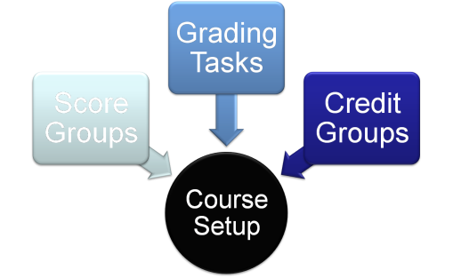
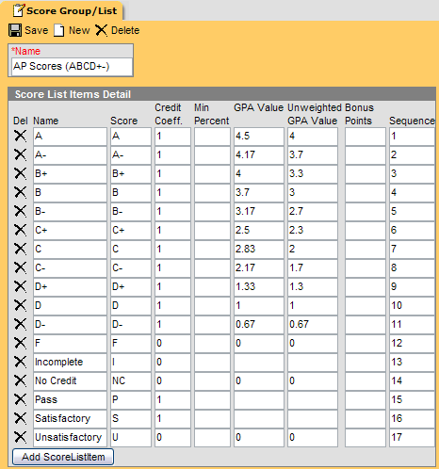
Score Groups
If +/- are used, must be included.
Additional marks that may be used on the report cards (NC, I, WF, etc) must be included.
Credit Coefficient- determines if the student receiving that mark receives full credit available (1) or none (0)
GPA Value used in GPA calculation… are there weighted scales (an A in an AP course worth 5.0, while an A in a regular class is 4.0? Need separate score groups)

Slide 5
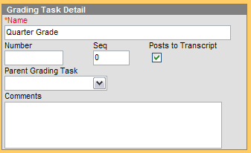
Grading Tasks
Grading Task- a mark that a teacher is expected to submit to the office detailing student progress.
  Examples: Midterm, term, final exam, semester grade.
  Are the correct ones marked as post to transcript?

Slide 6
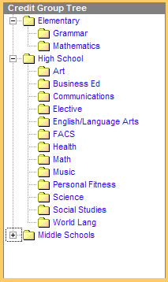
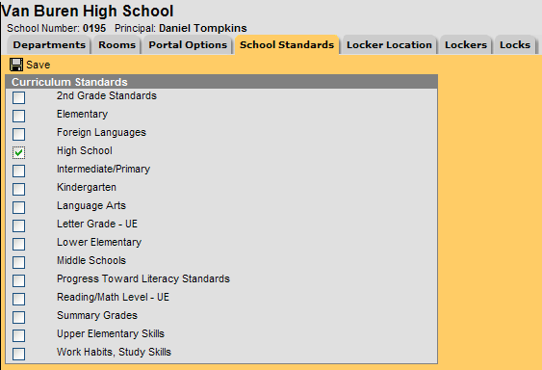
Credit Groups
Credit Groups detail how credits are organized on the transcript.
Credit Groups are then associated with a school in System Admin> Resources > Resources> School Standards.

Slide 7
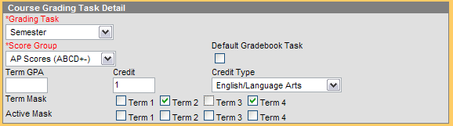
Course Setup
Course level setup connects a task to a score group and a credit type.
Also sets the term mask for when that grade is expected from teachers.
In this example, the Semester Grade (using the AP Scores Score Group) is expected from teachers during terms 2 and 4. Each time it is submitted, it is worth 1 English/Language Arts credit for the student on the transcript.

Slide 8
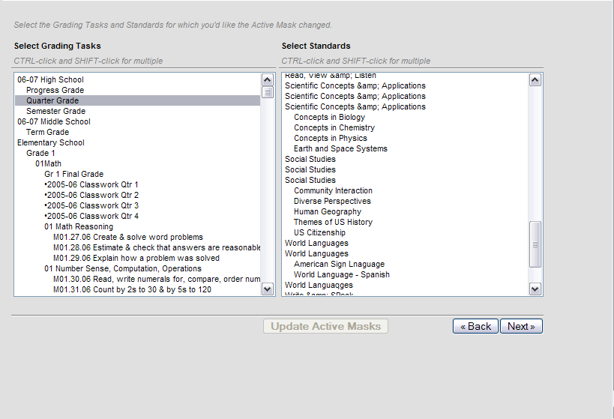
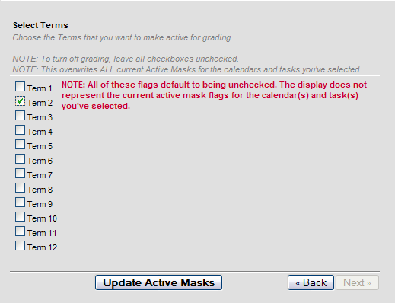
Opening the Grading Window
Select school(s) and calendar(s)
Select Grading Task(s) and/or standard(s)
Select the term(s) that should be open.
Click Update Masks.
Teacher Submission of Grades/Standards
NOTE: The term checkboxes are hard-coded to 12 terms, the max number Campus supports. Use the boxes for the number of terms corresponding to what your school has (semester schools will only use the first two).

Slide 9
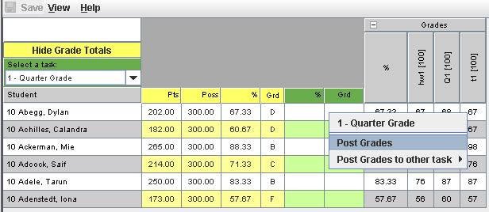
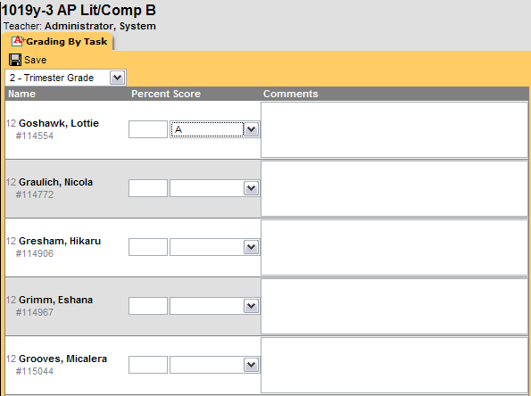
Teacher Submission of Grades/Standards
Teachers may submit grades via the “Post Grades” option in Gradebook, or by using the Grading by Task/Grading by Student tools of the Instruction Module.
NOTE: If desired OR required, comments may be entered using Grading by Task/Grading by Student. These comments may be done free-hand (unless a system preference is set to disable custom comments) or selected from canned comments created in System Admin.

Slide 10
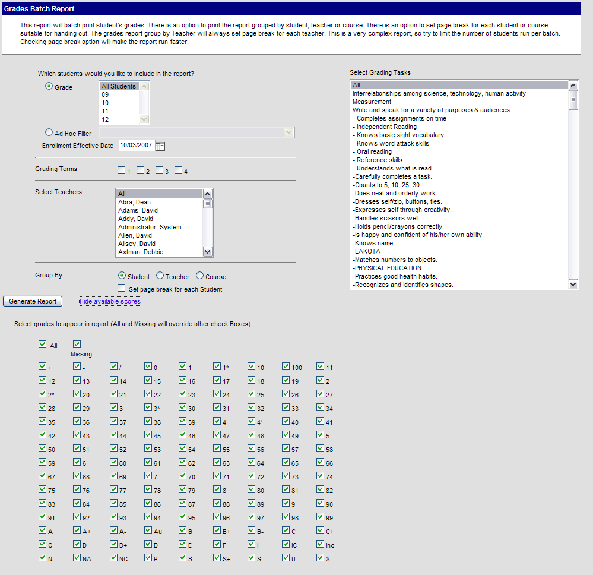
Reporting: Checking on Submitted Grades
Grading & Standards > Reports > Grades Report may be used for several quality & process checks.
  Missing grades (not yet submitted by the teacher)
  All grades submitted by a particular teacher.
  F’s, I’s, NC’s given out by all teachers.

Slide 11
Closing the Grading Window
Select school(s) and calendar(s)
Select Grading Task(s) and/or standard(s)
Leave all checkboxes unchecked.
Click Update Masks.
NOTE: The term checkboxes are hard-coded to 12 terms, the max number Campus supports. Use the boxes for the number of terms corresponding to what your school has (semester schools will only use the first two).

Slide 12
Creating & Printing Report Cards
Report cards can be created in three ways in Campus:
  Canned template setup in System Administration
    Saved templates can be reused again and again
      Report Card Batch tool AND student grades tab.
    Publish to Portal box allows parents to print their own report cards from home (or save as PDF and not print at all)
  On-the-fly options in Grading & Standards>Reports
    Flexible options for experimenting and creating new templates without saving and making available to others.
  AdHoc Report Designer/Builder
    Additional data elements not typically included on a report card can be brought in and used (next term’s schedule, fee balance, etc.)

Slide 13

Correcting Mistakes
IF report cards have been sent home and a teacher error is discovered PRIOR to grades being posted to the transcript (if applicable), the correction can be made in Scheduling> Courses.
  Search for the course/section.
  Select the grading by task OR Grading by Student Tab in the section.
  Make changes as needed.
P&P Question: How should the change be documented?

Slide 14
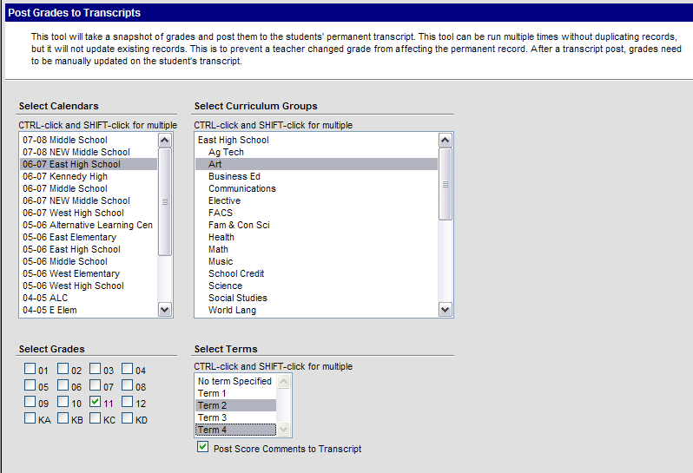
Transcript Posting
If the grades submitted should be transcripted grades, run Transcript Post (System Administration > Student Portfolio) to post selected curriculum groups to the transcript.
P&P: How long should the school wait to post transcripts after report cards have been sent home to catch errors and corrections?

Slide 15
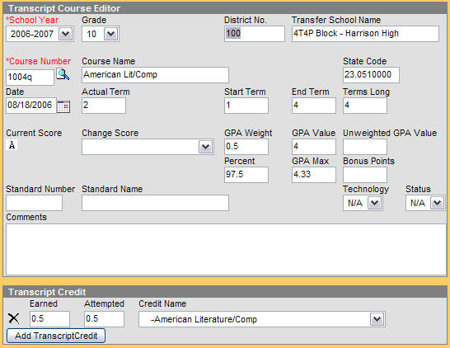
Correcting Transcripted Mistakes
If an error in the teacher-submitted grade is found after Post to Transcript has occurred, the grade will need to be changed on the student’s transcript tab in addition to the Grading by Task/Grading by Student tab in the section.

Slide 16
Review
Which happens first in the grading process: teacher submission or grades or opening the grading window?
List three ways of creating a report card template.
A teacher complains that she can’t submit a student’s A- in Grading by Task (only an A). What could be causing this issue?
A teacher made a mistake on the superintendent’s son’s math grade. Where should this be fixed?

Slide 17

Questions

