Slide 1
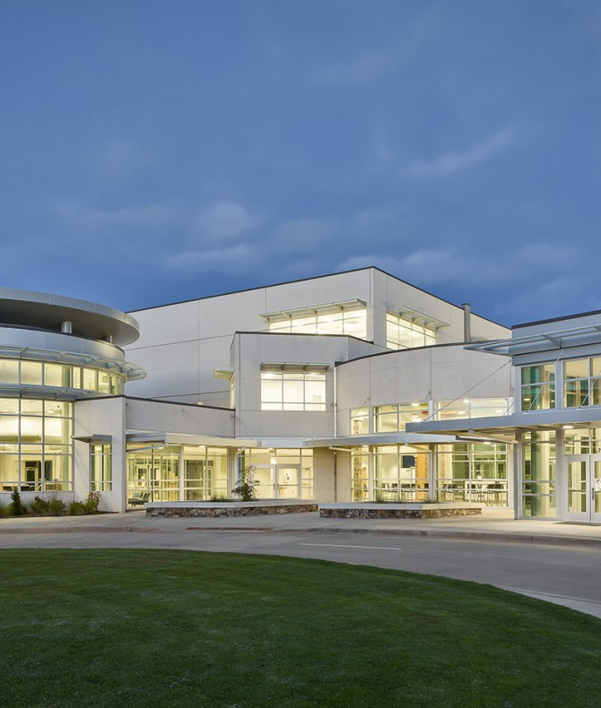
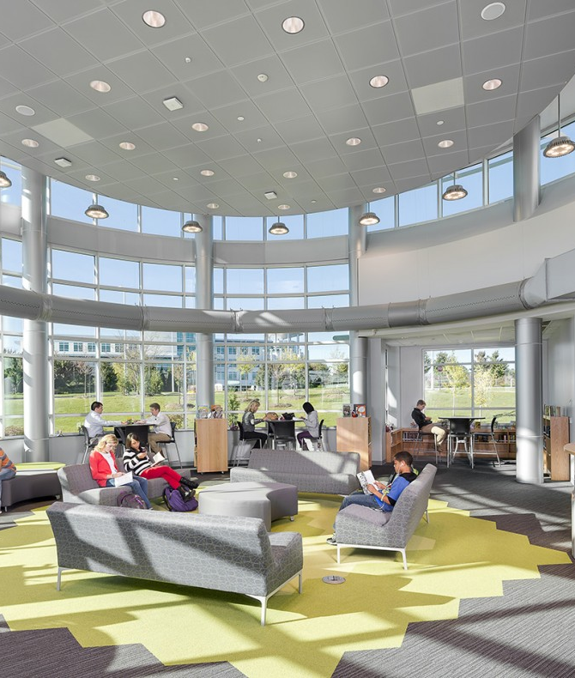
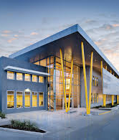
Princeton Public Schools Facilities Referendum
A Critical Need
A Transformative Opportunity
A Responsible Investment

Slide 2
A Critical Need

Slide 3
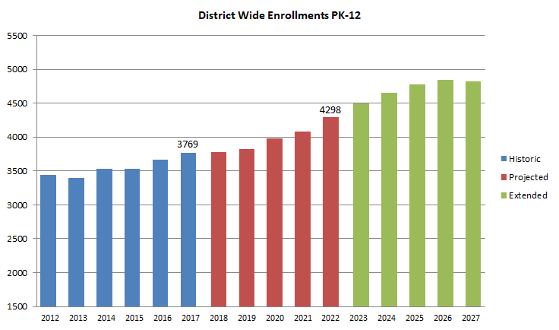
Critical Need
Capacity Crisis: Current and Future
2017: 3,769
2022: 4,298
2027: 4,820
5yr. 14% increase
10yr. 28% increase

Slide 4
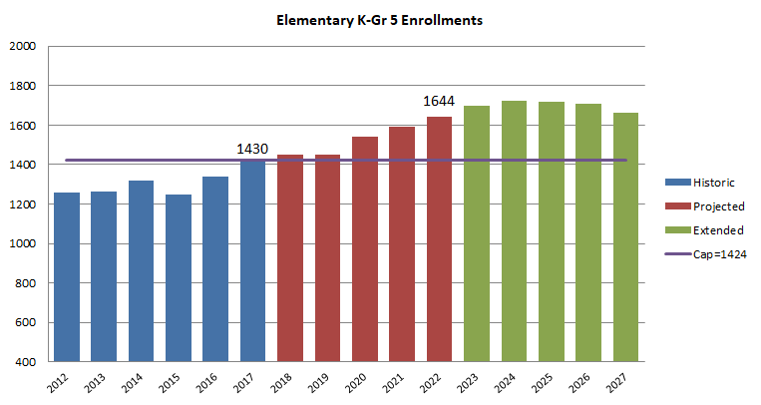
Capacity Crisis: Current and Future
Grades PreK-5
Currently at capacity.
200 more students in next 5 years
15% increase

Slide 5
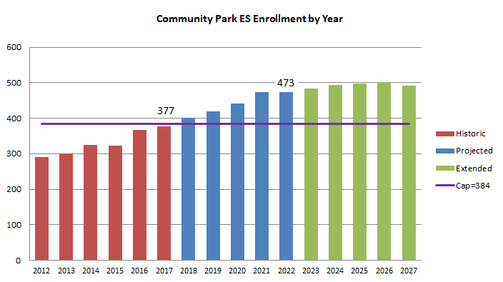
Community Park
Enrollment Projections
Currently at capacity.
90 over capacity by 2021
= 4 classrms of 22/23
500 by 2025

Slide 6
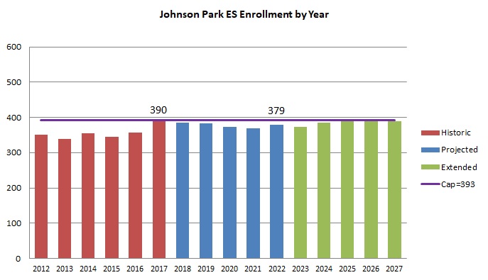
Johnson Park
Enrollment Projections
At capacity for next 10 years
No new housing projected for this area.

Slide 7
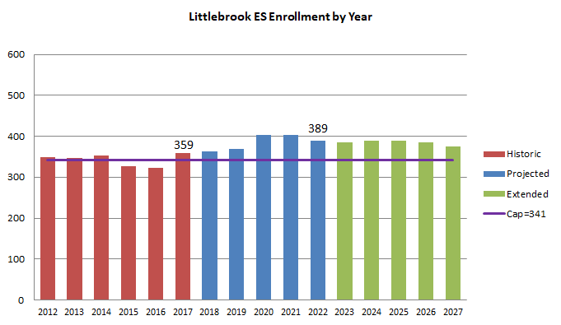
Littlebrook
Enrollment Projections
Currently over capacity by 18
50 more students by 2020 for enrollment of over 400.
Projected to stay above capacity

Slide 8
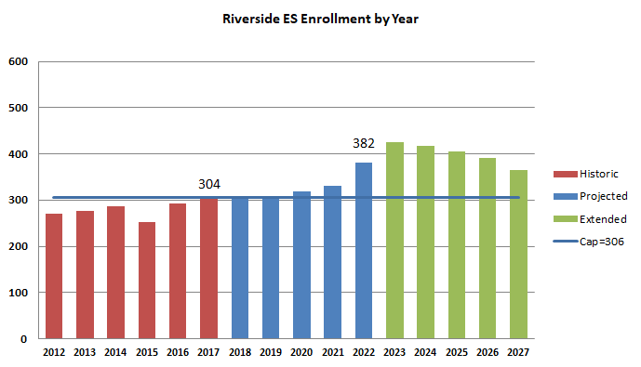
Riverside
Enrollment Projections
Historically under 300; projected to be larger than JP
426 by 2023
120 over capacity
= 6 classrms of
20.

Slide 9
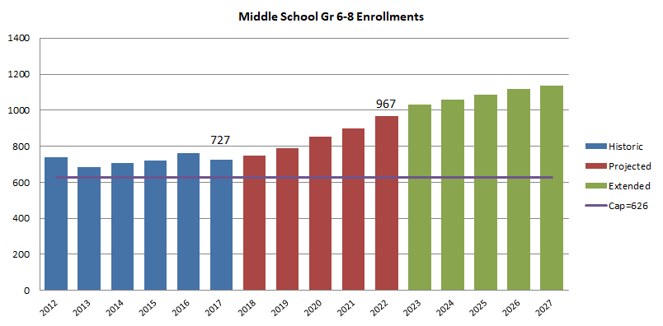
Capacity Crisis: Current and Future
Grades 6-8
Currently 100 over capacity
853 in 2020.
967 in 2022.
33% increase in 5 yrs.
240 stdnts
1,138 by 2027.

Slide 10
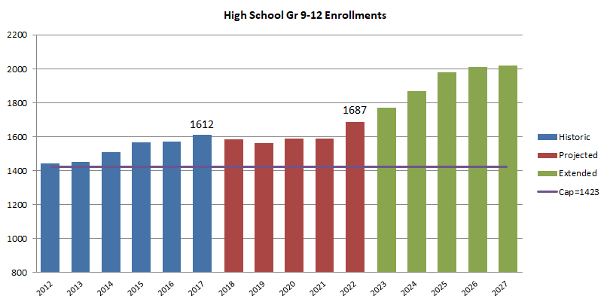
Capacity Crisis: Current and Future
Grades 9-12
Almost 200 over capacity of 1423.
Up another 100 by 2022 .
2000 by 2026.

Slide 11
How Has the District Already Been Managing Enrollment Growth?
PHS
  Converted rm. 98.5 (larger space) to create two health classrooms
  Two large classrooms in 130 hallway divided into four
  Converted 2 regular classrooms into science labs
  Converted supervisor’s office into small group instruction room
  Teacher lunchroom converted to Life Skills room
  Trailers for teacher offices – yielding two useable classrooms
  Instructional classroom created in Library
  Increase in some class sizes to 28-30
JW
  Use of all available classrooms
  Increases in class sizes to 28-30
Elementary
  Use of all available classrooms
  Spanish Instruction on a cart
  Increases in class sizes 20-25

Slide 12
What Is Our Vision for the Future?
PHS Expansion
New 5/6 School on VR Site
Space to accommodate 300-400 students
Multi-story Addition
  Flexible space for learning
  Cafeteria extension
Internal Renovations
  Courtyards?
  Classrooms?
  Library?
Additional Parking
Extends elementary nurturance while offering middle school exploration
Allows all children to experience new school and connect before JW & PHS
Clear and caring focus on transitions
Cost-effectively frees up space at MS and all 4 elementary schools
Maintains neighborhood elementary schools
Close-knit school communities in the midst of district-wide growth

Slide 13
5/6 School: Success Stories
Other Districts
The Lower Middle School has been successful because it combines the content specialization that is supported by most middle school academic structures with the nurturing sensibilities of the elementary years. It is truly just that simple!
Mike Richards, Principal
Montgomery
  Lower Middle School
Hillsborough
  Auten Road Intermediate
Bridgewater-Raritan
  Eisenhower Intermediate
  Hillside Intermediate
South Brunswick
  Upper Elementary School

Slide 14
5/6 School: Success Stories – South Brunswick Joanne Kerekes, Asst. Superintendent
For those of us fortunate enough to have been a part of the UES experience, you will hear in SBSD to this day that there were no better years than those.
I believe, had there not been a prior commitment to the two-middle school model, that the UES would have continued on and flourished.
It was indeed, a delicious combination of students, staff, and programs.
Socially, emotionally, 5th and 6th graders were in sync with one another. The cafeterias and hallways were unbelievably peaceful.
Regrouping across grade level was managed with ease.
The arts, and performance and research tasks flourished.
ECA’s focused on collaborative clubs – Odyssey of the Mind, Invention Convention
Alignment of curriculum made PD with staff as rich as I have ever experienced it. We were ahead of the curve.

Slide 15
What Else Might the Referendum Include?
Safety and Security
  Main entrances at all six schools need to be reconfigured to be both welcoming and secure
HVAC upgrades at all six schools
  High efficiency Boilers and Heating Pumps (current ones 15 – 20 years old)
  New generators needed for elementary schools in case of power outages
  AC in gyms, cafeterias
One or two new athletic fields w/turf, plus flexible indoor space
Alternate space for administration and transportation currently at VR
  Possible inclusion of Preschool Center to free up more space at RS, CP, JP

Slide 16
Critical Need:
Implications of Not Building Additional Space
Elementary
  Class sizes of 25-30 particularly at CP and RS
  Possible redistricting of elementary students from CP and RS to JP and LB
  Possible suspension of DLI program
Middle school
  Class sizes of 30-35
  Cutting of exploratory programs - coding, robotics, business, shop to repurpose space for required classes
  Need to renovate former Library to function as classrooms
High school
  Class sizes of 28-30
  Limiting of elective offerings so all students receive only required courses
  Possible difficulty of students meeting graduation requirements in arts and practical arts
  Split sessions?
  Staggered sessions?

Slide 17
A Transformative Opportunity

Slide 18
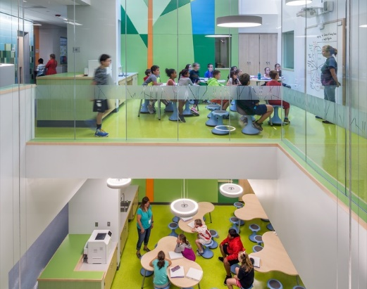
Schools are not buildings; they are the people in them.
How can we create spaces that will connect, support, and inspire those people?

Slide 19
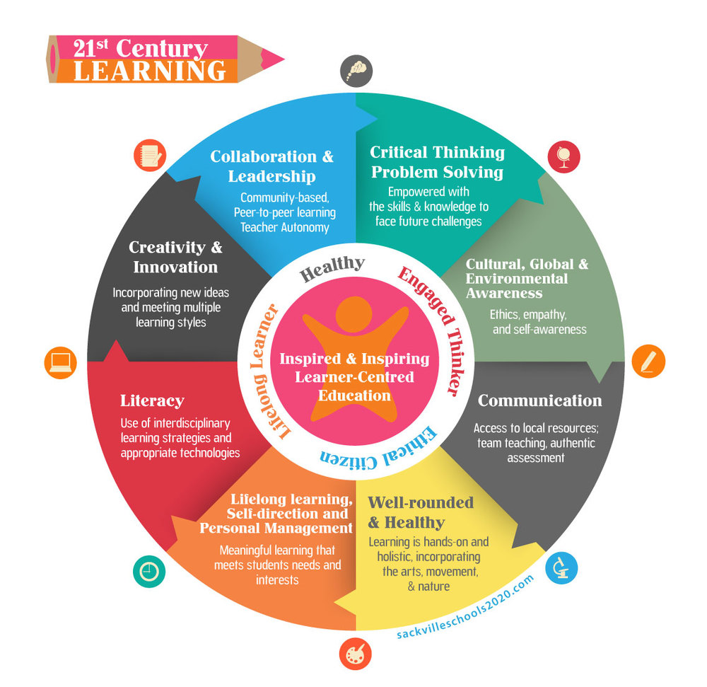
Inspiration Through 21st Learning
Schools should reflect the world for which we are preparing our students.

Slide 20
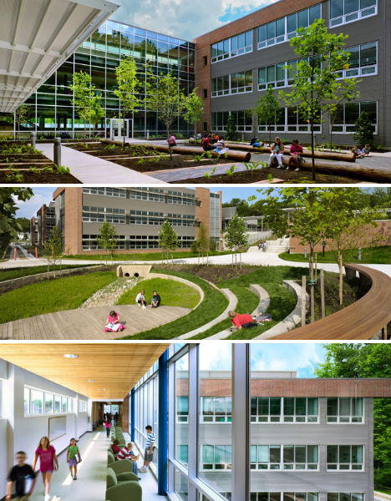
Inspiration Through Sustainability
The building itself becomes a laboratory for learning – and a cost-effective one.

Slide 21
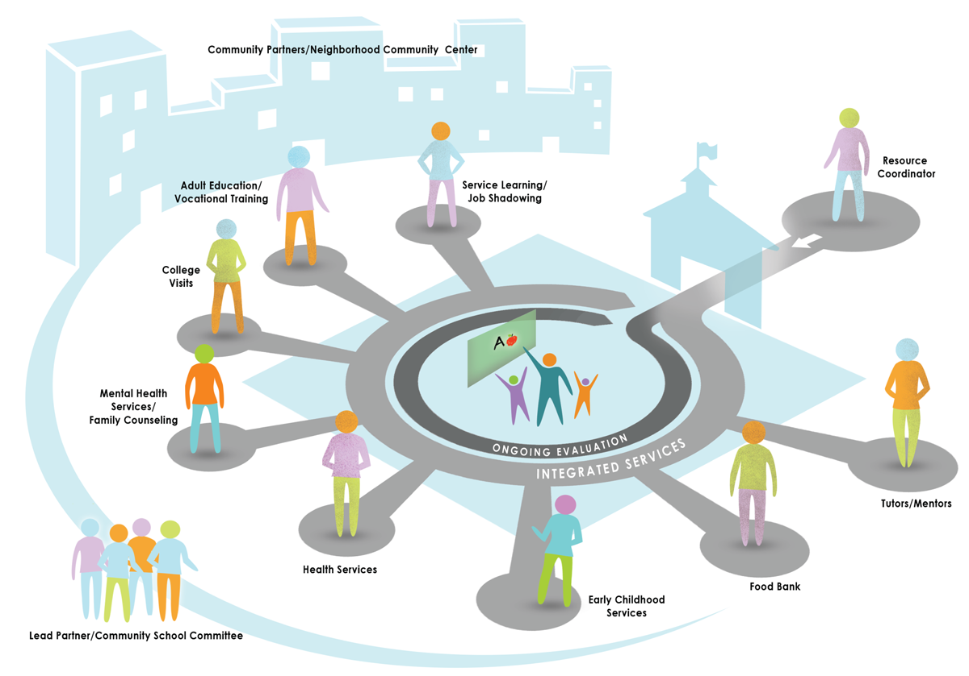
Inspiration Through Community Engagement
An opportunity to create a true community school focused on helping children and families thrive - intellectually, physically, emotionally.

Slide 22
A Responsible Investment

Slide 23

What Are We Investing In?
Our children and their success
Our school buildings
Our home values
The quality of our community

Slide 24
What Is The Financial Impact?
Projected costs determined once designs are finalized in March or April
Commitment to limited tax impact
  Increase in debt service from any proposed construction costs to be hundreds – not thousands - of dollars on the average assessed home
Tax impact expected to decline after 2022-23 when significant debt retires
District’s AAA bond rating = excellent interest rate
Independent financial advisers working with district on limiting the tax impact are from same group who assist our town

Slide 25
Other Financial Considerations
There will be some increased operating costs for opening a new school
The District is actively engaged in negotiating contributions to our operating fund from our non-public partners whose children attend our schools.
Maintaining our facilities is prudent stewardship.

Slide 26
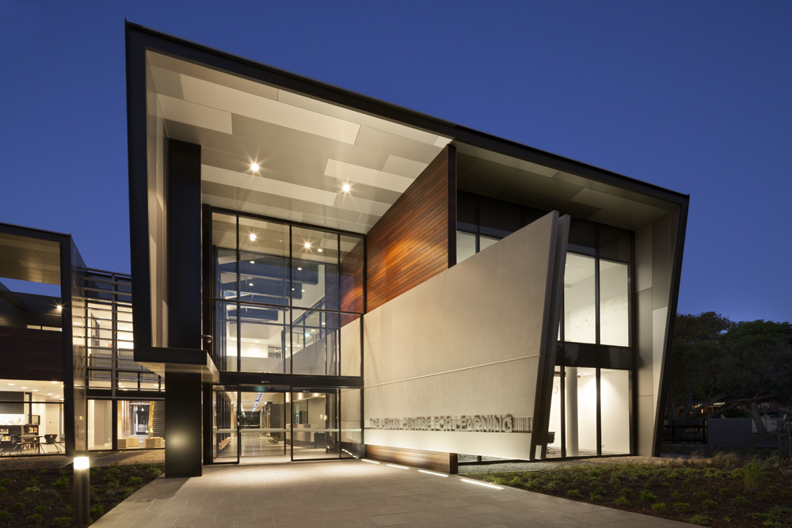
Referendum Timeline
Initial Stakeholder Input: January, 2018
Potential Designs shared with Community: February – March, 2018
Initial Plans to DOE: April 2018
Design Adjustment Phase with ongoing stakeholder input: March – Sept. 2018
Information sessions re: design, cost, benefit to students and the community: March – September, 2018
Referendum Vote: October 2, 2018
Construction Begins: Spring, 2019
Projected Opening of New School and Addition: September, 2020

Slide 27
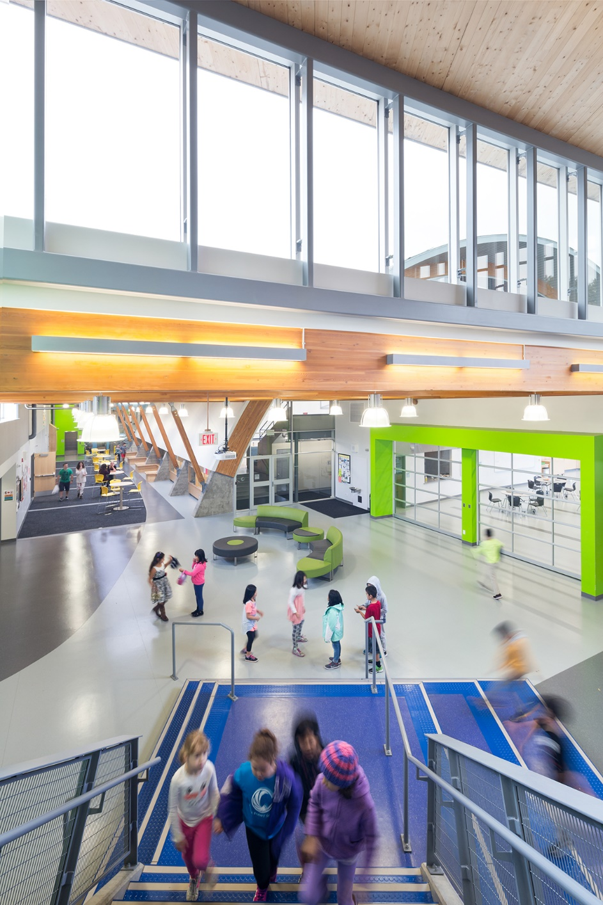
Summary
A Critical Need
A Transformative Opportunity
A Responsible Investment

Slide 28
An investment in education always pays the highest returns.
- Benjamin Franklin

Slide 29
Ideas or Questions?
referendum@princetonk12.org

Slide 31
What About Our Cranbury Students?
Send-Receive Relationship since 1990
280 students, 9-12, approximately 70 in each grade
Reducing our enrollment from Cranbury would hurt rather than help. Here’s why…
  $4.8 Million - Total tuition paid by Cranbury to PPS operating budget
  Direct costs – approximately $1.3 Million (12 – 15 teacher salaries plus benefits)
  Indirect costs – approximately $3.5 Million (Administration, support staff, CST, nurses, energy, technology, buildings and grounds, etc.)
  $3.5 Million loss from the operating budget would be equivalent to 36 teaching positions with HB. (PHS currently has 150 teachers)
  3.5 Million x 20 years = $70 Million. Far more than a $20 Million addition.
Remember:
  Projections are for PHS to be more than 500 students over capacity, so the need for space remains
  Cranbury enrollment is falling. Princeton’s is rising.

