Slide 1
Chromebook Tutorial
for Students

Slide 2
Hardware Overview
There are various hardware configurations dependent upon the model.
Power port
Headphones port
USB port(s)

Slide 3
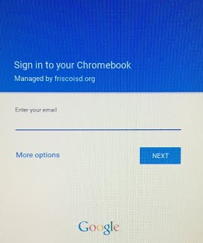
Sign In
use Email to sign in

Slide 4
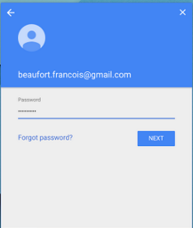
Sign In
Password

Slide 5
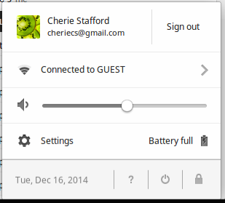
Status Area
Notes:
https://www.youtube.com/watch?v=NCnSWv70qgg&feature=youtu.be 1:12

Slide 6

Icons
Chrome
browser
Open windows
Apps

Slide 7
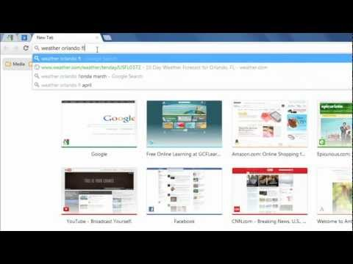
Chrome Browser Basics
Chrome: Browsing in Chrome
Notes:
http://youtu.be/47Iaa9oNdhY

Slide 8
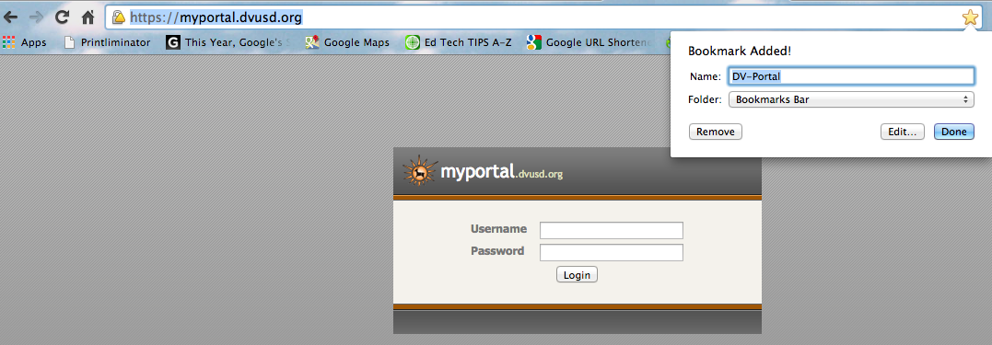
Chrome Bookmarks
Add a Bookmark for a Favorite Site
Click on the Star
Saved

Slide 9

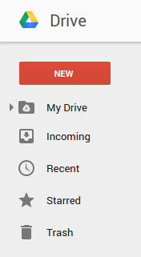
Google Drive
Folders
Creating
Sharing
Editors, Commenters, Viewers

Slide 10
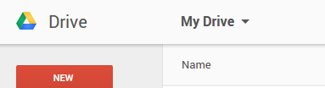

Google Drive
Sharing
Editors, Commenters, Viewers

Slide 11


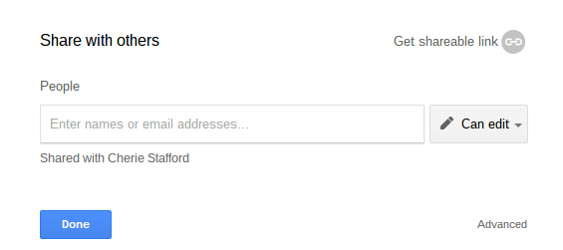
Docs
Create
Share
Editors
Commenters
Viewers
Collaborate

Slide 12
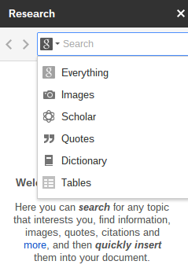
Docs
Tools
Spell check
Define
Word Count
Research
Notes:
under the tools how to do spell check, research, define (how to find the definition of a word quickly), word count, etc.

Slide 13

Slides
Research - Images

Slide 14

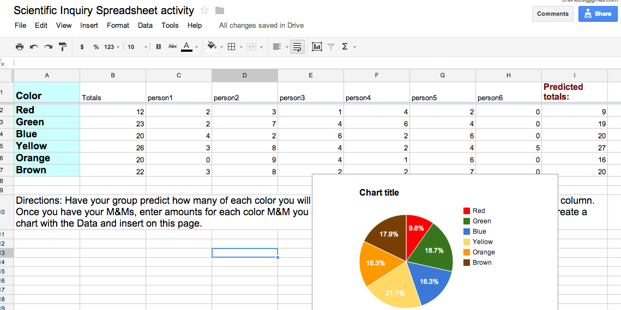
Sheets
Data and Charts

Slide 15
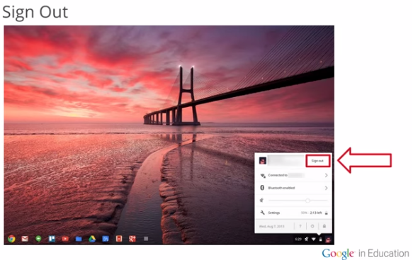
Sign Out
Click on the status area (lower right corner) and select Sign out
https://educourses.withgoogle.com/chrome/unit?unit=2&lesson=1

Slide 16
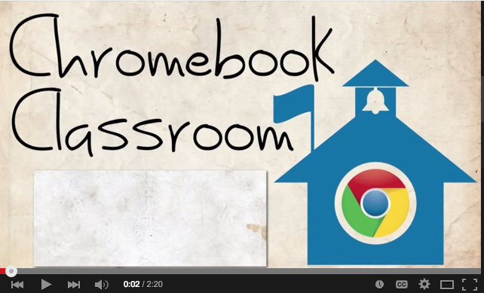
Students! Treat Your Chromebooks With Respect
Notes:
https://www.youtube.com/watch?v=rBFEfluPgmA&list=PL82E412BDD34266F5&index=1 2:20

Slide 17
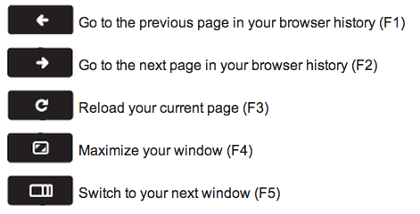
Shortcut Keys
http://support.google.com/chromeos/bin/answer.py?hl=en&answer=1047364

Slide 18
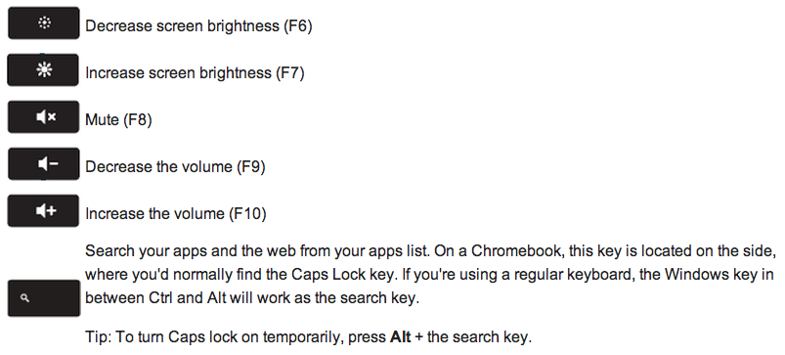
Shortcut Keys
http://support.google.com/chromeos/bin/answer.py?hl=en&answer=1047364

Slide 19
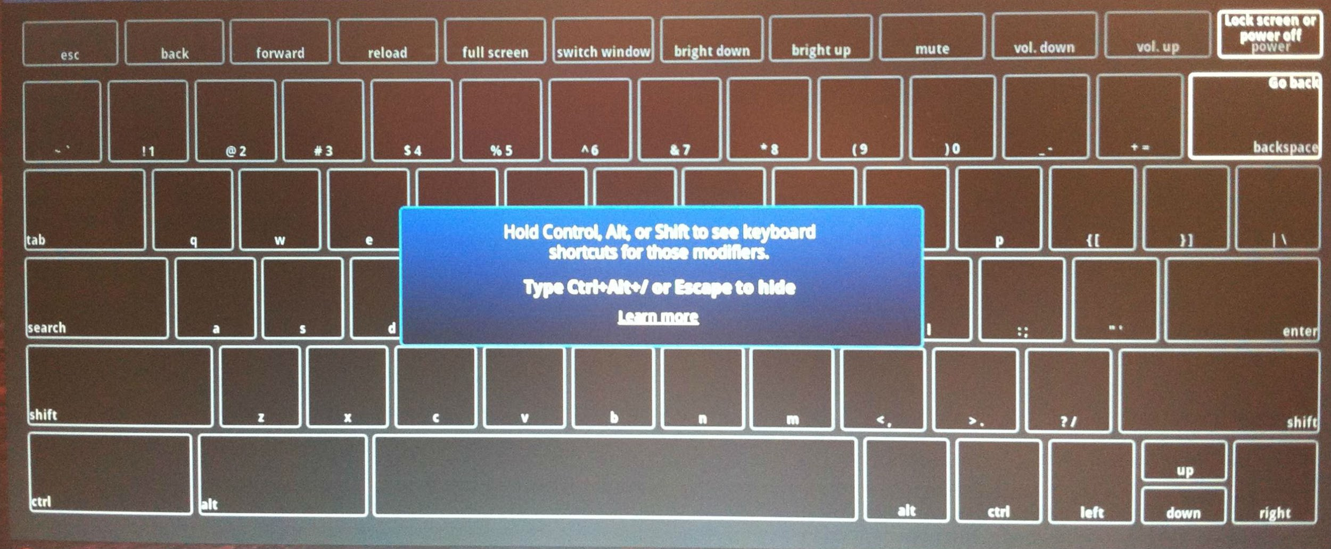
Ctrl + Alt + ?
To see a map of keyboard shortcuts on your screen, press Ctrl + Alt + ?

Slide 20
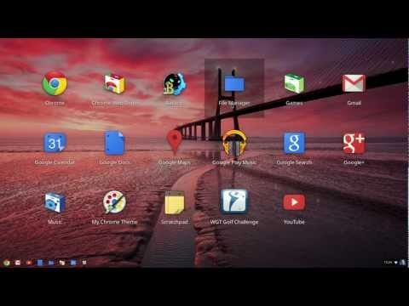
Chrome Operating System Tour

Slide 21
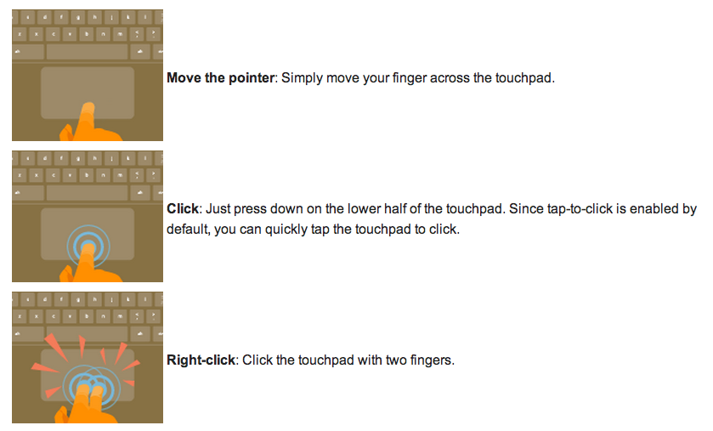
Touchpad Tips
https://support.google.com/chromeos/bin/answer.py?hl=en&answer=1047367&topic=2589149&ctx=topic

Slide 22
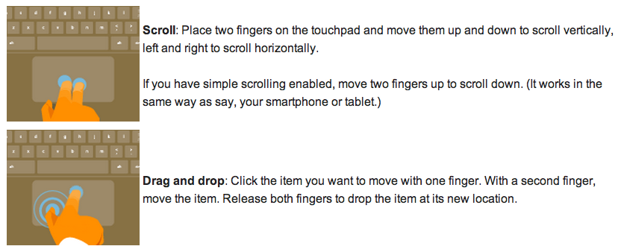
Touchpad Tips
https://support.google.com/chromeos/bin/answer.py?hl=en&answer=1047367&topic=2589149&ctx=topic

