Slide 1


Albuquerque High School

Slide 2
AVID Basics
AVID Binder
Agenda
Focused Notes
TRFs

Slide 3
AVID BINDER
In 9th & 10th grade, students are required to use one AVID Binder for all of their classes, which is provided for them at the beginning of the school year.
In 11th & 12th grade, students may choose to use the AVID binder.
Organization is a key component of the AVID class.

Slide 4
AGENDAS
Perhaps the most important part of organization is the school-issued agenda.
Students should write their daily assignments and manage their time in the agenda.
The use of a highlighting system is required.

Slide 5
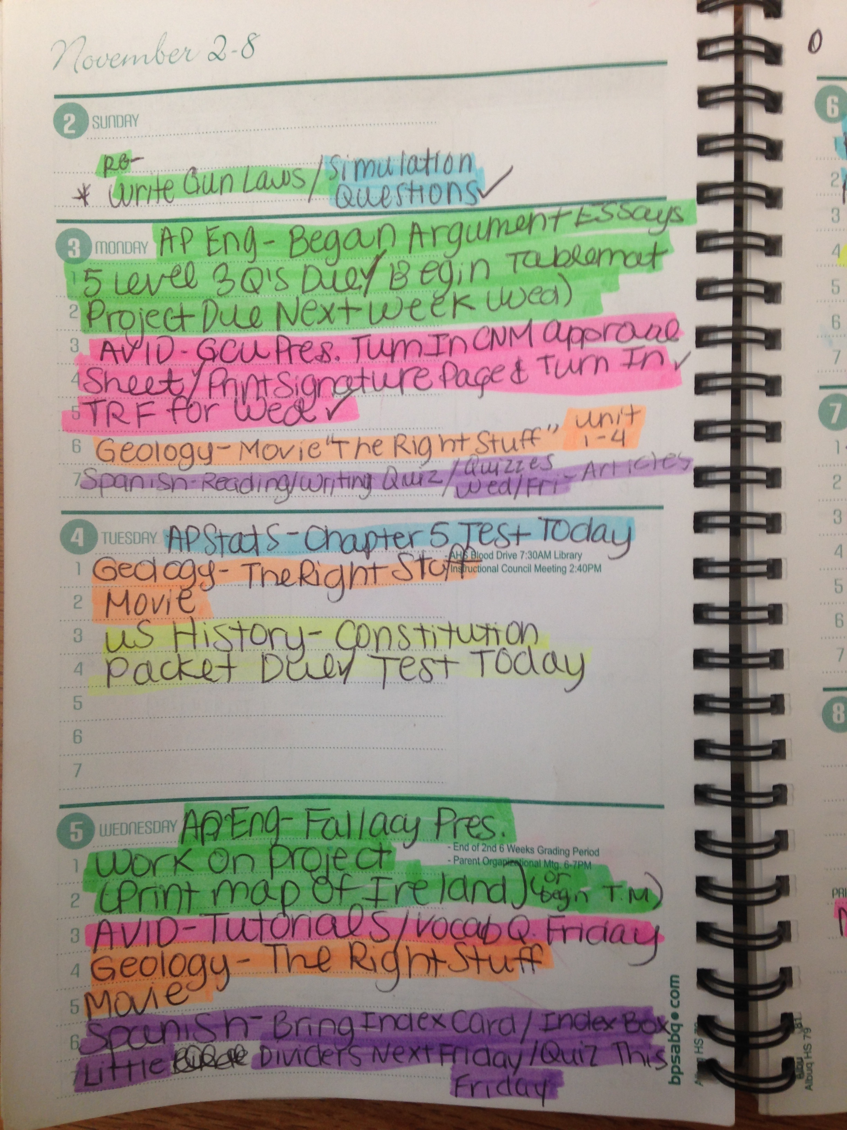
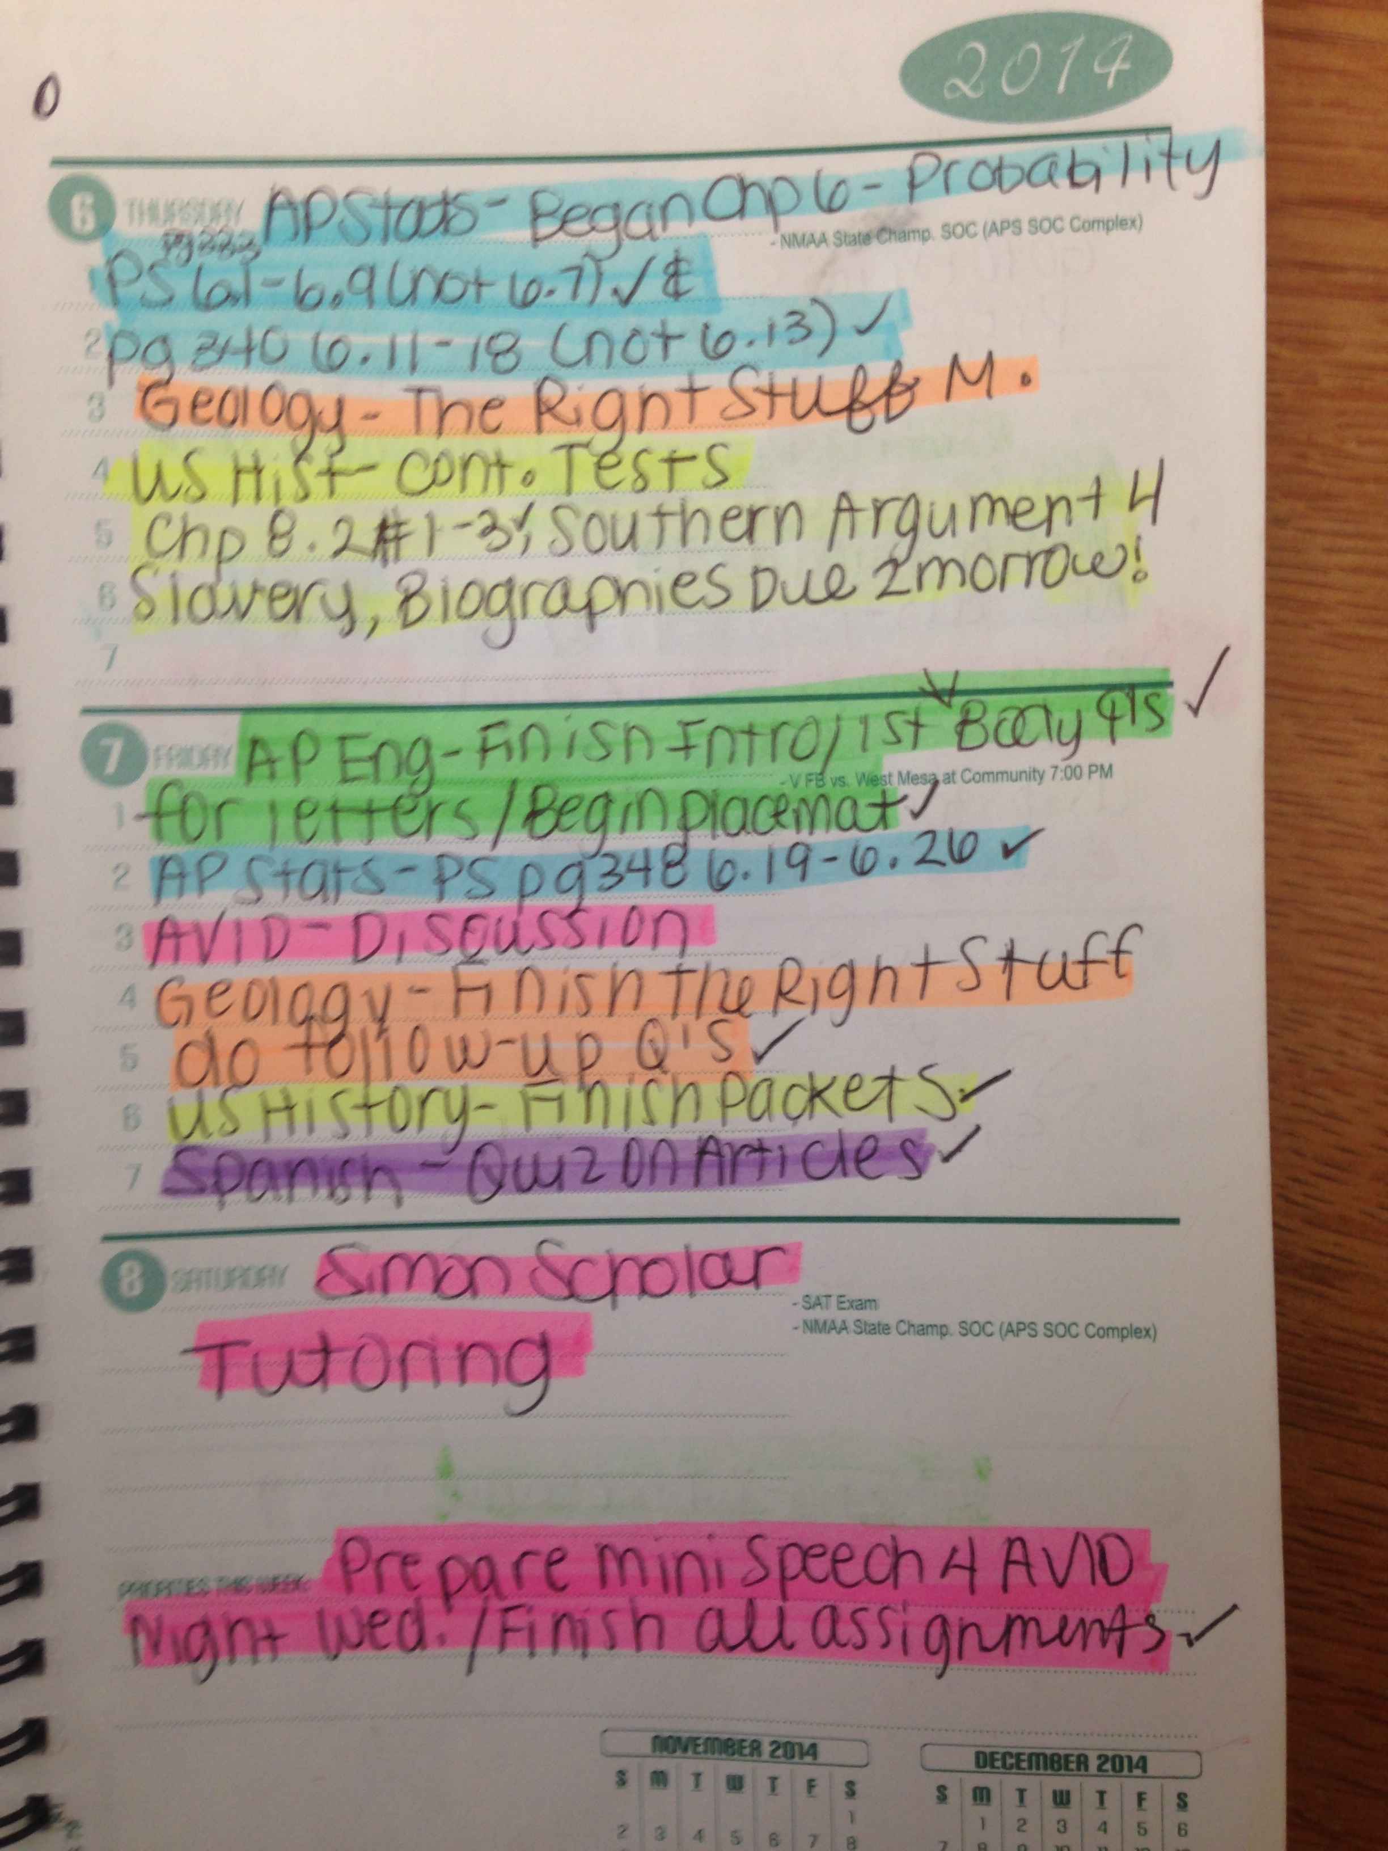

Slide 6
FOCUSED NOTES
Stimulates Critical Thinking skills
Help you work on assignments and study for tests outside of class
Helps organize and process information
Help you recall information and use your notes multiple times

Slide 7
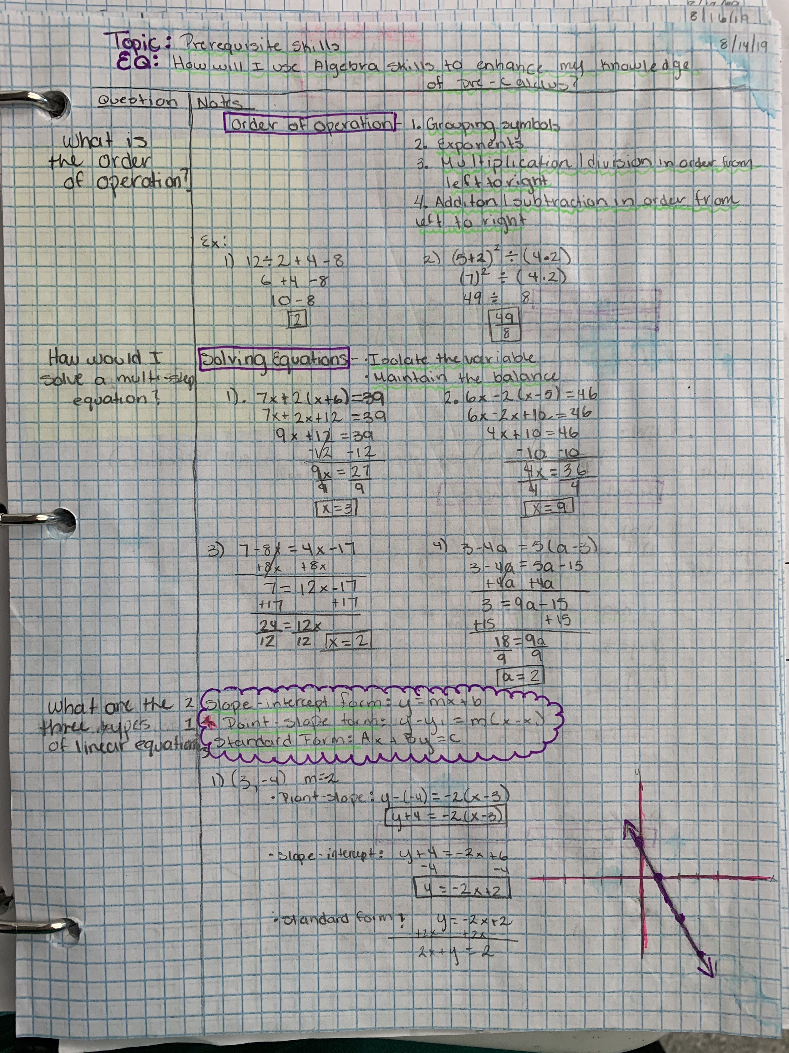
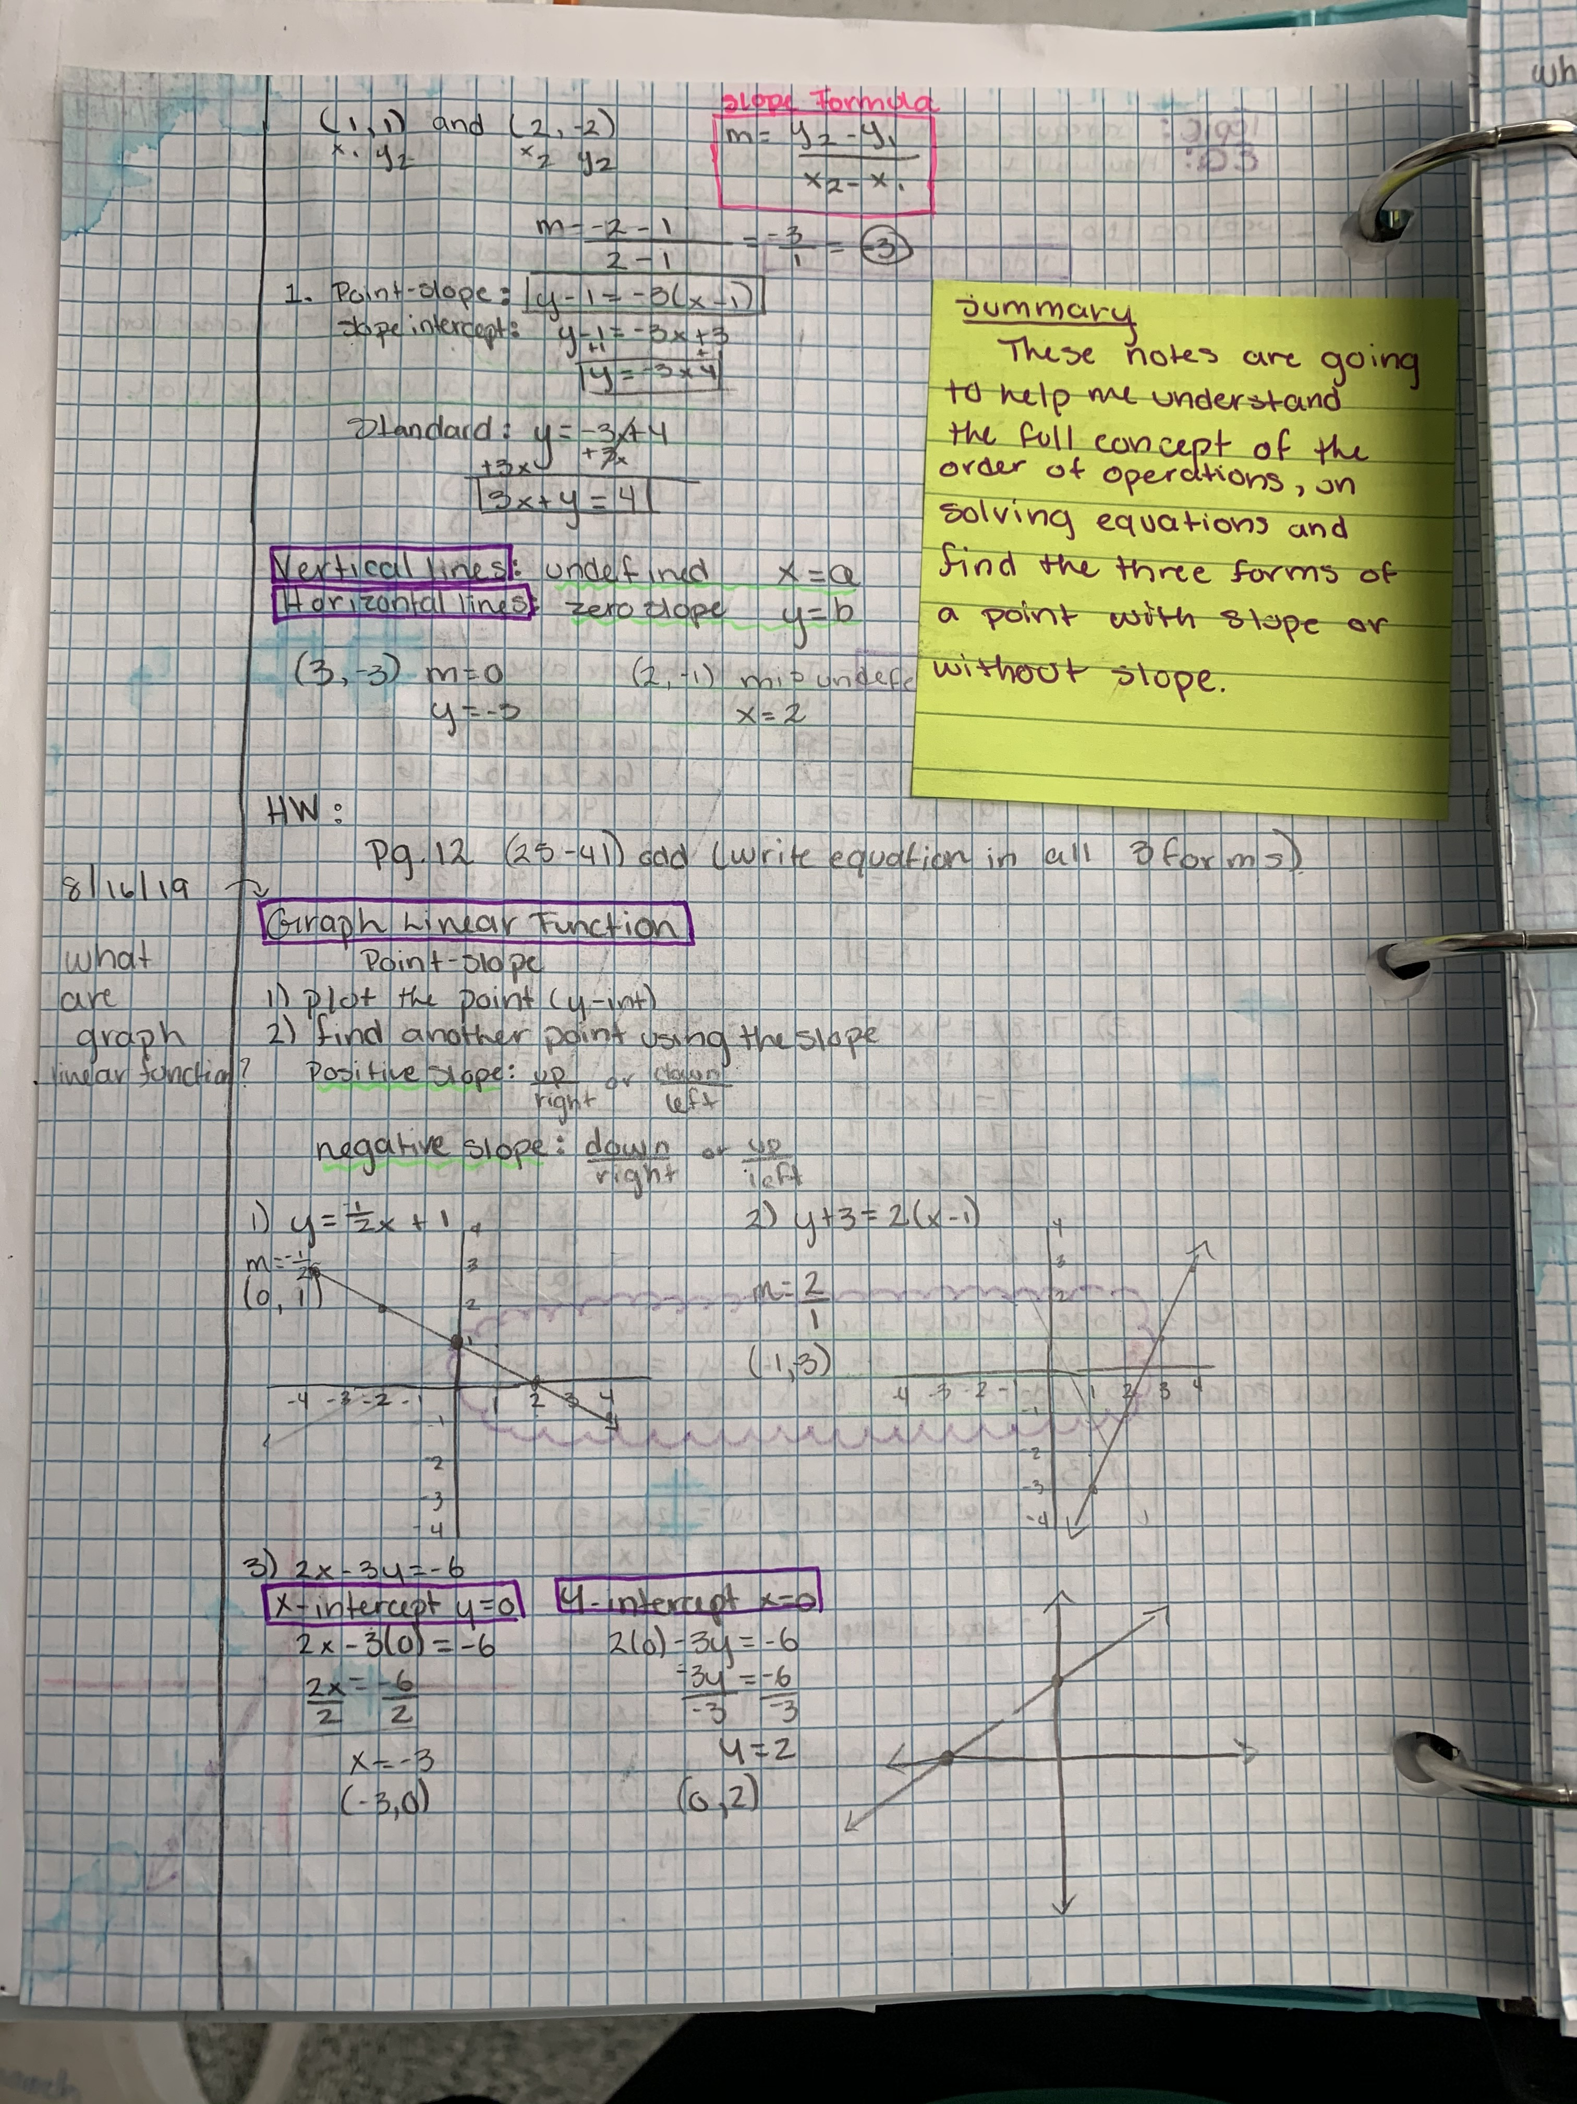

Slide 8
TRFs
Tutorial Request Forms (TRFs)
Students use TRFs for tutorials. Tutorials are a big part of the AVID program.
Students get the opportunity to receive help from an expert on something they did not understand from another class.

Slide 9
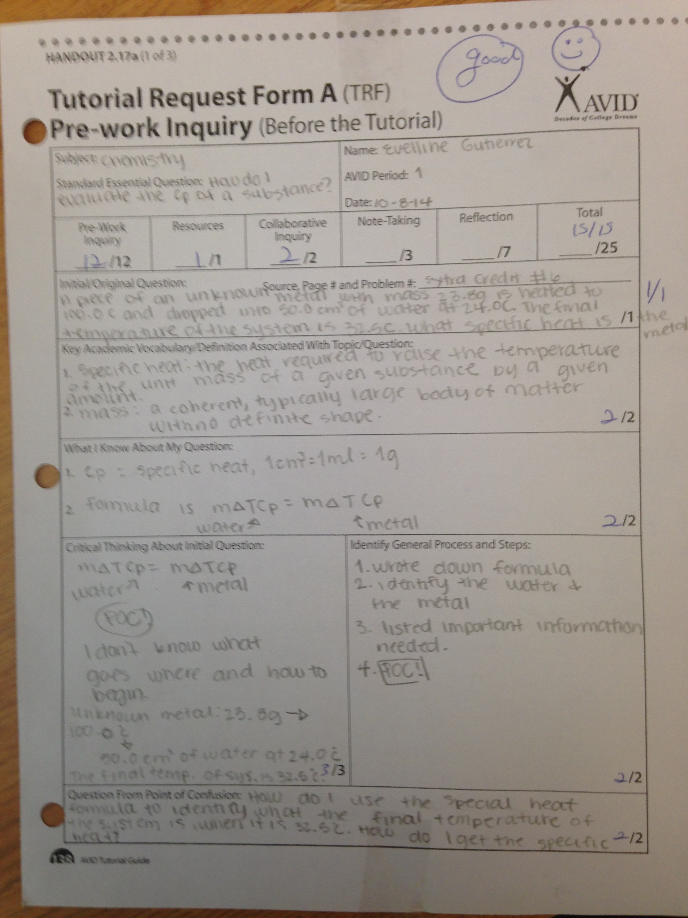

Slide 10
AVID MIDDLE VS HIGH SCHOOL
Similarities:
  Organization (binders, agenda)
  Tutorials & TRF’s
  Focus on high school & college readiness
Differences:
  Focus on graduating high school & getting into college
    College Applications
    Scholarships
    MUST GET CREDITS TO GRADUATE!
  Overnight college visits
  More individual accountability

Slide 11
FIELD TRIPS
Students in the AVID elective class participate in fundraisers in order to take college field trips.
Each year, students will participate in a minimum of 2 college visits.
Junior and Senior years students may take out-of-state field trips.
Students must meet academic eligibility in order to participate in field trips.

Slide 12
OH THE PLACES WE’VE BEEN…
The University of New Mexico
New Mexico State University (Las Cruces, NM)
New Mexico Tech (Socorro, NM)
New Mexico Highlands University (Las Vegas, NM)
Eastern New Mexico University (Portales, NM)
Northern New Mexico College (Española, NM)
Santa Fe College of Arts (Santa Fe, NM)
Colorado College (Colorado Springs, CO)
The University of Colorado (Denver, CO)
Denver University (Denver, CO)
Texas Tech University (Lubbock, TX)
Arizona State (Tempe, AZ)
Northern Arizona University (Flagstaff, AZ)
University of Nevada, Las Vegas (Las Vegas, NV)
Nevada State College (Henderson, NV)

Slide 13
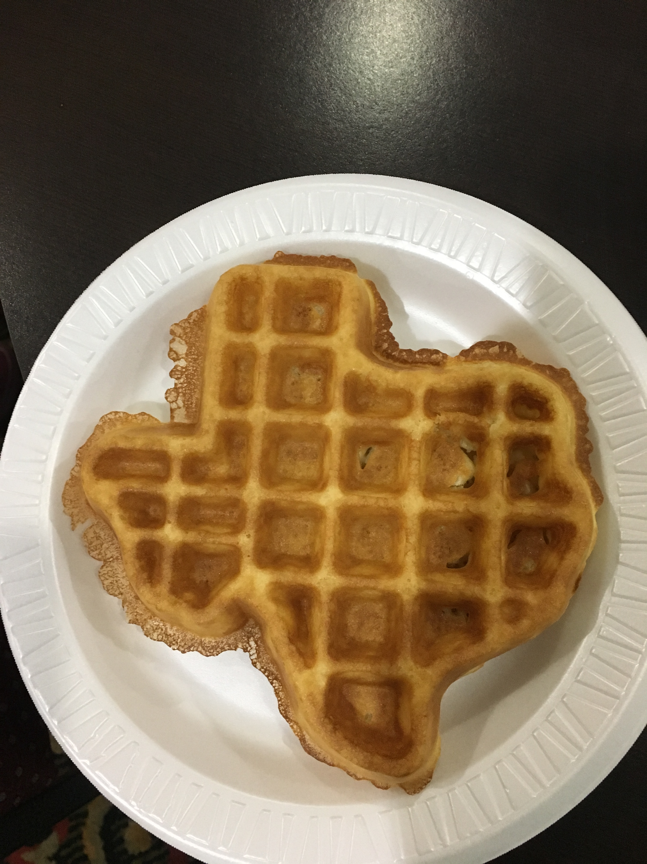
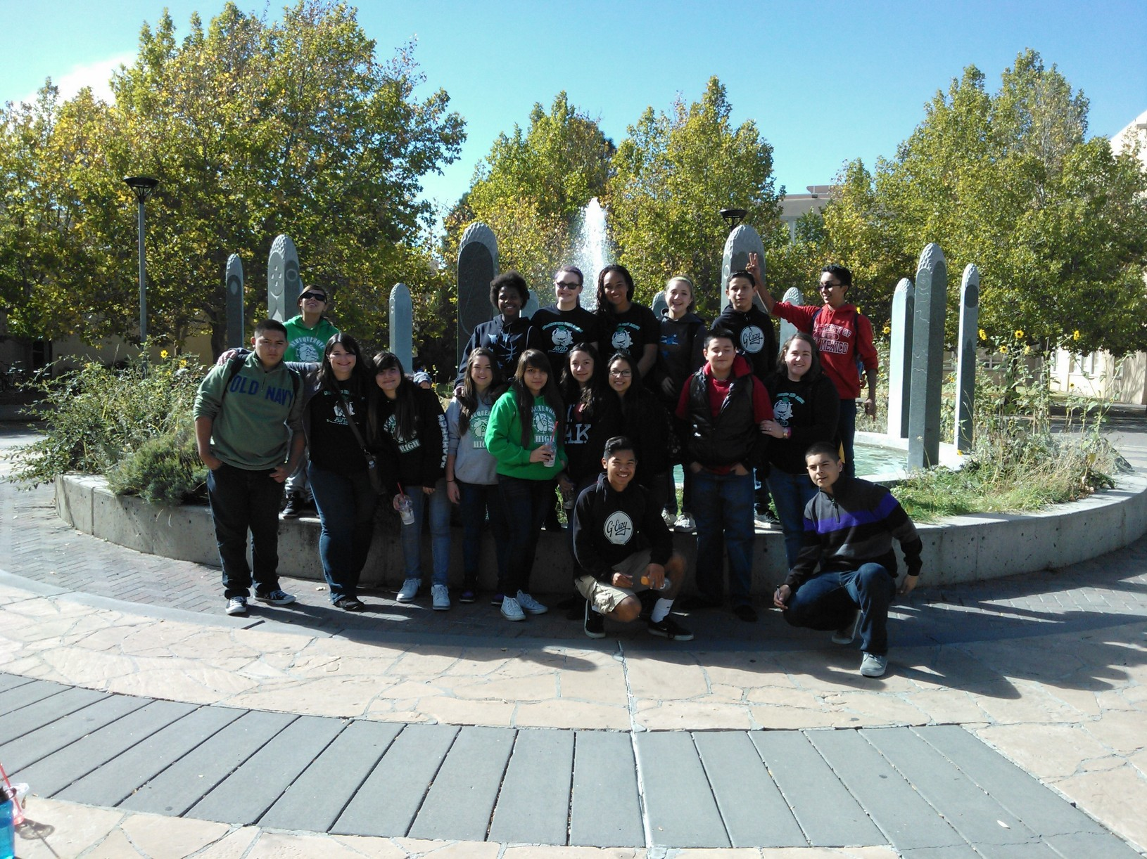

Slide 14
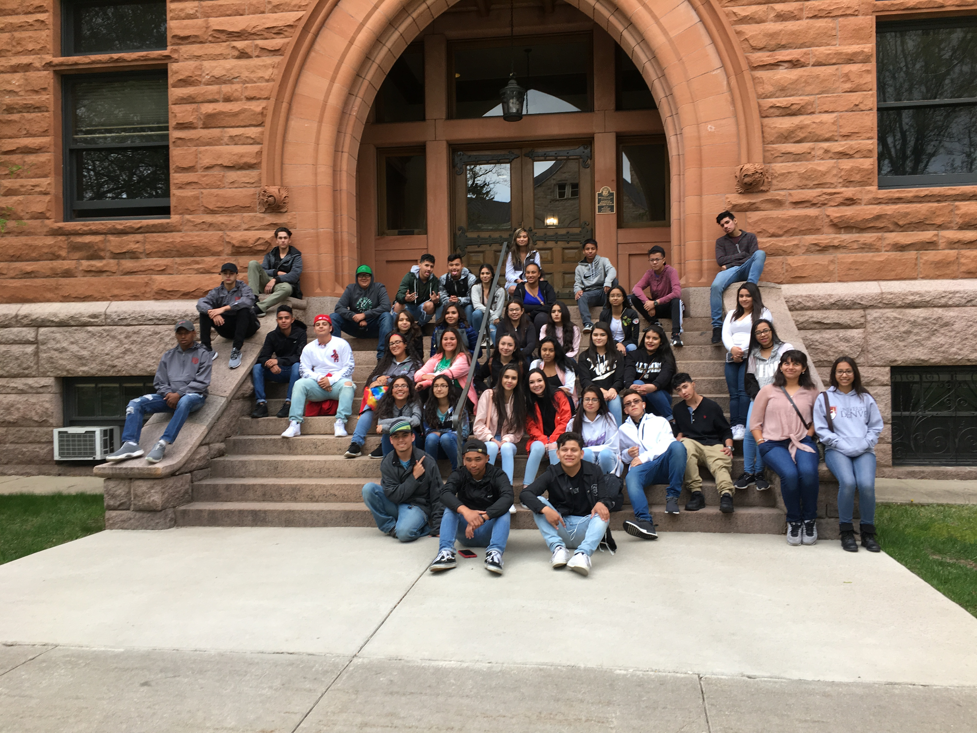
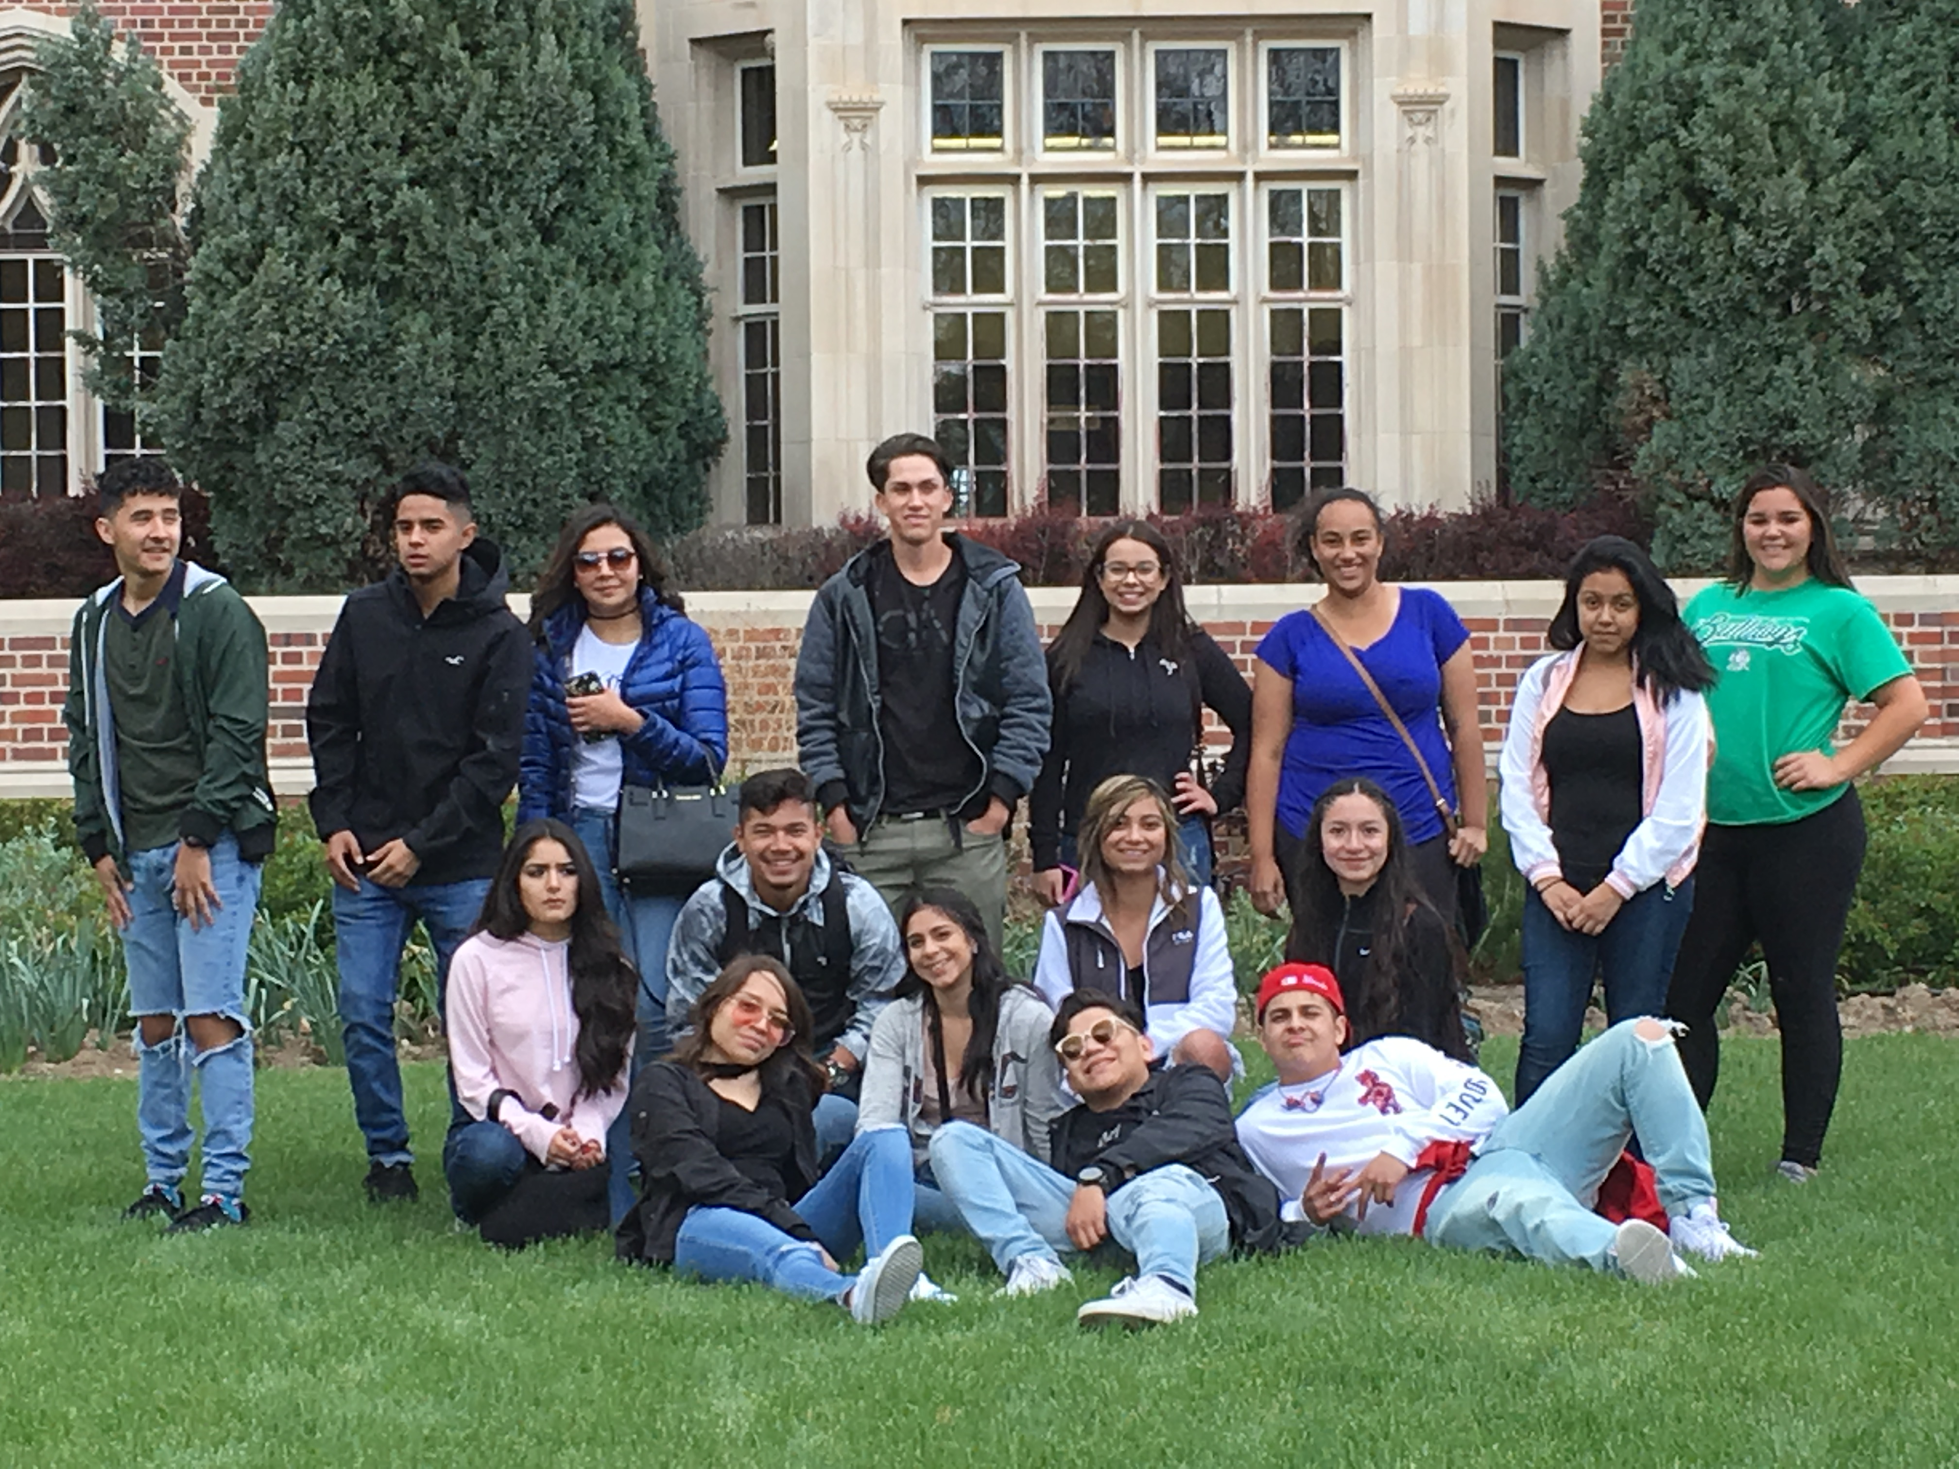
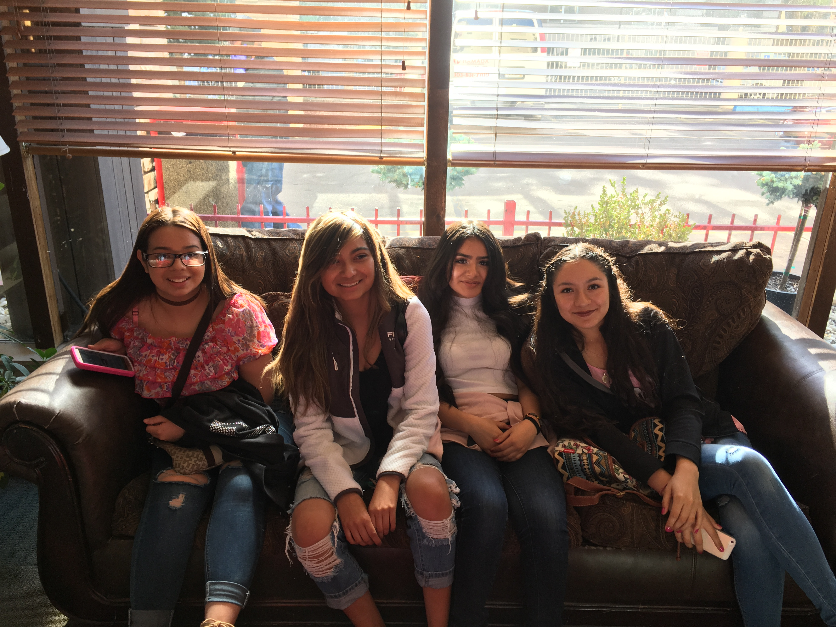
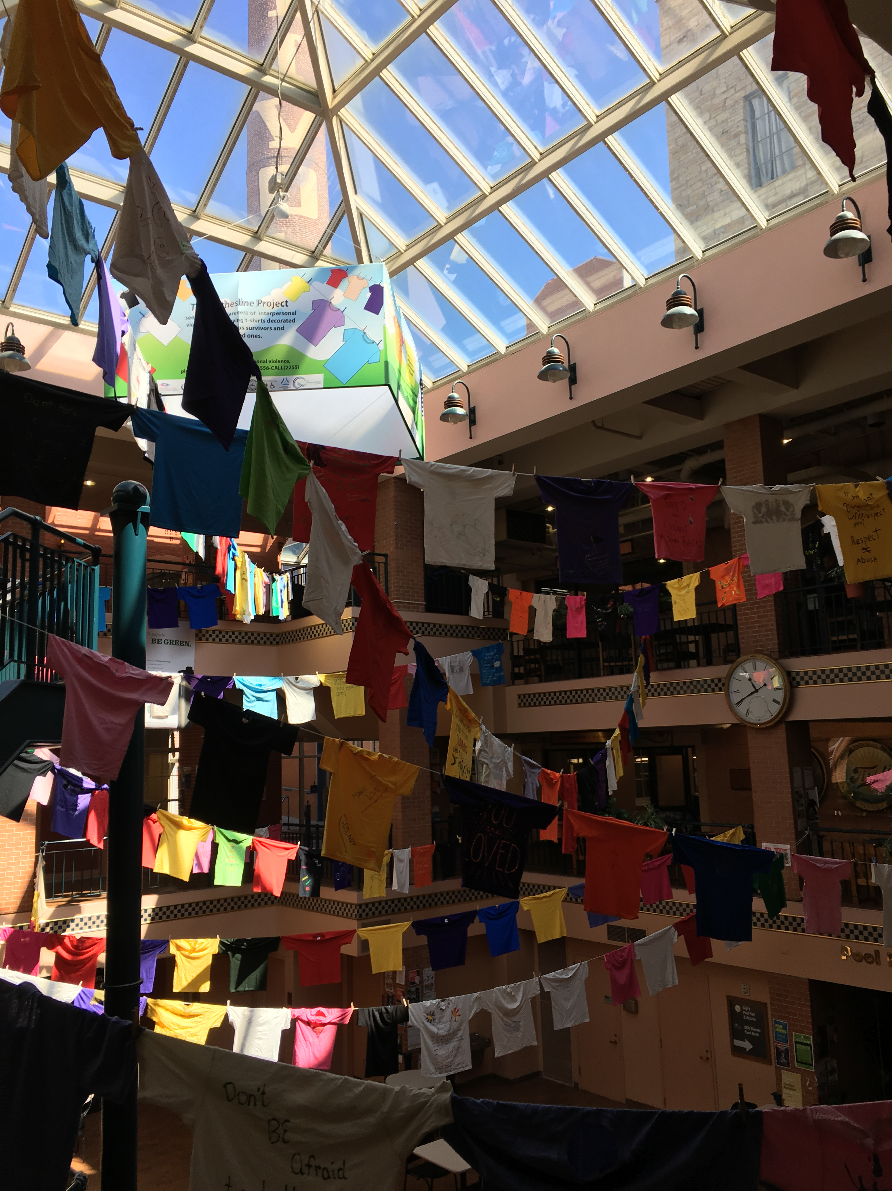

Slide 15
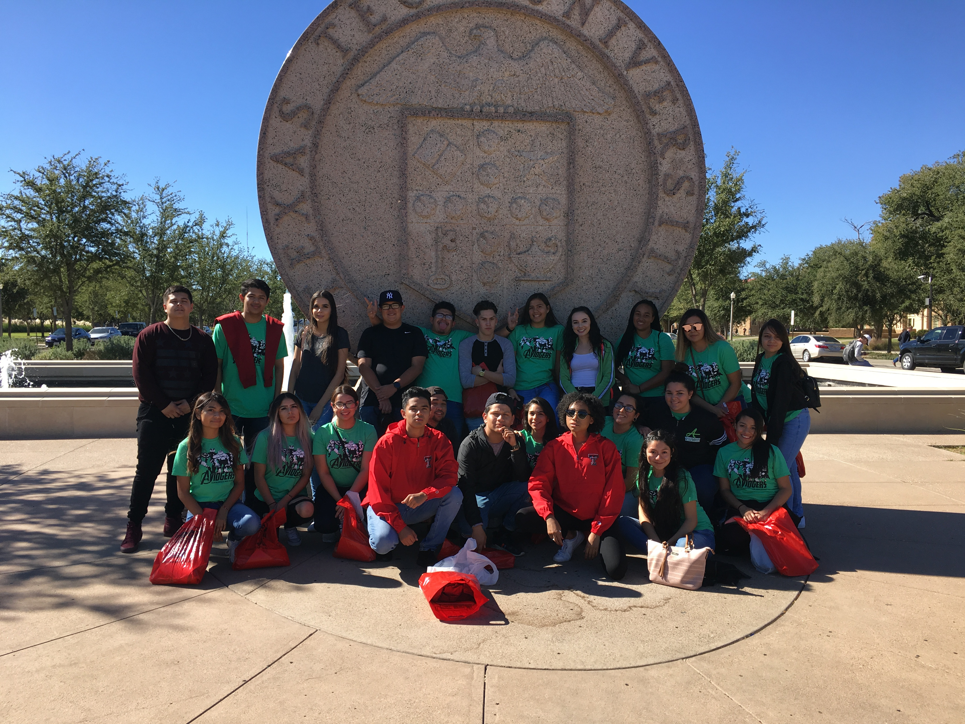
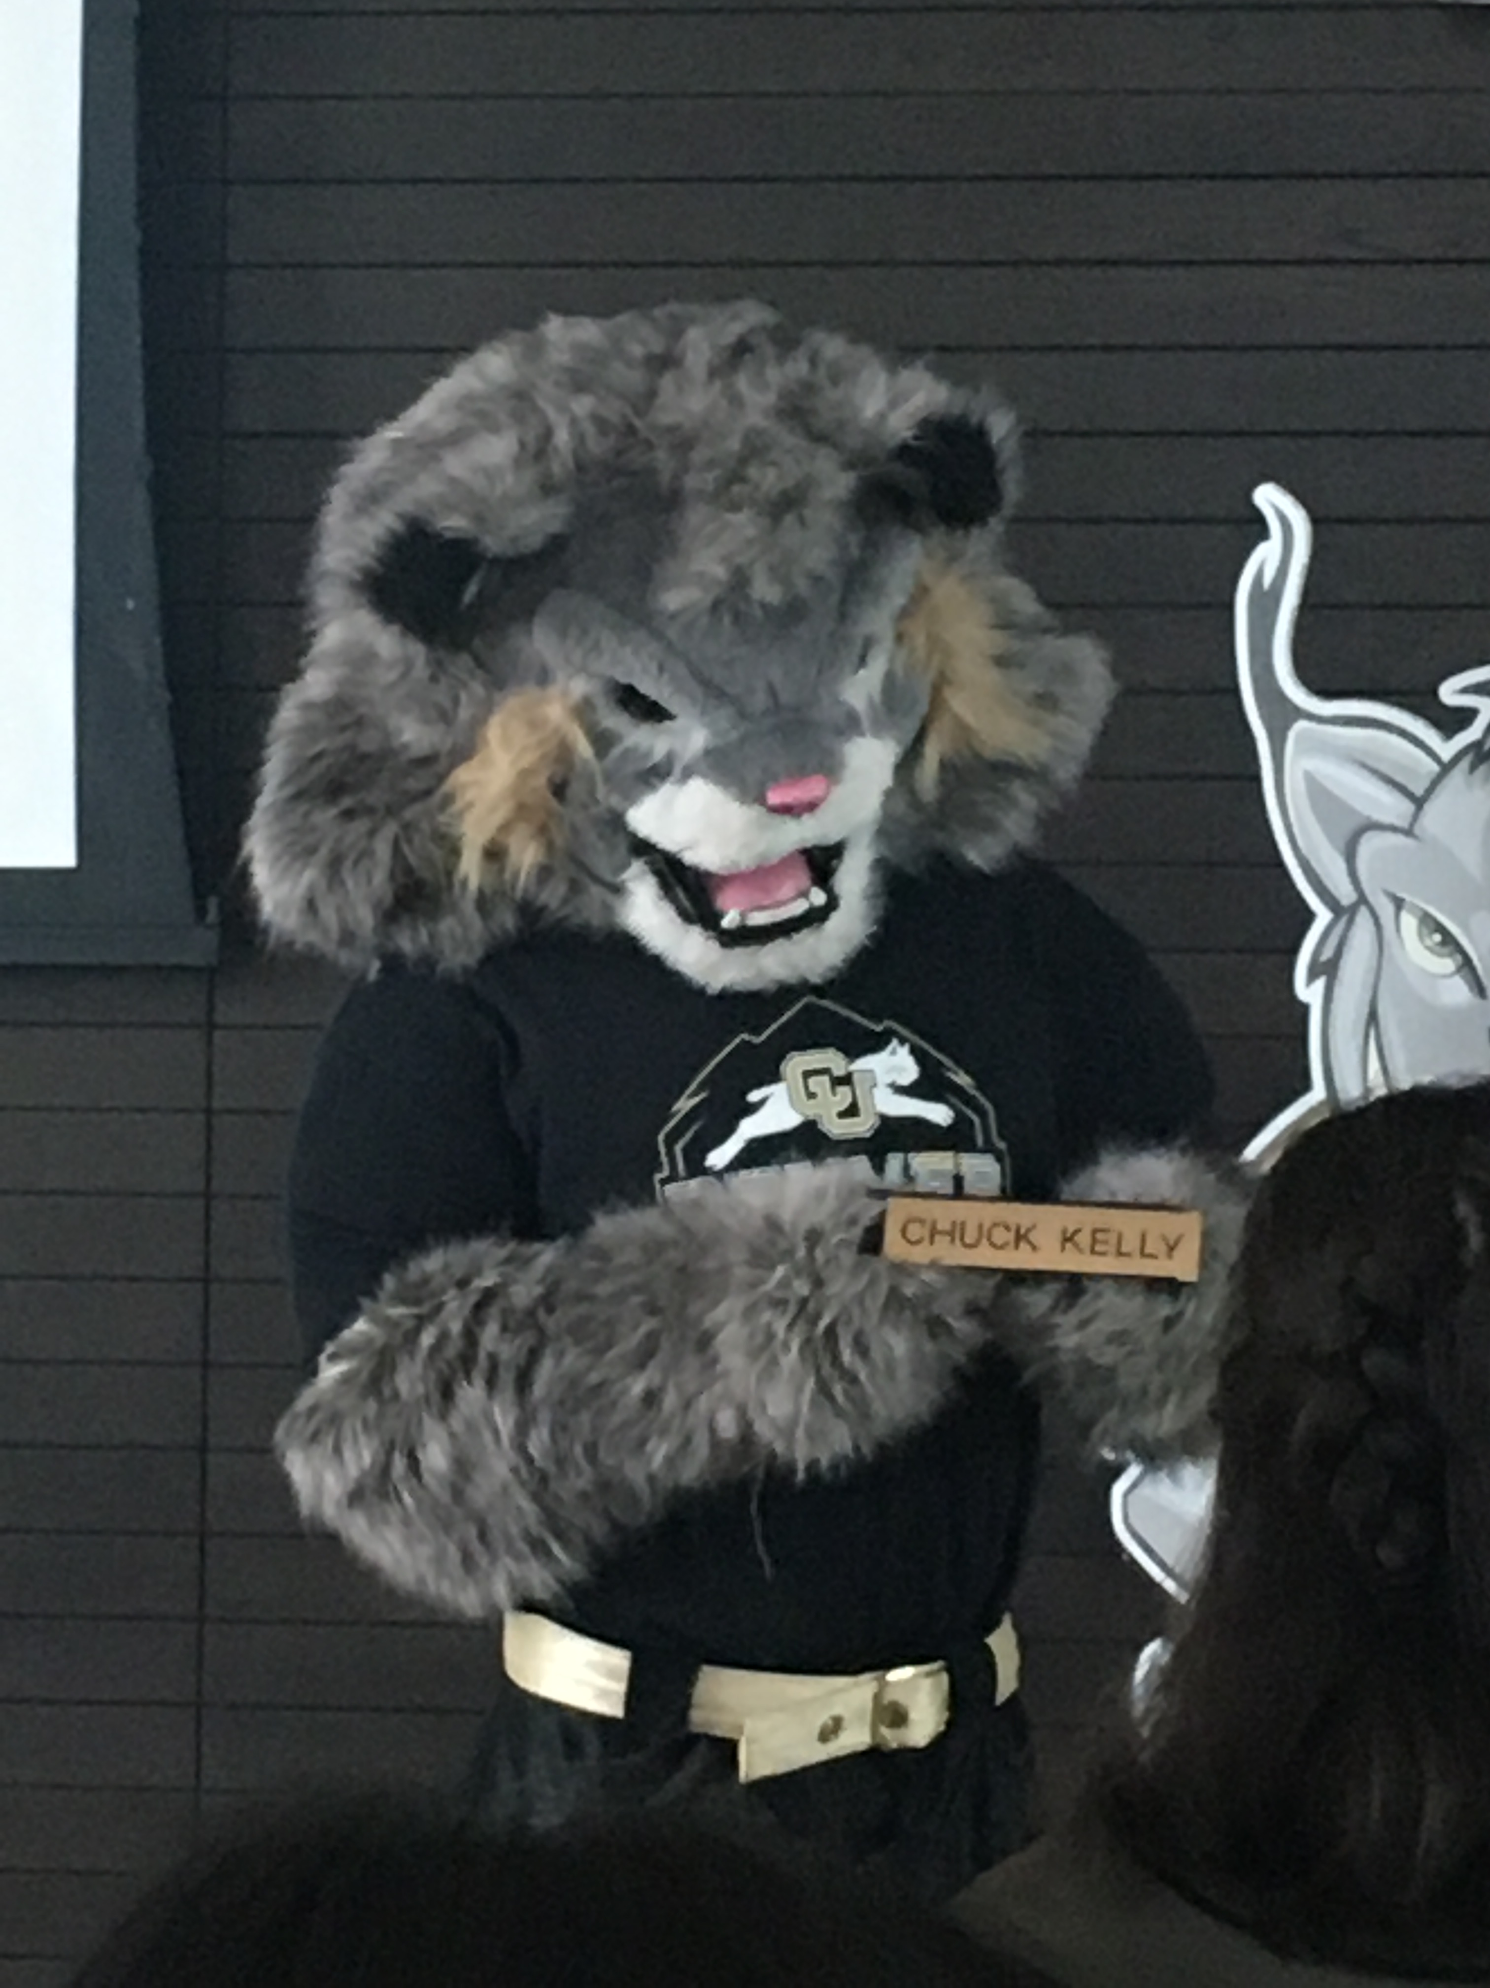
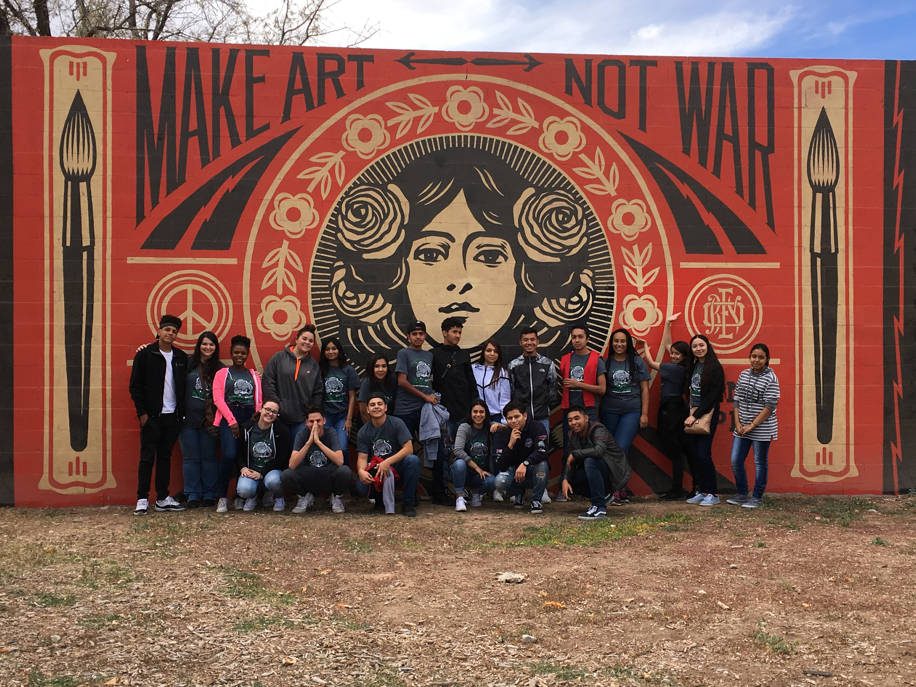
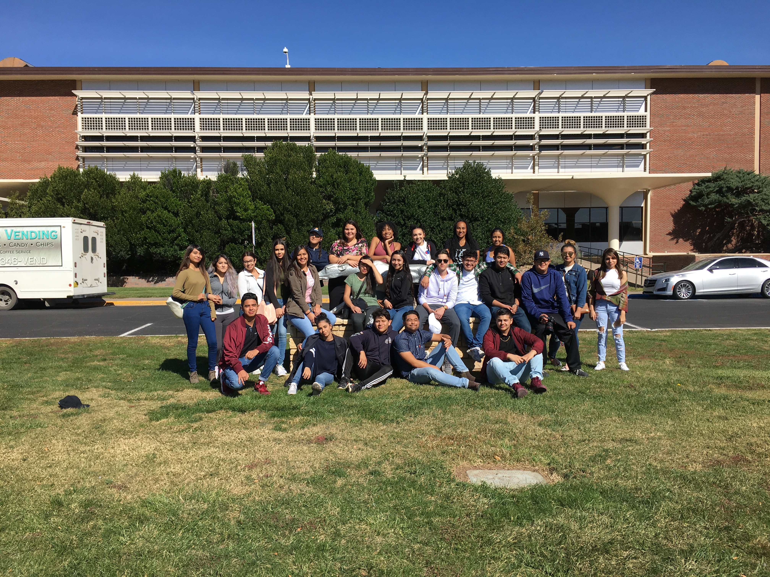

Slide 16
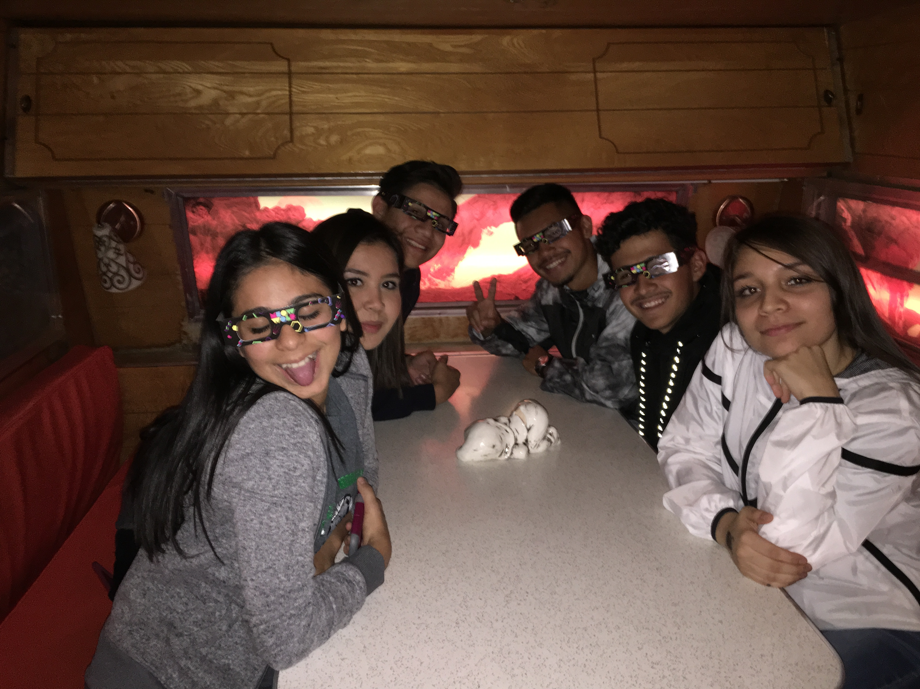
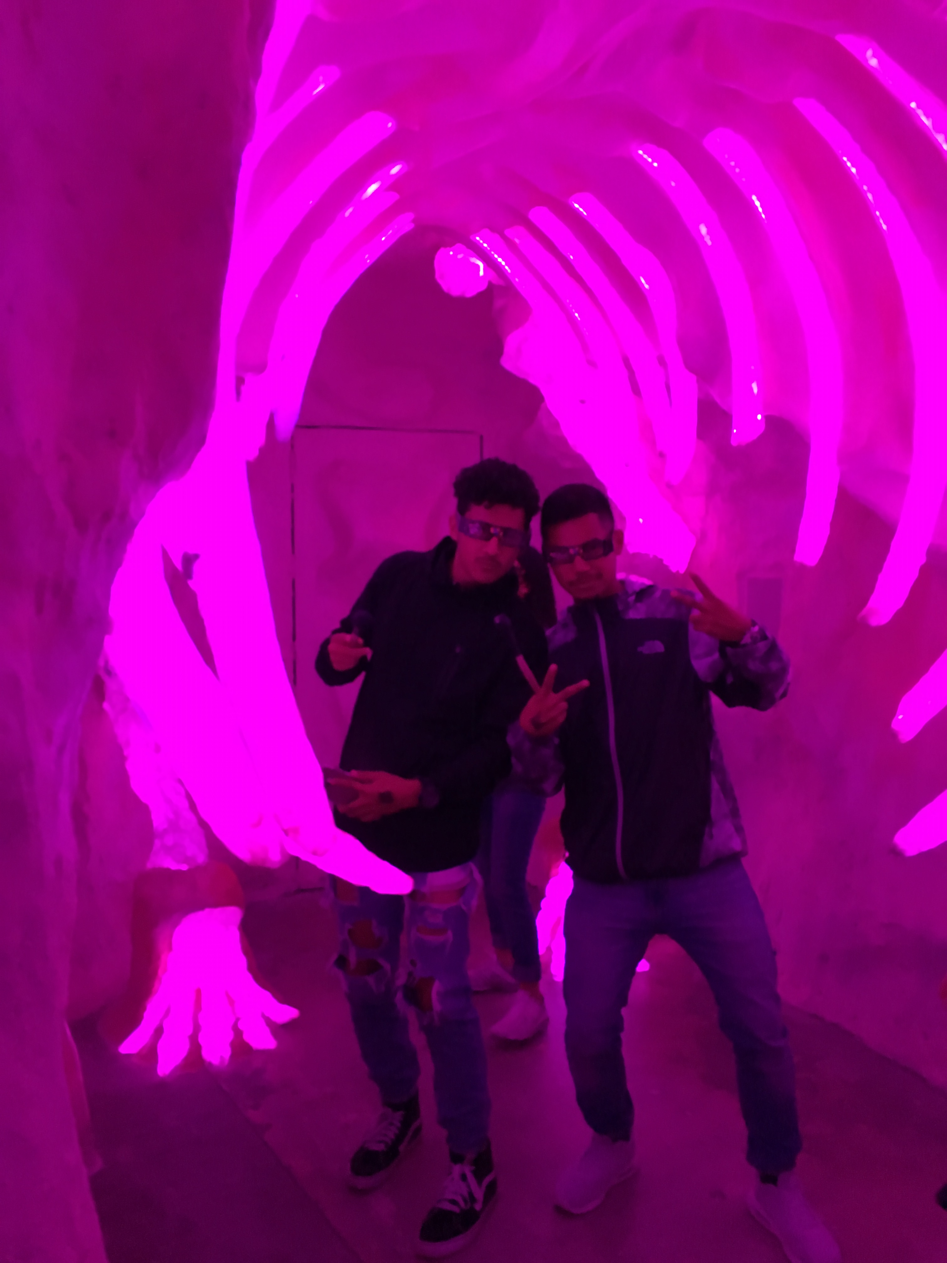
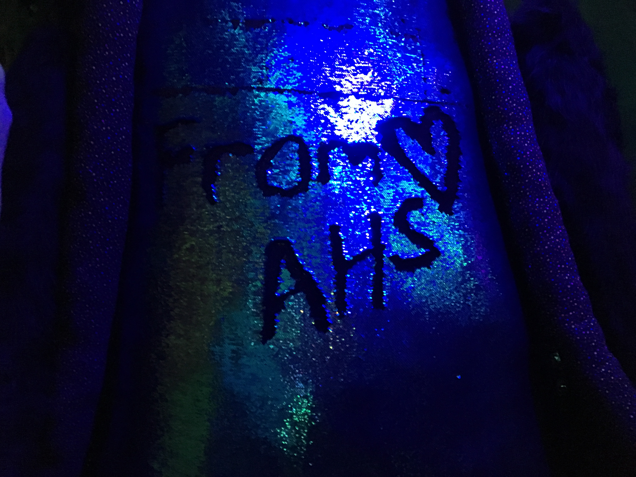

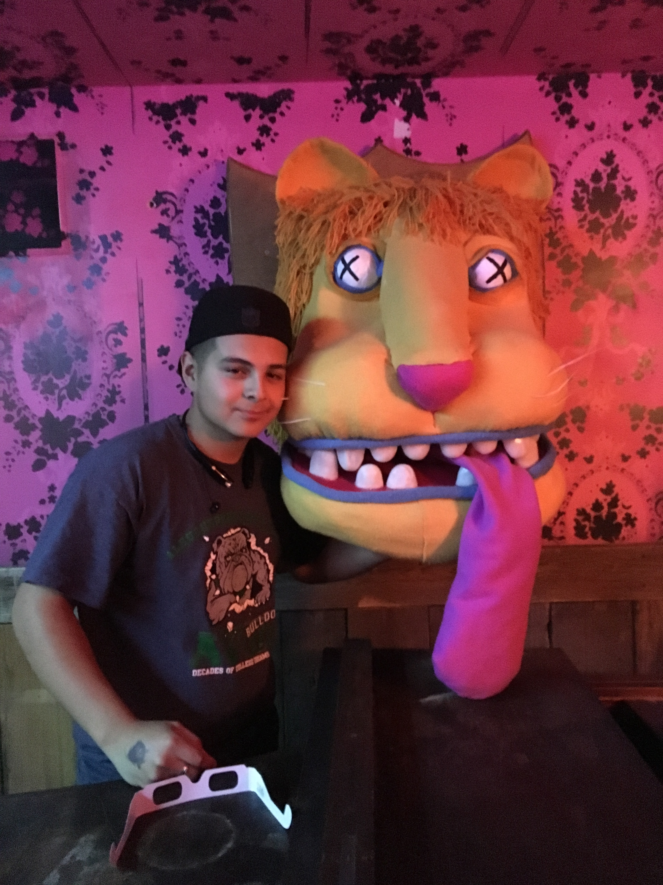

Slide 17
DO YOU WANT TO BE A MEMBER OF OUR AVID FAMILY?
See your AVID teacher for more info (spring)
  Applications will be available online
  Applications must be completed fully
  Submit a Flipgrid Interview Video
Be motivated
  AVID stands for Advancement Via Individual Determination. You have to want it!

