Slide 1
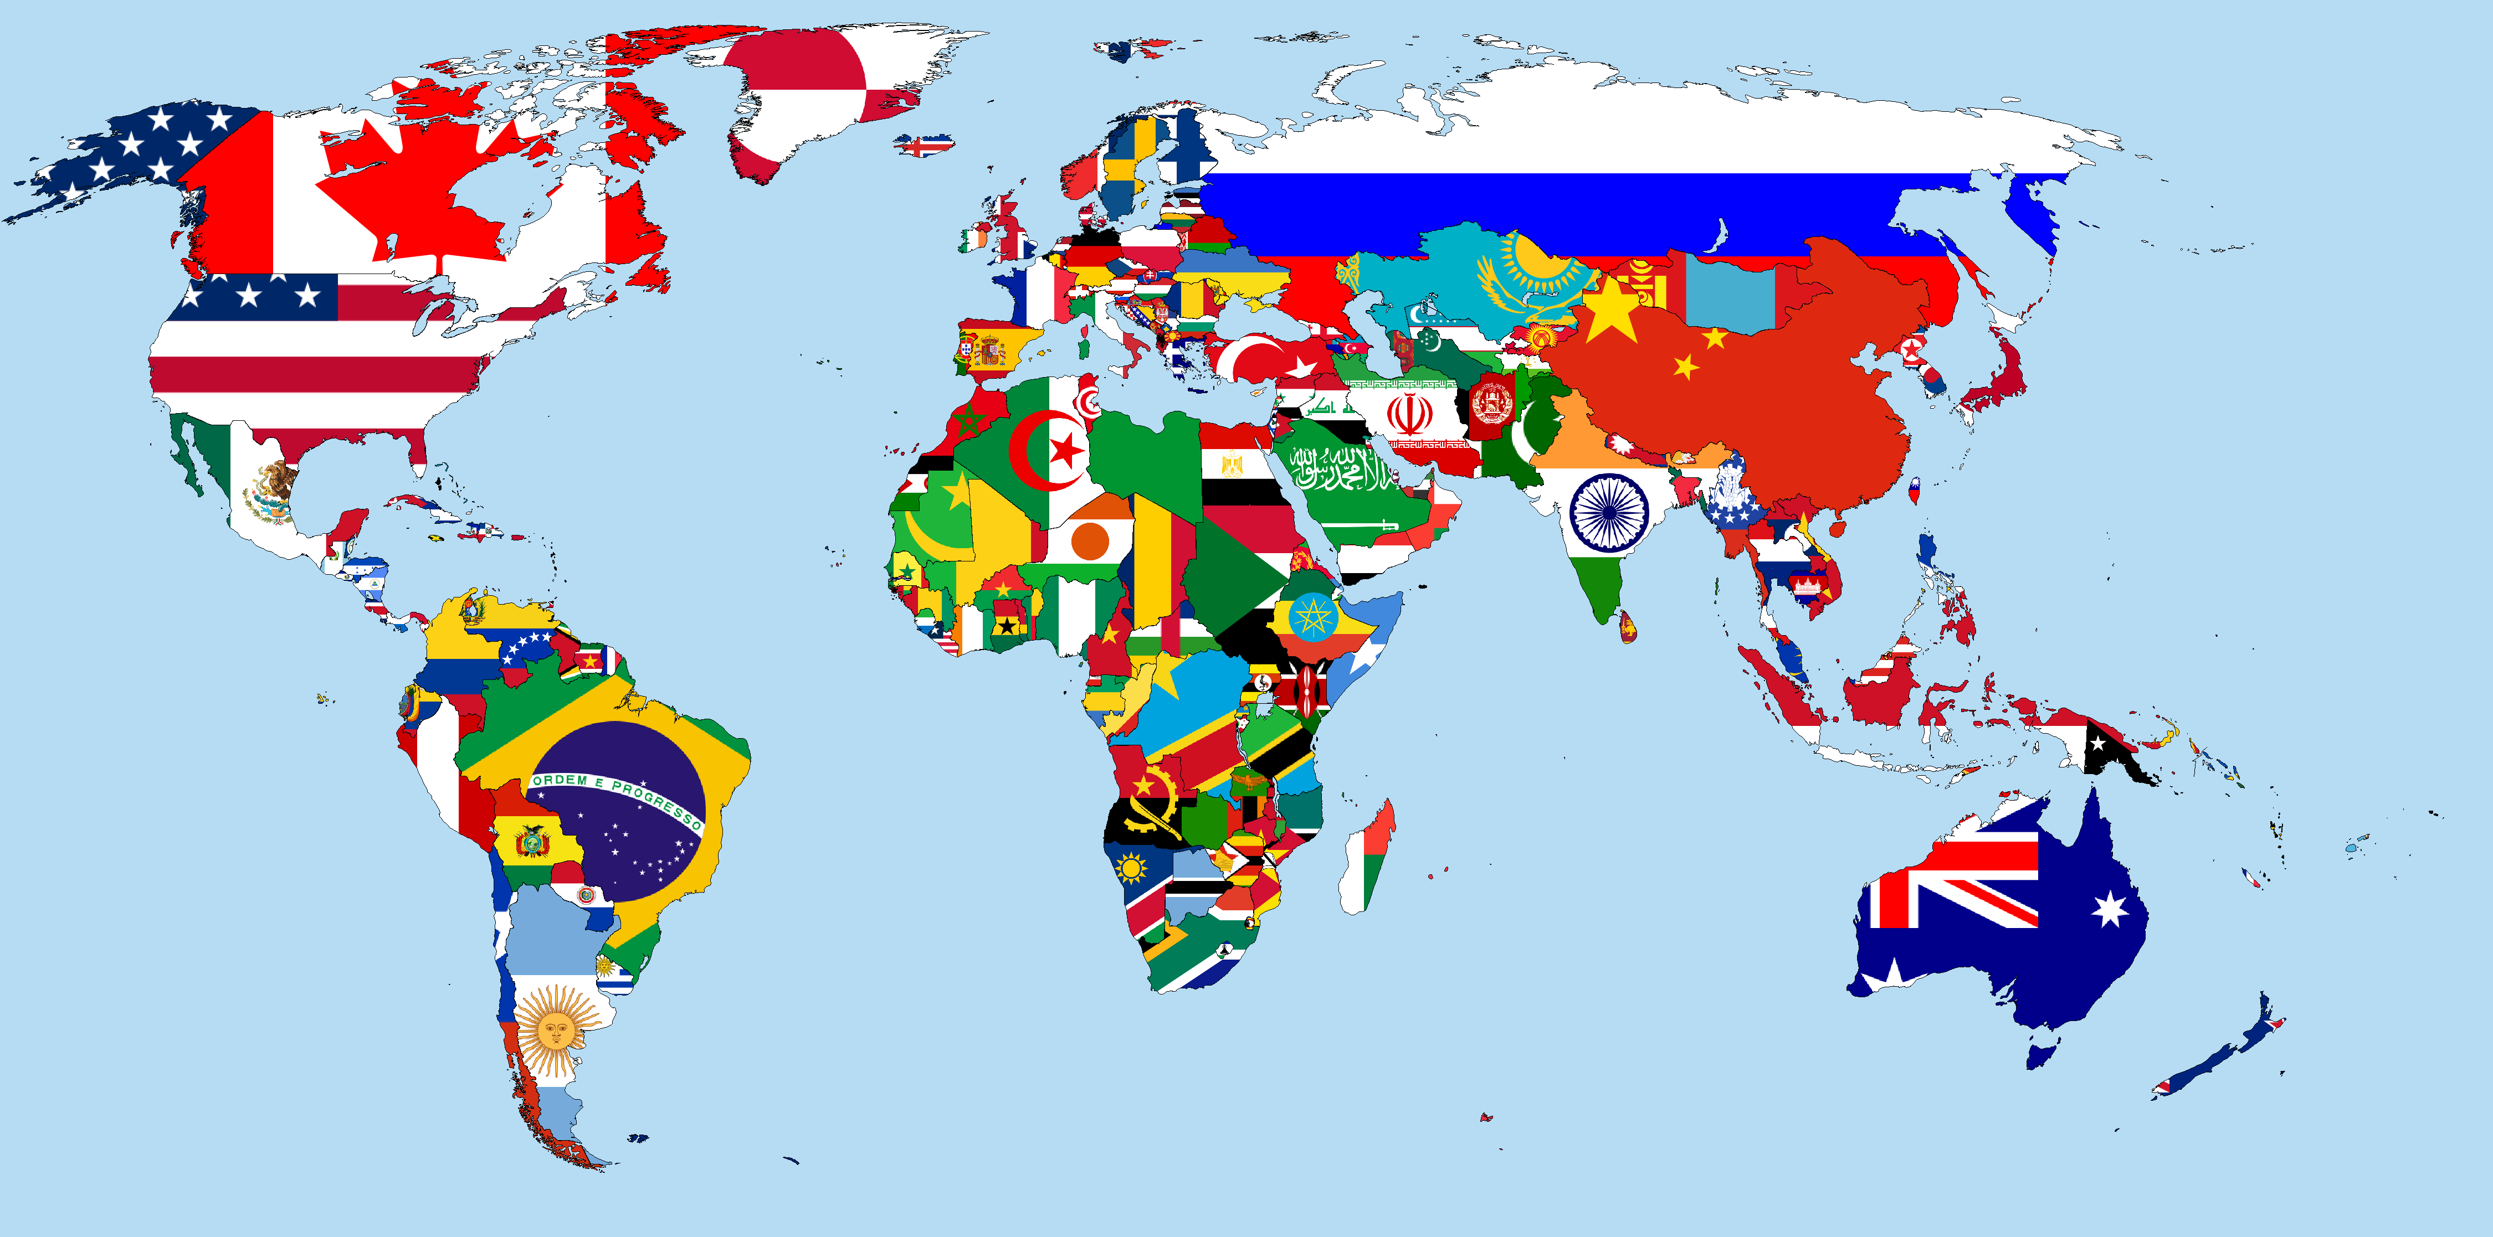
North Grove
Folk Dance Ensemble
Spring 2017
~46th International Children’s Folk Dance Festival on Saturday, May 6th 2017~

Slide 2
Long-ways Set

Slide 3
Partner Scattered/Free Formation

Slide 4
Partner Circle Formation

Slide 5
Trio Circle Formations

Slide 6
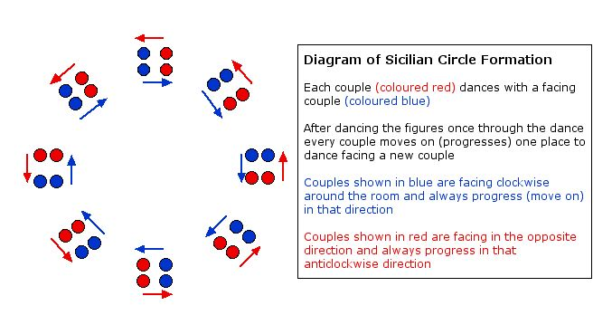
Sicilian Circle Formation!

Slide 7

Dancing Terms
Sashay/Chasse
Samba
Do-si-do
Casting off
Promenade
Polka-step
Two-step

Slide 8

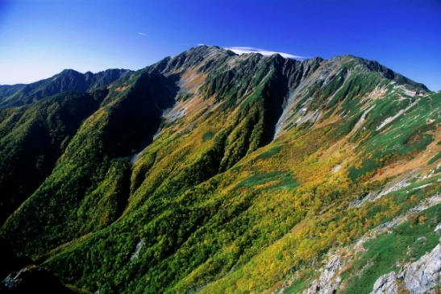
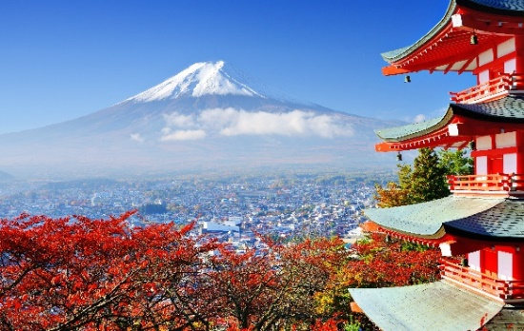
Tanko Bushi
Japanese Coal Miners’ Dance
Single Circle Facing CCW
Dig: RF toe touches then heel adds weight, LF same- arms dig on the same sides as feet
Spade over shoulder: RF toe back then heel down, LF same while arms toss coal over same shoulders
Shield eyes: same footwork as 2 plus Left arm up with palm out to shield and right arm back, then switch
Push cart: step forward R and L while arms push twice for each step at shoulder height
Dust off hands: feet come together, swing arms down and up and clap: ta ta-mi ta-di
  -Every other time add five slow claps after this figure

Slide 9

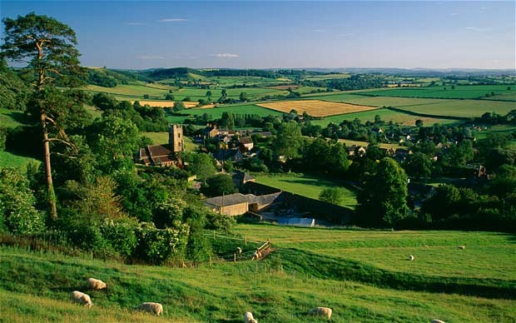
Trip to Town-O
English Country Dance
Formation: Sicilian Circle (partners shoulder-to-shoulder facing other set of partners)
Form: AABB
A1 (9+3 cts): Right hand star, circle around once with hands across (handshake)- 9 cts
-one single circle CCW on your spot- 3 cts
~right side partners, grab hands above
A2 (9+3 cts): Left hand star, circle around once with hands across (handshake)- 9 cts
-one single circle CW on your spot- 3 cts
B1 (3’s): With straight across partner, do right hand turn once around
With original side partner, do left hand turn once around
B2 (3’s): Face straight across partner and go forward and back (3 steps in, 3 steps out)
Three steps forward (right shoulder to right shoulder) and three to pass and meet new partners

Slide 10
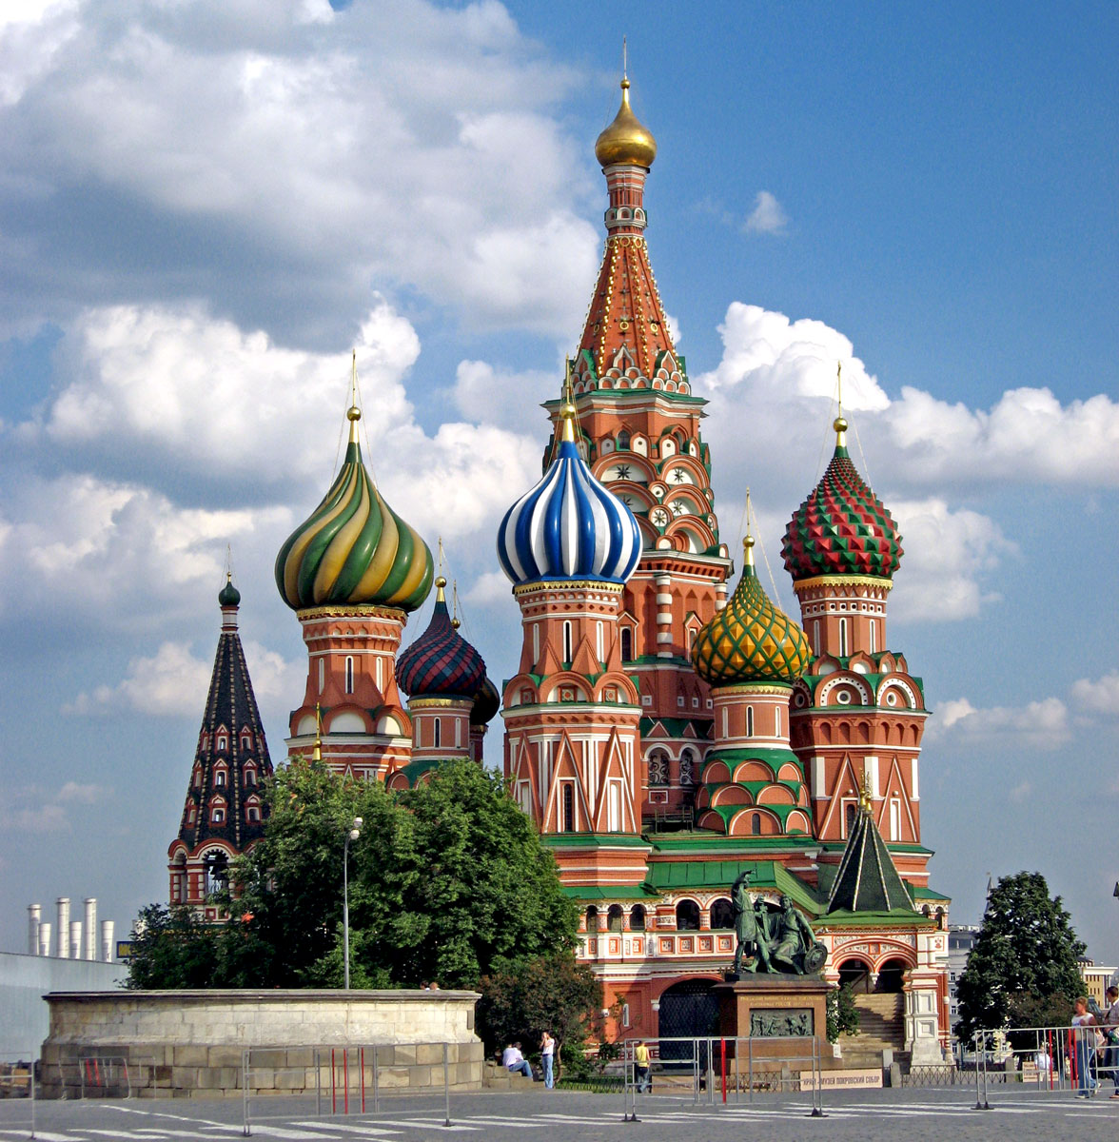
Troika
Russian Dance
Trio Formation (in rays from center); CCW movement
RF lead, 16 steps around the circle
Outer person goes under arch of other partners (8 cts)
Inside person goes under arch of other partners (8cts)
All three join hands moving in a mini CW circle 16 steps
-breakdown: 12 steps, stamp 13, 14, 15, freeze 16
Reverse circle (now trio moves in CCW pattern)
-breakdown: around 12 steps, open up into line again 13, 14, 15, prepare to move in rays again 16

Slide 11
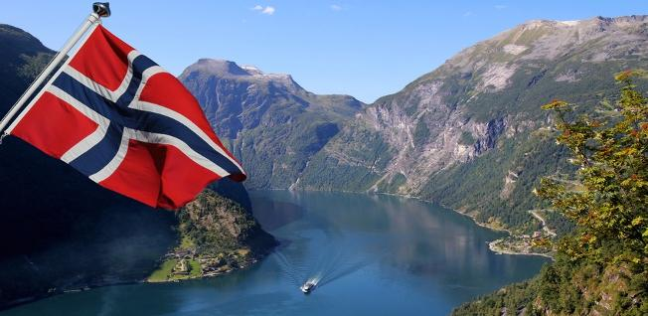
Norwegian Mountain March
Traditional Norwegian Dance – Trios in Circle Formation
~CCW movement around circle~
~Each section repeats once~
8 waltz steps forward starting with RF (repeat)
Leader of trio backs up with two waltz steps and lifts right arm up
Inside circle person goes under right arm of trio leader and is followed by outside circle person (repeat)
-front, inside, outside, front
-each person has two waltz steps to move (front person turns to front for last two)
-inside turns CW
-outer person turns CCW
*tip: hold scarves up until turn part completed

Slide 12

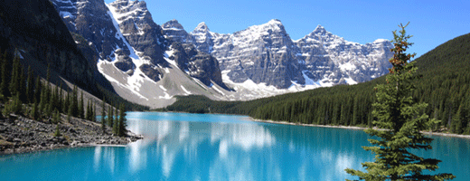
Dans a Trois
French Canadian Dance and Game
Trios in a Circle
Circle (of 3) to the left- 8 cts. (CW)
Circle to the right- 8 cts. (CCW)
Promenade in rays CCW for- 16 cts.
Outside person under arch- 8 cts.
Inside person under arch- 8 cts.
Center does right elbow turn with outside person and left elbow turn with inside- 16 cts.
Repeat elbow turns- 16 cts.
Edge people make archway for center people to walk through until music stops

Slide 13


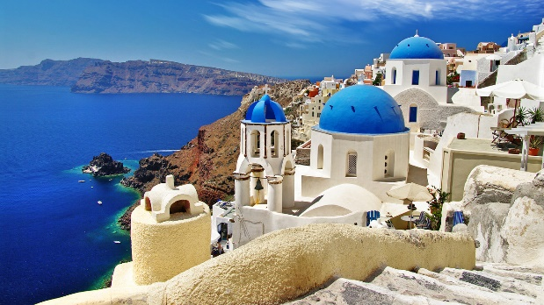
Lerikos
Greek Dance
Circle Formation, No Partner
Intro (32 counts long)
  holding hands, arms up, elbows bent at heart height
Part I- Singing 8 x’s
  GRAPEVINE with beat RF lead: step, behind, step, front, step, heel (LF)
  – Forward: L, R, L (rhythm: ta-di ta)
Part II- Instrumental 4 x’s
  GRAPEVINE with beat RF lead: step, behind, step, heel
  Forward 7 steps: L,R,L,R,L,R,L (ta-di ta-di ta-di ta)
  *NOTE: let grapevine part move you back out of center!

Slide 14
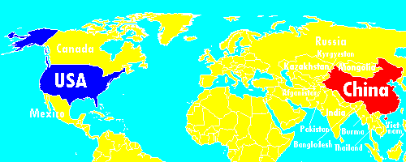
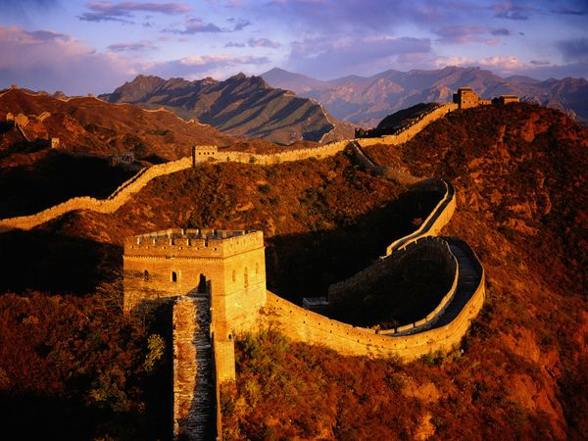
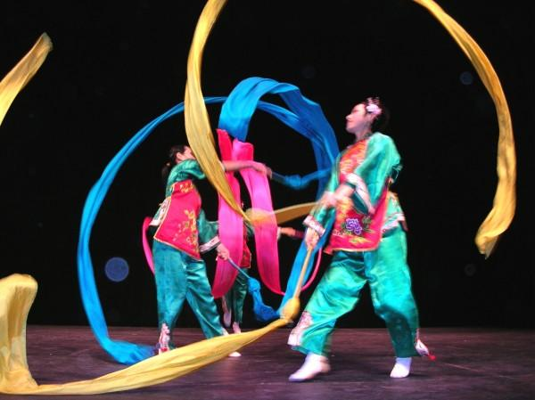
Chinese Ribbon Dance
FREE FORMATION
Hold ribbons in RIGHT hand and out of sight until you hear cymbals. 16 beats of moving and 4 beats to transition.
1st movement: Overhead, clockwise
2nd movement: In front, clockwise
3rd movement: “Backstroke” on right side with right hand
4th movement: “Backstroke” on left side with the left hand
5th movement: Right hand figure 8 in front
6th movement: “Back – front” figure 8 around your head
7th movement: Do a huge figure 8, alternating between right side of your body and the left side.
8th movement: In front, clockwise
Take a long bow ☺

Slide 15

Virginia Reel
Dates back to the 17th century! Most popular dance in America in the 1800’s.
LONG-WAYS SET
(8 is the magic number!)
Forward and back (2x’s)- in for 4, out for 4
Right elbow turn
Left elbow turn
Two hand turn
Do-si-do (hands to your sides)
Head couple: sashay down and back (16 cts.)
Head couple: right arm to partner and reel.
Sashay back
Cast off (aka: peel the banana!)
Under the arch and start again.

Slide 16

El Llanero
Venezuelan Dance
Long-ways set with lines facing each other
Move in grouping by 4’s and 8’s, waltz feel
Part I: Waltz Steps
  4 waltz steps in place (L, R, wait; R, L, wait…or facing line R, L, wait; L, R, wait)
    Turn body slightly with steps
    Accent beat one with a little stomp
    Boys line should have their L sides to the audience
  forward 2 and back 2 waltz steps from partner
  REPEAT
  forward 2 steps to partner and then 5 waltz steps to circle away from partner and back to original place
  end with 2 stomps in place
Part II:
  7 brush steps moving toward audience
  End with two stomps in place
  REPEAT this going opposite direction (toward audience)
Perform Parts I and II THREE times through
Coda:
  8 waltz steps toward partner
  On these steps, right shoulders next to each other, circle around each other
  Everyone ends in one straight line

Slide 17
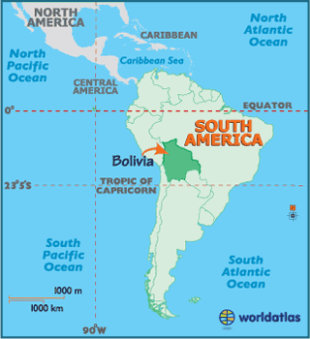

Chilili
Traditional Bolivian Dance
LONG-WAYS SET
Basic move= 3 steps, snap (up), 3 steps, clap (down)
Right 3 and snap, Left 3 and clap [2 x’s!]
In 3 (snap, look away), Out 3 (clap) [2 x’s]
In 3 (snap, face partner), Forward 3 (add a half turn and clap)- You will be in the OPPOSITE line after this move!

Slide 18

Norteño Mixer
Mexican Dance
Double Circle with Partners Facing
Truths to remember: stay light on your feet! Your partner will change- that’s why it’s called a mixer. ☺
Part I: inner circle moves CCW and outer circle moves CW
-step back on L, clap own hands
-cross over with R, clap hands with partner
-repeat: will clap hands with eight people *including original partner*
Part II (corrido): in and out of the circle in rays like a sun or a bunch of “W’s”
-partners holding hands in front of you
-inner person step back with L, R, L, R
-at same time, outer person stepping forward R, L, R, L
-while doing this, pair moving in a zigzag fashion
-repeat
Part III: open circle, partners standing next to each other and facing CCW
-step forward for 1, 2, 3, kick with outside feet
-step backward for 1, 2, 3, kick with inside feet
-repeat
Part IV: polka steps
-eight polka steps forward
-polka step= R, L, R and L, R, L…
-begin with inside foot

Slide 19

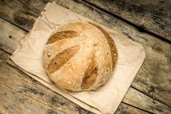

De Strigat
Romanian Dance
Circle formation, no partner
Celebratory Wedding Preparation Dance
Introduction (32 cts.)
Part 1: (24 cts.)
  RF lead, walking around circle CCW facing direction of travel
  Girls pretend to swish skirt
Part 2: (24 cts.)
  Continue walking around circle
  Add hands up in the air holding imaginary crown of flowers or loaf of bread
Part 3:
  Move into circle
  Small Step: R, clap, L, clap, R, clap-clap-clap
  Small Step: L, clap, R, clap, L, clap-clap-clap
  Small Step: R, clap, L, clap, R, clap-clap-clap
  Small Step: L, clap, R, clap, L, clap-clap-clap
Part 4: (rhythm for each of these moves is ta ta ta-di ta)
  Turn RF out, together, R, together, R
  Turn LF out, together, L, together, L
  Turn RF out, together, R, together, R
  Turn LF out, together, L, together, L

Slide 20
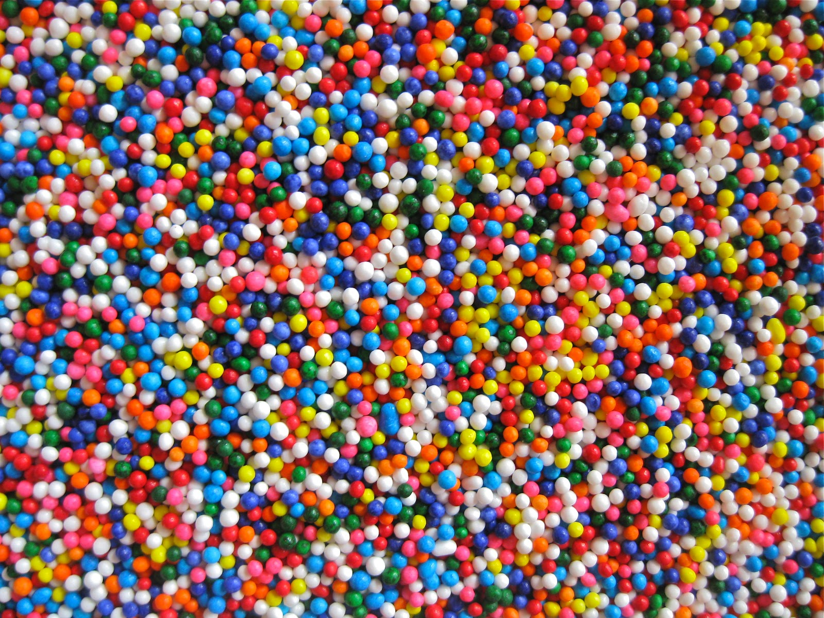
Montego Bay
American Dance
FREE FORMATION
Step together step to L for 4, clap
Step together step to R for 4, clap
Turn R, one- arm snaps over head: L, R, L
Three step turn to front
Forward: step (L), together, step,
R Kick, foot down, pat both thighs

Slide 21

Dances from past festivals…

Slide 22

Gün Ola
Traditional Turkish Dance
Close Crescent Moon or Circle Formation
Dance begins after two phrases of the music.
Hold hands up at elbow level with neighbors.
All about left foot!
PART 1:
LF over RF three times, bending knees during crossover
Then kick LF
Repeat until singing (eleven times through)
Part 2:
-two two-steps forward twice (LRL, RLR)
-stomp, pause, stomp
-repeat
-turn over R shoulder!
-three two-steps forward (LRL, RLR, LRL)
-step on R and turn over R shoulder while on this foot
-keep left foot lifted
-repeat all of Part II

Slide 23
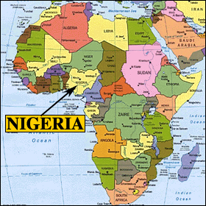
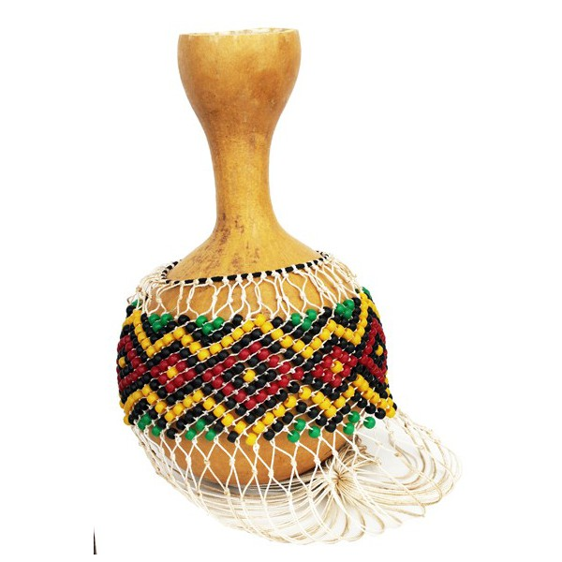
Ibo
Nigerian Dance
Long-ways Set, No Partners
Girl Part: begins dance- each group dances to impress the other who is watching
  Chopping motion with hands while two-step, side-to-side, starting RF (8 steps)
  4 Strong steps (RF forward, L arm bent with fist up, then same on L side…)
  Step back on RF and 360 spin/jump over 4 counts
  In place, step R, L, R, L on balls of feet
Boy Part: begin with back to audience/facing girl line, holding scarves low
  Step touch R, L for 8 beat (push scarf forward over head)
  LF grounded, RF steps in place 8 times while R arm shakes scarf held above head
  Swing scarf back, half turn around (toward other line) and jump back 4 times with scarf in both hands

Slide 24
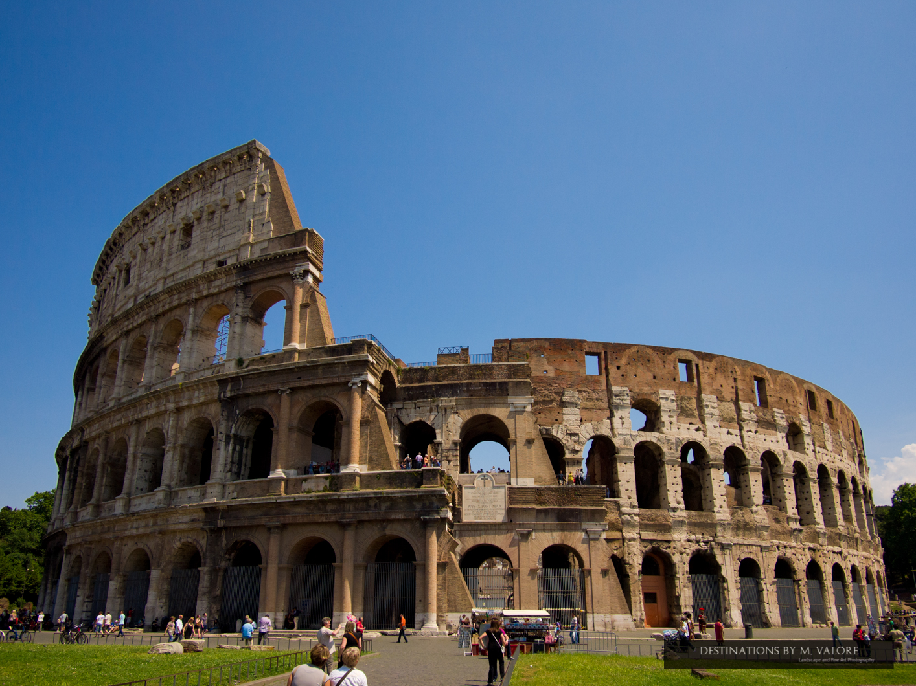

Tarantella
Traditional Italian
Circle Formation
1st Section= Circle, Arm, Pivot, Do-si-do
  Circle (16 L, 16 R)
  Arm (8 R, 8L, 8R, 8L)
  Pivot (on your own 8R, 8L)
  Do-si-do (16 R, 16L)
Second section= Circle, Arm, Pivot, Kneel
  Circle (16 L, 16 R)
  Arm (8 R, 8L, 8R, 8L)
  Pivot (on your own 8R, 8L)
  Kneel (16 around while partner A kneels, switch, 16 while B kneels)
Ending= Circle Outside (16 L and bow!)

Slide 25


La Bastringue
French Canadian Dance
Circle Formation standing next to partner (ABAB), take hands
Part I:
  Three steps into circle (L, R, L, kick R)
  Three steps out of circle (L, R, L, kick R)
Part II:
  Four two-steps to the left (bouncy)
  Four two-steps to the right (bouncy)
Part III:
  Partner A (girls) drops LH, B (boys) drop RH
  B’s lift hand and turn partner once under arm, 4 counts
  two-hand swing around for 12 counts
  Open and partner A is beside and on the outside of B going around the circle counterclockwise
  Promenade around (8 two-steps)
  Reform a circle, and everyone will have a new partner!

Slide 26
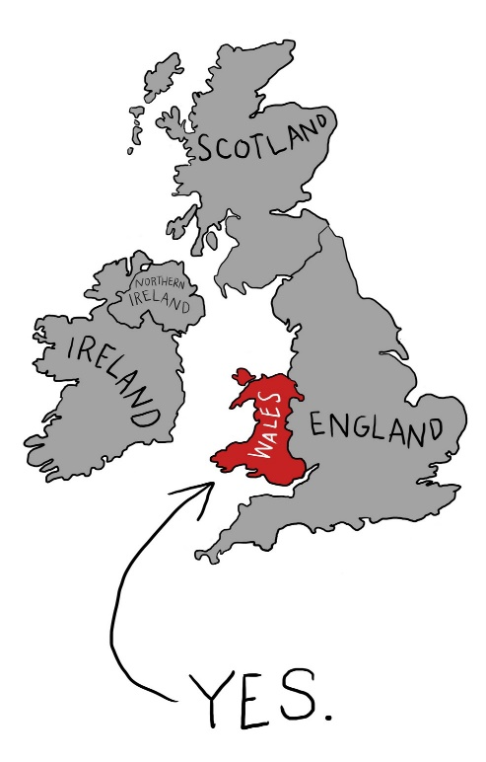

Robin Ddiog
“Lazy Robin”
Welsh Dance
Sicilian Circle Formation
Intro: one sustained note
Part I:
  Right hand star, circle around for 8
  Left hand star, circle around for 8
Part II:
  Couples facing CCW go under, over, under (8, 8, 8)
  Right hands join with two new people in another partner pair
  *TIP: Whichever direction you begin moving (CCW or CW, you always travel around the circle that way)
  *During chorus, you can sing the translated Welsh lyrics: “Hi, di-ho, di-hi-di-hi-di-ho- and the wind blows through the doorway.” ☺

Slide 27
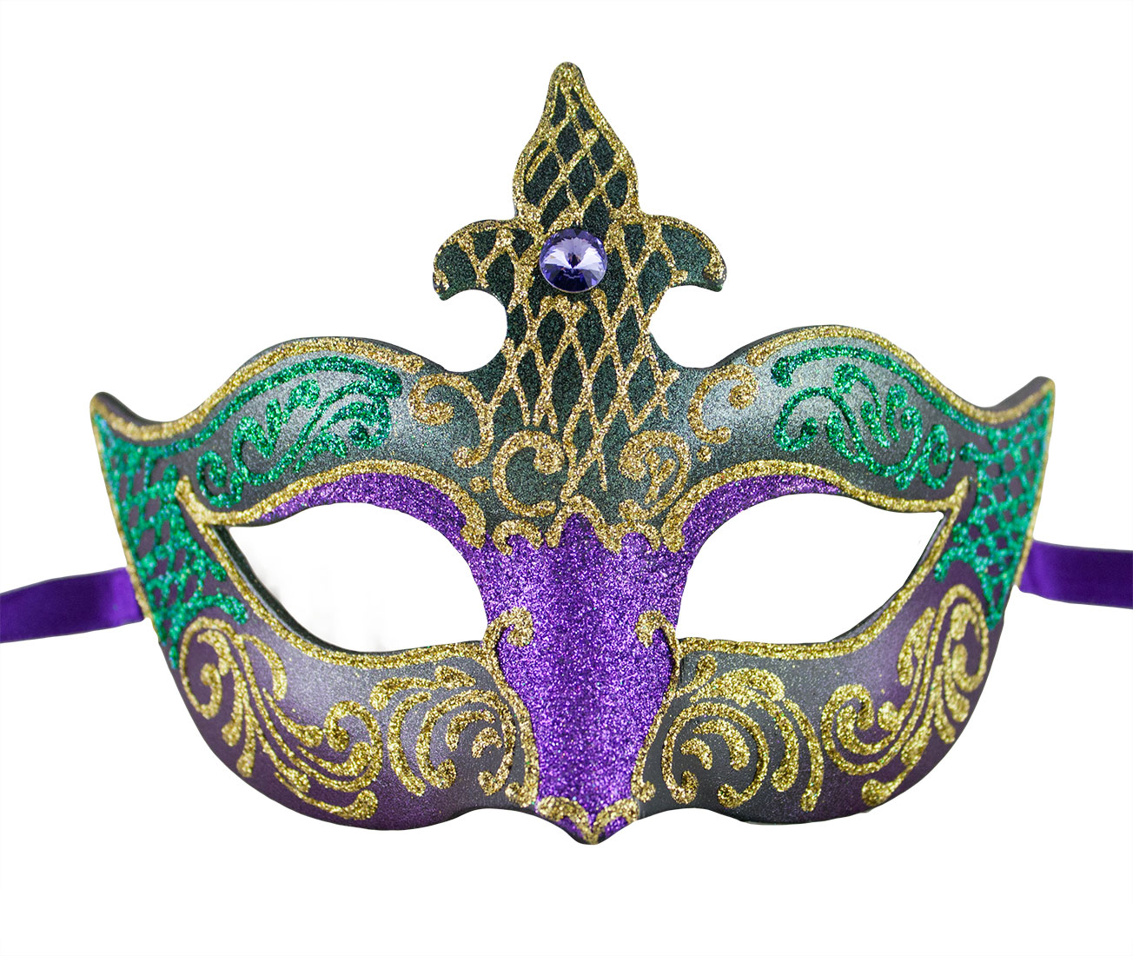
Iko Iko
Traditional New Orleans Mardi Gras Parade Song and Dance
FREE FORMATION
4 two-steps (going to right first)
2 pivots (right foot first)
R, L rlr
Samba with left foot forward (to the R) 4 x’s
Step left
Right foot forward and back 3 x’s
R, L

Slide 28
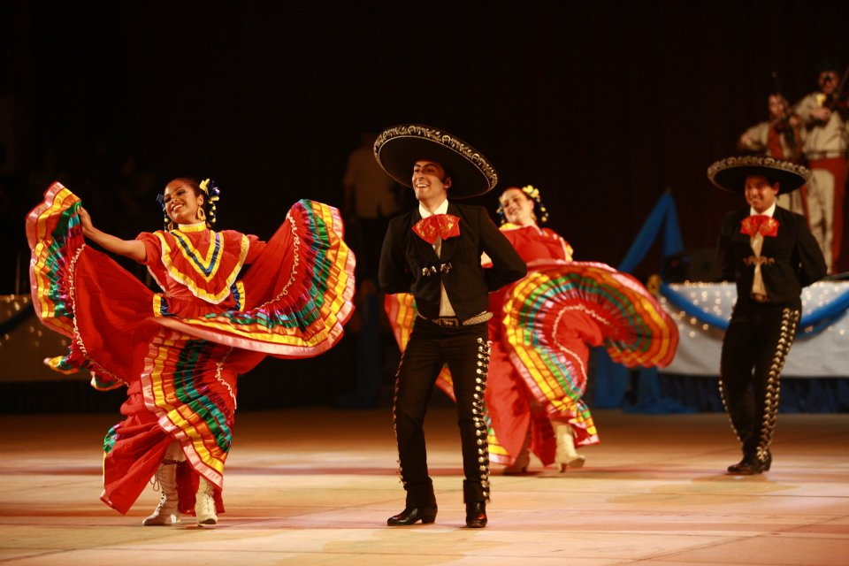
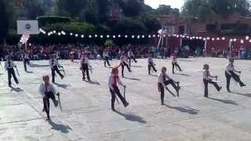
Los Machetes
Traditional Mexican Dance
Long-ways Set, Facing Down Line
16 steps toward front with machete hands
  Turn around (toward partner turn)
16 steps toward back with machete hands
  Face partner
4 steps out, 4 steps in (2x’s)
Clapping sequence
  1. Partner 2. Rt. Knee 3. Own 4. Left Knee
  5. Front 6. Back 7. Clap, clap, clap (front)
Hand turn with partner 8 to the rt., 8 to the left (2x’s)
Begin again!

Slide 29

Things to know and do:
  Quick look at pointers for today to be successful:
    Tanko Bushi (will not go full time)- clap together!
    Trip to Town-O- Always keep in mind if you are going CW or CCW around circle and don’t go too fast
    Danse a Trois: focus and game today?
    Norwegian Mountain March- everything happens twice + VOLUNTEER?
    Chinese Ribbon Dance- keep momentum going with ribbons and will perform this dance in long ways set
    Virginia Reel: careful peeling banana of students nearby, take time with forward and back AND clap in time!
    Chilili: keep up the good work!
  Ribbons and scarves placed against wall opposite the bleachers
  Quiet between songs- set the example for the rest of the school

Slide 30
Friday School Performance
 | School Performance | Time
1 | Tanko Bushi | 3:00
2 | Danse a Trois | 4:30
3 | Norwegian Mountain March | 2:45
4 | Chinese Ribbon Dance | 2:30
5 | Virginia Reel | 6:45
6 | Chilili | 2:45
7 | Trip to Town-O | 3:30

Slide 31

Folk Dance Ensemble: FYI
Backpacks by the closet or on sides of piano!
  *Please try to keep these up against a wall to maximize dancing space.
Sign-in!
Always meet on THURSDAYS!
Thank you for your communication!
Today’s plan= trio dances! BAILAMOS!!!

